Slide 1
CS3391 Assessment
No. | CILOs | Assignments | Quizzes | Exam
1. | Analyze programming problems, devise algorithms and propose programming techniques for solving the problems; | 100 points | 85 points | 90 points
2. | Write computer programs based on the algorithms devised and programming techniques chosen for solving problems;
3. | Work under time pressure; |  | 10 points | 10 points
4. | Collaborate with team-mates; |  | 5 points
50 Take-home Problems (Practice / Assignment) – CILO 1, 2
2 Quizzes – CILO 1, 2, 3, 4
1 Final Examination – CILO 1, 2, 3
Final Grade will be based on the weighted scores of Take-home Problems (45%), Quizzes (15%), Exam (40%).
CILO3: In each of the two quizzes, if at least one problem is solved, you’ll get 5 points; otherwise, 0. In the exam, if at least one problem is solved, you’ll get 10 points; otherwise, 0.
CILO4: In the quiz that student groups are formed, if at least one problem is solved, you’ll get 5 points; otherwise, 0.
To pass the course, a student has to achieve the following criteria.
CILO1&2: solved 30% of all the Take-home Problems
CILO3: obtained 5 points
Final Exam: scored 30%

Slide 2
“Spillover” Mechanism – With a Concave curve
mapping number of questions x in the assignment to the assignment score
f(x)=3x if x<10
f(x)=5+2.5x if 10<=x<30
f(x)=30+2x if 30<=x<35
f(x)=65+x if 35<=x<50
Points above 100 in the assignment will be carried over to losses in quizzes
For example, if you solved 50 questions in the assignment, your points for assignment will be 115 where the extra 15 points will be added towards quiz category with a weight 2. Therefore, your actual quiz mark will be added by 30.

Slide 3
Plagiarism
We take the issue of plagiarism seriously.
If 5 plagiarized answers in your practice questions are discovered, you will receive 0 mark on the entire assignment/practice part.
We have strong tools to detect both trivial and sophisticated plagiarism. We even add public domain C/C++ code to our pool for detecting plagiarism.
The Sherlock Plagiarism Detector
http://sydney.edu.au/engineering/it/~scilect/sherlock/

Slide 4
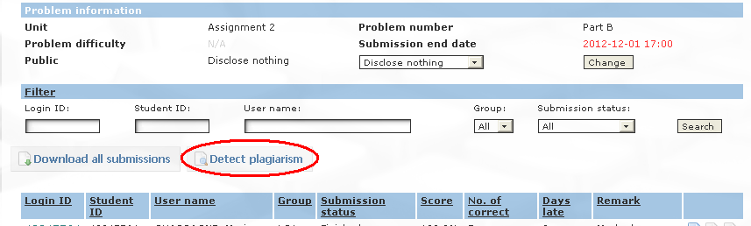
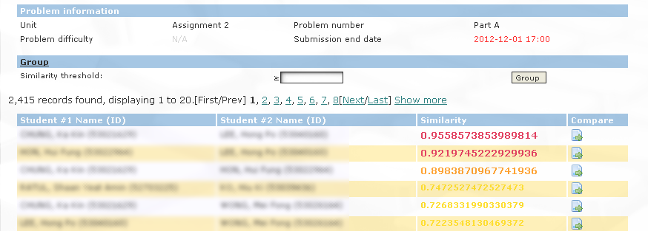
Plagiarism Detection

