Slide 1
Data Structure: Graph
Graph Searching and Topological Sort
Kenneth Lee

Slide 2

Outlines
Terms & Definitions
Representations of graphs
Searching graphs
  BFS – Breath-first search
  DFS - Depth-first search
Applications
Exercise

Slide 3

Terms and definitions
A graph G consists of:
  A non-empty set of vertices: V
  A set of edges: E
  E & V are related in a way that the vertices
  on both ends of an edge are members of V
  Usually written as G = (V, E)
Usually Vertices are used to represent a position or state meanwhile Edges are used to represent a transaction or relationship

Slide 4
Terms and definitions
There are a large number of variety on graph structure, in here, we assume no loop & parallel/multiple edges
(loop: an edge which joins a vertex to itself)
We may be working with graph with cycle, though…
(cycle: a path (sequence of vertices, length >= 3) which go back to the starting vertex with each edge used at most once)
D
F
D-C-E-F-D is a cycle
A
C
E

Slide 5
Terms and definitions
Graph can be directed or undirected.
In directed graph, there may be a pair of edges connecting the same pair of vertices
(going in opposite direction…)
Directed graph
Undirected graph

Slide 6
Terms and definitions
Degree of a vertex is the number of edges connecting to it
For directed graph, degree is further classified as in-degree (to this vertex) & out-degree (from this vertex)
C
Node A is having a degree of 3
(connects B, C, and D)
B
A
D
Y
X
Node W is having an
in-degree of 2 (X, Y)
and an out-degree of 1 (Z)
W
Z

Slide 7
Terms and definitions
Graph can be un-weighted or weighted, in which a value is associated with each edge.
In directed graph, the weights of edges going in opposite directions can be different.
For example:
  Whether a bus can go from Shatin to CityU: Unweighted (=1...)
  The bus fee it takes from Shatin to CityU: Weighted
Weighted graph
Unweighted graph
12
5
7
6
3
16

Slide 8
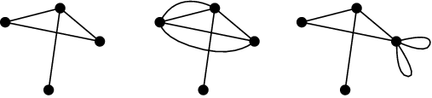
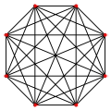
Terms and definitions
Simple graph:
  an un-weighted, undirected graph containing no graph loops or multiple edges
Complete graph:
  A simple graph in which every pair of vertices are connected directly.
  If number of vertices = V, number of edges = ?

Slide 9

Terms and definitions
Tree:
  A special type of connected acyclic graph
  Vertices connected by an edge inherit a parent-child relationship
  Tree is recursively defined
    A subtree is a portion of a tree data structure that can be viewed as a complete tree in itself
subtree
root
leaf
leaf
leaf
leaf

Slide 10
Terms and definitions
Tree:
  Implementation and usage of tree is a bit different from typical graphs (more on this in your yr2 course)
  What is the relationship between
  the number of vertices v.s. the number of edges?
Forest:
  Multiple connected components or a set of rooted trees
Forest

Slide 11
Representations of graphs
When working with graph, we always perform one of the following operation:
  Get the list of vertices connecting a given vertex.
  Is vertices A & B connected?
  What is the weight of edge from A to B?
  What is the in/out degree of a vertex?
2 standard representations
  Adjacency Matrix
  Adjacency List

Slide 12
Representations of graph
Adjacency Matrix
  Use N*N 2D array to represent the weight (or T/F) of one vertex to another
ABCD E FG
A undirected graph
0 0 1 0 0 0 0
0 0 1 1 0 0 0
1 1 0 1 1 0 0
0 1 1 0 0 1 0
0 0 1 0 0 1 1
0 0 0 1 1 0 0
0 0 0 0 1 0 0
A
B
C
D
E
F
G
D
B
F
G
C
A
E

Slide 13
Representations of graph
Adjacency Matrix
  For undirected graph, only half of the array is used
  Fast query on edge weight & connection
  Total memory used: N² (what if num of vertex = 10K?)
  Waste memory if the graph is sparse
  i.e. #Edge is much smaller than half of (#Vertex)²
  a large proportion of the array will be zero
  Slow when querying the list of neighboring vertices
  if the graph is sparse

Slide 14
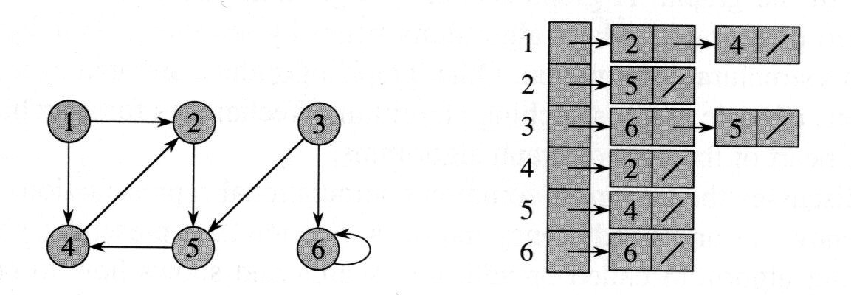
Representations of graph
Adjacency List

Slide 15
Representations of graph
Adjacency List
  Use link list (or equivalent) to store the list of neighboring vertex. (anyone use link-list in contest?)
  Save memory if the graph is sparse
  Query on edge weight / connection can be slow
  Graph update is slow (especially if one have to maintain order of neighbors)
  Enumeration of all neighbors is fast

Slide 16
Representations of graph
If memory is sufficient and graph update is in-frequent, can represent the graph in both methods at the same time…
  If you need fast enumeration of neighbors together with fast query of weight/connection
  e.g. List out all the neighbors of vertex A which do not connect to vertex B or vertex C…
Link-list can be replaced by 1D array with count
(enumeration of neighbor and query on degree will be fast)
For un-weighted adjacency matrix, you may consider other possibilities other than 0 & 1….

Slide 17
Graph Searching
To determine whether two vertices are connected (indirectly via some intermediate)
  A is a relative of B, B is a relative of C, are A & C relative?
To list out all members of a connected-component
  List out all the direct/indirect family members of A…
To find the shortest path (of un-weighted graph) from one vertex to another
  Travel from Shatin to Central with minimum number of change of transportation…
TWO algorithms:
  DFS (Depth First Search)
  BFS (Breadth First Search)

Slide 18
Depth first search (DFS)
Starts with vertex v:
DFS (v) {
visited[v] = true;
for each vertex w adjacent to v {
if (! visited[w])
DFS (w); //Recursion
}
}
D
B
F
C
DFS(A) = A, C, B, D, F, E, G
A
E
G

Slide 19
Breadth first search (BFS)
Non-recursive
Make use of Queue
Queue is a container with 1 entry & 1 exit,
having FIFO (First-In-First-Out) property
Enqueue/Dequeue: Add/Remove item from queue
BFS can be used to find the shortest distance from a vertex to vertex within an unweighted acyclic graph

Slide 20
BFS (v)
D
B
F
BFS(v) {
visited[v] = true;
Enqueue(v);
While queue not empty {
x = Dequeue();
for each vertex w adjacent to x {
if (! visited[w]) {
Enqueue (w);
visited[w] = true;
}
}
}
}
C
A
E
G
BFS(A) = A, C, B, D, E, G, F

Slide 21
Topological sort
One application of DFS is topological sort
(Topological sort can be solved by some other methods…)
A linear ordering of vertices:
If the directed graph contains an edge
(u, v), then u appears before v.
Use DFS to calculate the finishing time for each vertex
As each vertex is finished, insert it onto the front of a list
Return the list of vertices

Slide 22
An example (Ref: Introduction to Algorithms 2nd ED)
1
/ 4
socks
13
/ 14
2
/ 3
pants
5
/ 12
shoes
shirt
watch
belt
15
/ 16
tie
10
/ 11
6
/ 9
7
/ 8
jacket
Topological order:
watch, pants, shirt, belt, tie, jacket, socks, shoes

Slide 23
Exercises
Connectivity
Given an adjacency matrix of an undirected graph, you need to check if the graph is connected.
Input format:
1st line -- number of test cases
2nd line -- blank
3rd line -- (1st test case) n: width of the matrix (1<n≤20)
4th to (4+n)th line -- adjacency matrix
(5+n)th line -- blank
(6+n)th line -- (2nd test case) ….

Slide 24
100000000000
000000100010
100000000000
000000101000
000100000000
20
01001100000000000000
10100000000100010000
01011000001100000000
00101010100000000001
10110000000000000100
10000000000000000100
00010000000000000010
00000000111001000000
00010001000000000001
00000001000000000000
00100001000001000000
01100000000010110000
00000000000100101000
00000001001000000000
00000000000110000000
01000000000100000000
00000000000010000000
00001100000000000000
00000010000000000000
00010000100000000000
Sample input:
4
5
01111
10111
11011
11101
11110
6
001011
000100
100000
010000
100000
100000
12
001011010100
000100000000
100000000000
010000000001
100000000000
100000000000
000000001010
Sample output:
Yes
No
No
Yes

Slide 25
2. Measuring water
You are given 2 empty containers having capacities of x, y liters respectively (1≤x≤y≤100), and you need to use them to measure exactly z liter (0≤z<100) of water. The supply of water is unlimited and can be pour into / out of the containers. However, the pouring action is restricted:
  When filling water in a container, the container must be fully filled.
  When pouring water out of a container, all the water must be poured out unless the destination container is full.
Assume all containers are initially empty, write a program to count the minimum number of steps (fill/pour water) to get z Liters of water in any container.
Print “No Solution” if it is impossible to measure z Liters exactly.

Slide 26
Input format:
1st line -- (1st test case) x y z
2nd line -- (2nd test case) ….
(continue input until end of file)
Sample input:
5 3 4
6 3 4
Sample output:
6
No Solution

Slide 27
Exercises
Valladolid Programming Contest
  #459 - Graph Connectivity
  http://acm.uva.es/p/v4/459.html
  #567 - RISK
  http://acm.uva.es/p/v5/567.html
  #10009 - All Roads Lead Where?
  http://acm.uva.es/p/v100/10009.html
  10113 - Exchange Rates (requires GCD)
  http://acm.uva.es/p/v101/10113.html
  10150 - Doublets
  http://acm.uva.es/p/v101/10150.html

