Slide 1
Disjoint Sets
& Minimum Spanning Trees
Adapted from Kenneth Lee’s slides (February 2009)

Slide 2
Outline
Definition
Minimum Spanning Tree algorithms
  Prim’s Algorithm
  Kruscal’s Algorithm
Implementation of Kruscal’s Algorithm
Disjoint Set
Exercises

Slide 3
Definition of spanning tree
It is a tree and hence acyclic (i.e., no cycle)
It must connect all the vertices
It is generated from the given graph
i.e., spanning tree is a subset of the original (probably cyclic) graph

Slide 4
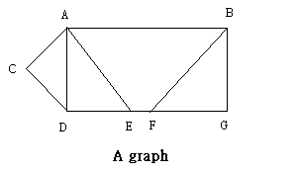
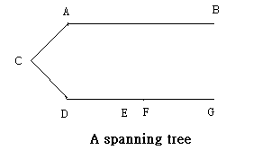
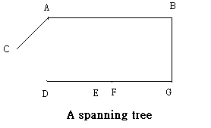
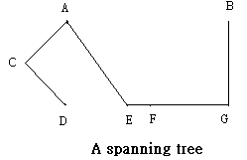
Spanning Trees
Connects all
vertices A..G
cycle

Slide 5
Minimum Spanning Tree
It is the spanning tree formed from a weighted undirected graph in which the total sum of values on edge has the minimum total weight
It can be found by 2 algorithms:
→ Prim’s algorithm
→ Kruskal’s algorithm

Slide 6
Prim’s algorithm
In each stage, the set of known vertices is grown by one vertex:
Find an unknown vertex which is nearest to the set of known vertices
  What is the distance from a vertex to a set?

Slide 7
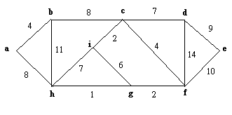
Prim’s algorithm
Start Prim’s algorithm with any vertex in the graph
For example, we start with {a} here…

Slide 8
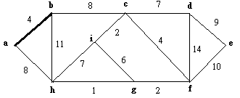
Prim’s algorithm
{a} connects to neighbors via two edges:
a-b (cost of 4) and
a-h (cost of 8)
Since edge a-b is having the smallest weight,
Edge a-b is selected and nodes selected in MST = {a,b}

Slide 9
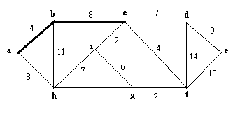
Prim’s algorithm
{a,b} connects to neighbors (nodes outside {a,b}) via three edges:
a-h (cost of 8), //old one…
b-h (cost of 11), and
b-c (cost of 8)
Since edge b-c is having the smallest weight (and c precedes h…),
Edge b-c is selected and nodes selected in MST = {a,b,c}

Slide 10
Prim’s Algorithm
{a,b,c} connects to neighbors via five edges:
a-h (cost of 4), b-h (cost of 8), //old ones…
c-d (cost of 7), c-f (cost of 4), c-i (cost of 2)
Since edge c-i is having the smallest weight,
Edge c-i is selected and nodes selected in MST = {a,b,c,i}

Slide 11
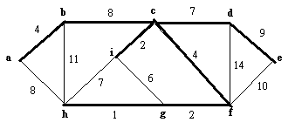
Prim’s Algorithm
Final result:
Observation: each time, a new node is added and CONNECTED

Slide 12
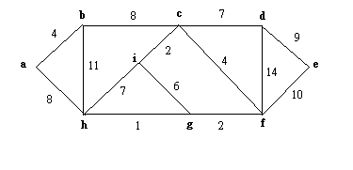
Kruskal’s algorithm
From the weighted graph,
1. SORT the edges in non descending order by weights
So we get : hg, ic, gf, ab, cf, ig, cd, hi, ah, bc, de, fe, bh, df

Slide 13
Kruskal’s algorithm
2. Start using the edge with least weight,
  if the edge does not form a cycle, this edge is accepted;
  if the edge forms a cycle, this edge is rejected.
  (implementation: how to check for cycle?)
3. Ignore all examined edges, repeat step 2 until all the vertices are connected

Slide 14
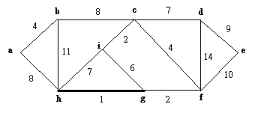
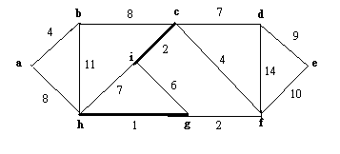
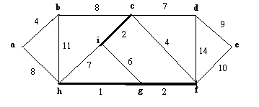
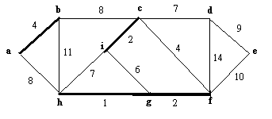
Kruskal’s algorithm
1
2
3
4

Slide 15
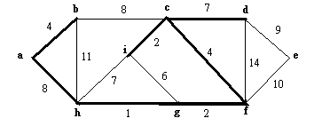
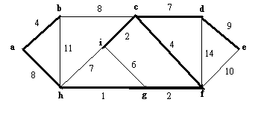
Kruskal’s algorithm
5
Not selected since it forms cycle
6
7

Slide 16
Minimum Spanning Tree
As we can see, 2 different algorithms can generate 2 different minimum spanning trees, but with the same total weight
This implies that a graph can have more than 1 minimum spanning tree (not unique)

Slide 17
Sorting in C…
qsort() function in <stdlib.h> can be used to sort integers, chars and structures
Example:
  int A[5]={1,3,7,5,2};
  qsort(A,5,sizeof(int),CMP);
CMP is a function written by programmer used to specify sorting order and comparison criteria
Size of element, in here, sizeof(int) = 4 bytes
Number of elements
Array Name, i.e. pointer/address of first element

Slide 18
Sorting in C…
Prototype of CMP() function…
int CMP(const void *a, const void *b)
Address/pointer of
any one element put
Into qsort()
Address/pointer of
another element put
Into qsort()
CMP() should compare the two elements
and see whether a or b should place first
a should be put before b: return –ve integer
a should be put after b: return +ve integer
a and b are identical: return 0

Slide 19
Sorting in C…
To sort array A[] in ascending order:
int CMP(const void *a, const void *b) {
int *A = (int*)a; //cast address to int pointer
int *B = (int*)b;
return (*A) – (*B); //how about descending order ?
}

Slide 20
How about sorting edge…
struct Edge{
int From, To, Length;
} All_Edges[1000];
:
const int CMP(const void *a, const void *b) {
Edge *A = (Edge*)a;
Edge *B = (Edge*)b;
return A->Length – B->Length;
}
:
qsort(All_Edges,nEdges,sizeof(Edge),CMP);

Slide 21


Coding Kruskal’s algorithm
Edge h-g is having min weight
Since h and g are not already (directly/indirectly) connected, so we accept this edge
Make h and g belong to the same set….. How?

Slide 22

Kruskal’s algorithm
Assume we have added edges hg, ic, gf, ab, cf
Now, we check edge ig
Vertex i and vertex g are already in the same Set h, that means it is connected already, hence we can reject this edge

Slide 23
Further More on Set
The classical operation of disjoint set are as follow:
“Are the items ‘1’ and ‘2’ in the same set?”
(query)
“Union the set containing ‘1’ with the set containing ‘2’” (merge)
Note: Each item must belong to exactly one set.

Slide 24
Disjoint Set Operation
1, 2, 3
0, 4, 5
6, 7, 8
Union the set containing ‘1’ with the set containing ‘5’
1, 2, 3
0, 4, 5
6, 7, 8
0, 1, 2, 3, 4, 5
6, 7, 8

Slide 25
How to implement?
Simple Structure – First, assign each element to a set containing its own. (Implement with an array)
0
1
2
3
4
P[0]
P[1]
P[2]
P[3]
P[4]
Union (0, 3)
0
1
2
0
4
P[0]
P[1]
P[2]
P[3]
P[4]

Slide 26
How to implement?
0
0
2
3
3
P[0]
P[1]
P[2]
P[3]
P[4]
Union (0, 3)
0
0
2
0
0
P[0]
P[1]
P[2]
P[3]
P[4]
Fast Query….but how about Merge operation?

Slide 27
How to implement?
// Union the sets of two elements
void Union (int element1, int element2) {
UnionSet(Find(element1), Find(element2));
}
// Union 2 sets... What if we merge 1000 items?
void UnionSet (int set1, int set2) {
for (int j=0; j<SIZE; j++)
if (A[j] == set2)
A[j] = set1;
}
// return the Set ID
int Find (int element) {
return A[element];
}

Slide 28
How to implement
Forest Method
Initialize : Assign Each element the value of –1, representing the index is the set ID
-1
-1
-1
-1
-1
-1
-1
-1
-1
-1
P[0]
P[1]
P[2]
P[3]
P[4]
Union (0, 3)
Union (0, 3)
-1
-1
-1
-1
-1
-1
0
0
-1
-1
P[0]
P[1]
P[2]
P[3]
P[4]

Slide 29
How to implement?
-1
0
-1
-1
3
P[0]
P[1]
P[2]
P[3]
P[4]
Union (0, 3)
-1
0
-1
0
3
P[0]
P[1]
P[2]
P[3]
P[4]

Slide 30
How to implement?
void Union (int element1, int element2) {
UnionSet(Find(element1), Find(element2));
}
void UnionSet (int set1, int set2) {
A[set2] = set1;
}
int Find (int element) {
if (A[element] == -1)
return element;
else
return Find(A[element]);
}
Find by Recursion
Fast Merge operation ….but …

Slide 31
How to implement : Enhancement
Worse case:
Disjoint Set Forest -> Linked-list representation
  Time waste in Path-Finding!
Two heuristics to improve it
  Union by size
  Path Compression
Union by Size:
  Idea: let root with fewer nodes point to the root with more nodes
  Implement: rank = upper bound on the height of tree (i.e. worse case: skewed tree)

Slide 32
How to implement : Enhancement
Merge F’s set with A’s set:
F
1
rank=5
A
G
A
rank=2
2
F
B
D
E
B
D
E
3
G
C
C
A
1
F
B
D
E
2
G
C

Slide 33
How to implement?
void Union (int element1, int element2) {
int root1=Find(element1);
int root2=Find(element2);
if (A[root1] < A[root2]) //root1 has more member
UnionSet(root1, root2);
else
UnionSet(root2, root1);
}
void UnionSet (int set1, int set2) {
A[set1] += A[set2]; // A[ root of set ] is negative, and its
A[set2] = set1; // magnitude is the num of members
}
int Find (int element) {
if (A[element] < 0)
return element;
else
return Find(A[element]);
}

Slide 34
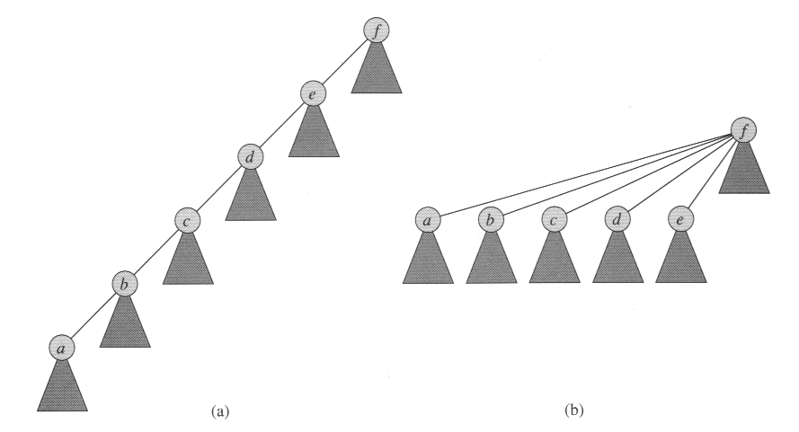
How to implement : Enhancement

Slide 35
Path Compression
int Find (int element) {
if (A[element] < 0)
return element;
else
return A[element] = Find(A[element]);
}
Path Compression!
Whenever Find() is performed, all items along the
path update its parent to the topmost root
Next query (Find()) will be faster…

Slide 36
Exercises
UVA Online judge:
  10147 Highways
  http://acm.uva.es/p/v101/10147.html
  534 Frogger
  http://acm.uva.es/p/v5/534.html
  10369 Arctic Network
  http://acm.uva.es/p/v103/10369.html

