Slide 1


Slide 2

Consider this network
Cap:1/0
Flow:0/0
Cap:1/0
Flow:0/0
Cap:1/0
Flow:0/0
1
2
T
S
Cap:1/0
Flow:0/0
Cap:1/0
Flow:0/0
Cap:1/0
Flow:0/0
Cap:1/0
Flow:0/0
3
4

Slide 3
residue flow = cap - flow
Cap:1/0
Flow:1/-1
Cap:1/0
Flow:1/-1
Cap:1/0
Flow:1/-1
1
2
T
S
Cap:1/0
Flow:0/0
Cap:1/0
Flow:0/0
Cap:1/0
Flow:0/0
Cap:1/0
Flow:0/0
3
4

Slide 4
residue flow = cap – flow
Now…
residue flow: node 1 to 2 = 1-1 = 0 < can’t use
residue flow: node 2 to 1 = 0-(-1) = 1 < can use
Cap:1/0
Flow:1/-1
Cap:1/0
Flow:1/-1
Cap:1/0
Flow:1/-1
1
2
T
S
Cap:1/0
Flow:0/0
Cap:1/0
Flow:0/0
Cap:1/0
Flow:0/0
Cap:1/0
Flow:0/0
3
4

Slide 5
So, it becomes:
Cap:1/0
Flow:1/-1
Cap:1/0
Flow:1/-1
Cap:1/0
Flow:1/-1
1
2
T
S
Cap:1/0
Flow:0/0
Cap:1/0
Flow:0/0
Cap:1/0
Flow:0/0
Cap:1/0
Flow:0/0
3
4

Slide 6
Cancellation
this edge is cancelled.
Cap:1/0
Flow:1/-1
Cap:1/0
Flow:1/-1
Cap:1/0
Flow:1/-1
1
2
T
S
Cap:1/0
Flow:0/0
Cap:1/0
Flow:0/0
Cap:1/0
Flow:0/0
Cap:1/0
Flow:0/0
3
4

Slide 7
Cancellation
this edge is cancelled.
Cap:1/0
Flow:0/0
Cap:1/0
Flow:1/-1
Cap:1/0
Flow:1/-1
1
2
T
S
Cap:1/0
Flow:1/-1
Cap:1/0
Flow:1/-1
Cap:1/0
Flow:1/-1
Cap:1/0
Flow:1/-1
3
4

Slide 8

How to handle this…?
Cap:10/0
Flow:0/0
2
Cap:10/0
Flow:0/0
1
Cap = 5
flow from S to 2 = 5
S

Slide 9
Cap = 5
1
1
Transform =>
Cap = 5
in
out

Slide 10

Cap:10/0
Flow:0/0
Cap:10/0
Flow:0/0
S
1
2
Cap = 5
Cap = 5
1-out
1-in
Cap:10/0
Flow:0/0
Cap:10/0
Flow:0/0
S
2

Slide 11

Using “split vertex”, the size of graph will increase = (n*2)
S
1
2
S-in
S-out
1-in
1-out
2-in
2-out

Slide 12
How to code?
In node: (original node)
Out node: (original node)+n
or
In node: (original node)*2
Out node: (original node)*2+1
0-in
1-in
1-out
2-in
2-out
0-out

Slide 13

Suppose you want to send k large files from s to t but never have two files use the same network link (to avoid congestion on the links).

Slide 14

Given directed graph G , and two nodes s and t, find k paths from s to t such that no two paths share an edge.

Slide 15

Given an instance of k-Edge-Disjoint Paths,
Create an instance of Maximum Network Flow.
The maximum flow will used to find the k edge disjoint paths.

Slide 16
Suppose we had k edge-disjoint s − t paths.
We could sent 1 unit of flow along each path without violating the capacity constraints.
If there are k edge-disjoint s − t paths in directed, unit-weight graph G , then the maximum s − t flow is ≥ k.

Slide 17
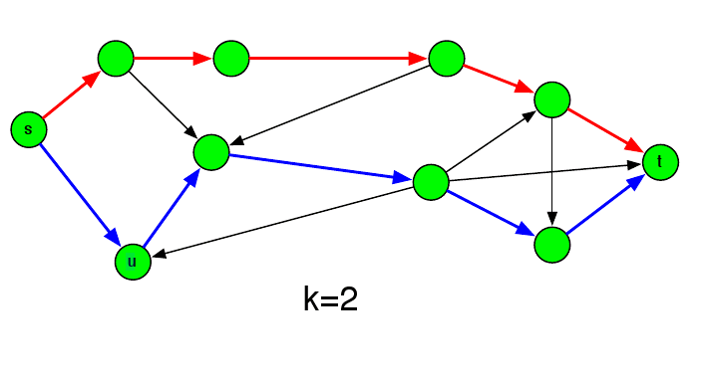

Slide 18

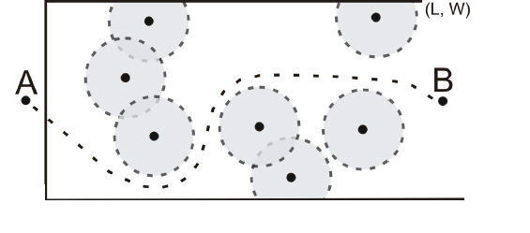
CityU OJ 362

Slide 19
If this problem just asks you whether a winger can go to L without being tackles or not…
Reduce to graph problem!

Slide 20

Let robots, border of North and South be vertex
Connect North -> robot if the robot touches/overlap with border of North
Connect robot -> South if the robot touches/overlap with border of South
Connect robot_1 <-> robot_2 with undirected edge if two robots touches/overlap each other

Slide 21
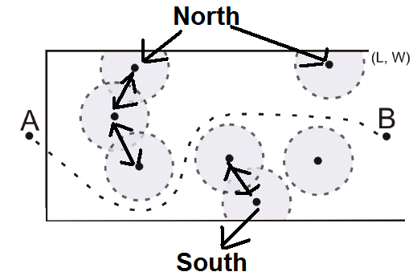

Slide 22
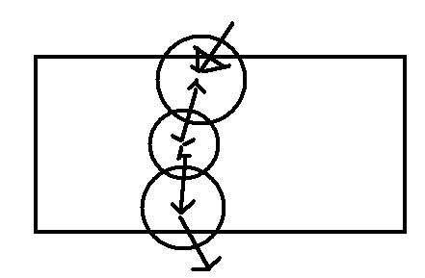
If there is a path from north to south, it means a winger need to “eat some tackles”

Slide 23

The problem now is transformed to “what is the minimum number of vertex should be remove in order to disconnect North and South”
“Disconnect” = cut
“minimum… disconnect” = minimum cut!
minimum cut = maximum flow!!!

Slide 24

The problem now is transformed to “How many paths going from North to South, if vertex can be only used once in the path?”
similar to Edge disjoint Path
But now is Vertex disjoint Path

Slide 25
Either of these will lead to same algorithm
Cut vertex, not edge
=> Capacity of vertex is a main concern
=> Capacity of edge can be ignored
Try to link up with previous topic

Slide 26
Set capacity of vertex be 1
  Be the “bottleneck” of the network graph
Set capacity of edge be INF

Slide 27
North
1-in
1-out
2-in
2-out
3-out
3-in
South
K = 1

Slide 28
How to know a circle touch/overlap with
  North border?
  South border?
  Another Circle?

Slide 29
Q & A

