Slide 1
CS 3391
Suffix Array
Hao YUAN

Slide 2
What is suffixes?
T = innovation S[1]= innovation S[2]= nnovation S[3]= novation S[4]= ovation S[5]= vation S[6]= ation S[7]= tion S[8]= ion S[9]= on S[10]= n
Given a string ( or text )
T = t₁ t₂ t₃ … t_{n-1} t_{n}
then it has n suffixes,
they are
Suffix(T,i) = S[i]
= t_{i} t_{i+1} t_{i+2} … t_{n}
for
1≤i≤n

Slide 3
Why suffixes?
Prefix of a string T = t₁ t₂ t₃ … t_{n-1} t_{n}
  Prefix(T,i) = t₁ t₂ t₃ … t_{i-1} t_{i}
Tricky ( keep in mind please )
  Any substring (or pattern) of T, must be a prefix of some suffix from T!
  Example T = mississippi,
  P = ssip
  then P = Prefix( Suffix(T, 6), 4 )

Slide 4
Exact Pattern Matching
How do you find the occurrence of a pattern P in a text T?
  Test for each i whether P is a prefix of Suffix(T,i)
Naïve implementation: O(PT) time, too slow!
Knuth-Morris-Pratt ( 1977, SIAM J. Comput. )
  Key Point: ignore testing impossible suffixes
  O( P ) preprocessing P
    Calculate Next(k): which suffix should try next when the first k chars of P are matched in the current suffix?
  O( P + T ) searchLCAing for any text T
  Will be covered in CS 4335

Slide 5
Match Concurrently
KMP test suffixes in sequential order
  Why not do the testing concurrently?

Slide 6
Match Concurrently (e.g.)
Example
T= mississipi
P= ssip
mississipi
ississipi
ssissipi
sissipi
issipi
ssipi
sipi
ipi
pi
i
Notes:
The mississippi is misprinted, remember to correct it.

Slide 7

Match Concurrently (e.g.)
Example
T= mississippi
P= ssip
matching s
mississipi
ississipi
ssissipi
sissipi
issipi
ssipi
sipi
ipi
pi
i

Slide 8
Match Concurrently (e.g.)
Example
T= mississippi
P= ssip
matching ss
mississipi
ississipi
ssissipi
sissipi
issipi
ssipi
sipi
ipi
pi
i

Slide 9
Match Concurrently (e.g.)
Example
T= mississippi
P= ssip
matching ssi
mississipi
ississipi
ssissipi
sissipi
issipi
ssipi
sipi
ipi
pi
i

Slide 10
Match Concurrently (e.g.)
Example
T= mississippi
P= ssip
matching ssip
mississipi
ississipi
ssissipi
sissipi
issipi
ssipi
sipi
ipi
pi
i

Slide 11
Trie ( “retrieval” )
But we do not have |T| CPUs!
Put all suffixes into a Trie!

Slide 12
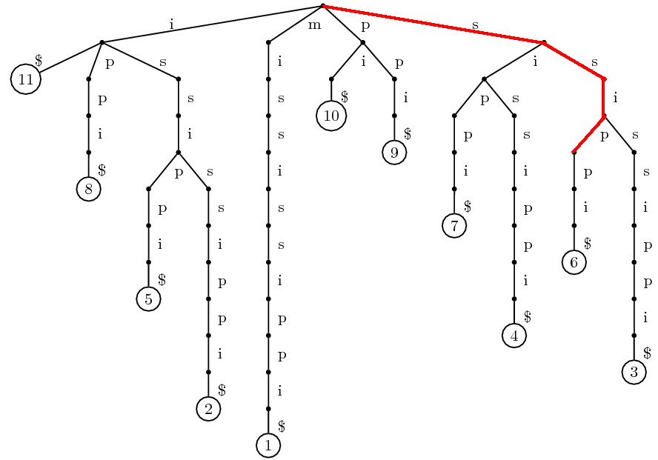
A Tree of Mississippi

Slide 13
Trie ( “retrieval” ) (cont.)
Put all suffixes into a Trie!
  Every top-down path starts from root corresponds to a substring
  Those paths ending with a leaf
  correspond to suffixes
Complexity
  Preprocessing O(T²)
  Matching O(P)

Slide 14
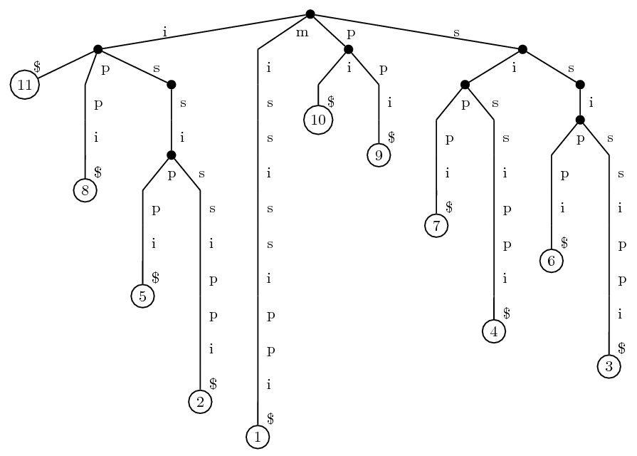
Suffix Tree
Trie of all suffixes: too much nodes! O(T²)
Suffix Tree
  Compact Trie
  O(T) nodes

Slide 15
Suffix Tree of Mississippi

Slide 16
Suffix Tree
Trie of all suffixes: too much nodes! O(T²)
Suffix Tree
  Compact Trie of all suffixes
  O(T) nodes
  Compact representation of substring
    e.g. T[3..7] = t₃t₄…t₇
  O(T) storage

Slide 17
Constructing Suffix Tree
The Suffix Tree can be constructed in Linear Time
  Assume that the alphabet set is constant size.
  English Alphabet: {a,b,c,…,z} : 26
  Language of DNA: {A,T,C,G} : 4
P. Weiner, 1973
  Linear pattern matching algorithms
  the 14th IEEE Annual Symposium on Switching and Automata Theory
E. M. McCreight, 1976
  A space-economical suffix tree construction algorithm
  Journal of ACM, Volume 23 Issue 2
E. Ukkonen, 1995
  Constructing suffix trees on-line in linear time
  Algorithmica, Volume 14 Issue 3

Slide 18
KMP v.s. Suffix Tree
KMP
  Preprocess Pattern in O(P) time
  Search in any Text in O(P+T) time
Suffix Tree
  Preprocess Text in O(T) time
  Search for any Pattern in O(P) time

Slide 19
Match Char by Char
Example
T= mississippi
P= ssip
S[ 1]= mississippi
S[ 2]= ississippi
S[ 3]= ssissippi
S[ 4]= sissippi
S[ 5]= issippi
S[ 6]= ssippi
S[ 7]= sippi
S[ 8]= ippi
S[ 9]= ppi
S[10]= pi
S[11]= i

Slide 20
Match Char by Char
Example
T= mississippi
P= ssip
Sort Suffixes First!
S[11]= i
S[ 8]= ippi
S[ 5]= issippi
S[ 2]= ississippi
S[ 1]= mississippi
S[10]= pi
S[ 9]= ppi
S[ 7]= sippi
S[ 4]= sissippi
S[ 6]= ssippi
S[ 3]= ssissippi

Slide 21
Match Char by Char
Suffix Array
T= mississippi
S[11]= i
S[ 8]= ippi
S[ 5]= issippi
S[ 2]= ississippi
S[ 1]= mississippi
S[10]= pi
S[ 9]= ppi
S[ 7]= sippi
S[ 4]= sissippi
S[ 6]= ssippi
S[ 3]= ssissippi

Slide 22
Match Char by Char
Suffix Array
T= mississippi
Search s
S[11]= i
S[ 8]= ippi
S[ 5]= issippi
S[ 2]= ississippi
S[ 1]= mississippi
S[10]= pi
S[ 9]= ppi
S[ 7]= sippi
S[ 4]= sissippi
S[ 6]= ssippi
S[ 3]= ssissippi
Binary Search for Lower Bound
Binary Search for Upper Bound

Slide 23
Match Char by Char
Suffix Array
T= mississippi
Search ss
S[11]= i
S[ 8]= ippi
S[ 5]= issippi
S[ 2]= ississippi
S[ 1]= mississippi
S[10]= pi
S[ 9]= ppi
S[ 7]= sippi
S[ 4]= sissippi
S[ 6]= ssippi
S[ 3]= ssissippi

Slide 24
Match Char by Char
Suffix Array
T= mississippi
Search ssi
S[11]= i
S[ 8]= ippi
S[ 5]= issippi
S[ 2]= ississippi
S[ 1]= mississippi
S[10]= pi
S[ 9]= ppi
S[ 7]= sippi
S[ 4]= sissippi
S[ 6]= ssippi
S[ 3]= ssissippi

Slide 25
Match Char by Char
Suffix Array
T= mississippi
Search ssip
S[11]= i
S[ 8]= ippi
S[ 5]= issippi
S[ 2]= ississippi
S[ 1]= mississippi
S[10]= pi
S[ 9]= ppi
S[ 7]= sippi
S[ 4]= sissippi
S[ 6]= ssippi
S[ 3]= ssissippi

Slide 26

Suffix Array
Suffix Array (SA) : sorted indexes of all suffixes of a string in lexicographical order.
Given the Suffix Array of T
  Find all occurrences of P by a naïve binary search
  in O( P \log T ) time
  Can be done in O(P) time
  (more advanced topic)
But how to get the Suffix Array?
  In another words: How to sort suffixes?

Slide 27
Sorting Suffixes
QSort or other comparison-based method
  O( n² \log n )
  Much faster in practice ( real world problem )
Radix Sort
  O( n² )

Slide 28
Efficient Algorithms
Doubling Algorithm
  Udi Manber and Gene Myers, Suffix arrays: a new method for on-line string searches
  SODA 1990, SIAM J. Comput. 1993
  O( n \log n )
Skew Algorithm (for integer alphabet)
  Kärkkäinen, Sanders and Burkhardt,
  Linear Work Suffix Array Construction,
  Journal of the ACM, 2006
  O( n )

Slide 29
L-order
Definition: S[i]≤_{L} S[j]
  Use the first L chars of each suffixes as key
Examples:
  ippi <₂ issippi
  ssissippi =₃ ssippi
  ssissippi >₄ ssippi

Slide 30
Doubling Algorithm
Sort by 1-order ( ≤₁ )
S[ 2]= ississippi
S[ 5]= issippi
S[ 8]= ippi
S[11]= i
S[ 1]= mississippi
S[ 9]= ppi
S[10]= pi
S[ 3]= ssissippi
S[ 4]= sissippi
S[ 6]= ssippi
S[ 7]= sippi

Slide 31
Doubling Algorithm
Sort by 1-order ( ≤₁ )
Sort by 2-order ( ≤₂ )
S[11]= i
S[ 8]= ippi
S[ 2]= ississippi
S[ 5]= issippi
S[ 1]= mississippi
S[10]= pi
S[ 9]= ppi
S[ 4]= sissippi
S[ 7]= sippi
S[ 3]= ssissippi
S[ 6]= ssippi

Slide 32
Doubling Algorithm
Sort by 1-order ( ≤₁ )
Sort by 2-order ( ≤₂ )
Then…
Sort by 3-order ( ≤₃ ) ?
  No! This is what Radix Sort do for general strings.
  But we are sorting suffixes!
Sort by 4-order ( ≤₄ ) directly
S[11]= i
S[ 8]= ippi
S[ 2]= ississippi
S[ 5]= issippi
S[ 1]= mississippi
S[10]= pi
S[ 9]= ppi
S[ 4]= sissippi
S[ 7]= sippi
S[ 3]= ssissippi
S[ 6]= ssippi

Slide 33
Extend 2-order to 4-order
To compare
  S[3]=ssissippi
  S[6]=ssippi
ss is sippi
ss ip pi
issippi>₂ippi
from S[5]>₂S[8]
S[11]= i
S[ 8]= ippi
S[ 2]= ississippi
S[ 5]= issippi
S[ 1]= mississippi
S[10]= pi
S[ 9]= ppi
S[ 4]= sissippi
S[ 7]= sippi
S[ 3]= ssissippi
S[ 6]= ssippi

Slide 34
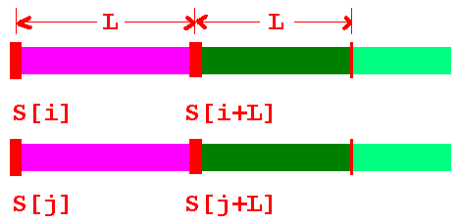
Extend L-order to 2L-order
If we have the L-order, then 2L-order could be obtain by
  S[i] <_{L} S[j] ➔ S[i] <_{2L} S[j]
  S[i] >_{L} S[j] ➔ S[i] >_{2L} S[j]
  S[i] =_{L} S[j]
    S[i+L] <_{L} S[j+L] ➔ S[i] <_{2L} S[j]
    S[i+L] >_{L} S[j+L] ➔ S[i] >_{2L} S[j]

Slide 35
Complexity of Doubling Algorithm
Doubling Algorithm
  L = 1,2,4,8,16,32,… until exceeds n
  O( \log n ) phases, each phase O( n )
  Total Complexity
    Time O( n \log n )
    Space O( n )
Optimal for general alphabet set
Expected Running Time for Uniform Alphabet
  O( n )

Slide 36
Skew Algorithm
Integer Alphabet: ∑={1,2,3,…,n}
Basic Idea
  Group 3 consecutive chars into a new one.
    mis sis sip pi$
    ∑’={ ‘mis’, ‘sis’, ‘sip’, ‘pi$’ }
  Sort the new alphabet set ∑’
  Sort S[i] for { i mod 3 = 1 }
  Sort S[i] for { i mod 3 = 2 }
  Merge the result
T(n) = O(n) + 2T(n/3) = O(n)
Easy to implement! (See the JACM paper if interested)

