Slide 1
NP-Complete Problems
Polynomial time vs exponential time
  Polynomial O(n^{k}),
    where n is the input size
      e.g., number of nodes in a graph, the length of strings , etc
    k is a constant
      e.g., k=2 in LCS, k=1 in KMP, etc.
  Exponential time: 2^{n} or n^{n}
    n= 2 10 20, 30
    2^{n} 4 1024 1 million 1000 million
    If a computer solves a problem of size n in one hour, now you have a computer 1,000,000 faster, what size of the problem can you solve in one hour?
      n+20 (2^{n+20} ≈1,000,0002^{n})
      The improvement is small.
      Hardware improves little on problems of exponential running time
      Exponential running time is considered as “not efficient”.

Slide 2
Story
All algorithms we have studied so far are polynomial time algorithms (unless specified).
Facts: people have not yet found any polynomial time algorithms for some famous problems, (e.g., Hamilton Circuit, longest simple path, Steiner trees).
Question: Do there exist polynomial time algorithms for those famous problems？
Answer: No body knows.

Slide 3
Story
Research topic: Prove that polynomial time algorithms do not exist for those famous problems, e.g., Hamilton circuit problem.
  Turing award
  Vinay Deolalikar attempted 2010, but failed.
To answer the question, people define two classes
  P class
  NP class.
To answer if P≠NP, a rich area, NP-completeness theory is developed.

Slide 4
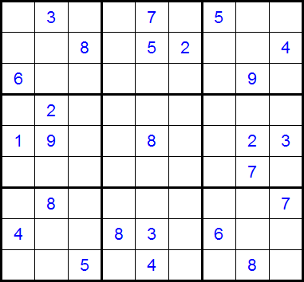

Slide 5
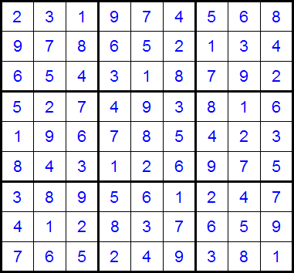

Slide 6
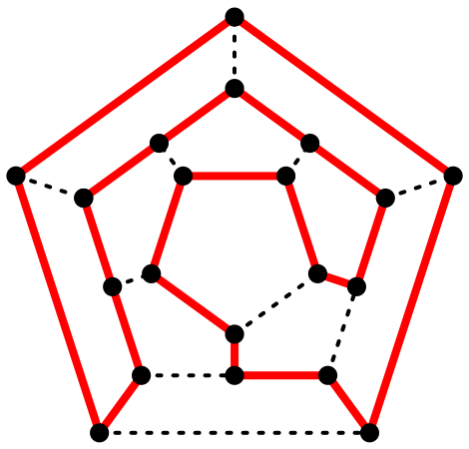
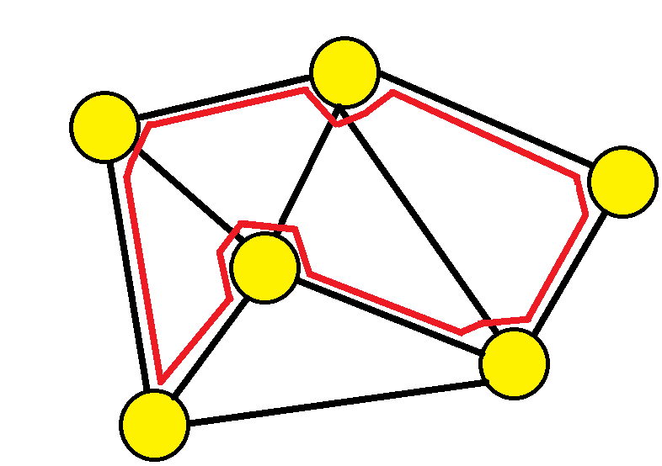

Slide 7
Class P and Class NP
Class P contains problems which are solvable in polynomial time.
  The problems have algorithms in O(n^{k}) time, where n is the input size and k is a constant.
Class NP consists of those problem that are verifiable in polynomial time.
  we can verify that the solution is correct in time polynomial in the input size to the problem.
  algorithms produce an answer by a series of “correct guesses”
Example: Hamilton Circuit: given an order of the n distinct vertices (v₁, v₂, …, v_{n}), we can test if (v_{i}, v _{i+1}) is an edge in G for i=1, 2, …, n-1 and (v_{n}, v₁) is an edge in G in time O(n) (polynomial in the input size).

Slide 8
Class P and Class NP
P⊆NP
  by definition,
If we can design a polynomial time algorithm for problem A, then A is in P.
However, if we have not been able to design a polynomial time algorithm for A, then two possibilities:
  No polynomial time algorithm for A or
  We are not smart.
  Open problem: P≠NP?

Slide 9
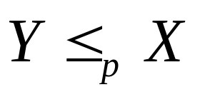
Polynomial-Time Reductions
Suppose a black box (an algorithm) can solve instances of problem X. If we give an instance of X as input the black box will return the correct answer in a single step.
Question: Can we “transform” problem Y into X. Can an arbitrary instance of problem Y be solved by the black box?
  We can use the black box polynomial number of times.
  We can use polynomial number of standard computational steps
  If yes, then Y is polynomial-time reducible to X.

Slide 10
NP-Complete
A problem X is NP-complete if
  it is in NP, and
  any problem Y in NP has a polynomial time reduction to X.
  it is the hardest problem in NP.
  If ONE NP-complete problem can be solved in polynomial time, then any problem in class NP can be solved in polynomial time.
The first NPC problem is Satisfiability problem
  Proved by Cook in 1971 and obtains the Turing Award for this work

Slide 11
Boolean formula
A boolean formula f(x₁, x₂, …x_{n}), where x_{i} are boolean variables (either 0 or 1), contains boolean variables and boolean operations AND, OR and NOT .
Clause: variables and their negations are connected with OR operation, e.g., (x₁ OR NOTx₂ OR x₅)
Conjunctive normal form of boolean formula:
contains m clauses connected with AND operation.
Example:
(x₁ OR NOT x₂) AND (x₁ OR NOT x₃ OR x₆) AND (x₂ OR x₆) AND (NOT x₃ OR x₅).
  Here we have four clauses.

Slide 12
Satisfiability problem
Input: conjunctive normal form with n variables, x₁, x₂, …, x_{n}.
Problem: find an assignment of x₁, x₂, …, x_{n} (setting each x_{i} to be 0 or 1) such that the formula is true (satisfied).
Example: conjunctive normal form is
(x₁ OR NOTx₂) AND (NOT x₁ OR x₃).
The formula is true for assignment
x₁=1, x₂=0, x₃=1.
Note: for n Boolean variables, there are 2^{n} assignments.
Testing if formula=1 can be done in polynomial time for any given assignment.
Given an assignment that satisfies formula=1 is hard.

Slide 13
The First NP-complete Problem
Theorem: Satisfiability problem is NP-complete.
  It is the first NP-complete problem.
  S. A. Cook in 1971 http://en.wikipedia.org/wiki/Stephen_Cook
  Won Turing prize for his work.
Significance:
  If Satisfiability problem is in P, then ALL problems in class NP are in P.
  To solve P≠NP, you should work on NPC problems such as satisfiability problem.
  We can use the first NPC problem, Satisfiability problem, to show other NP-complete problems.

Slide 14
How to show that a problem is NPC?
To show that problem A is NP-complete, we can
  First, find a NP-complete problem B.
  Then, show that
    IF problem A is P, then B is in P.
    that is, to give a polynomial time reduction from B to A.
  Remarks: Since a NPC problem, problem B, is the hardest in class NP, problem A is also the hardest

Slide 15
Hamilton circuit and Longest Simple Path
Hamilton circuit : a circuit uses every vertex of the graph exactly once except for the last vertex, which duplicates the first vertex.
  It was shown to be NP-complete.
Longest Simple Path:
  Input: V={v₁, v₂, ..., v_{n}} be a set of nodes in a graph G and d(v_{i}, v_{j}) the distance between v_{i} and v_{j,},
  Output: a longest simple path from u to v .
Theorem: The longest simple path problem is NP-complete.

Slide 16
Theorem: The longest simple path (LSP) problem is NP-complete.
Proof:
Hamilton Circuit Problem (HC): Given a graph G=(V, E), find a Hamilton Circuit.
We want to show that if the longest simple path problem is in P, then the Hamilton circuit problem is in P.
Design a polynomial time algorithm to solve HC by using an algorithm for LSP.
Step 0: Set the length of each edge in G to be 1
Step 1: for each edge (u, v)∈E do
find the longest simple path P from u to v in G.
Step 2: if the length of P is n-1 then by adding edge (u, v) we
obtain a Hamilton circuit in G.
Step 3: if no Hamilton circuit is found for every (u, v) then
print “no Hamilton circuit exists”
Conclusion:
if LSP is in P, then HC is also in P.
Since HC was proved to be NP-complete, LSP is also NP-complete.

Slide 17
Some basic NP-complete problems
3-Satisfiability : Each clause contains at most three variavles or their negations.
Vertex Cover: Given a graph G=(V, E), find a subset V’ of V such that for each edge (u, v) in E, at least one of u and v is in V’ and the size of V’ is minimized.
Hamilton Circuit: (definition was given before)
History: Satisfiability→3-Satisfiability→vertex cover→Hamilton circuit.
Those proofs are very hard.

Slide 18
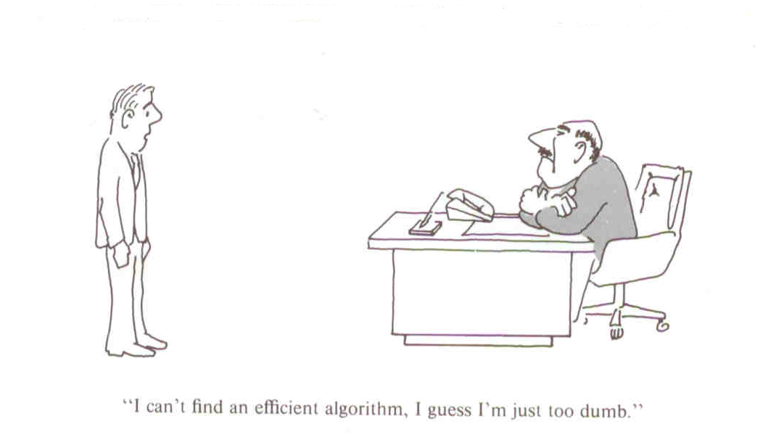
115/11/08
CS4335 Design and Analysis of Algorithms /WANG Lusheng
Page <number>

Slide 19
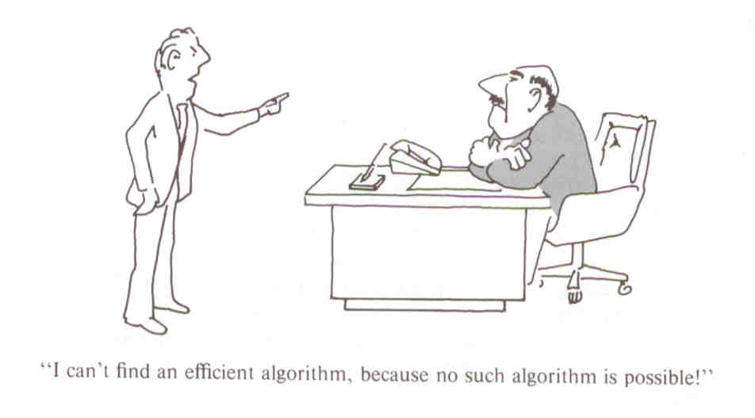
115/11/08
CS4335 Design and Analysis of Algorithms /WANG Lusheng
Page <number>

Slide 20
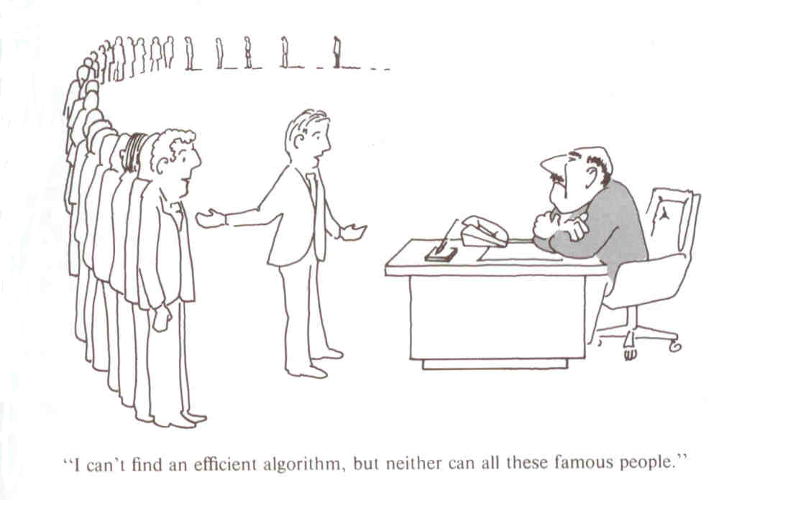
115/11/08
CS4335 Design and Analysis of Algorithms /WANG Lusheng
Page <number>

