Slide 1
Recursion: Example
factorial(n)
if (n == 1)
return 1;
else
return n * factorial(n - 1);
Base case
Recurrence Relation

Slide 2

Another Example: Fibonacci number
F0=F1=1
1, 1, 2, 3, 5, 8, 13, …..
fib(n)
{
if (n <= 1) return 1;
else return fib(n-1) + fib(n-2);
}
Base cases
Recurrence relation

Slide 3
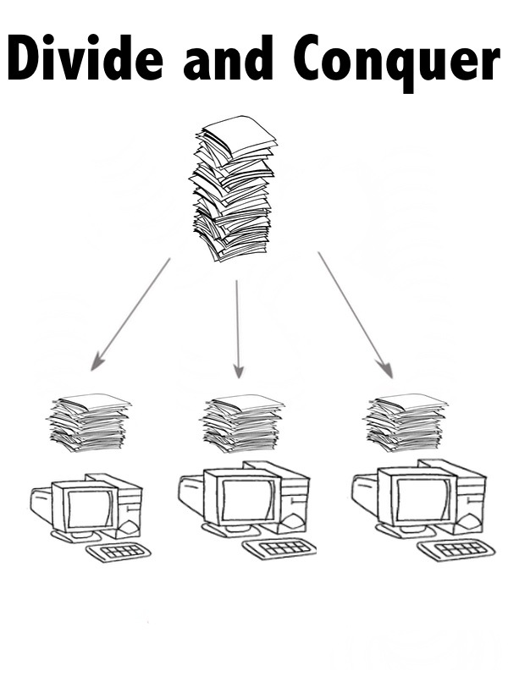

Slide 4
Basic Principle
Merge Sort
Multiplication

Slide 5
Divide and Conquer: Basic Principle
  At each level of recursion
  Divide: split the problem into sub-problems that are similar to the original but smaller in size
  Recur: solve each sub-problem recursively.
  Conquer: Combine the solutions to create a solution to the original problem.

Slide 6
1. Merge Sort

Slide 7
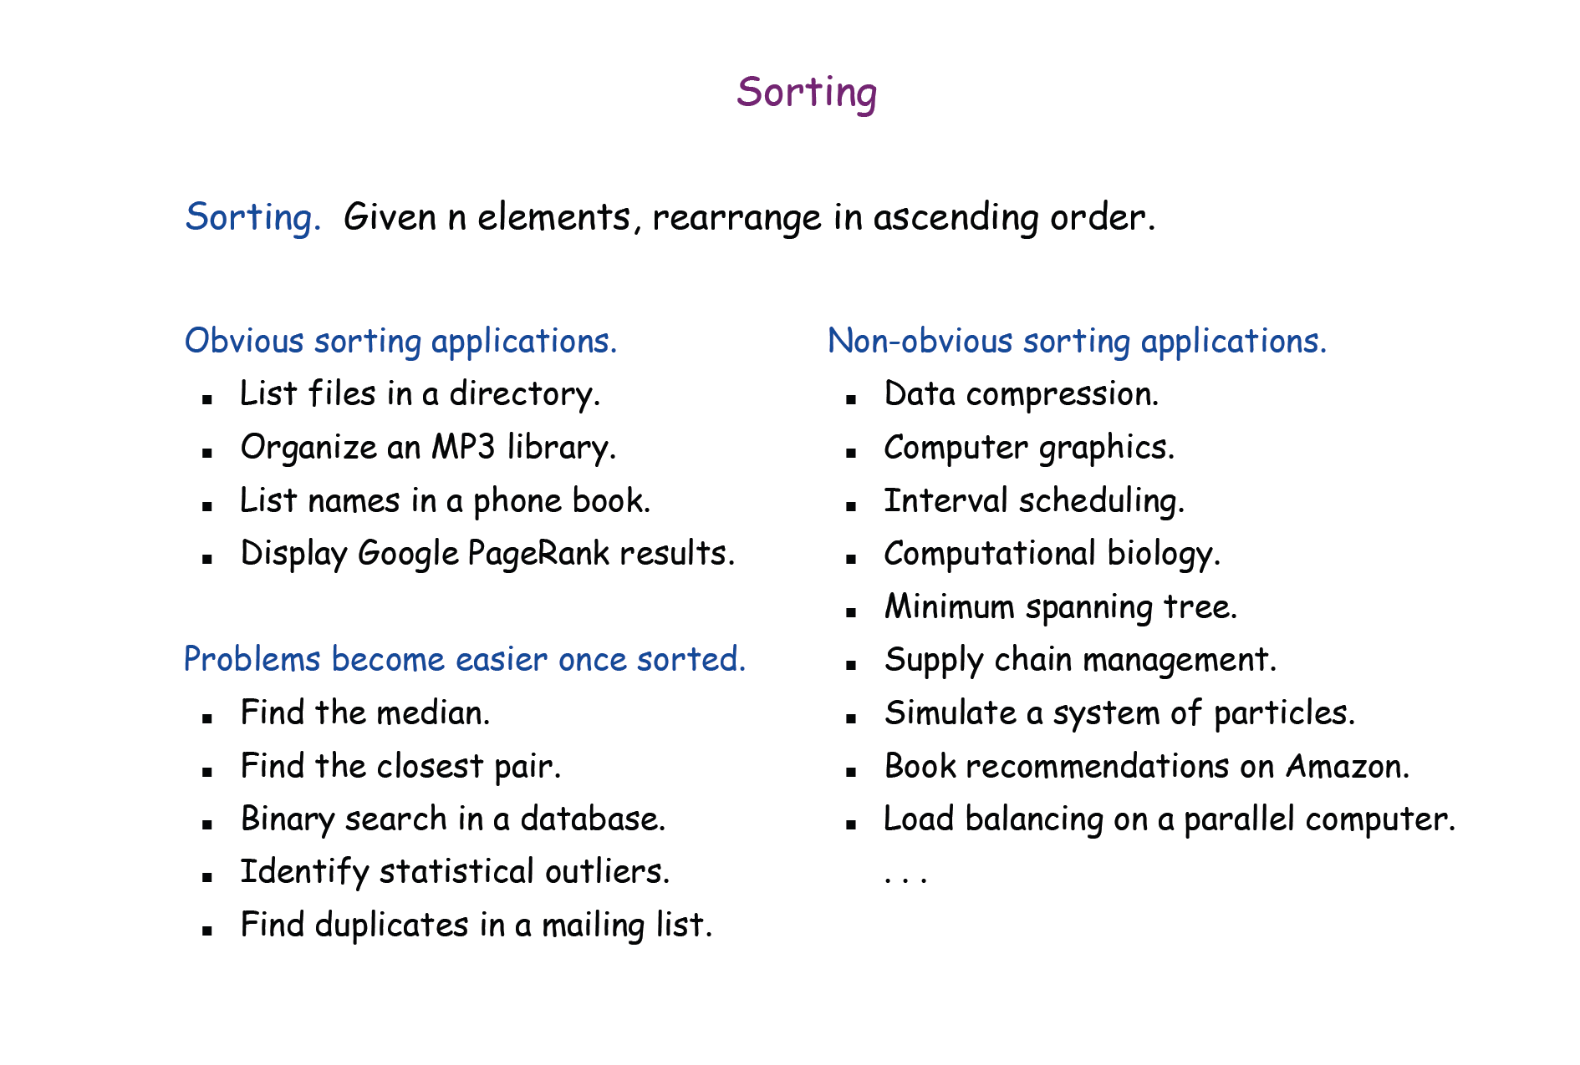

Slide 8
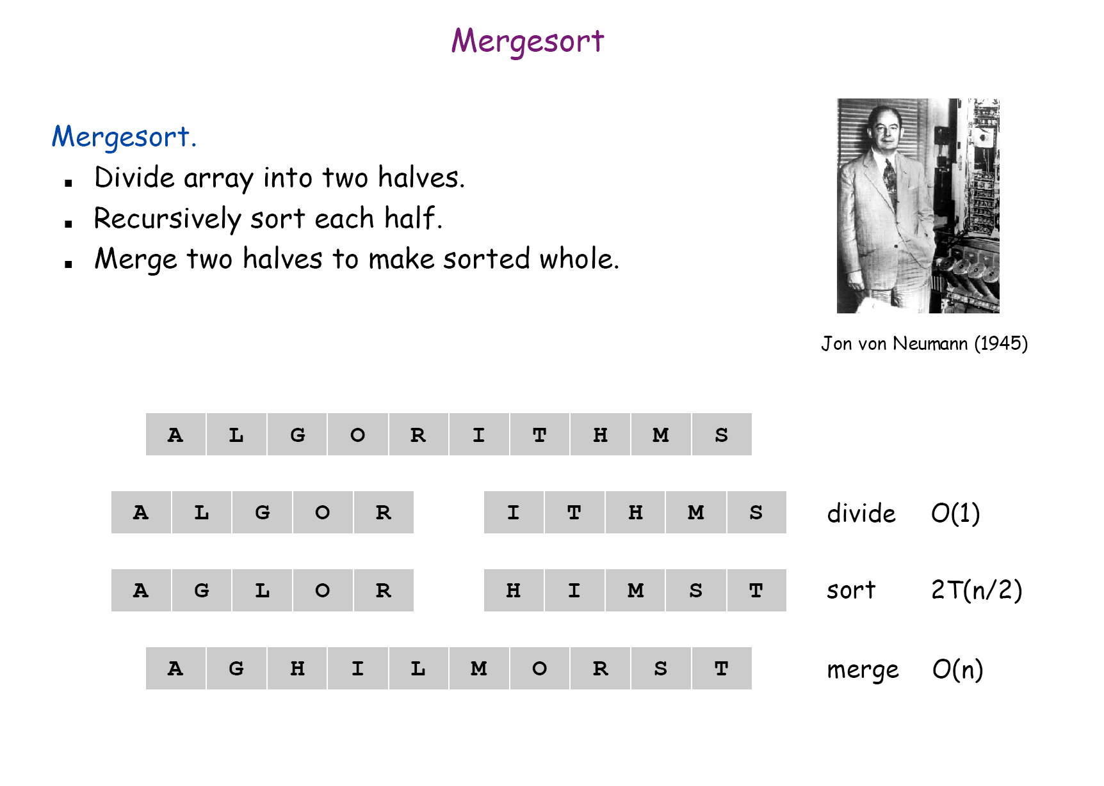

Slide 9
Merging (cont.)
X:
3 | 10 | 23 | 54
Y:
1 | 5 | 25 | 75
Result:

Slide 10
Merging (cont.)
X:
3 | 10 | 23 | 54
Y:
 | 5 | 25 | 75
Result:
1

Slide 11
Merging (cont.)
X:
 | 10 | 23 | 54
Y:
 | 5 | 25 | 75
Result:
1 | 3

Slide 12
Merging (cont.)
X:
 | 10 | 23 | 54
Y:
 |  | 25 | 75
Result:
1 | 3 | 5

Slide 13
Merging (cont.)
X:
 |  | 23 | 54
Y:
 |  | 25 | 75
Result:
1 | 3 | 5 | 10

Slide 14
Merging (cont.)
X:
 |  |  | 54
Y:
 |  | 25 | 75
Result:
1 | 3 | 5 | 10 | 23

Slide 15
Merging (cont.)
X:
 |  |  | 54
Y:
 |  |  | 75
Result:
1 | 3 | 5 | 10 | 23 | 25

Slide 16
Merging (cont.)
X:
Y:
 |  |  | 75
Result:
1 | 3 | 5 | 10 | 23 | 25 | 54

Slide 17
Merging (cont.)
X:
Y:
Result:
1 | 3 | 5 | 10 | 23 | 25 | 54 | 75

Slide 18
Merge Sort Example
99 | 6 | 86 | 15 | 58 | 35 | 86 | 4 | 0

Slide 19
Merge Sort Example
99 | 6 | 86 | 15 | 58 | 35 | 86 | 4 | 0
99 | 6 | 86 | 15
58 | 35 | 86 | 4 | 0

Slide 20
Merge Sort Example
99 | 6 | 86 | 15 | 58 | 35 | 86 | 4 | 0
99 | 6 | 86 | 15
58 | 35 | 86 | 4 | 0
99 | 6
86 | 15
58 | 35
86 | 4 | 0

Slide 21
Merge Sort Example
99 | 6 | 86 | 15 | 58 | 35 | 86 | 4 | 0
99 | 6 | 86 | 15
58 | 35 | 86 | 4 | 0
99 | 6
86 | 15
58 | 35
86 | 4 | 0
99
6
86
15
58
35
86
4 | 0

Slide 22
Merge Sort Example
99 | 6 | 86 | 15 | 58 | 35 | 86 | 4 | 0
99 | 6 | 86 | 15
58 | 35 | 86 | 4 | 0
99 | 6
86 | 15
58 | 35
86 | 4 | 0
99
6
86
15
58
35
86
4 | 0
4
0

Slide 23
Merge Sort Example
99
6
86
15
58
35
86
0 | 4
Merge
4
0

Slide 24
Merge Sort Example
6 | 99
15 | 86
58 | 35
0 | 4 | 86
99
6
86
15
58
35
86
0 | 4
Merge

Slide 25
Merge Sort Example
6 | 15 | 86 | 99
0 | 4 | 35 | 58 | 86
6 | 99
15 | 86
58 | 35
0 | 4 | 86
Merge

Slide 26
Merge Sort Example
0 | 4 | 6 | 15 | 35 | 58 | 86 | 86 | 99
6 | 15 | 86 | 99
0 | 4 | 35 | 58 | 86
Merge

Slide 27
Merge Sort Example
0 | 4 | 6 | 15 | 35 | 58 | 86 | 86 | 99

Slide 28
Merge-Sort
Merge-sort on an input sequence S with n elements consists of three steps:
  Divide: partition S into two sequences S₁ and S₂ of about n/2 elements each
  Recur: recursively sort S₁ and S₂
  Conquer: merge S₁ and S₂ into a unique sorted sequence
Algorithm mergeSort(S)
Input sequence S with n elements
Output sequence S
if S.size() > 1{
  (S₁, S₂) ← partition(S, n/2)
  mergeSort(S₁)
  mergeSort(S₂)
  S ← merge(S₁, S₂)}
Merge Sort

Slide 29
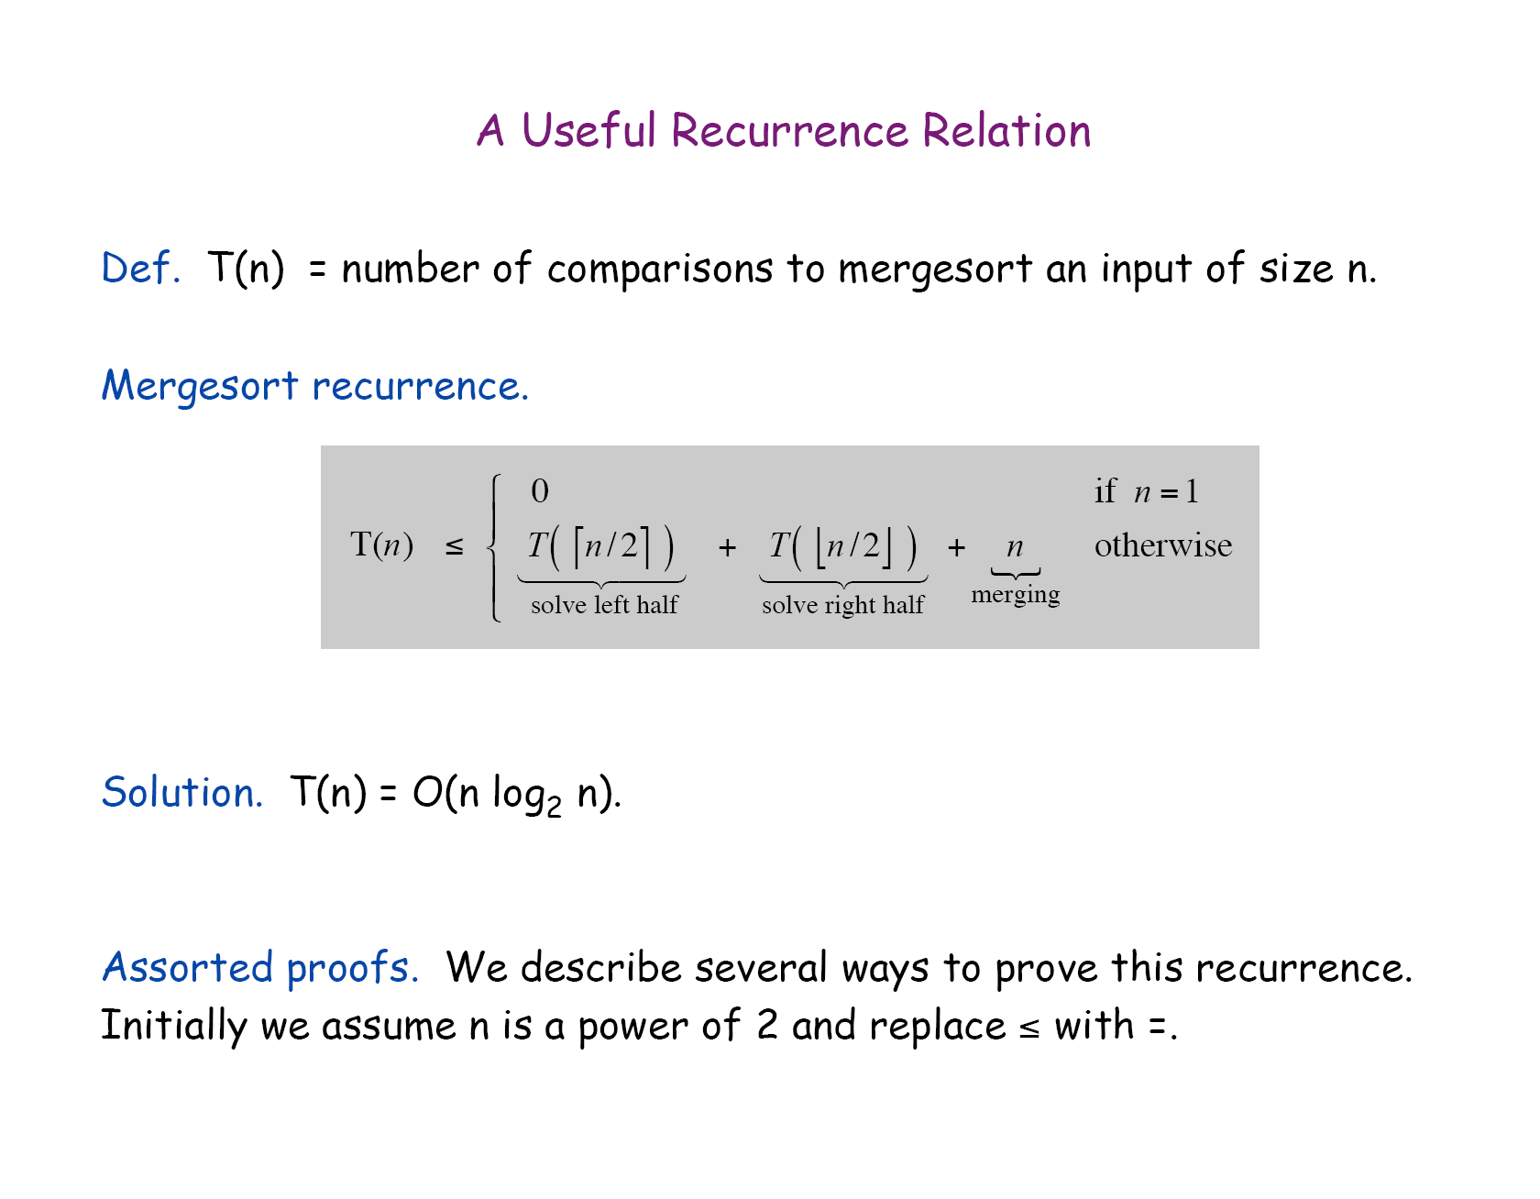

Slide 30
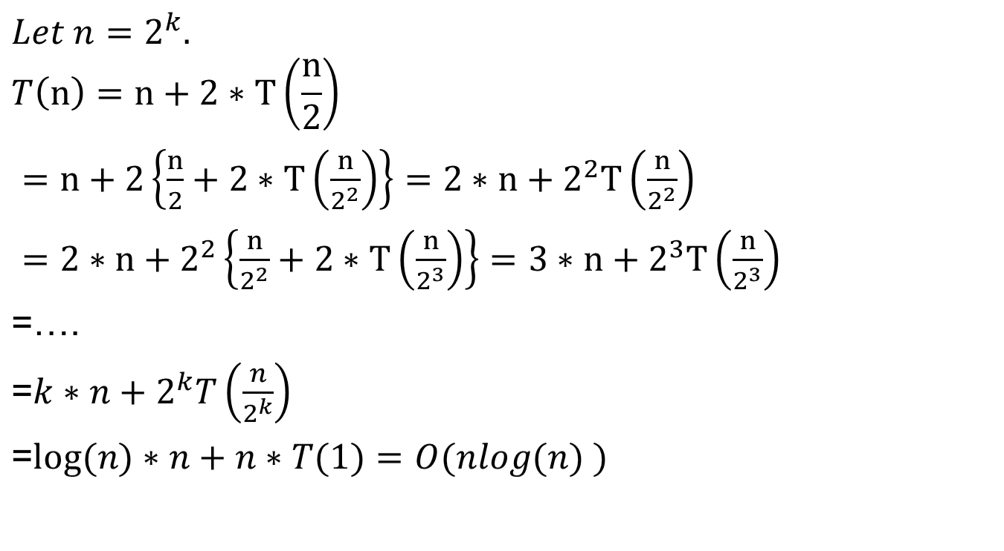
2 ^{log n}=n

Slide 31
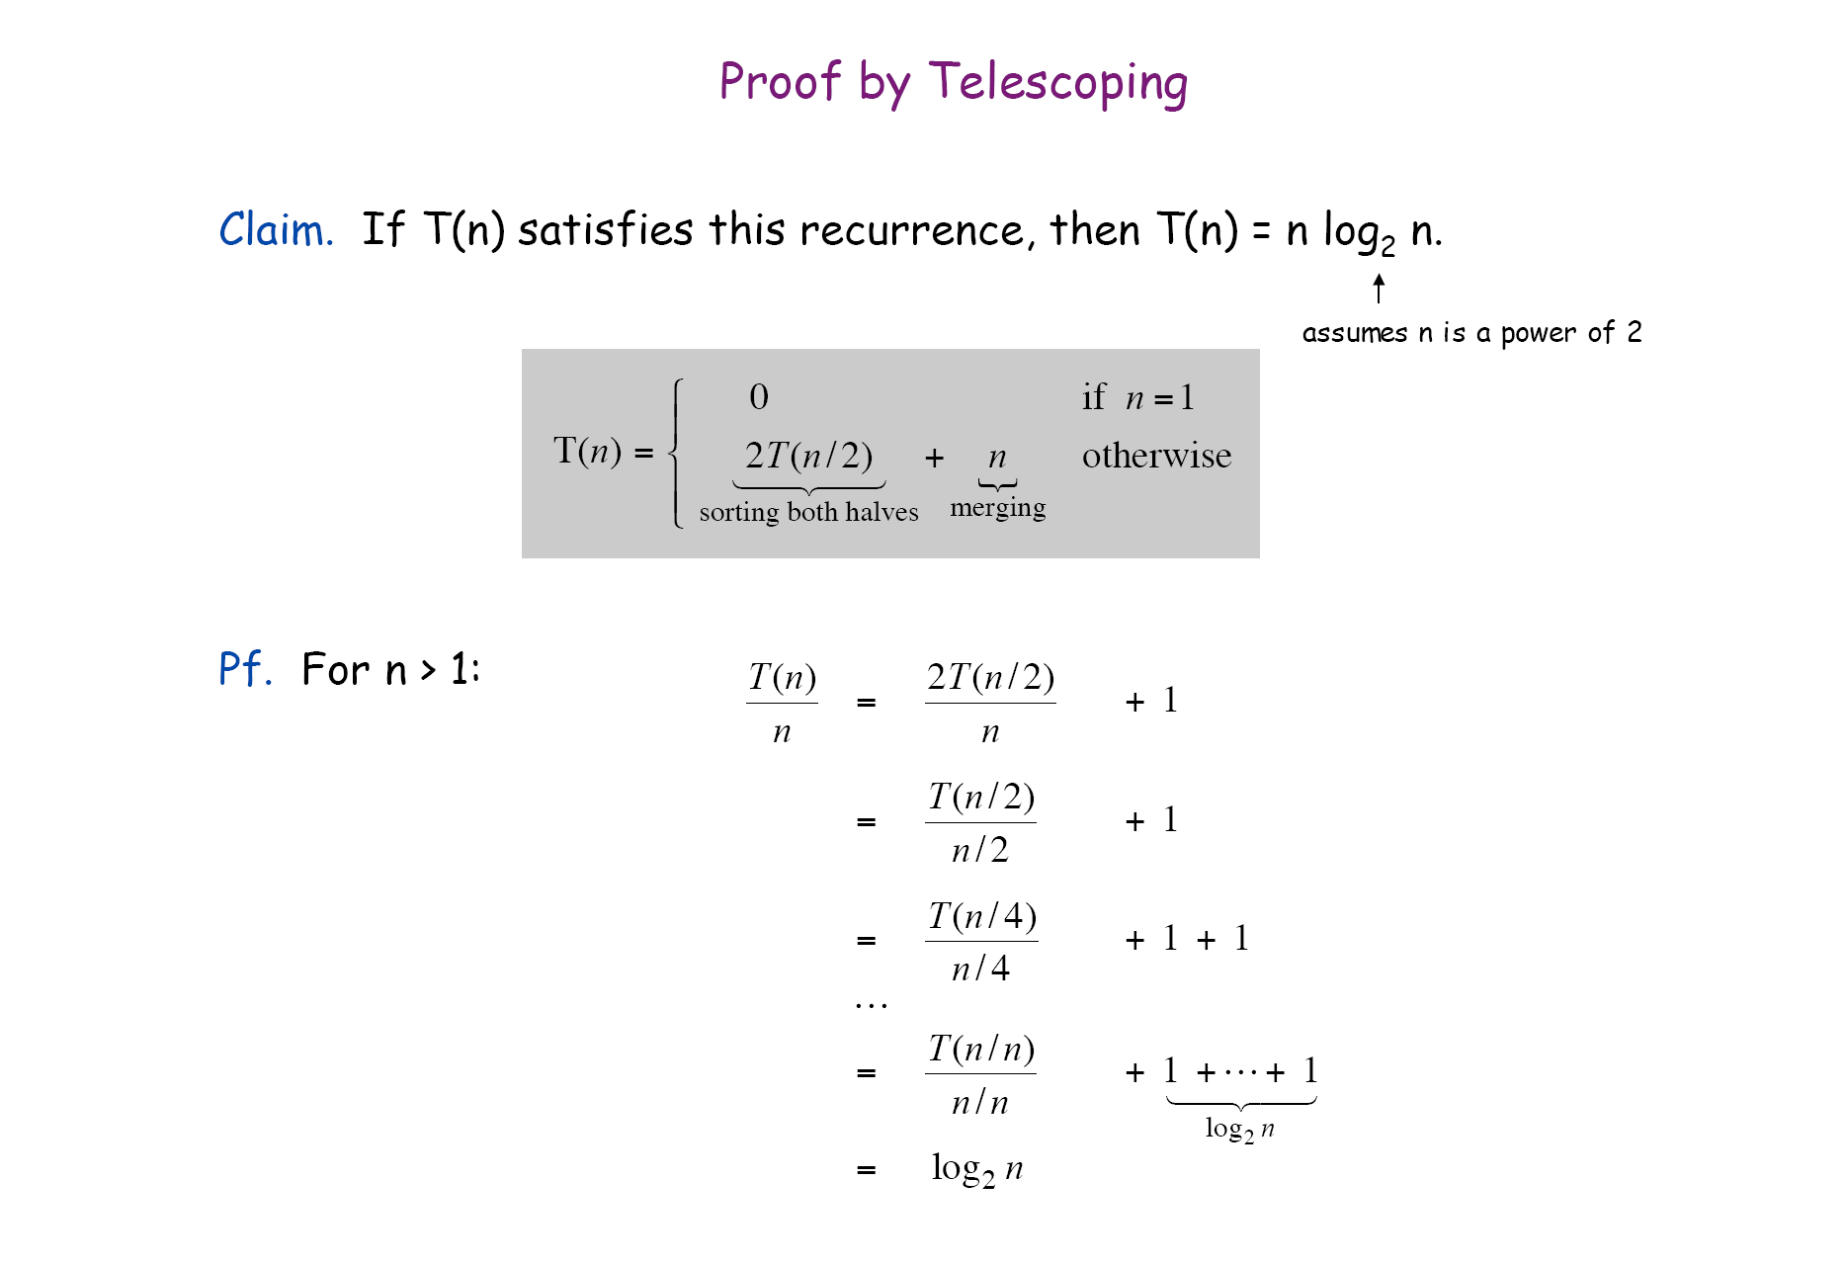

Slide 32
2. Counting Inversions

Slide 33
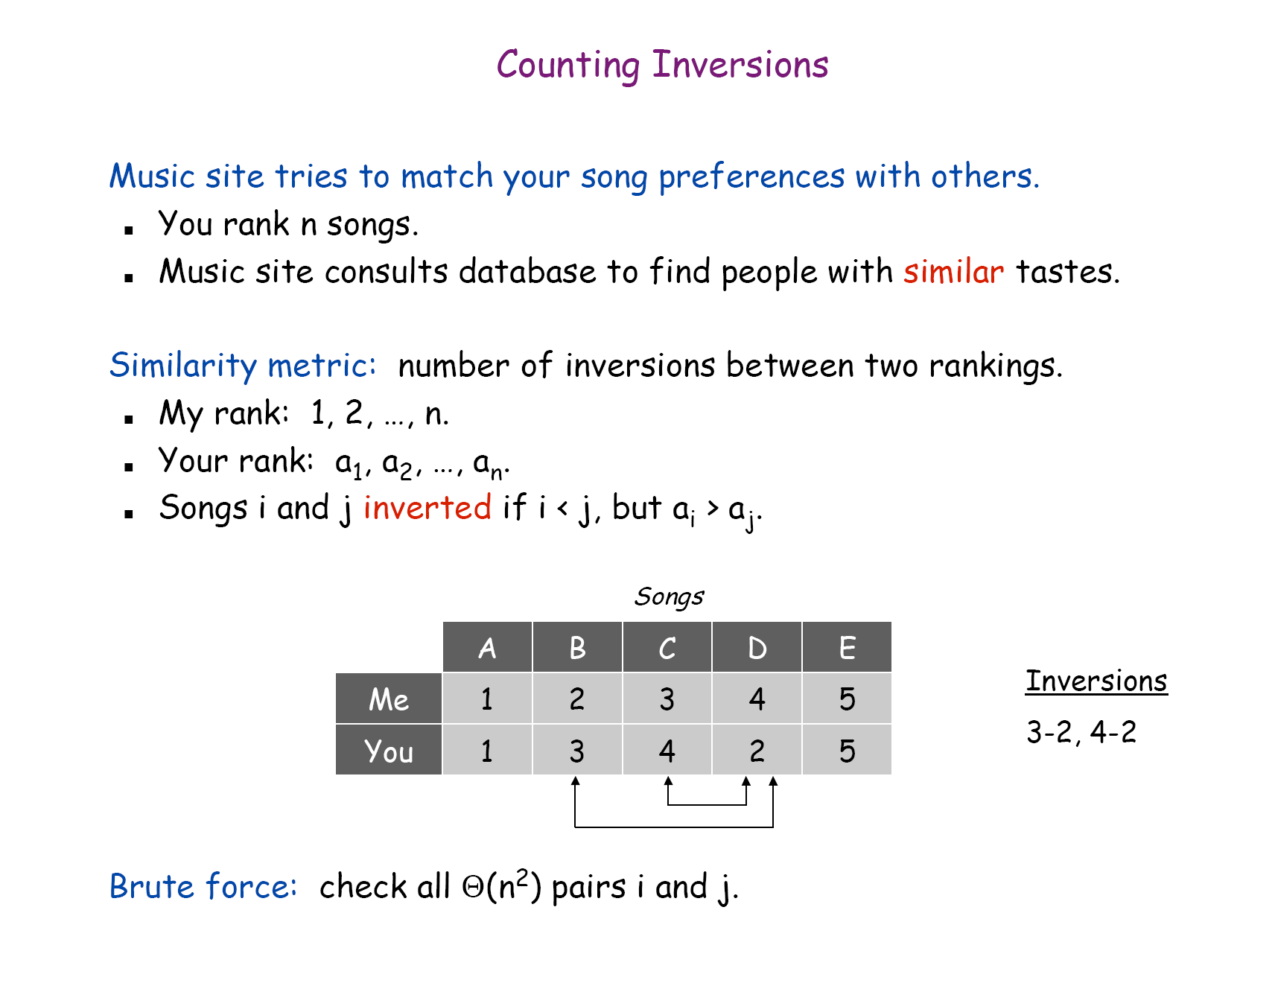
We can assume that the first rank is 1, 2, ,…n.
example
R1: g, q, p, r, m→1, 2, 3, 4, 5
R2: q, p, r, g, m→2, 3, 4, 1, 5

Slide 34
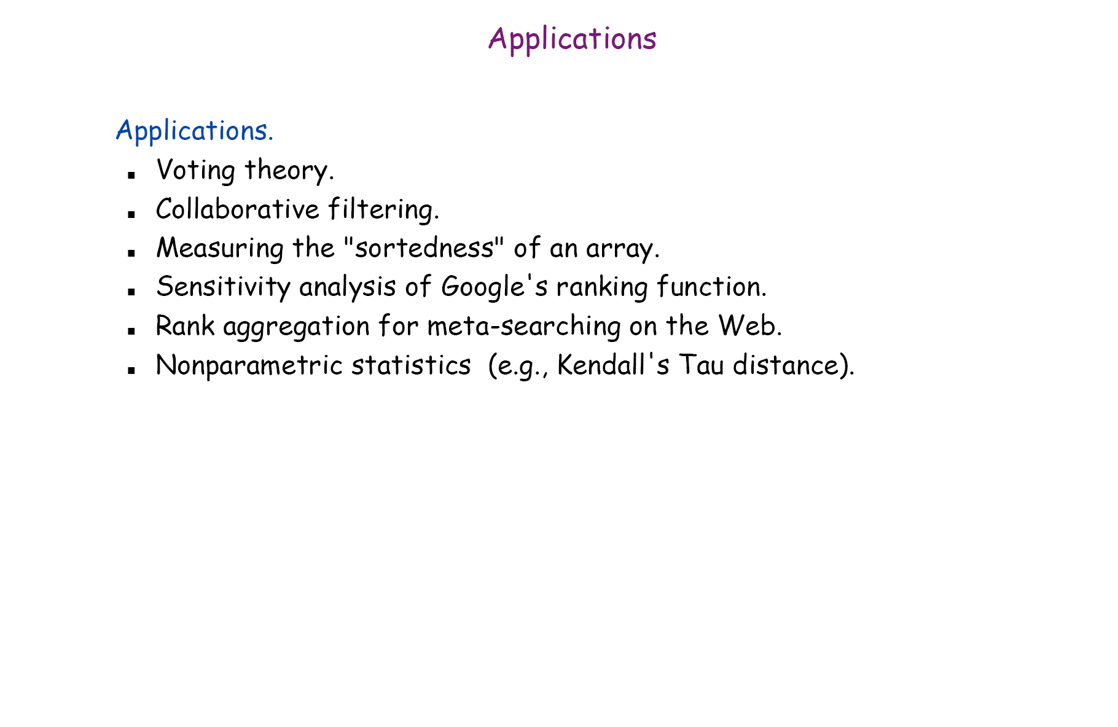

Slide 35
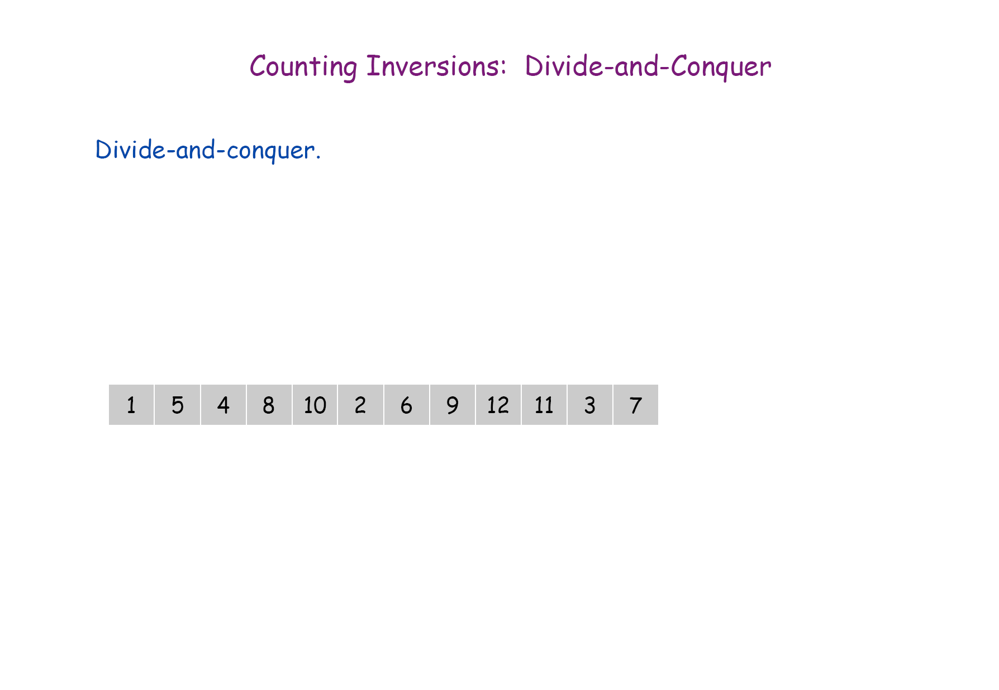

Slide 36
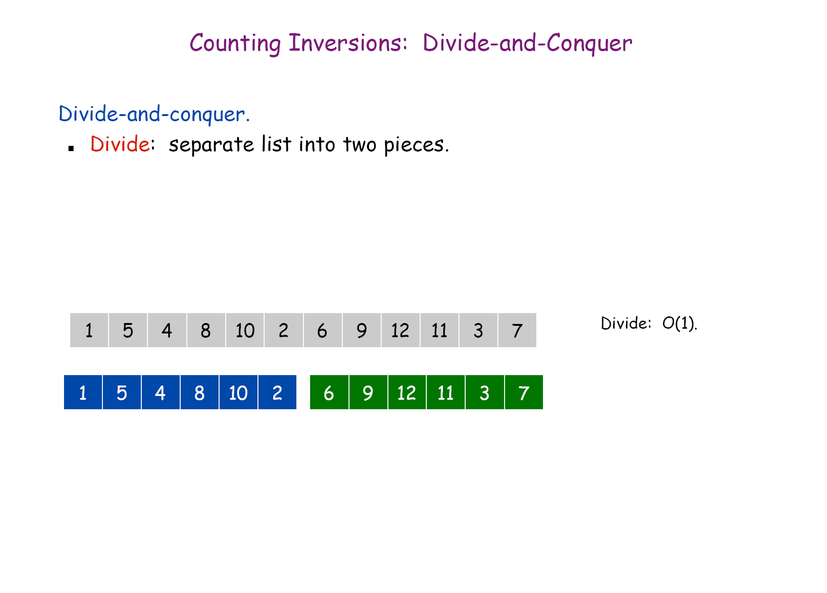

Slide 37
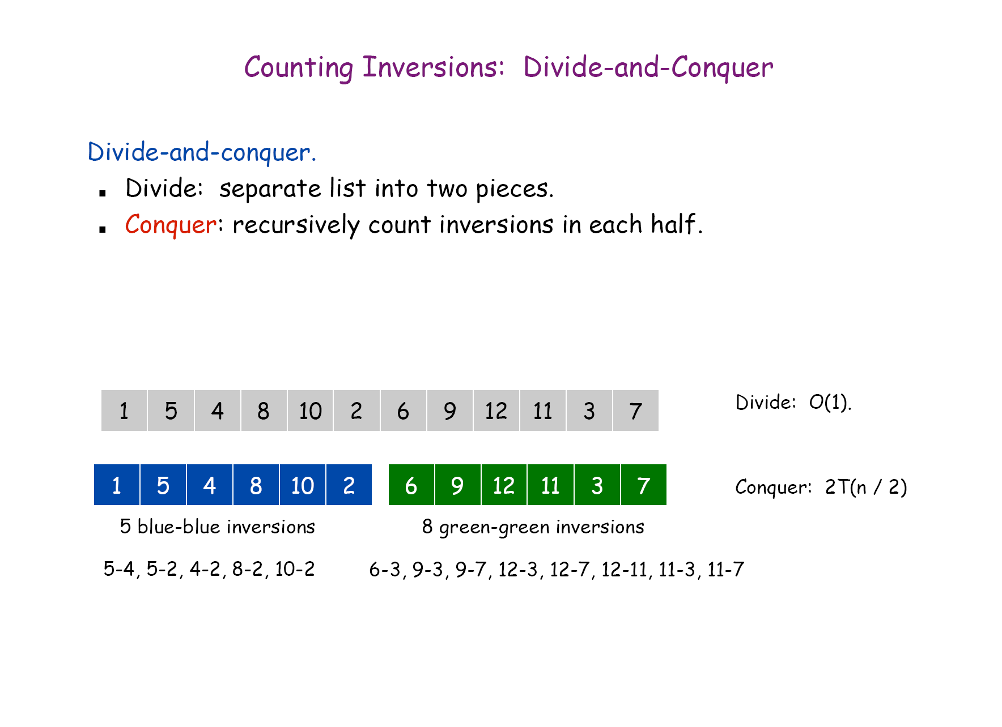

Slide 38
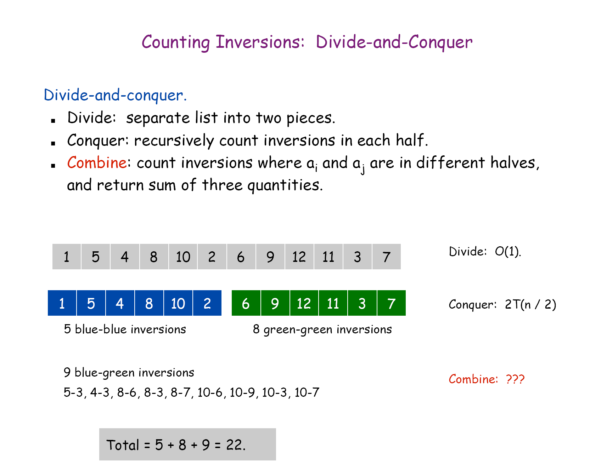

Slide 39
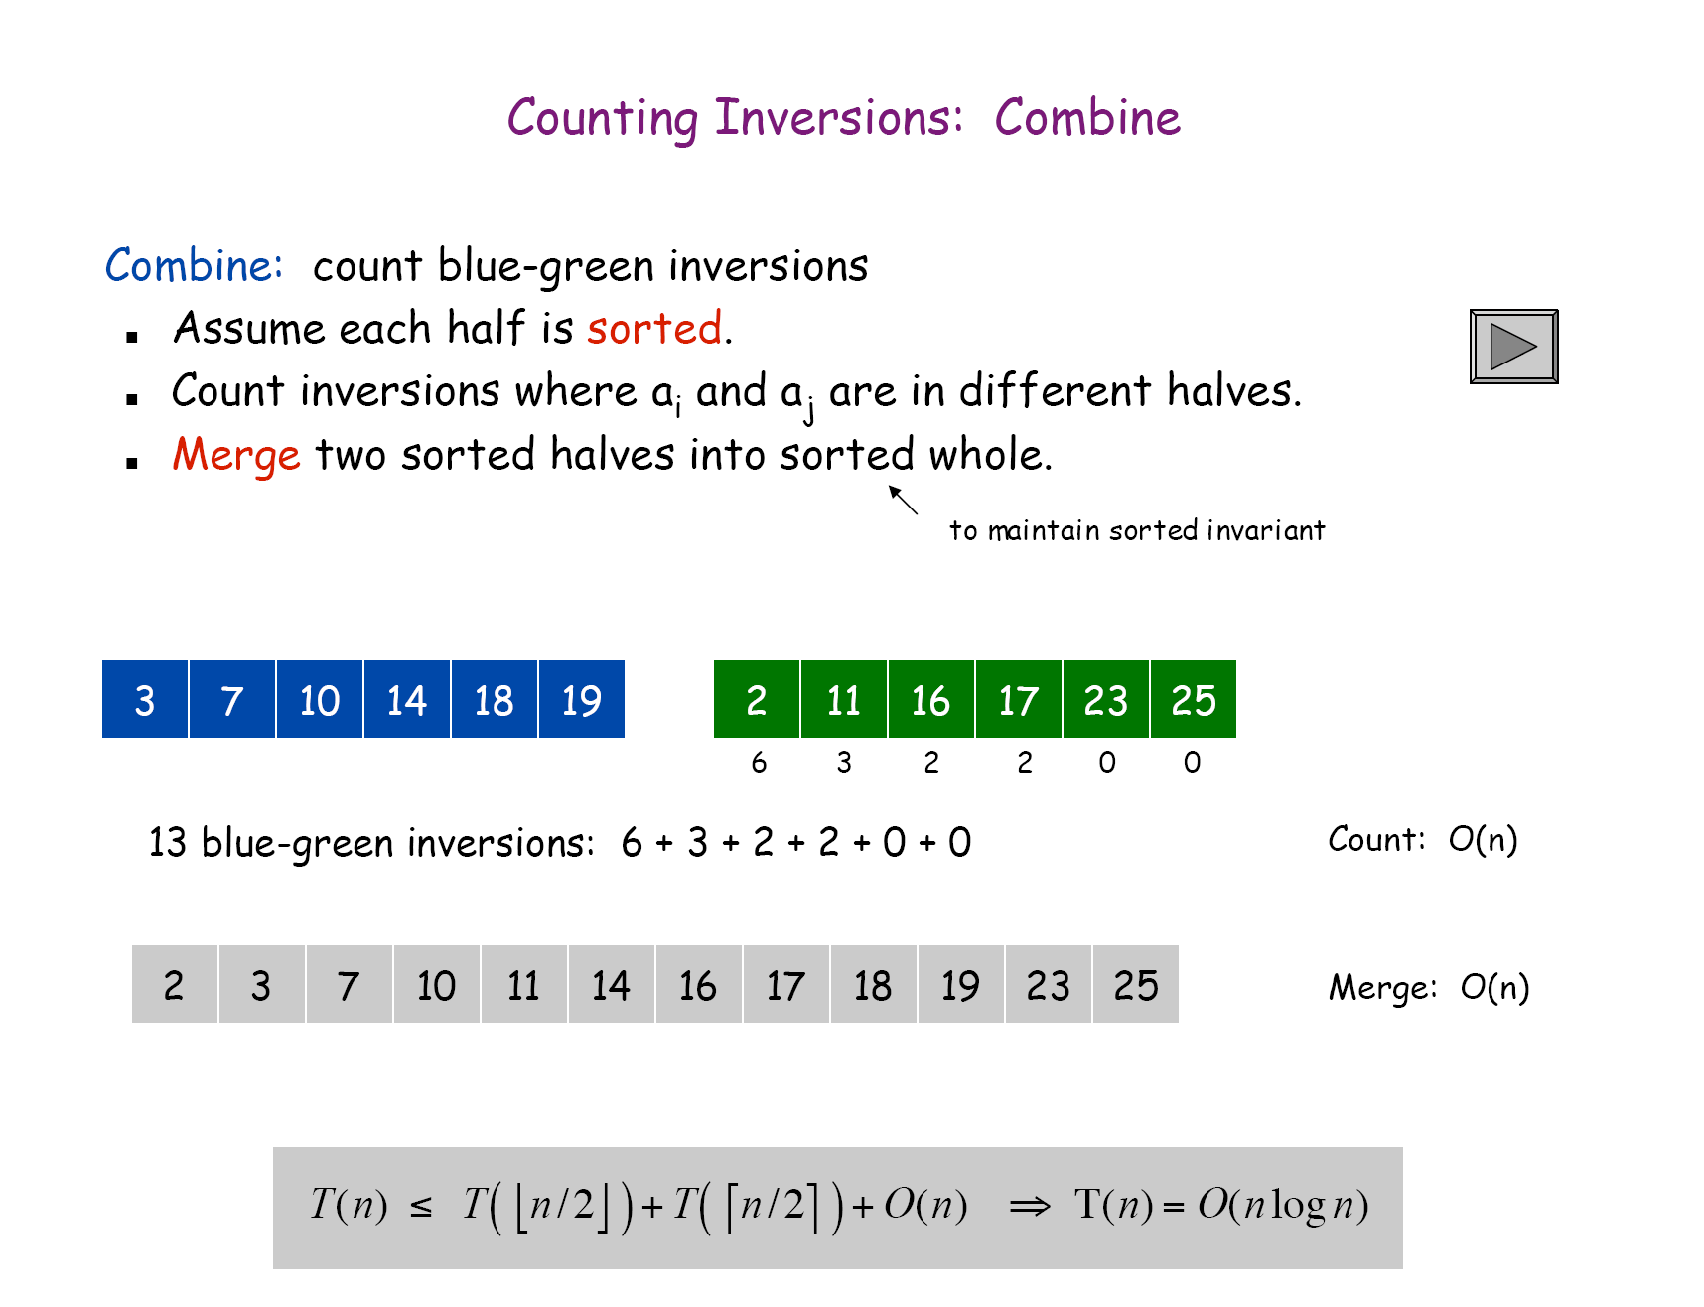

Slide 40
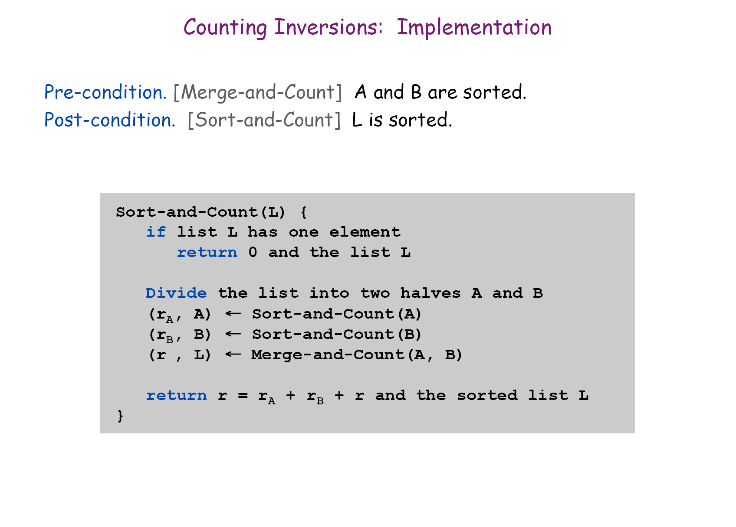

Slide 41
Merge and Count Process: Another example.
1, 2, 8, 10, 11, 12; 3, 4, 5, 6, 7, 9;
4 4 4 4 4 3
# of inversions
1, 2, 3, 4, 5, 6, 7, 8, 9, 10, 11, 12.
Time for merge : O(n).

Slide 42
3. Number Multiplication

Slide 43
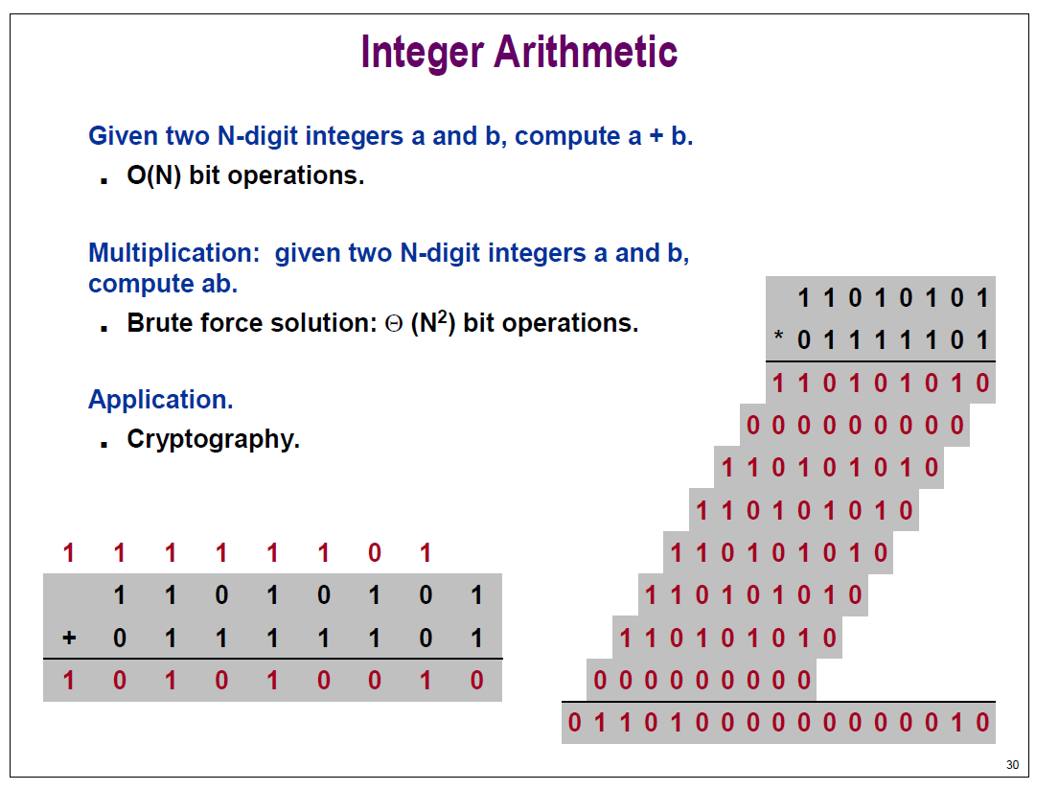
chapter25

Slide 44
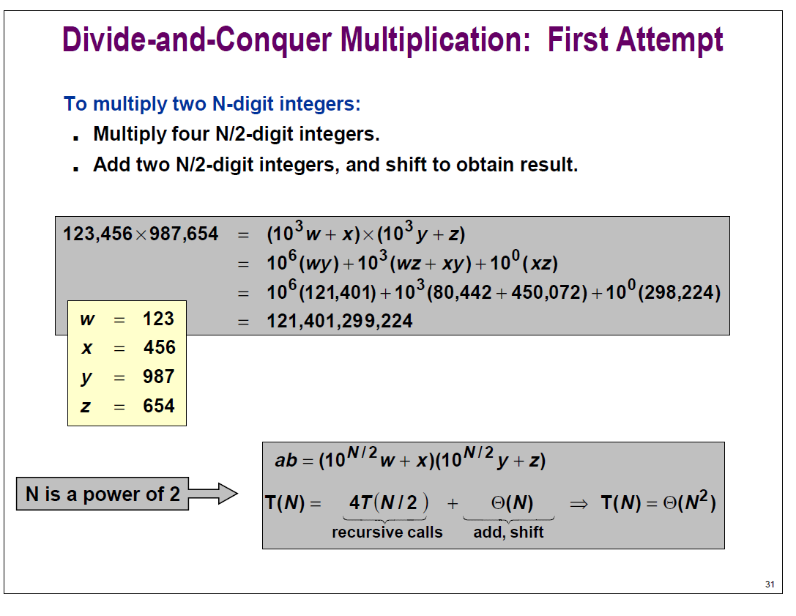
Backtracking and time complexity
Backtracking is used to get the schedule.
Time complexity
  O(n) if the jobs are sorted.
  Total time: O(n log n) including sorting.
chapter25

Slide 45
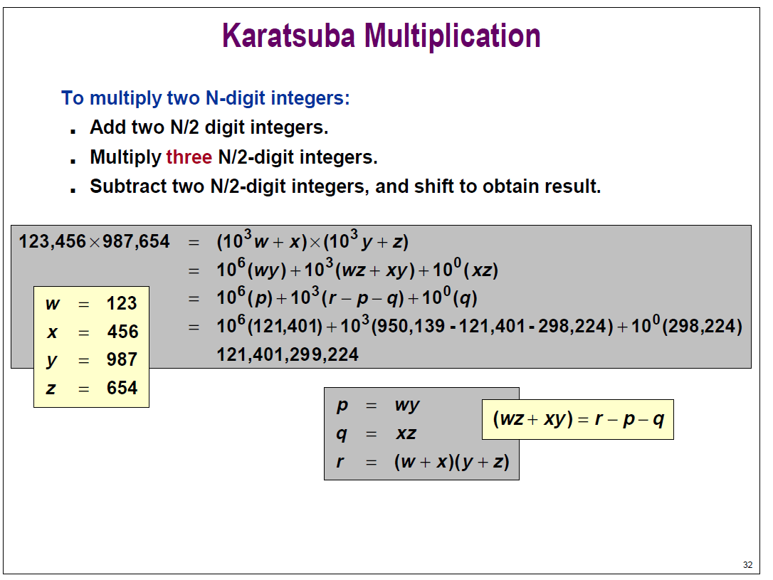
Weighted Interval Scheduling: Bottom-Up
Input: n, s₁, s₂, …, s_{n}, f₁, f₂, …, f_{n}, v₁, v₂, …, v_{n}
Sort jobs by finish times so that f₁≤f₂≤ … ≤f_{n}.
Compute p(1), p(2) , …, p(n)
M[0]=0;
for j = 1 to n do
M[j] = max { v_{j}+m[p(j)], m[j-1]}
if (M[j] == m[j-1]) then B[j]=j-1 else B[j]=p(j) /*for backtracking
m=n;
while ( m ≠0)
{ print “job m”; m=B[m]; }
chapter25

Slide 46
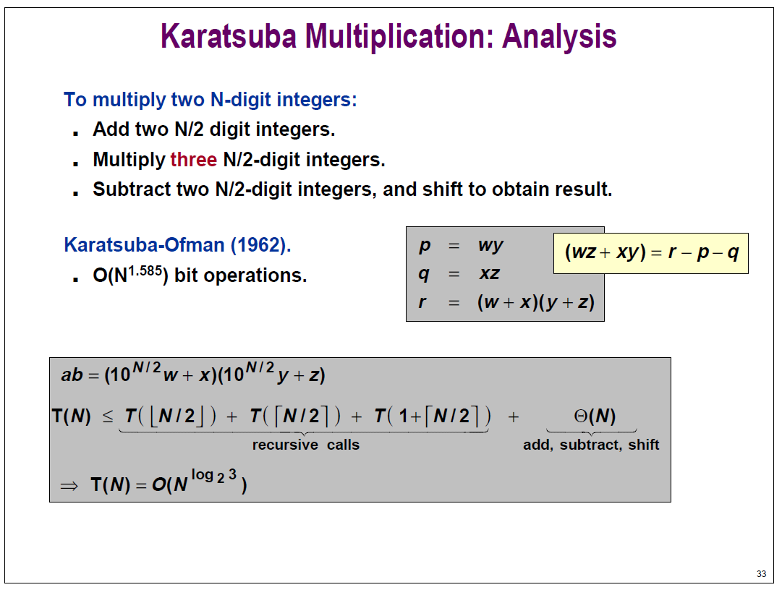
Weighted Interval Scheduling: Bottom-Up
Input: n, s₁, s₂, …, s_{n}, f₁, f₂, …, f_{n}, v₁, v₂, …, v_{n}
Sort jobs by finish times so that f₁≤f₂≤ … ≤f_{n}.
Compute p(1), p(2) , …, p(n)
M[0]=0;
for j = 1 to n do
M[j] = max { v_{j}+m[p(j)], m[j-1]}
if (M[j] == m[j-1]) then B[j]=j-1 else B[j]=p(j) /*for backtracking
m=n;
while ( m ≠0)
{ print “job m”; m=B[m]; }
Solving recurrence equation is not required.
chapter25

Slide 47
Summary
Basic Principle
Merge Sort
Multiplication (Fun part, will not be tested
We use this example to show that
    Recurrence equations play important role to estimate the running time
    Solving recurrence equations is very hard and there are postgraduate courses for solving recurrence equations.
Solving recurrence equation of slide 33 is not required.

