Slide 1
Lecture 9
Dynamic Programming Methods for
Longest Common Subsequence
Shortest Common Supersequence
0-1 Knapsack Problem.

Slide 2
What we learned so far:
Euler Circuit Problem. Theorem and algorithm
Greedy Algorithms
  Interval scheduling and interval partitioning problems. Algorithms, correctness, running time.
  MST: Kruskal and Prim Algorithms, theorem, running times with different data structures.
  Single-source shortest path: Dijkstra algorithm: algorithm, running time and correctness.
Divide and Conquer: divide, recur, and conquer
  Merge sort: algorithm and running time
  Counting Inversions: algorithms and running: two jobs are easier than one.

Slide 3
Dynamic Programming
* Break problems into subproblems and combine their solutions into solutions to larger problems.
In contrast to divide-and-conquer, dynamic programming uses memorization: each sub-problem is solved only once and the result of each sub-problem is stored in a table

Slide 4
1. Longest common subsequence (LCS)

Slide 5
A string : A = b a c a d
A subsequence of A: deleting zero or more symbols from A
(not necessarily consecutive)
  e.g. ad, ac, bac, acad, bacad, bcd.
Common subsequences of A = b a c a d and B = a c c b a d c b:
ad, ac, bac, acad.
The longest common subsequence (LCS) of A and B: acad.

Slide 6
Longest common subsequence problem
Input: Two sequences X=x₁x₂...x_{m}, and Y=y₁y₂...y_{n}.
Output: a longest common subsequence of X and Y.
A brute-force approach:
Suppose that m≥n. Try all subsequence of X (There are 2^{m} subsequence of X), test if such a subsequence is also a subsequence of Y, and select the one with the longest length.
chapter25

Slide 7
Charactering a longest common subsequence
Theorem (Optimal substructure of an LCS)
Let X=x₁x₂...x_{i}, and Y=y₁y₂...y_{j} be two sequences,
and Z=be a LCS of X and Y.
1. If x_{i}=y_{j}, Z=LCS(x₁x₂...x_{i-1}, y₁y₂...y_{j-1} ) + x_{i}
2. If x_{i} ≠y_{j}, Z is the longer one among LCS(x₁x₂...x_{i-1}, y₁y₂...y_{j} ) and LCS(x₁x₂...x_{i}, y₁y₂...y_{j-1} ).
chapter25

Slide 8
The recursive equation
Let c[i,j] be the length of an LCS of X[1...i] and Y[1...j].
c[i,j] can be computed as follows:
0 if i=0 or j=0,
c[i,j]= c[i-1,j-1]+1 if i,j>0 and x_{i}=y_{j},
max{c[i,j-1],c[i-1,j]} if i,j>0 and x_{i}≠y_{j}.
Computing the length of an LCS
There are n×m c[i,j]’s. So we can compute them in
a specific order.
chapter25

Slide 9
The algorithm to compute an LCS
1. for i=1 to m do
2. c[i,0]=0;
3. for j=0 to n do
4. c[0,j]=0;
5. for i=1 to m do
6. for j=1 to n do
7. {
8. if x[i] ==y[j] then
9. c[i,j]=c[i-1,j-1]+1;
10 b[i,j]=1;
11. else if c[i-1,j]>=c[i,j-1] then
12. c[i,j]=c[i-1,j]
13. b[i,j]=2;
14. else c[i,j]=c[i,j-1]
15. b[i,j]=3;
14 }
chapter25

Slide 10
Example 3: X=BDCABA and Y=ABCBDAB.
 | y_{i} | B | D | C | A | B | A
x_{i}
A
B
C
B
D
A
B
chapter25

Slide 11
Example 3: X=BDCABA and Y=ABCBDAB.
 | y_{i} | B | D | C | A | B | A
x_{i} | 0 | 0 | 0 | 0 | 0 | 0 | 0
A | 0 | 0 | 0 | 0 | 1 | 1 | 1
B | 0 | 1 | 1 | 1 | 1 | 2 | 2
C | 0 | 1 | 1 | 2 | 2 | 2 | 2
B | 0 | 1 | 1 | 2 | 2 | 3 | 3
D | 0 | 1 | 2 | 2 | 2 | 3 | 3
A | 0 | 1 | 2 | 2 | 3 | 3 | 4
B | 0 | 1 | 2 | 2 | 3 | 4 | 4
chapter25

Slide 12
Constructing an LCS (back-tracking)
We can find an LCS using b[i,j]’s.
We start with b[n,m] and track back to some cell b[0,i] or b[i,0].
The algorithm to construct an LCS (backtracking)
  1. i=m
  2. j=n;
  3. if i==0 or j==0 then exit;
  4. if b[i,j]==1 then
  {
  i=i-1;
  j=j-1;
  print “x_{i}”;
  }
  5. if b[i,j]==2 i=i-1
  6. if b[i,j]==3 j=j-1
  7. Goto Step 3.
The time complexity: O(nm).
chapter25

Slide 13
2. Shortest common super-sequence

Slide 14
Shortest common supersequence
Definition: Let X and Y be two sequences. A sequence Z is a supersequence of X and Y if both X and Y are subsequences of Z.
Shortest common supersequence problem:
  Input: Two sequences X and Y.
  Output: a shortest common supersequence of X and Y.
Example: X=abc and Y=abb. Both abbc and abcb are the shortest common supersequences for X and Y.

Slide 15
Example 1:
X=humans, Y=chimpanzees
SCS(X, Y)=SCS(human, chimpanzee)+s
Example 2:
X=human, Y=chimpanzee
SCS(X, Y)=shorter(
SCS(huma, chimpanzee)+n,
SCS(human, chimpanze)+e)
Exmple 3:
X=human, Y=“”
SCS(X, Y)=human

Slide 16
Recursive Equation:
Let c[i,j] be the length of an SCS of X[1...i] and Y[1...j].
c[i,j] can be computed as follows:
j if i=0
i if j=0,
c[i,j]= c[i-1,j-1]+1 if i,j>0 and x_{i}=y_{j},
min{c[i,j-1]+1,c[i-1,j]+1} if i,j>0 and x_{i}≠y_{j}.

Slide 17
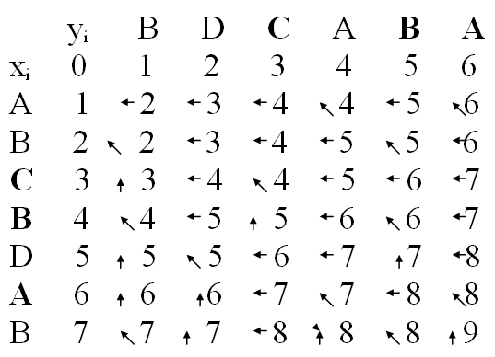

Slide 18
The pseudo-codes
for i=0 to n do
c[i, 0]=i;
for j=0 to m do
c[0,j]=j;
for i=1 to n do
for j=1 to m do
if (xi == yj) c[i ,j]= c[i-1, j-1]+1; b[i.j]=1;
else {
c[i,j]=min{c[i-1,j]+1, c[i,j-1]+1}.
if (c[i,j]=c[i-1,j]+1 then b[i,j]=2;
else b[i,j]=3;
}
p=n, q=m; / backtracking
while (p≠0 or q≠0)
{ if (b[p,q]==1) then {print x[p]; p=p-1; q=q-1}
if (b[p,q]==2) then {print x[p]; p=p-1}
if (b[p,q]==3) then {print y[q]; q=q-1}
}

Slide 19
Example SCS for X=BDCABA and Y=ABCBDAB.
 | y_{i} | B | D | C | A | B | A
x_{i} | 0 | 1 | 2 | 3 | 4 | 5 | 6
A
B
C
B
D
A
B

Slide 20
Example SCS for X=BDCABA and Y=ABCBDAB.
 | y_{i} | B | D | C | A | B | A
x_{i} | 0 | 1 | 2 | 3 | 4 | 5 | 6
A | 1 | 2 | 3 | 4 | 4 | 5 | 6
B | 2 | 2 | 3 | 4 | 5 | 5 | 6
C | 3 | 3 | 4 | 4 | 5 | 6 | 7
B | 4 | 4 | 5 | 5 | 6 | 6 | 7
D | 5 | 5 | 5 | 6 | 7 | 7 | 8
A | 6 | 6 | 6 | 6 | 7 | 8 | 8
B | 7 | 7 | 7 | 7 | 8 | 8 | 9

Slide 21
Dynamic Programming
Step 1: Structure and subproblem definition:
– find a relation between the original problem and the smaller problems.
Step 2: Bottom-up computation: Compute an optimal solution in a bottom-up fashion by using a table structure.
Step 3: Construction of optimal solution: Construct an optimal solution from computed information.

Slide 22
3. 0-1 Knapsack Problem

Slide 23
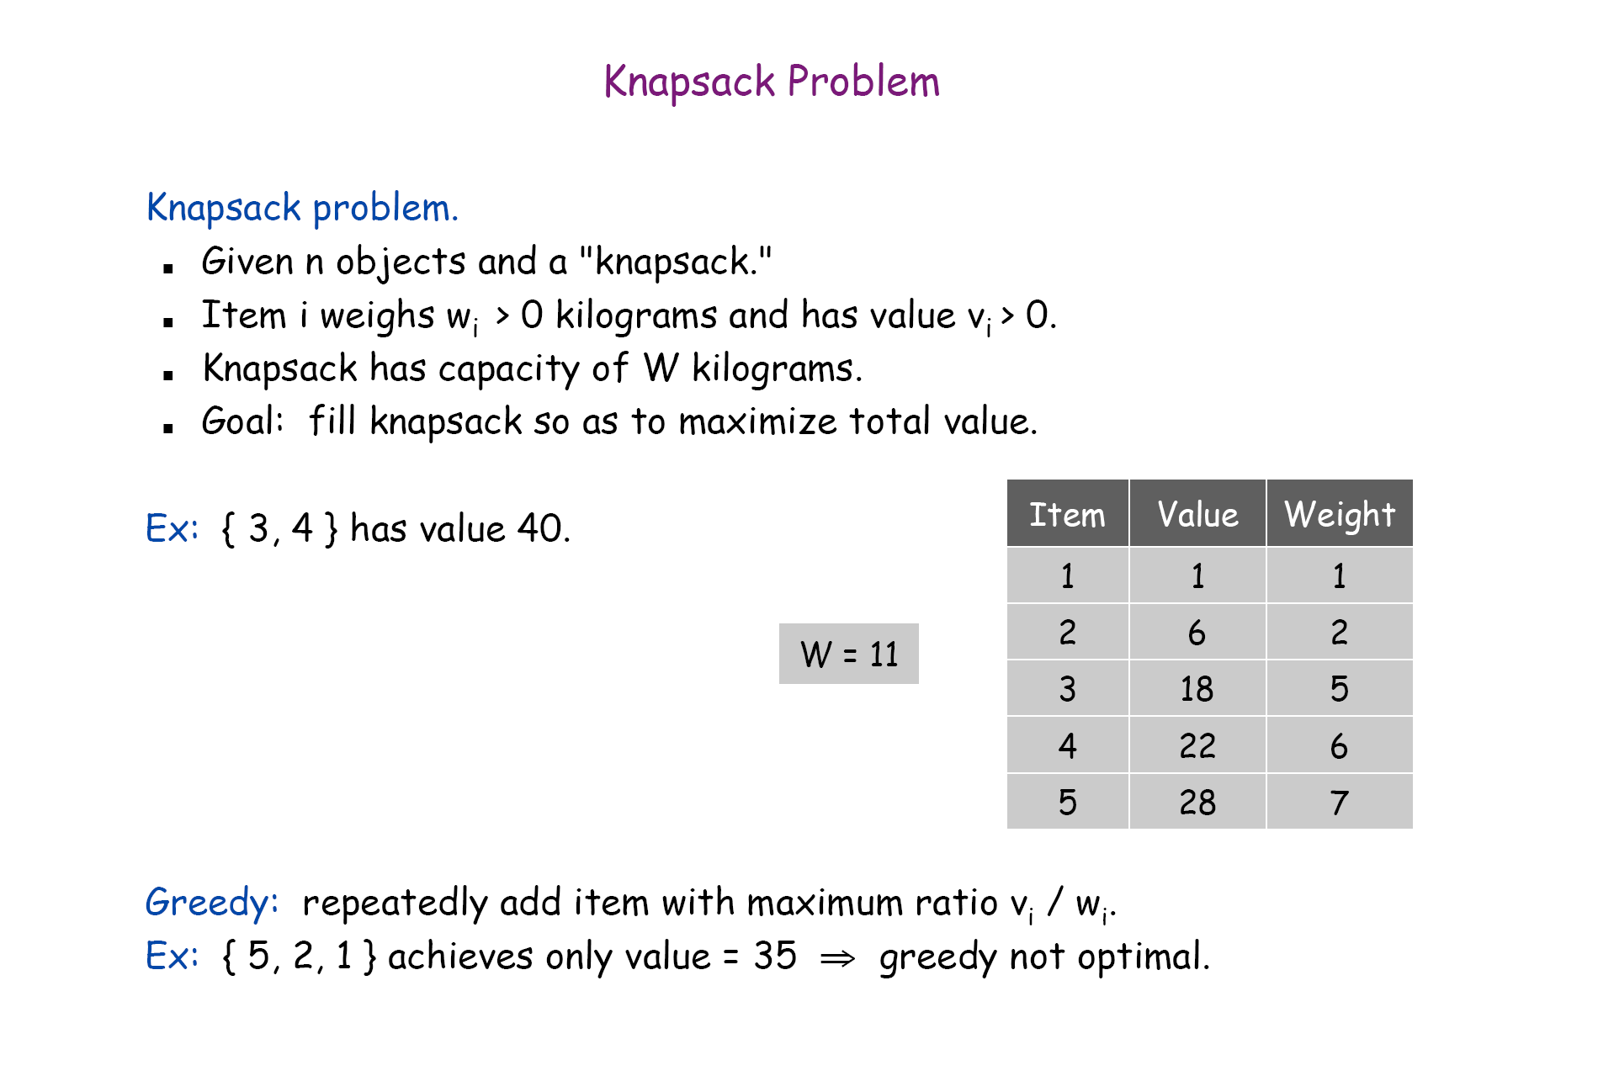
0-1 version

Slide 24
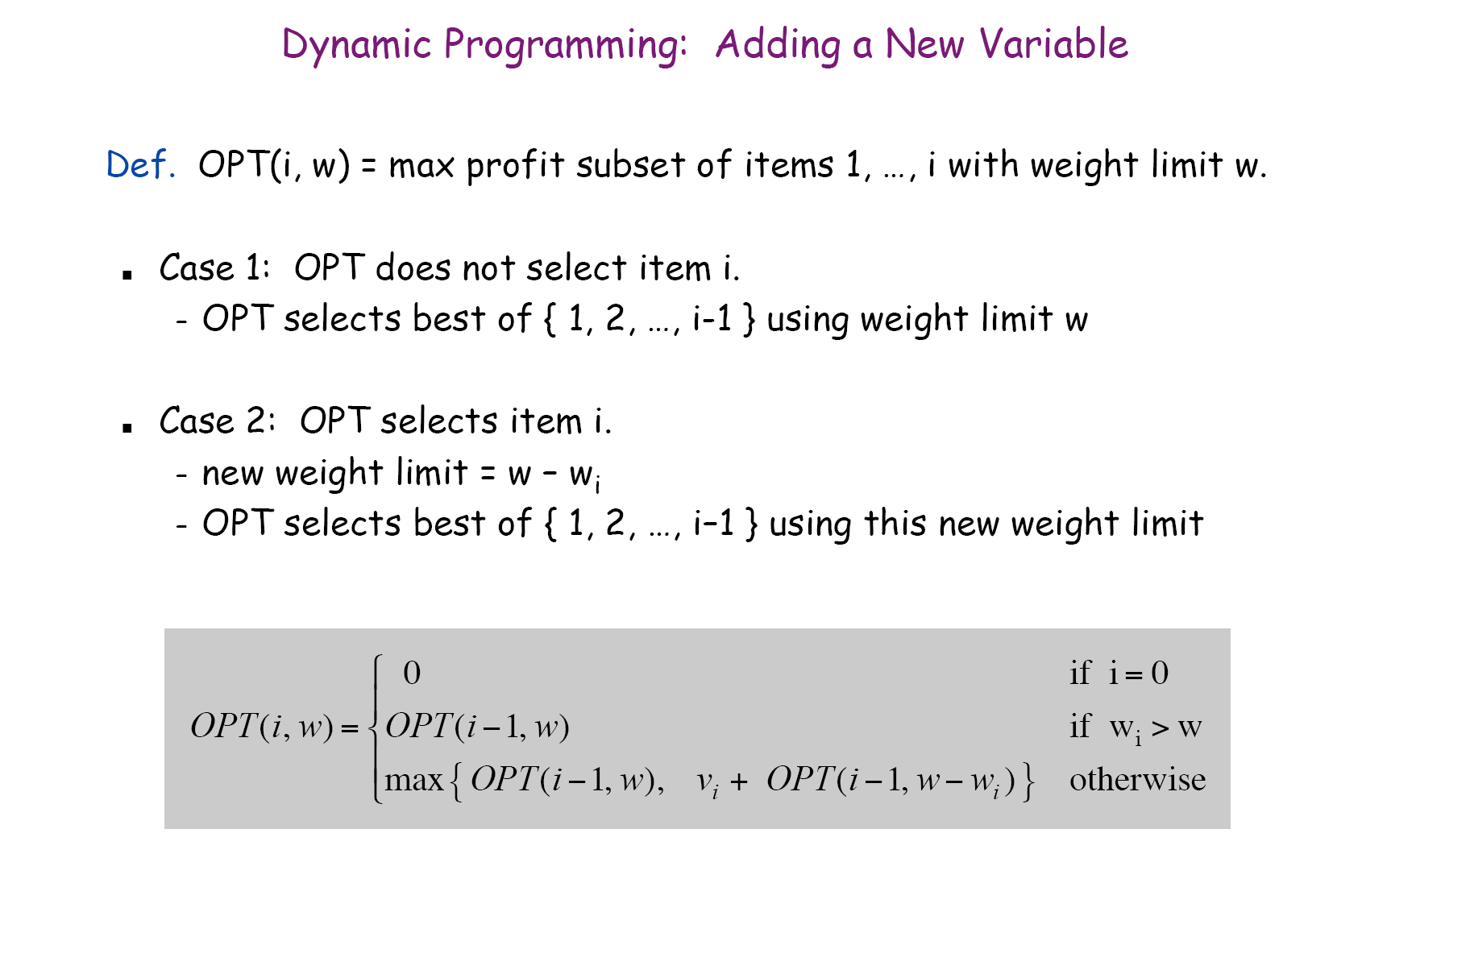

Slide 25
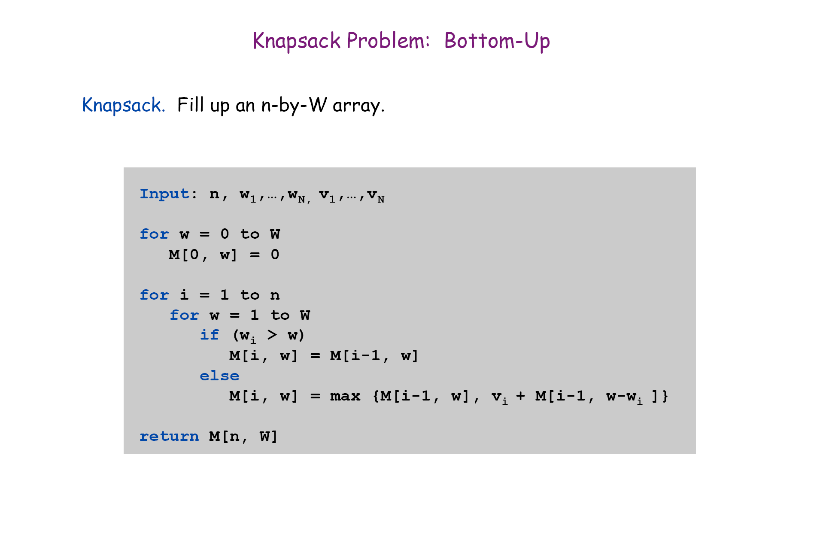

Slide 26
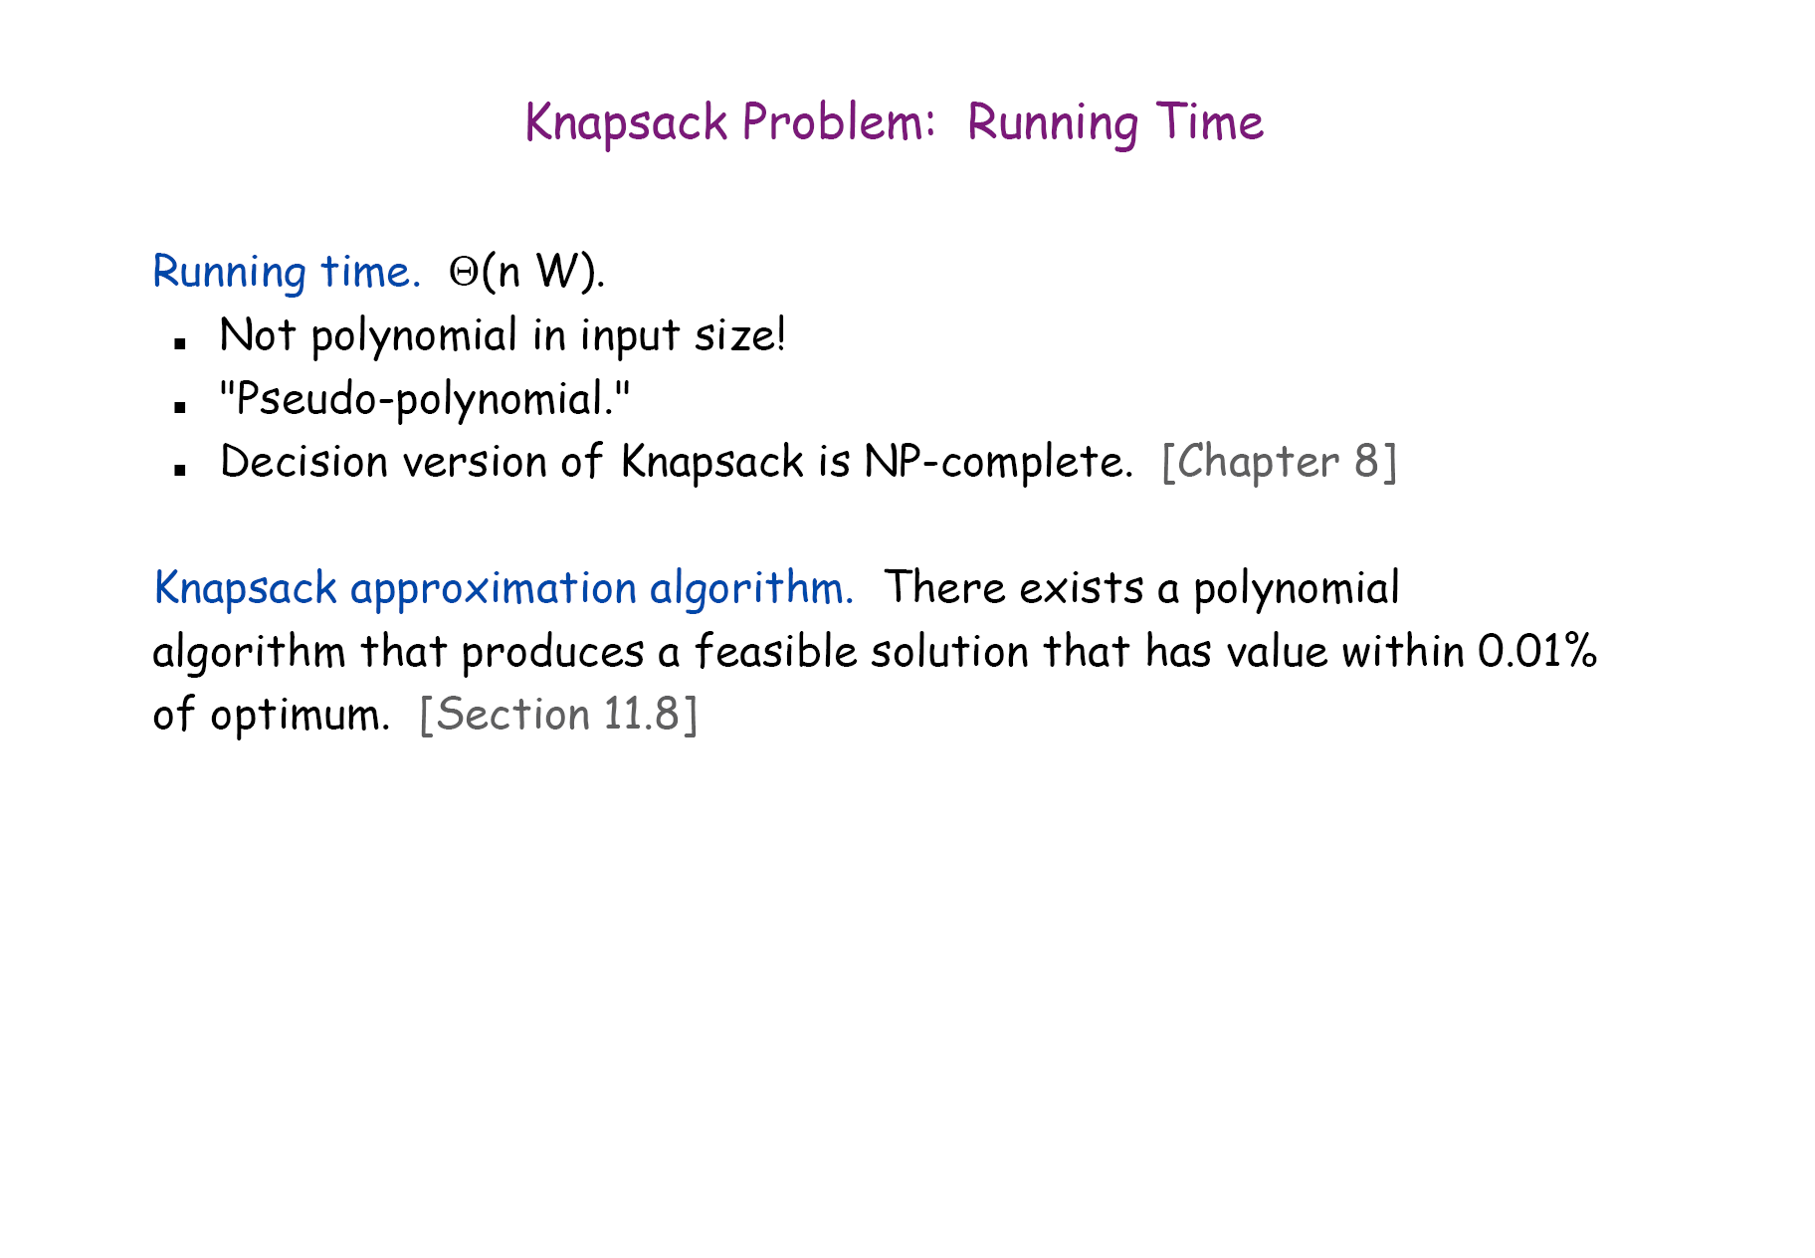

Slide 27
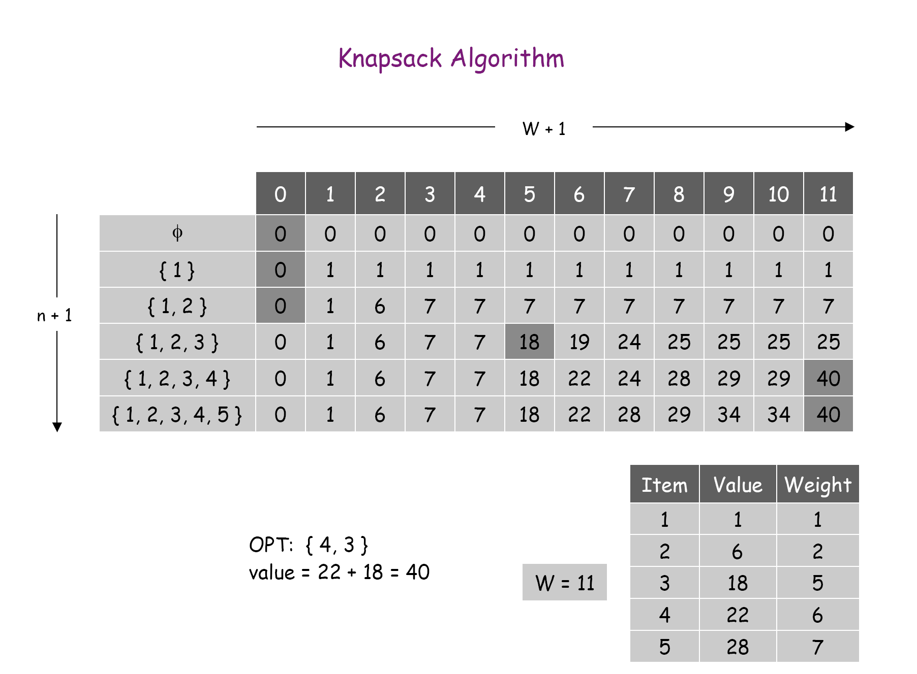

Slide 28
Chanllenge Q1: Billboard placement (Not Required)
You are trying to decide where to place billboards on a highway that goes East-West for M miles. The possible sites for billboards are given by numbers x₁, …, x_{n} each in the interval [0, M]. If you place a billboard at location x_{i}, you get a revenue r_{i}.
You have to follow a regulation: no two of the billboards can be within less than or equal to 5 miles of each other.
You want to place billboards at a subset of the sites so that you maximize your revenue subject to this constraint.
How?

Slide 29
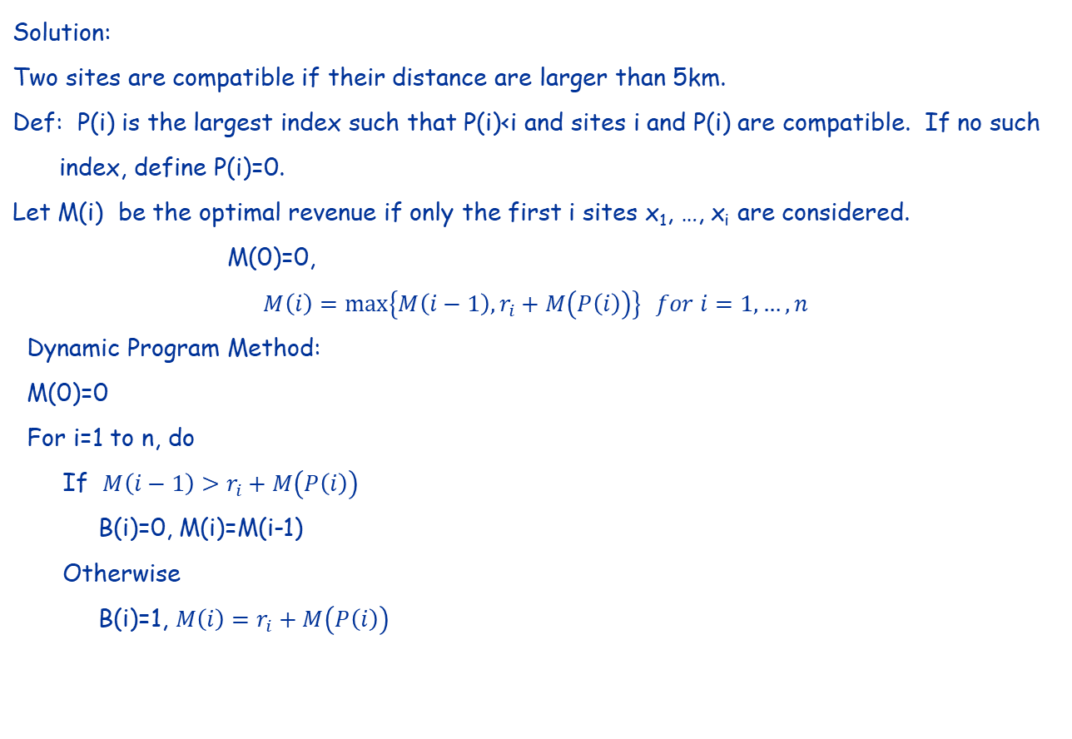

Slide 30
Backtracking:
p=n
While{p isn’t 0} do
{If B(p)=1,
select site p, and p=P(n),
Otherwise,
p=p-1,
}

