Slide 1
SDSC 3006 L02 Class 10. Deep Learning
Name: Yiren Liu
Email: yirenliu2-c@my.cityu.edu.hk
School of Data Science
City University of Hong Kong

Slide 2
Outline
Single Layer Network (linear)
Multilayer Network (non-linear)
Convolution Neural Network (Image Analysis)

Slide 3
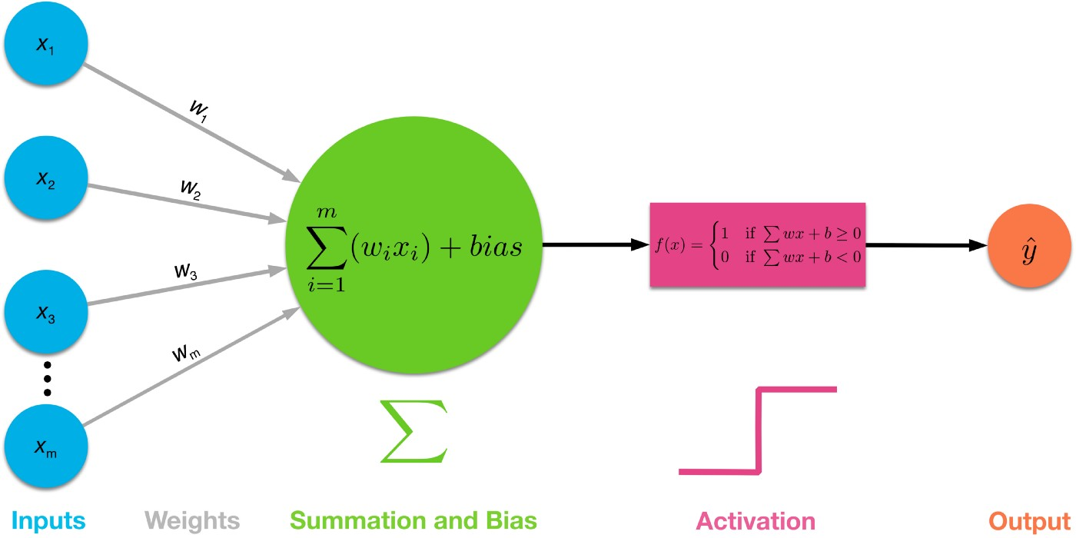
Single Neural Network

Slide 4
Breakthrough
Breakthrough: Multi-Layer Perceptron
Fast forward almost two decades to 1986, Geoffrey Hinton, David Rumelhart, and Ronald Williams published a paper “Learning representations by back-propagating errors”, which introduced:
Backpropagation, a procedure to repeatedly adjust the weights so as to minimize the difference between actual output and desired output
Hidden Layers, which are neuron nodes stacked in between inputs and outputs, allowing neural networks to learn more complicated features (such as XOR logic)
Ref: https://towardsdatascience.com/multi-layer-neural-networks-with-sigmoid-function-deep-learning-for-rookies-2-bf464f09eb7f

Slide 5
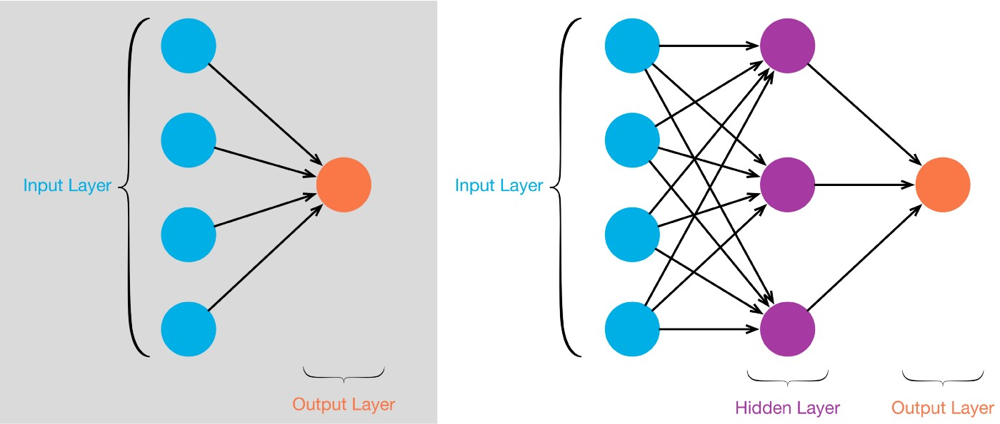
Single layer to Multilayer Network

Slide 6
Drawbacks of MLP
There are several drawbacks of MLP’s, especially when it comes to image processing. MLPs use one perceptron for each input (e.g. pixel in an image, multiplied by 3 in RGB case). The amount of weights rapidly becomes unmanageable for large images, e.g. 224 x 224 pixel image with 3 color channels there are around 150,000 weights that must be trained!
Another common problem is that MLPs react differently to an input (images) and its shifted version — they are not translation invariant.

Slide 7
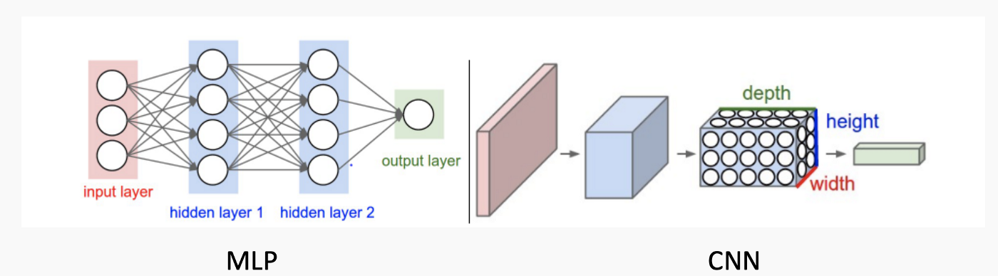
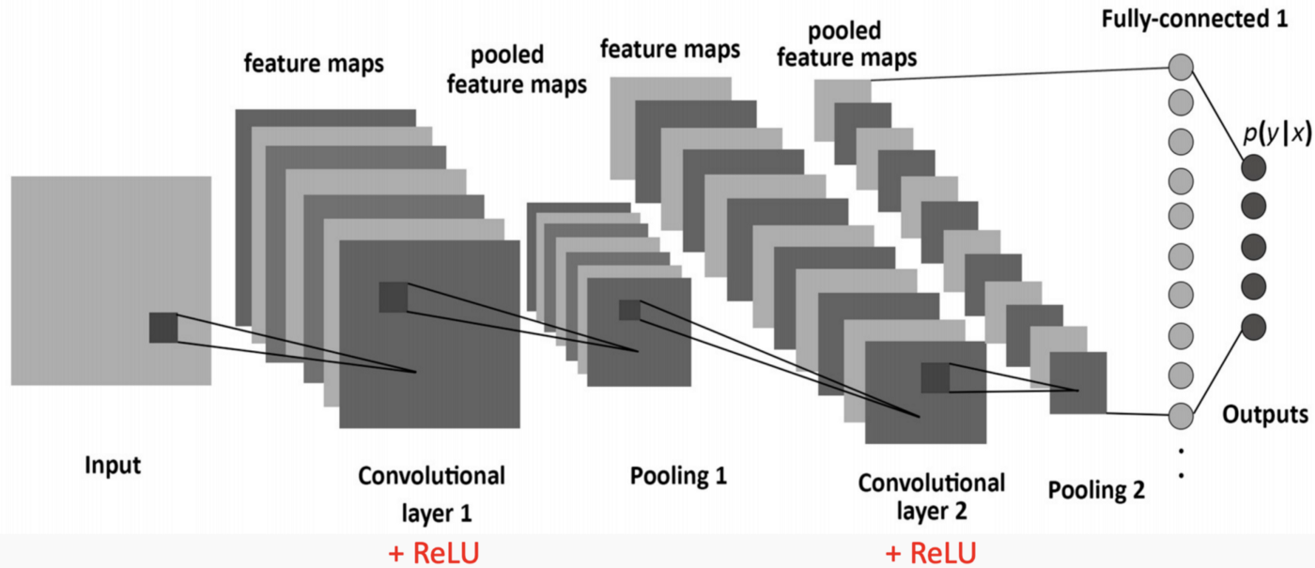
MLP to CNN
Ref: https://towardsdatascience.com/simple-introduction-to-convolutional-neural-networks-cdf8d3077bac

Slide 8
Keys of CNN
There are three types of layers in a convolutional neural network (Each of these layers has different parameters that can be optimized):
Convolutional layers are the layers where filters are applied to the original image, or to other feature maps in a deep CNN. This is where most of the user-specified parameters are in the network. The most important parameters are the number of kernels and the size of the kernels.
Pooling layers are similar to convolutional layers, but they perform a specific function such as max pooling, which takes the maximum value in a certain filter region, or average pooling, which takes the average value in a filter region. These are typically used to reduce the dimensionality of the network.
Fully connected layers are placed before the classification output of a CNN and are used to flatten the results before classification. This is similar to the output layer of an MLP.

Slide 9
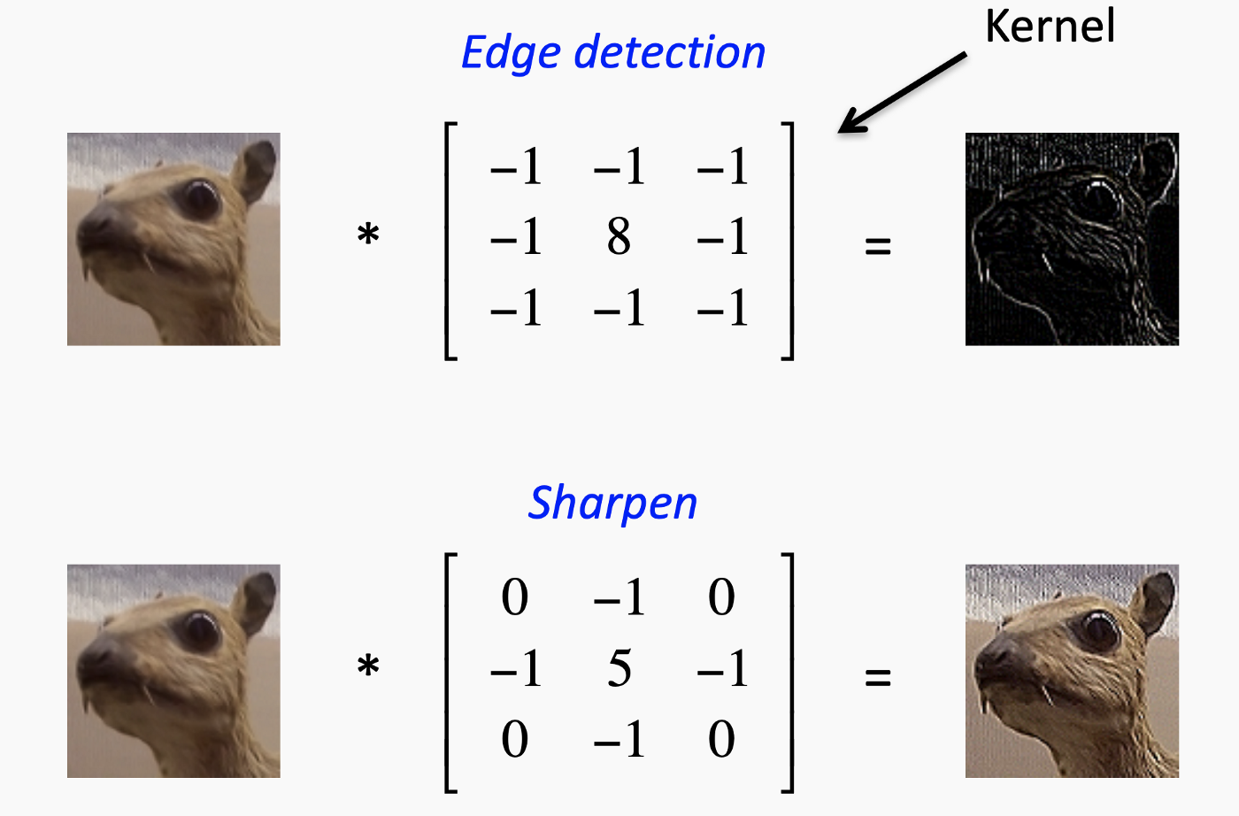

Convolution: made up of a large number of convolution filters(a little matrix).
Max Pooling: condense a large image into a smaller pooling summary image.
Max Pool $\left[\begin{aligned}1 2 5 3 \\ 3 0 1 2 \\ 2 1 3 4 \\ 1 1 2 0 \end{aligned}\right]→\left[\begin{matrix}3 & 5 \\ 2 & 4\end{matrix}\right]$

Slide 10
How to Work Deep Learning Networks
A deep learning model is composed of one input layer, two or more hidden layers, and one final layer. The input layer receives input data and passes the inputs to the first hidden layer. The hidden layers perform mathematical computations on inputs.

Slide 11
Details
The “Deep” in Deep Learning refers to having more than one hidden layer. The output layer returns the output data. Each connection between neurons is associated with a weight. This weight shows the importance of the input value. The initial weights are set randomly. Each neuron has an activation function. Once a batch of input data has passed through all the layers of the neural network, it returns the output data through the output layer.
The loss or cost function measures the difference between the actual result and the predicted result. To build a good model, you want your loss function to be close to zero. To find the minimum cost function, you use the gradient descent technique. Gradient descent works by changing the weights in small increments after each data set iteration.
Reference: https://tensorflow.rstudio.com/tutorials/quickstart/beginner
https://keras.io/getting_started/

Slide 12
Deep Learning in R
Using TensorFlow with keras (seems not work on MacOS with M1 chip, please watch video of Lab01 for details)
The ’deepnet’ package
The ‘nnet’ package
The ’neuralnet’ package

Slide 13
Watch Lab01 Video for the implementation of following codes

Slide 14
Single Layer Network

Slide 15
Introduction
Layers: Input(1), Hidden(?), Output(1).
Activation fuction: a non-linear function, such as sigmoid, tanh and ReLU.
Loss: a measurement of NN, less is better. For instance, squared-error and cross-entropy.
One-hot: a vector with one in the position related to its class and zeros elsewhere.

Slide 16
Implementation
#set up data and separate it
library (ISLR2)
Gitters = na.omit(Hitters)
n = nrow(Gitters)
set.seed (13)
ntest = trunc(n/3)
testid = sample(1:n, ntest)
x = scale(model.matrix(Salary~.-1, data = Gitters))
y = Gitters$Salary
#linear model for comparison
lfit = lm(Salary~., data = Gitters[-testid , ])
lpred = predict (lfit , Gitters[testid , ])
with (Gitters[testid , ], mean (abs (lpred - Salary)))

Slide 17
Implementation
##installation steps of tensorflow and keras: see lab02
##create model structure of NN using keras
library (keras)
modnn = keras_model_sequential() %>%
layer_dense(units=50, activation="relu", input_shape=ncol(x)) %>%
layer_dropout(rate=0.4) %>%
layer_dense(units=1)
##pipe operator %>% passes the previous term as the first argument to the next function
##dropout: randomly drop the activations from previous layer(set to 0)
modnn %>% compile (loss = "mse", optimizer = optimizer_rmsprop(), metrics = list ("mean_absolute_error") )
##compile: not change R object, but relates to python

Slide 18
Implementation
##plot the history to display the mae for the training and test data
history = modnn %>% fit(x[-testid,], y[-testid], epochs=200, batch_size=32, validation_data = list(x[testid,], y[testid]))
##batch_size: randomly choose training obs for SGD
install.packages('ggplots’)
plot (history)
##calculate
mae npred =predict (modnn , x[testid , ])
mean ( abs (y[testid] - npred))

Slide 19
Multilayer Network

Slide 20
Implementation
mnist = dataset_mnist()
librag_train = mnist$train$y
x_train = mnist$train$x
g_train = mnist$train$y
x_test = mnist$test$x
g_test = mnist$test$y
dim(x_train)
dim(x_test)
# reshape the array into matrix and "one-hot"
x_train = array_reshape(x_train, c(nrow(x_train), 784))
x_test = array_reshape(x_test, c(nrow(x_test), 784))
y_train = to_categorical(g_train, 10)
y_test = to_categorical(g_test, 10)
# rescale the original data(0~255) into unit interval
x_train =x_train / 255
x_test = x_test / 255

Slide 21
Implementation
##structure of NN
modelnn = keras_model_sequential()
modelnn %>%
layer_dense(units=256, activation=“relu”, input_shape=c(784)) %>%
layer_dropout(rate=0.4) %>%
layer_dense(units=128, activation="relu") %>%
layer_dropout(rate=0.3) %>%
layer_dense(units=10, activation="softmax")
##summary(modelnn)

Slide 22
Implementation
##structure of NN
modelnn %>% compile(loss=“categorical_crossentropy”, optimizer=optimizer_rmsprop(), metrics=c("accuracy"))
##supply training data, and fit the model
system.time(history <- modelnn %>%
fit(x_train, y_train, epochs=30, batch_size=128, validation_split=0.2))
plot(history, smooth=FALSE)
##evaluate the model by caculate the accuracy
accuracy = function (pred, truth)
mean(drop (pred) == drop (truth))
modelnn %>% predict_classes(x_test) %>% accuracy(g_test)

