Slide 1
SDSC 3006 L02 Class 3. Classification
Name: Yiren Liu
Email: yirenliu2-c@my.cityu.edu.hk
School of Data Science
City University of Hong Kong

Slide 2
Outline
Logistic regression
LDA and QDA
ROC curve
KNN

Slide 3
Logistic Regression

Slide 4
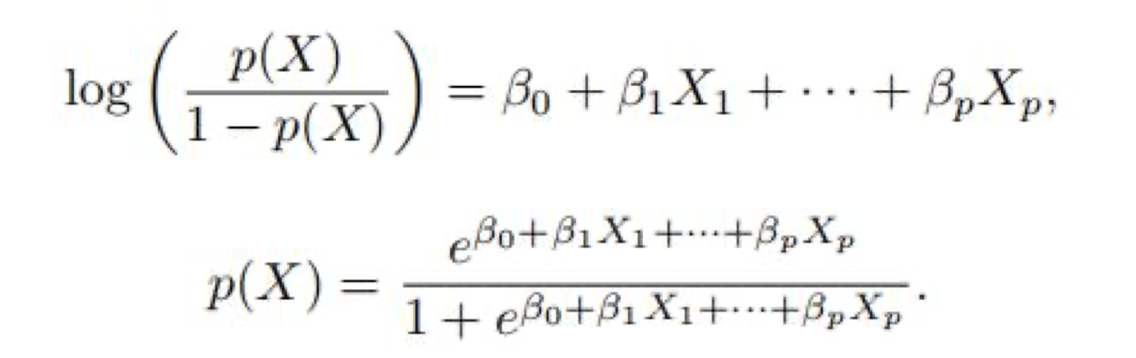
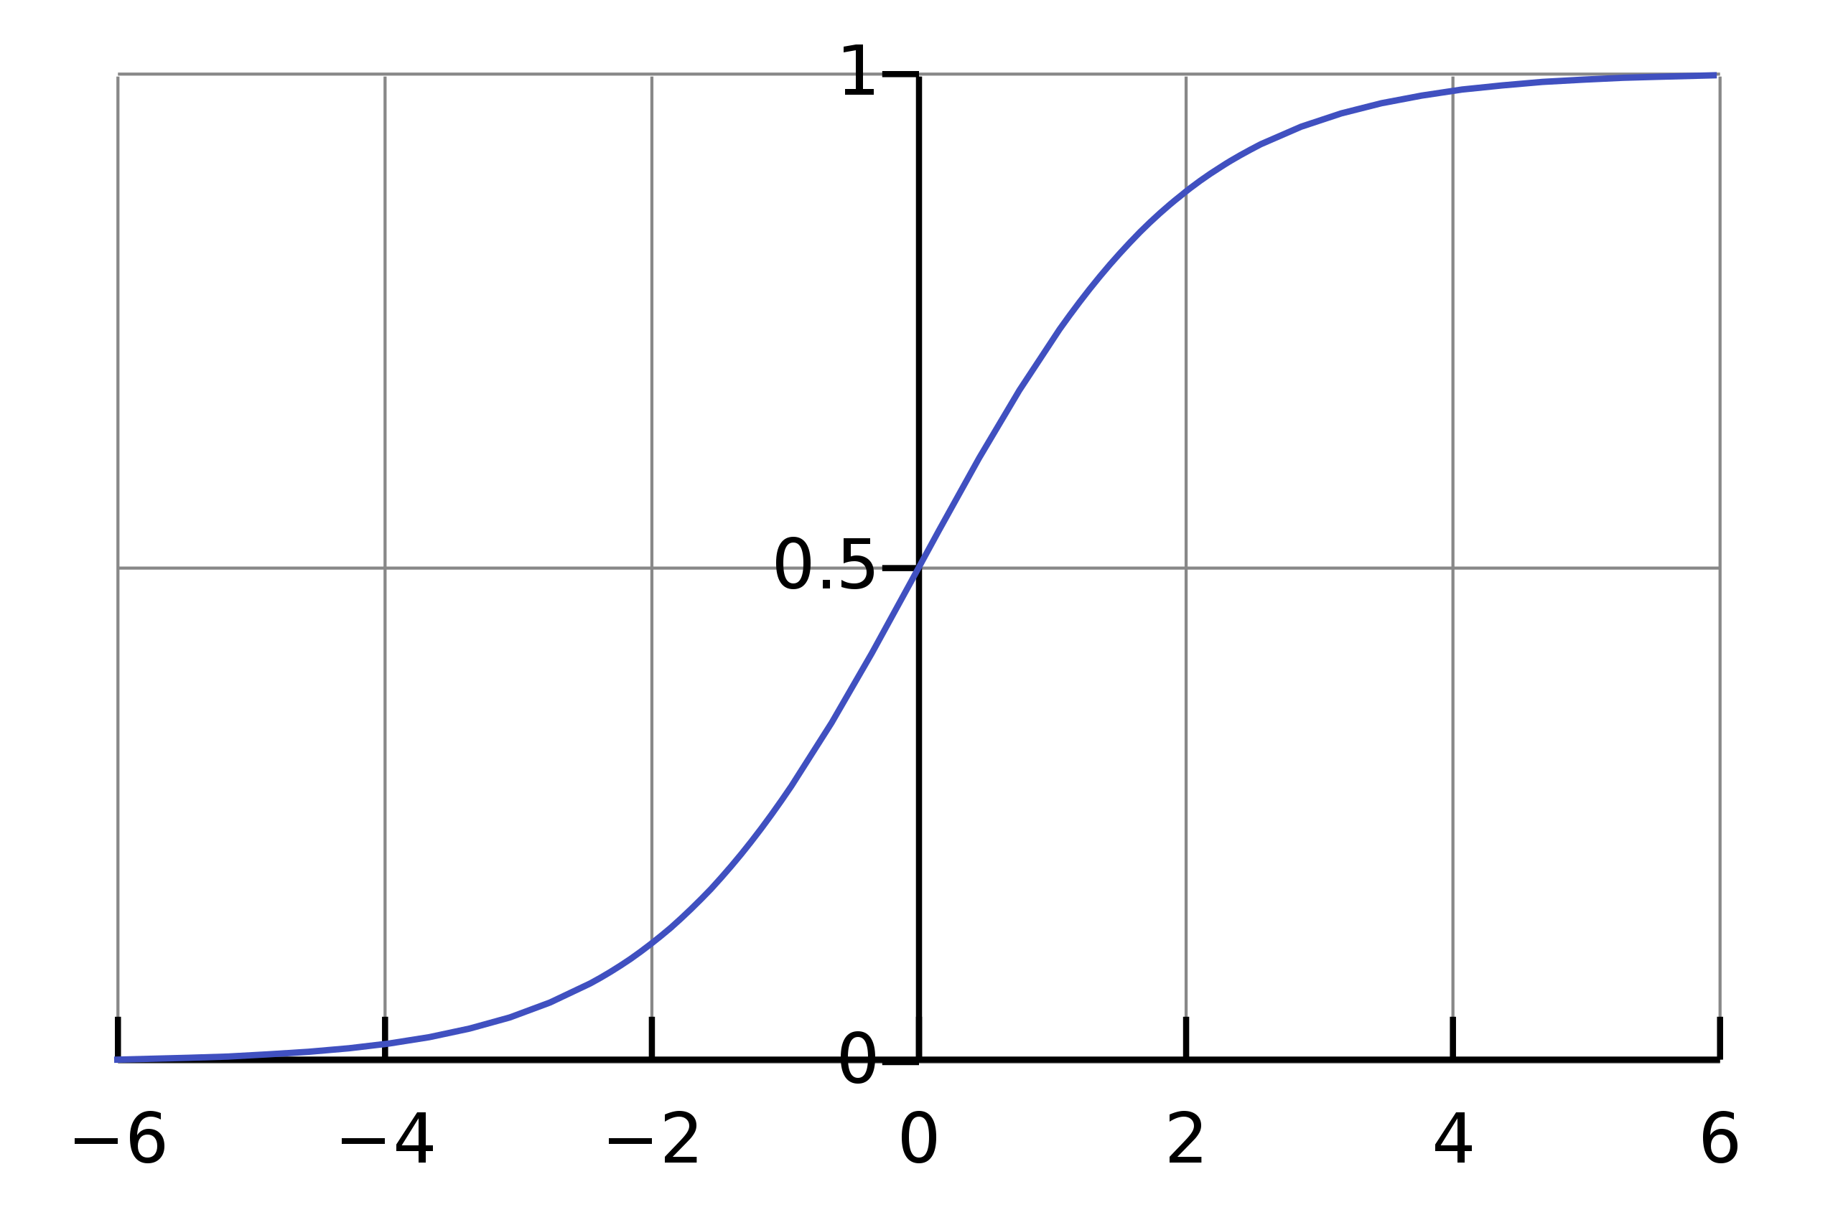
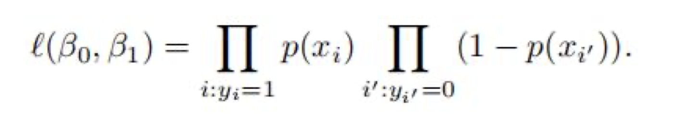
Preliminary
Model structure
This X is an event
Parameters estimation method: maximum likelihood
Sigmoid function
Accuracy of estimates: z-statistics (p-value)
Logistic regression help you to calculate a probability of X.

Slide 5
Preliminary
Smarket data set in the ISLR2 package.
Percentage returns for the S&P 500 stock index in 2001~2005.
Predict the Direction (Up/Down) of the stock market on a day based on the values in the previous days (Lag1,…,Lag5), etc.
Code:
library(ISLR2) names(Smarket) dim(Smarket) attach(Smarket)

Slide 6
Step1-Training model
Code of logistic model logistic.fit=glm(Direction~Lag1+Lag2+Lag3+Lag4+Lag5+Volume, data=Smarket, family=binomial) summary(logistic.fit)
What is the meaning of Number of Fisher Scoring iterations? We use Fisher’s Scoring algorithm(numerical method) here instead of calculating MLE.

Slide 7
Step2-predictions
Get the prediction of probability: logistic.probs=predict(logistic.fit,type="response") ##print the first ten probabilities logistic.probs[1:10]
Meaning of prob: prob of going up, this is what we calculate ##check dummy variable contrasts (Direction)
Convert the prob to class: logistic.pred=rep("Down",1250) #create all ”down” array
logistic.pred[logistic.probs>0.5]="Up" #set threshold 0.5

Slide 8
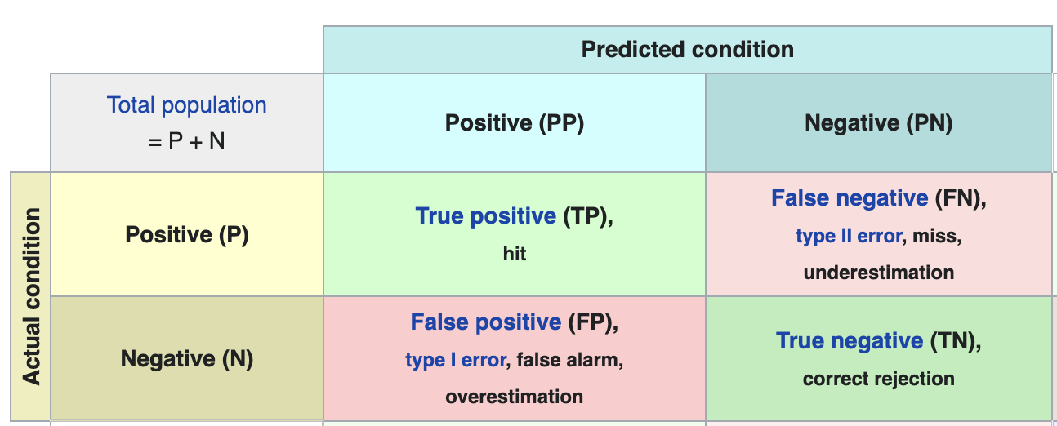
Step3-Accuracy
Confusion matrix table(logistic.pred,Direction)
calculate prediction accuracy: 0.5216 #(507+145)/1250 or mean(logistic.pred==Direction)
What this accuracy means? It appears that the logistic regression model is working a little better than random guessing. However, this result is misleading because we trained and tested the model on the same set. In other words, 1 − 52.2% = 47.8% is the training error rate. Training error rate often underestimate the test error rate!

Slide 9
Cross validation
Split the data set into a training set and a test set: For example, use data in year 2001~2004 for training, and data in year 2005 for test.
Fit a logistic regression model using the training set
Find the test error rate using the test set

Slide 10
Cross validation
##Step 1: Split data (2001~2004 for training, 2005 for test)
train=(Year<2005)
Smarket.2005=Smarket[!train,]
Direction.2005=Direction[!train]
##Step 2: Train model on training data logistic.fit=glm(Direction~Lag1+Lag2+Lag3+Lag4+Lag5+Volume, data=Smarket,family=binomial,subset=train)
##Step 3: Make Prediction on test data
logistic.probs=predict(logistic.fit,Smarket.2005,type="response")
logistic.pred=rep("Down", 252)
#length(Direction.2005)
logistic.pred[logistic.probs>0.5] = "Up”
##Step 4: Assess prediction accuracy
table(logistic.pred,Direction.2005)
mean(logistic.pred==Direction.2005)

Slide 11
Summary of Results
Test error rate = 1‒48% = 52% (Training error rate = 47.8%). Prediction of the logistic regression is even worse than random guessing!
It is not surprising, since the stock market is too random to predict.
Maybe removing some predictors which have high p-values can improve the prediction performance.

Slide 12
LDA and QDA

Slide 13
Keys
Smarket data set in the ISLR2 package.
Predict the Direction (Up/Down) of the stock market.
Split the data set into training data and test data.
Apply function lda() and qda() in the MASS library
Next are the steps of LDA, You can change the words lda to qda to implement QDA

Slide 14
Steps of LDA
## Step 1 - Obtain dataset and Split it library(ISLR2) library(MASS) attach(Smarket) train=(Year<2005) Smarket.2005 = Smarket[!train,] Direction.2005 = Direction[!train]
## Step 2 - Train model and predict lda.fit=lda(Direction~Lag1+Lag2, data=Smarket, subset=train) lda.pred = predict(lda.fit,Smarket.2005) names(lda.pred) #see what prediction contains ##lda.pred$class ##lda.pred$posterior

Slide 15
Step
## Step 3 - Calculate prediction accuracy lda.class = lda.pred$class table(lda.class,Direction.2005) mean(lda.class==Direction.2005)
## Step 4 - Change threshold (Extra) lda.class = rep("Down",length(Direction.2005))
lda.class[lda.pred$posterior[,2]>0.49] = "Up"
table(lda.class,Direction.2005) mean(lda.class==Direction.2005)

Slide 16
ROC curve

Slide 17
ROC curve
Smarket data set in the ISLR2 package.
Why we draw ROC curve: to compare the performance between methods.
Compare two methods: logistic regression, LDA
Method: Write a function roc.curve() which calculate and print the ROC curve for a given method.

Slide 18
ROC curve of Logistic Regression
library(ISLR2)
attach(Smarket)
##fit logistic regression to all data (2001~2005)
LR.fit = glm(Direction~Lag1+Lag2+Lag3,family=binomial,data=Smarket) ##predict probability of "UP"
LR.pred = predict(LR.fit,type="response")

Slide 19
ROC curve of Logistic Regression
## Calculate FPR and TPR under a given threshold
roc.curve=function(s,print=FALSE){ Ps=(LR.pred>s)*1 FP=sum((Ps==1)*(Direction==“Down”))/sum(Direction==“Down”) TP=sum((Ps==1)*(Direction==“Up”))/sum(Direction==“Up”) if(print==TRUE){ print(table(Observed=Direction,Predicted=Ps)) } vect=c(FP,TP) names(vect)=c("FPR","TPR") return(vect)
} threshold=0.5 roc.curve(threshold,print=TRUE) ## Plot ROC curve ROC.curve=Vectorize(roc.curve) M.ROC=ROC.curve(seq(0,1,by=0.01)) plot(M.ROC[1,],M.ROC[2,],col="grey",lwd=2,type="l",xlab="False positive rate",ylab="True positive rate")

Slide 20
ROC curve of LDA
library(ISLR2) attach(Smarket) ## fit model to all data library(MASS) LDA.fit = lda(Direction~Lag1+Lag2+Lag3,data=Smarket) ## predict probabilities of training data LDA.pred0 = predict(LDA.fit,type="response") LDA.pred = LDA.pred0$posterior[,2]

Slide 21
ROC curve of LDA
## Calculate FPR and TPR under a given threshold
roc.curve=function(s,print=FALSE){
Ps=(LDA.pred>s)*1 FP=sum((Ps==1)*(Direction=="Down"))/sum(Direction=="Down") TP=sum((Ps==1)*(Direction=="Up"))/sum(Direction=="Up")
if(print==TRUE){
print(table(Observed=Direction,Predicted=Ps))
}
vect=c(FP,TP)
names(vect)=c("FPR","TPR")
return(vect) }
threshold=0.5
roc.curve(threshold,print=TRUE)
## Plot ROC Curve
ROC.curve=Vectorize(roc.curve)
M.ROC=ROC.curve(seq(0,1,by=0.01)) plot(M.ROC[1,],M.ROC[2,],col="blue",lwd=2,type="l",xlab="False positive rate",ylab="True positive rate")

Slide 22
KNN

Slide 23
Notice in KNN
Use the knn() function in the class library, which requires 4 inputs (training observation, test observation, training response, number of K).
This function does not follow the two-step (first model fitting, then prediction) approach; it generates predictions using a single command.

Slide 24
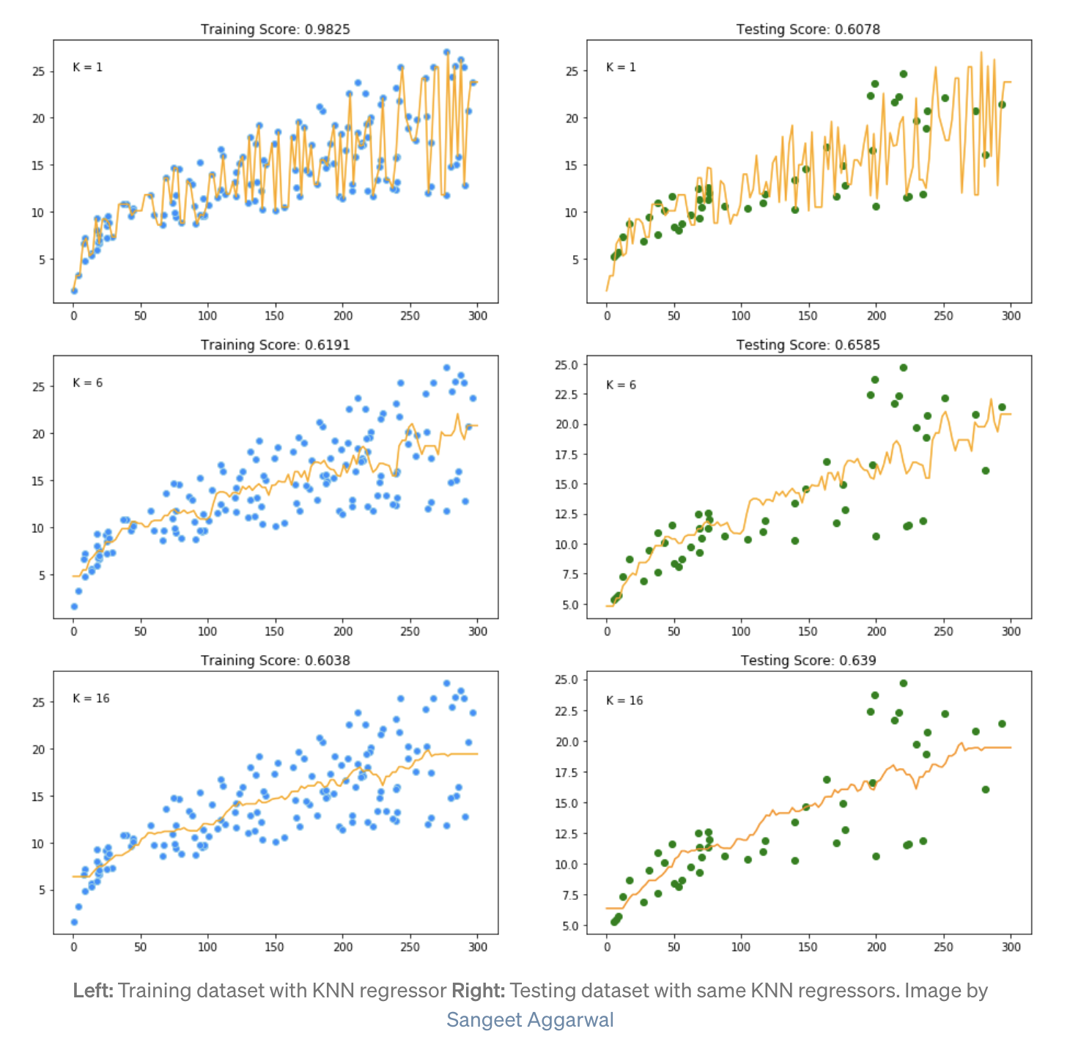
A picture example of KNN

Slide 25
Code of KNN
library(ISLR2) attach(Smarket) library(class) train=(Year<2005) train.X=cbind(Lag1,Lag2)[train,] #training data of observation test.X=cbind(Lag1,Lag2)[!train,] #test data of observation train.Direction=Direction[train] #training data of response knn.pred1=knn(train.X,test.X,train.Direction,k=1) table(knn.pred1,Direction.2005) mean(knn.pred1==Direction.2005) #predict accuracy ##change k to get different results knn.pred2=knn(train.X, test.X, train.Direction, k=3) table(knn.pred2,Direction.2005) mean(knn.pred2==Direction.2005)

