Slide 1
SDSC 3006 L02
Class 4. Cross Validation
Name: Yiren Liu
Email: yirenliu2-c@my.cityu.edu.hk
School of Data Science
City University of Hong Kong

Slide 2
Outline
Validation Set Approach
Leave-One-Out CV
K-fold CV

Slide 3
Validation Set Approach

Slide 4
Introduction
Data set: Auto dataset in ISLR
Target 1: find how mpg(response) depends on horsepower(predictor).
Possible models:
mpg ~ horsepower (linear)
mpg ~ horsepower + horspower^2 (quadratic)
mpg ~ horsepower + horspower^2 + horspower^3 (cubic)
Target 2: find the best model among above.
Method: validation set approach
1. Randomly split the data set into training set and validation set.
2. Fit each model using the training data set.
3. Estimate test error rate using the validation data set.
4. The model with the lowest validation (testing) MSE is the winner!

Slide 5
Code
library(ISLR)
attach(Auto)
#generate same set of random numbers every time this code is executed set.seed(1)
#try set.seed(2) to generate another set after one trial
#pick half of the samples in dataset randomly to be training set
l=length(mpg)
train = sample(l , l/2) #set of indexes
mpg.test = mpg[-train] #rest is validation set

Slide 6
Code
#fit 3 models respectively using the training data
lm.fit1 = lm(mpg~horsepower,data=Auto,subset=train)
lm.fit2 = lm(mpg~poly(horsepower,2),data=Auto,subset=train)
lm.fit3 = lm(mpg~poly(horsepower,3),data=Auto,subset=train)
#make predictions for each model
lm.pred1 = predict(lm.fit1,Auto[-train,])
lm.pred2 = predict(lm.fit2,Auto[-train,])
lm.pred3 = predict(lm.fit3,Auto[-train,])
#calculate MSE for each model
mean((mpg.test-lm.pred1)^2) #linear
mean((mpg.test-lm.pred2)^2) #quadratic
mean((mpg.test-lm.pred3)^2) #cubic

Slide 7
LOOCV

Slide 8
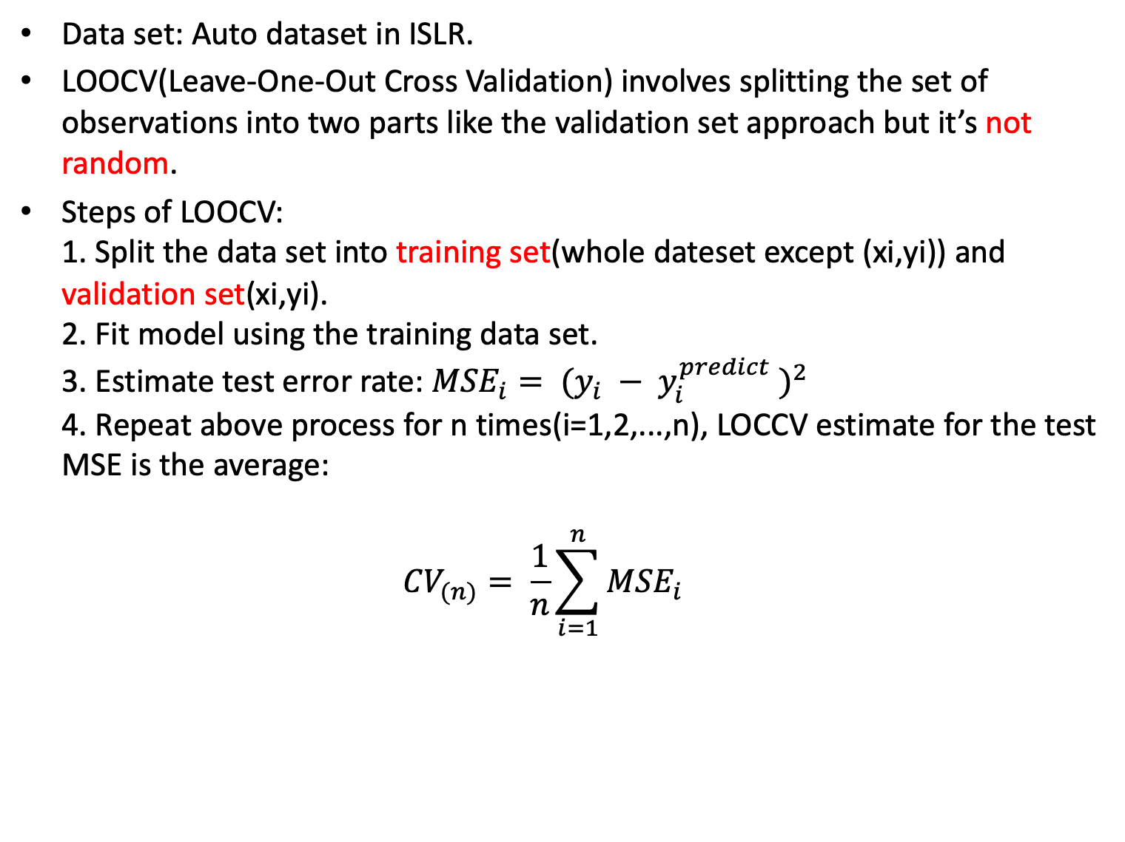
Introduction
Data set: Auto dataset in ISLR.
LOOCV(Leave-One-Out Cross Validation) involves splitting the set of observations into two parts like the validation set approach but it’s not random.
Steps of LOOCV:
1. Split the data set into training set(whole dateset except (xi,yi)) and validation set(xi,yi).
2. Fit model using the training data set.
3. Estimate test error rate: ${MSE}_{i}= {(y_{i} − y_{i}^{predict} )}^{2}$
4. Repeat above process for n times(i=1,2,...,n), LOCCV estimate for the test MSE is the average:
${CV}_{(n)}= \frac{1}{n}\sum_{i=1}^{n}{{MSE}_{i}}$

Slide 9
R implemention
Notice:
1. LOOCV can be automatically computed for generalized linear models using the glm() and cv.glm() functions.
2. Since linear regression belongs to generalized linear models, we can use the glm() function rather than lm() to fit each model.
3. The cv.glm() function is in the boot library.
Code:
library(ISLR)
attach(Auto)
library(boot)
glm.fit = glm(mpg~horsepower,data=Auto)
cv.err = cv.glm(Auto,glm.fit)
cv.err$delta #average MSE and adjusted MSE

Slide 10
R implemention
Code:
#Write loop statement to repeat LOOCV process for all models
cv.error = rep(0,5) #initial value
#for polynomials from order 1 to 5 calculate average MSE
for (i in 1:5){ glm.fit = glm(mpg~poly(horsepower,i),data=Auto)
cv.error[i] = cv.glm(Auto,glm.fit)$delta[1]
}
cv.error

Slide 11
K-fold CV

Slide 12
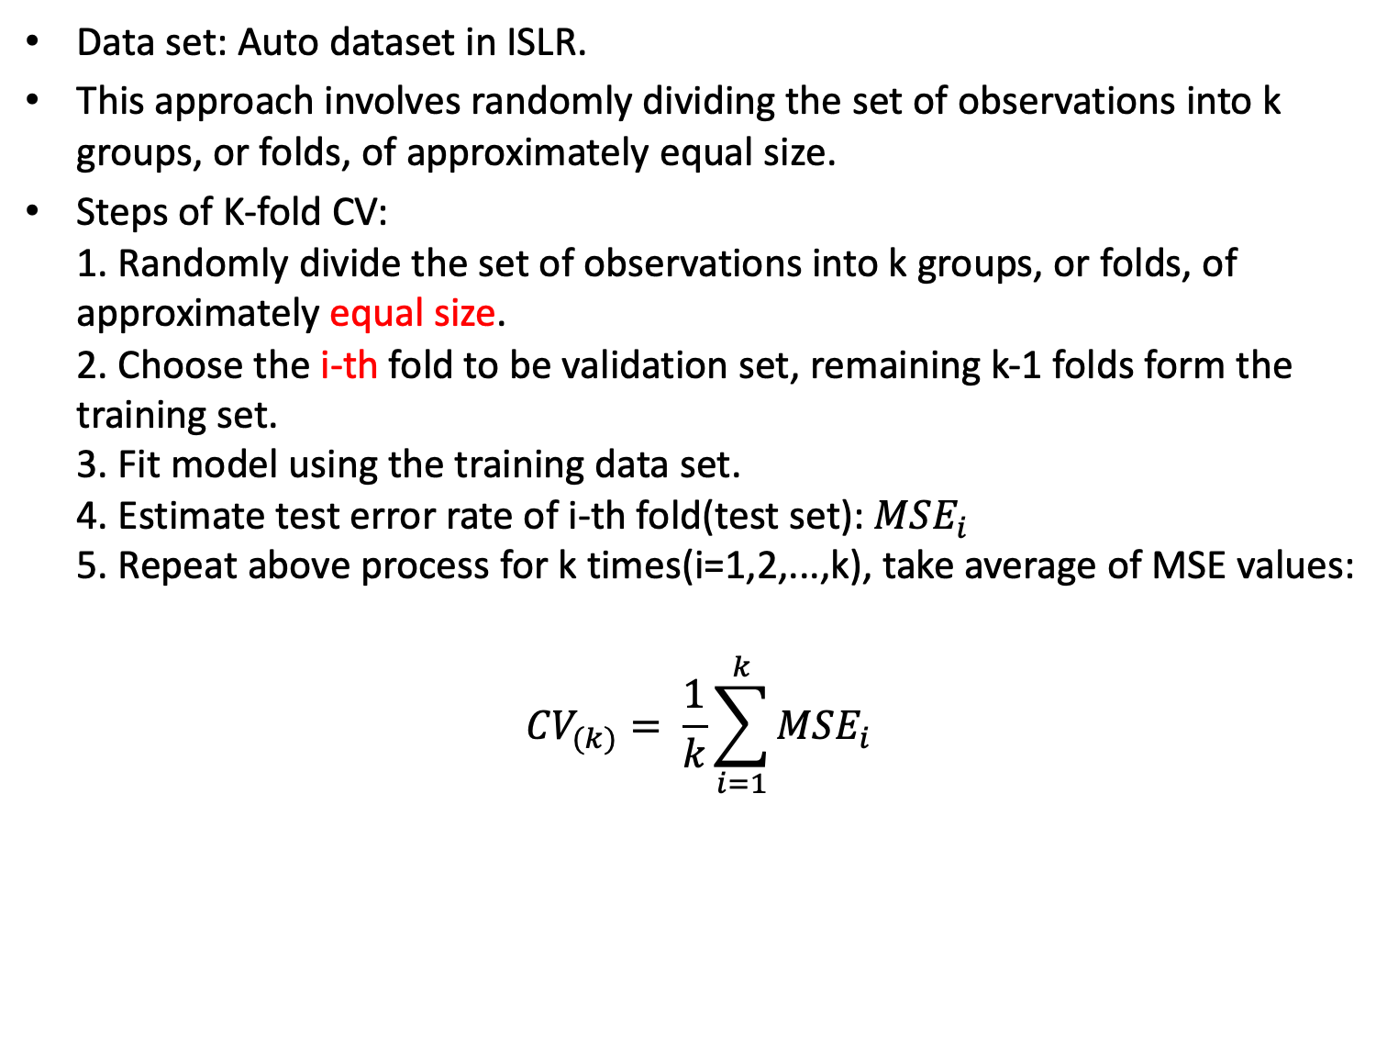
Introduction
Data set: Auto dataset in ISLR.
This approach involves randomly dividing the set of observations into k groups, or folds, of approximately equal size.
Steps of K-fold CV:
1. Randomly divide the set of observations into k groups, or folds, of approximately equal size.
2. Choose the i-th fold to be validation set, remaining k-1 folds form the training set.
3. Fit model using the training data set.
4. Estimate test error rate of i-th fold(test set): ${MSE}_{i}$
5. Repeat above process for k times(i=1,2,...,k), take average of MSE values:
$${CV}_{(k)}= \frac{1}{k}\sum_{i=1}^{k}{{MSE}_{i}}$$

Slide 13
R implemention
Notice: the cv.glm() function can also be used to implement k-fold CV, just set k value.
Code:
library(ISLR)
attach(Auto)
library(boot)
set.seed(1) #test polynomials from order 1 to 10 (loop)
cv.error.10 = rep(0,10)
for (i in 1:10) {
glm.fit = glm(mpg~poly(horsepower,i),data=Auto)
cv.error.10[i] = cv.glm(Auto,glm.fit, K=10)$delta[1]
}
cv.error.10

