Slide 1
SDSC 3006 L02 Class 5. Bootstrap and model selection
Name: Yiren Liu
Email: yirenliu2-c@my.cityu.edu.hk
School of Data Science
City University of Hong Kong

Slide 2
Outline
Bootstrap
Model Selection

Slide 3
Bootstrap

Slide 4
What is Bootstrap?
How Bootstrapping Resamples Your Data to Create Simulated Datasets
Bootstrapping resamples the original dataset with replacement many thousands of times to create simulated datasets. This process involves drawing random samples from the original dataset. Here’s how it works:
The bootstrap method has an equal probability of randomly drawing each original data point for inclusion in the resampled datasets.
The procedure can select a data point more than once for a resampled dataset. This property is the “with replacement” aspect of the process.
The procedure creates resampled datasets that are the same size as the original dataset.
The process ends with your simulated datasets having many different combinations of the values that exist in the original dataset. Each simulated dataset has its own set of sample statistics, such as the mean, median, and standard deviation. Bootstrapping procedures use the distribution of the sample statistics across the simulated samples as the sampling distribution.
Reference: Jim Frost, Introduction to Bootstrapping in Statistics with an Example. URL: https://statisticsbyjim.com/hypothesis-testing/bootstrapping/

Slide 5
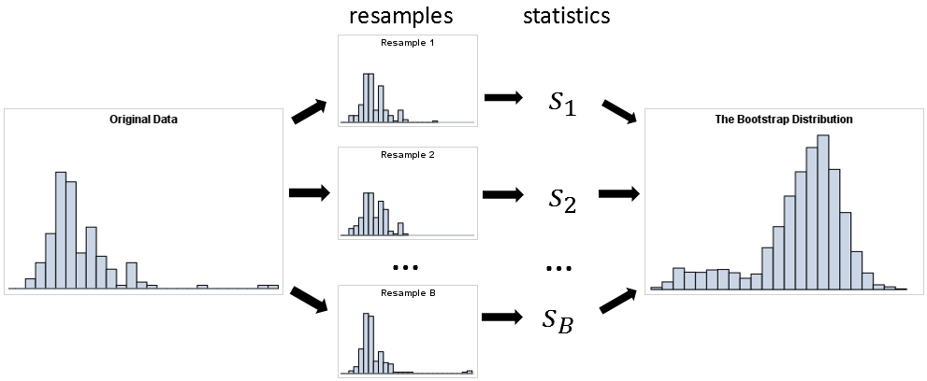
Bootstrap
Repeat B times
100 samples
100 samples
Average of B times statistics
100 samples
100 samples

Slide 6
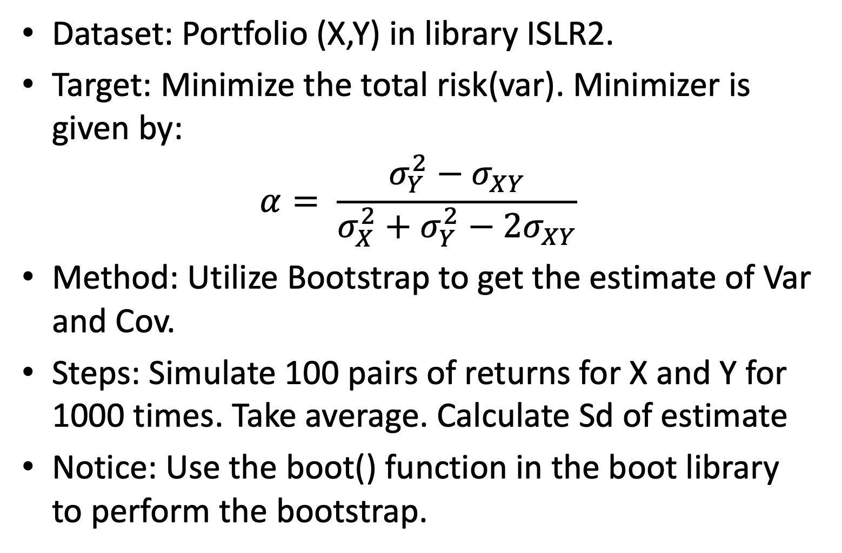
Introduction
Dataset: Portfolio (X,Y) in library ISLR2.
Target: Minimize the total risk(var). Minimizer is given by:
$$α= \frac{σ_{Y}^{2}−σ_{XY}}{σ_{X}^{2}+σ_{Y}^{2}−2σ_{XY}}$$
Method: Utilize Bootstrap to get the estimate of Var and Cov.
Steps: Simulate 100 pairs of returns for X and Y for 1000 times. Take average. Calculate Sd of estimate
Notice: Use the boot() function in the boot library to perform the bootstrap.

Slide 7
Code
library(ISLR2)
attach(Portfolio)
##create a function to calculate alpha
alpha.fn = function(data,index){
X=data$X[index]
Y=data$Y[index]
return(var(Y)-cov(X,Y))/(var(X)+var(Y)-2*cov(X,Y))
}
##estimate alpha using all 100 observations
alpha.fn(Portfolio,1:100)
#randomly select 100 observations from the dataset with replacement
set.seed(1)
alpha.fn(Portfolio,sample(100,100,replace=T))
#estimates based on 1000 bootstrap samples
library(boot)
boot(Portfolio,alpha.fn,R=1000)

Slide 8
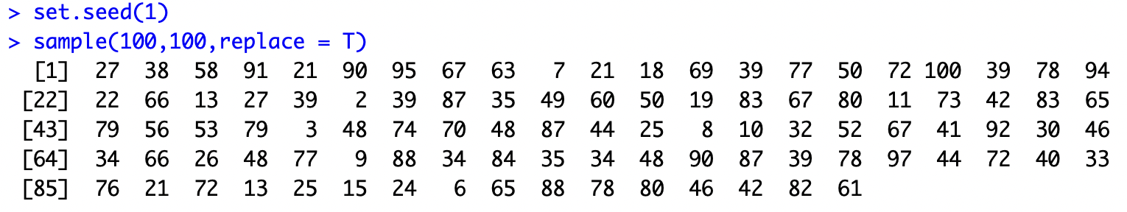
Q and A
Question: How can we get 100 simulated values from 100 true observations?
Answer: Each time we can choose randomly from the range 1 to 100 with replacement, which means we can choose the same value for several times.
Give a try for 10 samples from uniform(-5,5). Try to estimate the mean.

Slide 9
Model Selection

Slide 10
Introduction
Dataset: Hitters in library ISLR.
Target: Predict a baseball player’s Salary based on several predictors.
Methods: Best Subset Selection, Stepwise Selection (Forward and Backward) and Cross Validation
Steps: refer Algorithm 6.1, 6.2, 6.3.
Keys: The criterion for different model of fixed model size: RSS or R^2. The criteria for the best among different model size: Cp (AIC), BIC, or adjusted R^2. Install packages leaps.

Slide 11
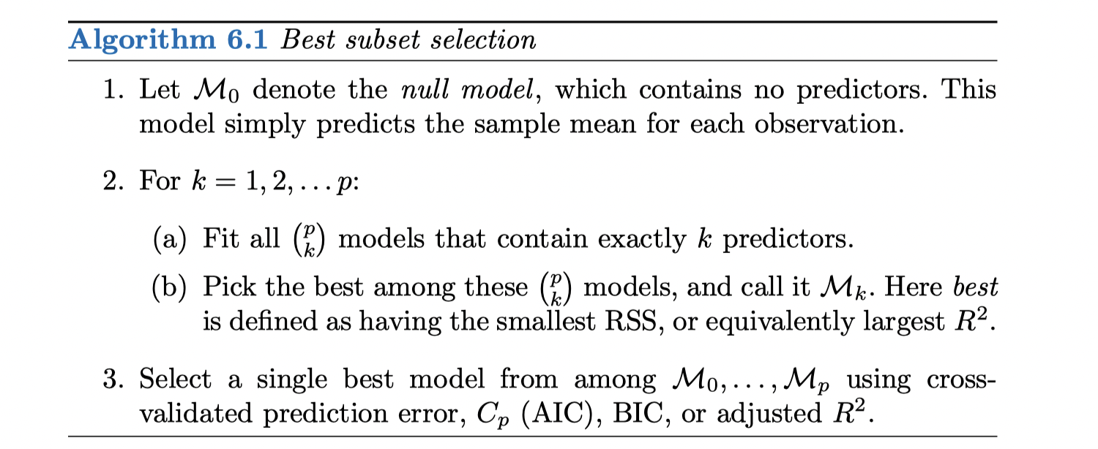
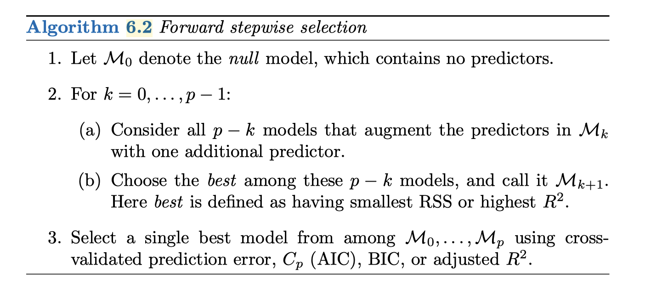
Algorithms

Slide 12
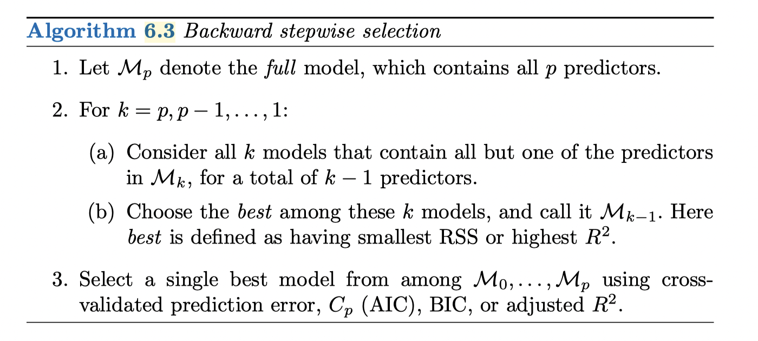
Algorithms

Slide 13
What is AIC, BIC?
The Akaike information criterion (AIC) and the Bayesian information criterion (BIC) provide measures of model performance that account for model complexity. AIC and BIC combine a term reflecting how well the model fits the data with a term that penalizes the model in proportion to its number of parameters.

Slide 14
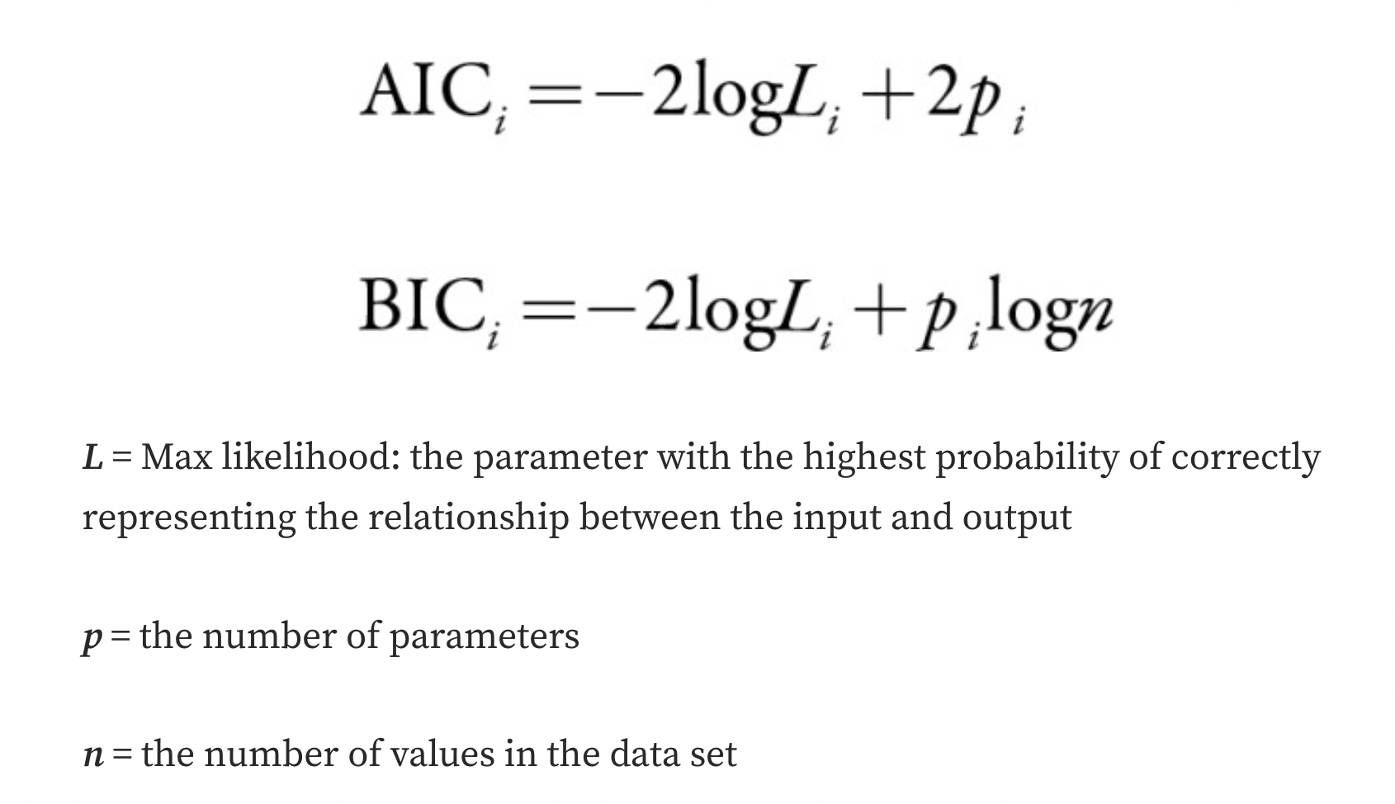
What is AIC, BIC?

Slide 15
What is Maximum likelihood (L)
Maximum likelihood is the probability that the predicted parameter is an accurate representation of the relationship between the independent and dependent variable. For example, what is the likelihood that our predicted gradient is correct? Maximum likelihood is derived from the comparison of all the possible parameters followed by the selection of the parameter that has the highest chance of being correct. In both formulas, the natural log (ln) of the maximum likelihood is used as the measurement of the model's accuracy in explaining the sample data.

Slide 16
Pre-processing
library(ISLR)
names(Hitters)
dim(Hitters)
sum(is.na(Hitters$Salary)) #total number of missing salary ("NA")
Hitters=na.omit(Hitters) #remove rows with missing values in any variable
dim(Hitters)
sum(is.na(Hitters))

Slide 17
Best Subset Selection
# install.packages(“leaps”), install it if not installed
library(leaps)
regfit.full = regsubsets(Salary~.,Hitters)
##print the best set of predictors for each model size; by default, only return results up to the best 8-predictor model
summary(regfit.full)
##to return as many predictors as specified(Max=19)
regfit.full = regsubsets(Salary~.,data=Hitters,nvmax=19)
reg.summary = summary(regfit.full)
names(reg.summary)

Slide 18
Best Subset Selection
##create figure contains four subfigure(2*2)
par(mfrow=c(2,2))
#Figure 1
plot(reg.summary$rss,xlab="Number of predictors",ylab="RSS",type="l")
#Figure 2
plot(reg.summary$adjr2,xlab="Number of predictors",ylab="Adjusted RSq",type="l")
a=which.max(reg.summary$adjr2) #highlight maximizer points(a,reg.summary$adjr2[a], col="red",cex=2,pch=20)

Slide 19
Best Subset Selection
#Figure 3
plot(reg.summary$cp,xlab="Number of predictors",ylab="Cp",type='l')
b=which.min(reg.summary$cp)
points(b,reg.summary$cp[b],col="red",cex=2,pch=20)
#Figure 4
plot(reg.summary$bic,xlab="Number of predictors",ylab="BIC",type='l')
c=which.min(reg.summary$bic)
points(c,reg.summary$bic[c],col="red",cex=2,pch=20)
##print the coefficient estimates of the best model by BIC coef(regfit.full,c)

Slide 20
Stepwise Selection
regfit.fwd=regsubsets(Salary~.,data=Hitters,nvmax=19,
method="forward")
summary(regfit.fwd)
#summary(regfit.fwd)$bic(or cp, adjr2) regfit.bwd=regsubsets(Salary~.,data=Hitters,nvmax=19,
method="backward")
summary(regfit.bwd)
##print the coefficient estimates of the 7-predictor model coef(regfit.full,7)
coef(regfit.fwd,7)
coef(regfit.bwd,7)

Slide 21
CV for model selection
##Randomly split data into a training set and a test
set.seed(1)
train=sample(c(TRUE,FALSE), nrow(Hitters), rep=TRUE)
test=(!train)
##Perform best subset selection regfit.best=regsubsets(Salary~.,data=Hitters[train,],nvmax=19) ##building an "X" matrix from test data test.mat=model.matrix(Salary~.,data=Hitters[test,])

Slide 22
CV for model selection
##Compute test MSE of the 19 models(size from 1 to 19)
val.errors=rep(NA,19)
for(i in 1:19){
coefi=coef(regfit.best,id=i)
pred=test.mat[,names(coefi)]%*%coefi
#matrix product
val.errors[i]=mean((Hitters$Salary[test]-pred)^2)
}
val.errors

Slide 23
CV for model selection
##Find the best model
best_size=which.min(val.errors) coef(regfit.best,best_size)
##after finding the best model, we need to fit this model using the full data set to obtain more accurate coefficient estimates
regfit.best=regsubsets(Salary~.,data=Hitters,nvmax=19)
coef(regfit.best,best_size)

