Slide 1
SDSC 3006 L02 Class 6. Shrinkage method
Name: Yiren Liu
Email: yirenliu2-c@my.cityu.edu.hk
School of Data Science
City University of Hong Kong

Slide 2
Outline
Ridge Regression
Lasso Regression

Slide 3
Ridge Regression

Slide 4
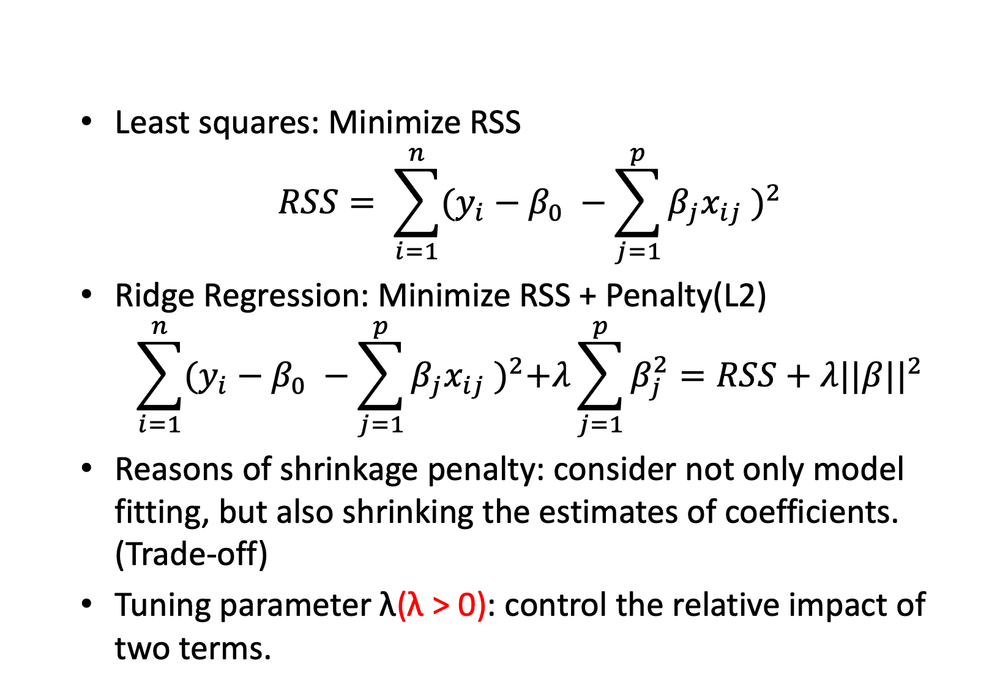
Introduction
Least squares: Minimize RSS
$$RSS= \sum_{i=1}^{n}{{(y_{i}−β_{0} −\sum_{j=1}^{p}{β_{j}x_{ij}} )}^{2}}$$
Ridge Regression: Minimize RSS + Penalty(L2)
$$\sum_{i=1}^{n}{{(y_{i}−β_{0} −\sum_{j=1}^{p}{β_{j}x_{ij}} )}^{2}+λ\sum_{j=1}^{p}{β_{j}^{2}}}=RSS+{λ||β||}^{2}$$
Reasons of shrinkage penalty: consider not only model fitting, but also shrinking the estimates of coefficients. (Trade-off)
Tuning parameter λ(λ > 0): control the relative impact of two terms.

Slide 5
Initialize Data
Hitters data set: predict a baseball player’s Salary based on various statistics associated with performance in the previous year.
library(ISLR)
names(Hitters)
dim(Hitters)
sum(is.na(Hitters$Salary))
Hitters=na.omit(Hitters)
dim(Hitters)
sum(is.na(Hitters))

Slide 6
Fitting using Ridge
##the function glmnet() in the glmnet package install.packages("glmnet")
library(glmnet)
#create dataset for fitting
x=model.matrix(Salary~.,Hitters)[,-1] #x: 19 predictors
y=Hitters$Salary
#why remove the 1st column? Beta*x^T + intercept = [beta0 beta] * [1 X]
##consider a vector of lambda values ranging from 10^10 to 10^-2 grid=10^seq(10,-2,length=100) #length: points of grid ridge.mod=glmnet(x, y, alpha=0, lambda=grid)
#alpha=0:Ridge alpha=1: LASSO
dim(coef(ridge.mod)) #20*100

Slide 7
Result
##the 50th value of lambda
ridge.mod$lambda[50]
coef(ridge.mod)[,50]
##Norm of the estimates
sqrt(sum(coef(ridge.mod)[-1,50]^2))
##the 60th value of lambda
ridge.mod$lambda[60]
coef(ridge.mod)[,60]
sqrt(sum(coef(ridge.mod)[-1,60]^2))
##For new value of lambda
##for example, lambda=25
predict(ridge.mod,s=25,type="coefficients")[1:20,]

Slide 8
Cross validation for Ridge
##split the data into a training and a test set, try to use K-fold cross-validation by yourself
set.seed(1)
train=sample(1:nrow(x), nrow(x)/2)
test=(-train) y.test=y[test]
##fit ridge regression on training data
grid=10^seq(10,-2,length=100) ridge.mod=glmnet(x[train,],y[train],alpha=0,lambda=grid)
##predict on test set using lamda=4, 1e10, 0
ridge.pred1=predict(ridge.mod, s=4,newx=x[test,])
mean((ridge.pred1-y.test)^2) #test MSE ridge.pred2=predict(ridge.mod,s=1e10,newx=x[test,])
mean((ridge.pred2-y.test)^2)
ridge.pred3=predict(ridge.mod,s=0,newx=x[test,])
mean((ridge.pred3-y.test)^2)

Slide 9
Select Tuning Parameter
##cross validation to get the best lambda
set.seed(1)
cv.out=cv.glmnet(x[train,],y[train],alpha=0) #default is 10-folds CV
plot(cv.out)
bestlam=cv.out$lambda.min
bestlam
##now predict with the best lambda ridge.pred=predict(ridge.mod,s=bestlam,newx=x[test,])
mean((ridge.pred-y.test)^2)
##refit ridge regression on the full dataset
out=glmnet(x,y,alpha=0)
predict(out,type="coefficients",s=bestlam)[1:20,]

Slide 10
Lasso Regression

Slide 11
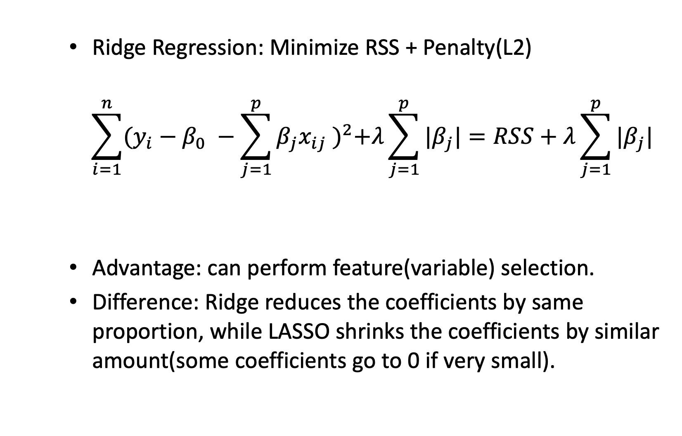
Introduction
Ridge Regression: Minimize RSS + Penalty(L2)
$$\sum_{i=1}^{n}{{(y_{i}−β_{0} −\sum_{j=1}^{p}{β_{j}x_{ij}} )}^{2}+λ\sum_{j=1}^{p}{|β_{j}|}}=RSS+λ\sum_{j=1}^{p}{|β_{j}|}$$
Advantage: can perform feature(variable) selection.
Difference: Ridge reduces the coefficients by same proportion, while LASSO shrinks the coefficients by similar amount(some coefficients go to 0 if very small).

Slide 12
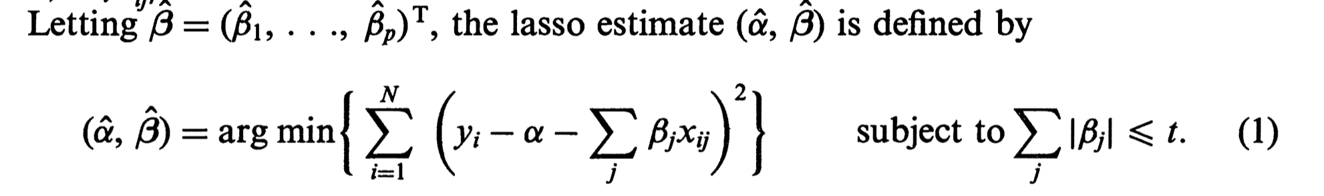
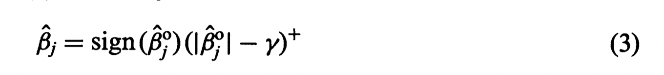
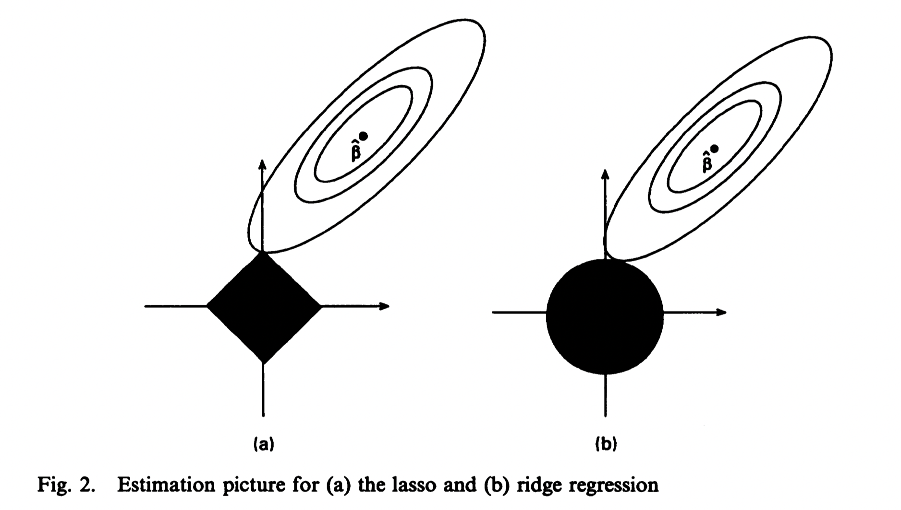
Introduction
Reference: Tibshirani, Robert. “Regression Shrinkage and Selection via the Lasso.” Journal of the Royal Statistical Society. Series B (Methodological) 58, no. 1 (1996): 267–88.

Slide 13
LASSO implementation
##for LASSO we use alpha=1
lasso.mod=glmnet(x[train,],y[train],alpha=1,lambda=grid)
plot(lasso.mod)
##use CV to find the optimal lambda
set.seed(1)
cv.out=cv.glmnet(x[train,],y[train],alpha=1)
plot(cv.out)
bestlam=cv.out$lambda.min

Slide 14
LASSO implementation
##use best lambda for prediction lasso.pred=predict(lasso.mod,s=bestlam,newx=x[test,])
mean((lasso.pred-y.test)^2)
out=glmnet(x,y,alpha=1,lambda=grid)
lasso.coef=predict(out,type="coefficients",s=bestlam)[1:20,]
##check the estimated coefficients and the ‘0’ coefficients
lasso.coef
lasso.coef[lasso.coef!=0]

