Slide 1
SDSC 3006 L02 Class 8. Tree and SVM
Name: Yiren Liu
Email: yirenliu2-c@my.cityu.edu.hk
School of Data Science
City University of Hong Kong

Slide 2
Outline
Bagging and Random Forests
Boosting
Support Vector Classifier

Slide 3
Bagging and Random Forests

Slide 4
Details
Bagging:
Bootstrap Aggregating, also known as bagging, is a machine learning ensemble meta-algorithm designed to improve the stability and accuracy of machine learning algorithms used in statistical classification and regression. It decreases the variance and helps to avoid overfitting. It is usually applied to decision tree methods. Bagging is a special case of the model averaging approach.

Slide 5
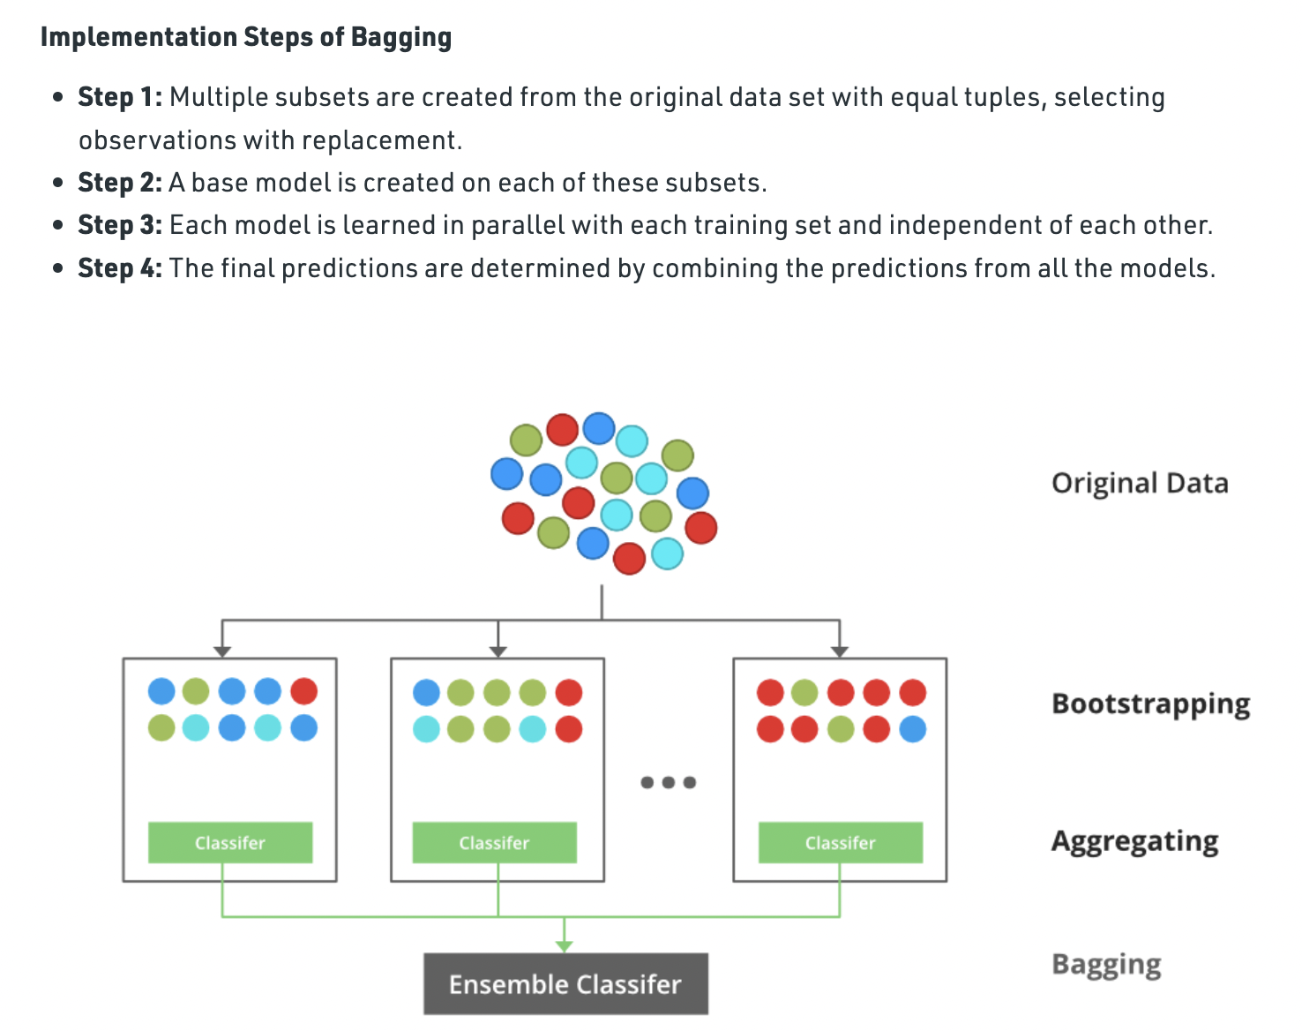
Details

Slide 6
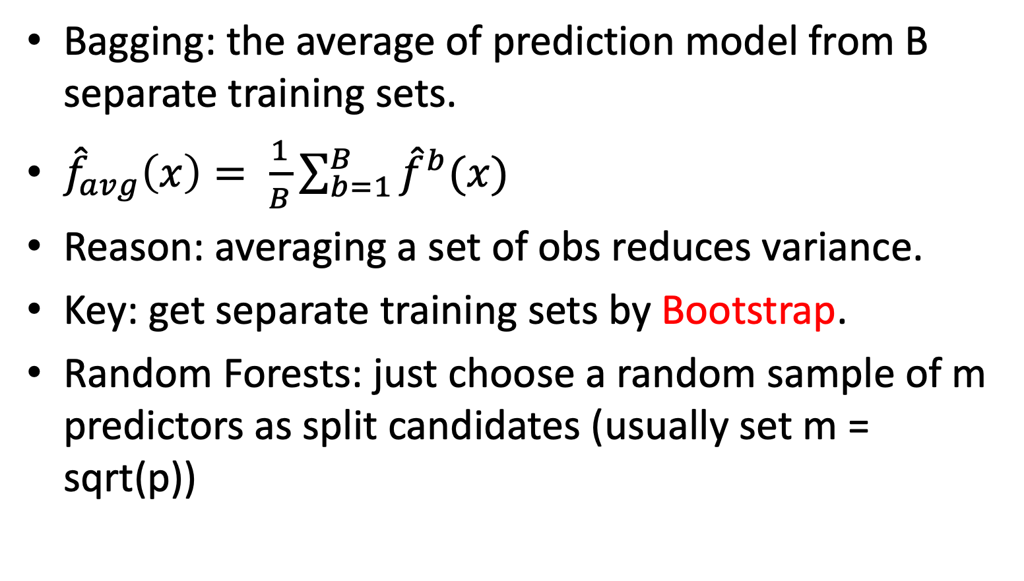
Introduction
Bagging: the average of prediction model from B separate training sets.
${\hat{f}}_{avg}\left(x\right)= \frac{1}{B}\sum_{b=1}^{B}{{\hat{f}}^{b}(x)}$
Reason: averaging a set of obs reduces variance.
Key: get separate training sets by Bootstrap.
Random Forests: just choose a random sample of m predictors as split candidates (usually set m = sqrt(p))

Slide 7
R Implementation of Bagging
Bagging can be viewed as a special case of a random forest with m=p. Therefore, it can be performed using the randomForest() function in the randomForest package.
Boston data set in the MASS library: predict medv (median home price) of a neighborhood based on various predictors (totally 13 predictors)
install.packages("randomForest")
library(randomForest)
library(MASS)
attach(Boston)
##prepare training and test data
set.seed(1)
train = sample(1:nrow(Boston), nrow(Boston)/2)
boston.test=Boston[-train,"medv"]

Slide 8
R Implementation of Bagging
##bagging: randomforest with mtry=number of Predictors
set.seed(1)
bag.boston=randomForest(medv~.,data=Boston,subset=train, mtry=13, ntree=100, importance=TRUE)
bag.boston
##calculate test MSE
yhat.bag=predict(bag.boston,newdata=Boston[-train ,])
mean((yhat.bag-boston.test)^2)
##actual observations of test data and predictions
plot(yhat.bag,boston.test)
abline(0,1) #line with intercept 0 and slope 1

Slide 9
R Implementation of Random Forests
##mtry=number of Predictors
set.seed(1)
rf.boston=randomForest(medv~.,data=Boston,subset=train, mtry=6,ntree=100,importance=TRUE)
yhat.rf=predict(rf.boston,newdata=Boston[-train,])
mean((yhat.rf-boston.test)^2)

Slide 10
Boosting

Slide 11
Details
Boosting:
Boosting is an ensemble modeling technique that attempts to build a strong classifier from the number of weak classifiers.
Firstly, a model is built from the training data. Then the second model is built which tries to correct the errors present in the first model. This procedure is continued and models are added until either the complete training data set is predicted correctly or the maximum number of models is added.

Slide 12
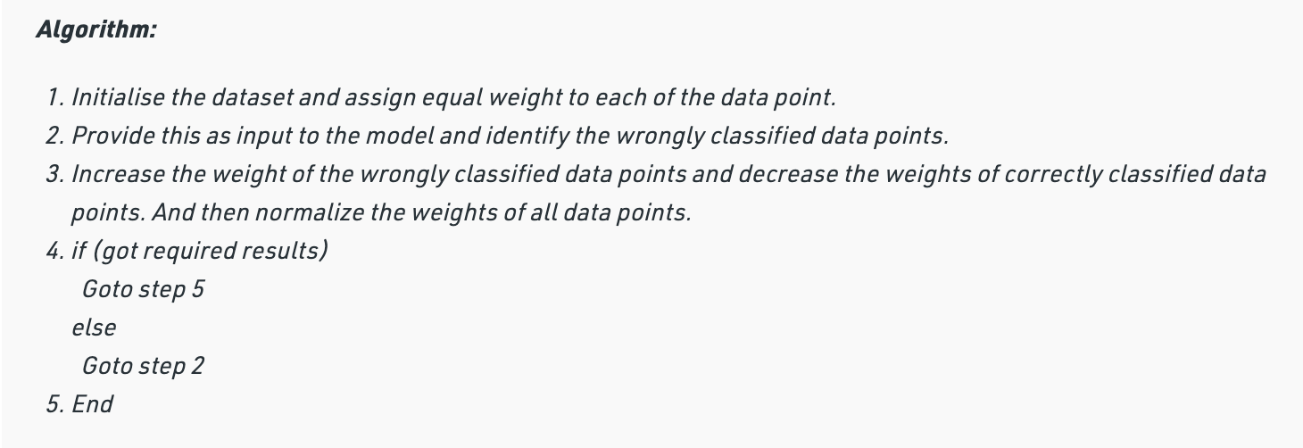
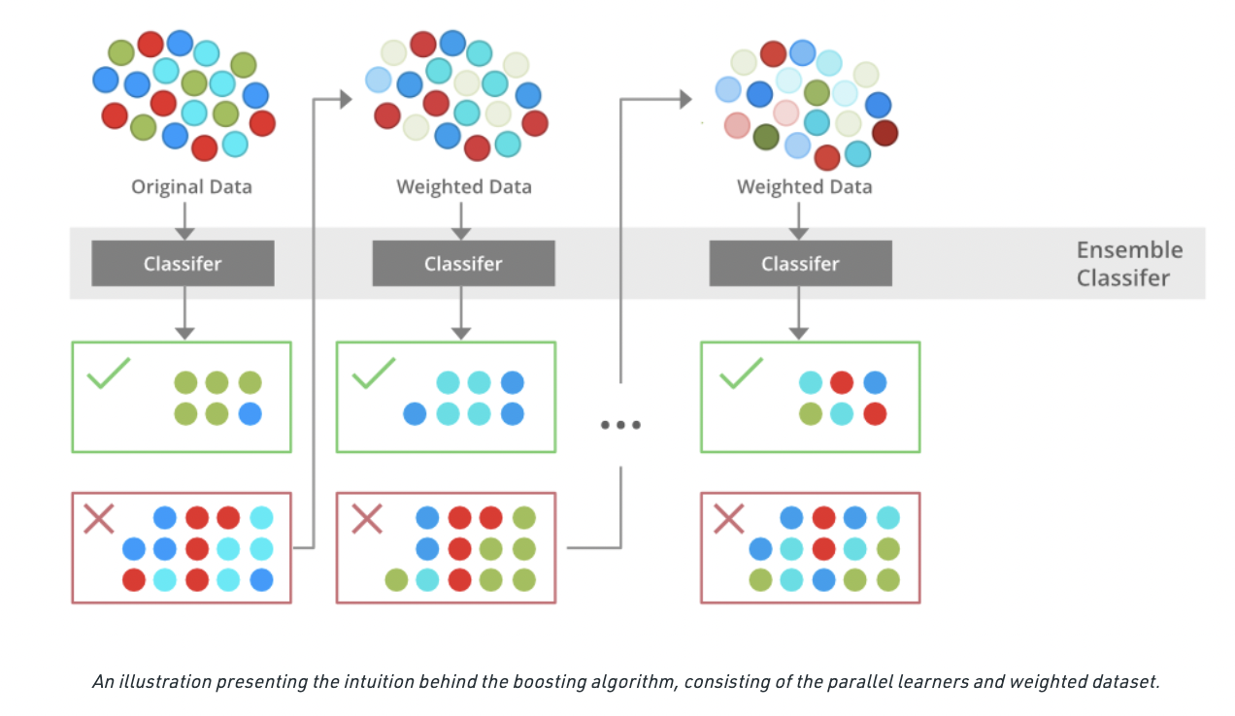
Details

Slide 13
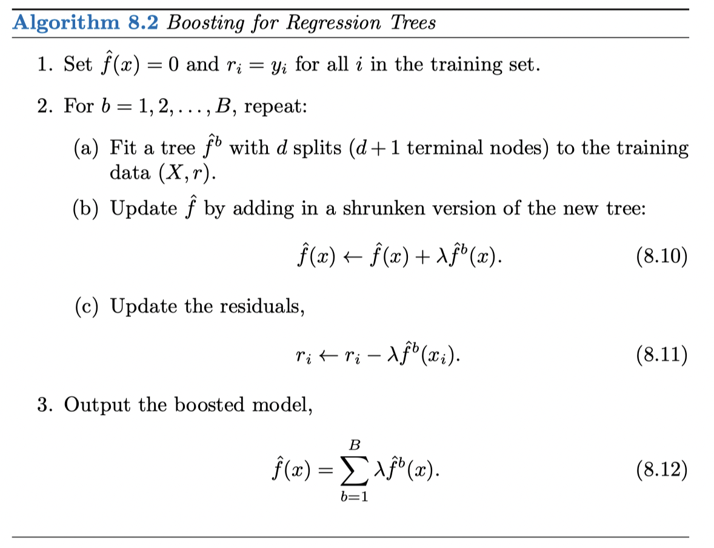
Introduction
Boosting: at each iteration, we fit a tree using the current residuals, rather than the outcome Y, and add this new decision tree into fitted function
Three parameters: number of trees B, shrinkage parameter lamda (usually 0.01 or 0.001), splits of tree d (usually 1, like a stump).

Slide 14
R Implementation of Boosting
##Use gbm() function in gbm package to fit boosted regression trees to the Boston data
install.packages("gbm")
library(gbm)
set.seed(1)
boost.boston = gbm(medv~.,data=Boston[train,], distribution="gaussian",n.trees=5000, interaction.depth=4)
##regression: distribution="gaussian" classification: distribution="bernoulli"
summary(boost.boston) ##relative influence plot
par(mfrow=c(1,2))
plot(boost.boston,i=“rm”) ##partial dependence plot
plot(boost.boston,i="lstat")
yhat.boost = predict(boost.boston,newdata=Boston[-train,], n.trees=5000) mean((yhat.boost-boston.test)^2)

Slide 15
Support Vector Classifier

Slide 16
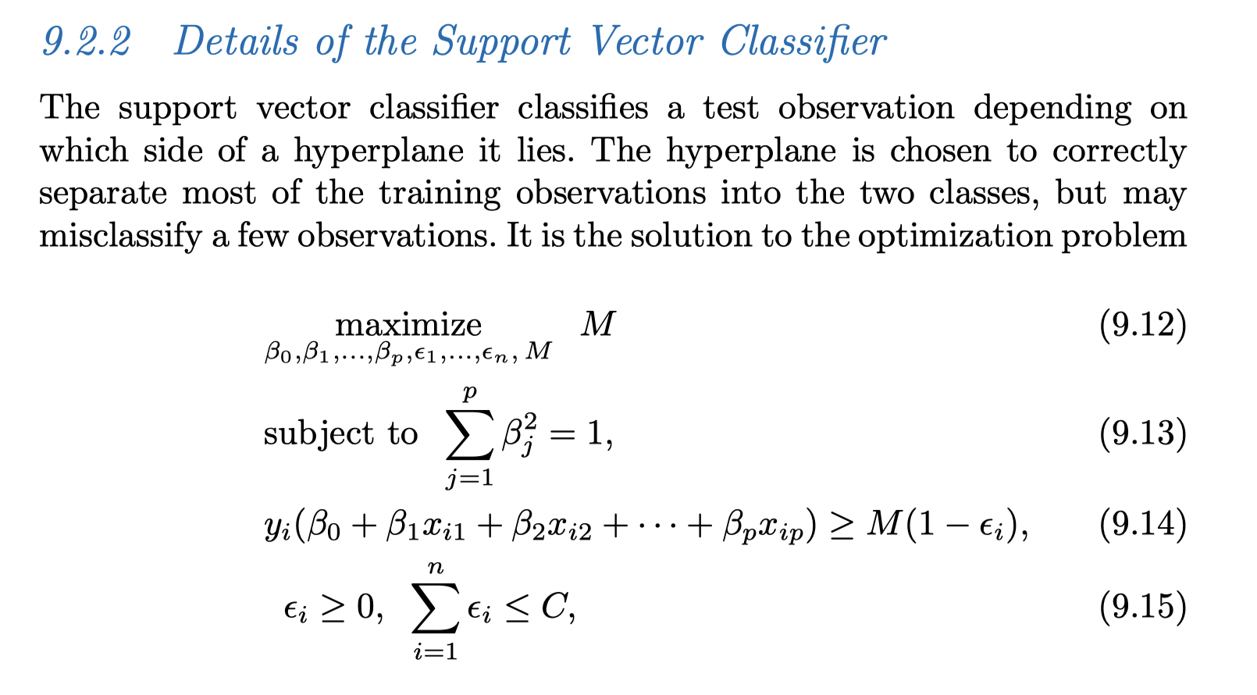
Details

Slide 17
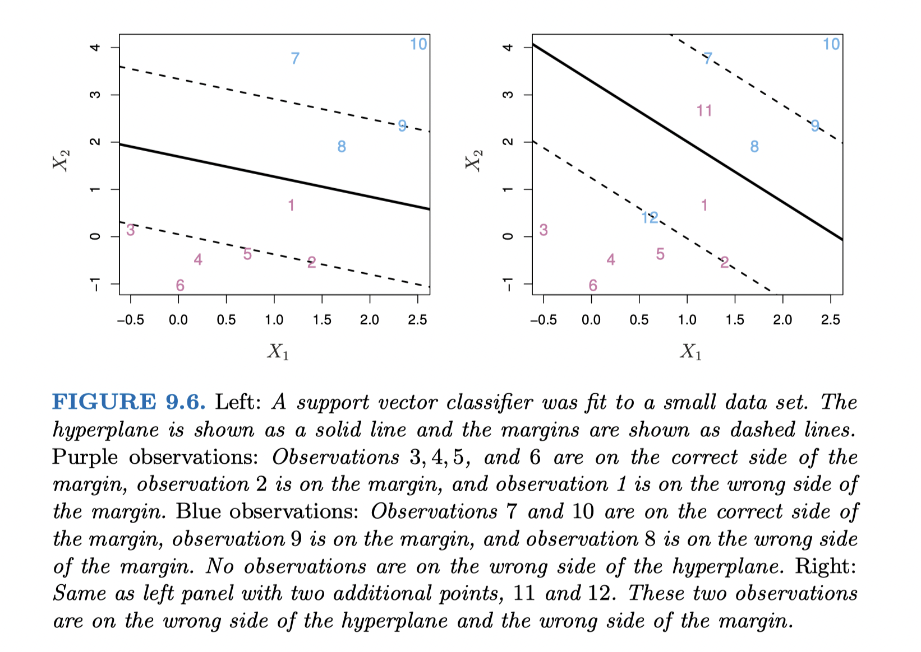
Details

Slide 18
Implementation
Use the e1071 library to demonstrate the support vector classifier and the SVM on a two-dimensional example.
install.packages("e1071")
library(e1071)
##Generate training data
set.seed(1)
x=matrix(rnorm(20*2),ncol=2)
y=c(rep(-1,10),rep(1,10))
x[y==1,]=x[y==1,]+1
plot(x,col=(3-y)) ##color=2(red), 4(blue) red:1, blue:-1

Slide 19
Implementation
##Fit the support vector classifier
dat=data.frame(x=x,y=as.factor(y))
dat
svmfit=svm(y~.,data=dat,kernel="linear",cost=10,scale=FALSE)
##"cost" is similar to tuning parameter C, but with opposite effects: small "cost", wide margin; large "cost", narrow margin
plot(svmfit,dat)
summary(svmfit)
##Find support vectors
svmfit$index
##Use a smaller value for cost
svmfit=svm(y~.,data=dat,kernel="linear",cost=0.1,scale=FALSE)
plot(svmfit,dat)

Slide 20
Implementation
##Use cross validation to find best value for cost
set.seed(1)
tune.out=tune(svm,y~.,data=dat,kernel="linear", ranges=list(cost=c(0.001,0.01,0.1,1,5,10,100)))
summary(tune.out)
##Best model
bestmod = tune.out$best.model
summary(bestmod)
plot(bestmod ,dat)

Slide 21
Implementation
##Generate test data
xtest=matrix(rnorm(20*2),ncol=2)
ytest=sample(c(-1,1),20,rep=TRUE)
xtest[ytest==1,]=xtest[ytest==1,]+1 testdat=data.frame(x=xtest,y=as.factor(ytest))
##Prediction
ypred=predict(bestmod,testdat)
table(predict=ypred,truth=testdat$y)

