Slide 1
SDSC 3006 L02 Class 9. SVM and PCA
Name: Yiren Liu
Email: yirenliu2-c@my.cityu.edu.hk
School of Data Science
City University of Hong Kong

Slide 2
Outline
Support Vector Machine
Principal Components Analysis
Principal Components Regression

Slide 3
Support Vector Machine

Slide 4
Implementation
Notice:
1. SVM is an extension of the support vector classifier, using different kernels(non-linear).
2. Use the e1071 library to demonstrate the SVM on a two-dimensional example.
library(e1071)
##Generate data with nonlinear boundary
set.seed(1)
x=matrix(rnorm(200*2),ncol=2)
x[1:100,]=x[1:100,]+2
x[101:150,]=x[101:150,]-2
y=c(rep(1,150),rep(2,50))
dat=data.frame(x=x,y=as.factor(y))
plot(x,col=(3-y))

Slide 5
Implementation
##Use SVM with a radial kernel
train=sample(200,100) svmfit=svm(y~.,data=dat[train,],kernel="radial",gamma=1,cost=1)
##"cost" is similar to tuning parameter C, but with opposite
##effects: small "cost", wide margin; large "cost", narrow margin
plot(svmfit,dat[train,])
summary(svmfit)

Slide 6
Implementation
##Select best values for "gamma" and "cost" by CV tune.out=tune(svm,y~.,data=dat[train,],kernel="radial",ranges =list(cost=c(0.1,1,10,100,1000),gamma=c(0.5,1,2,3,4)))
summary(tune.out)
##Use SVM with a polynomial kernel svmfit=svm(y~.,data=dat[train,],kernel="polynomial" , degree=2,ranges=list(cost=c(0.001,0.01,0.1,1,5,10,100)))
plot(svmfit,dat[train,])
$$A$$

Slide 7
Principal Components Analysis

Slide 8
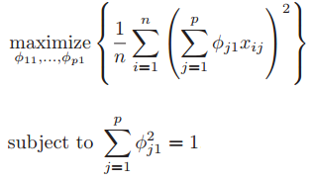
Details
Objective:
Notice: The principal components are the eigenvectors of a covariance matrix, and hence they are orthogonal. Importantly, the dataset on which PCA technique is to be used must be scaled. The results are also sensitive to the relative scaling.

Slide 9
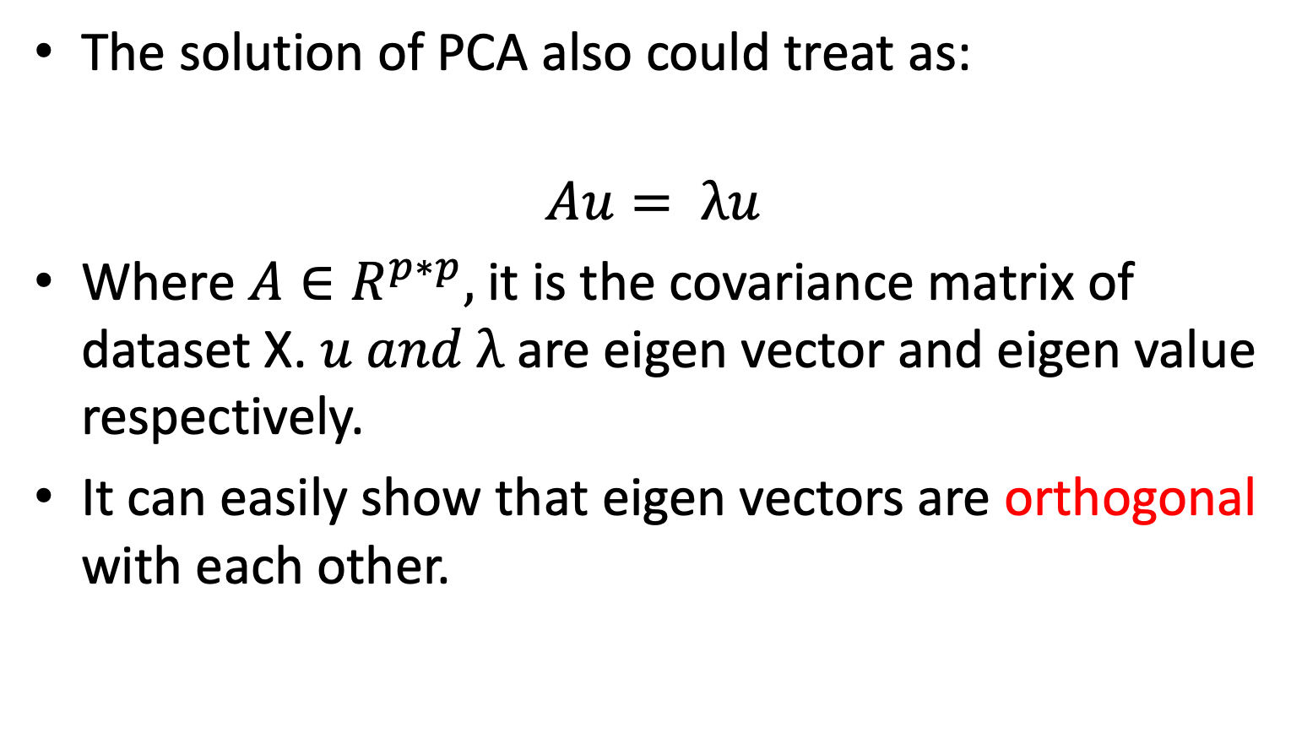
Details
The solution of PCA also could treat as:
$$Au= λu$$
Where $A∈R^{p∗p},$it is the covariance matrix of dataset X. $u and λ$ are eigen vector and eigen value respectively.
It can easily show that eigen vectors are orthogonal with each other.

Slide 10
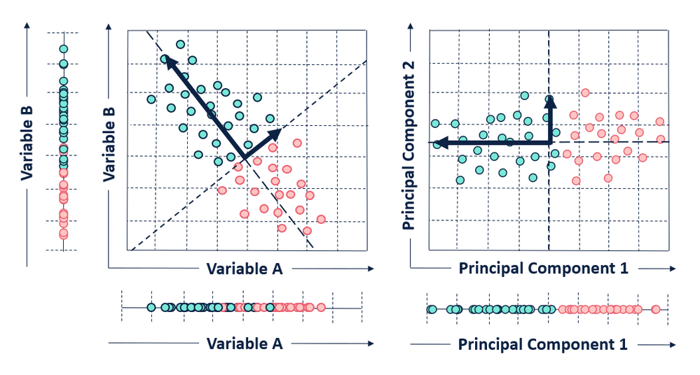
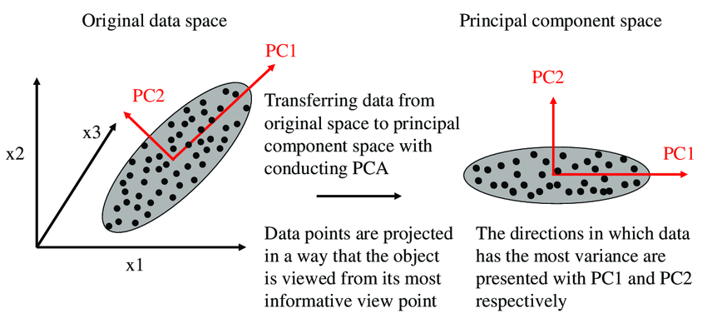
Examples
Example 1:
2D case:
PC1 will find a direction that make all points have largest variance. In other words, points vary the most in PC1 direction.
Example 2:
3D case:

Slide 11
Implementation
Notice:
1. We perform PCA on the USArrests data set, which is part of the base R package.
2. Using the prcomp() function, which is one of several functions in R that perform PCA.
3. By default, the prcomp() function centers the variables to have mean zero. ‘Option scale = TRUE’ scale the variables to have sd 1.

Slide 12
Implementation
names (USArrests)
pr.out = prcomp (USArrests , scale = TRUE)
names (pr.out)
##rotation: principal component loadings
pr.out$rotation
biplot (pr.out , scale = 0)
##sdev: standard deviation of principal components
pr.out$sdev
pr.var = pr.out$sdev^2

Slide 13
Implementation
##compute the proportion of variance explained by each principal component
pve = pr.var / sum (pr.var)
par (mfrow = c(1, 2))
plot (pve , xlab = " Principal Component ", ylab = " Proportion of Variance Explained ", ylim = c(0, 1), type = "b")
plot ( cumsum (pve), xlab = " Principal Component ", ylab = " Cumulative Proportion of Variance Explained ", ylim = c(0, 1), type = "b")

Slide 14
Principal Components Regression

Slide 15
Details
The principal components regression (PCR) approach involves constructing the ﬁrst M principal components, Z_1 , . . . , Z_M , and then using these components as the predictors in a linear regression model that is ﬁt using least squares.

Slide 16
Details
If the assumption underlying PCR holds, then ﬁtting a least squares model to Z 1 , . . . , Z M will lead to better results than ﬁtting a least squares model to X 1 , . . . , X p , since most or all of the information in the data that relates to the response is contained in Z 1 , . . . , Z M , and by estimating only M ≪ p coeﬃcients we can mitigate overﬁtting.

Slide 17
Implementation
Notice:
1. PCR can be performed using pcr() fuction in pls library
2. We now apply PCR to the Hitters data, in order to predict Salary.
install.packages('pls’)
library(ISLR)
library(pls)
attach(Hitters)
Hitters = na.omit (Hitters) ##remove rows with missing values
set.seed (2)
pcr.fit = pcr(Salary ~ ., data = Hitters , scale = TRUE, validation = "CV")
##10-fold cross-validation
summary (pcr.fit)
##plot the CV scores
validationplot(pcr.fit , val.type = "MSEP")

Slide 18
Implementation
##create training set and test set
x=model.matrix(Salary~.,Hitters)[,-1]
y=Hitters$Salary
train=sample(1:nrow(x), nrow(x)/2)
test=(-train)
y.test=y[test]
##perform PCR on training set
set.seed(1)
pcr.fit = pcr(Salary ~ ., data = Hitters , subset = train , scale = TRUE , validation = "CV")
validationplot (pcr.fit , val.type = “MSEP”) ##find the best M
##compute test MSE
pcr.pred = predict(pcr.fit , x[test , ], ncomp = 5)
mean ((pcr.pred - y.test)^2) ##compare with shrinkage method?
##perform PCR on full data
pcr.fit = pcr (y ~ x, scale = TRUE , ncomp = 5)

