Slide 1
ACM Training
Greedy, Enumeration and Guess

Slide 2
Outlines
Enumeration
  Simplest method
  How to reduce the instances you have to enumerate?
Greedy
  Every time pick the current “best” choice
  How to define best?
  How to prove that optimal solution can be obtained in this way?

Slide 3
Example 1
Coin Flipping
  There are N (N<10000) rows of coins
  Each row consists of 9 coins
  They formulate a matrix of size N*9
  Some coins are heads up and some are tails up
  We can flip a whole row or a whole column every time
  Find a flipping method that can make the number of “heads up” coins maximum

Slide 4
Example 2
Discrete Function
  A discrete function is defined on {1,2,3,…,N}
  Function values are between 2⁻³² and 2³²
  Find two points on the function curve such that
    Any function point between these two points are below the line connecting these two points
    The slope of the line connecting these two points are as large as possible
  O(n³) → O(n²)
  O(n²) → O(n)

Slide 5
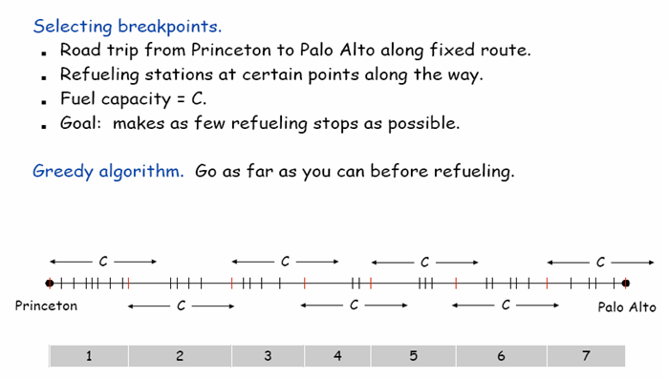
Example 3 – Selecting Breakpoints

Slide 6
Example 4 – Gone Fishing
There are n fishing lakes on a line
Labeled 1, 2, 3, …, n from left to right
H hours’ fishing time
Start from lake 1
5*T_{i} minutes to reach lake i+1 from lake i
At the same lake i
  The first 5 minutes can produce F_{i} fishes
  Every 5 minutes more will see a decrease of D_{i} in the number of fishes produced
How to get the maximum number of fishes?

Slide 7
Example 5 – Enlightened Landscape
X₁
X₂
X₃
X₄
X₅
X₆

Slide 8
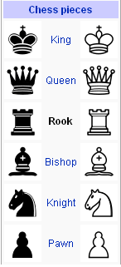
Example 6 – The best way to put rooks
(open for your try)
▪
▪
▪
▪

Slide 9
Game of Matches
There is a pile of n matches
  Player 1 pick some matches (k matches) from the pile but he cannot take them all
  Player 2 pick t matches (at least 1, at most 2k)
  Player 1 pick s matches (at least 1, at most 2t)
  …
The one who have no match to pick from the pile will lose
Input: n
Output: whether the first player can win

