Slide 1
Team 17
Skin Cancer Detection and Interpretation

Slide 2
Our aims:
Design and implement our deep learning model
We want to implement our own model to see if we can design a model that can classify skin cancer.
Design and implement one or more deep learning systems, experiment with various algorithms to maximise the learning capability.
We want to compare our models results to that of other pre-trained models.

Slide 3
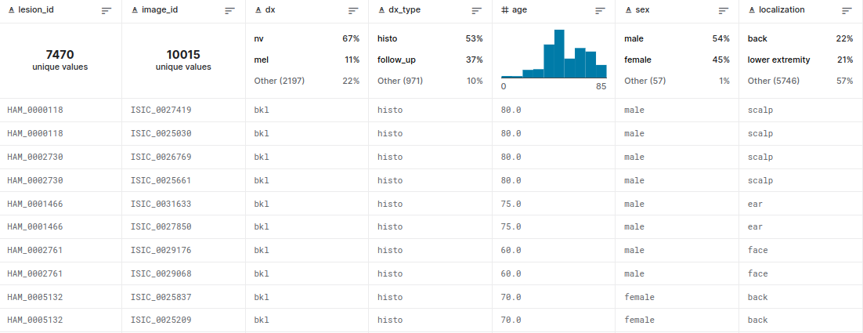
Our dataset:
HAM10000 (for start)
A training set for academic machine learning can be created using the dataset, which comprises of 10015 dermatoscopic images. All significant diagnostic categories for pigmented lesions are represented in the cases in a representative manner:
Actinic keratoses and intraepithelial carcinoma / Bowen's disease (akiec),
basal cell carcinoma (bcc),
benign keratosis-like lesions (solar lentigines / seborrheic keratoses and lichen-planus like keratoses, bkl),
dermatofibroma (df),
melanoma (mel),
melanocytic nevi (nv) and
vascular lesions (angiomas, angiokeratomas, pyogenic granulomas and hemorrhage, vasc).

Slide 4
Object detection:
Looking at the dataset images, Image classification may struggle to give good results because there aren't many features to work with.
On the other hand, object detection model can be used for this dataset. Separating the cancer mark with the rest of the skin will hopefully give enough information for the model to train.
It will help to illustrate to the viewer where the model is deriving it prediction from. This could give the human reviewer reassurance in the model's prediction.

Slide 5
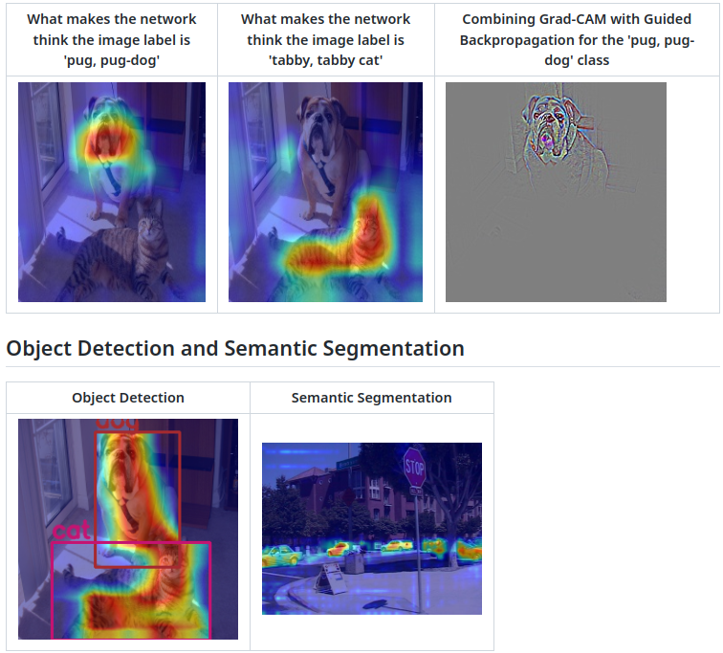
Visualization techniques:
pytorch-grad-cam
This is a package with state of the art methods for Explainable AI for computer vision. This can be used for diagnosing model predictions, either in production or while developing models. The aim is also to serve as a benchmark of algorithms and metrics for research of new explainability methods.

Slide 6
Additional information:
(e.g. age, sex, location etc.)
We want to experiment with adding parameters to our data to see if this will affect the effectiveness of our model predictions. We believe that additional information may have correlation to the likelihood if the patient is having skin cancer and what type of skin cancer.

Slide 7
Development

Slide 8
Testing different Pretrained models
We tested three different pretrained models:
Resnet50 gave us the best results
Pre trained Model | 5 Epochs(Percentage accuracy) | 20 Epochs(Percentage accuracy)
Resnet50 | 77.1% | 83%
VGG16 | 66.2% | 71.1%
Efficientnet | 63% | 76.7%

Slide 9
Testing different Resnet Models
We tested the different Resnet models to see which one would give us the best results:
Resnet101 gave us the best accuracy
Resnet Model | 10 Epochs(Percentage correct)
Resnet18 | 71%
Resnet34 | 73%
Resnet50 | 75%
Resnet101 | 76%
Resnet152 | 75%

Slide 10
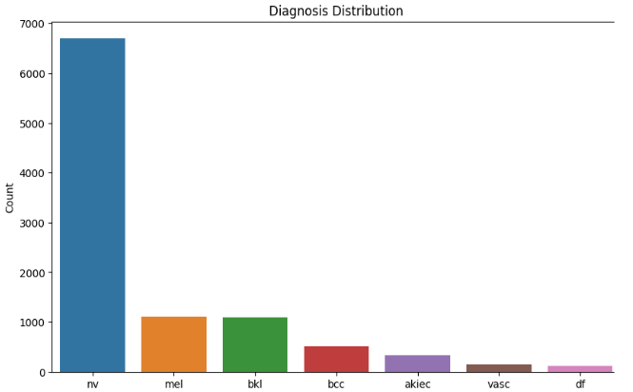
Improving the dataset
Looking at our data set we could see that the data was not evenly distributed

Slide 11
Improving the dataset
Here is the accuracy for each class on the original distribution
Lesion type | Accuracy percentage | Number of test samples
Actinic keratoses(akiec) | 3 | 61
Basal cell carcinoma(bcc) | 35 | 107
Benign keratosis-like(bkl) | 41 | 224
Dermatofibroma(df) | 0 | 19
Melanoma(mel) | 20 | 211
Melanocytic nevi(nv) | 97 | 1355
Vascular lesions(vasc) | 85 | 26

Slide 12
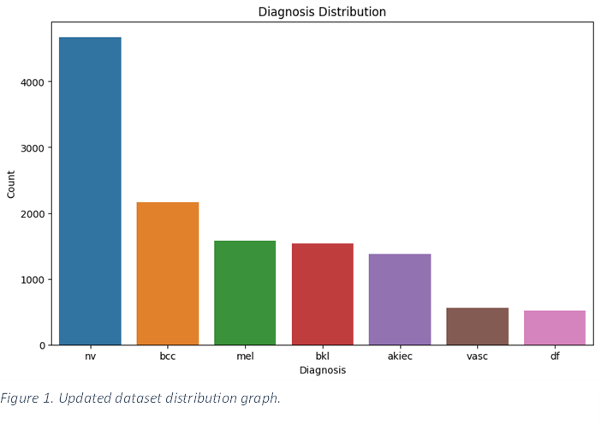
Improving the dataset
We then selectively transformed some of the classes to increase their numbers

Slide 13
Transformations used
RandomPerspective
  Changes the perspective of the image
RandomRotation
  Randomly rotates the image from X to Y degrees
RandomVerticalFlip & RandomHorizontalFlip
  Randomly flips the image vertically or horizontally
RandomPosterize
  Randomly posterizes the image by reducing the number of bits of each colour channel.
RandomAdjustSharpness
  Randomly adjusts the sharpness of the given image
RandomAffine
  Transformation of the image keeping centre invariant

Slide 14
Improving the dataset
Our alterations to the data set improved the accuracy of most of our classes
Improving the distribution of the dataset gave us a 4% increase in overall accuracy from 76% to 80% accuracy.
Lesion type | Accuracy percentage | Percentage improvement from original dataset.
Actinic keratoses(akiec) | 44 | 41
Basal cell carcinoma(bcc) | 78 | 43
Benign keratosis-like(bkl) | 50 | 9
Dermatofibroma(df) | 63 | 63
Melanoma(mel) | 49 | 29
Melanocytic nevi(nv) | 91 | -6
Vascular lesions(vasc) | 85 | 0

Slide 15
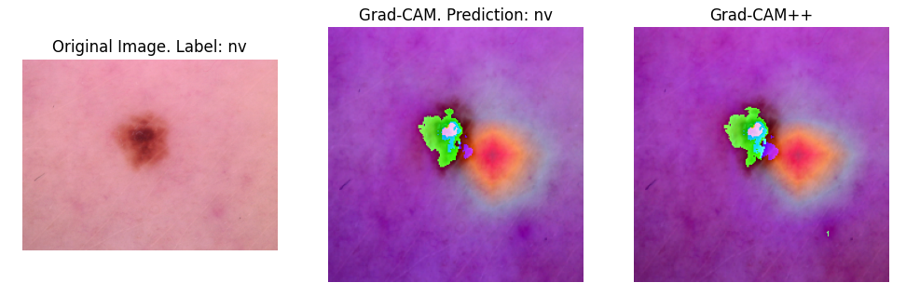
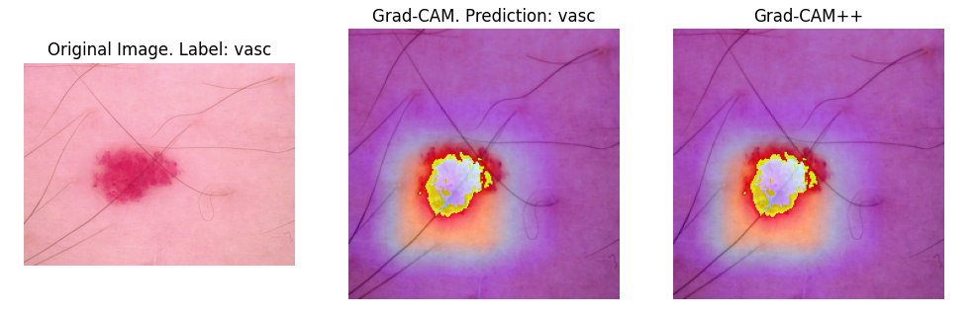
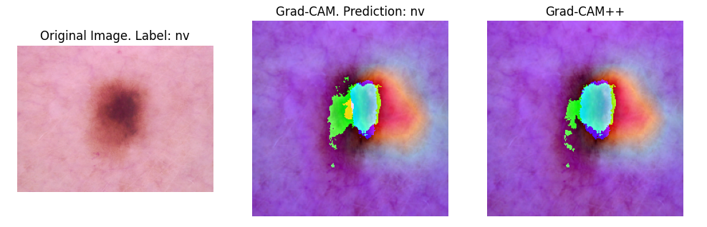
Visualization techniques:
We used two methods from pytorch-grad-cam, Grad-CAM and Grad-CAM++, to interpret our deep learning model for skin cancer classification. These methods can produce heatmaps that show which pixels of an image are most relevant for the model’s prediction of a certain class.
For example, if the model predicts that an image has skin cancer, Grad-CAM and Grad-CAM++ can highlight the regions of the skin that have the most evidence of cancer. This can help us understand how our model works, and identify any errors or biases that it might have.
Grad-CAM and Grad-CAM++ are especially important for cancer classification, because they can provide visual explanations that can be verified by medical experts and patients.

Slide 16
Adding the contextual model
Besides using the image pixels as input, we also used the metadata of the images, such as diagnosis type, sex, age, and localization, to train a separate model for classification.
We defined a simple two-layer neural network with 64 hidden units and used cross-entropy loss and Adam optimizer to train it.
We evaluated the model on the test set using accuracy score and obtained a result of 95%. This model can provide additional information and insights for our skin cancer classification task.
Our initial goal was to combine the predictions of the two models, the image-based model and the metadata-based model, to obtain a more robust and accurate classifier.
However, we encountered some difficulties in doing so, such as how to align the data, how to weight the models, and how to handle conflicting predictions.
Due to time constraints, we were not able to resolve these issues. This is one of the limitations of our project and a direction for future work.

