Slide 1
TamaDolphin
A project with two different technologies, but one scope.
Advance User Interface 2018-2019
Group 13 – Tangible VR
Giuseppe Mauri giuseppe3.mauri@mail.polimi.it
Giulia Meneghin giulia.meneghin@mail.polimi.it

Slide 2
WHAT IS TAMADOLPHIN?:
An interactive game realized for NDD children that aims to stimulate the communication.
A new way to educate the children with innovative technologies (Virtual Reality and Smart Objects).
WHY IS SO IMPORTANT?
There is need to help the NDD children relate to the society.
The context lacks of custom-designed solutions, and our project helps these children to discuss and solve common problems.

Slide 3
Needs
Provide an application specifically designed for disabled(NDD) children.
A way to stimulate and improve the users capacity of communication.
Develop an higher level of attention of the users.
Goals
Stimulate collaboration.
Improve coordination.
Maintain a high concentration.
Learn the ability to interpret the needs of others.
Requirements
There must be 2 users(NDD children) and a therapist.
There must be a 3D model of a dolphin, in a VR world, that simulates the main human needs.
One of the users must use a “Smart” dolphin puppet, which replicates the main human needs.
The two representations of the dolphin must simulate the same need while in the corresponding game phase.
The two users have to resolve together the same dolphin need.
When one of the users is resolving the task, the other must be careful and wait for next instruction.
Incorrect decisions should be used to improve communication.
The communication parts must be translated into system input.
Therapist must use the website application to translate the verbal communication of the VR user.
The two dolphins must emit feedback based on the input correctness.

Slide 4
STUDY OF THE "STATE OF THE ART"
There are no similar projects that use the two technologies on two different users.
Many therapeutic activities are aimed at improving certain aspects of verbal communication in autistic children.
Using innovative technologies with autistic children and young people allows to present the didactic and educational material choosing a mainly visual-spatial language that we know to be their strong point.
Some recent scientific studies have shown improvements in social skills by some adolescents with autism after the use of advanced technologies. Our project is a combination of two different technologies: virtual reality and smart object. Each child will have to use one of the two technologies. Our project deals with a research topic that is not much developed: the collaboration between disabled children and communication between two different technologies. There are no similar projects to ours, which use the two technologies simultaneously on two different users.
OTHER PROJECTS | OUR PROJECT
VR is used to free up anxiety and isolate | We use it to focus attention on a single object and create an ideal environment to wait without too much distraction.
The smart object is used for therapy and relaxation methods | We use it as a means to solve tasks and simulate the needs of the object.
-> Our project deals with a research topic that is not much developed: the collaboration between disabled children and communication between two different technologies.

Slide 5
HOW DID WE ACHIEVE THE SOLUTION?
With a combination of two different technologies.
Allowing children to use these technologies to work together to achieve the same goal in two different ways.
Allowing the therapist to use special moments dedicated to verbal communication in which she is not just a spectator but plays a concrete and active role as a therapist.
THE SMART OBJECT
THE VR

Slide 6
HOW DID WE DESIGNED TAMADOLPHIN?
Key Point: realize the simple and functional user experience.
Main Feature: collaboration -> which is possible even though the two players use two completely different technologies. -> Thanks to the therapist
VR
Virtual User Experience
Smart object
Real User Experience
Web Site
Therapist Experience

Slide 7
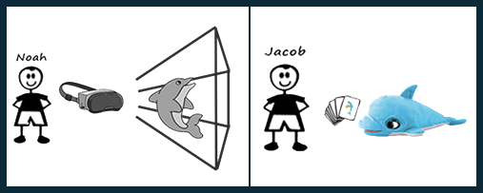
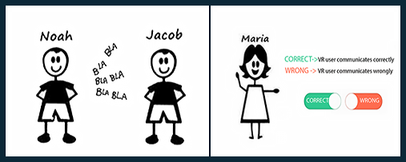
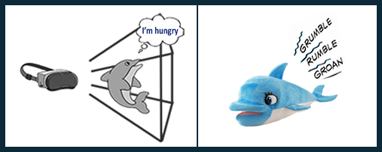
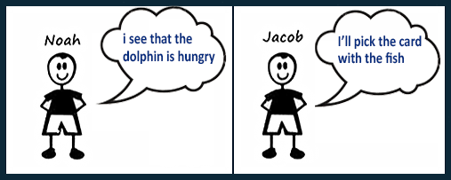
SCENARIO
One child will use the viewer and the other the smart object.
The communication is between two children, and a therapist will supervise the proposed activity.
We present the same need for the dolphin in different ways depending on the technology used.
The two children should collaborate together to solve the dolphin's need.

Slide 8
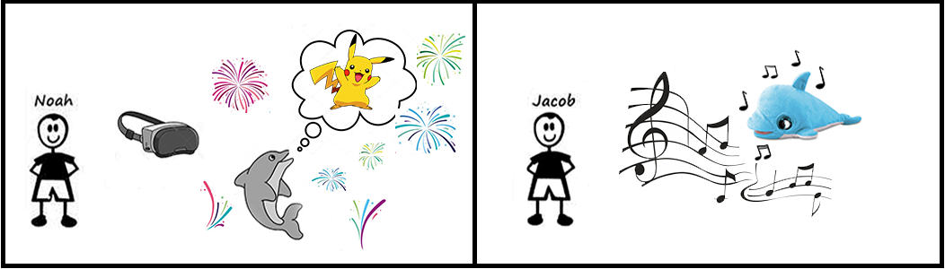
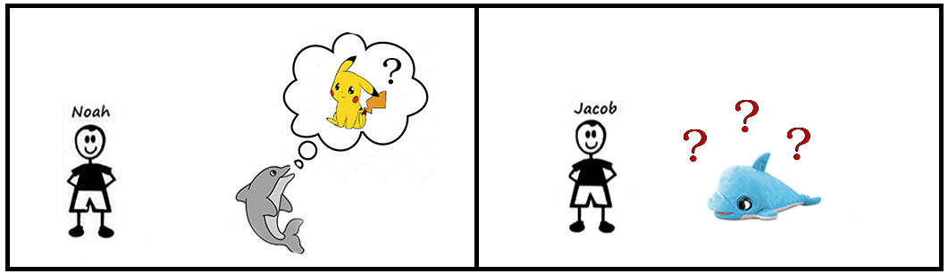
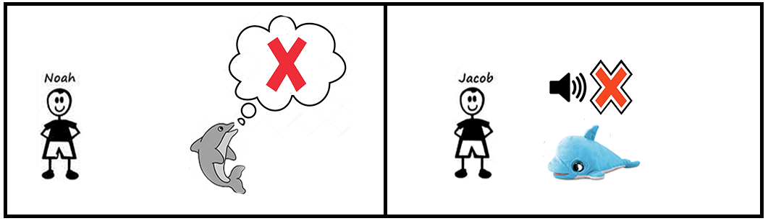
WE MANAGE DIFFERENT OUTCOME
VR communication | Card Used | Feedback
Correct | Correct | Positive
Correct | Wrong | Question Mark
Wrong | Correct | Question Mark
Wrong | Wrong | Negative

Slide 9
SCENARIO CIBO
The child in the VR world will have to look for the right food
After he finds what he thinks is right, he communicates it.
After the therapist confirms the choice, the food flies in front of the dolphin.
The other child chooses which food he thinks the dolphin can eat.

Slide 10
WE MANAGE DIFFERENT OUTCOME PARTE 2
VR communication | Card Used | Same Choice | Feedback
Correct | Correct | Yes | Positive
Correct | Wrong | No | Question Mark
Wrong | Correct | No | Question Mark
Wrong | Wrong | No | Question Mark
Wrong | Wrong | Yes | Negative

Slide 11
Value proposition
TamaDolphin has a lot of potential as a project thanks to its strength that is verbal Communication
Cosa possiamo fare ancora

