Slide 1
TamaDolphin
A project with two different technologies, but one scope.
Advance User Interface 2018-2019
Group 13 – Tangible VR
Giuseppe Mauri giuseppe3.mauri@mail.polimi.it
Giulia Meneghin giulia.meneghin@mail.polimi.it

Slide 2
WHAT IS TAMADOLPHIN?:
An interactive game realized for NDD children that aims to stimulate the communication.
A new way to educate the children with innovative technologies (Virtual Reality and Smart Objects).
WHY IS SO IMPORTANT?
There is need to help the NDD children relate to the society.
The context lacks of custom-designed solutions, and our project helps these children to discuss and solve common problems.
HOW DID WE RESOLVE THIS PROBLEM?
With a tangible-VR game between two children collaborating together to achieve the same goal in two different ways.

Slide 3
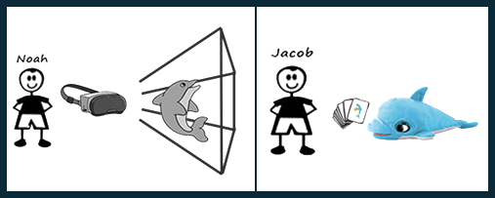
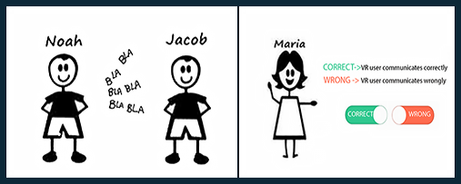
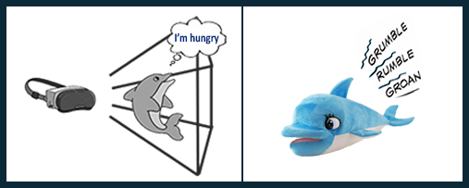
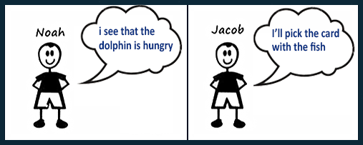
HOW DID WE DESIGNED TAMADOLPHIN?
One child will use the viewer and the other the smart object.
The communication is between two children, and a therapist will supervise the proposed activity.
We present the same need for the dolphin in different ways depending on the technology used.
The two children should collaborate together to solve the dolphin's need.

Slide 4
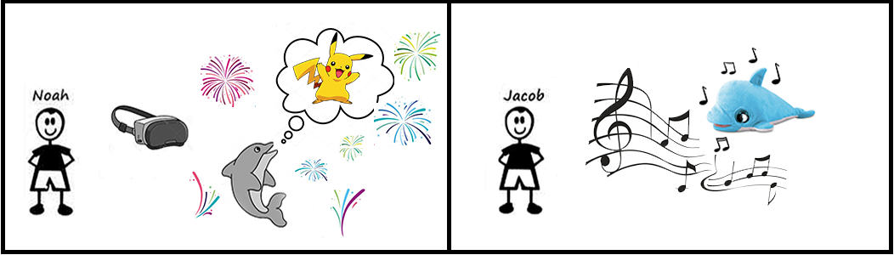
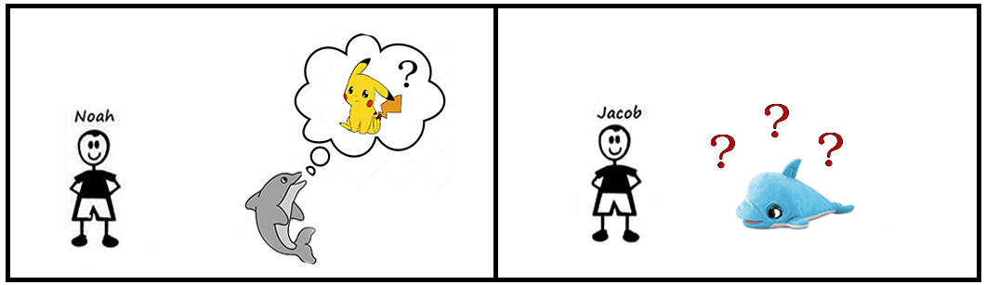
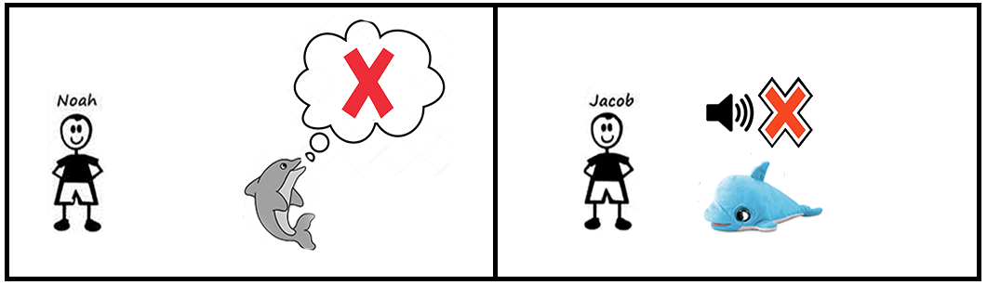
WE MANAGE DIFFERENT OUTCOME
VR comunication | Card Used | Feedback
Correct | Correct | Positive
Correct | Wrong | Question Mark
Wrong | Correct | Question Mark
Wrong | Wrong | Negative

