Slide 1
TamaDolphin
A project with two different technologies, but one scope.
Advance User Interface 2018-2019
Group 13 – Tangible VR
Giuseppe Mauri giuseppe3.mauri@mail.polimi.it
Giulia Meneghin giulia.meneghin@mail.polimi.it

Slide 2
WHAT IS TAMADOLPHIN?:
An interactive game realized for NDD children that aims to stimulate the communication.
A new way to educate the children with innovative technologies (Virtual Reality and Smart Objects).
WHY IS SO IMPORTANT?
There is need to help the NDD children relate to the society.
The context lacks of custom-designed solutions, and our project helps these children to discuss and solve common problems.

Slide 3
Needs
Provide an application specifically designed for disabled(NDD) children.
A way to stimulate and improve the users capacity of communication.
Develop an higher level of attention of the users.
Goals
Stimulate collaboration.
Improve coordination.
Maintain a high concentration.
Learn the ability to interpret the needs of others.
Requirements
There must be 2 users(NDD children) and a therapist.
There must be a 3D model of a dolphin, in a VR world, that simulates the main human needs.
One of the users must use a “Smart” dolphin puppet, which replicates the main human needs.
The two representations of the dolphin must simulate the same need while in the corresponding game phase.
The two users have to resolve together the same dolphin need.
When one of the users is resolving the task, the other must be careful and wait for next instruction.
Incorrect decisions should be used to improve communication.
The communication parts must be translated into system input.
Therapist must use the website application to translate the verbal communication of the VR user.
The two dolphins must emit feedback based on the input correctness.

Slide 4
STUDY OF THE "STATE OF THE ART"
Communication
Therapeutic activities for NDD
Emotional control
Enjoying
Improvement in social skills
Reduction of external stimuli
Use of innovative technologies
New research topic
Communication between two technologies
Collaboration between disabled children
Our project research area
First experiment with VR and Smart object

Slide 5
HOW DID WE ACHIEVE THE SOLUTION?
With a combination of two different technologies.
Allowing children to use these technologies to work together to achieve the same goal in two different ways.
Allowing the therapist to use special moments dedicated to verbal communication in which she is not just a spectator but plays a concrete and active role as a therapist.
THE VR
THE SMART OBJECT

Slide 6
HOW DID WE DESIGNED TAMADOLPHIN?
Key Point : Realize the simple and functional user experience.
Main Feature: Collaboration -> Which is possible even though the two players use two completely different technologies. -> Thanks to the therapist.
VR
Virtual User Experience
Smart object
Real User Experience
Web Site
Therapist Experience

Slide 7
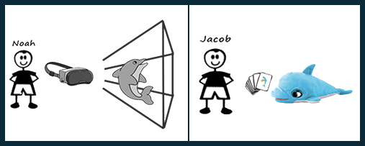
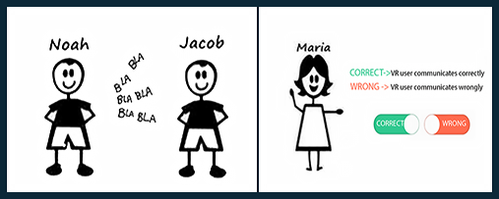
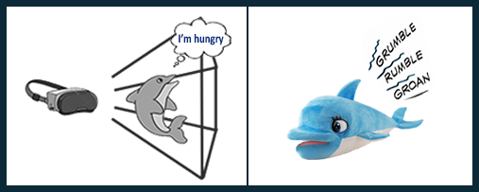
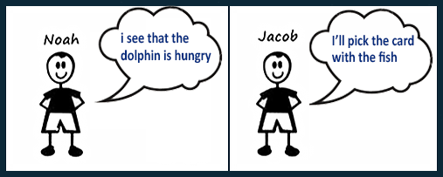
GAME FLOW
One child will use the viewer and the other the smart object.
The communication is between two children, and a therapist will supervise the proposed activity.
We present the same need for the dolphin in different ways depending on the technology used.
The two children should collaborate together to solve the dolphin's need.

Slide 8
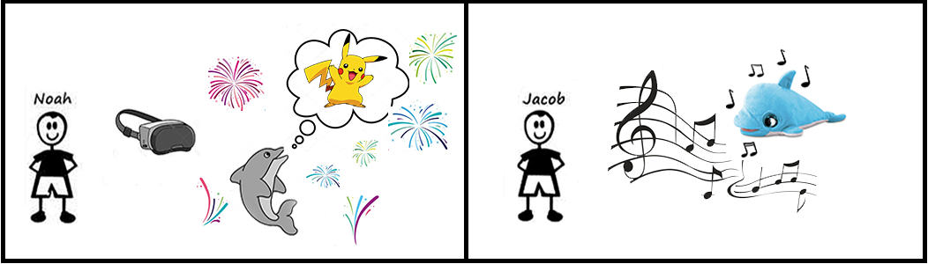
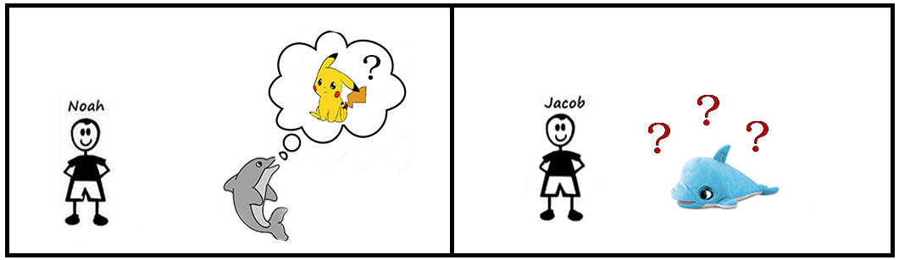
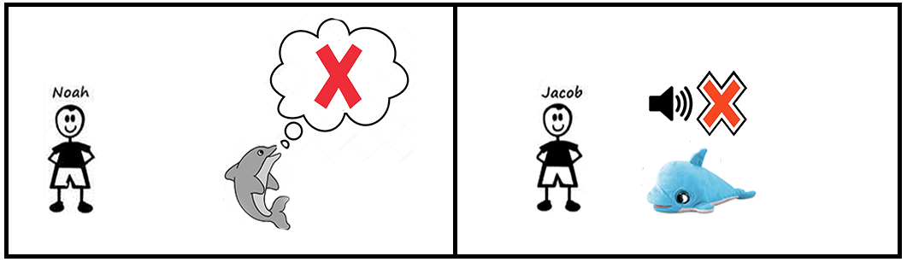
WE MANAGE DIFFERENT OUTCOME
VR communication | Card Used | Feedback
Correct | Correct | Positive
Correct | Wrong | Question Mark
Wrong | Correct | Question Mark
Wrong | Wrong | Negative

Slide 9
SCENARIO PHASE 2
The child in the VR world will have to look for the right food.
After he finds what he thinks is right, he communicates it.
After the therapist confirms the choice, the food flies in front of the dolphin.
The other child chooses which food he thinks the dolphin can eat.

Slide 10
OUTCOME PHASE 2
VR communication | Card Used | Same Choice | Feedback
Correct | Correct | Yes | Positive
Correct | Wrong | No | Question Mark
Wrong | Correct | No | Question Mark
Wrong | Wrong | No | Question Mark
Wrong | Wrong | Yes | Negative

Slide 11
CONCLUSION
Excellent solution to the problem of verbal communication.
Interactive and fun game.
Great potential.
Infinite possibilities with the communication phases.
FUTURE IMPROVEMENT
Introduction of new round.
Rounds also starts with the need on the physical dolphin.
New game typology (Labyrinth).

