Slide 1
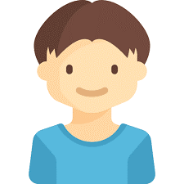
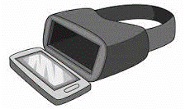


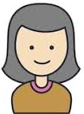
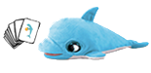
Vr user
Vr Device
Router
Web page
Therapist
Sam user
Smart Object Sam

Slide 2
VR communication | Card Used | Same Choice | Feedback
Correct | Correct | Yes | Positive
Correct | Wrong | No | Question Mark
Wrong | Correct | No | Question Mark
Wrong | Wrong | No | Question Mark
Wrong | Wrong | Yes | Negative
VR communication | Card Used | Feedback
Correct | Correct | Positive
Correct | Wrong | Question Mark
Wrong | Correct | Question Mark
Wrong | Wrong | Negative

Slide 3
Feedback | Phase | VR | Smart Object
Positive | Find Need | Appear Fork, Knife, Bib and the Table moves in front of the dolphin | Led: All Green. Sound: Happy Dolphin
 | Find Food | Eat the fish | Led: All Green. Sound: Happy Dolphin
Question Mark | Find Need | Appear Question Mark | Led: All Grey. Sound: Disappointment
 | Find Food | Appear Question Mark | Led: All Grey. Sound: Disappointment
Wrong | Find Need | Appear Wrong Mark | Led: All Red. Sound: Sad Dolphin
 | Find Food | Appear Wrong Mark | Led: All Red. Sound: Sad Dolphin
Feedback | Phase | VR | Smart Object
Representation of need | Find Need | The dolphin moves the mouth, a cloud suggests its need | Led: Belly Red. Sound: Hungry Dolphin
 | Find Food | The dolphin wears a bib and has a knife and a fork in his hand. A table with a dish on and, 4 food buckets will appears | Led: Belly Grey. Sound: Hungry Dolphin

