Slide 1
Doing Data Science
Case Study 1
EDA on Beers and Breweries in the USA
By Jeff Johnson, Alonso Salcido, Lihao Wang

Slide 2
Resource
Over 500 breweries across the US
Breweries in 50 States and DC
Over 2,400 different beers
100 styles of beers
Ale
IPA
Other
Null Values
ABV: 62
IBU: 1005
Style: 5

Slide 3
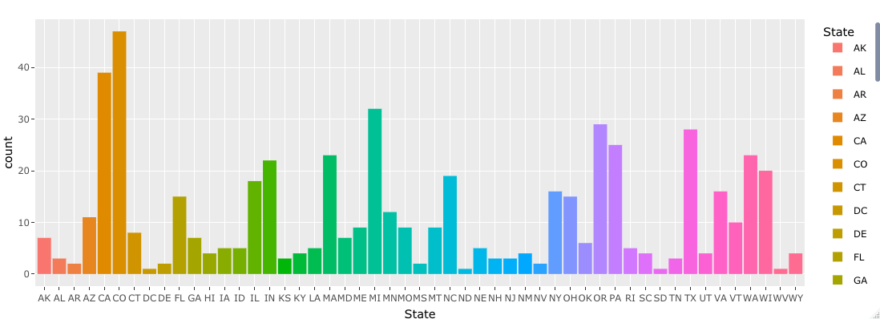
Breweries Present in Each State
States with most Breweries:
CO 47
CA 39
MI 32
Notes:
Industry are solid in… state
Effects of breweries # in states

Slide 4
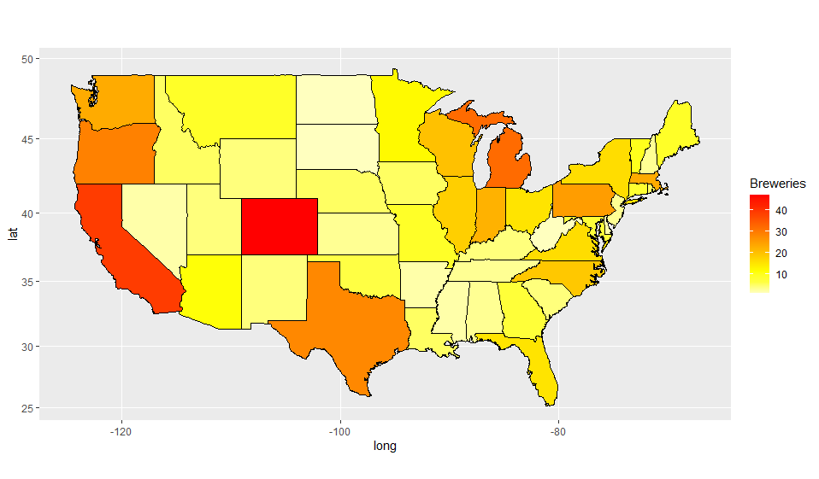
Distribution of Breweries by State
Notes:
Address the red states:
-Colorado and California have the most breweries
-16% of the total number of Breweries are on the west coast

Slide 5
Address Missing Values
Missing values were omitted from the dataset
Other options
Replacing with mean/median
Pros：Keep more potential data point without dramatic effect
Cons: Unrealistic data makeup, potential ethical problem
Replacing with zeros
Pros：Keep more potential data point
Cons： Pull down the distribution to more skewed

Slide 6
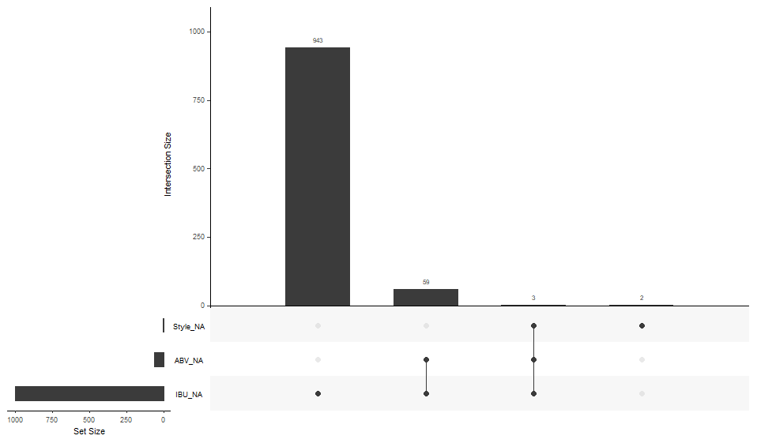
Address Missing Values(con’t)

Slide 7
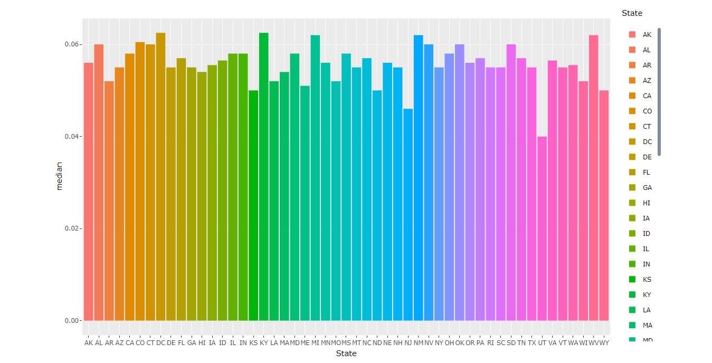
Median comparison(ABV)
Highest ABV
Lee Hills Series Vol 5 by Upslope Brewing Co.(0.128) .
Boulder, Colorado
Notes:
balanced median with abv due to tatste
The market perference and most common beer as common sense

Slide 8
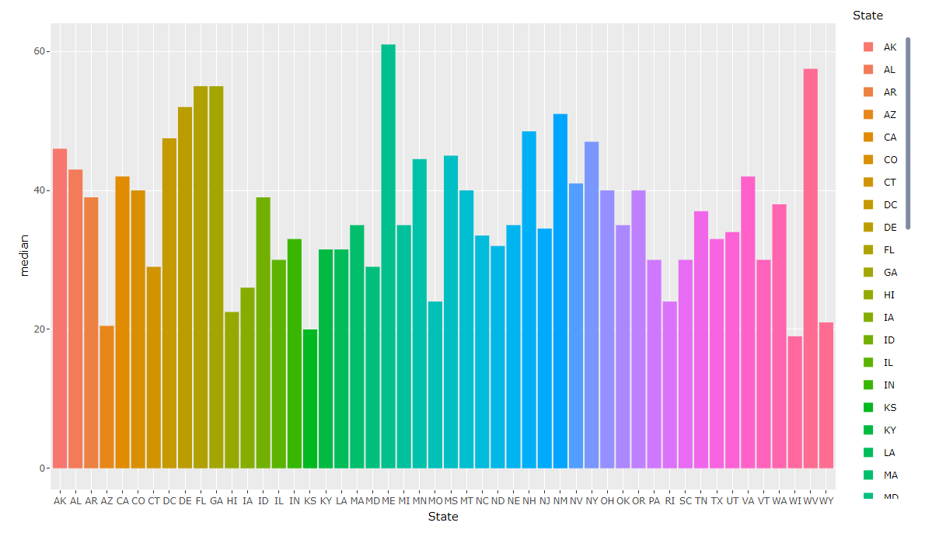
Median comparison (IBU)
Highest IBU
Bitter Bitch Imperial IPA (138 IBU) by Astoria Brewing Co.
Astoria, Oregon
Notes:
Oregon has the most bitter beer. Bitter Bitch Imperial IPA (138 IBU) by Astoria Brewing Company in Astoria, OR.
The varing median if bitterness are due to personal taste and each product has own target customer
this is effected by local material

Slide 9
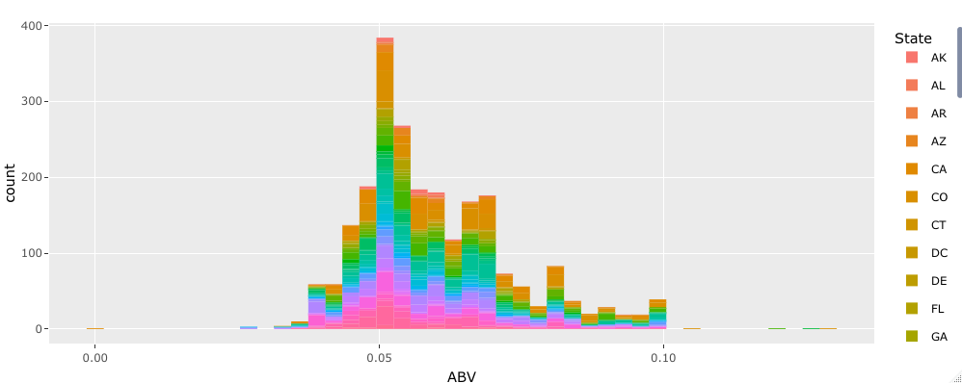
ABV Distribution
ABV
Min: 0.001
1st Quartile: 0.05
Median: 0.056
Mean: 0.06
3rd Quartile: 0.067
Max: 0.128
Notes:
Condensed on the region above 5% of content percentage
agree with common knowledge of % of most beers.
Right skewed as the statring point around 3% and spread up to 12%
potential outliar of 0.01 and 0.128

Slide 10
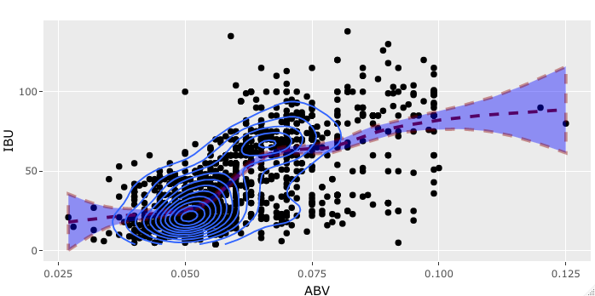
Bitterness and Alcohol Content Relationship
Bitterness and Alcohol
Positve Relationship
Correlation Coefficient= +0.67.
Notes:
Proceed with auto fitting with glm
get twisted
find data centers of two density and this cause the curvature
Bitterness and alcohol content have a positve relationship with a correlation coefficient of +0.67.

Slide 11
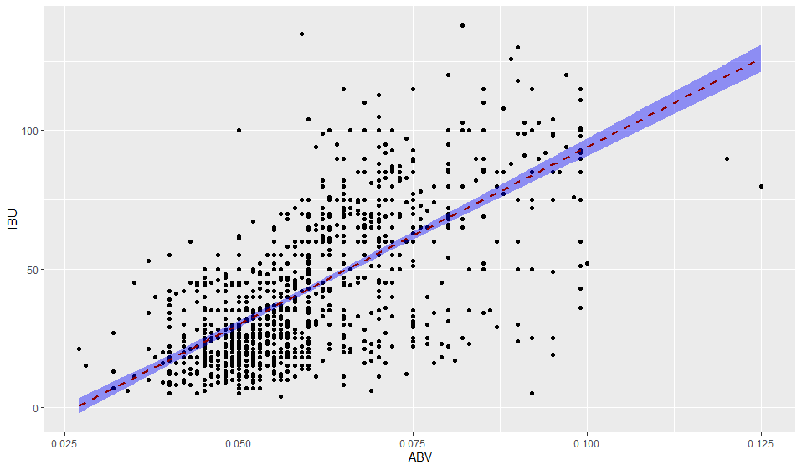
Bitterness and Alcohol Content Relationship(con’t)
Linear model fit：
IBU=1282*ABV-34.1
Notes:
after glm proceed with a lm
find the linear correlation function
less effected by auto regression
residual 19.26 and r^2 0.4497

Slide 12
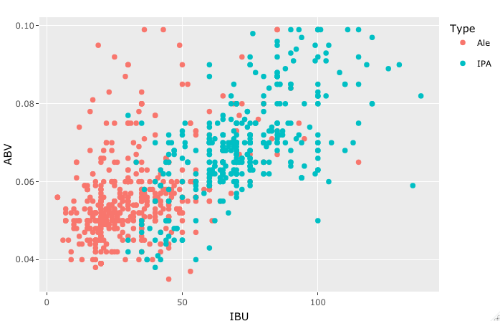
IPA’s vs Ales- Bitterness and Alcohol Content
Notes:
With the exceptions of Outliers Ale beers are clustered on the lowered ranks of the ABV and IBU contents while IPA’s tend to have a higher alcohol volume and bitterness.

Slide 13
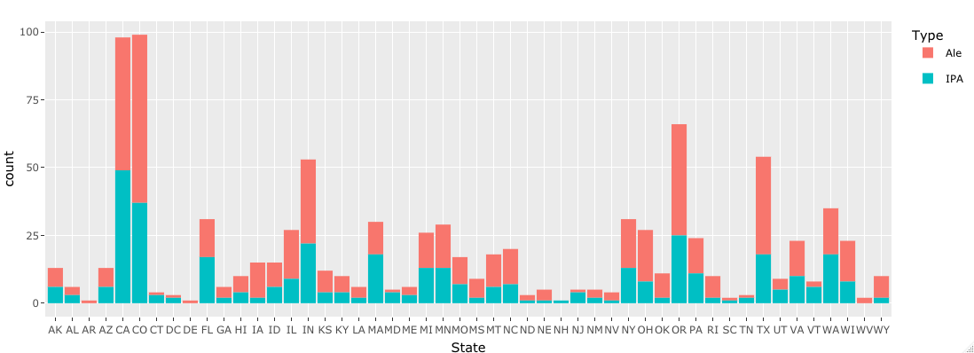
Beer Distribution by State
Ale and IPA Distribution
CO: 99
CA: 98
MI: 26

Slide 14
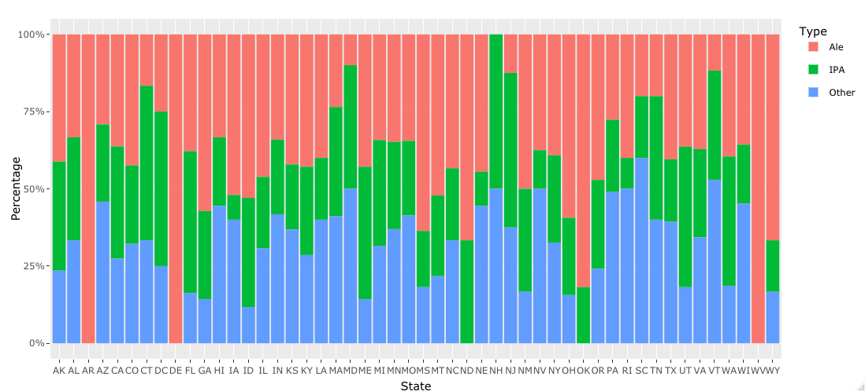
Beer Preference by State
Notes:
Except certain 5 states ,the rest are majorly balanced of producing beer.
valuable for further investigation

