Slide 1
Digital Services Overview Orientation Day 2
August 2016

Slide 2
Day 2 Agenda
Day 2 – Digital Services and Agile Introduction
Morning | Digital Services Playbook Digital Services Overview Agile Overview
Lunch w/Live Digital Assignment Teams (12:30-1:30 pm)
Afternoon | Special Guest Agile Overview – Continued!

Slide 3
Digital Services Playbook
Charles Worthington, USDS (or other Digital Service Expert)

Slide 4
Digital Services Overview
Name Here, Facilitator

Slide 5
Digital Services Overview: A Drink from a Firehose
Agenda:
Digital Services Playbook: Best Practices for Digital Services
The Digital Services Marketplace
Software Development (“Agile” vs “Waterfall”)
Open Source Software
Cloud Services (“X” as a Service/ Xaas)
Warning: This is going to be “highly technical;” get ready to shift your paradigms!

Slide 6
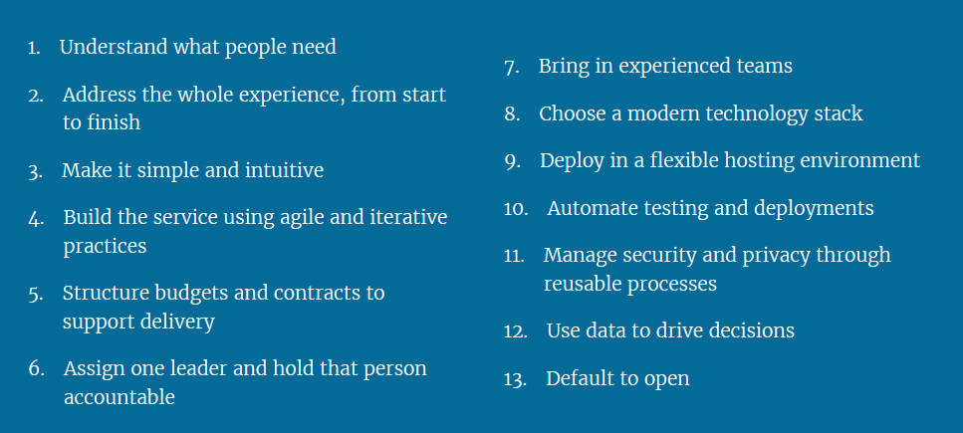
The Digital Services Playbook (https://playbook.cio.gov/)
A playbook of 13 key “plays” drawn from successful practices from the private sector and government that, if followed together, will help government build effective digital services.

Slide 7
Software Development: Agile vs Waterfall
Waterfall | Agile
Traditional government software development process | Best practice software development process for both private sector and government
Gather every requirement and functionality you can afford or think of, stick it in a Statement of Work (SOW) | Product Vision based on User Stories (functionality) provides sufficient performance-based info to describe the agency’s need (FAR Part 11)
Inherent Problems: Agency has no interim product between contract award and final delivery Requirements and priorities change between award and final delivery, impacting scope, time, and budget Vendor lock-in risk Inability to jettison contractor Performance/cost/schedule risks compound over life of project | Inherent Benefits: Develop applications and systems in frequent incremental releases Agency is delivered increasing functionality and value with each release Embraces requirements and priorities changes between award and final delivery Allow flexibility to support detailed changes as needed

Slide 8
Agile Practices: Defining the Need
The “Need” (Product Vision) is:
High level summary of desired functionality (User Stories) with mission context
A brief statement of the desired future state that would be achieved through the project initiative
A User Story can be:
Very detailed or describe needed functionality more broadly and be further composed of more detailed User Stories (called “Epics”)
Format: “As a (type of user), I need to be able to (perform ‘X’ function) so that (description of benefit gained)”
Product Backlog:
Backlog is simply a list of User Stories (functionality) that is required for the project, but has not yet been developed and released/deployed.
The Backlog provides performance-based flexibility and responsiveness to the customers’ needs

Slide 9
Example of Defining the Need in an Agile Environment
Requirement: An agency needs a customer support system that allows its users (citizens or government employees) to submit questions and receive help from a specific part of the agency organization.
Functionality?
A web-based user interface
Form design and management
Database management
Audit functionality
Metrics/ reporting capability
Need to combine into User Stories in order to:
Provide context and more complete understanding of the need for both the government and the contractor(s).
Establish a Product Vision that adequately encompasses the Agency’s need.

Slide 10
Step 1: Create User Stories
Work with requirement owner to create User Stories/Epics that will drive the Product Vision. The examples below are not all-inclusive:
Need: A web-based user interface
User Stories:
As an agency customer, I need secure, user-friendly, intuitive internet access to the agency’s services and customer support operations so that I can get status of my case and rapid resolution in accordance with the agency’s mission.
As an agency customer service representative, I need the to be able to interact and follow up electronically with my customers to provide excellent customer service and resolve their issues rapidly and effectively.
Need: Form design and management
User Story: As an agency customer service representative, I need editable, interactive, and internet accessible forms for my customers that allow them to securely provide complete information that facilitates rapid resolution of their issues and help prevent additional requests to the customer for additional information.

Slide 11
Step 1: Create User Stories, Cont.
Need: Database management
User Story: As an agency, we need database management capability to record and archive all aspects of the work accomplished on customer cases by the agency to support audits, compliance with the Records Act, and resource management.
Need: Audit functionality
User Story: As agency supervisors, we need to track all statuses of active cases and their eventual resolution to ensure that proper and timely service is being provided in accordance with agency procedures and policy
Need: Metrics/ reporting capability
User Story: As agency leadership, we need to regularly see metrics and reports on customer service case activity to support audits and resource management

Slide 12
Step 2: Develop the Product Vision
Product Vision:
“This federal agency requires a software application system that allows it to effectively and rapidly receive, manage, and process support requests and other input from its customers consistent with the agency’s mission. The system must provide easy customer access to agency services and facilitate rapid provision of those services through an intuitive and friendly user interface, workload management functionality, audit, archive, and metrics capability. The delivered system will be flexible and responsive to the needs of the customer and agency, and provide the ability to handle large amounts of customer traffic and data. “
Product Vision
Epic
Epic
User Story
User Story
User Story
User Story
User Story

Slide 13
Step 3: Backlog , Sprints, and Releases
Once the Backlog (list of User Stories) is established, a series of development cycles called “Sprints” are started
Sprints are a fixed time period; i.e. two weeks in duration, but remain two weeks in duration throughout the entire development
Software Releases (deployment) are scheduled based on what is built in a series of Sprints
The development (Sprint) team, including the client (government) and developer (contractor) personnel, decide:
What backlog items (User Stories) are priority for building in a Sprint
How many of those priority User Stories can be built during a fixed Sprint cycle
Defines the “size” of User Stories in units of “Story Points”
Determines the number of Story Points possible for each sprint; know as “velocity”

Slide 14
Agile Practices: Sprints and Releases Illustration
Backlog:
User Story/ Story Points
Sprints
Size to Velocity, Build and Test
Releases
Deployed software
Story 1/15 pts
Backlog:
User Story/Story Points
Story 2/5 pts
Story 3/25 pts
Sprint 1
Velocity=50
Sprint 2
Velocity=50
Release 1
Deployed software
Story 4/35 pts
Story 5/20 pts
Story 6/20 pts
Story 7/25 pts
Note: The first Release is typically the Minimum Viable Product (MVP).
Story 8/30 pts
Story 9/40 pts
The Minimum Viable Product is the smallest piece of software that can be built and deployed that provides value to the customer.
Story 10/25 pts
Story 11/30 pts

Slide 15
Agile Practices: Summary
Based on what we have learned so far, let’s look again at the hypothetical case of the generic agency customer support system:
Release 1: The web-based user interface because even without the rest of the items in the backlog, there is value in providing this interface with the agency’s customers. This is the Minimum Viable Product (MVP).
Release 2: Database management to support metrics and workload assignment when customers need assistance.
Release 3: Add metrics and reporting functionality to the system to help the agency analyze customer needs and demographics.
Release 4: Form management functionality to rapidly generate or adjust the forms customers use in the web-based interface based on what the agency is learning about its customer needs from the metrics and reporting functionality.
Key Takeaways:
Value for stakeholders is provided with each release over the life of the project
Improved project management and performance is facilitated through the use of incremental development. Problems are not allowed to snowball

Slide 16
Open Source Software
Open Source Software (OSS) is typically described as free software as opposed to software requiring paid licenses
Use of OSS still requires licensing and carries terms and conditions with it regarding use and distribution:
Attribution may be required when used by other firms to develop software applications for sale to their customers
Developers using OSS may be required to submit their projects or OSS modifications to the copyright
Modification submission usually accomplished by use of on-line/web-based repositories such as Github, Docker, or BitBucket; they provide source code, version control, and means to share suggested enhancements, awareness of discovered vulnerabilities, and projects using the OSS with the copyright holder and the open source developer community

Slide 17
Open Source Software
The Government is increasingly procuring software applications and systems based on OSS for a number of reasons:
Top federal guidance (OMB, OFPP, GSA, DoD) is to use OSS where possible
OSS that is well supported and popular with developers in the user community can be very capable, reliable, secure, and less prone to obsolescence
OSS is available with the source code, giving unlimited government rights to use, modify, reproduce, and distribute all the computer software technical data- including the source code
Unlimited Government Rights in the software means that:
The government can use the developed software/application in perpetuity without royalty ($$)
The government can use the computer software technical data to enable competition for further development, enhancements, technical support, upgrades, and training at lower cost and risk

Slide 18
Open Source vs. Proprietary Comparison
 | Open Source Software | Proprietary Software
Examples | Linux, FireFox, MySQL | Microsoft Office, Oracle, most government contract writing systems
License for use | Required, but no cost | Required, $$$ (typically)
Intellectual Property/ Copyrights | Copyrighted | Copyrighted
Maintenance, upgrades | Open Source Community of developers facilitated by free access to Source Code | “In-house” by copyright owner employees. Source Code tightly controlled
Revenue models for developers. | Paid for development, maintenance, upgrades, training | Same as OSS developers, but add royalties from licenses

Slide 19
Cloud Services (“X as a Service”)
Cloud Services/”X as a Service” (XaaS) is defined as:
A model for enabling ubiquitous, convenient, on-demand network access to a shared pool of configurable computing resources (e.g., networks, servers, storage, applications and services) that can be rapidly provisioned and released with minimal management effort or service provider interaction. (National Institute of Technology (NIST))
Translation: An organization (government entity, private sector firm, or combination) provides Internet-based computing with shared processing resources to computers and other devices on demand.

Slide 20
Cloud Services (“X as a Service”)
What are the different types of Cloud computing environments and services?
There are two distinct models for Cloud services that must be understood by both technical and acquisition professionals:
The Cloud Deployment model
the Cloud Service model.
Each type of Cloud model
Has an impact on multiple areas in the acquisition of Cloud services.
Encompasses a wide spectrum of possible services and configurations that need to be tailored in the acquisition to the specific needs of your agency.
Cloud services allow government agencies to flexibly and rapidly provision their IT/Digital Services needs through cloud providers instead of making huge investments in time and resources provisioning their own resources that will likely not be fully utilized.

Slide 21
Cloud Services Deployment Models
It is the cloud provider’s client population arrangement
For example, a private cloud services only one client organization on a particular infrastructure, where a public cloud provides services to multiple client organizations across its infrastructure, also known as a “multitenant” environment. There are four basic deployment models:
Private
Community
Public
Hybrid

Slide 22
Cloud Deployment Models
Private cloud:
Infrastructure is provisioned for exclusive use by a single organization comprising multiple consumers (e.g., business units)
May be owned, managed, and operated by the organization, a third party, or some combination of them, and it may exist on or off premises
Community cloud:
Infrastructure is provisioned for exclusive use by a specific community of consumers from organizations that have shared concerns (e.g., mission, security requirements, policy, and compliance considerations)
May be owned, managed, and operated by one or more of the organizations in the community, a third party, or some combination of them, and it may exist on or off premises

Slide 23
Cloud Deployment Models (Cont)
Public cloud:
Infrastructure is provisioned for open use by the general public. It may be owned, managed, and operated by a business, academic, or government organization, or some combination of them
Exists on the premises of the cloud provider
Hybrid cloud:
Infrastructure is a composition of two or more distinct cloud infrastructures (private, community, or public) that remain unique entities but are bound together by standardized or proprietary technology that enables data and application portability (e.g., cloud bursting for load balancing between clouds).

Slide 24
Cloud Service Models (“X as a Service”)
Software as a Service (SaaS) – licensing model where you pay a company to develop and provide a software solution. The provider is responsible for maintaining, updating, and operating the software (e.g., Microsoft 360, Mac OS). Nearly all organizations use SaaS for basic operating and administrative services where a standard service will address all of the most important user stories.
Examples: Gmail (Google email application), Facebook
Platform as a Service (PaaS) – an organization’s web applications are hosted in a cloud computing provider’s infrastructure. The cloud provider offers their platform, which powers the website, email, communications, etc. (e.g., website design services like SquareSpace or WordPress). This is good for organizations that don’t have complex and unique needs for servicing user needs.
Examples: Amazon Web Services, SalesForce.com
Infrastructure as a Service (IaaS) – an organization gets its computing resources over the internet from a cloud computing provider (e.g., DropBox, Google Docs, Apple Cloud). This is good for organizations where computing is not a core capability or need of the business.
Examples: Amazon Cloud Services, Verizon, AT&T

Slide 25
Break – 10 minutes
Guess the source of this statement! We’ll reveal the answer when you return from lunch.
“No problem of human destiny is beyond human beings.”

Slide 26
Digital Acquisition Pilot Agile Basics
August 2016

Slide 27
Agenda
Agile Overview
Scrum Framework
Product Backlog
Release Planning
Sprint Planning
Sprint Implementation
Sprint Review
Sprint Retrospective

Slide 28

Learning Objectives
By the end of this course, you will:
Have a high-level understanding of the Agile Principles
Be able to implement Scrum on your project(s)
Have an understanding of Scrum in the context of “how private sector does it”
Benefits to you:
Gain knowledge on Agile approach
Promote better digital services outcomes

Slide 29








Agile Manifesto
“We are uncovering better ways of developing software by doing it and helping others do it. Through this work we have come to value……
 | Individuals and interactions | over | processes and tools
 | Working software | over | comprehensive documentation
 | Customer collaboration | over | contract negotiation
 | Responding to change | over | following a plan
….that is, while there is value in the items on the right, we value the items on the left more.” http://agilemanifesto.org

Slide 30
12 Agile Principles
Our highest priority is to satisfy the customer through early and continuous delivery of valuable software.
Welcome changing requirements, even late in development. Agile processes harness change for the customer’s competitive advantage.
Deliver working software frequently, from a couple of weeks to a couple of months, with a preference to the shorter timescale.
Business people and developers must work together daily throughout the project.
Note: There are also plenty of successful matrixed teams.

Slide 31
12 Agile Principles (continued)
Build projects around motivated individuals. Give them the environment and support they need, and trust them to get the job done.
The most efficient and effective method of conveying information to and within a development team is face-to-face conversation.
Note: Teams aren’t always co-located.
Working software is the primary measure of progress.
Agile processes promote sustainable development. The sponsors, developers, and users should be able to maintain a constant pace indefinitely.

Slide 32
12 Agile Principles (continued)
Continuous attention to technical excellence and good design enhances agility.
Simplicity – the art of maximizing the amount of work not done – is essential.
The best architectures, requirements, and designs emerge from self-organizing teams.
At regular intervals, the team reflects on how to become more effective, then tunes and adjusts its behavior accordingly.

Slide 33
What Problem Are We Trying to Solve Using Agile?
Waterfall development involves sequential phases and a “throw it over the wall at completion” approach.
1 . Requirements Analysis
2. Architecture and Design
3. Code
4. Test
5. Deploy
At this point, we find out if the product developed will meet the customers’ needs.
Documentation becomes a proxy for the users’ needs
Cost of change increases as project progresses

Slide 34
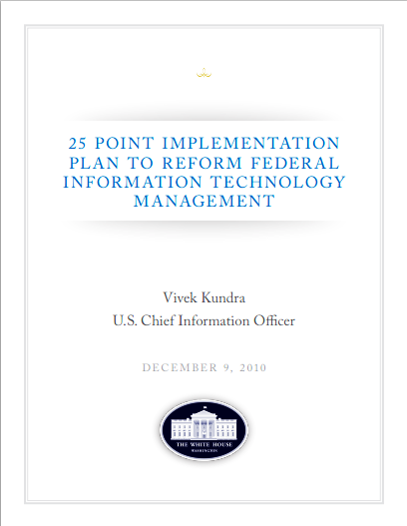
Expected/Realized Benefits of Applying Agile
Benefits according to the White House and OMB:
By following a modular approach, agencies can recognize the following benefits:
Delivery of usable capabilities that provide value to customers more rapidly as agency missions and priorities mature and evolve
Increased flexibility
Decreased overall investment risk
Creation of new opportunities for small businesses to compete for the work
Greater visibility into contractor performance
More efficient use of funding

Slide 35
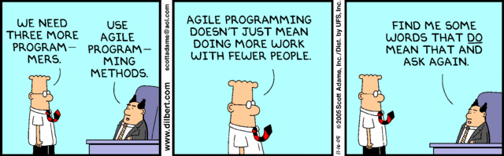
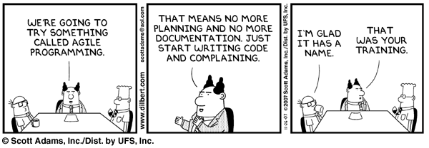
What Agile is NOT
Misconceptions

Slide 36
Why Are There Different Types?
There are many agile methods to choose from. They all agree with the Agile Manifesto, but they differ in the practices that they suggest.

Slide 37

Iterations
Iterations are predefined timeframes, during which a portion of work or a task is done. Iteration is the generic agile term for a single development cycle used in the Iterative and Incremental Development (IID) processes. Sprint is the Scrum terminology for the iterations.
KANBAN
SCRUM
Continuous flow/delivery (no iterations)
Just-in-time backlog
Specialized teams
Focus is on efficiencies & Lean practices
Limit work in process
Measure the lead time
Visualize your workflow
Fixed Sprints (1- 4 weeks)
Time-boxed iterations
Ceremonies
Planning Meetings
Kickoffs
Standups
Work in cross-functional teams
Prescribed roles
Scrum Master
Product Owner
Development Team
Teams will make changes during the next sprint
Source: Stackoverflow.com

Slide 38
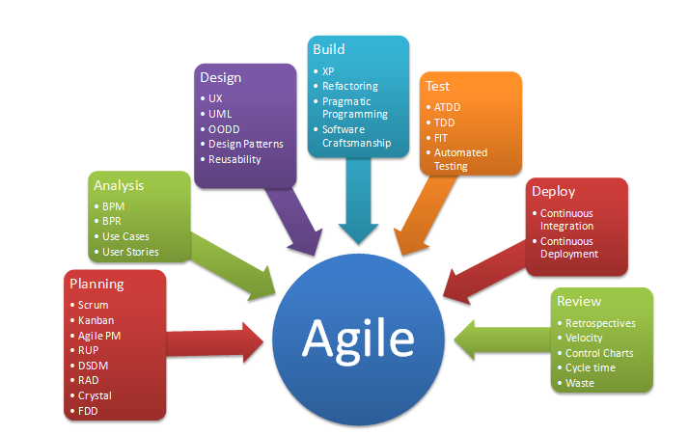
Phases and Methods for Implementing Agile Approach

Slide 39
Working Lunch with Your Teams

Slide 40
Scrum Framework
Setting the Stage

Slide 41
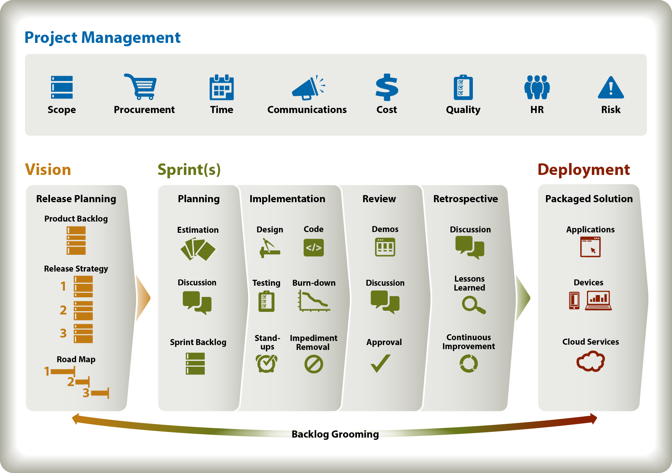
ICF Approach
Scrum Framework

Slide 42
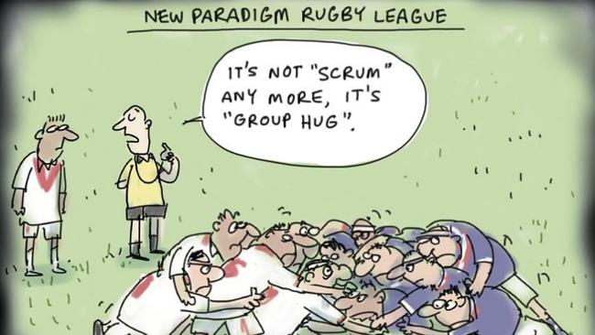
Form Scrum Team

Slide 43




The Scrum Team
Scrum Framework
Product Owner
Scrum Master
Development Team
Additional Stakeholders
SMEs
Users

Slide 44
The Product Owner
Scrum Framework
The best Product Owners are:
Available – provides product features/details, acceptance criteria and prioritization
Knowledgeable – understands end-user wants and needs; responsible to stakeholders and the team
Empowered – understands the business domain; ensures return on investment

Slide 45

Project Manager and Scrum
At companies and agencies, PMs may serve as a:
Product Owner
Scrum Master
Neither combination is optimal
Why?
Too many stakeholders to please (Senior Mgt, Scrum Team, Customer…)
Scrum Masters are servant leaders; PMs are directors
Conflicting priorities by role

Slide 46
Product Backlog
Master Wish List

Slide 47
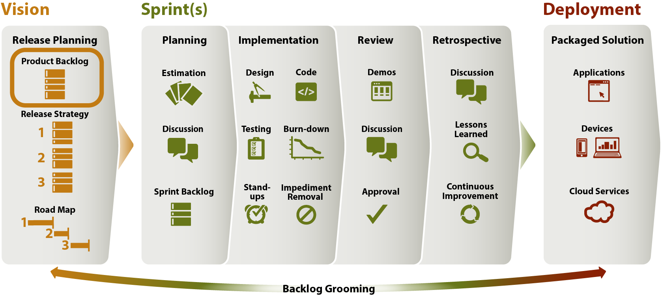
Purpose
Product Backlog
To create a list of stories that represents the Customer’s Vision for the product

Slide 48


Roles and Responsibilities
Product Backlog
Product Owner
Creates initial user stories
Prioritizes user stories based on highest business value
Ultimately responsible for Product Backlog
Scrum Master
Works with Product Owner to create user stories
Assists in Product Backlog grooming
Facilitates user story estimation
Scrum Team
Adds user stories to Product Backlog
Assists in Product Backlog grooming
Estimates user stories
Additional Stakeholders
May inform the Product Backlog through the Product Owner
Project Manager:
Communicates contract scope constraints

Slide 49

Create Product Backlog
PRODUT BACKLOG
The Product Owner creates the initial Product Backlog
Product Backlog = Prioritized list of desired features
User Stories expressed clearly
Ordered from highest to lowest priority
Includes acceptance criteria for each story
Tips:
Ensures it is visible, transparent, and clear to the Scrum Team
It’s a living thing…it is never complete
It should not contain vacations, sick days, meetings
Highest priority
stories on top
Lower priority
stories on bottom
“IF IT’S NOT IN THE PRODUCT BACKLOG, IT DOESN’T EXIST.” - Jeff Sutherland

Slide 50
User Stories
PRODUCT BACKLOG
User story is one or more sentences in the everyday or business language of the end user or user of a system that captures what a user does or needs to do as part of his or her job function
User story format
As the [role], I need to [X], so that I may do [Y].
As a traveler, I need a map of North America so that I can see the location of the Great Lakes.

Slide 51
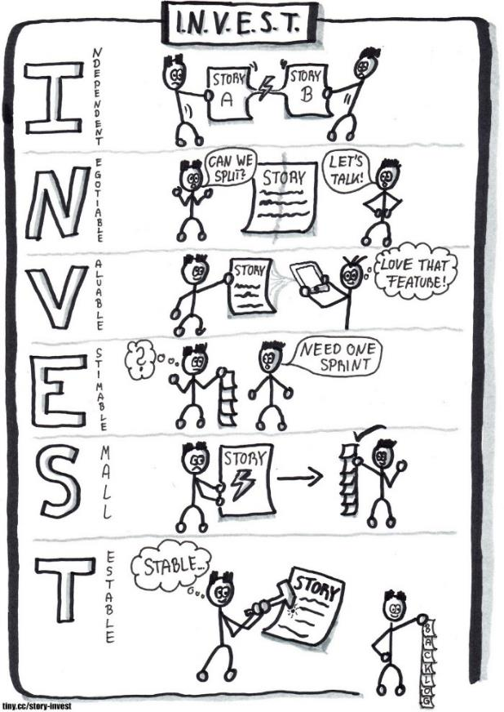
Write Quality User Stories
PRODUCT BACKLOG
INDEPENDENT: Self-contained, in a way that there is no inherent dependency on another user story.
NEGOTIABLE: Up until they are part of an iteration, can always be changed and rewritten.
VALUABLE: Must deliver value to the end user.
ESTIMABLE: Must always be able to estimate the size of a user story.
SMALL: Should not be so big as to become impossible to plan/task/prioritize with certainty.
TESTABLE: User story or its related description must provide the necessary information to make test development possible.

Slide 52
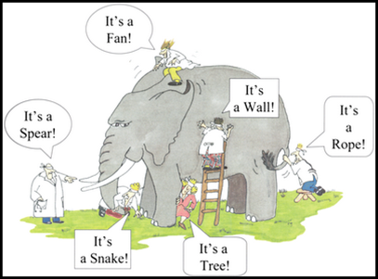
User Story – Acceptance Criteria
PRODUCT BACKLOG
Defines the boundaries of a user story
What’s in scope / what’s out of scope
Used to confirm when a story is completed and working as intended
Comes from dialogue between Scrum Team and Product Owner
Ask questions to gain clarity!
Should not allow for gray areas

Slide 53
User Story – Example Acceptance Criteria
PRODUCT BACKLOG
As a traveler, I need a map of North America so that I can see the location of the Great Lakes.
Acceptance Criteria
See all 3 countries (Canada, US, and Mexico) labeled and divided.
Measure the correct proportion/size of each country when compared to each other and to the overall map.
See the correct placement and labels of the Great Lakes on the map: Lake Erie, Lake Huron, Lake Michigan, Lake Ontario, and Lake Superior
Measure the correct proportion/size from Great Lake to Great Lake and compared to the overall map.

Slide 54
Exercise: Discuss Product Needs with PO
Product BACKLOG
Each team has an assigned Product Owner who will provide the end-product vision
Each team will select their Scrum Master who will be the timekeeper/facilitator for the day
Scrum Master: Use your timer or mobile phone as your stopwatch
Task Details
The Scrum Team and Scrum Master ask the Product Owner questions in order to understand Client needs
Team members capture responses/ideas on index cards
Materials
4x6 index cards, pens
Time Constraints
5 minutes total time

Slide 55
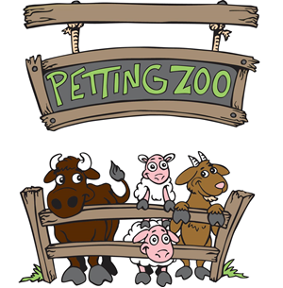
Create a Play-Doh Petting Zoo
Product backlog
You will build a petting zoo which includes animal pens, people and zoo animals…and so much more!
Pre-prepared user stories, acceptance criteria and tasks are posted to your team scrum board.

Slide 56
Prioritize Product Backlog – Business Value
PRODUCT BACKLOG
Product Owner:
Evaluates business value of Product Backlog items
Example value drivers:
Return on Investment (ROI) to the Customer organization
% of users impacted (biggest hit items)
What can be used immediately?
Team evaluates:
Risk
Address high risk stories with high business value early?
Complexity
Implement complex stories with high business value first?
Dependencies
Do stories build upon each other and therefore must follow a certain order of operations?

Slide 57
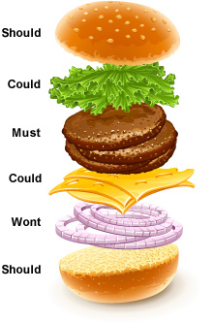
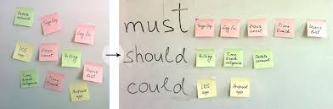
Prioritize Product Backlog – MoSCoW Method
PRODUCT BACKLOG
Must have
Describes a feature that is fundamental to the system
Should have
Features that are important but there is a short-term workaround
Could have
Features that can be left out of the release if time runs out
Won’t have this time

Slide 58
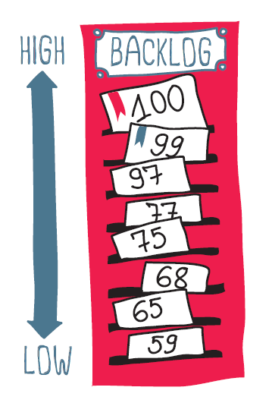
Exercise: Prioritize Product Backlog
Product BACKLOG
Task Details
Scrum Team organizes stories from highest value to lowest value on the white board
Place top to bottom under “Product Backlog”
Remember the Product Owner is ultimately responsible for business value prioritization, and therefore should be actively involved.
Materials
User stories
Scrum board
Time Constraints
3 minutes

Slide 59
Release Planning
Get the Big Picture

Slide 60
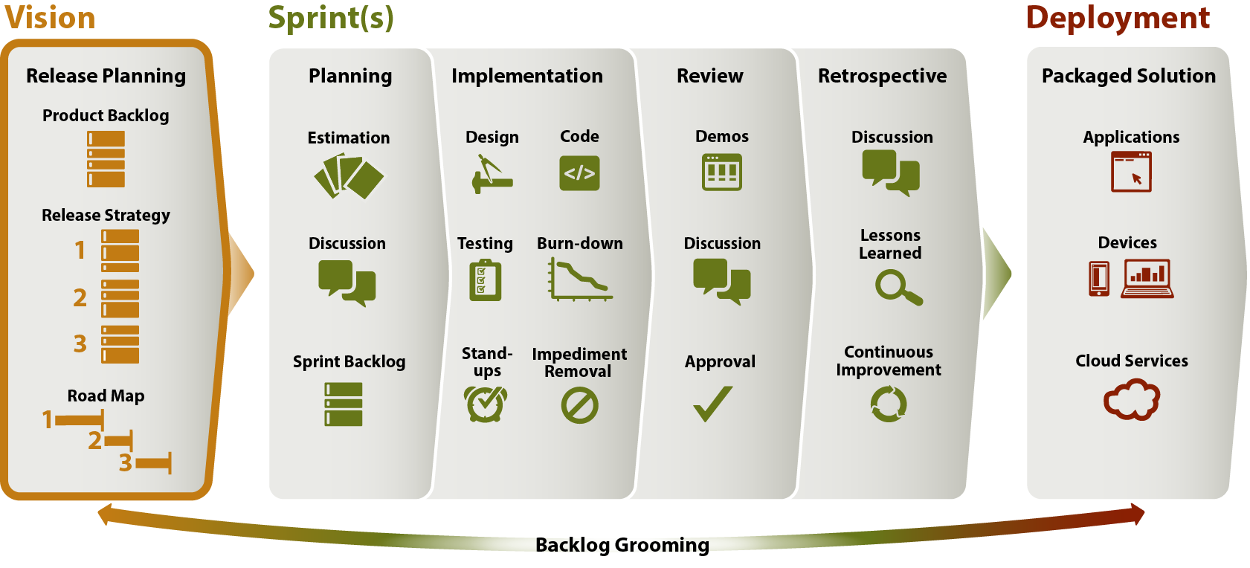
Purpose
Release Planning
To create a high-level plan for the next release by building the Product Backlog, establishing a Release Strategy, and producing a Road Map.

Slide 61
Roles and Responsibilities
Release Planning
Product Owner
Prioritizes the Product Backlog
Reviews and approves the Release Planning outputs
Radiates information to internal stakeholders
Scrum Master
Conducts Release Planning meeting
Completes the Release Road Map
Reviews the Road Map with Product Owner
Radiates information to the organization, as needed
Scrum Team
Identifies and provides feedback for technical priority considerations or impediments
Additional Stakeholders
SME input
User input
Internal Support
HR, CIT, Procurement, etc.
Owning Group input
TRS, BIS, SAS, etc.
Project Manager:
Identifies external impacts to Release Planning
Provides Resources
Reviews and approves plans

Slide 62
Scrum Metrics
Release Planning
Capacity
Velocity
Sprint Hours Capacity
Hours available to work on the project during the sprint
Focus Factor
% of time spent executing user stories
Excludes time spent in meetings, doing admin work, having discussions, etc.
Sprint Points Capacity
Max points available per sprint based on average team capacity, focus factor and velocity
Points per sprint
# of points completed per sprint
Points per hour
# of points completed per hour logged in the agile tool (does not include non-focused time)
How to calculate velocity
Leverage actual velocity if at least one sprint has been executed
Calculate predicted velocity during release planning if no sprints have been executed

Slide 63
Create Road Map
Release Planning
Assign epics/stories to Sprints based on:
Product Backlog prioritization/Release strategy
Sprint Capacity and Sprint Velocity – how many user stories can be accomplished per Sprint with the assigned FTEs?
If you want to save time, you can use the industry average for Focus Factor of 40%-60% instead of calculating it manually.
# of Sprints before the release date
Sprint 1
Sprint 2
Sprint 3
Epic
Epic
Epic
Epic
Story
Story
Story
Story
Story
Story
Story
Story
Story
Story
Story
Story
Story
Story
Epic
Story
Story
Story
Story
Story

Slide 64
Exercise: Create Release Road Map
Release Planning
Task Details
Scrum Master facilitates discussion and performs the following:
Group stories into 3 sprints, draw dividing lines for each sprint, and number each sprint.
Scrum Team actively participates in discussion
Project Constraints
High-level product (“must have” stories) must be completed by the release date
Not all stories have to be assigned to a sprint
(We will perform 2 sprints; each sprint is 15 minutes long)
Remember, only the Scrum Team performs work
Materials
Markers
Scrum board
Prioritized Product Backlog
Sticky notes (for sprint goals)
Time Constraints
5 minutes

Slide 65
Sprint Planning
Defining scope for the sprint

Slide 66
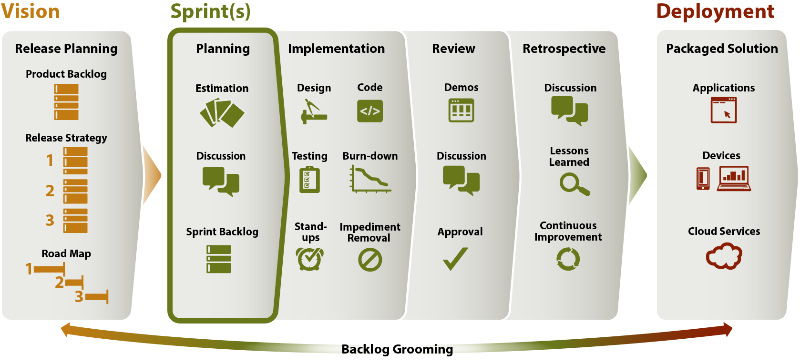
Purpose
Sprint Planning
To prepare for the sprint by reviewing/updating the Sprint Backlog, creating tasks, estimating tasks, and assigning work

Slide 67
Typical Sprint Planning Meeting Activities
Sprint Planning
Scrum Master:
Schedules the meeting (typically the 1st day of the sprint)
Calculates Sprint Hours and Points Capacity
Reviews Sprint Goal and Road Map
Reviews Metrics
Team:
Reviews/Updates Sprint Backlog
Reviews, updates, and estimates stories
Creates and estimates tasks for each story
Development Team members volunteer to complete stories/tasks
Revises Sprint Goal / Sprint scope, if necessary

Slide 68
Estimation
Sprint Planning
ICF common methods
Story points
T-shirt size
What are story points?
Unit-less measures of relative size assigned to user stories
Story points allow the team to focus on the pure size and complexity of delivering a specific piece of functionality rather than trying to perfectly estimate a duration of time required for the completion of the functionality
Consider…
How big or complex is the story?
How much doubt/risk is there related to implementing the story?
How does it compare to other stories (relative sizing)?
Why can’t we estimate using hours?
Since story points have no relevance to actual hours, it makes it easy for Scrum Teams to think abstractly about the effort required to complete a story without feeling confined to hour estimates

Slide 69
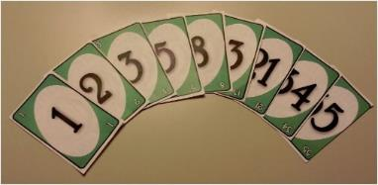


Estimation Techniques
sprint planning
Planning Poker
Scrum Team members are equipped with playing cards
Each team member assigns cards to user stories with his/her estimate
Members with highest and lowest cards present their case
Team reaches consensus
Card options
Fibonacci series: 1, 2, 3, 5, 8, 13, 21, 34, 55, 89…
Some planning poker decks also include 0 and ½
Each new value is the sum of the two previous values
T-shirt sizes: XS, S, M, L, XL, XXL….
Your own sequence – the key is relative sizes!

Slide 70
Create and Estimate Tasks
Sprint Planning
Break user stories down into Tasks
Tasks = Steps/Activities needed to implement a user story and as a result meet all acceptance criteria
Tasks may include the traditional steps in a development lifecycle, such as :
Design
Development
Unit Testing
System Testing
User Acceptance Testing
Documentation
Team members volunteer for each task
The assigned team member estimates his/her tasks in HOURS

Slide 71
Exercise: Estimate User Stories
Sprint planning
Task Details
Scrum Team members estimate the Product Backlog stories using the poker cards provided
Start with the highest priority user story
Highest and lowest estimates are defended by the team members who submitted those estimates
If too big, consider slicing existing stories into 2 or more stories
Scrum Master facilitates the discussions and adds agreed upon estimates to each user story card
Product Owner is available to answer questions
Materials
User stories
Pens
Poker cards (1 set per Scrum Team member):
Some team(s) get Fibonacci cards / Some team(s) get T-shirt sizes cards
Time Constraints
8 minutes

Slide 72
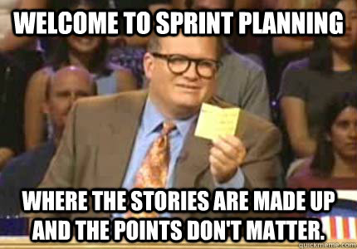
Exercise: Conduct Sprint Planning
Sprint planning
Set up
Pre-prepared user stories and associated tasks are posted on your team’s Scrum Board = Sprint Backlog
Task Details
Scrum Team members determine the Sprint goal; Scrum Master posts the goal
Scrum Team members volunteer for each task and provide their estimate in minutes
Keep capacity in mind – each person has 15 minutes of work
Scrum Master writes the task estimate and team member initials on the task and moves tasks to the Sprint’s “To Do” column
Materials
Scrum Board
User stories and tasks
Pens
Time Constraints
15 minutes

Slide 73
Sprint Implementation
Ready to Rumble?

Slide 74
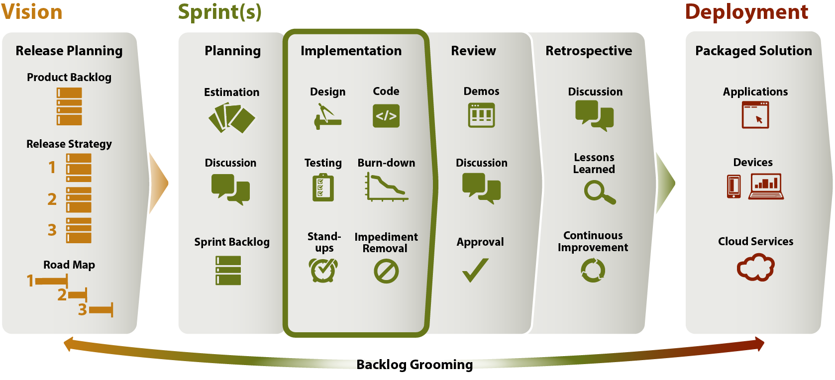
Purpose
Sprint Implementation
Perform and report on stories allocated to the sprint

Slide 75
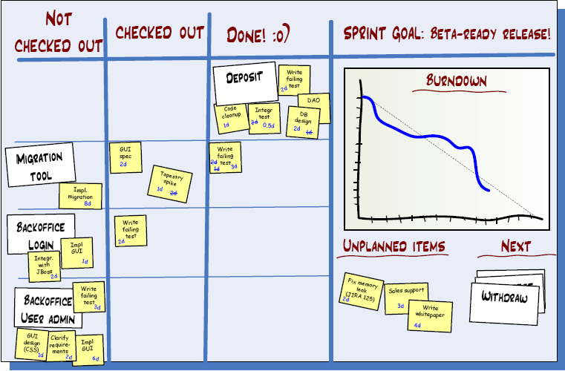
Track Progress
sprint Implementation
Development Team
Moves items across the board to their appropriate column
Tracks time spent on each task
Scrum Master
Reviews progress/makes adjustments, if needed
Evaluate changes in task assignments
Identify/address impediments

Slide 76
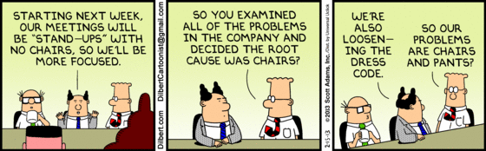
Conduct Stand-ups
sprint Implementation
Daily - same time, same place, same bat channel
15 minutes, time-boxed event
ALL Team members share status and impediments
“What I completed”; “What I plan to work on”; “What is in my way”
Provides transparency
Means to communicate need for help/cross-training
If you cannot attend, provide status to team prior to the stand-up

Slide 77
Scope Management
sprint Implementation
Scrum Team grooms the Product Backlog for the next sprint
Performed as a group in a meeting
OR…
Each team member modifies the Product Backlog individually
What about changes mid-sprint?
Product Owner, Scrum Master and/or Scrum Team may add items to the Product Backlog
Scrum Master protects the team sprint commitment by not allowing significant user story changes/additions mid-sprint
In coordination with the Product Owner
If there are changes mid-sprint, the Scrum Master highlights the changes during the Sprint Review
Product Owner re-prioritizes Product Backlog to incorporate any new changes in a subsequent sprint

Slide 78
Exercise: Conduct Sprint Implementation
Sprint implementation
Task Details
Scrum Team implements the assigned tasks and moves them across the Scrum Board
Conduct a Stand-up: Scrum Team provides status and impediments
What did you do before the Stand-up? What will you do before the end of the Sprint? Do you have any impediments?
If impediments arise, the Scrum Master adds them to the Scrum Board
How/Where impediments are captured is up to the Scrum Master
Have the product ready to demo at the end of the Sprint
Materials
Scrum Board
Foam board, Play-Doh, toothpicks, and anything else from your table
Time Constraints
15 minutes total
Stand-up at 8 minute mark (clock stops for the Stand-up)—keep it brief!

Slide 79
Sprint Review
Show me what you got!

Slide 80
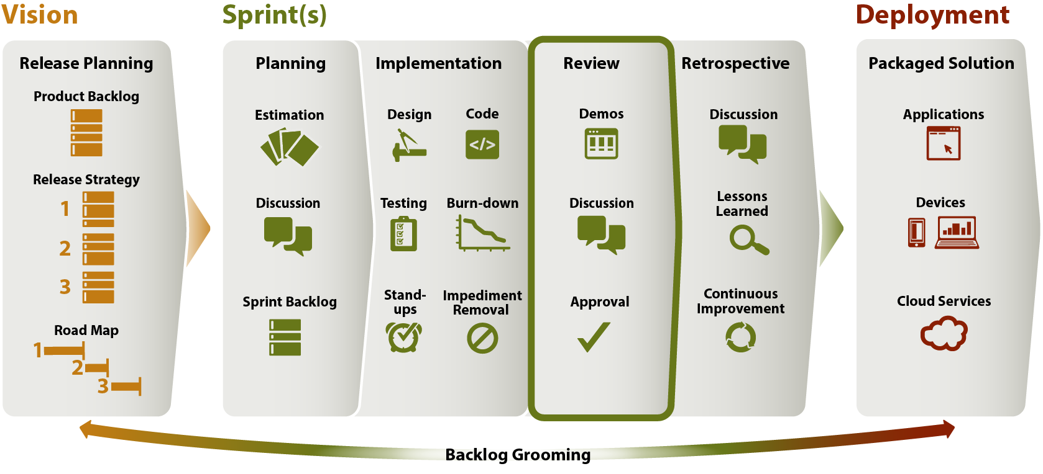
Purpose
sprint review
Development Team reviews and demonstrates the items completed
Show functionality, usefulness and value
Stakeholders see progress and provide feedback

Slide 81
Conduct the Meeting
sprint review
Scrum Master
Development Team
Product Owner
Facilitates session
Introduces Sprint goal and new capabilities
Collects and documents feedback, i.e., meeting notes
Documents decisions made
Introduces goals of next Sprint/Release
Demos items completed during the Sprint
in order of highest business value
Highlights development challenges and breakthroughs
Asks questions
Provides feedback
Additional Stakeholders (optional)
SMEs/Users – provide feedback
PM – observes
Sr. Mgt. - observes

Slide 82

Exercise: Conduct Sprint Review
Sprint review
Task Details
Scrum Teams visit other teams’ tables to view their completed work
Materials
Completed zoo elements
Time Constraints
8 minutes total time

Slide 83

Next Steps
sprint review
Scrum Master updates the Scrum Board
Completed and approved items are removed from board
Incomplete items are moved to Product Backlog
Scrum Master and/or Product Owner add/refine new features, changes, or enhancements as Product Backlog items
Product Owner re-prioritizes Product Backlog
Scrum Master meets with Project Manager (separately) to inform any needed changes to scope, schedule or budget

Slide 84
Sprint Retrospective
What and how can we do better?

Slide 85
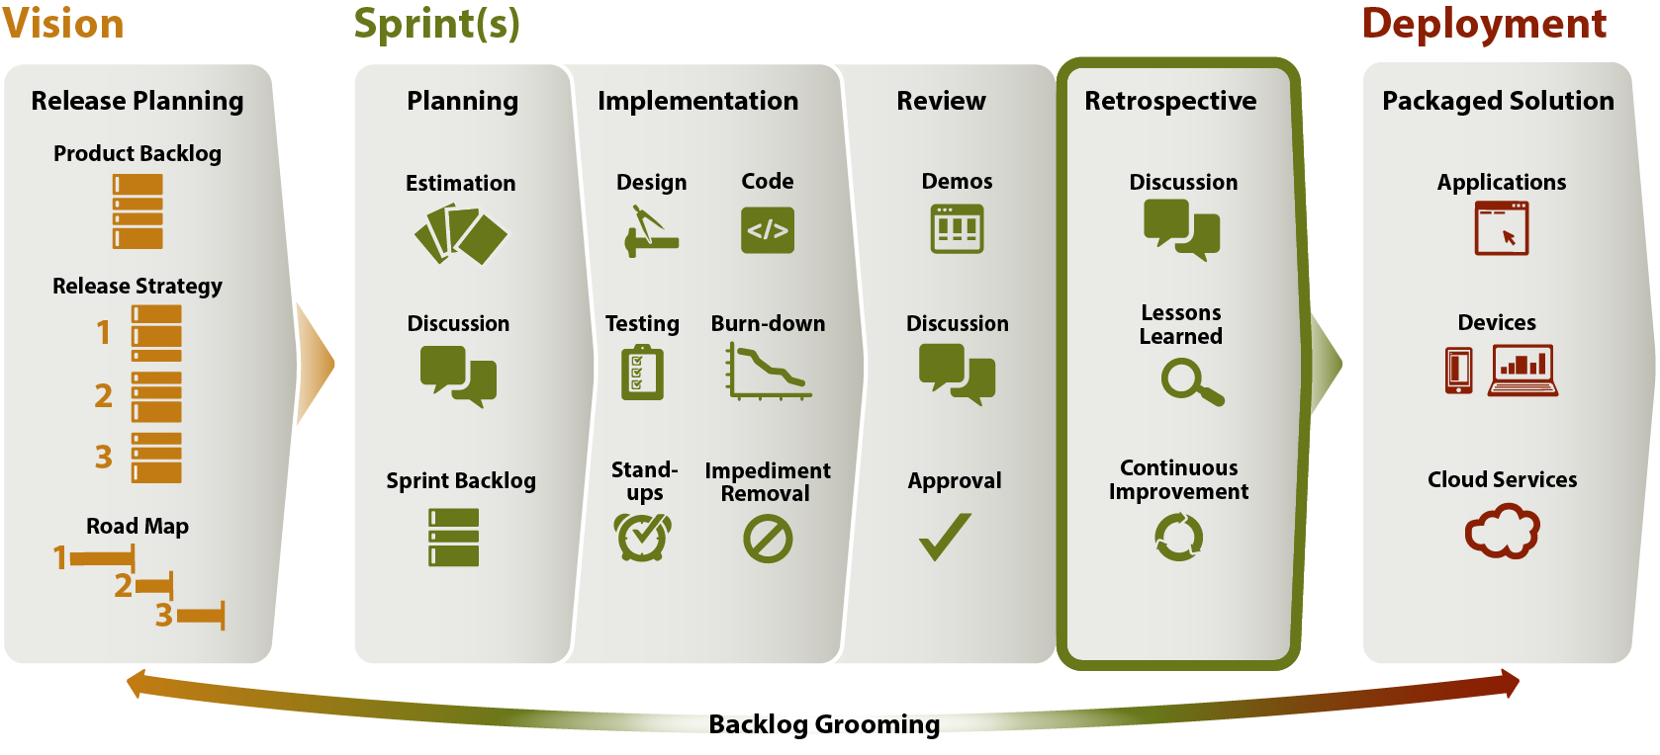
Purpose
Sprint Retrospective
As a Scrum Team, reflect on the past sprint in order to capture lessons learned, decisions and/or action items.

Slide 86

Quantitative vs Qualitative Reflection
Sprint Retrospective
Quantitative: Work analysis
Performed prior to the meeting by the Scrum Master
Committed vs. completed
Hours and story points
Burn-down chart
Actual focus factor
Actual velocity
Unplanned work introduced during sprint
Qualitative: Reflection Analysis
Performed during the meeting by the Scrum Team
Individual interpretations of the Sprint
What worked well
What did not work well
Potential impediments
Improvement suggestions

Slide 87
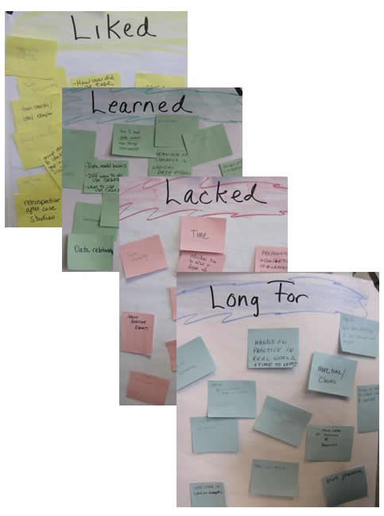
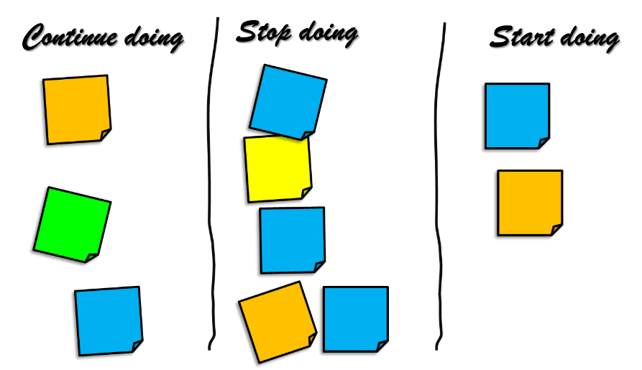
During Meeting: Qualitative Analysis
Sprint Retrospective

Slide 88
After the Meeting: Outcomes
Sprint Retrospective
For all approaches, the Scrum Master captures Lessons Learned and Improvement Opportunities:
Root causes of negative events
Strategies of how to continue positive events
Impediments encountered and potential workarounds
New backlog items
New Risks
The Scrum Master also captures Action Items:
Address root causes of negative events
Remove impediments
Report needed changes to scope, schedule, budget
Update Product Backlog
Capture new risks in Risk Register

Slide 89
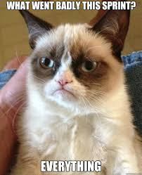
Exercise: Conduct Sprint Retrospective
Sprint retrospective
Task Details
Using the provided materials for the assigned approach, perform a Retrospective with your team (Scrum Master facilitates):
4 L’s (Liked, Learned, Lacked, Longed For)
Continue, Start, Stop
Materials
Sticky notes
Pens
Time Constraints
8 minutes

Slide 90
Wrap-Up & Reminders
Reminder to complete your pre-assessment ASAP (NLT Aug. 8)
Read the Small Business Administration (SBA) ONE Contracting Systems Modernization Procurement documents tonight (if possible)

