Slide 1
Digital Acquisition Pilot Iteration 2.B Planning Meeting
October 11 – October 21, 2016
Notes:
Good morning, and welcome back from your long weekend. We hope that everyone enjoyed their time off.

Slide 2
Agenda
Updates and logistics
Iteration 2.B Welcome and Introduction
Focus of the iteration
Sessions and activities that compose the iteration
Classroom Session information
Notes:
Facilitator Notes:
We’re going to be getting right back into the swing of things, and we have some big deadlines coming up. Today we’ll be going over upcoming deadlines and other updates, some classroom session logistics, and we’ll walk through Iteration 2.B

Slide 3
Notes/Updates
Badging back for Iteration 2.B
Don’t forget to complete the Stakeholder Analysis assignment!
Email the opportunity you identify to our program email address (DigitalAcquisitionMVP@icfi.com)
Initial write-up is due October 14
Shadowing Reminder
By the end of Release 2, you must identify your shadowing opportunity
Additional information available in the Shadowing tab of the Course Introduction
Email opportunity to program email address
Notes:
Facilitator Notes:
Badging will be up and running again for Iteration 2.B. Our team is also working to award badges for the past iterations (1.B and 2.A).
As a reminder, the written assignment for your Stakeholder Analysis is due on Oct. 14. For this assignment, you should be including:
The identified stakeholders you intend to interview
Status of scheduling those interviews
Your list of questions you plan to ask
Shadowing: By the end of release 2 you need to identify the following information:
Name of person/group you will be shadowing and their agency/company:
Description of the project/event you will be shadowing:
How did you identify this opportunity?
When will you complete your shadowing experience?
What is the total duration of your shadowing experience?
For the actual shadowing piece of the assignment, you will have until the end of the course to complete your shadowing.

Slide 4
Iteration 2.B – What It’s All About
Iteration 2.A – Where We’ve Been
Analyze stakeholders in your sphere of influence that impact digital services acquisition.
Assess your agency’s readiness for change and innovation.
Ask effective questions to understand the agency’s need and make recommendations on a course of action for a digital acquisition procurement.
Analyze a digital service need to determine its most appropriate market.
Iteration 2.B – What’s Next
Identify why communicating openly and responsibly with potential vendors is critical to digital services acquisition success and how to do it.
Differentiate between buying compliance and buying outcomes.
Conduct effective market research for digital services.
Notes:
Facilitator Notes:
Congratulations on completing iteration 2.A. To review, you:
Analyzed stakeholders in your sphere of influence that impact digital services acquisition.
Assessed your agency’s readiness for change and innovation.
Asked effective questions to understand the agency’s need and make recommendations on a course of action for a digital acquisition procurement.
Analyzed a digital service need to determine its most appropriate market.
In this next iteration, Iteration 2.B, you will:
Identify why communicating openly and responsibly with potential vendors is critical to digital services acquisition success and how to do it.
Differentiate between buying compliance and buying outcomes.
Conduct effective market research for digital services.

Slide 5
Iteration 2.B Timeline
Iteration 2.B – September/October
Oct. 10 | 11 | 12 | 13 | 14
Iteration Planning Meeting
11:00 – 11:30 am ET
Oct. 17 | 18 | 19 | 20 | 21
Release 2 Classroom Session (Optional Day 1)
8:00 – 4:00 pm ET
Release 2 Classroom Session Day 2
8:00 – 4:00 pm ET
Release 2 Classroom Session Day 3
8:00 – 4:00 pm ET
Release 2 Classroom Session Day 4
8:00 – 4:00 pm ET
Release 2 Classroom Session Day 5
8:00 – 4:00 pm ET
Online Learning: Responsible Pre-Solicitation Communication
30 minutes
Online Learning: Building Your Market Research Toolkit
30 minutes
Readings (S&G)
2 hours
Live Digital Assignment: Product Vision and Demo Day
5 hours
Release 2 Assessment
30 minutes
Release 2 Classroom Session
5 days
Notes:
Facilitator Notes:
We’ve kept this iteration fairly short because of the classroom sessions. You’ll notice that we have two online learnings that we think should take you about 30 minutes each.
Additionally, we have some silver and gold readings and discussions; you’ll be continuing work on your LDA; and the Release 2 Assessment will be coming toward the end of the release.
And, of course, we have the classroom session that you will be attending next week.

Slide 6
Iteration Web Conference
Iteration 2.B – September – October
Oct. 10 | 11 | 12 | 13 | 14
Iteration Planning Meeting
11:00 – 11:30 am ET
Oct. 17 | 18 | 19 | 20 | 21
Release 2 Classroom Session (Optional Day 1)
8:00 – 4:00 pm ET
Release 2 Classroom Session Day 2
8:00 – 4:00 pm ET
Release 2 Classroom Session Day 3
8:00 – 4:00 pm ET
Release 2 Classroom Session Day 4
8:00 – 4:00 pm ET
Release 2 Classroom Session Day 5
8:00 – 4:00 pm ET
FHWA building: 1310 North Courthouse Road, Suite 300, Arlington, VA 22201
8am to 4pm each day.
Day 1: Optional LDA group session
Days 2-5: Classroom training sessions
Notes:
Facilitator Notes:
The Release 2 Classroom session is coming up. Our classroom session will be held at FHWA’s Arlington location: 1310 North Courthouse Road, Suite 300, Arlington, VA 22201 from 8am to 4pm each day.
We’ll be getting into the classroom schedule a little bit more in later slides, but Day 1 is an optional session intended for your groups to continue working on your LDA. Days 2-5 will be instructor led facilitation.

Slide 7
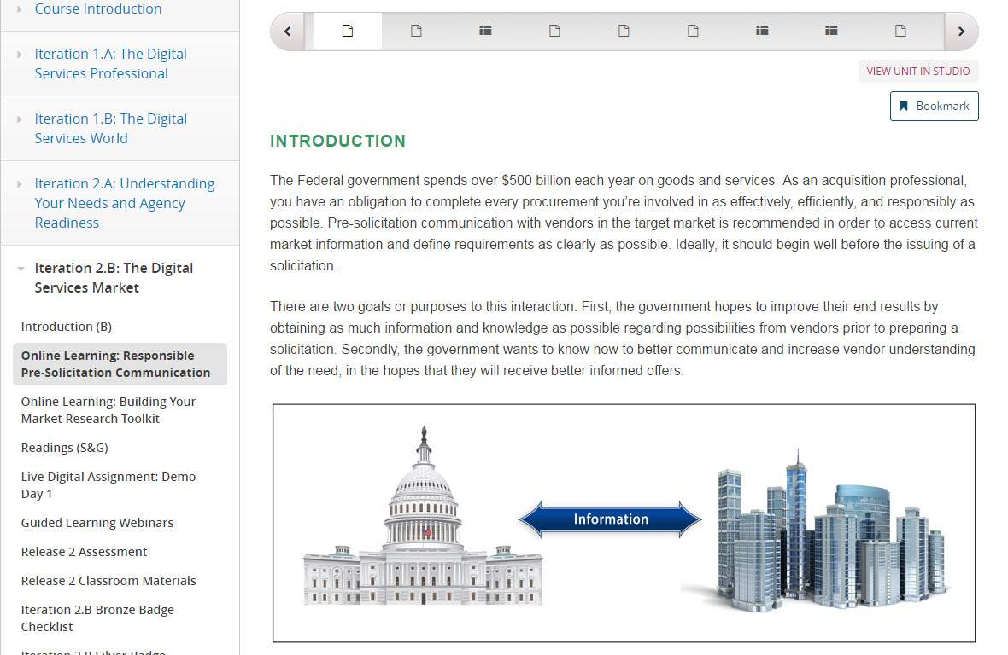
Online Learning: Responsible Pre-Solicitation Communication
Online Learning: Responsible Pre-Solicitation Communication
About 30 minutes
Bronze-level requirement
Discusses why pre-solicitation communication with offerors is an important step in acquisition process
Describes ways you can communicate effectively with potential vendors
Identifies best practices for pre-solicitation communication
Notes:
Facilitator Notes:
This 30-minute bronze activity introduces you to pre-solicitation communication. It covers an array of pre-solicitation communication topics, including:
Why pre-solicitation communication with offerors is important in the acquisition of digital services.
Ways in which you can communicate effectively with potential vendors prior to solicitation of digital services.
Best practices for responsible pre-solicitation communication when procuring digital services.

Slide 8
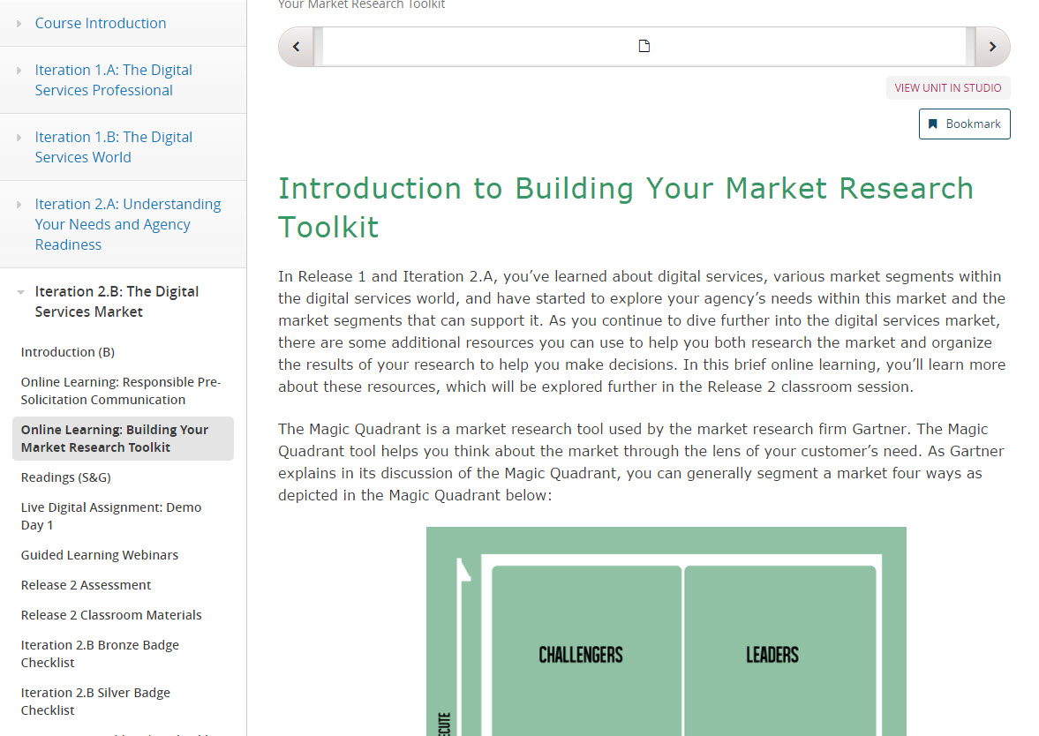
Online Learning: Building Your Market Research Toolkit
Online Learning: Building Your Market Research Toolkit
About 30 minutes
Bronze-level requirement
Introduces resources that can be used to further market research (Gartner Magic Quadrant)
Market Intelligence vs. Market Research
Notes:
Facilitator Notes:
The online learning: Building Your Market Research Toolkit should take you approximately 30 minutes to complete.
This module will introduce resources that you can use to help your market research—including the Gartner Magic Quadrant. There is also a reading that discusses how to tailor the Gartner Quadrant for your own use.
Finally, we’ll take a look at market intelligence vs. market research with a short article that covers how market intelligence can help your agency frame an understanding of the commercial market.

Slide 9
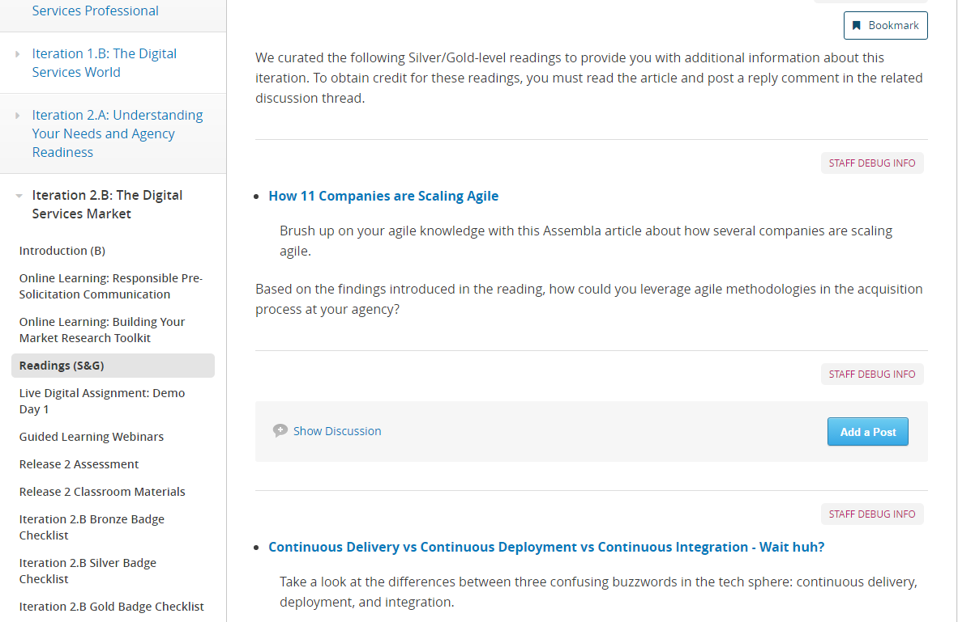
Readings (S&G)
Readings (S&G)
2 hours
Silver and gold level requirement
“How 11 Companies are Scaling Agile”
“Continuous Delivery vs Continuous Deployment vs Continuous Integration - Wait huh?”
“7 Signs This Person isn't Actually a UX Designer”
“Webby Awards 2016: Best Activism Websites”
“The 22 Most Innovative Web Platforms of 2016”
Notes:
Facilitator Notes:
In addition to the articles that are included in the bronze-level activities, this iteration features 5 silver and gold readings. For each article, you should respond to the related discussion post.
The readings include:
“How 11 Companies are Scaling Agile”
“Continuous Delivery vs Continuous Deployment vs Continuous Integration - Wait huh?”
“7 Signs This Person isn't Actually a UX Designer”
“Webby Awards 2016: Best Activism Websites”
“The 22 Most Innovative Web Platforms of 2016”
In these articles, topics covered will range from innovators in web development, to the difference between a true user experience designer and a fraud.

Slide 10
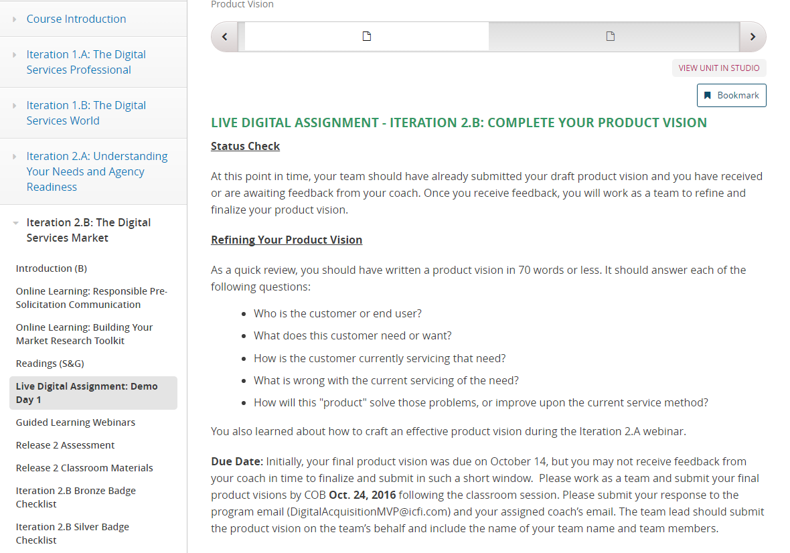
Live Digital Assignment: Product Vision and Demo Day
Live Digital Assignment
5 hours estimated time
Continued development of product vision
Now due COB Oct. 24
Preparation for Classroom Session Demo Day
10-minute presentation to include:
Overall project and hypothesis
Testing plan
Product vision
Tools you’ll use for testing your plan
Key takeaways/anticipated next steps
Questions for the group/challenges
Notes:
Facilitator Notes:
For the LDA this iteration, we have two tasks for you to complete. First, you should continue development of your product vision.
We have extended the due date for this assignment to Oct. 24, rather than October 14. Our thought was that you might not get feedback from your assignment coach in time to make the changes that are needed.
Due to the classroom session taking up the week of the 17-21st, we have decided to give you Monday Oct. 24 to finish the product vision if necessary.
In addition to the product vision, you will be preparing a 10-minute presentation of your project so far for the classroom session. This presentation should include:
Your overall project and hypothesis. Discuss you experiences using the design process to hone in on this hypothesis.
Your plan for executing and testing your hypothesis. How are you planning on (or how have you been) using agile principles to test your hypothesis?
Your product vision (i.e., the need you are addressing for your customer).
Systems/collaboration tools that you’ll use to execute your plan.
Your key learnings/takeaways, successes, challenges, and anticipated next steps. To craft this section, ask yourselves questions like the following: What are you most proud of? Where have you struggled most? What are you most excited about as you move forward?
Questions for the group or challenges you’re currently working through.
More information about your demo day presentations is in the portal– please take note of the instructions in the portal. You should have some kind of visual or takeaway materials to support your presentation.

Slide 11
Live Digital Assignment – Demo Day
Deliver a 10-minute presentation on October 21, 2016, during the afternoon classroom session.
Share your presentation materials and other documentation with the facilitators and assignment leads via email (DigitalAcquisitionMVP@icfi.com).
Plan to use Day 1 of the Classroom Session to work on your presentations
Notes:
Facilitator Notes:
Deliver a 10-minute presentation on October 21, 2016, during the afternoon classroom session.
Share your presentation materials and other documentation with the facilitators and assignment leads via email (DigitalAcquisitionMVP@icfi.com).
Plan to use Day 1 of the Classroom Session to work on your presentations
Check out the portal for further details about your demo day presentations

Slide 12
What’s Next

Slide 13
Release 2 Classroom Session
Release 2 Classroom Session
Classroom Session for Release 2 will be from Oct. 17 – 21
Day 1: Optional LDA group session
Day 2: Release 1 review, stakeholder engagement
Day 3: Hear from an acquisition expert, non-traditional vendor guest speaker
Day 4: Market research, influencing conversations, acquisition strategy guest panel
Day 5: LDA Demo Day, introduction to Release 3
FHWA’s Arlington Location– 1310 North Courthouse Road, Suite 300, Arlington, VA 22201
8:00am – 4:00pm each day
Metro is SafeTracking the Orange Line
Notes:
Facilitator Notes:
The Release 2 Classroom session is coming up. Our classroom session will be held at FHWA’s Arlington location: 1310 North Courthouse Road, Suite 300, Arlington, VA 22201 from 8am to 4pm each day.
This location is off of the orange line, and metro is currently SafeTracking the Orange line. There will be very limited metro access—please plan accordingly.
Day 1 is an optional session intended for your groups to continue working on your LDA. Days 2-5 will be instructor led facilitation.
This is a chance for you to work on your Demo Day presentations and any additional work you need to do for your product vision. Traci, Brent, and your assignment coaches will be there to provide you with any additional guidance that you may need. It is strongly recommended that you attend this session despite it being designated as optional. This is a great opportunity to get together with your team and put together a strong presentation.
On Day 2 there will be a Release 1 review, stakeholder engagement
In Day 3 we will hear from an acquisition expert, non-traditional vendor guest speaker
Day 4 will cover Market research, influencing conversations, guest panel to talk about acquisition strategy.
And on Day 5 is the LDA Demo Day, and introduction to Release 3
This is just an overview of the activities that will come! We look forward to seeing you next week.

Slide 14
Release 2 Assessment
Release 2 Assessment
The assessment will be hosted in the portal for this release.
More details will be released for this later in the iteration.
Notes:
Facilitator Notes:
Finally, we will have the Release 2 Assessment at the end of this iteration. More information will be available soon!

