Slide 1
Digital Acquisition Pilot Iteration 3.A Planning Meeting
October 24 – November 4, 2016
Notes:
Good morning, and welcome back. We hope that everyone enjoyed the classroom session.

Slide 2
Agenda
Updates and logistics
Iteration 3.A Welcome and Introduction
Focus of the iteration
Sessions and activities that compose the iteration
Classroom Session information
Notes:
Facilitator Notes:
We’re going to be getting right back into the swing of things, and we have some big deadlines coming up. Today we’ll be going over upcoming deadlines and other updates, some classroom session logistics, and we’ll walk through Iteration 2.B

Slide 3
Notes/Updates
Don’t forget to complete the Product Vision LDA assignment!
Email the product vision to our program email address (DigitalAcquisitionMVP@icfi.com)
Final write-up is due October 24 (today!)
Release 2 Assessment Reminder
By the end of the day on Wednesday, October 26, you should have completed the Release 2 Assessment.
Shadowing reminder
Your shadowing opportunity should have been submitted by now, please get that in as soon as possible if you have not already.
Notes:
Facilitator Notes:
Don’t forget to complete the Product Vision LDA assignment!
Email the product vision to our program email address (DigitalAcquisitionMVP@icfi.com)
Final write-up is due October 24 (today!)
Release 2 Assessment Reminder
By the end of the day on Wednesday, October 26, you should have completed the Release 2 Assessment.
Shadowing reminder

Slide 4
Iteration 3.A – What It’s All About
Iteration 2.B – Where We’ve Been
Identify why communicating openly and responsibly with potential vendors is critical to digital services acquisition success and how to do it.
Differentiate between buying compliance and buying outcomes.
Conduct effective market research for digital services.
Iteration 3.A – What’s Next
Identify how to develop an acquisition strategy for digital services.
Select an acquisition strategy that supports your customer's needs for a digital acquisition.
Identify strategies and communication methods to apply at different phases of the change lifecycle.
Identify evaluation methods and criteria on cost and pricing, terms and conditions, security concerns (cyber), and data rights to evaluate vendor maturity and ability to deliver a product that solves a given need and given the definition of success.
Notes:
Facilitator Notes:
Congratulations on completing iteration 2.A. To review, you:
Analyzed stakeholders in your sphere of influence that impact digital services acquisition.
Assessed your agency’s readiness for change and innovation.
Asked effective questions to understand the agency’s need and make recommendations on a course of action for a digital acquisition procurement.
Analyzed a digital service need to determine its most appropriate market.
In this next iteration, Iteration 2.B, you will:
Identify how to develop an acquisition strategy for digital services.
Select an acquisition strategy that supports your customer's needs for a digital acquisition.
Identify strategies and communication methods to apply at different phases of the change lifecycle.
Identify evaluation methods and criteria on cost and pricing, terms and conditions, security concerns (cyber), and data rights to evaluate vendor maturity and ability to deliver a product that solves a given need and given the definition of success.

Slide 5
Iteration 3.A Timeline
Iteration 3.A – September/October
Oct. 24 | 25 | 26 | 272 | 28
Iteration Planning Meeting
11:00 – 11:30 am ET
Oct. 31 | 1 | 2 | 3 | 4
Iteration Web Conference
11:00 – 12:00 pm ET
Iteration 3.A Pre-Assessment
30 minutes
Readings (S&G)
1 hour
Online Learning: The Acquisition Strategy
30 minutes
Online Learnings: Influence and Difficult Conversations
1 hour (30 minutes each)
Activity: 3.A Blog: Challenges
2 hours
Activity: 18F Evaluation
2 hours
Live Digital Assignment
Notes:
Facilitator Notes:

Slide 6
Iteration Web Conference
Iteration 3.A – September – October
Oct. 24 | 25 | 26 | 27 | 28
Iteration Planning Meeting
11:00 – 11:30 am ET
Oct. 31 | 1 | 2 | 3 | 4
Iteration Web Conference
11:00 – 12:00 pm ET
Notes:
Facilitator Notes:
The Release 2 Classroom session is coming up. Our classroom session will be held at FHWA’s Arlington location: 1310 North Courthouse Road, Suite 300, Arlington, VA 22201 from 8am to 4pm each day.
We’ll be getting into the classroom schedule a little bit more in later slides, but Day 1 is an optional session intended for your groups to continue working on your LDA. Days 2-5 will be instructor led facilitation.

Slide 7
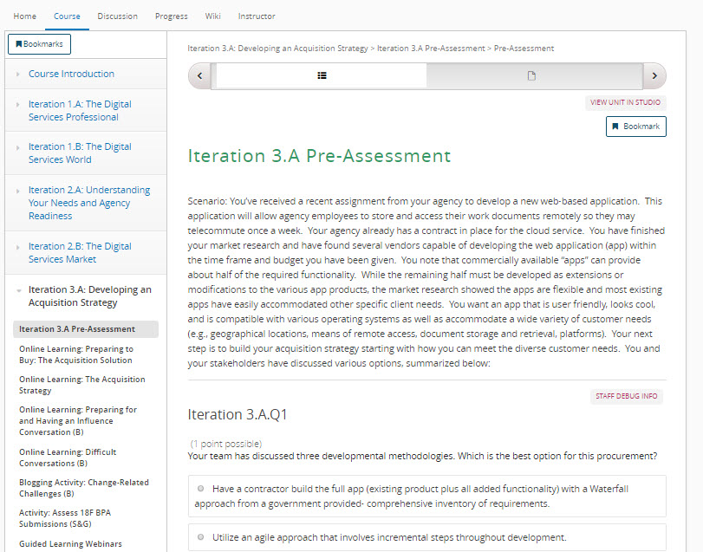
Iteration 3.A Pre-Assessment
Online Learning: Responsible Pre-Solicitation Communication
About 30 minutes
Tests your knowledge of iteration topics
Will be compared to results from post assessments to further develop Individual Development Plan.
Notes:
Facilitator Notes:
This 30-minute pre-assessment introduces you to Iteration 3.A performance objectives. This short assessment provides scenario-based questions, and will help you gauge where you currently stand with the upcoming material.

Slide 8
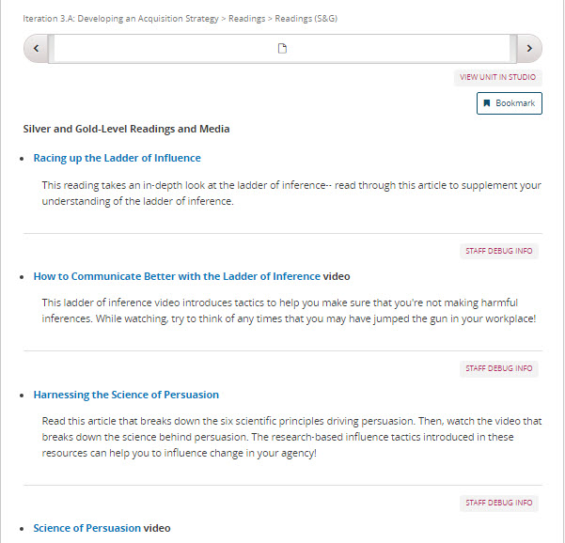
Readings and Media (S&G)
Readings and Media (S&G)
About 30 minutes
Bronze-level requirement
Introduces resources that can be used to further market research (Gartner Magic Quadrant)
Market Intelligence vs. Market Research
Notes:
Facilitator Notes:
The silver and gold readings for this iteration take a closer look at influence. These readings take a closer look at important influence topics including the Ladder of Inference, and the science behind persuasion.
For both of the readings, there is also a related video.

Slide 9
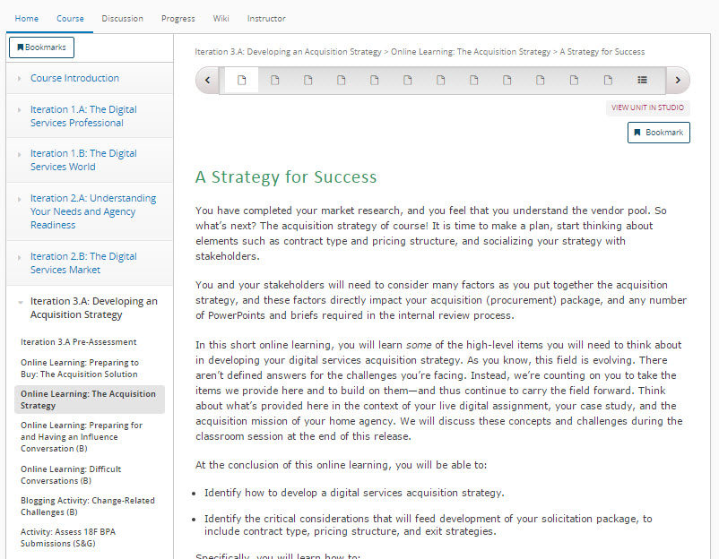
Online Learning: The Acquisition Strategy (B)
Online Learning: The Acquisition Strategy (B)
2 hours
Bronze-level requirement
Identify how to develop a digital services acquisition strategy.
Identify the critical considerations that will feed development of your solicitation package, to include contract type, pricing structure, and exit strategies.
Notes:
Facilitator Notes:
The Acquisition Strategy online learning will prepare you to develop your digital services acquisition strategy. Several high-level items are introduced that should be considered when developing said strategy.
You will learn several things in this module, including how to:
Identify the data needed prior to developing the solicitation and releasing it to the public.
Identify the elements of an acquisition strategy and how they feed the acquisition package in support of the overall solution in a digital services environment.
Determine stakeholder needs and techniques for helping them understand agile acquisition for digital services.
Differentiate between when you can modify an existing contract to meet agile software development or digital services needs and when you should develop a new contract to meet the need

Slide 10
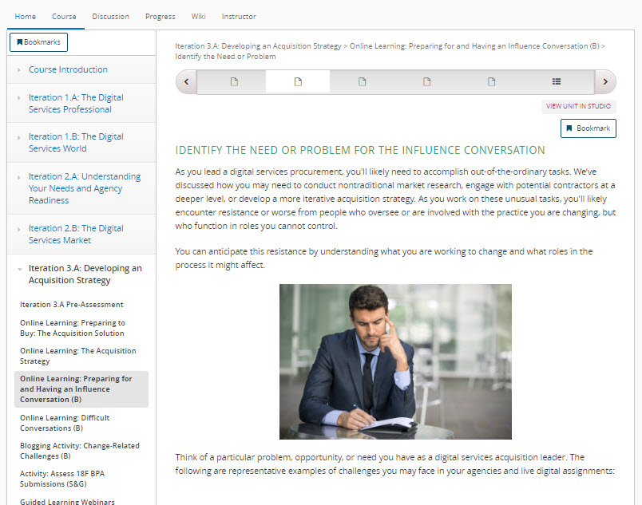
Online Learning: Preparing for and Having an Influence Conversation (B)
Online Learning: Preparing for and Having an Influence Conversation (B)
30 minutes
Bronze-level requirement
Quick review of the influence conversation material that was introduced in the classroom session.
Review this material to reinforce your understanding of influence
Notes:
Facilitator Notes:
In the classroom session you spent time working on conducting influence conversations. This online learning will reinforce the concepts learned there, as well as explain the reasoning behind these concepts. This online learning will be quick, but you should use it to ensure that you are ready to be an agent of change!

Slide 11
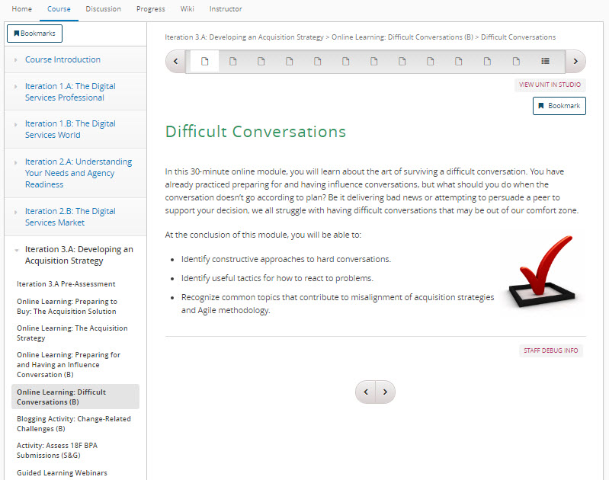
Online Learning: Difficult Conversations (B)
Online Learning: Difficult Conversations(B)
30 minutes
Bronze-level requirement
Introduces difficulties that may arise from influence conversations or other similar scenarios.
Use this online learning to see how to handle a variety of difficult conversations that you will encounter in the workplace.
Notes:
Facilitator Notes:
Building from the influence conversations piece, this online learning discusses the challenges of having difficult conversations, and the different tactics you can leverage to navigate these difficult conversations. By the end of the online learning, you’ll be able to:
Identify constructive approaches to hard conversations.
Identify useful tactics for how to react to problems.
Recognize common topics that contribute to misalignment of acquisition strategies and Agile methodology.

Slide 12
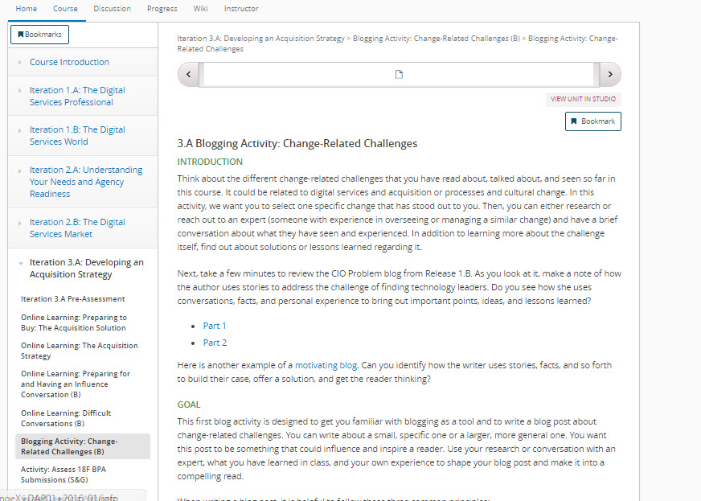
Blogging Activity: Change-Related Challenges(B)
Blogging Activity: Change-Related Challenges (B)
2 hours
Bronze-level requirement
Write your first blog post for this course with this activity!
Think about change-related challenges that you have seen so far in the course, and write a blog post about what that problem is and what solutions are currently available.
Notes:
Facilitator Notes:
In this iteration, we’ll have you write your first blog post for this course! Don’t worry, we have detailed instructions in the module that will walk you through setting everything up.
In this activity, your goal is to identify a challenge that you’ve seen either firsthand or heard about through this course, and write a blog post that covers possible solutions. You should explain the challenge, and conduct research or interviews to identify possible solutions.
If you have any trouble with this activity, or with getting the blog set up, please contact us through our program email at DigitalAcquisitionMVP@icfi.com.

Slide 13
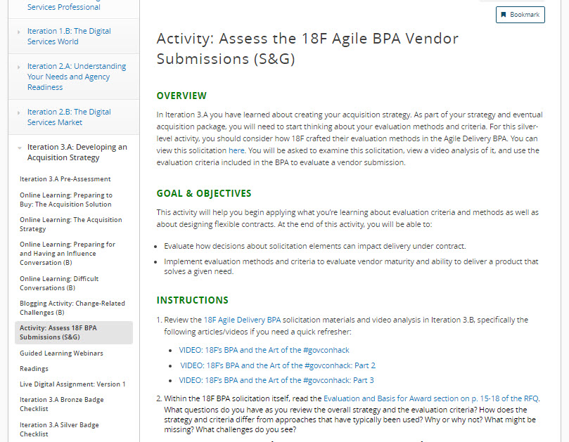
Activity: Assess the 18F Agile BPA Vendor Submissions (S&G)
Activity: Assess the 18F Agile BPA Vendor Submissions (S&G)
2 hours
Silver/Gold-level requirement
Take a look at 18F Agile BPA solicitation and view analysis videos
Evaluate vendor submissions based upon agile requirements and criteria set forth
Write a blog post that shares your thoughts and questions by the end of the iteration (November 4)
Notes:
Facilitator Notes:
For this activity, you will look at the 18F Agile Delivery BPA. You will be considering the evaluation methods and criteria set forth in the BPA as a way to evaluate a vendor submission. This will help you in planning for your own acquisition strategy and package.
There is a deliverable for this activity– By the end of the iteration, you should create a blog post that shares your thoughts, raises questions that you still have, and answers the questions set forth in the online learning.

Slide 14
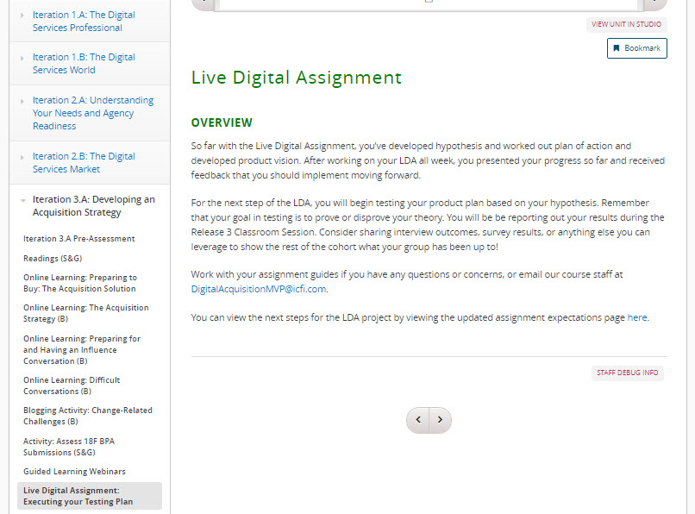
Live Digital Assignment: Developing a Plan for How to Test
Live Digital Assignment
During Release 3 you will be determining how to test your product plan against your hypothesis, and then begin the testing process.
Testing against your hypothesis can range from conducting interviews to creating and implementing a survey. Your test must be implemented by the final Demo Day during the January session (Jan. 9-11)
In the Release 3 Classroom session you will have another report out. You should be prepared to share your plan for testing.
Notes:
Facilitator Notes:
During Release 3, you will determine how to test against your hypothesis and then get to work testing it.
Your test should be a way to prove or disprove your hypothesis. Some groups have already identified what this test will be – if so, you are one step ahead so work on implementing your test.
Ideas for how to test against your hypothesis include conducting interviews or creating and implementing a survey. Your test must be implemented by the final Demo Day during January 9-11 so that you can share what you learned in your test.
At the end of Release 3, you will have another report out in the classroom session. At that time, you should share your plan for how to test against your hypothesis.
If you have any questions or concerns, please email our course staff (DigitalAcquisitionMVP@icfi.com), or work with your assignment guides

Slide 15
Activity: Developing the Acquisition Strategy
Based on your team results of the market research that you completed in class in Iteration 2, use that information to influence your acquisition strategy.
To the extent possible, complete the lean acquisition canvas template attached with information provided or with logical extensions of available information to form a vision of what and how this requirement will be acquired.
For any section(s) that you are not able to credibly complete, please identify what information is required that would prevent you from completing the strategy.
Identify what strategy you would use to secure the outstanding information needed to complete your acquisition strategy.
You are encouraged to collaborate within your team for ideas and to complete this draft assignment. However, you will each submit your own draft acquisition strategy.
Notes:
Facilitator Notes:
Based on your team results of the market research that you completed in class in Iteration 2, use that information to influence your acquisition strategy.
To the extent possible, complete the lean acquisition canvas template attached with information provided or with logical extensions of available information to form a vision of what and how this requirement will be acquired.
For any section(s) that you are not able to credibly complete, please identify what information is required that would prevent you from completing the strategy.
Identify what strategy you would use to secure the outstanding information needed to complete your acquisition strategy.
You are encouraged to collaborate within your team for ideas and to complete this draft assignment. However, you will each submit your own draft acquisition strategy.

