Slide 1
Digital Acquisition Pilot Iteration 3.B Planning Meeting
November 7 – November 18, 2016

Slide 2
Agenda
Iteration 3.B Welcome and Introduction
Reminders and updates
Sessions and activities that compose the iteration
Release 3 Classroom Session: What to Expect
Notes:
Facilitator Notes:
Today we’ll be starting with some reminders and updates, including a new badging feature we want to introduce.
Then we’ll go over all of the activities for this iteration, and we’ll wrap up with an introduction to the release 3 classroom session.

Slide 3

New Badging Framework
Badging Update
All badges are now automatically tracked (no more checklists!)
As you earn a badge, it will display within the assessment section.
Select the “Mark as complete” button at the end of each activity to receive credit
You will be assigned specific silver-level activities based on your performance in the Iteration Pre-Assessments
To receive the silver badge you must complete all of the silver activities listed in the “Associated Activities” area of the assessment section
To receive a gold badge, you will complete all silver-level activities
Notes:
Facilitator Notes:
All activities now feature a “Mark as complete” button. This allows the badges to be automatically checked, and there will be no more checklists at the end of modules.
This also means that if you don’t get to the end of each activity and select the button, you will not be receiving credit.
As you earn a badge, it will appear automatically in the feedback page of the assessment section.
In the pre-assessment section, you will be assigned silver-level activities based on your performance on the assessment. You will be assigned activities that are tied to the learning objectives that you did not test as well on, with the intent of strengthening those weaker areas.
To receive the silver badge, you must complete all of the silver activities listed in the “Associated Activities” area of the assessment section.
For a gold badge, you must complete all silver level activities.

Slide 4
Notes and Updates
Assessments
We have some folks who have not completed the Release 2 Assessment yet
Iteration 3.A Post-Assessment
Live Digital Assignment
In the classroom session you will have to demo your work to date. This includes at least your project plan, testing methods, and updates on testing.
Notes:
Facilitator Notes:
Some other updates– we still have folks who have not completed the Release 2 Assessment. You should have received an email if you have not. Thank you to those of you who have completed the assessment already.
Please don’t forget to take the Iteration 3.A Post-Assessment as well if you have not done so already. This is a bronze-level activity.
In regards to the Live Digital Assignment, your task is the same as from 3.A. We ask that you spend time conducting testing if you have not already, and you will be presenting your progress to date in the classroom session.

Slide 5
Iteration 3.B – What It’s All About
Iteration 3.A – Where We’ve Been
Identify how to develop an acquisition strategy for digital services.
Select an acquisition strategy that supports your customer's needs for a digital acquisition.
Identify strategies and communication methods to apply at different phases of the change lifecycle.
Identify evaluation methods and criteria on cost and pricing, terms and conditions, security concerns (cyber), and data rights to evaluate vendor maturity and ability to deliver a product that solves a given need and given the definition of success.
Iteration 3.B – What’s Next
Identify the role that security plays in digital service contracts.
Develop your acquisition package for procuring digital services, including proposal and source selection methods.
Define evaluation criteria, given evaluation strategy discussed in your acquisition strategy.
Notes:
Facilitator Notes:
Congratulations wrapping up iteration 3.A. To review, you:
Identified how to develop an acquisition strategy for digital services.
Selected an acquisition strategy that supports your customer's needs for a digital acquisition.
Identified strategies and communication methods to apply at different phases of the change lifecycle.
Identified evaluation methods and criteria on cost and pricing, terms and conditions, security concerns (cyber), and data rights to evaluate vendor maturity and ability to deliver a product that solves a given need and given the definition of success.
In this next iteration, Iteration 3.B, you will:
Identify the role that security plays in digital service contracts.
Develop your acquisition package for procuring digital services, including proposal and source selection methods.
Define evaluation criteria, given evaluation strategy discussed in your acquisition strategy.

Slide 6
Iteration 3.B Timeline and Bronze Activities
Iteration 3.B – November
Nov. 7 | 8 | 9 | 10 | 11
Iteration Planning Meeting
11:00 – 11:30 am ET
Webinar: Digital Services Security
11:00 – 12:00 pm ET
14 | 15 | 16 | 17 | 18
Release 3 Classroom Session (Optional Day 1)
8:00 – 4:00 pm ET
Release 3 Classroom Session
8:00 – 4:00 pm ET
Iteration 3.B Pre-Assessment
30 minutes
Webinar: Digital Services: More Secure than You Think They Are
1 hour
MAP Case Study: Developing an RFQ
1 hour
Online Learning: Compliance & Other Legal Issues
1 hour
Activity: Top Evaluation Criteria
1 hour
Iteration 3.B Post-Assessment
30 minutes
Notes:
Facilitator Notes:
This week we have the Iteration Planning meeting today, and on Thursday we have a webinar on Digital Services Security. You should have received an invite for that last week, and we’ll talk about that a little bit more shortly.
As you know, next week is the classroom session. Day 1 will be structured the same as the Release 2 classroom, and days 2-5 will be focused on training new material.
The activities you see on this page are the bronze-level activities:
Iteration 3.B Pre-Assessment
Webinar: Digital Services: More Secure than You Think They Are
MAP Case Study: Developing and RFQ
Online Learning: Compliance & Other Legal Issues
Activity: Top Evaluation Criteria
Iteration 3.B Post-Assessment

Slide 7
Iteration 3.B Timeline and Silver Activities
Iteration 3.B - November
Nov. 7 | 8 | 9 | 10 | 11
Iteration Planning Meeting
11:00 – 11:30 am ET
Webinar: Digital Services Security
11:00 – 12:00 pm ET
14 | 15 | 16 | 17 | 18
Release 3 Classroom Session (Optional Day 1)
8:00 – 4:00 pm ET
Release 3 Classroom Session
8:00 – 4:00 pm ET
Activity: FedRAMP and Digital Services (S)
30 minutes
Activity: Acquisition Package Analysis (S)
30 minutes
Activity: Further Practice with Evaluation Criteria (S)
30 minutes
Activity: Evaluation Criteria Research (S)
30 minutes
Notes:
Facilitator Notes:
In addition to the bronze level activities, you will be assigned a variety of silver level activities, dependent on your pre-assessment results.
These activities include:
A FedRAMP and Digital Services review activity,
An Acquisition Package Analysis activity,
Further Practice with Evaluation Criteria,
And an Evaluation Criteria Research activity.

Slide 8
Iteration 3.B Web Conference
Iteration 3.B – November
Nov. 7 | 8 | 9 | 10 | 11
60-minute Webinar
Evan Cooke, Senior Policy Advisor at OSTP and former CTO at Twilio
Leveraging the cloud -- how the cloud works, securely connecting to the cloud, mobile devices and the cloud, and compliance and the ATO process.
Iteration Planning Meeting
11:00 – 11:30 am ET
Webinar: Digital Security
11:00 – 12:00 pm ET
14 | 15 | 16 | 17 | 18
Release 3 Classroom Session (Optional Day 1)
8:00 – 4:00 pm ET
Release 3 Classroom Session
8:00 – 4:00 pm ET
Notes:
Facilitator Notes:
On Thursday, we’ll be having the webinar with Evan Cooke as our guest speaker. Evan is a Senior Policy Advisor at the Office of Science and Technology Policy. He also co-founded and served as CTO at Twilio.
In the tech space today, you can’t go anywhere without hearing about the cloud. Evan is going to talk about how you can leverage the cloud in government, and how the cloud works. He’ll discuss securely connecting to the cloud, how mobile devices work with the cloud, and compliance and the ATO process.

Slide 9
Iteration Web Conference
Iteration 3.B – November
Oct. 10 | 11 | 12 | 13 | 14
Iteration Planning Meeting
11:00 – 11:30 am ET
Oct. 17 | 18 | 19 | 20 | 21
Release 3 Classroom Session (Optional Day 1)
8:00 – 4:00 pm ET
Release 3 Classroom Session Day 2
8:00 – 4:00 pm ET
Release 3 Classroom Session Day 3
8:00 – 4:00 pm ET
Release 3 Classroom Session Day 4
8:00 – 4:00 pm ET
Release 3 Classroom Session Day 5
8:00 – 4:00 pm ET
1655 North Fort Myer Drive Suite 1000, Arlington, VA 22209
8am to 4pm each day.
Day 1: Optional LDA group session
Days 2-5: Classroom training sessions
Notes:
Facilitator Notes:
We’ve already discussed this a little bit, but the classroom session is coming up. It will be from 8-4 each day, at 1655 North Fort Myer Drive Suite 1000, Arlington, VA 22209.

Slide 10
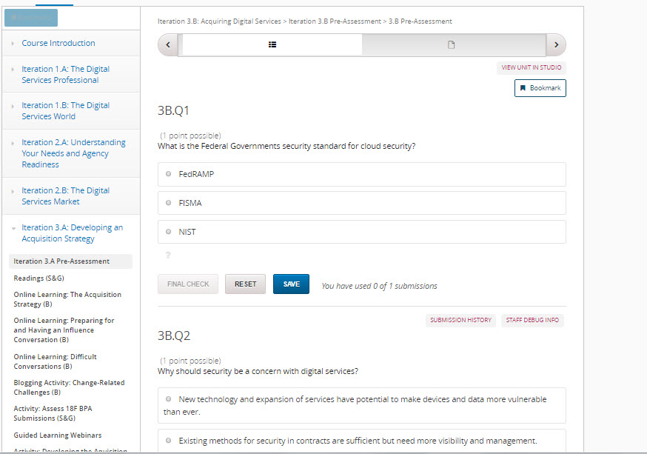
Iteration 3.B Pre-Assessment
Iteration 3.B Pre-Assessment
About 30 minutes
Bronze-level requirement
Presents you with a real-life challenge that you may encounter on the job
Use exercise as a gauge to determine your knowledge going into this iteration
Notes:
Facilitator Notes:
This 30-minute core activity introduces you to the content for this release in an applied and engaging manner--by presenting you with a real-life challenge that you may encounter on the job.
Use this exercise as another gauge (along with the results of your pre-assessment) to determine where you are and how well you perform against the learning objectives for this release.
Although this isn't a formal assessment, we will review your results and those of your peers to see where the class has strengths and weaknesses. That way, we can tailor materials and discussions to focus in on areas where participants are struggling or need extra guidance.

Slide 11
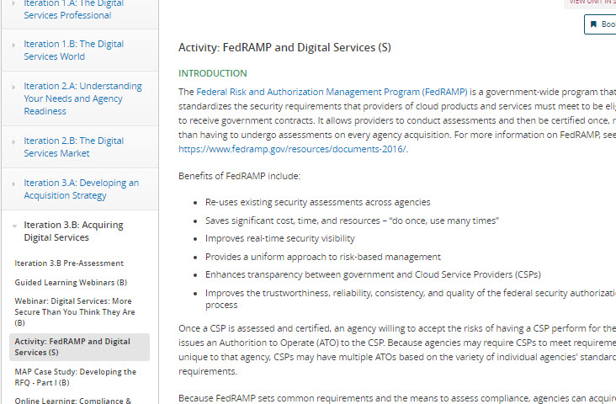
Activity: FedRAMP and Digital Services
Activity: FedRAMP and Digital Services
About 30 minutes
Silver-level requirement
Introduces the FedRAMP
You will Research requirements for systems to be granted an ATO
Conclude activity by answering series of questions on the discussion board.
Notes:
Facilitator Notes:
About 30 minutes
Silver-level requirement
Introduces the FedRAMP – you will either be reviewing the website or Twitter feed (which is updated regularly)
You will Research requirements for systems to be granted an Authorization to Operate (ATO)
Conclude activity by answering series of questions on the discussion board. You must post your discussion responses by the end of the iteration – November 18 – to receive credit.

Slide 12
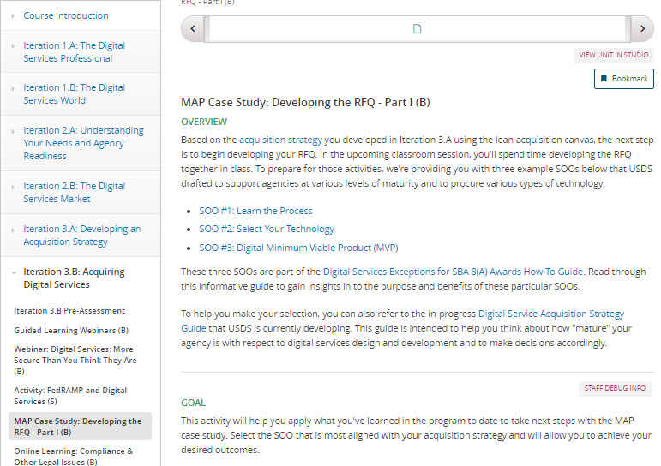
MAP Case Study: Developing the RFQ - Part I
MAP Case Study: Developing the RFQ - Part I
1 hour
Bronze-level requirement
Builds from the acquisition strategy you developed in 3.A
Compare real SOOs
Share your thoughts with the cohort in the classroom session.
Notes:
Facilitator Notes:
In this bronze-level activity, you’ll be taking a look at 3 different SOOs that USDS drafted to support agencies at various levels of maturity.
This activity will prepare you for the classroom session, where you will spend time developing an RFQ.
When looking at the SOOs, you should identify one that is most aligned with your acquisition strategy. Once you have done so, consider:
Why you chose that SOO
What made the SOO a better fit over another
As a part of the process, do you need to train your team on using agile? How “mature” is your team in their use of agile?
You should bring your notes and answers for these questions to the classroom session.

Slide 13
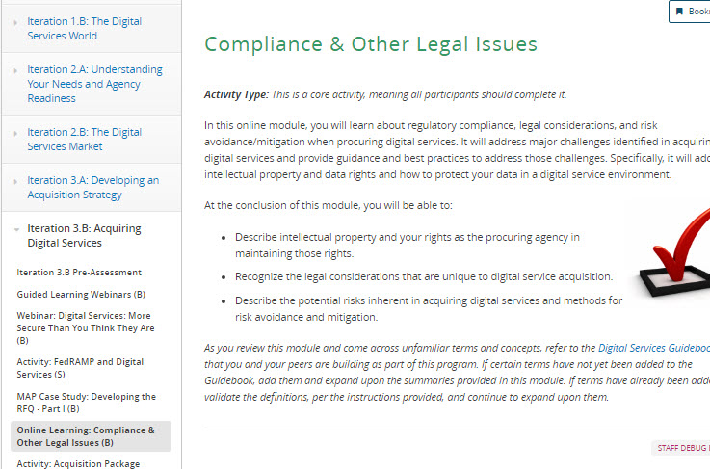
Online Learning: Compliance and Other Legal Issues
Online Learning: Compliance and Other Legal Issues
1 hour online learning
Bronze-level requirement
Focus on intellectual property and your rights as the procuring agency.
Introduces legal considerations that are unique to digital service acquisition
Discusses potential risks inherent in acquiring digital services
Notes:
Facilitator Notes:
This 1 hour online learning has three main goals:
Describe intellectual property and your rights as the procuring agency in maintaining those rights.
Recognize the legal considerations that are unique to digital service acquisition.
Describe the potential risks inherent in acquiring digital services and methods for risk avoidance and mitigation.
This is a bronze-level requirement.

Slide 14
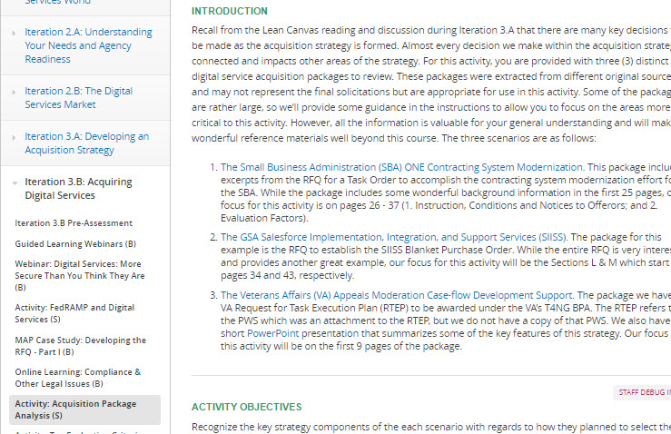
Activity: Acquisition Package Analysis
Activity: Acquisition Package Analysis
About 30 minutes
Silver-level Activity
Take a look at 3 digital services acquisition packages.
Consider how they differ from traditional IT selection strategies
Post to the discussion board by November 18th.
Notes:
Facilitator Notes:
For this silver-level activity, we estimate that it will take about 30 minutes.
You will:
Examine 3 digital services acquisition packages
Consider how they differ from traditional IT selection strategies
Post to the discussion board by November 18th.

Slide 15
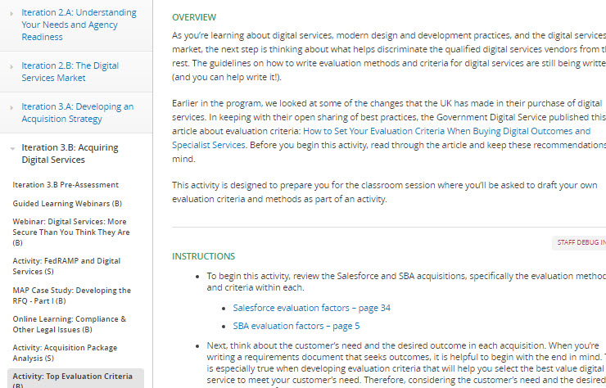
Activity: Top Evaluation Criteria
Activity: Top Evaluation Criteria
1 hour
Bronze-level activity
Take another look at the digital services acquisition packages
Consider the evaluation criteria and determine the top criteria in each of the acquisitions.
In the course Wiki, you will post the criteria you selected, instructions, and explanations.
Notes:
Facilitator Notes:
We estimate that this bronze-level activity will take an hour.
In this activity, you will:
Take another look at the digital services acquisition packages
Consider the evaluation criteria and determine the top criteria in each of the acquisitions.
In the course Wiki, you will post the criteria you selected, instructions, and explanations.
We will begin to use the course Wiki more moving forward, and the following slides will walk you through how to use it.

Slide 16
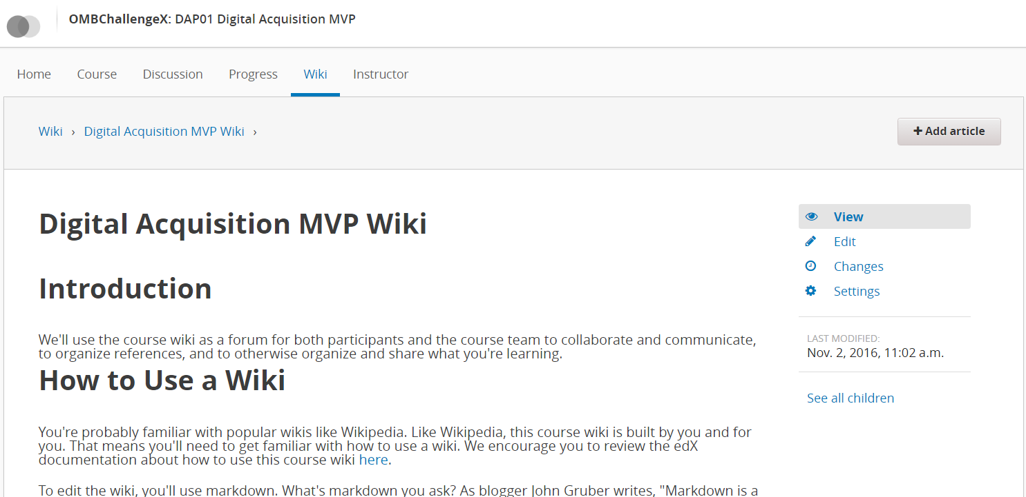
Welcome to the Class Wiki!
Notes:
Facilitator Notes:
This iteration, you are going to get the opportunity to post some activity responses to the class wiki!

Slide 17
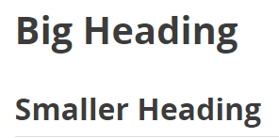
Markdown 101
It’s easier than HTML!
Type your responses as you would in Notepad (without any formatting)
Formatting is done with a few special syntax characters
For example: If you want to have a heading, use one or more hashtags.
Markdown Syntax What you will see
# Big heading
## Smaller heading
Notes:
Facilitator Notes:
Markdown is used for the class wiki. It is a text-to-HTML conversion tool that lets you write easy-to-read and easy-to-write text in a way that HTML can then convert it and display it in the wiki.
It’s much easier than HTML!
When you start writing your response, write as you would in Notepad – so in a way that does not have any formatting. Then, put in the Markdown syntax you need to format your response.
Look at this example here. If you want to have a heading, use a hashtag. If you want a large heading, use one hashtag. If you want a smaller heading, use two or more. The more hashtags the smaller the heading.
Let’s look at one more example.

Slide 18
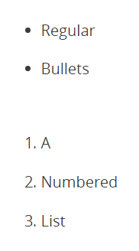
Markdown 101
For example: If you want to have a bulleted list:
For dots, use an asterisk.
For numbers, write the number, followed by a period
Markdown Syntax What you will see
* Regular
* Bullet
1. A
2. Numbered
3. List
Notes:
Facilitator Notes:
This example is for lists.
If you want a list that uses dots, put an asterisk before each line that is in the list.
If you want a list that is numbered, type the number followed by a period.
All the information you will need to post your activity responses is available in the activity instructions and on the Wiki tab. Take a look at the Markdown Syntax link as you get started. In fact, keep it open in a separate window, so you can reference as you write your response – it’s a great, easy-to-use resource.

Slide 19
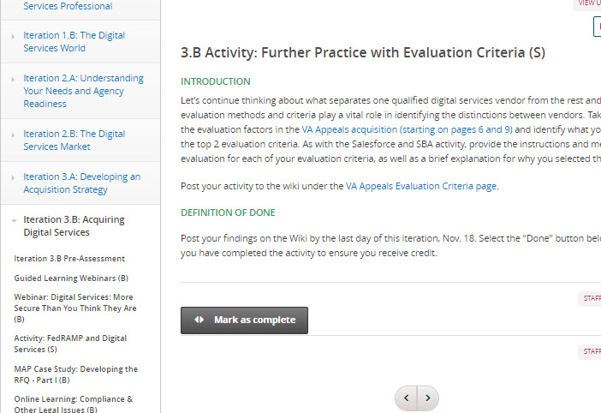
Activity: Further Practice with Evaluation Criteria
Activity: Further Practice with Evaluation Criteria
About 30 minutes
Silver-level activity
For this activity, you will consider the evaluation criteria of the VA Appeals acquisition
Select the top 2 evaluation criteria
Post to the course Wiki under the VA Appeals Evaluation Criteria page
Due Nov. 18
Notes:
Facilitator Notes:
This activity should take about 30 minutes, and it is a silver-level activity.
For this activity, you will consider the evaluation criteria of the VA Appeals acquisition
Select the top 2 evaluation criteria
Post to the course Wiki under the VA Appeals Evaluation Criteria page
Due Nov. 18

Slide 20
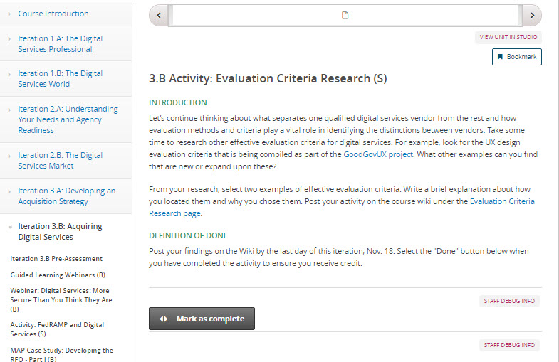
Activity: Evaluation Criteria Research
Activity: Evaluation Criteria Research
About 30 minutes
Silver-level activity
Continued discussion of evaluation criteria
Research other effective evaluation criteria for digital services
Due Nov. 18
Notes:
Facilitator Notes:
This activity should take about 30 minutes, and it is a silver-level activity.
For this activity, you will see what separates one qualified digital services vendor from the rest by looking at other effective evaluation criteria for digital services.
Select 2 examples of effective evaluation criteria that emerge in your research.
Post to the course Wiki under the Evaluation Criteria Research page.
Due Nov. 18

Slide 21
What’s Next

Slide 22
Iteration 3.B Post-Assessment
The 3.B Post-Assessment will be ready by the week of November 14.
We ask that you complete the assessment by the end of the week.

Slide 23
Release 3 Classroom Session
Release 3 Classroom Session
Classroom Session for Release 3 will be from Oct. 14 – 18
ASI’s Arlington office: 1655 North Fort Myer Drive, Suite 1000; Arlington, VA 22209
A detailed agenda that outlines the session activities and topics will be sent from the course email later today.
Notes:
Facilitator Notes:

