Slide 1
Digital Acquisition Pilot Iteration 1.B Planning Meeting
August 2016

Slide 2
Agenda
Iteration 1.B Welcome and Introduction
Focus of the iteration
Sessions and activities that compose the iteration
Release 1 Assessment

Slide 3
Iteration 1.B – What It’s All About
Iteration 1.A – Where We’ve Been
Got inside the role of digital services professionals to understand the what, who, how, and why of digital services
Explored key guidance and digital service players – Digital Services Playbook, TechFAR, USDS, role of coders
Started integrating into networks in the digital service community
Iteration 1.B – What’s Next
Identify the available sources of supply within the digital services market segments, such as Open Source Software, Big Data, XaaS, Cloud, and more.
Identify the high-level principles of agile development that make it effective.
Describe what sets agile methods apart from waterfall development and delivery methods.

Slide 4
Iteration 1.B Timeline
Iteration 1.B - August
22 | 23 | 24 | 25 | 26
Iteration Planning Meeting
11:00 – 11:30 am ET
29 | 30 | 31 | 1 | 2
Iteration Web Conference
11:00 – 12:00 pm ET
Reading
90-minutes
Two Online Learnings
2 hours and 30 minutes total
Activity: Trend Analysis of Fast Company’s Most Innovative Companies
60-minutes
Live Digital Assignment: Draft
2 hours
Release 1 Assessment
30-minutes

Slide 5
Iteration Web Conference
Iteration 1.B - November
22 | 23 | 24 | 25 | 26
Iteration Planning Meeting
11:00 – 11:30 am ET
29 | 30 | 31 | 1 | 2
Iteration Web Conference
11:00 – 12:00 pm ET
60-minute webinar in Adobe Connect
Bronze-level Requirement
Reflection on what you’ve been exploring, your observations, and any feedback on Iteration 1.B
Brief presentations (1-2 minutes) on your live digital assignment in the Iteration Retrospective
Notes:
Feel free to send along slides or other documents you want to share with the facilitators

Slide 6
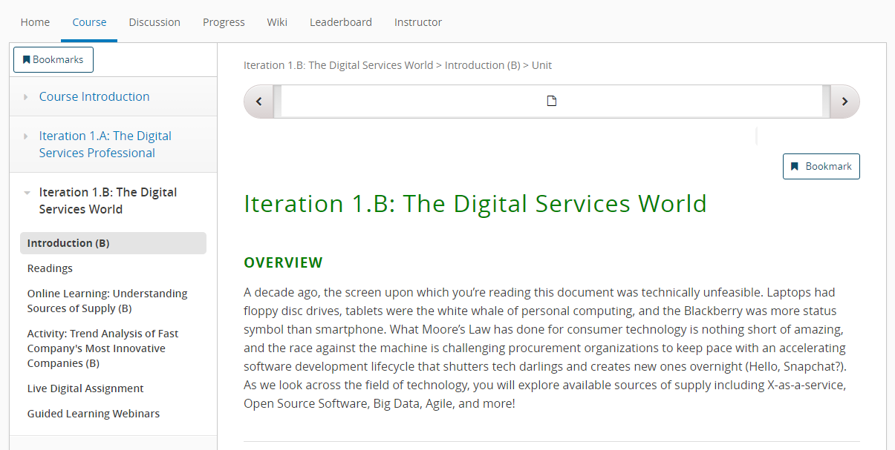
Readings
Bronze Level Readings
About 90-minutes
The CIO Problem
Case Study: Agile and GSA
Fast Company’s Most Innovative
Achieving Efficiency, Transparency, and Innovation
Don’t forget to complete the “Badge Completion Check” at the end of the iteration – this allows us to track participation for badging!

Slide 7
Readings
Silver/Gold Level Readings and Podcasts
Behind the Buy Podcast Series
Scrum Guide
Industry Insight: Kanban
Lean Startup Principles
Industry Insight: Why DevOps is good for government
18F: Technical Debt
Industry Insight: Open Source Tools
Acquiring Digital Services Using Open Source Software
Don’t forget to complete the “Badge Completion Check” at the end of the iteration – this allows us to track participation for badging!

Slide 8
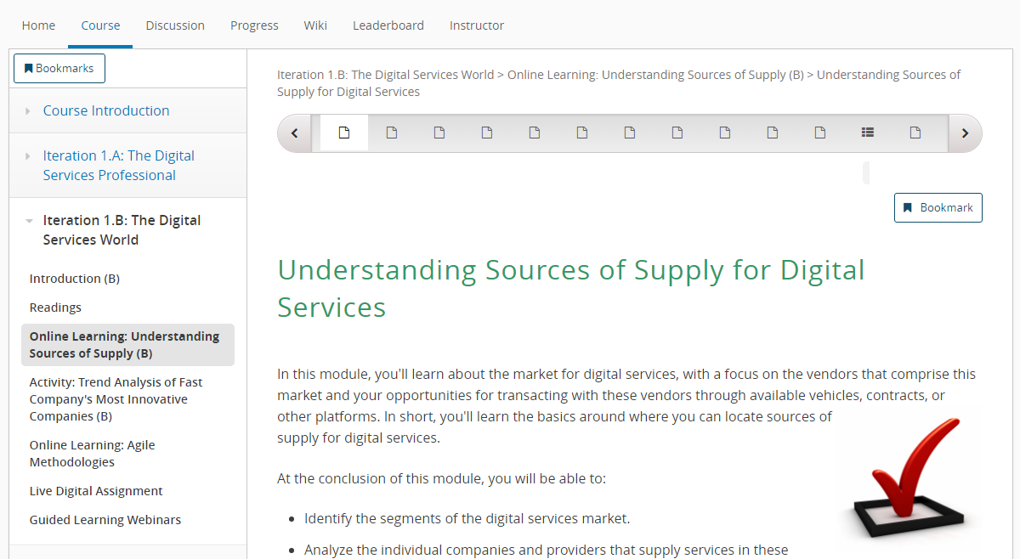
Online Learning
Understanding Sources of Supply
60-minute online article
Bronze-level requirement
Examines multiple digital service marketplace segments, including X-as-a-service, Open Source Software, Big Data, Agile, and more.
Don’t forget to complete the “Badge Completion Check” at the end of the iteration – this allows us to track participation for badging!

Slide 9
Activity: Trend Analysis of Fast Company’s Most Innovative Companies
Trend Analysis
About 60-minutes
Bronze-level requirement
Review the Fast Company’s Most Innovative Report
Analyze trends and identify interesting facts/trends to share on digital-focused companies
Post your ideas to the discussion board

Slide 10
Online Learning
Agile Methodologies
60-minute online article
Bronze-level requirement
Agile Methodologies through some content and video clips from a talk that Neil Chauduri held with the Pilot program of this course.
Don’t forget to complete the “Badge Completion Check” at the end of the iteration – this allows us to track participation for badging!

Slide 11
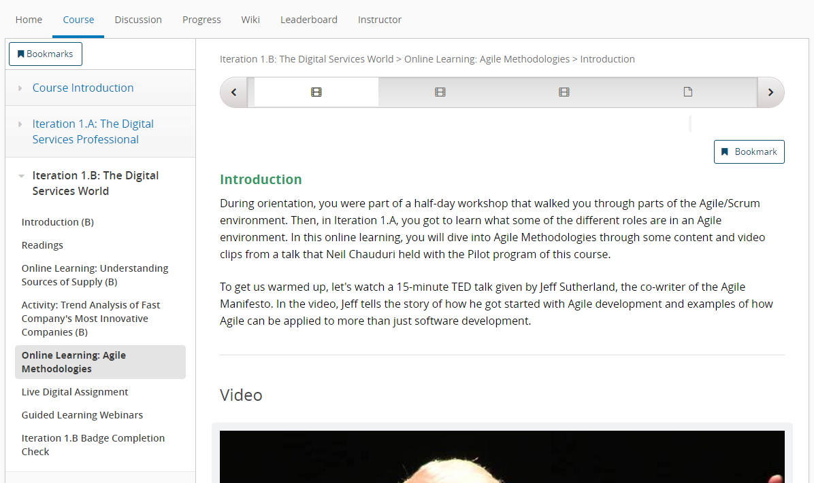
Last Step – Iteration 1.B Badge Completion Check
Iteration 1.B Completion Checks
Go through and answer that you have completed required activities to obtain your Bronze, Silver, or Gold badge

Slide 12
Live Digital Assignment – Iteration 1.B: The Digital Services World
About 2 hours
Work with your live digital assignment team to create a plan for testing your hypothesis based on the feedback you received from your USDS assignment guide
Draft plan due by Aug. 24
Share your plan in 1-2 minutes in the Iteration Web Conference

Slide 13
What’s Next

Slide 14
Release 1 Assessment
Outcome of activity - multiple choice knowledge test of what you learned, showing you and the instructors how your knowledge has increased.
Should take about 30 minutes to complete
Located in the edX portal at the bottom of the Courseware of Iteration 1.b

