Slide 1
Digital Services Contracting Professional Development MVP Program Release 3 Classroom Session
November 2016
Notes:
Facilitator Notes:
Presenter: Melissa
Welcome! Congratulations on making it through a very busy month!
As you may have noticed, there are tables with each of your group names on them, so please sit with your LDA groups for now.
We hope that working with your groups yesterday went well. If you have anything you started and wanted to wrap up, you’ll have some more time to work with your group today.
These next few slides will go over some of the logistics for the classroom session.

Slide 2

Logistics
Room is open from 7:30 a.m. to 4:30 p.m. every day
Internet access
Restrooms
Water, coffee, and kitchen
Several places for lunch on N Lynn St
Brown Bag Sessions
Notes:
Duration: 2 minutes
Timing: 8:00-8:02 am
Presenter: Melissa
Facilitator Notes:
Room is open from 7:30 am to 4:30 pm each day
Internet and password are on the white board.
During lunch, the USDS team will be available for optional brown bag sessions where further questions and discussions can occur.

Slide 3
Where You’ve Been
Release 1 – Digital Services in 21st Century Government
Understanding what digital services are, how digital services are designed and delivered, and the current role of a government digital services professional
A scan of the digital services market – potential sources of supply and how to communicate with them pre-solicitation
Release 2 – Understanding What You’re Buying
Exploring the need or outcome you’re trying to achieve with what you’re buying
Identifying and partnering with key stakeholders who will impact your acquisition
Conducting market research and preparing to develop your acquisition strategy
You are here!
Release 3 – How Do You Buy?
Utilizing agile techniques such as the lean canvas for acquisition planning
Analyzing evaluation criteria and the various elements of a procurement package
Identifying your organization’s readiness for agile and the role that plays in your acquisition strategy
Notes:
Duration: 3 minutes
Timing: 8:02-8:05 am
Presenter: Melissa
Facilitator Notes:
Release 1 focused on understanding the landscape of digital services today.
Release 2 focused on gaining an understanding of what you’re buying by exploring the need or outcome you’re trying to achieve, identifying and partnering with key stakeholders who will impact the acquisition, and finally thinking about what the acquisition strategy will look like.
In Release 3, you examined how to buy digital service solutions.
You learned to effectively use techniques for acquiring digital service solutions in your solicitation/acquisition strategy.
You learned how to develop an acquisition strategy that supports your customer’s needs, a communication plan and schedule to collaborate with key stakeholders, a cost and pricing criteria, and more.
You also learned about acquiring digital services– from identifying the role that security plays in digital service contracts, to defining evaluation criteria based on a given acquisition strategy.

Slide 4
Where You’re Going
Release 4 – Awarding & Administering Digital Service Contracts
Awarding digital service contracts by assessing the readiness of the technical evaluation team and implementing evaluation methods and criteria to evaluate vendor maturity
Managing digital services delivery
Identifying when failure occurs and what to do when it does
Notes:
Duration: 2 minutes
Timing: 8:05-8:07
Presenter: Melissa
Facilitator Notes:
In Release 4, you will evaluate vendors who deliver digital services using instantaneous, objective metrics on project health, developed via appropriately applied lean thinking and agile development methods while experimenting with flexible contract design and administration strategies.
You will practice awarding digital service contracts by assessing the readiness of the technical evaluation team, implementing evaluation methods and criteria to evaluate vendor maturity, and more.
You will also learn about digital services delivery and how to identify software engineering practices for high-quality digital services, identify when failure actually occurs, and determine how to execute an exit strategy.

Slide 5
Day 2 Agenda
Day 2
Morning | Classroom Session Introduction and Welcome Back Brief Review of Release 2 The Acquisition Strategy & Organizational Readiness Exit Strategies
LUNCH
Afternoon | Pricing/Contract Type for Cloud and Agile Live Digital Assignment Group Work
Notes:
Duration: 3 minutes
Timing: 8:07-8:10 am
Facilitator Notes:
Presenter: Melissa
Today, we’ll be doing a brief review of your journey thus far, starting with a look at Release 2 and your assessment results.
Then we will move in to a discussion on the Acquisition Strategy.

Slide 6
Orientation Agenda
Day 3
Day 4
Day 5
Morning | Using the Lean Acquisition Canvas Competing, and WINNING, in the Arena of Ideas
LUNCH
Afternoon | Challenge.gov Guest Speakers SOOs, SOWs, PWSs…Oh My!
Morning | MAP Case Study: SOO Selection Putting It All Together Security Considerations
LUNCH
Afternoon | Acquisition Package Vendor Roundtable
Morning | Release 4: Awarding & Administering Digital Service Contracts Intro Metrics Activity
LUNCH
Afternoon | Live Digital Assignment Report Out and Reflection Classroom Session Conclusion
Notes:
Duration: 5 minutes
Timing: 8:10-8:15 am
Presented by: Melissa
Facilitator Notes:
Day 3
Day 3 will be focusing on
Day 4
In Day 4, we will focus on
Day 5
Day 5 is

Slide 7
Release 2 Review – William Randolph
Notes:
Duration: 1 hour
Timing: 8:15 – 9:15
Presented by: Will Randolph
Facilitator Notes:

Slide 8
Release 2 Retrospective
In Release 2, you focused on market research and understanding the market place. This included non-traditional research:
Challenges
MVPs
Reverse Industry Day
Blogging
So which technique do you plan to use on your next procurement?
Notes:
Duration: 10 minutes
Timing: 8:15-8:25 am
Presenter: William
Facilitator Notes:
Begin with a short review of what they did in Release 2:
Release 2 focused on gaining an understanding of what you’re buying by exploring the need or outcome you’re trying to achieve, identifying and partnering with key stakeholders who will impact the acquisition, and finally thinking about what the acquisition strategy will look like.
In Iteration 2.A: Understanding Your Needs and Agency Readiness, you explored your agency’s readiness for change and innovation. You practiced analyzing a digital service need by determining what type of solution is most effective in a given scenario, ranging from open source and proprietary to COTS. You also began work on a stakeholder analysis to identify the needs and outcomes of different stakeholders and how to actively partner with them. The reality is that requirements, outcomes, and needs are all influenced by the user or customer, so ensuring that you are on the same page as your customer is key to a successful digital acquisition.
In Iteration 2.B: The Digital Services Market, you learned about communicating openly and responsibly with potential vendors using a variety of methods, including some newer methods that can be effective in reaching non-traditional vendors within the marketplace (think challenges, MVPs, reverse industry days). You also continued work on your live digital assignment by refining your product vision. Finally, you completed your stakeholder analysis and worked on preparing your live digital assignment demo day presentation.

Slide 9
Release 2 Assessment Results
Release 2 Assessment Mean Scores by Objective
Overall score: 64% (mean)
Strongest Performance Objective (2.5):
Identify why communicating openly and responsibly with potential vendors is critical to digital services acquisition success and how to do it.
Notes:
Duration: 5 minutes
Timing: 8:25-8:30 am
Presenter: William
Facilitator Notes:
Overall, your cohort’s scores on the assessment for this release was 64%. Scores ranged from 47% to 80% on the knowledge questions portion of the Release 2 Assessment. The best performance was seen on objective 2.5, which is to “Identify why communicating openly and responsibly with potential vendors is critical to digital services acquisition success and how to do it.” Your cohort also scored well on objective 2.2, which is to “Assess your agency’s readiness for change and innovation.”
The objectives were:
2.1 Analyze stakeholders in your sphere of influence that will impact digital services acquisition.
2.2 Assess your agency’s readiness for change and innovation.
2.3 Analyze a digital service need to determine the most appropriate market for the service.
2.4 Ask effective exploratory questions to understand the agency's need and make recommendations on a course of action for a digital acquisition procurement.
2.5 Identify why communicating openly and responsibly with potential vendors is critical to digital services acquisition success and how to do it.
2.6 Differentiate between buying compliance and buying outcomes.
2.7 Conduct effective market research for digital services.

Slide 10
Pre-Program and Release 2 Assessment Results Comparison
Comparison of Cohort Pre-Program Assessment and Release 2 Scores for Release 2 Performance Objectives
Performance Objective | Score Increase | Equal Score | Score Decrease
2.1 | 29% | 0% | 71%
2.2 | 74% | 0% | 26%
2.3 | 48% | 0% | 52%
2.4 | 70% | 4% | 26%
2.5 | 87% | 9% | 4%
2.6 | 0% | 30% | 70%
2.7 | 17% | 4% | 78%
The greatest percentage of participants saw an increase in Objective 2.5, 2.2, and 2.4 scores
Interpretation Caution: Pre-program assessment typically had fewer items than Release 2, making it easier to perform well on the pre-assessment
Notes:
Duration: 5 minutes
Timing: 8:30-8:35 am
Presenter: Heather
Facilitator Notes:
Next, we look at the comparison of scores, by performance objective, from the Pre-Program assessment to the Release 2 assessment. The biggest increase from Pre-Assessment to Release 1 Assessment was for Objective 2.5 (Identify why communicating openly and responsibly with potential vendors is critical to digital services acquisition success and how to do it.) Objectives 2.2 and 2.4 also saw relatively larger score increases.
For Objective 2.6, the cohort started off with high scores so there was not much room for improvement. Additionally, the pre-assessment only had one question for this performance objective. This means that it was easier to get 100% on the pre-assessment than on the Release 2 assessment.
With the exception of objective 2.2, the Pre-Assessment had fewer questions per objective than the Release 1 assessment, so it may have been easier to receive a high score. The Release 2 Assessment afforded the opportunity to respond to more questions per performance objective, giving more of a fine-tuned evaluation of each person’s knowledge, but as a result the test may have been more difficult.

Slide 11

Release 2 Assessment Results
Analyze stakeholders in your sphere of influence that will impact digital services acquisition.
Notes:
Duration: 10 minutes
Timing: 8:35-9:40 am
Presenter: Willaim
Facilitator Notes:
With that said, there are a few key areas that we want to review this morning before we dive in to release 3. These are the areas where you achieved the lowest average scores.
Specifically, we see the lowest scores for objective 2.1 and 2.7.

Slide 12
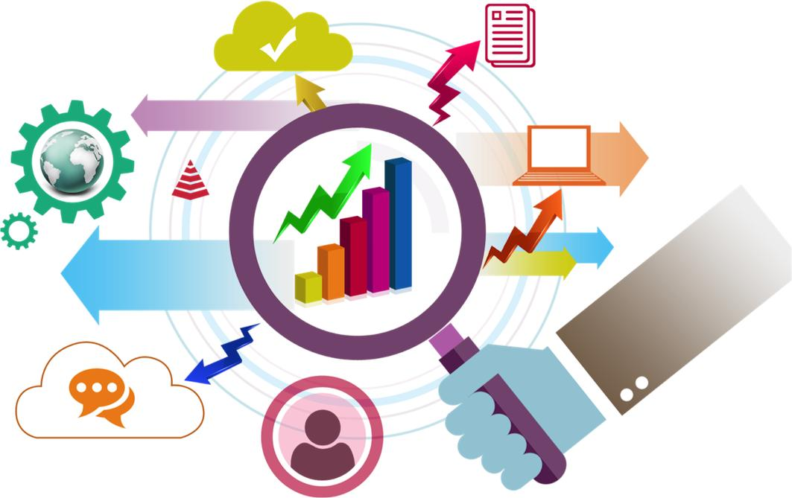
Release 2 Assessment Results
Conduct effective market research for digital services.
Notes:
Duration: 10 minutes
Timing: 8:40-8:50 am
Presenter: Willaim
Facilitator Notes:
With that said, there are a few key areas that we want to review this morning before we dive in to release 3. These are the areas where you achieved the lowest average scores.
Specifically, we see the lowest scores for objective 2.1 and 2.7.

Slide 13

Release 2 Assessment Results
Differentiate between buying compliance and buying outcomes.
Notes:
Duration: 10 minutes
Timing: 8:50-9:00 am
Presenter: William
Facilitator Notes:
With that said, there are a few key areas that we want to review this morning before we dive in to release 3. These are the areas where you achieved the lowest average scores.
Specifically, we see the lowest scores for objective 2.1 and 2.7.

Slide 14
The Acquisition Strategy & Organizational Readiness
Notes:
Duration: 1 hour 45 minutes
Timing: 9:15-11:00
Presented by: Traci/USDS Team
Facilitator Notes:
In this lesson, we will be covering key points of the acquisition strategy. Here are notes from our walkthrough:
Based on where your org is, will use different strategies
Lean canvas is not the tool of acq strategy; it’s how you plot out the information you’ve learned in a clear, easy way
This section is focused on what they need to know in acq strategy related to digital services, talk about examples and case studies they’ve already seen. How ready was agency when we went in there to employ acq strategy? VA team, how was that strategy handled – how would you handle with an agency that hasn’t done it before?

Slide 15
The Acquisition Strategy
Reference Guidance for Acquisition Strategy goals:
Digital Service Acquisition Principles
Digital Service Playbook
Notes:
Duration: ? minutes
Timing: 11:01-
Presented by: Traci/USDS
Facilitator Notes:
Place holder for Traci slides on:
Lesson on acq strategy but not the lean canvases yet, that is day 3:
Exit strategy discussion, building on what was presented in the 3.A online learning
“It depends…”: Using the org readiness/maturity model to tailor your acquisition approach to the maturity of the org and the outcome you’re looking to achieve
Using the lean acquisition canvas: SBA example

Slide 16
The Acquisition Strategy
8(a)
Existing Multi-Award vehicle
New Multi-Award Vehicle
Schedule 70
Open Market
Notes:
Duration: ? minutes
Timing: 11:01-
Presented by: Traci/USDS
Facilitator Notes:
Place holder for Traci slides on:
Lesson on acq strategy but not the lean canvases yet, that is day 3:
Exit strategy discussion, building on what was presented in the 3.A online learning
“It depends…”: Using the org readiness/maturity model to tailor your acquisition approach to the maturity of the org and the outcome you’re looking to achieve
Using the lean acquisition canvas: SBA example

Slide 17
New Multi-Award Vehicles: BPAs, IDIQs
Pros:
Best method for facilitation of modular contracting methods
Keeps pricing and quality continually competitive
Multi-phased solicitation methods
Award Term works best
Cons:
Additional Acq lead time to establish
Notes:
Duration: ? minutes
Timing: 11:01-
Presented by: Traci/USDS
Facilitator Notes:
Place holder for Traci slides on:
Lesson on acq strategy but not the lean canvases yet, that is day 3:
Exit strategy discussion, building on what was presented in the 3.A online learning
“It depends…”: Using the org readiness/maturity model to tailor your acquisition approach to the maturity of the org and the outcome you’re looking to achieve
Using the lean acquisition canvas: SBA example

Slide 18
Existing Multi-Award Vehicles: BPAs, IDIQs
Pros:
Best method for facilitation of modular contracting methods
Keeps pricing and quality continually competitive
Multi-phased solicitation methods
Award Term works best
NASA SEWP facilitates fast access to digital service products
Cons:
Large vendor pools may not give “acq time” savings
Companies may not have the true digital service capabilities
Notes:
Duration: ? minutes
Timing: 11:01-
Presented by: Traci/USDS
Facilitator Notes:
Place holder for Traci slides on:
Lesson on acq strategy but not the lean canvases yet, that is day 3:
Exit strategy discussion, building on what was presented in the 3.A online learning
“It depends…”: Using the org readiness/maturity model to tailor your acquisition approach to the maturity of the org and the outcome you’re looking to achieve
Using the lean acquisition canvas: SBA example

Slide 19
Schedule 70: IT Schedule
Pros:
Large varied scope and capabilities of companies
Task Orders easier than contracts
Facilitates creating own BPA: Agile BPA, SalesForce SIISS BPAs
Small Business set asides allowed
Cons:
Companies may not have the true digital service capabilities
Long time to add or change services/products
Notes:
Duration: ? minutes
Timing: 11:01-
Presented by: Traci/USDS
Facilitator Notes:
Place holder for Traci slides on:
Lesson on acq strategy but not the lean canvases yet, that is day 3:
Exit strategy discussion, building on what was presented in the 3.A online learning
“It depends…”: Using the org readiness/maturity model to tailor your acquisition approach to the maturity of the org and the outcome you’re looking to achieve
Using the lean acquisition canvas: SBA example

Slide 20
Open Market
Pros:
Access to new entrant companies who are SMEs in digital service
Can create BPA under 13.5
Allows easy solicitation procedures and eval criteria, including oral proposals
Cons:
Unknown number of respondents a potential
May be difficult to select this option before other required sources
Notes:
Duration: ? minutes
Timing: 11:01-
Presented by: Traci/USDS
Facilitator Notes:
Place holder for Traci slides on:
Lesson on acq strategy but not the lean canvases yet, that is day 3:
Exit strategy discussion, building on what was presented in the 3.A online learning
“It depends…”: Using the org readiness/maturity model to tailor your acquisition approach to the maturity of the org and the outcome you’re looking to achieve
Using the lean acquisition canvas: SBA example

Slide 21
8(a) Program
Pros:
One of the fastest route to award
Sole source up to $4M
New Waiver for digital service
Helps meet agency socio-economic goals
Modification/changes mid-performance easier
Cons:
Companies may not have the true digital service capabilities
No competition so pricing must be negotiated
Notes:
Duration: ? minutes
Timing: 11:01-
Presented by: Traci/USDS
Facilitator Notes:
Place holder for Traci slides on:
Lesson on acq strategy but not the lean canvases yet, that is day 3:
Exit strategy discussion, building on what was presented in the 3.A online learning
“It depends…”: Using the org readiness/maturity model to tailor your acquisition approach to the maturity of the org and the outcome you’re looking to achieve
Using the lean acquisition canvas: SBA example

Slide 22
Software Strategies
Open Source
How healthy is the product and community that supports it?
Who and what skills do practitioners need to have to develop
What license requirements are imposed https://opensource.org/licenses
COTS
What is the license structure and what are the hidden costs
When is the fiscal year end for the “company” – deals happen
Who are the resellers? NASA/GSA?
Is there a Certified Partner Network and how can you leverage it? SalesForce, Cisco
What does product refresh look like? When are THEY iterating and how can you contribute if you have a problem?
Notes:
Duration: ? minutes
Timing: 11:01-
Presented by: Traci/USDS
Facilitator Notes:
Place holder for Traci slides on:
Lesson on acq strategy but not the lean canvases yet, that is day 3:
Exit strategy discussion, building on what was presented in the 3.A online learning
“It depends…”: Using the org readiness/maturity model to tailor your acquisition approach to the maturity of the org and the outcome you’re looking to achieve
Using the lean acquisition canvas: SBA example

Slide 23
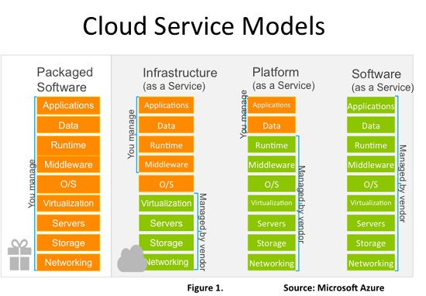
X-As-A-Service Strategies

Slide 24
X-As-A-Service Strategies
Questions to think about:
What service is included in the subscription?
How is this priced for non-government customers?
How are interfaces, APIs, and containerized solutions (docker) managed for the service?
Security: FedRamp? NIST Compliant?

Slide 25
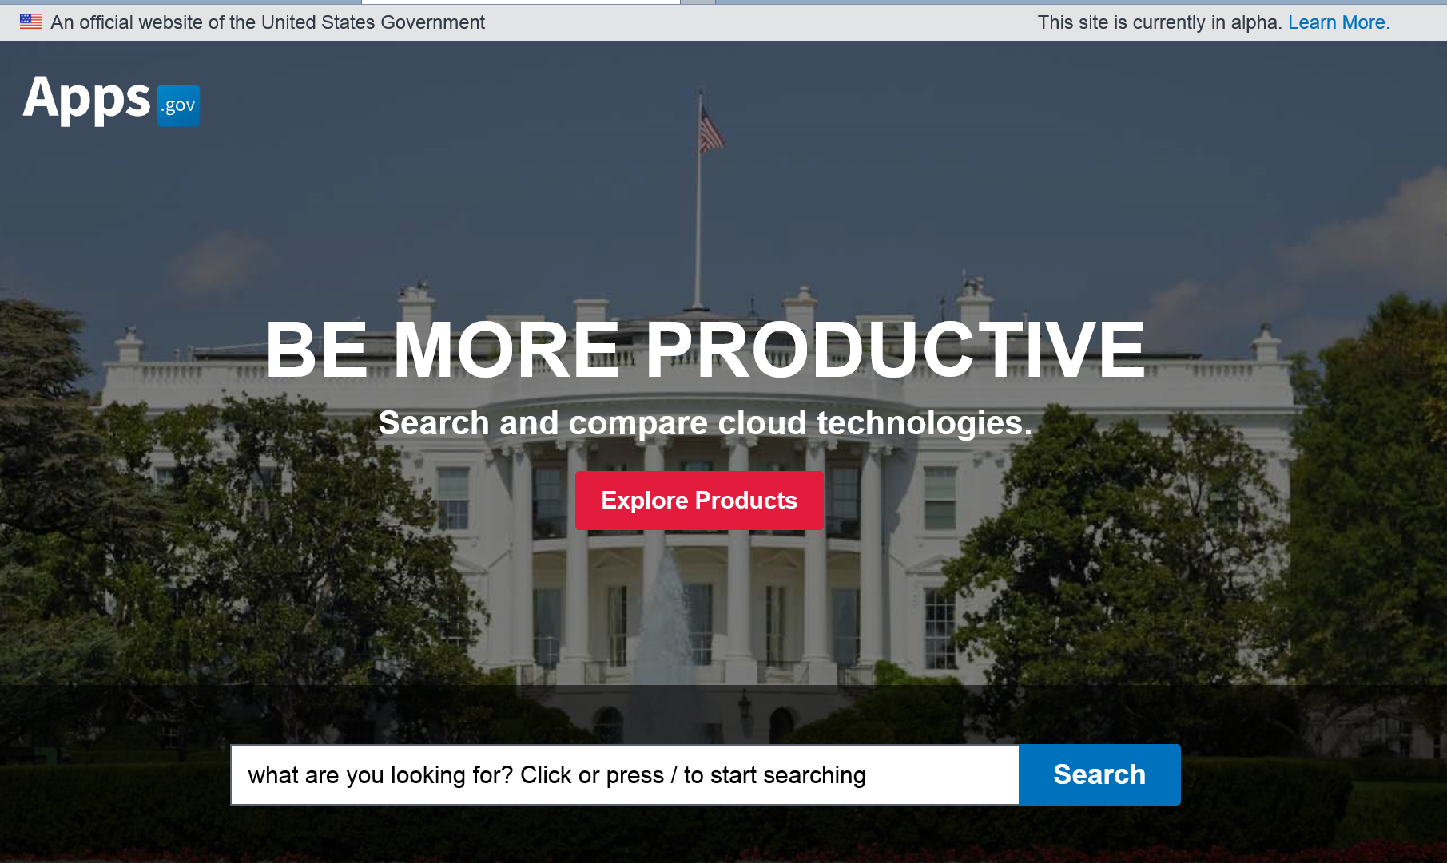
X-As-A-Service Strategies

Slide 26
Organizational Readiness + Strategy
 | Novice | Intermediary | Expert
Agency/Program Persona Characterization | Has not done agile or digital service before. | Has done agile or digital service as a project and is familiar with concepts and deliverables | Comprised of designers, engineers, agile SMEs who are steeped in the concepts and can actually perform the work
Requirements Document | SOO | SOO + PWS | SOO + PWS + SOW
Trust Factor | Build Together | Walk in the door | Inherent throughout

Slide 27
Morning Break
Notes:
Duration: 15 minutes
Timing: 11:00-11:15
Presented by: Melissa
Facilitator Notes:
Instruct participants to take a 15 minute break.
Direct to restrooms and water cooler.

Slide 28
Exercise: Exit Strategies

Slide 29
Exercise: Exit Strategies
Scenario 1:
Your acquisition hits the news: “TSA Spends $1.4 million for a Randomizer app that chooses left or right”
The contract is 2 years in the middle of performance, the “randomizer app” is only one portion of the full deliverable of modernizing TSA systems. 3 years in options left on the POP.
Program office decides it wants to cancel the contract to distance itself from the negative press.
Is there an exit strategy? What should you do?
Notes:
Duration: 15 minutes
Timing: 11:15-11:30
Presented by: Traci/USDS team
Facilitator Notes:

Slide 30
Exercise: Exit Strategies
Scenario 2:
You are conducting a new acquisition for an update to your agency’s conference room scheduler system. The current system is a proprietary system managed by a vendor that you do not have performance issues with. The current contract expires in 4 months and you do have one additional option remaining.
You are planning to move to agile development methods, but realize your agency is not organizationally ready
What strategies or methods do you have available?
Notes:
Duration: 15 minutes
Timing: 11:15-11:30
Presented by: Traci/USDS team
Facilitator Notes:

Slide 31
Exercise: Exit Strategies
Scenario 3:
You award a FFP/iteration task order for digital services including UX design and development support for a high profile citizen facing service for your agency. Additionally, they are supporting the infrastructure with COTS tools they bought on the agency’s behalf.
The contractor has a very rough time getting ramped up due to frequently changing personnel. They are behind on their iterations and are not delivering product that is capably of being released to end users.
What do the exit strategies look like? How would the COTS tools be managed?
Notes:
Duration: 15 minutes
Timing: 11:15-11:30
Presented by: Traci/USDS team
Facilitator Notes:

Slide 32
Exercise: Exit Strategies
Scenario 4:
You’re going to award your first purchase order(s) for support services to implement Drupal, an open source content management service. You intend to make sure that all code is delivered to code.gov and released in an open source format. Your program office wants to have the open source community contribute to the applications built.
How can your acquisition strategy be set up to facilitate this?
Notes:
Duration: 15 minutes
Timing: 11:15-11:30
Presented by: Traci/USDS team
Facilitator Notes:

Slide 33
Lunch
Notes:
Timing: 1 hour
Presented by: Melissa
Facilitator Notes:
The lunch break will run from 12-1:00pm.

Slide 34
Let’s Talk Pricing/Contract Type for Cloud and Agile
Notes:
Facilitator: Traci Walker
Duration: 1 hour, 30 minutes
Timing: 1:00-2:30 pm
Facilitator Notes:
This session will be a discussion of pricing strategies and contract types for cloud and agile procurements.

Slide 35
Afternoon Break
Notes:
Duration: 15 minutes
Timing: 2:30-2:45
Presented by: Melissa
Facilitator Notes:
Instruct participants to take a 15 minute break.
Direct to restrooms and water cooler.

Slide 36
Live Digital Assignment Working Session
Notes:
Timing: 2:45-4:00
Presented by: Melissa
Facilitator Notes:
For the last hour of the day, we have set aside more time for you to work with your Live Digital Assignment teams.
You should spend this time preparing for the demo day we are holding Friday, during which you will report out your progress to the cohort.
You should walk through each aspect of your project.

Slide 37
Demo Day Preparation
Prepare to report out your findings to the cohort later this week with a 10-minute presentation. Be prepared to discuss:
Overall project and market research.
Your Product Vision.
Your plan for testing your hypothesis.
Your key learnings/takeaways, successes, challenges, and anticipated next steps.
Notes:
Timing: 2:45-4:00
Presented by: Melissa
Facilitator Notes:
While you work on your Live Digital Assign
What we are expercting is a brief out of where their project is now, their hypothesis, and their testing plan for the hypothesisment, please reach out to the staff if you have any questions or comments and we will be glad to help.

