Slide 1
Digital Acquisition Pilot Iteration 4.A Planning Meeting
December 5 – December 16, 2016

Slide 2
Agenda
Introducing our new facilitator, Peter Bonner
Iteration 4.A Welcome and Introduction
Reminders and updates
Capstone
Iteration 3.B Post-Assessment
Sessions and activities that compose the iteration
Notes:
Facilitator Notes:
Today we’ll be starting with some reminders and updates. Then we’ll go over all of the activities for this iteration, including your capstone presentation.

Slide 3
Notes and Updates
Assessments
We have several folks who have not completed the Iteration 3.B Post-Assessment yet
Iteration 4.A Pre-Assessment
Outstanding assignments
You will receive an update this week on any outstanding assignments that you have to turn in.
Notes:
Facilitator Notes:
Some other updates– we still have folks who have not completed the Iteration 3.B Post-Assessment. Please remember that this is a bronze requirement, and you must complete it to pass the class.
Our facilitation team is going to send an update out this week to with information on which assignments you still have to complete/turn in.

Slide 4
Iteration 4.A – What It’s All About
Iteration 3.B – Where We’ve Been
Identify the role that security plays in digital service contracts.
Develop your acquisition package for procuring digital services, including proposal and source selection methods.
Define evaluation criteria, given evaluation strategy discussed in your acquisition strategy.
Iteration 4.A– What’s Next
Select a technical evaluation team with the necessary digital skills.
Identify how to get the best value solution for your program by negotiating tradeoffs.
Determine the next steps that follow contract award.
Identify the effective characteristics of a change agent and strategies to apply at different phases of the change lifecycle as you return to your agency.
Notes:
Facilitator Notes:
Congratulations wrapping up iteration 3.B. To review, you:
Identified how to develop an acquisition strategy for digital services.
Selected an acquisition strategy that supports your customer's needs for a digital acquisition.
Identified strategies and communication methods to apply at different phases of the change lifecycle.
Identified evaluation methods and criteria on cost and pricing, terms and conditions, security concerns (cyber), and data rights to evaluate vendor maturity and ability to deliver a product that solves a given need and given the definition of success.
In this next iteration, Iteration 4.A, you will:
Select a technical evaluation team with the necessary digital skills.
Identify how to get the best value solution for your program by negotiating tradeoffs.
Determine the next steps that follow contract award.
Identify the effective characteristics of a change agent and strategies to apply at different phases of the change lifecycle as you return to your agency.

Slide 5
Iteration 4.A Timeline and Bronze Activities
Iteration 4.A – December
Dec. 5 | 6 | 7 | 8 | 9
Iteration Planning Meeting
11:00 – 11:30 am ET
12 | 13 | 14 | 15 | 16
Webinar: Post-Award Administration
1:00 – 2:00 pm ET
Iteration 4.A Pre-Assessment
30 minutes
Online Learnings:
The Tech Evaluation Team, The Tradeoff Game Negotiating with Vendors, The Power of an Effective Debrief, Leading Change
Reading: Post Award Management of Agile Contracts
30 Minutes
Webinar: SBA Post-Award Administration
1 hour
Activity: Blog Your Acquisition Package
2 hours
Iteration 4.A Post-Assessment
30 minutes
Notes:
Facilitator Notes:
This week we have the Iteration Planning meeting today, and on Tuesday of next week we have the iteration web conference. The following slides will have more details about that.
There are several online learnings for this iteration– we have 5 online learnings that range from 30 minutes to a half hour each. We also have an activity that we estimate may take up to two hours.
As usual, you will have a pre and post assessment for the iteration. Please do not forget about these!
The activities you see on this page are the bronze-level activities, we will discuss the silver activities more with our activity walkthrough.

Slide 6
Iteration 4.A Webinar: Post-Award Administration
Iteration 4.A - December
Dec. 5 | 6 | 7 | 8 | 9
Iteration Planning Meeting
11:00 – 11:30 am ET
12 | 13 | 14 | 15 | 16
Webinar: Post-Award Administration
1:00 – 2:00 pm ET
Webinar with Mary O’Toole
Tuesday, December 13 from 1:00 – 2:00pm
We will post a recording and transcript to the portal if you are unable to attend.
Notes:
Facilitator Notes:
Mary O’Toole is the Product Manager on the SBA Digital ONE Modernization effort that you learned about earlier in the program. She will discuss post-award administration activities and lessons learned from her experiences in this role.

Slide 7
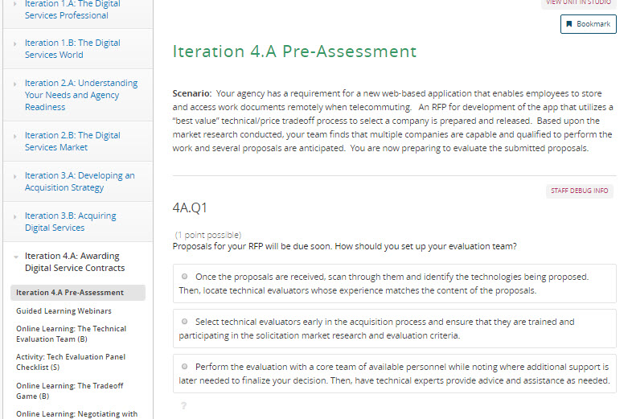
Iteration 4.A Pre-Assessment
Iteration 4.A Pre-Assessment
About 30 minutes
Bronze-level requirement
Presents you with a real-life challenge that you may encounter on the job
Use exercise as a gauge to determine your knowledge going into this iteration
Notes:
Facilitator Notes:
As with previous iteration, this 30-minute pre-assessment introduces you to the content for this release in an applied and engaging manner--by presenting you with a real-life challenge that you may encounter on the job.
Use this exercise a gauge to determine where you are and how well you perform against the learning objectives for this release. As with Release 3, you will receive the results of your pre-assessment immediately along with the activities you need to complete to earn your badges for this iteration.
Although this isn't a formal assessment, we will review your results and those of your peers to see where the class has strengths and weaknesses. That way, we can tailor materials and discussions to focus in on areas where participants are struggling or need extra guidance.

Slide 8
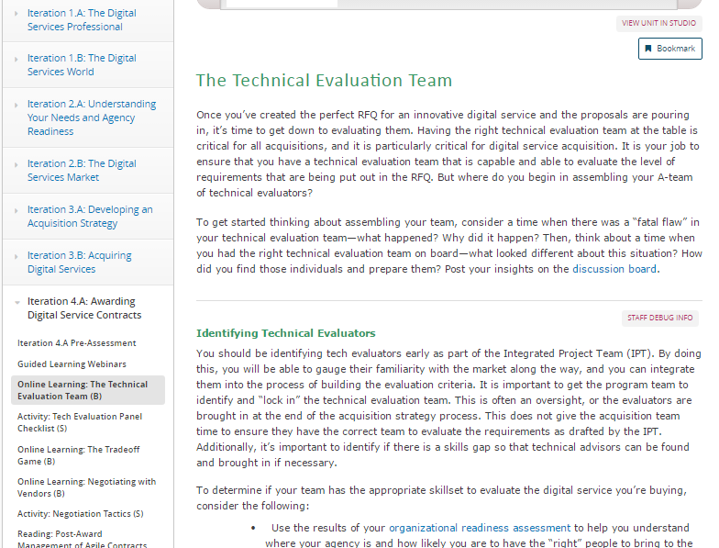
Online Learning: The Technical Evaluation Team (B)
Online Learning: The Technical Evaluation Team
About 30 minutes
Bronze-level requirement
Selecting a cross-functional team
Training and preparing the evaluation team
Facing challenges that emerge in the process
Notes:
Facilitator Notes:
About 30 minutes
Bronze-level requirement
This activity walks you through how to select a technical evaluation team that is cross-functional and has the necessary skillsets to evaluate a digital services procurement. This will significantly increase the chances of your acquisition’s success.
The module provides guidance on how to prepare and train the team.
You’ll also learn about some of the challenges you may face, and how to work through them.

Slide 9
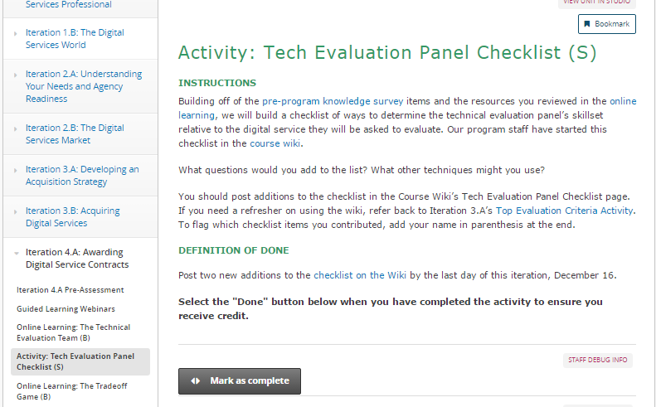
Activity: Tech Evaluation Panel Checklist (S)
Activity: Tech Evaluation Panel Checklist
30 minutes
Silver-level requirement
Build a checklist you can reference to determine the technical evaluation panel’s skillset relative to the digital service.
The facilitation team has started a list in the Course Wiki, you should add at least two new items.
Notes:
Facilitator Notes:
In this silver-level activity, you’ll build a checklist you can use to determine the technical evaluation panel’s skillset relative to the digital service each member will evaluate.
You should reference the pre-program knowledge survey (which we have linked) and the previous online learning to help you develop your checklist items
The goal of this activity is to build a checklist for the whole cohort to use, so we ask that you contribute with at least two new items. The facilitation team has started the list in the Course Wiki.
If you are don’t remember how to use the course wiki or markdown, we’ve included a link to the guidance from Iteration 3.A.

Slide 10
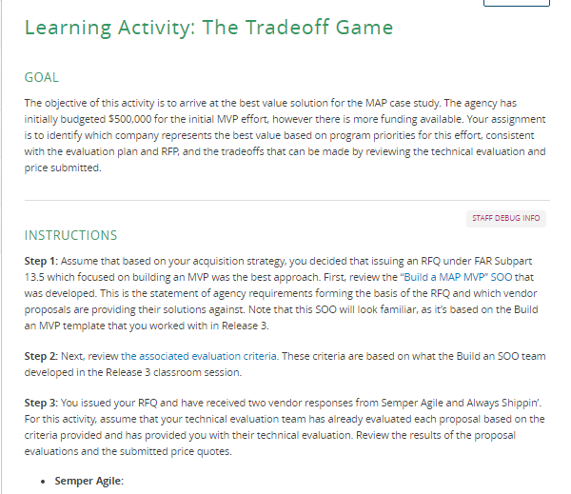
Online Learning: The Tradeoff Game (B)
Online Learning: The Tradeoff Game
1 hour online learning
Bronze-level requirement
Focus on determining which solution offers the best value to your agency.
For this activity, you will be evaluating two mock proposals, and given evaluation criteria, determine which is the best value.
Extension of the MAP Case Study
Notes:
Facilitator Notes:
This 1 hour online learning has the goal of helping you determine how to get the best value solution. At a high-level, we bring back the MAP case study you’ve been introduced to earlier in the program. The MAP agency has decided to solicit an MVP to solve their challenges, and you’ll need to review the SOO and evaluation criteria, which is based on what you developed in the Release 3 classroom, and then review the results of the technical evaluation of two mock proposals. Then, we ask you to think about the best tradeoff and questions you’ll need to ask. This will be an activity that we then build on and explore further in the Release 4 classroom session.
This is a bronze-level requirement, meaning you’ll need to complete it to receive credit for this iteration.

Slide 11
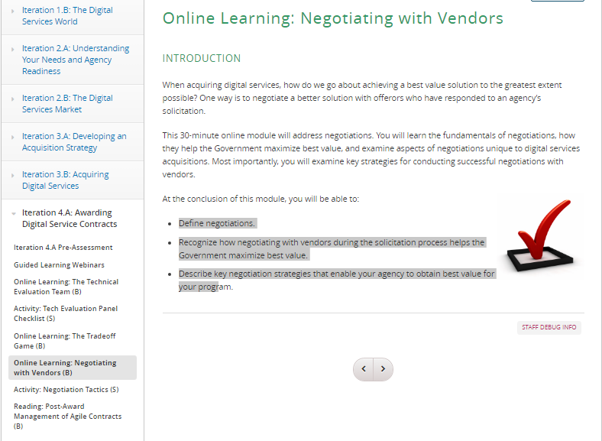
Online Learning: Negotiating with Vendors (B)
Online Learning: Negotiating with Vendors
1 hour online learning
Bronze-level requirement
You will be able to:
Define negotiations
Recognize how negotiation during the solicitation process helps the government maximize best value
Describe key negotiation strategies to obtain best value
Notes:
Facilitator Notes:
While you’re already likely familiar with negotiations in general, this online learning presents a refresher and some additional considerations from the perspective of digital services. The module will help you:
Define negotiations.
Recognize how negotiating with vendors during the solicitation process helps the government maximize best value.
Describe key negotiation strategies that enable your agency to obtain best value for your program.
This is also a bronze-level requirement.

Slide 12
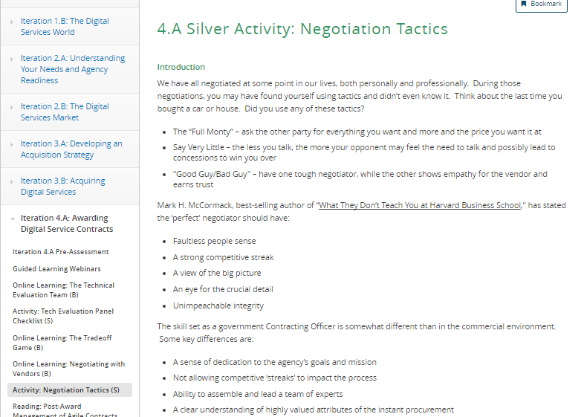
Activity: Negotiation Tactics (S)
Activity: Acquisition Package Analysis
About 30 minutes
Silver-level Activity
Use the Course Wiki to share a time when you have had to use negotiation with someone else.
Consider the setting, goal of the negotiation, tactics used, and the result of the negotiation.
Notes:
Facilitator Notes:
In this silver-level activity, we’ll build on the bronze activity and have you use the course wiki to share about when you have used negotiation tactics in your work. You’ll answer a series of questions to complete this activity.

Slide 13
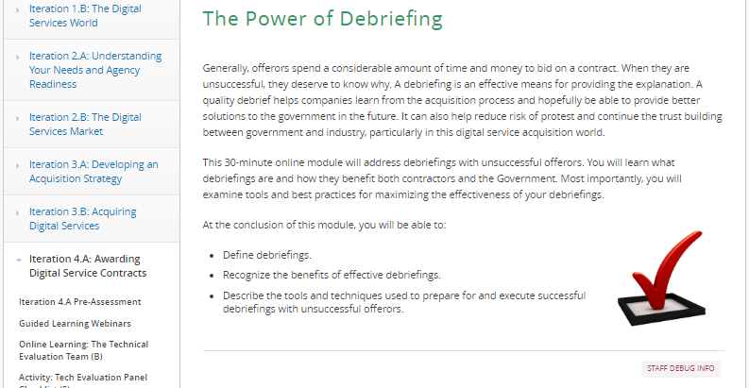
Online Learning: The Power of Debriefing (B)
Online Learning: The Power of Debriefing
30 minutes
Bronze-level activity
Define debriefings.
Recognize the benefits of effective debriefings.
Describe the tools and techniques that are used to prepare for and execute successful debriefings with unsuccessful offerors.
Notes:
Facilitator Notes:
Next, we have another online learning focused on debriefing. Once again, you’ve learned about debriefing before, but this module presents some new perspectives on the topic specific to digital services and why debriefing is so important.

Slide 14
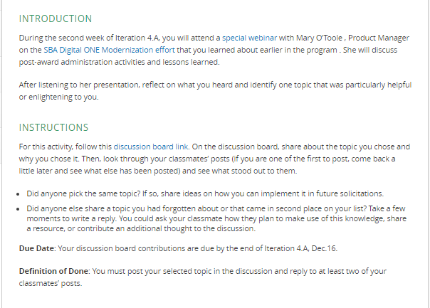
Activity: Post-Award Webinar Discussion (S)
Activity: Post-Award Webinar Discussion
About 30 minutes
Silver-level activity
Reflect on the webinar, and identify one topic that was particularly helpful or interesting.
Post your insights to the linked discussion boarded, and respond to two others.
Notes:
Facilitator Notes:
Based on the SBA webinar discussed at the beginning of this meeting, this is a silver activity that builds upon it. We ask that you post the most helpful or interesting thing you learned to the discussion page, and respond to two of your classmates.
This activity should take about 30 minutes, and it is a silver-level activity.

Slide 15
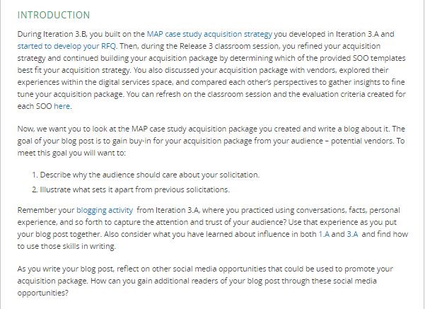
Activity: Blog Your Acq Package! (B)
Activity: Blog Your Acquisition Package
About 2 hours
Practice “pitching” the MAP case study in a blog post—to help you practice using a non-traditional means to communicate out about a solicitation
Notes:
Facilitator Notes:
Now we move into several activities that focus on additional knowledge and skills that you can use back on the job as you start to lead change and promote innovative approaches that attract non-traditional vendors. So in line with this goal, in this bronze level activity, we ask that you practice using a non-traditional means to communicate out about a solicitation—specifically a blog about the acquisition package you developed in the Release 3 classroom session. So by that we mean, assume that you were to be putting the acquisition package that your team worked on in the classroom “on the streets” and were using blogging as a means to communicate out about it. As you’ll see in the write-up on the portal, we ask that you pull from our previous discussions of effective communication and ways to gain buy-in in putting together your response.
This activity should take about 2 hours, and it is a bronze-level activity.

Slide 16
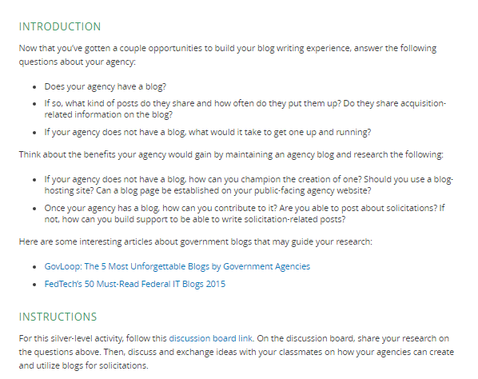
Activity: Blogging Research (S)
Activity: Blogging Research
About 2 hours
Write a discussion post about your agency and blogging.
Does it have a blog?
What kind of posts do they share? Do they share acq-related information on the blog?
Notes:
Facilitator Notes:
Next, and related to blogging, we have a silver-level activity where we ask you to do some research into how your agency is using blogging and whether solicitations have been—or could be shared—on it. This activity should take about 2 hours, and it is a silver-level activity.

Slide 17
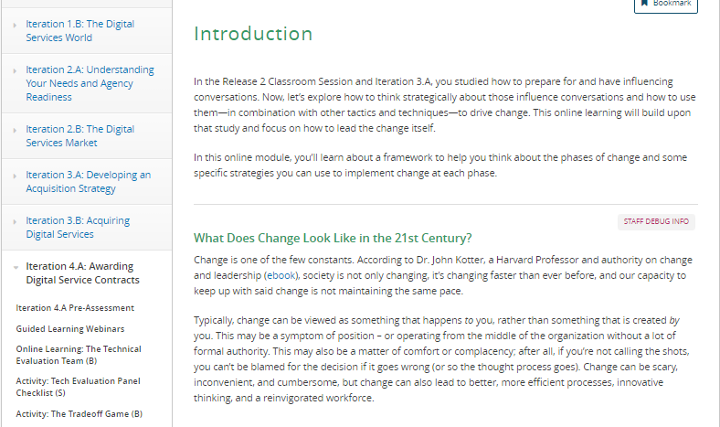
Online Learning: Leading Change (B)
Online Learning: Leading Change
About 30 minutes
Bronze-level activity
In this module, we will walk through a framework that you can use to help you think about the phases of change
Specific strategies you can use to implement change
Notes:
Facilitator Notes:
Next, we have an online learning that is all about leading change. You’ve been introduced to some of the techniques you can use to influence and have difficult conversations; in this module, we build on that and focus on an overarching framework (Kotter’s model, which is probably familiar to those of you who have studied this topic before) that you can use to think about how to do so.
This online learning should take about 30 minutes, and it is a bronze-level activity.

Slide 18
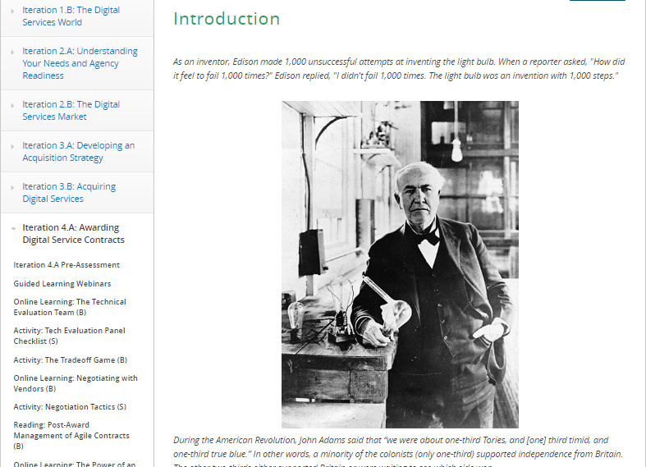
Online Learning: Building Your Resilience (S)
Online Learning: Building Your Resilience
About 30 minutes
Silver-level activity
In this module, we will walk through several techniques to respond productively to setbacks and pushback.
Topics include:
Growth mindset
Wellness rituals
Responding to negative feedback
Notes:
Facilitator Notes:
In this 30-minute online module, you’ll learn techniques to help you cultivate your mindset around change and thus, respond productively when you encounter setbacks and pushback. Specifically, you’ll learn:
Characteristics of a “growth mindset”
Wellness rituals and techniques that can enhance your performance during transition
How resilience and a growth mindset help you take risks and innovate
How to positively respond to negative feedback and failure by analyzing the situation and adjusting your approach
How to differentiate between situations where it makes sense to continue pushing for change and others where you may need to redirect
This is a silver-level online learning

Slide 19
What’s Next
Notes:
Facilitator Notes:

Slide 20
Iteration 4.A Post-Assessment
The 4.A Post-Assessment will be ready by the week of December 12.
We ask that you complete the assessment by the end of the week.
Notes:
Facilitator Notes:
Reminder that we’ll have an Iteration 4.A post-assessment for you to complete to measure your progress through the iteration. PLEASE complete this in a timely fashion—it’s important for us to understand how you’re doing as a cohort and is required in order for you to graduate on Jan. 11.

Slide 21

Capstone Skills Test
After Release 4, you will take the Capstone Skills Test
Seven (7) real-world animated scenarios
3-5 situational questions per scenario
Take before the classroom session
Notes:
Facilitator Notes:
Let students know that the Capstone Skills Test (the final test for the course that encompasses everything they have learned) is coming up at the end of Release 4.
The test will be scenario-based with 3-5 questions per scenario.
Everyone must complete the Capstone Skills Test before the Release 4 classroom session.

Slide 22

Live Digital Assignment Final Presentation
Final presentation will be during the Release 4 Classroom session.
You will pitch your product to a panel of faculty and guests.
The goal is to gain the panels’ commitment of time and resources to fully build out your product.
The portal contains detailed instructions on what to present.
Presentation Rules
15 minutes to present; 10 minutes for questions
All team members must participate/talk in the presentation
Notes:
Facilitator Notes:
In addition to the Capstone Skills Test, the final presentations for the Live Digital Assignment are coming up.
They will be done during the Release 4 Classroom session.
Unlike the previous presentations, your final presentations will be a pitch in front of a panel comprised of USDS, OFPP or other guests.
The presentations will be similar to the reality show Shark Tank, where each group must pitch their Live Digital Assignment product to the panel to gain the panelists commitment of time and resources to pick up the project and build it out.
There are detailed instructions on the portal, including a list of talking points that must be covered during each presentation.
The presentation rules are:
Each group has 15 minutes to present and 10 minutes for questions
All team members must participate (meaning perform part of the presentation)

Slide 23
Live Digital Assignment Final Presentation
You will provide self-ratings and peer ratings (i.e., fellow team members)
Peer Rating Dimensions
Engaged Contribution
Collaborative Action
Rating panel (i.e., faculty, invited guests) will provide ratings
Panel Ratings Dimensions
Investment Buy-in
The Pitch Itself
Notes:
Facilitator Notes:
As you heard during the Course orientation, your live digital assignments will be graded on both self and peer ratings, as well as ratings from the panelists at the final presentations.
There are four rating dimensions, and they are weighted equally.
The self and peer ratings are: Engaged Contribution and Collaborative Action.
Because of the restructuring to the Live Digital Assignment, the panel ratings have change from what was in Orientation. The new ratings are: Investment Buy-in and the Pitch Itself.
The next few slides will show the details of each rating

Slide 24
Live Digital Assignment: Self Ratings & Peer Ratings
Engaged Contribution Displays and applies adequate individual effort and tangible contributions to creating team work products, attends and actively participates in team events, motivates self and others to sustain enthusiasm and effective participation
Low | Medium | High
Does not display a “fire in the belly” or “quiet intensity of purpose,” participates at a low and/or inconsistent level, does not encourage fellow team members’ contributions | Tentative or intermittent willingness to “stretch” and apply his/her passion for the work, participates at a moderate level, inconsistent enthusiasm and support for fellow team members | Consistently displays passion for team excellence, strives to achieve “stretch” goals or overcome task challenges with a positive attitude, consistently participates at a high level, consistently inspires the best from fellow team members
Notes:
Facilitator Notes:
Walk the students through the main definition of the Self/Peer rating and the different scores that can be earned.

Slide 25
Live Digital Assignment: Self Ratings & Peer Ratings
Collaborative Action Contributes to a cohesive, inclusive and motivated team atmosphere, assesses relative team members’ areas of strength and works to combine efforts to create quality team products, identifies performance problems in a fact-based manner that facilitates mutual problem-solving, contributes to moving the team forward to achieving results
Low | Medium | High
At times, displays difficulty defining his/her role in the team, may engage in power dynamics (push-pull) when navigating team members’ contributions, and may not address performance problems constructively | Understands his/her role and authority dynamics within the team, has moderate understanding of how to combine/synthesize team members’ contributions, displays behaviors that include multiple perspectives, and acknowledges performance problems | Displays command of his/her role and useful ways of leveraging his/her expertise for the combined benefit of the group, regularly moves the team forward towards achieving results, maximizes the power of multiple perspectives within the team, and addresses performance problems in a fact-based manner to facilitate mutual problem-solving
Notes:
Facilitator Notes:
Walk the students through the main definition of the Self/Peer rating and the different scores that can be earned.

Slide 26
Live Digital Assignment: Expert Panel Ratings
Investment Buy-In The “Investors” will support this new endeavor because the information presented explains how the product could be implemented, how it will improve the end users experience in some way, and how the potential of the product indicates return on investment.
No | Maybe | Yes
Is not able to illustrate the future of the product and what success would look like. Does not have attainable future goals or plans on how to implement or further test the product. | Has presented some of what success will look like, but the product’s future is either not fully thought out or has an unrealistic plan moving forward. | Successfully shows the panelist what success of the product will look like in the near and distant future. Has a good plan on how to move forward and implement or further test the product.
Notes:
Facilitator Notes:
Walk the students through the main definition of the Panel rating and the different scores that can be earned.

Slide 27
Live Digital Assignment: Expert Panel Ratings
The Pitch Itself The Presentation team was able to convey technical concepts, influencing techniques, and visuals to project in a compelling, engaging manner that inspires an investor to support the new endeavor. Builds trust and a bond with the investors such that enduring involvement is highly probable.
Needs Work | OK | Great
Does not use the presentation in a way that influences a panelist to support their product. Introduces skepticism instead of building trust with the investor. May have relied more heavily on some team members to “carry” the presentation than a united message. | Presents the material well but leaves the panelist with some small doubts about the product. Covered the required elements but left the investors wanting more information. | Presentation was coherent, polished, and utilized all team members to gain the investors’ interest and trust in the product.
Notes:
Facilitator Notes:
Walk the students through the main definition of the Panel rating and the different scores that can be earned.

