Slide 1
Developing a Product Vision

Slide 2
What is a Product Vision?

Slide 3
PRODUCT VISION
The product vision is the overarching goal you are aiming for, the reason for creating the product
You must first have a clear understanding of the problem you want to solve #truenorth
Notes:
- If you don’t know where you’re trying to get to, the odds of getting there are slim
To choose the right vision, ask yourself:
- what is the problem is we are trying to solve?
- why you are excited to work on the product
- why your care about it?
- what positive change the product should bring about and how it will shape the future?

Slide 4
A PRODUCT VISION IS NOT…
The Product Vision is not the Product
The Product Vision is not the Product Strategy
Notes:
Be clear on the difference between the product VISION and the PRODUCT and don’t confuse the two.
The former is the motivation for developing the product; the latter is a means to achieve the overarching goal.
Your product vision should not be a plan that shows how to reach your goal.
Instead, you should keep the product vision and the product strategy – the path towards the goal – separate.
This enables to change your strategy while staying grounded in your vision. (This is called to pivot in Lean Startup.)

Slide 5
The Shared Vision
Notes:
- You can come up with the most beautiful vision but it’s without buy-in.
- To create alignment, and to facilitate effective collaboration, the product vision must be shared
- Everyone must have the same vision.
- Without a shared vision, people follow their own goals making it much harder to achieve product success.

Slide 6
DEVELOPING A SHARED VISION
A stake in the ground with a giant flag on the horizon
The role of the Product Owner is to lead towards the flag
Once developed, it needs to be socialized
Notes:
- The product vision is a stake in the stand
- It is a giant flag on the horizon
- The role of the IPT is to lead towards the flag
- Once the IPTs have the vision, it needs to be socialized
- The more everyone can see the flag, the more they will converge
- And once the flag is in the sand, even if markets change or there is a crisis shift – you can pick up the flag and move to a new location

Slide 7
DEVELOPING A SHARED VISION
“If you are working on something exciting that you really care about, you don’t have to be pushed. The vision pulls you.” -Steve Jobs
Notes:
Your vision should therefore motivate people, connect them to the product, and inspire them.
A vision focused on creating a benefit for others provides a particularly deep motivation and a lasting inspiration.
People excel because they believe that they are doing something meaningful and beneficial.
IPT owns the flag, and constantly moves towards the flag. Socializes the vision. This is important.

Slide 8
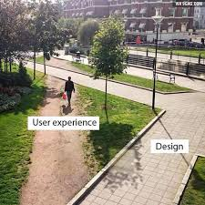
ELEMENTS OF A SHARED VISION
Product vision has a focus on the experience of users
It inspires and motivates
Notes:
- A common trap is to focus only on technological innovation, but this would be a mistake, since technology changes over time.
- Predicting new technology five years out will be near impossible.
- The best teams ensure they focus on the experience of the user, divorced from the underlying technology.
- The vision talks about how users experience the product or service. Experiences don’t change quickly and make for a better long-term target

Slide 9
Understanding the Problem
Notes:
- There can be no solution until there is a clear understanding of the problem
- Don’t assume everyone knows the problem upfront

Slide 10
UNDERSTANDING THE PROBLEM
The best designed products or services have deep understanding of the problem of the experience they are trying to solve.
Notes:
- If you don’t know it, you want to use an agile process to understand the problem(s)
- This will most certainly back us into corners and won’t be good

Slide 11
UNDERSTANDING FALL IN LOVE WITH THE PROBLEM
A well crafted product vision will permeate the entire process from implementation (or acquisition)strategy to product roadmaps, to stories, to how they are executed
Notes:
- Fall in love with the problem first.
- This is not a quick thing, but is core to being successful

Slide 12
Guess the Product!

Slide 13
PRODUCT VISION EXAMPLES
“Our vision is to be earth's most customer centric company; to build a place where people can come to find and discover anything they might want to buy online."
Notes:
Work backwards… who is it?

Slide 14
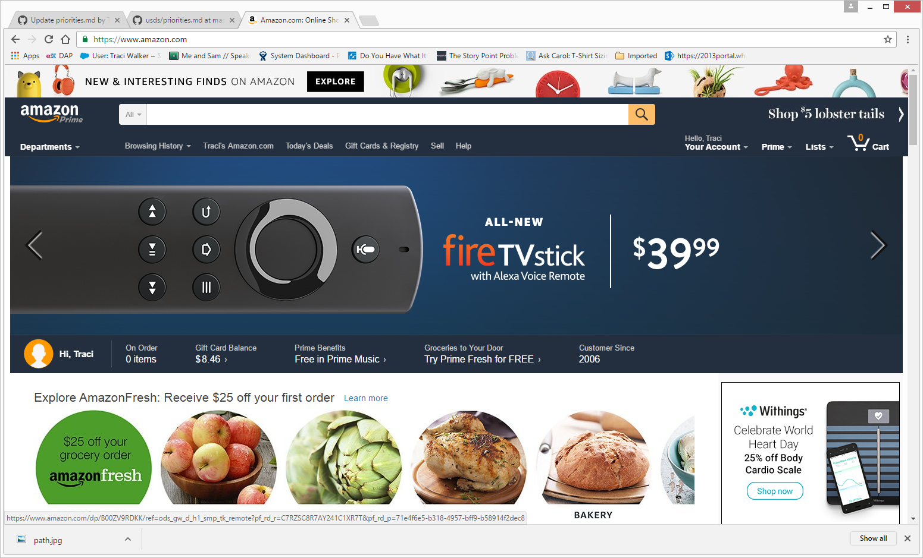
Amazon
Notes:
Amazon

Slide 15
PRODUCT VISION EXAMPLES
“Our vision is to create a better everyday life for the many people. Our business idea supports this vision by offering a wide range of well-designed, functional home furnishing products at prices so low that as many people as possible will be able to afford them.”
Notes:
Who is it?

Slide 16
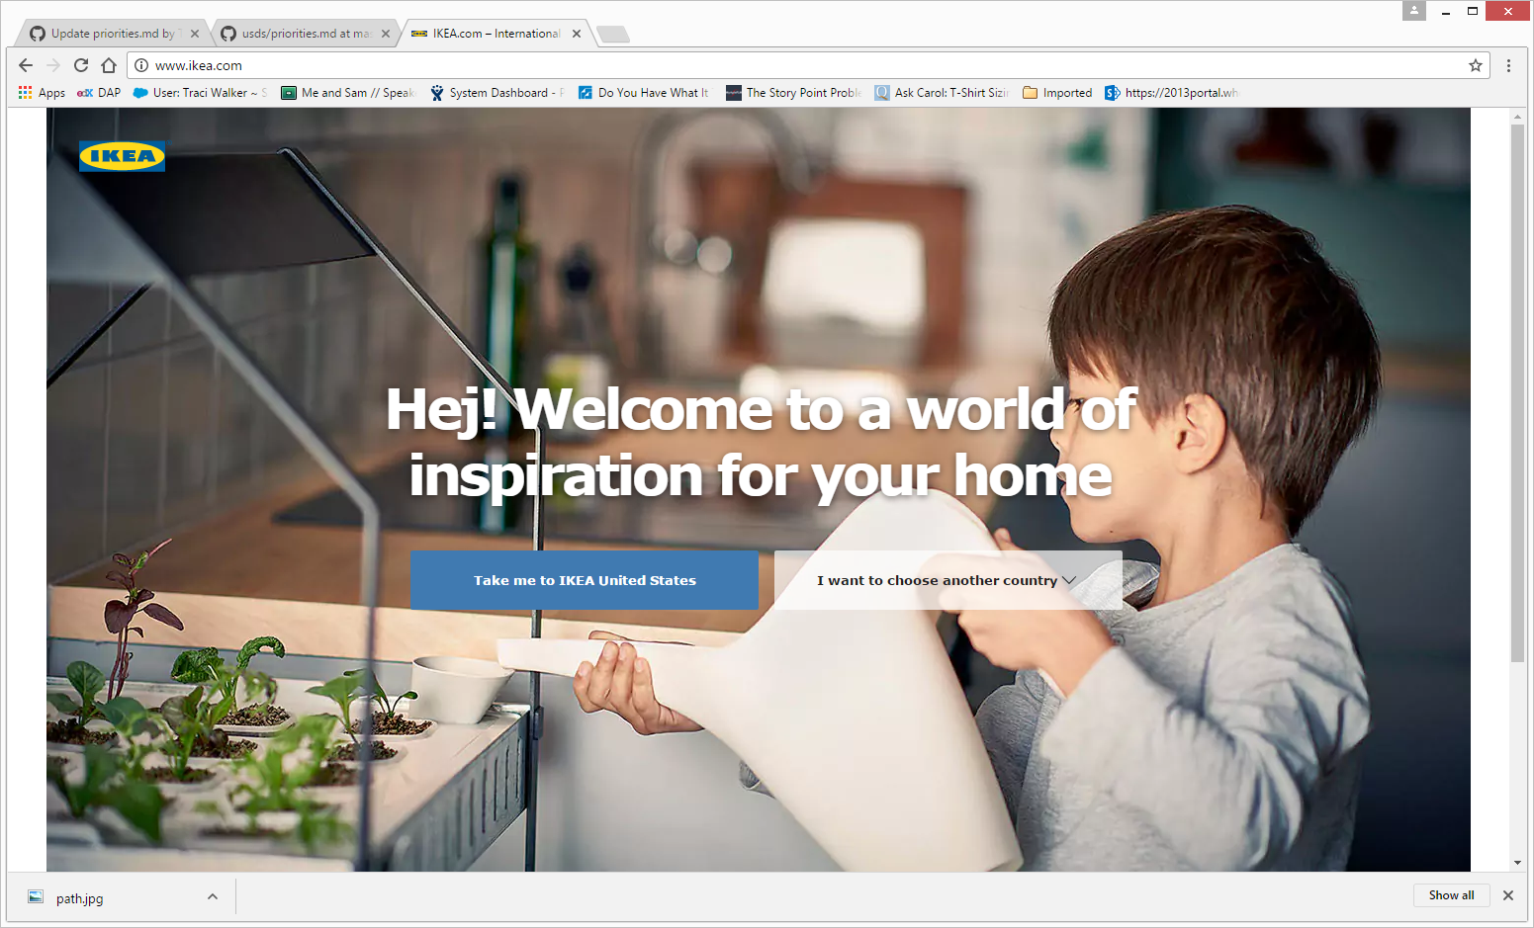
IKEA
Notes:
Ikea

Slide 17
PRODUCT VISION EXAMPLES
“One day, 30% of all retail transactions in the US will be online.
People will buy from the company with the best service and the best selection.
Zappos.com will be that online store.”
Notes:
This is an example of a viewpoint to the future-
What does this vision NOT mention? Shoes_ It is looking to the future and what it CAN become – not what it does now

Slide 18
PRODUCT VISION EXAMPLES
“Building a single unified digital experience for all veterans”
Notes:
Guess what this relates too

Slide 19
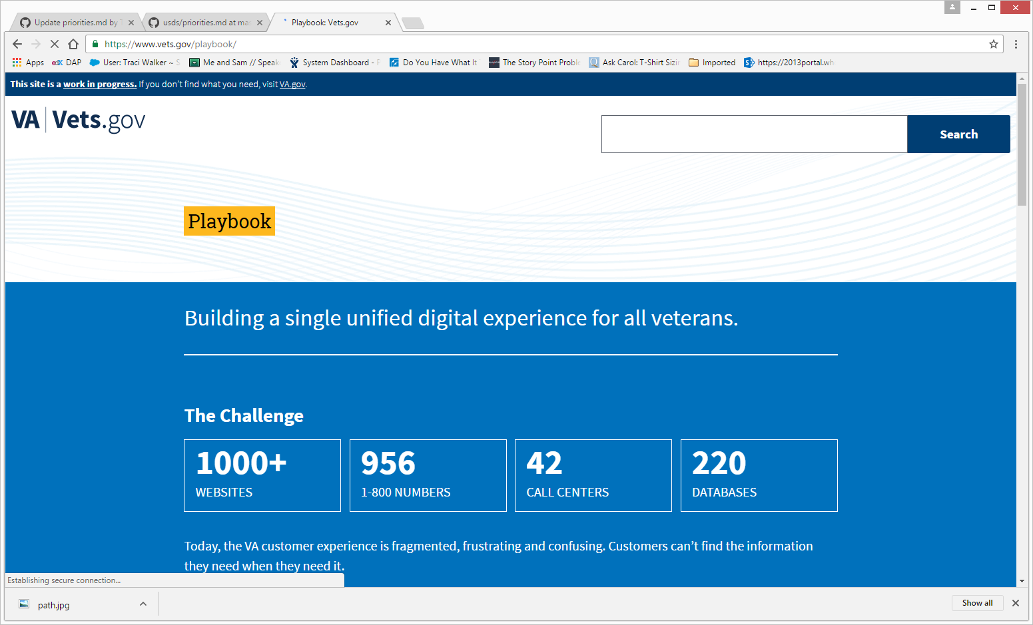
VETS.GOV - Dept of Veteran Affairs
Notes:
Ikea

Slide 20
PRODUCT VISION EXAMPLES
“Engage and educate potential college students of any age or background, and those that support and advise them, to find the schools best suited for them”
Notes:
Ikea

Slide 21
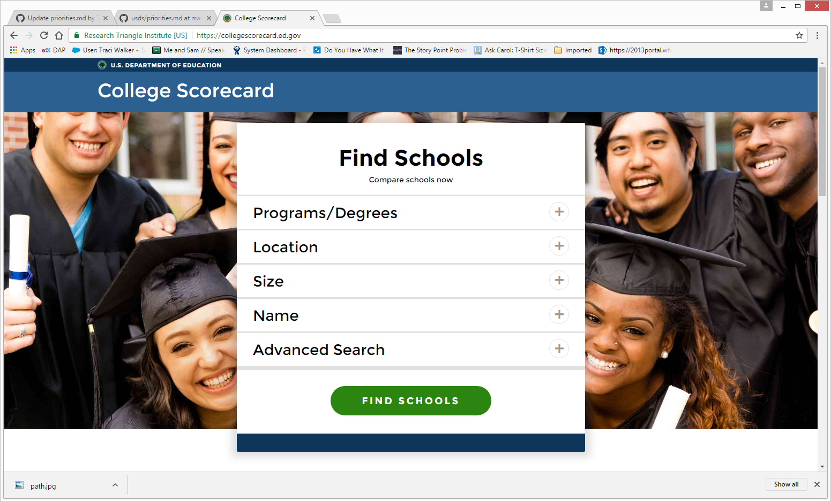
College Scorecard – Dept. of Education
Notes:
Ikea

Slide 22
Developing a Product Vision

Slide 23
ELEMENTS OF A PRODUCT VISION
Vision is a viewport into the future
It is not a description
It’s how something is different in 3-5 years from now
It is the outcomes we are looking for
Notes:
- When we speak about Vision it is a viewport into the future
- It is not a description
- It’s how something is different in 3-5 years from now
- It is the outcomes we are looking for

Slide 24
ELEMENTS OF A PRODUCT VISION
Say a lot in a few words
Ideally it can be memorized and recited
Be deliberate about every element
Notes:
- When we speak about Vision it is a viewport into the future
- It is not a description
- It’s how something is different in 3-5 years from now
- It is the outcomes we are looking for

Slide 25
DEVELOPING A PRODUCT VISION
Two methods to try
Geoffrey Moore’s template
Roman Pichler’s Product Vision Board
Notes:
Make your product vision broad and ambitious so that it engages people and it can facilities a change in the strategy.
Remember- its not about picking the technology or the solution at this point and putting that into the vision- that will come

Slide 26
Geoffrey Moore’s Template
For (target customer)
Who (statement of the need or opportunity)
The (product name) is a (product category)
That (key benefit, compelling reason to buy)
Unlike (primary competitive alternative)
Our product (statement of primary differentiation)
Notes:
Pros: Walks through the questions easily and gives you the prompts
Cons: Can get long winded and uninspiring as if it’s a “canned” Product Vision

Slide 27
Blackberry
“For business e-mail users who want to better manage the increasing number of messages they receive when out of the office, BlackBerry is a mobile e-mail solution that provides a real-time link to their desktop e-mail for sending, reading and responding to important messages. Unlike other mobile e-mail solutions, BlackBerry is wearable, secure, and always connected”.
Notes:
Example is Blackberry – it’s a clear product vision that sets the expectation of what the product will be.

Slide 28
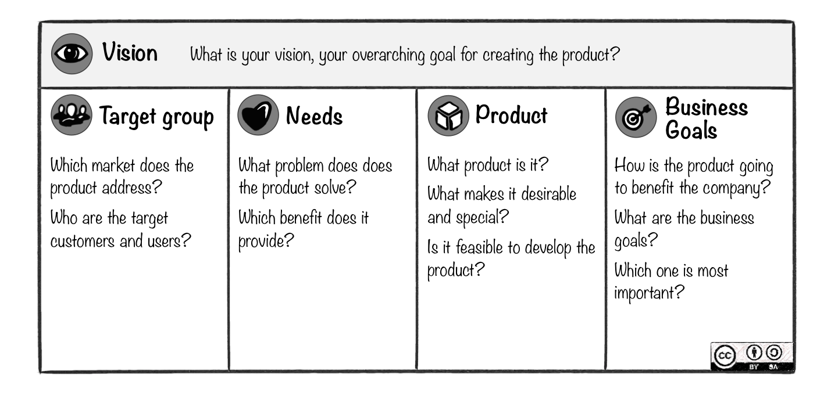
Roman Pichler’s Vision Board
Notes:
This combines both the product vision and the strategy together

Slide 29
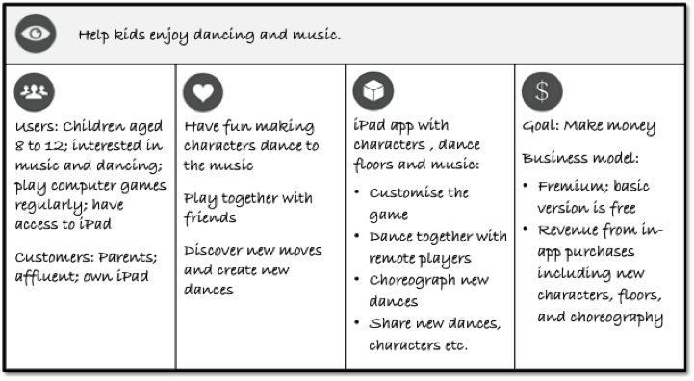
Example
Notes:
Example is Blackberry – it’s a clear product vision that sets the expectation of what the product will be.

Slide 30
Using the Product Vision the Acquisition Process
Notes:
How do you use a Product Vision within the Acquisition Process?

Slide 31
USING THE PROCUCT VISION IN THE ACQUISITION PROCESS
The Product Vision is an overarching goal that can be the top line of the Statement of Objectives
This helps scope out the work and acquisition strategies that must be done to facilitate the product vision coming true

Slide 32
USING THE PROCUCT VISION IN THE ACQUISITION PROCESS
If a Product Vision has not been created it is important to incorporate it as an objective
It can also be its own contract: getting the services necessary to facilitate user research, hypothesis building and product vision creation

Slide 33
Questions?
Notes:
How do you use a Product Vision within the Acquisition Process?

