Slide 1
Table Assignments for Day 2
Group 1
Group 2
Group 3
Group 4
Group 5
Group 6

Slide 2
Digital Services Contracting Professional Development MVP Program Release 2 Classroom Session
October 2016
Notes:
Facilitator Notes:
Have participants sit in assigned groups on previous slide.
Presenter: Heather
Welcome! Congratulations on making it through the first half of the course!
We hope that working with your groups yesterday went well. If you have anything you started and wanted to wrap up, you’ll have some more time to work with your group today.
These next few slides will go over some of the logistics for the classroom session.

Slide 3
Logistics for the Next Four Days
Room is open from 7:30 a.m. to 4:00 p.m. every day – note this likely means we will need to wrap up around 3:45 p.m.
Class is from 8:00 a.m. – 4:00 p.m.
Assigned seating each day for you to meet participants outside your LDA team
Internet access
Restrooms
Student lounge with laptops and printer
Full kitchen to store your lunch, grab water and coffee
Notes:
Duration: 2 minutes
Timing: 8:00-8:02 am
Presenter: Heather
Facilitator Notes:
Room is open from 7:30 am to 4:30 pm each day
As those of you who are using the metro may already know, the Metro is conducting SafeTrack maintenance, and since this training site is on the Orange line, we ask you to continue to plan accordingly. There is due to be continuous single tracking on the orange line through October 20.

Slide 4
Announcements
Badging is back up for 1.B, 2.A, and 2.B in the portal
Complete your Iteration Completion Checks in the left navigation under each iteration to get issued badges – some of you could have done this before the site went down in which case you will already have a badge
Reminder to do research based on MAP case assignment for tomorrow – this will be the focus of the morning
We will also be discussing your stakeholder analysis later this morning so make sure that’s handy
Dinner this week
Notes:
Updates and news –
Badging
Reminder to do research based on the MAP case assignment – open source, proprietary, or COTS – will be discussing Wednesday beginning in the morning.
Individually research solutions and their likely respective impacts (positive or negative) based on the product vision. More specifically, we came up with some research questions for each of your groups based on your topic. For more info, review in the portal under Iteration 2A: Practice Analyzing a Digital Services Need.
Any announcements from Traci on “things going on”, events to attend, etc.

Slide 5
Where You’ve Been
Release 1 – Digital Services in 21st Century Government
Understanding what digital services is, how digital services is executed, and the current role of a government digital services professional
A scan of the digital services market – potential sources of supply and how to communicate with them pre-solicitation
Release 2 – Understanding What You’re Buying
Exploring the need or outcome you’re trying to achieve with what you’re buying
Identifying and partnering with key stakeholders who will impact your acquisition
Conducting market research and preparing to develop your acquisition strategy
Notes:
Duration: 3 minutes
Timing: 8:02-8:05 am
Presenter: Heather
Facilitator Notes:
Release 1 focused on understanding the landscape of digital services in the 21st century. We talked about the pace of change in industry. We’ve all heard about some of the companies coming out of Silicon Valley, and the rapid stand up and stand down of companies. In this release, we talked about the overall landscape: where it’s at and what it means for you as a digital acquisition professional. For example,
In Release 1.A, the online learnings focused on the who and what of digital services.
We defined key terms like cloud, x-as-a-service, open source, and agile.
We also walked through how digital services are built using the agile approach.
An orientation to key documentation including the Tech Far and Digital Services Playbook.
Your role as a digital services acquisition professional.
Lastly, we had Alex Ose come talk to you about open source.
In Release 1.B, you analyzed the market for digital services by taking a look at the sources of supply. We also took a closer look at agile methodologies including the distinction between Kanban and Scrum and how to measure agile projects.
Release 2 focused on gaining an understanding of what you’re buying by exploring the need or outcome you’re trying to achieve and identifying and partnering with key stakeholders who will impact the acquisition.
In Iteration 2.A: Understanding Your Needs and Agency Readiness, you:
Explored your agency’s readiness for change and innovation.
You practiced analyzing a digital service need by determining what type of solution is most effective in a given scenario, ranging from open source and proprietary to COTS. This was the case assignment that we will work with tomorrow.
You also began work on a stakeholder analysis to identify the needs and outcomes of different stakeholders and how to actively partner with them.
Finally, Clair Koroma from USDS presented a webinar on the product vision.
In Iteration 2.B: The Digital Services Market, it’s all about market research and ongoing communication with vendors using some newer methods that can be effective in reaching non-traditional vendors within the marketplace (think challenges, MVPs, reverse industry days). You got started on this, but your research on the MAP case will be key, which we’ll discuss more tomorrow. Finally, you were introduced to the Gartner Magic Quadrant, which we will go over in more detail on Friday.

Slide 6
Where You’re Going
Release 3 – How Do You Buy?
How to effectively acquire digital service
The acquisition strategy
Use of Lean Canvas tool
Pricing
Evaluation methods and criteria
The solicitation package
Release 4 – Awarding & Administering Digital Service Contracts
Evaluate vendors who deliver digital services using metrics on project health, developed via lean thinking and agile development methods
Notes:
Duration: 2 minutes
Timing: 8:05-8:07
Presenter: Heather
Facilitator Notes:
In Release 3, you will examine how to set yourself up to buy digital services including creation of the acquisition strategy and the solicitation package. We will spend a lot of time on the acquisition strategy including how to put the Lean Canvas tool into action, pricing agile (use FFP), and evaluation methods and criteria. This is what we know you are really curious about and is where digital contracting officers spend a lot of their time. We’ll also talk about the solicitation package – how to put together an SOO and get together the rest of the package.
In Release 4, continuing the acquisition lifecycle, we will focus on award and administration of contracts. In the pilot, we got a lot of feedback on how it would be helpful to what a digital contracting officer’s ongoing role and support looks like. We started talking about this with the SBA team’s experience, and will likely loop back to this. We’ll also bring in a vendor who will talk about agile project administration.
Classroom sessions will follow each of these releases.

Slide 7
Day 2 Agenda
Day 2
Morning | Classroom Session Introduction and Icebreaker Brief Review of Release 1 The Importance of Understanding Stakeholder Challenges
LUNCH
Afternoon | The Importance of Understanding Stakeholder Challenges (Part II) Live Digital Assignment Group Work
Notes:
Duration: 3 minutes
Timing: 8:07-8:10 am
Facilitator Notes:
Presenter: Heather
Today, we’ll be doing an icebreaker activity to kick things off.
In the Orientation Classroom Session debrief, it was noted that everyone was able to get to know their table and their LDA groups, but not the others in the room. The purpose of this activity will be to help you meet other participants outside of your LDA group, while discussing acquisition challenges that you have/are encountering and doing a little team-building. This activity focuses on innovation including the idea of failing fast. This will take about the first hour.
We’ll be following that with a review of Release 1, which will cover:
A review of key aspects of Release 1, including: open source, x-as-a-service, and security left by Neil.
A discussion of the Release 1 Assessment results and where are opportunities are as we move forward.
This will take about another hour.
The last piece of the morning’s training will be centered on the challenges you face in your agency with stakeholders and in your anticipated role as a digital services change agent. Here, we’ll be tying in some of the content from Iteration 2.A, like your change readiness surveys, and consider it in the context of some new information. This will be a relatively informal group discussion on some of the challenges that are arising in your workplace and how to work through them.
After lunch, we’ll continue the discussion of understanding stakeholder challenges with some guest speakers from the USDS team. They’ll share some of their insights on how to make government transformation happen.
You’ll wrap up the day by meeting with your LDA groups to continue developing your demo day presentations for Friday. Before I let you go for Demo Day, we’ll do a short recap of what to include in your presentations. We anticipate about 90 minutes of time for you to work on your LDA this afternoon. This is the only day that we currently have time built into the agenda.

Slide 8
Orientation Agenda
Day 3
Day 4
Day 5
Morning | MAP Case Study Review Beyond the RFI
LUNCH
Afternoon | Market Research Case Study Recap Guest speakers: The Vendor Perspective on Doing Business with Government
Morning | Influencing conversations roleplays Review of Salesforce Market Research Study
LUNCH
Afternoon | VA Guest Panel – Implementing an Acquisition Strategy in an innovative way
Morning | Release 3 Introduction to the Acquisition Strategy Lean Canvas Introduction
LUNCH
Afternoon | LDA Report Out and Reflection Classroom Session Conclusion
Notes:
Duration: 5 minutes
Timing: 8:10-8:15 am
Presented by: Heather
Facilitator Notes:
Day 3
Day 3 will focus on market research. We’ll review the case study from the online material, start another activity, and we’ll listen to guest speakers discuss their experience as a non-traditional vendor.
MAP Case Study Review
Team Huddle: Meet with team to discuss group’s findings
Team Briefing: Group presentations and discussion of COTS vs. open source vs. proprietary solutions
Beyond the RFI
Examine market research strategies used in digital services that you could use other than an RFI – how can you put these strategies into practice?
Case Study Recap
Report out on how your team plans to conduct market research based on the innovation market research strategies you learned about
Discuss in depth with large group discussions
Guest Speakers
A vendor will talk to you about doing business with the government, particularly when they haven’t traditionally worked in this space. What are they interested in? What are the challenges they need to overcome?
Day 4
In Day 4, we will focus on how to influence others and we’ll shift to start looking at acquisition strategy.
Influencing conversations roleplays
In the morning, we’ll bring in some special guests to play different roles in government like an IT Program Manager, a vendor, a non-IT leader, etc. You’ll play the role of a digital contracting officer and test out your influence skills. We did this activity in the pilot and got some great feedback from our USDS and some of my colleagues.
Review of Salesforce Market Research Study
Talk about Salesforce Market Research Study and results
Transitioning from Market Research to Discussion of Acquisition Strategy: VA Guest Panel
Led by one of our former participants from the pilot, he recently implemented an acquisition strategy in an innovative way that was a combo of a written submission and code submission – punchline is that they gave vendors 72 hours to submit code on Github
Day 5
The Day 5 morning is all about an introduction to the acquisition strategy. We’ll also introduce the Lean Canvas tool that you reviewed in the online learning for 2B. We’ll walk through how it can be used to support your acquisition strategy.
LDA Report Out and Reflection
Present your progress to-date in the Live Digital Assignment.
Include your hypothesis, product vision, key takeaways, and any challenges.
Classroom Session Conclusion
Review key concepts from Releases 1 and 2
Gather feedback on MVP progress

Slide 9
Activity: Icebreaker
Notes:
Duration: 2 minutes
Timing: 8:15-8:17 am
Presented by: Heather
Facilitator Notes:
In the Orientation Classroom Session debrief, your feedback showed that everyone was able to get to know their table and their LDA groups, but not the rest of the group. The purpose of this activity is to help you meet other participants outside of your LDA group and work on an activity together.
Distribute handout/turn to page in Learner Guide and handout baggies of supplies but do not let learners open them yet.
For this activity, we’re going to have you get up and move around a little bit.
Have participants number off from one to six, and then seat them based on number. [this line may change based on the activity used]

Slide 10
Activity Instructions
Activity Instructions
Your group represents a private research and development company that is helping to build a biodome in Arizona
In the design phase you must work with your group to select targets for your biodome across three factors:
Construction time
Number of building pieces used
Height of the model
In the construction phase, your model must remain freestanding for at least 2 minutes to qualify for scoring
At the end of the exercise, groups that have met all their targets will be compared
The group that has the most points will be considered the most successful
If there is a tie, the group that has assembled its prototype in the least amount of time will win
Notes:
Duration: 3 minutes
Timing: 8:17-8:20 am
Presented by: Heather
Facilitator Notes:
Today we will practice our ability to work in a team to accomplish a challenging goal.
This goal is highly compliance driven so it is important you pay close attention to the instructions to ensure your team is successful in this effort.
Your group represents a private research and development company that is helping to build a biodome in Arizona. In this activity, you will design and construct a prototype of your tower with the goal of maximizing profit.
In the design phase (the first 5 minutes of this activity), you must select targets that you believe your biodome will achieve across three factors: construction time, number of building pieces used, and height of the model.
You should also take the time to examine your materials to help you identify those targets.
In the construction phase, your model must remain freestanding (it can’t be leaning or propped up against anything) for at least 2 minutes to qualify for scoring.
At the end of the exercise, groups that have met all their targets will be compared.
The group that has the most points will be considered the most successful. If there is a tie, the group that has assembled its prototype in the least amount of time will win.

Slide 11
Design Phase
You will have 10 minutes to identify your targets for each factor
Note that you may receive bonus points for exceeding your targets
You will be disqualified if your biodome does not meet your projected targets
Review the target scoring sheet and decide on targets for the following factors:
Number of pieces the biodome design requires (fewer pieces = less maintenance/overhead = more points)
Time required for assembly of the biodome (faster = better readiness factor in crisis = more points); and
Height of the biodome (taller = better ability to get solar energy = more points)
Notes:
Duration: 7 minutes
Timing: 8:20-8:27
Presented by: Heather
Facilitator Notes:
Instructions
First, take a few minutes to review the instructions in your Learner Guide.
Organize your group in a way that seems most effective to you.
Review the target scoring sheet and decide on targets for the following factors:
Number of pieces the biodome requires (fewer pieces = less maintenance/overhead = more points)
Time required for assembly of the biodome (faster = better readiness factor in crisis = more points); and
Height of the biodome (taller = better ability to get solar energy = more points)
Note that you will get bonus points for setting and meeting targets at certain levels so don’t set your targets too low and miss out on extra points. Conversely, don’t set your targets too high as your biodome will be disqualified if it fails to meet any targets.
Note that tape, staples and any scissor cuts do not count towards the number of building pieces. These are “free” pieces.
If you break a piece into smaller pieces, each new piece counts as a piece used. For example, if you cut a straw into two halves, and use both halves, that straw is now considered two pieces used.
You may not begin construction during the target setting/design phase. You can however, interact with pieces and see how they might fit together. For example, you cannot use the stapler, scissors or tape during the planning period.
All pieces must be completely disassembled before the start of the construction period.
At end of planning period, write down each group’s targets on the flipchart at the front of the room and turn it away so other groups cannot see who have already set targets.
After walking the participants through the design phase of the activity, begin timing the 5 minute phase.

Slide 12
Construction Period
Now you will have up to 10 minutes to construct your model.
Remember the compliance requirements to avoid being disqualified.
When you finish assembling your biodome, all team members must alert me or the co-facilitator of your completion by stepping away from the biodome and raising your hands in the air.
One of us will shout out the time it took you to complete your tower; write it down in your Learner Guide
Notes:
Duration: 15 minutes
Timing: 8:27-8:42
Presented by: Heather
Facilitator Notes:
I will signal when you can begin building so that everyone begins at the same time.
Refer to the matrix on the flipchart for the targets you have set; note that you are allowed to amend your approach to building the model but you will not be able to change your targets from this point onward.
Your point values will be based on the actual result, not the target. Remember that you must at least meet your target value to get points for your actual results. You can also get bonus points for the target you set for yourself, and meet.
When you finish assembling your biodome, all team members must alert me or the co-facilitator of your completion by stepping away from the biodome and raising your hands in the air.
One of us will shout out the time it took you to complete your biodome; write it down for record in your Participant Packet.
Your model must stand for at least 2 minutes beyond your final completion time, without any supports. Be sure to plan for this requirement and delegate one person to watch the clock to ensure this is the case. This can be the same person you designate as your actual results recorder.
We will also come over and measure your biodome. Make sure you record this.
Keep track of the number of building pieces you are using; record this in your Learner Guide as well.
Record your actual results on the board for final scoring. If you did not meet your target value for any of the factors, place an “X” over that result.
About halfway through the construction period, interrupt participants.

Slide 13
Additional Requirement
You must incorporate a roll of Post-Its into your biodome
The Post-Its cannot be touching the table
The clock will reset at 10 minutes
Notes:
Duration: 15 minutes
Timing: 8:42-8:57
Presented by: Heather
Facilitator Notes:
We just received a new requirement from the client, due to a new regulation regarding quality. All biodomes must incorporate two Starburst. It’s your food supply. The Starburst cannot be touching the table directly. Remember, your model will not be compliant unless you incorporate this additional requirement. This piece will not count toward your number of pieces. Because of this new requirement, I am re-starting the clock with 10 minutes beginning now.

Slide 14
Biodome in Arizona Debrief
What did your team do that worked well? What did your team do that did not work well?
What concepts from this activity apply to the Digital Acquisition MVP?
What types of influencing strategies did you use in either the design or construction phase?
If we were to apply this to your live digital assignments, at what phase are you right now?
Notes:
Duration: 3 minutes
Timing: 8:57-9:00
Presented by: Heather
Facilitator Notes:
How’s everyone do? Did your teams achieve the goal? If you achieved the goal, what did your team do that worked well? If your team did not do well, where did your team get stuck? What would you do differently if you had this activity to do again?
Overestimated the targets that they would be able to achieve.
Struggled to agree on a strategy and execute against it.
Struggled when the Starburst was introduced.
Did you apply any of the concepts you’ve learned so far in the Digital Acquisition MVP? How does this activity apply to what you’re learning about digital contracting?
What about taking calculated risks? The tradeoff between setting an easily achievable target and trying something new or greater.
What about failing fast and experimentation? This activity is a version of the Marshmallow Challenge. Have you guys seen the Ted Talk?
When the new requirement came up, did that change your team’s testing strategies? In acquisition, you need to be able to flex if and when new requirements come up. Because the tech industry is constantly changing, this might happen more than you expect.
Did anyone use any interesting strategies to influence either the design or construction phase? Influence will be a big part of this week – we’ll talk about how to communicate highly technical content, how to get stakeholders onboard, how to have difficult conversations where you need someone to do something. If you did use influence, be thinking about how it played out.
Think to your LDA—the design phase ties back to what you’ve done so far with your hypothesis and product vision. When you get with your live digital assignment teams, be thinking about how your team will start to move into the building phase. What are you positioned to do well? Where could be some of the challenges for your team as you work in implementation? Have you identified those risks?

Slide 15
Pre-Program and Release 1 Assessment Results

Slide 16

Assessment Approach
Why assessments?
To give you feedback that can guide your program efforts
To enable continuous program customization
So far, you have participated in:
Pre-Program Assessment
Eight scenarios and 51 multiple choice items
Release 1 Assessment
28 multiple choice items
Notes:
As you know, this program includes assessments of your knowledge related to the performance objectives. The purpose of these assessments is two-fold. First, the assessments are used to give you feedback on your performance that can help guide your effort in the program. The second purpose of the assessments is to gather cohort-level information that can be used to customize the program and ensure that topics are covered at the right level for the cohort.
So far, you have participated in two assessments. The first was a pre-program assessment that included questions about content across all four of the releases. This pre-program assessment was scenario based, with a total of eight scenarios (four aligned to each release) and a total of 51 multiple choice questions. The second assessment that you took was the Release 1 assessment, that focused completely on content related to the Release 1 performance objectives. After asking about your Release 1 activities and perceptions of the course and content, it included 28 multiple choice questions to assess your knowledge. The assessment also included some questions about what activities you performed, how much time you spent, and how you might have started using what you are learning on the job.

Slide 17
Pre-Program Assessment: Cohort Overview
Best performance on Release 3 questions
The lowest scores were for Release 4 questions
Wide range of scores on this Release
Notes:
As a reminder, the Pre-Program assessment included scenarios with questions related to the performance objectives in each of the four releases. Overall, the best performance was seen on questions related to the Release 3 objectives, with an average score of about 68%. On this assessment, Release 3 had highest number of questions associated with it, so it also had the greatest opportunity for demonstration of knowledge by the cohort.
The lowest scores were for Release 4, with an average score of about 57%. Release 4 had a wide range of scores, meaning that some students did very well and others had lower levels of knowledge.

Slide 18
Pre-Program Assessment: Performance Objectives
Strongest Performance Objectives
Objective 1.3: Identify modern design, development, and delivery methods used by digital services professionals
Objective 1.4: Identify “who’s who” in the digital services arena, including public and private sector organizations and individuals
Weakest Performance Objectives
Objective 4.5: Identify software engineering practices for high-quality digital services like version control, continuous integration, and continuous delivery
Objective 2.5: Identify why communicating openly and responsibly with potential vendors is critical to digital services acquisition success and how to do it
Notes:
On this slide, you can see the strongest and weakest performance objectives in terms of performance on the Pre-Program assessment. Program faculty/staff are using these results to refine what content you receive and what activities we ask you to participate in to maximize your learning and mastery. We are using these results to help us ensure we don’t belabor content you, as a cohort, already have a good grasp of – and “go deeper” into content where the cohort has more trouble initially.

Slide 19
Release 1 Assessment: Cohort Overview
Overall cohort mean score: 60%
Average of 15.68/28 items correct
Strongest Performance Objective
1.4: Identify “who’s who” in the digital services arena
Weakest Performance Objectives
1.7: Identify the high-level principles of agile development
1.8: Describe what sets agile methods apart
Notes:
Overall, your cohort’s score on the assessment for this release was 60%. Individual test scores ranged from 30% to 81% on the Release 1 Assessment. As a group, the best performance was seen on objective 1.4 (identify who’s who in the digital services area).
On the other hand, the weakest performance as a group was seen on objectives 1.7 and 1.8, with average scores of about 57% on each of these two objectives. These data are used to adjust the curriculum to ensure we adequately address the lower performing objectives.

Slide 20
Comparing the Pre-Program and Release 1 Assessments
Comparison of Cohort Pre-Program Assessment and Release 1 Scores for Release 1 Performance Objectives
Performance Objective | Score Increase | Equal Score | Score Decrease
1.1 | 41% | 56% | 4%
1.2 | 19% | 59% | 22%
1.3 | 0% | 93% | 7%
1.4 | 4% | 89% | 7%
1.5 | 19% | 44% | 37%
1.6 | 37% | 30% | 33%
1.7 | 26% | 52% | 22%
1.8 | 7% | 78% | 15%
The greatest percentage of participants saw an increase in Objective 1.1 scores
Objectives 1.3 and 1.4 were the strongest in the Pre-Assessment, meaning there was less room for improvement
Caution: The Pre-Assessment had fewer questions, so it may have been easier to receive a high score (as compared to Release 1).
Notes:
Finally, we look at the comparison of scores, by performance objective, from the Pre-Program assessment to the Release 1 assessment. The biggest increase from Pre-Assessment to Release 1 Assessment was for Objective 1.1 (Define digital services and the problems they can be used to solve.) Objectives 1.6, 1.7 also saw relatively larger score increases.
For Objectives 1.3 and 1.4, the cohort started off with high scores so there was not much room for improvement.
Remember when interpreting these data that the Pre-Assessment had fewer questions per objective than the Release 1 assessment, so it may have been easier to receive a high score. The Release 1 Assessment afforded the opportunity to respond to more questions per performance objective, giving more of a fine-tuned evaluation of each person’s knowledge, but as a result may have been more difficult.

Slide 21
Release 1 Review – Neil Chaudhuri

Slide 22

Tips
Be patient.
Don’t let the perfect be the enemy of the good.

Slide 23
Before We Begin
A couple of good questions

Slide 24
About Me
President of Vidya (@VidyaSource)
Over a decade of experience in software engineering with commercial and government clients
Member of GAO Agile Expert Group and contributor to a GAO government report on agile
Author and presenter
Certified in stuff

Slide 25
Agenda
Knowing the Stakeholders
Agile Start to Finish
Building Digital Services
Using the Cloud
Notes:
Tips: be patient. These are difficult topics. Don’t try too hard to be perfect, these are difficult concepts.
Background
Agenda: Knowing the Stakeholders
Agile Start to Finish
Building Digital Services
Using the cloud

Slide 26
Agenda
Knowing the Stakeholders
Agile Start to Finish
Building Digital Services
Using the Cloud

Slide 27
The Product Owner
The Play’s the thing
Responsibilities
Empowered to make decisions for all stakeholders
Responsible for the ROI
Maintains product backlog and prioritizes features sprint to sprint
Defines acceptance criteria and decides what passes
Notes:
Responsible for making decisions on behalf of all stakeholders
Responsible for the ROI
Maintains product backlog (the list of things you need to do. It never goes away—there’s always something to do) and prioritizes features.
Prioritizing features from sprint to sprint to determine what is the most important
Define Acceptance criteria and decides what passes. There are acceptance criteria that should be objective.

Slide 28
Other Stakeholders
Development lead
UX designers/UI developers
Software engineers
Database engineers
Testers
Deployment/automation engineers
Security specialists
Notes:
Development lead – makes sure that development is in line with the product owner
The UX designers/UI developers – they make sure that things are intuitive. That user experience details are in place. The designers make sure that it’s clear what should happen, and the UI developer actually builds that code.
Software engineers build the meat of the code. They handle the business logic for coding
Database engineers
Testing—ensure product is conforming to specs of product owner
Deployment/automation engineers
Security specialists
The most important stakeholders are the American people.
Sometimes people on a digital services team will be some of these different types of stakeholders, but often these are the people you bring in.

Slide 29
The Most Important Stakeholders
The American people

Slide 30
Agenda
Knowing the Stakeholders
Agile Start to Finish
Building Digital Services
Using the Cloud

Slide 31
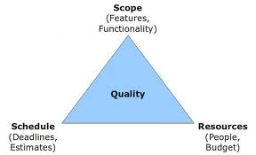
The Traditional Approach
Plan-driven software development
Plan developed early with heavy resources long before any software is built
Speculates on where things will be in the future
Updates to the plan tightly controlled and variance from the plan measured throughout
Success measured by limiting variance
Phased gate model
Based on the Triple Constraint with fixed scope
Notes:
Based on an industrial/construction metaphor
Lot of effort spent trying to make sure everything is specified
Scope fixed while schedule and cost negotiated
Plan quickly falls out of sync with technical and business realities
Project failure discovered late because problems not visible until later stages
Premature closure yields little business value bc functionality not delivered until later stages
The traditional approach is waterfall. This is plan driven development—the plan is developed early with heavy resources well before any software is built. As long as you keep deviations from plan controlled, you should be fine.

Slide 32
Don’t Go Chasing Waterfall
Ill-suited for creative work
Plan obsolescent before it’s even finished
Resistance to “scope creep”
Phase-gate approach antithetical to optimizing flow
Gold plating
Notes:
Software development is a creative effort—that kind of mindset does not lend itself well to a waterfall, or plan-driven mindset. Because the plan takes into account concepts that may not exist or be relevant until years down the road, waterfall isn’t as useful.
Resistance to “scope creep”
In waterfall, there is a lot of overlap. Think about traffic—a big batch of cars on the road at the same time. It’s not as efficient as if there would be small batches of cars on the road at a time. The case is the same for development.
Gold plating

Slide 33
A Lot of Waste
Often or Always
Used: 20%
Sometimes
Rarely
16%
19%
Often
Never
13%
45%
Always
7%
Rarely or Never
Used: 64%
Software features built the traditional way
Notes:
A lot of features end up not being used in waterfall development. High priority and necessary features may not be defined.
Waste of time and money to design, code, test 2/3 of features produced
And track, compile, integrate, document
Happens bc stakeholders feel they only have one shot
Also hides bugs bc they never get exposed

Slide 34
Benefits of an Agile Approach
“JEDUF” replaces BDUF
Smarter planning
Only the highest-priority scope elements developed
Frequent customer feedback after short, fixed iterations
Automation and metrics
Continuous adjustments to scope based on evolving business needs
Fail fast
Collective code ownership
Consistent delivery of working software
Notes:
JEDUF replaces BDUF – “Just enough design up front” replaces “big design up front.” In Agile, you’ll notice a lot of brevity. There is, however, still a lot of planning in Agile. There’s a common misconception that there isn’t a lot of planning. Instead planning varies on what is needed and when.
Only the highest priority elements are developed.
Automation and metrics—automated processes help us see where we’re at. Often in government, if something doesn’t work as it needs to, people don’t know.
Failing fast—there is experimentation, failures will occur.
Collective code ownership – the whole codebase is an atom that everyone is working on collectively.
Most important thing, delivering working software each time.
Smarter planning—if someone who doesn’t understand how to use agile wants to know how long something would take, how would you answer that?
If there is a target date that you have to go live, you have to work within those bounds.
I’m a fan of saying, let’s have a first release, and see what comes out of that. Once we have some actual data of how they’re performing, we can extrapolate that out. If we can at least collect some data to get an idea of how the team is performing, then we can start to see how long it’ll take.
When we go back to our agencies, the mindset is, “how long is this going to take?” It’s good for us to be able to answer this question.
With waterfall development, often when these estimates are given, they’re incorrect. We try to be more accurate with estimates. It’s best to push for a sprint or two to see how everything is progressing.
It seems as if you’re either going to build something from scratch, or implementing an existing program (COTS)?
It’s hard to assign absolutes. If you are going with a COTS tool, it may be hard to implement agile.
It’s like a recipe—by following a recipe, you know what you’ll have to do to make the dish. If you’re cooking without a recipe, an agile approach will help. It’s certainly a case by case basis. IF you’re doing something predictable, you may not need to use agile.

Slide 35
Agile Product Vision
“I believe this nation should commit itself to achieving the goal, before this decade is out, of landing a man on the moon and returning him safely to the Earth.”
-- President John F. Kennedy

Slide 36
Agile Product Vision Formats
Elevator Pitch
Product Datasheet
Product Vision Box
User Conference Slides
Press Release
Magazine Review
Notes:
An agile product vision is succinct—the example provided is quick, only 30 words. You need to be getting at just enough to move forward. It can be thought of as an elevator pitch.
A product vision box—if your application came in a box, what would it say on that box?
If you were to talk about your product at a conference, how would you talk about it in 2-3 slides.
Press release, magazine review - -what would you want these to say?

Slide 37
High-Level Product Backlog
Comprised of high-level user stories called “epics”
Typically created by the same people who created the Product Vision
Driven and prioritized by the Product Owner
Continuously updated throughout the project
Notes:
Comprised of high-level user stories called epic. Meant to represent, at a high level, what features you’re trying to get. Typically the same people who created the product vision will create the backlog. This is all driven and prioritized by the product owner.

Slide 38
User Stories Redux
Convenient format for briefly representing business value in business terms
“3 C’s”
Card
Conversations
Confirmation
As a wiki user, I want to upload files so I can share them with colleagues.
Notes:
As you’ve already heard, user stories use a convenient format.
3 C’s – Card, conversations, confirmation

Slide 39
Product Roadmap
Series of goal-oriented releases for achieving the Product Vision
Frequent, incremental deployments of Minimum Releasable Features
Decided by stakeholders
Must meet functional and quality expectations
Periodic release strategy simplest
High-level technological concerns important
Continuously updated
Notes:
Series of goal-oriented releases for achieving the product vision
Frequent incremental deployments of Minimum Releasable Features—decided by stakeholders and must meet functional/quality expectations.
High level technological concerns are important, and they are continuously updated.
How do you transition from one system to another?
There is no one answer. You have to identify the users you wan to first transition with. You might rule it out to a certain subset of people, and then see how things go, and eventually weed out different options.
Minimum Releasable Features—is that quality or quantity?
Those are features that you must have for the release to be viable. However, we build quality in from the start. You should be building and implementing with automation. If there are problems that come up, you should be able to identify that quickly. There should not be a notion of tradeoff for building fast over well= you want to invest the time to build code well.
If you’re figuring out how long your sprint should be, you should be anticipating trouble?
One of the problems with waterfall—because its this handoff process and you’re thrashing, people don’t tend to pass along for testing.

Slide 40
Lean Thinking
Discipline offering the conceptual underpinnings of agile development
Key concepts
MVP
Validated learning
Actionable metrics vs. vanity metrics
Notes:
We tend to think that we know what users want, have in mind, etc.
Think about the Toyota example. How do you efficiently take what you have and make the most of it?
We have a product backlog, how can we verify that we’re doing the right thing? The answer to that is to develop an MVP—minimum viable product. There are things like this that you can get out of an MVP.
You can tell if you’re on the right track with validated learning.
Actionable metrics vs vanity metrics.

Slide 41
Lean Software Development
Eliminate waste
Amplify learning
Decide as late as possible
Deliver as fast as possible
Empower the team
Build integrity in
See the whole
Notes:
This slide has some of the big principles from software development:
Eliminate the waste.
Amplify learning
Decide as late as possible is not the same as procrastination

Slide 42
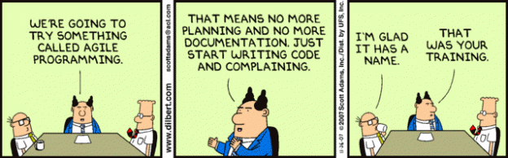
Agile Principles
Defined by the signatories to the Agile Manifesto

Slide 43
Kanban
Meta-process heavily influenced by Lean Thinking
Key principles
Visualize work
Limit work in process
Manage flow
Little’s Law: Cycle time = WIP/Throughput
Ideal for high-interrupt work and generic workflows but certainly applicable to application development

Slide 44
Scrum
Formalized process with a prescriptive approach to applying lean principles
Best suited to application development
Ceremonies
Sprint Planning Meeting
Daily Standup
Review and Retrospective
Roles
Product Owner (Play 6)
ScrumMaster
Delivery Team (Play 7)
Notes:
Building from scratch with high predictability. There is nothing in scrum that contradicts Kanban, but it is very prescriptive and formal. There are certain rules that you’re supposed to follow for a reason. A lot of people equate scrum and agile, but they are not the same.
In a sprint planning meeting, you get into detailed planning, you have daily standups that run from 10-15 minutes with the tem, and you have a review and retrospective each sprint
Question: From a CO, evaluation perspective – I imagine a vendor coming back and telling me how they’re going to use either of these, and what they’re going to use.
If they say Kanban is what they want for the contract, you should ask them what metrics they’ll show you that things are moving—how they’ll demonstrate that
Misapplying scrum is very possible, though, and is project specific. You want to know where each is best suited. If a vendor comes to you with a particular way they want to work, you should have them explain how they’ll prove that they’re delivering.
In addition to knowing the differences between the processes, it’s important to know when each should be used.
When the requirements are determined, it’s important if the project team is defining with method of agile is going to be used. You can be prescriptive in the RFQ. If that’s not the case, industry can come back to you with something.
If you don’t have technical expertise, you need a technical representative on the evaluation team.
A potential solution is reserving the right to use government advisors—allows you to look outside of your agency for help
A key part of your acquisition strategy is asking for the right kind of solution based on the team that’s going to be evaluating it. We were talking earlier about baselining. Instead of doing the whole huge procurement, it may be beneficial to do a small few month procurement.
Have a technical expert help write the evaluation criteria to comb through proposals more carefully.
Even in the circumstances where you know you have someone who can evaluate it, you may still fail. In agile, if you realize that you did a terrible job evaluating, you can adjust from there with buy-in from leadership.
There’s the idea that you’ll know what to expect as you understand scrum and Kanban. Even if you get something wrong, you can evaluate that retrospectively. You can look at metrics to identify where vendors may be able to improve, and you can have them adjust to correct that in a later sprint.

Slide 45
Not Everything Is A Nail
When not to go agile
Software installations with minimal customization
Straightforward data migrations
Otherwise Scrum for application development and Kanban for generic workflows

Slide 46
Why It Matters
Digital Service Playbook
Assessing vendor understanding of lean and agile concepts pre-award
Delivering value
Eliminating waste
Evaluating vendor approaches
Defining the boundaries for lead/cycle time
Agreement among stakeholders on when the clock starts
Definition of Done
Notes:
Building quality in—another automated test type should be 508 compliance.
What do you define as baseline ONM?
Basically a system that’s in production that I’m now trying to maintain. Kanban can typically work with that—the findings there should be communicated to a team developing a new version.
So requirements can be hybrid with agile?
Exactly.
ONM Kanban, App development – Scrum
In my history, we’ve gotten rid of the concept of the ONM contract. The idea that it’s related to a steady-state system is false. It’s going to be based on your end-user needs, and how much needs to be implemented to the system. We want to realize that things are always going to be in a state of development/enhancement.
In the past there have always been two buckets—build, and then maintain. That’s no longer the case as often.

Slide 47
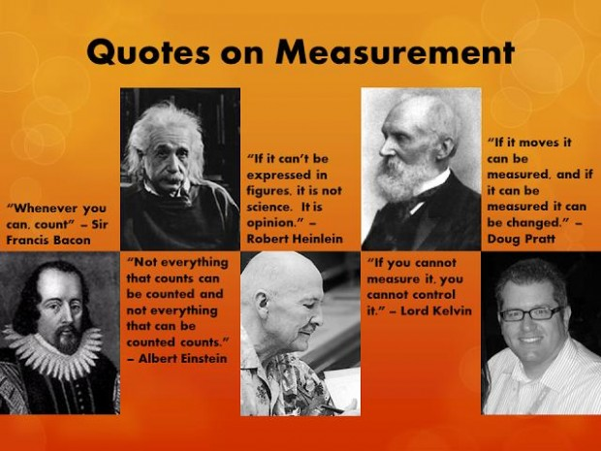
Agile Metrics
“Amplify learning”
Fail fast

Slide 48
Core Agile Metrics
Lead/cycle time
Throughput
Cumulative flow
Bugs (number, type, severity)
Scrum
Metrics we already know
Story points
Burndown
Velocity
Potential flaws
Relative
Administrative burden
#NoEstimates
Notes:
Lead/cycle time
Throughput
Cumulative flow
Bugs (number, type, severity)
Scrum

Slide 49
Sources for Metrics
Project tracking system
Source control
Build pipeline
System monitoring

Slide 50
Why It Matters
Digital Services Playbook plays 4, 7, 9-12
Immediate understanding of project health
Pre-award evaluation of vendor maturity
Metrics and automation awareness
Willingness for scrutiny
Distinguishing bugs and avoiding recidivism
Delivery speed
Post-award
Identifying barriers to productivity
Stakeholder pressure
Absence of Product Owner
Staffing issues
Fail fast
Building trust through transparency and continuous delivery
Transition plan
Process metrics vs. Product metrics
Notes:
Digital Services Playbook – plays 4, 7, 9-12
Immediate understanding of project health
Pre-award evaluation of vendor maturity
Metrics and automation awareness
Willingness for scrutiny
Distinguishing bugs and avoiding recidivism
Delivery speed
Post award
Identifying barriers to productivity
Transition plan

Slide 51
Agenda
Knowing the Stakeholders
Agile Start to Finish
Building Digital Services
Using the Cloud

Slide 52
Technology for a Better World
“I want us to ask ourselves every day, how are we using technology to make a real difference in people’s lives.” – President Obama

Slide 53
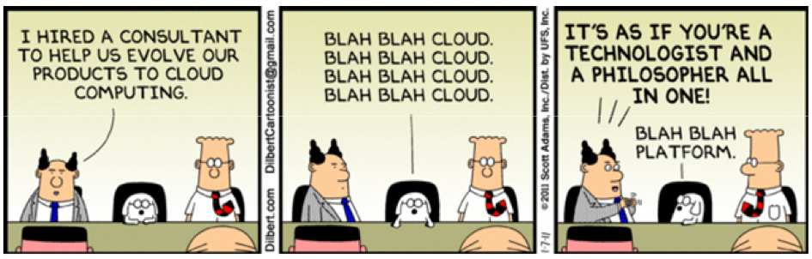
The Cloud
IaaS
AWS
Microsoft Azure
PaaS
Heroku
Microsoft Azure
SaaS
Dropbox
Microsoft Office 360/Google Docs
Notes:
The cloud is about outsourcing things that you could otherwise do yourself.
Infrastructure as a service – the barebones to store stuff, computation, etc.
Platform as a service allows you to build applications with stuff that’s already in place.
Software as a System

Slide 54
Elastic Cloud Pricing
Resource consumption
Compute power
Memory
Bandwidth
Disk space
Tiered usage
Notes:
When it comes to the pricing of the cloud, it’s more a pay as you consume resources. There is elastic pricing. If there’s a spike when usage goes up, it may be more beneficial to buy more storage or bandwidth to prepare for that, vs other times of year when things are slower.
Alternatively, there is tiered usage – you get charged according to high, medium, low usage.

Slide 55
Advantages
Lower costs
Simplicity
Automation
Notes:
Advantages include:
•lower costs (typically),
•simplicity, and
•automation.

Slide 56
Disadvantages
Not free
Novelty
Data rights
Security
Roles and responsibilities
Unknown geographic boundaries
Understanding which applications are “ready”
Lock in
Notes:
Disadvantages:
•it’s not free
•Novelty – the government has requirements that are difficult to work with cloud.
These potential pain points include: data rights, security, roles and responsibilities, unknown geographic boundaries, understanding which applications “ready,” lock are in.

Slide 57
FedRAMP
Standardized approach for provisioning secure cloud services under continuous monitoring
Enables choice from vendors blessed by Joint Authorization Board
Challenges
One size doesn’t fit all
Cumbersome process
Areas for improvement
Streamlined process
SLA “profiles”
Notes:
Standardized approach for provisioning secure cloud services under continuous monitoring
Enables choice from vendors approved by Joint Authorization Board.
ATO from one agency doesn’t necessarily carry over to another

Slide 58
Open-Source
“Free” software respecting developer freedom and collaboration
Freedom to use, distribute, modify, copy, run software and/or data
Common licenses
Apache
GNU
MIT
Mitigates but does not eliminate vendor lock-in

Slide 59
Why It Matters
Digital Service Playbook plays 7, 8, 9, 13
TechFAR
Modern technologies essential
Time to market
Performance, scalability, security, monitoring
Vendor knowledge and motivation
Market research with open-source
Reconciling open-source with contract language
Applicability of FAR
Liability

Slide 60
References
Lean Startup by Eric Ries
Agile Estimating and Planning by Mike Cohn
Essential Scrum by Kenny Rubin
Kanban in Action by Marcus Hammarberg and Joakim Sundén
Lean Software Development by Mary and Tom Poppendieck
Agile Metrics in Action by Christopher W.H. Davis
Collaboration Explained by Jean Tabaka
Lean UX by Jeff Gothelf

Slide 61

Questions
Notes:
Under agile, how do we handle changing scope?
We take the concept of separating the technical requirements from the requirements. You don’t have a requirements document that lists out everything that is needed on the technical side. The contract itself is around buying the process. The scope isn’t going to change around your contract. The technical features are in those user stories, and are separated out from the contract. It takes into account that there’s no way to know what the technical requirements are going to be.
Under matrix, you talked about no estimates?
The “no estimates” movement is about how long they think it will take for the development to happen. It’s not so much related to the cost estimate. It’s a look at the productivity that the team is going to get out.
The no estimates idea is also a contested methodology—it’s not universally accepted.
When you talk about cloud services—how do IP rights come into play? If we don’t actually own the software application that we’re using?
The data should belong to you. I don’t believe that FedRAMP will allow you to move without having full rights. As a contracting officer, you want to be aware of who owns what.
With the release of the federal source code policy, we’re working on creating some objective language that talks about ownership of the software beneath us. When you buy a COTS solution, you often have the ownership of that until your license runs up, but what you built is still owned by you. Sometimes that’s not the case, and when a license is up, they take your data as well.

Slide 62
Morning Break
Notes:
Duration: 15 minutes
Timing: 10:45 – 11:00am
Presented by: Heather
Facilitator Notes:
Instruct participants to take a 10 minute break.
Direct to restrooms and water cooler.

Slide 63
The Importance of Understanding Stakeholder Challenges
Notes:
Duration: 1 minute
Timing: 11:00-11:01
Presented by: Heather
Facilitator Notes:
In Iteration 2.A, you started to consider the role of stakeholders. As an advocate for change, stakeholder engagement is key to moving the needle. In the following slides, we will take a closer look at why it is important to understand stakeholder challenges, as well as how to understand them.

Slide 64
Two Inputs to Prepare for Change
Stakeholder analysis
Identify 2-4 stakeholders to interview based on:
Greatest perceived influence or control over digital services procurement
Greatest perceived influence or control over acquisition process
Potential involvement in your role as an ambassador digital services acquisition
Reflect on potential benefits and challenges to their engagement
Reflect how to position yourself
Prepare for the interview/conversation
Notes:
Duration: 2 minutes
Timing: 11:01-11:03
Presented by: Heather
Facilitator Notes:
Yes, there are lots of other inputs to prepare for change that we’re going to teach you about, but let’s just talk about two of them for now that you did in Release 2 – 1) your stakeholder analysis; and 2) your change and innovation readiness survey.
In your stakeholder analysis, you did a couple of things. You:
Identified your stakeholders to interview
Reflected on potential benefits and challenges to their engagement
Reflected on how to position yourself
Prepared for the interview/conversation and interviews you would be having.

Slide 65
Stakeholder Analysis and Challenges
Why is stakeholder engagement so critical on digital services efforts?
A cross-functional team of high performers will be better prepared to take on the frequently evolving, rapid pace of digital projects.
Acquisition tends to resist the uncertain. Uncommon acquisition practices may require stakeholder support to be adopted.
There should be significant interaction between agency team members, contractors, and other stakeholders.
Notes:
Duration: 5 minutes
Timing: 11:20-11:25
Presented by: Heather
Facilitator Notes:
In order to begin breaking down barriers with stakeholders is to engage them.
This content from iteration 2.A outlines why stakeholder engagement is so important.
According to Agile theory and the TechFAR, it’s critical to bring together the “right” cross-functional team of high performers in order to take on the frequently evolving, rapid pace of digital projects. In addition, “Big A” acquisition methods advocate for broad inclusion of agency leaders, managers, acquisition policy, and oversight functions in the acquisition lifecycle.
As a function that, in part, is responsible for reducing the risks of legal, regulatory, financial, and compliance exposure in contracting, acquisition resists the unfamiliar and uncertain. Acquisition strategies you may want to pursue in digital services may attract greater scrutiny merely by the fact that they are not common practices in the agency, even though they are legal and adhere to acquisition regulation and agency procurement policy.
To get your stakeholders comfortable with your approaches, you should anticipate a high level of interaction between agency team members, contractors, and other stakeholders.

Slide 66
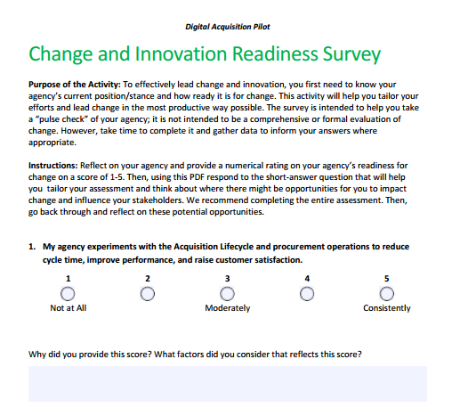
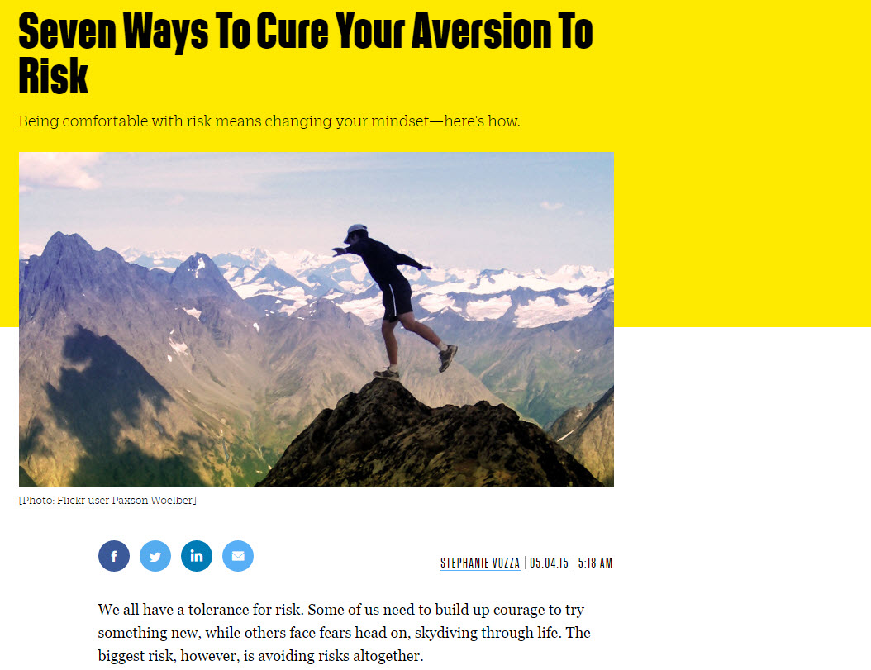
Change and Innovation Readiness Survey
Notes:
Duration: 5 minutes
Timing: 11:25-11:30
Presented by: Heather
Facilitator Notes:
You read the, “Seven Ways to Cure Your Aversion to Risk” article prior to assessing your agency with the Change Readiness Survey. If your agency is averse to risk, the door to innovation may be bolted shut.
You assessed your agency’s readiness for change and innovation – this assessment takes the organizational perspective, considering whether or not your agency is ready to take on change.

Slide 67
Stakeholder Analysis - Discussion
Who have you identified as stakeholders that you would like to interview? What are you hoping to uncover in your interview that will:
Clarify your understanding
Understand what motivates them
Get them to sign on to try something new
What are a couple of the questions you came up with to facilitate your interview?
How did you answer Question 4 in the stakeholder activity?
How will you position yourself?
What are some strategies you can use to influence change in your agency?
Notes:
Duration: 17 minutes
Timing: 11:03-11:20
Presented by: Heather
Facilitator Notes:
We wanted to leave some time for you all to discuss who you identified as stakeholders to interview, what you are hoping to get out of the interview, and what questions you are going to ask. Ask someone to kickoff with who they’re going to interview, have them answer questions. Ask if anyone else is going to interview that stakeholder. Move onto next stakeholder.
Product owner.
Senior contracting team.
Legal.
If you anticipate a barrier with a stakeholder/s or your agency, what are some strategies you can use to overcome that barrier?
Start small with a limited number of departments who would need to be involved – reading book on mobile development
Use the class to communicate intentionally that you’re trying something new and to position yourself as a partner in these types of opportunities.

Slide 68
Identify the Need or Problem
Identify the need or problem you are trying to solve
Create a goal for your conversation – either to address the entire problem or a part of the problem
Write it down and keep it handy so you can keep tracking back to it throughout the conversation
Notes:
Duration: 5 minutes
Timing: 11:30-11:35
Presented by: Heather
Facilitator Notes:
Why is this important? Because when you’re influencing others, you need to first identify the need or problem you are trying to solve and then create a goal for your conversation. If you’re not sure what you’re going to get out of a conversation, then you for sure aren’t going to get it. While your purpose for these interviews may just be information gathering, you still have a purpose you’re ultimately trying to solve – acquire digital services more efficiently and effectively. That’s your need – make sure to track back to your questions and ensure they help you meet that goal.

Slide 69
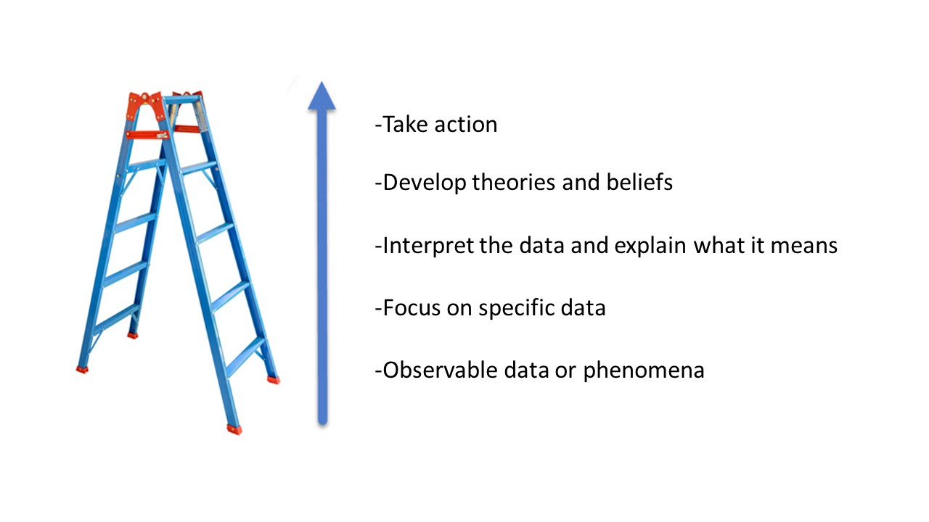
Ladder of Inference
Use the ladder of inference to determine the assumptions of each party
Observable data
Focus on specific data
Interpret the data and explain meaning
Develop theories and beliefs
Take action
Notes:
Duration: 5 minutes
Timing: 11:45-11:50
Presented by: Heather
Facilitator Notes:
After you have confirmed who the conversation will be with, the next step is preparing for that conversation. A good model to work with in this phase of planning is the Ladder of Inference.
The goal of using the ladder of inference is to determine the assumptions of each party. By identifying these preconceived notions, you can prepare yourself for what may come in the conversation by recognizing your own biases, as well as those of the person you will be talking to.
The bottom “rung” of the ladder is observable data or phenomena in the real world.
This is information that is readily available for everyone to evaluate, and it consists of all of the information available on a particular topic. If you are trying to influence another contracting officer, it might be a record of all of their contract awards and who they go to.
The second rung up is “focus on specific data.” Maybe you are surprised to notice that they work a lot with one or two vendors.
When looking at an entire scenario, one person may focus on one piece of the information, while another looks at a different piece. Understanding where there may be discrepancies in this is key. For instance, if your assumption about a barrier is based on a different piece of information than a stakeholder has considered, chances are they may not have ever thought about the problem you have identified, or vice versa.
The middle rung is, “interpret the data and explain what it means.” You start to interpret what it means that they work with the same vendor a lot – maybe they’re comfortable with the product and worried that a change = switching costs
At this stage, the data that an individual is evaluating is starting to form meaning in their mind. You are making sense of the information that you have zeroed in on.
The fourth rung, “develop theories and beliefs,” comes after the information has been interpreted. You start to really make assumptions this person is risk adverse.
This is where opinions have really shaped, and this step is another opportunity for discrepancies to arise.
The final rung is take action. – Ask them why! If they’re risk adverse, don’t suggest a huge change, suggest a smaller one.
In response to the theories or beliefs we develop, we take action. This can be where barriers arise, or in your case, it can be where an influence conversation will emerge from.
The main message – understand your colleague’s assumptions and perspective. Then, given their assumptions and perspectives, how can you flex your approach to develop strategies that align with your agency’s current position?

Slide 70
Other Preparation Notes
How much time do I need? | Consider your working relationship with the other party Consider what you’re communicating about Schedule your meeting length accordingly
Where is an appropriate place? | Consider whether you need to have a private space or whether it’s okay to “catch the other party” in between meetings
Does the other party need to prepare? | Identify any context or pre-reads you want to share with the other party
Notes:
Duration: 10 minutes
Timing: 11:50-12:00
Presented by: Heather
Facilitator Notes:
There are several additional things to consider when planning an influence conversation.
How much time do you need?
You should schedule your meeting length based on how long you think the conversation will take—be realistic. If you’re talking about a complex issue, you probably shouldn’t schedule a short meeting. Your working relationship with the other party may affect the amount of time needed as well.
Where is an appropriate place?
You should also be considering where you should have this conversation. This ties in with the amount of time needed, but you also need to think about the nature of the discussion. It may be better to have the conversation in private, or it may be ok to catch the person in between other meetings.
Does the other party need to prepare?
Depending on the nature of the conversation, the other party may need to prepare. If this is the case, be sure to provide them adequate time and resources to gather the information that they will need to have a meaningful discussion. If they are not provided with enough time or resources to prepare, chances are that the conversation will not be that effective.
There are several things that you should be thinking about as you prepare to engage a stakeholder to address challenges/barriers. Later in the week, we will be putting your influence conversation skills to the test with a roleplay activity.
Ask participants what tactics they plan on using in preparation for their conversation with influencers at their agencies.
After discussing various ways to engage stakeholders

Slide 71
Group Discussion – Your Strategies
Work in groups to discuss strategies you can use in your agency to impact change
Why will this strategy “work” in your agency?
How will you help to make it happen?

Slide 72
Lunch
Notes:
Timing: 1 hour
Presented by: Heather
Facilitator Notes:
The lunch break will run from 12-1:00pm.

Slide 73
Understanding Stakeholder Challenges – Part II
Notes:
Duration: 1 hour
Timing: 1:00-2:00
Presented by: Emily ____ from USDS
Now, we’ll hear from Emily at USDS with more about understanding stakeholder challenges. [will be adding background information on Emily for introduction purposes]
[USDS guest speaker will then take over.]

Slide 74
Live Digital Assignment Working Session
Notes:
Timing: 2:00-3:00
Presented by: Heather
Facilitator Notes:
For the last hour of the day, we have set aside more time for you to work with your Live Digital Assignment teams.
You should spend this time preparing for the demo day we are holding tomorrow, in which you will report out your assignment to the cohort.
You should walk through each aspect of your project– the hypothesis, product vision, and progress on testing your hypothesis.

Slide 75
Demo Day Preparation
Prepare to report out your findings to the cohort later this week with a 10-minute presentation. Be prepared to discuss:
Overall project and hypothesis.
Your plan for executing and testing your hypothesis.
Product Vision
Systems/collaboration tools that you’ll use to execute your plan.
Your key learnings/takeaways, successes, challenges, and anticipated next steps.
Questions for the group or challenges you’re currently working through.
Notes:
Timing: 3:00-4:00
Presented by: Heather
Facilitator Notes:
While you work on your Live Digital Assignment, please reach out to the staff if you have any questions or comments and we will be glad to help.
If your presentation is all set, you may also use this time to work on any outstanding work for Release 2, including the Assessment, and Iteration 2.B work, etc.

