Slide 1
Release 3 Classroom Session – Day 5
November 18, 2016

Slide 2
Day 5 Agenda
Day 5 – Preview of Release 3 and Demo Day
Morning | Logistics until end of program Pick a SOO to complete the pre-award cycle Managing digital service delivery Metrics Activity
Lunch (12:00-1:00 pm)
Afternoon | Final wrap-up and feedback gathering Live Digital Assignment Presentations
Notes:
Facilitator: Heather
Duration: 10 minutes
Timing: 8:00-8:10 am
Facilitator Notes :
Welcome everyone back. It has been an long week, but a productive one.
Let’s finish strong!
Begin with telling the cohort that today we will dive in a preview of Release 4. This is in an effort to talk about what they are going to learn about over the next month and the expectations for what will be accomplished moving forward.
Then explain that we will be having a special metrics activity where they will get to examine scenarios about agile, Kanban, and cloud.
After lunch, it is presentation time. Each group will get to pitch their project to the class and our guest judges. They should provide an overview of their project, market research, hypothesis, and testing plan. Then, they should share how their hypothesis test went, what they learned, and where they want to take the project in the future.
Finally, we will wrap up this classroom session and talk about what we did throughout the week.

Slide 3
Release 4: Awarding & Administering Digital Service Contracts Introduction
Making the Award, Managing the Contract, and Incentives
Notes:
Facilitator: Heather
Duration: 1 hour and 45 minutes
Timing: 8:10-8:30am
Facilitator Notes:
The following slides will give an introduction to the topics within Release 4.

Slide 4




Introduction to Release 4
Awarding and Managing Contracts
Iteration 4.A: Awarding Digital Service Contracts
The source selection and award process
Preparing for post-award management, kick-off, expectations, schedule, and so forth
Iteration 4.B: Digital Services Delivery
Performance evaluation – How do you know when it is going badly?
Using an exit strategy
Capstone and Classroom Preview:
Final Capstone Assessment
Live Digital Assignment final presentations
What’s next?
Notes:
Facilitator: Heather
Duration: 5 minutes
Timing: 8:10-8:15 am
Facilitator Notes :
Here you want to show them how release 4 comes together, both A and B combined.
Release 4 is all about Awarding and Managing your contract now that you have completed the solicitation and received vendor proposals. In this release, they will focus how to select the best vendor, how to evaluate and incentivize the vendor’s work, how to recognize when failure occurs, and what to do if it does.
The class is in the final leg of the course, and after Release 4, they will have their final assessment and classroom session, which will include the final presentation of their live digital assignment.

Slide 5
Iteration 4.A: Awarding Digital Service Contracts Performance Objectives
Assess the readiness of the technical evaluation team.
Understand when and how to negotiate during the solicitation process.
Describe how to run an effective evaluation to get the best solution.
Determine the next steps that follow contract award. (Kickoff, Ramp-up, Baselining)
Notes:
Facilitator: Heather
Duration: 5 minutes
Timing: 8:15-8:20 am
Facilitator Notes :
Briefly review the core objectives.
We start with 4.A, Awarding Digital Service Contracts . Discuss how, now that they have completed the Acquisition Strategy, release the solicitation, and received vendor responses, they must assess their technical evaluation team.
In to the next bullet, discuss how to utilize evaluation methods and criteria to evaluate whether or not a vendor can deliver the product.
Then describe how running an effective evaluation can help you achieve the best solution.
Finally, share how they will go through what to do once the contract has been awarded – everything from the kick-off meeting to Baselining.
What does this all lead up to? A successful contract and product with a carefully chosen vendor.

Slide 6
Iteration 4.B: Digital Services Delivery Performance Objectives
Identify software engineering practices for high-quality digital services like version control, continuous integration, and continuous delivery.
Explain which metrics can be used, how they are derived, and why they are used.
Determine how to execute an exit strategy and course correct.
Identify when failure actually occurs.
Notes:
Facilitator: Heather
Duration: 5 minutes
Timing: 8:20-8:25 am
Facilitator Notes :
Briefly review the core objectives.
The biggest thing they will do in this iteration is develop their SOO. So are they ready, did they take all the steps necessary to have what they need to write the SOO?
Go over the mental checklist of what should be complete before they write and release the SOO (Facilitator to fill this in to the notes)

Slide 7
Capstone and Final Classroom Preview
At the end of Release 4, we will have a final capstone assessment
Covers all course content
You’ll need a passing grade in order to pass the course
There is also one final classroom session
Schedule: January 9th – January 11th
Final review
Guest Speakers
What’s next
Presentation of final Live Digital Assignment Projects
Graduation!!
Notes:
Facilitator: Heather
Duration: 5 minutes
Timing: 8:25-8:30 am
Facilitator Notes :
At the end of Release 4, we will have a final capstone assessment. It will cover all course content, and you’ll need a passing grade in order to pass the course.
There is also one final classroom session, which is scheduled from January 4th – January 11th. The classroom will include things like: a final review, guest speakers, discussions about what’s next for you all, and final presentations of your Live Digital Assignment Projects.
Graduation!!

Slide 8
Iteration 4.A Awarding Digital Service Contracts Introductions
Notes:
Facilitator: Will
Duration: 30 minutes
Timing: 8:30 – 9:00 am
Facilitator Notes :
This section will talk about key concepts around awarding digital service contracts

Slide 9

Iteration 4.A: Awarding Digital Service Contracts
Iteration 4.A schedule: December 5th through December 16th
How do you select and prepare your technical evaluation team?
Notes:
Facilitator: Will
Duration: 6 minutes
Timing: 8:30 – 8:36 am
Facilitator Notes:
Let students know that Iteration 4.A will run from November 28th through December 8th
One of the important topics that will be covered is selecting and preparing your technical evaluation team.
You will see some existing best practices around this.
However, this is practice is still being developed, and you all will get to be among those who define what a digital services technical evaluation team should look like.
During the iteration, you will have opportunities to consider, discuss, and share what your team should look like, how you find them, and how you prepare them.

Slide 10
Iteration 4.A: Awarding Digital Service Contracts
When and how should you negotiate during a solicitation?
How are we getting the best value solution?
Do you open negotiations or not?
What are some tactics that can help you adjust to the room and personalities to get your desired outcome?
Notes:
Facilitator: Will
Duration: 6 minutes
Timing: 8:36 – 8:42 am
Facilitator Notes:
Another thing you will be learning about is negotiations during a solicitation.
When and how should you negotiate?
Are you getting the best value solution?
Are you the one who starts negotiations?

Slide 11
Iteration 4.A: Awarding Digital Service Contracts
How do you run an effective evaluation and get the best solution?
What are the tradeoffs the team needs to prepare to dicuss?
How do you get the best value?
Do you understand what you are evaluating?
Notes:
Facilitator: Will
Duration: 6 minutes
Timing: 8:42 – 8:48 am
Facilitator Notes:
Introduce the following with the students:
How do you run an effective evaluation and get the best solution?
What are the tradeoffs between time and getting the best people?
How do you get the best value? How much can you get for a price?

Slide 12
Iteration 4.A: Awarding Digital Service Contracts
What comes after a contract is awarded?
Debriefing
Administration tasks
Kickoff
Project planning
What do these tasks look like for an agile project?
Contract Financing
Notes:
Facilitator: Will
Duration: 6 minutes
Timing: 8:48 – 8:54 am
Facilitator Notes:
After your contract is awarded, your work does not end. In 4.A, you will learn about what comes afterwards.
Some common tasks are debriefing and administrative tasks like a kickoff meeting and project planning. These tasks can look different when working on an agile project. Can anyone give me an example?
You also have important decisions to make around the contract’s financing, and you will look at strategies to help you.

Slide 13

Iteration 4.A: Awarding Digital Service Contracts
Acquisition Blogging Opportunity
Think about the acquisition package you worked on during this Classroom experience
Write to an audience whom you want to support your acquisition
How do you gain their buy-in?
Why is it important to them?
Consider what social media you could use to promote your post
Notes:
Facilitator: Will
Duration: 6 minutes
Timing: 8:54 – 9:00 am
Facilitator Notes:
We’ve been seeing some good posts on the program blog, and Iteration 4.A gives you another opportunity to utilize this new tool.
You’ve been working hard on your acquisition package this week, and now you have the chance to sell your acquisition package to the readers of the program blog. Think about how you can gain their support for your acquisition and talk about why it is important to them.
Finally, consider how you can use social media to promote your blog post.

Slide 14
Iteration 4.B Digital Services Delivery Introduction
Notes:
Facilitator: Neil
Duration: 60 minutes
Timing: 9:00 – 10:00 am
Facilitator Notes :
This section will talk about Iteration 4.B, which is about digital services delivery.

Slide 15
Hart and Holmström
Winners of the 2016 Nobel Prize for Economics
Identify two factors
Conflict of interests
Measurement
Implications for government contracting
Limit over-incentivizing for cost reduction
Promote accurate, meaningful measurement
Notes:
Facilitator: Neil
Duration: 5 minutes
Timing: 9:00-9:35 am
Facilitator Notes :
This iteration will run from December 19th through December 30th.

Slide 16
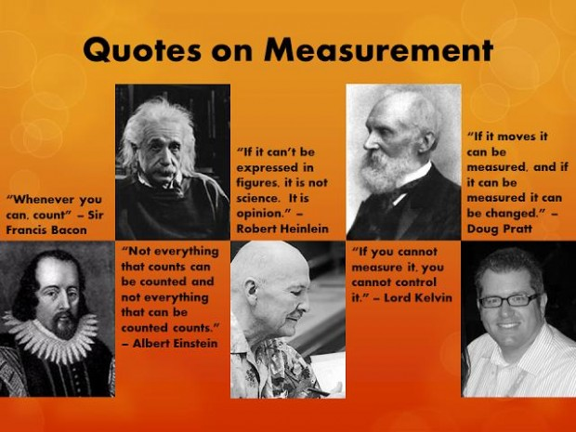
Agile Metrics
“Amplify learning”
Fail fast

Slide 17
Core Agile Metrics
Lead/cycle time
Throughput
Cumulative flow
Bugs (number, type, severity)
Scrum
Metrics we already know
Story points
Burndown
Velocity
Potential flaws
Relative
Administrative burden
#NoEstimates

Slide 18
Sources for Metrics
Project tracking system
Source control
Build pipeline
System monitoring

Slide 19
Project Tracking System Metrics
Estimates
Tags
Bugs
Recidivism
Assignees

Slide 20
Sample Project Tracking Systems
JIRA
Trello
OnTime
LeanKit
RealTimeBoard
TeamPulse
PlanBox
FogBugz

Slide 21
Source Control Metrics
Who, what, when, where of code changes
Distributed source control
Accepted and denied pull requests
Reviews

Slide 22
Sample Version Control Systems
Git
Subversion
CVS
Mercurial
Team Foundation Server

Slide 23
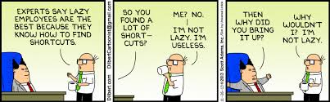
An Important Lesson
Focus on idle work; not idle workers.

Slide 24
Build Pipeline
Automated software builds
Automated artifact versioning
Automated documentation generation
Automated testing
Automated static analysis
Automated deployment
Sample tools
Jenkins
Hudson
Travis CI
Bamboo
GoCD

Slide 25
Automated Testing
Types of tests
Developer tests
Unit tests
Integration tests
Functional acceptance tests
Non-functional tests
Scalability
Security
Accessibility
Metrics
Tests passed/failed
Time to run
Number of tests total
Number of tests run
Can make for an interesting review
Quality from the start

Slide 26
Functional Acceptance Testing
Should use Behavior-Driven Development (BDD)
Tests defined as specifications
Reasonably plain-English scenarios mapped to executable code
Created by the Product Owner with the vendor
Sample tools
Cucumber
Numerous language- and framework-specific tools

Slide 27
Scalability Testing
Ensures application continues to perform with greater demands on bandwidth, memory, processing power, I/O, etc.
Different kinds of load
Users
Data
Static assets
Sample tools
Gatling (reports)
JMeter

Slide 28
Security Testing
Ensures application remains secure from all threat vectors
Multiple fronts
Functional tests from user interface
Functional tests from elsewhere
Tests against common vulnerabilities
BDD Security
Gauntltt
Mittn
Infrastructure scanning
OWASP Zap

Slide 29
Accessibility Testing
Particularly critical for web interfaces produced by government ​
Not nearly as mature so may have to resort to periodic manual testing​
Sample tools​
Pa11y​
AATT

Slide 30
An Aside: Testing As Documentation
Guaranteed to be current
Baseline with existing metrics
Essential for a good transition plan

Slide 31
Static Analysis
Measures code quality
Provides hints into functionality, scalability, security
Technical debt metrics
Code coverage
Duplication
Cyclomatic complexity
Adherence to standards
Lines of code
Sample tools
SonarQube
Numerous COTS

Slide 32
Technical Debt
Typically refers to shortcuts developers may take to get stuff done fast
Types
Naïve
Necessary
Strategic
Common causes
Deadlines
Faking velocity
Insufficient code coverage
Consequences
Increased time to market
Bugs
Schedule and budget sink
Poor morale
A bad product

Slide 33
Continuous Delivery
Automated deployment to production
Accomplished with DevOps
Metrics
Deployment frequency
Lead time
Failure rate
Mean Time To Recover (MTTR)

Slide 34
System Monitoring In Production
Operations
System uptime
Resource utilization
Anomalies
Availability of external resources
Usability
Web analytics (e.g. bounce, conversion, response, error rates)
Social media
Ratings

Slide 35
Sample System Monitoring Tools
New Relic
Splunk
Hyperspin
StatsD with Graphite
Gnip
Modern application technologies
Good logging and analytics

Slide 36
Mashups
Combining data > Data in isolation
API data visualized with dashboard tools

Slide 37
Why It Matters
Digital Services Playbook plays 4, 7, 9-12
Immediate understanding of project health
Pre-award evaluation of vendor maturity
Metrics and automation awareness
Willingness for scrutiny
Distinguishing bugs and avoiding recidivism
Delivery speed
Post-award
Identifying barriers to productivity
Stakeholder pressure
Absence of Product Owner
Staffing issues
Fail fast
Building trust through transparency and continuous delivery
Transition plan
Process metrics vs. Product metrics

Slide 38
Epilogue: Engineer Motivation
Sense of mission
Technical challenge
Cool technology
Notes:
Facilitator: Neil
Duration: minutes
Timing: 9:35 - am
Facilitator Notes :

Slide 39

Questions and Discussion

Slide 40
Morning Break
Notes:
Facilitator: Heather
Duration: 15 minutes
Timing: 10:00-10:15 am
Facilitator Notes:
Instruct participants to take a 15 minute break.
Direct to restrooms and water cooler.

Slide 41
Metrics Activity
Notes:
Facilitator: Heather/Neil
Duration: 1 hour and 45 minutes
Timing: 10:15 am-12:00 pm
Facilitator Notes:
Now, we will begin a special Metrics Activities. This activity was first delivered to the Pilot program, who really enjoyed getting to work with these real-world scenarios.

Slide 42
Why This Activity Is Important
The importance of tracking and monitoring digital and agile
COs don’t need to run the data, but they do need to know the questions to ask to uncover potential issues or risks to your project
Give you a sense of the types of challenges that arise when managing digital and agile projects
A total of 5 scenarios you could encounter when managing agile, Kanban, and Cloud
Recognize that the same data could tell different stories
Work with your group to generate questions and answers about the data and identify what is, or should be, happening in each scenario
Learn from others’ experiences managing these projects
Notes:
Facilitator: Heather/Neil
Duration: 5 minutes
Timing: 10:15 am – 10:20am
Facilitator Notes :
This activity will give you real world examples of why tracking and monitoring metrics for digital services and agile are important.
You won’t need to run the data yourself, but COs need to know what questions to ask to discover potential issues or risks to a project.
There are a total of 5 scenarios that you will work through in this activity. They cover everything from managing agile to Kanban and Cloud.
As you begin, keep in mind that the same data can tell you different stories. Your group with work together to identify what’s going on in each scenario. Afterward, we will debrief and share each other’s insights and experience.

Slide 43

Activity Overview and Instructions
Activity Overview
Set of cards on your table that include a situation on metrics (each table has a different set of cards)
Cards include 3-4 questions that become more involved/introduce new details – take about 4-5 minutes on each question – you will have 15 minutes on each rotation
Activity Instructions
Turn over the first card, review the situation, and respond as a group
Turn over the next card in your stack, respond to it, etc.
Organize the stack for the next group and rotate; you’ll rotate to all 5 situations
Notes:
Facilitator: Heather/Neil
Duration: 1 hour 15 minutes
Timing: 10:20 am – 11:35am
Facilitator Notes :
You will work in teams for this activity and rotate around the room from table to table. Each table has a different scenario and set of cards. The cards include 3-4 questions that become more involved and introduce new details as you move through them. Everyone will be using the same set of cards, so please take notes on a separate piece of paper.
You will have 15 minutes to work through each scenario. Your team will turn over the first card, review it, and respond as a group before moving on to the next card. After 15 minutes, you will move over to the next table and scenario.

Slide 44
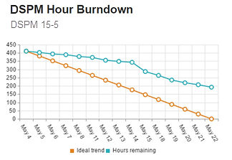
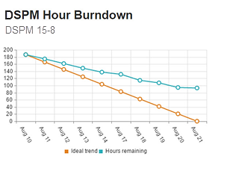
Debrief – Reading a Burndown Chart from a 3-Week Sprint
What should you “zero in on” when reviewing these two burndown charts? What are some reasons that 15-5 could be three weeks long while 15-8 is only two weeks long?
How can user stories, scope, and resources impact the trends you observe in the charts (both positively and negatively)?
Notes:
Facilitator: Heather/Neil
Duration: 5 minutes
Timing: 11:35am -11:40 am
Facilitator Notes :
Situation:
The Department of Digital Services wants a customer-focused suite of services. They have set up an Agile team of 5 people, and the student is the CO.
The students must compare burndown charts to identify how they did in a 3-week sprint and a 2-week sprint.
Questions:
Why the sprints were different lengths
Think about scope and what could effect that
What good and bad scope looks like and how they effect the charts

Slide 45
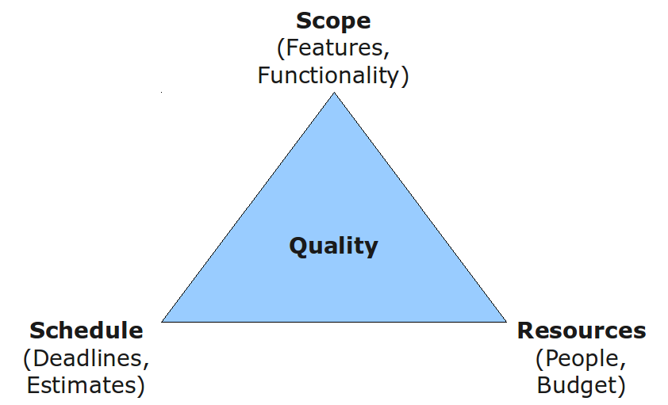
Debrief – Scoping Stories to Prevent a Bottleneck
How does the INVEST test help you scope the stories in this scenario?
What are the tradeoffs of restructuring, and how do you keep quality as a constant deliverable?
I
ndependent
N
egotiable
V
aluable
E
stimate-able
S
mall
T
estable
Notes:
Facilitator: Heather/Neil
Duration: 5 minutes
Timing: 11:40am -11:45 am
Facilitator Notes :
Situation:
An agile team has been tasked to build a system that will provide federal employees with the ability to apply for transit benefits online and the workflow/capability that allows administrators to manage benefits. Student are given two user stories to consider.
Question:
Think about how to foresee potential issues
How to test user stories
How to maintain quality

Slide 46
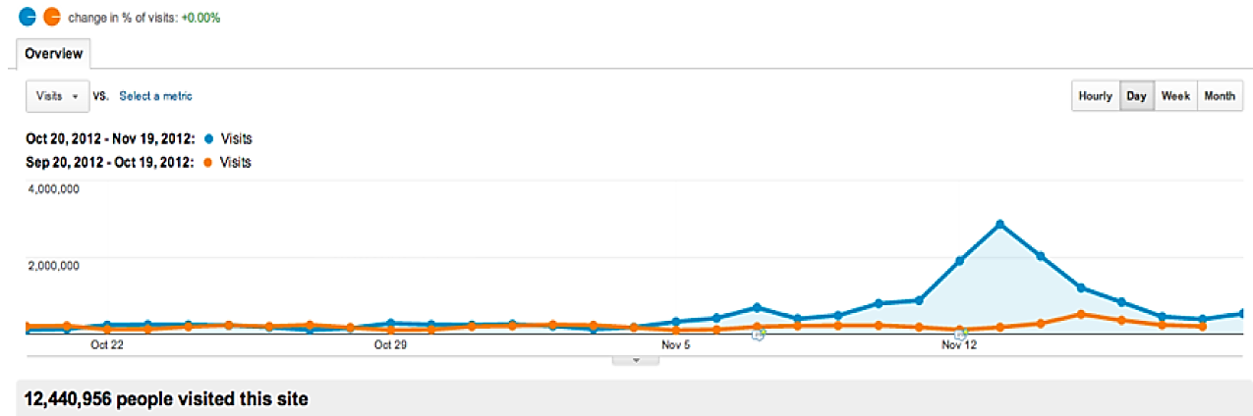
Debrief – Cloud Provisioning
What can you conclude about the data in the following chart?
If you see a prolonged spike in site traffic, what should you do?
What is your sense of how the contract will perform in comparison to the ceiling?
What are your recommendations for the following year?
Notes:
Facilitator: Heather/Neil
Duration: 5 minutes
Timing: 11:45am -11:50 am
Facilitator Notes :
Situation:
Your agency has a public facing website that traditionally serves an annual average of roughly 2 million visits per day and has procured Amazon Web Services on a T&M basis. The website sees a spike in November.
Questions:
Think about what should be done (if anything)
What would they do if the numbers in the spike were higher or lasted longer?
What should you consider with costs and forecasting ahead?

Slide 47

Debrief – Preparing for a Weekly Meeting Using Burndown Charts
What key points help you understand the overall status of multiple projects?
When running the contract administration meetings, what types of topics should you bring up?
How do you keep team momentum and engagement no matter what the project status is?
Notes:
Facilitator: Heather/Neil
Duration: 5 minutes
Timing: 11:50am -11:55 am
Facilitator Notes :
Situation:
The students are overseeing two digital services projects. One is going well – the burndown chart is tracking well, and the task is moving forward. The other is not going well – the burndown chart shows a loss of momentum, and the task has reached a bottleneck.
Question:
Speculate about what could be happening with each project
How they would present feedback (good and bad) to the teams in check-in meetings?

Slide 48
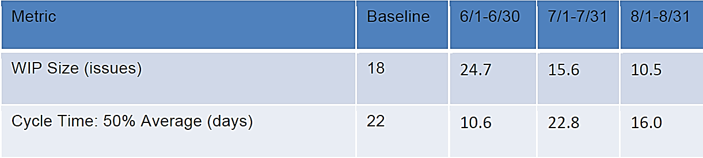
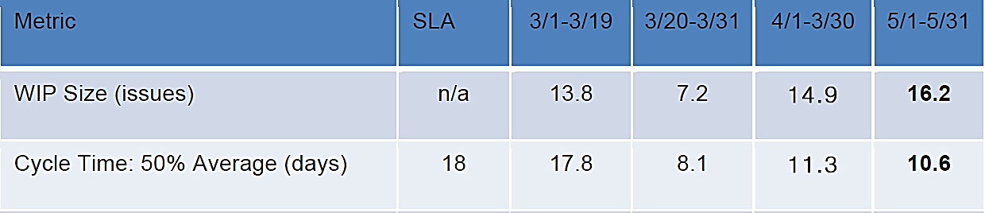
Debrief – Managing Workflow Using Kanban
In May 2015, is your team doing well? How can you tell?
What happens if you do not group user stories into small, medium, and large groups?
If you have lots of large user stories, what can you do to help them take less time?
What other metrics should be tracked to know you’re getting a quality product?
August 2013
May 2015
Notes:
Facilitator: Heather/Neil
Duration: 5 minutes
Timing: 11:55am -12:00 pm
Facilitator Notes :
Situation:
Your team is working on an agile project that uses Kanban to track the team’s progress on user stories.
Questions:
Look at different tables that represent cycle time
Where did the actual numbers fall (positive or negative)?
What effects do large and small story cards have?
What other metrics should be tracked?

Slide 49
LUNCH!
Notes:
Facilitator: Heather
Duration: 1 hour
Timing: Lunch is scheduled to occurred from 12-1 pm. Adjust that timing depending on how the schedule is moving along.
To prepare for LDA assignment presentations after lunch, encourage participants to load up their materials to the facilitator’s computer using a jump drive and/or by emailing their presentation.
Cue up presentations on facilitator computer so that presentations are ready for use after lunch.

Slide 50
Wrap Up & Classroom Session Feedback
Notes:
Facilitator: Heather/Melissa Duration: 30 minutes
Timing: 1:00-1:30pm
Facilitator Notes – Heather:
Now that you’ve had time to see all of the presentations, we wanted to come back together to debrief on the past three days and gather your feedback on your classroom experience. This will be similar to the orientation session, we’ll be closing with the “liked, learned, and longed for” post it activity.

Slide 51
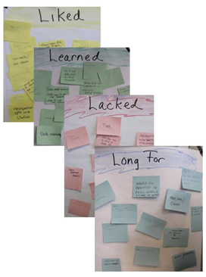
Liked, Learned, Lacked, Longed for Feedback on Orientation
Liked – things you really liked
Learned – things you have learned
Lacked – things you have seen the team doing, but consider that could be done better.
Longed for – something you desired or wished for
Notes:
Facilitator: Heather/Melissa
Duration: 5 minutes
Timing: 1:00-1:05 pm
Facilitator Notes:
We’re going to take a little time now and think back through everything we did this week. As we do so, we’d like you to use the sticky notes in front of you to write down:
Things that you really liked about an activity
What activity might have taught you something really meaningful and what that is
If there were any activities that could have been done better
If there was some activity that you feel should have been done.
You do not have to write a sticky note for each activity in this classroom session, but the ones that stood out.
Your feedback will be helpful for the next classroom session and future trainings, as well as a reminder to yourself of what you have learned and experienced this week.
The next few slides will list all the activities to help jog your memory – as we did a lot this week!

Slide 52

Classroom Session Review – Day 1
Live Digital Assignment working session
Notes:
Facilitator: Heather/Melissa
Duration: 5 minutes
Timing: 1:05-1:10pm
Facilitator Notes:
Ask participants how helpful the LDA working session was for their groups.

Slide 53
Classroom Session Review – Day 2
Welcome Back… So What Has Changed?
Brief Review of Release 2
The Acquisition Strategy
Exit Strategies and Organizational Readiness Exercise
Pricing/Contract Type for Cloud and Agile
Live Digital Assignment Group Work
Day 2
Notes:
Facilitator: Heather/Melissa
Duration: 5 minutes
Timing: 1:10-1:15pm
Facilitator Notes – Heather:
Ask participants what stood out to them in each piece of Day 2:
Welcome Back… So What Has Changed?
Brief Review of Release 2
The Acquisition Strategy
Exit Strategies and Organizational Readiness Exercise
Challenge.gov Guest Speakers
Live Digital Assignment Group Work

Slide 54
Classroom Session Review – Day 3
Using the Lean Acquisition Canvas
Winning in the Arena if Ideas
Challenge.gov Guest Speakers
SOOs, SOWs, PWSs… Oh My!
Day 3
Notes:
Facilitator: Heather/Melissa
Duration: 5 minutes
Timing: 1:15-1:20pm
Facilitator Notes – Heather:
Ask participants what stood out to them in each piece of Day 3:
Using the Lean Acquisition Canvas
MAP Case Study
Let’s Talk Pricing and Contract Type for Cloud and Agile
Guest Speakers: Acumen

Slide 55
Classroom Session Review – Day 4
MAP Case Study: SOO
Putting It All Together
Acquisition Package Vendor Roundtable
Day 4
Security Considerations
Notes:
Facilitator: Heather/Melissa
Duration: 5 minutes
Timing: 1:20-1:25pm
Facilitator Notes – Heather:
Ask participants what stood out to them in each piece of Day 4:
SOOs, SOWs, PWSs… Oh My!
Putting It All Together
Acquisition Package Vendor Roundtable

Slide 56
Classroom Session Review – Day 5
Release 4: Awarding & Administering Digital Service Contracts Intro
Metrics Activity
Live Digital Assignment Report Out and Reflection
Day 5
Notes:
Facilitator: Heather/Melissa
Duration: 5 minutes
Timing: 1:25-1:30pm
Facilitator Notes – Heather:
Ask participants what stood out to them in each piece of Day 5:
Release 4: Awarding & Administering Digital Service Contracts Introduction
Metrics Activity
LDA Report Out and Reflection
Post your sticky notes up on the wall so they can be collected.

Slide 57
Live Digital Assignment
Presentation Time
Notes:
Facilitator: Heather/Will
Section Duration: 1 hour 30 minutes
Timing: 1:30-3:00pm

Slide 58

Your Presentation Instructions
Please get into your team and get your presentation materials ready.
Notes:
Facilitator: Heather
Duration: 5 minutes
Timing: 1:30-1:35 pm
Facilitator Notes :
Get everyone settled and into their teams. Make sure to visit with each team and see if they have everything they need to present.
Brief the class that each team will get 10 minutes to present and at the end for their presentation, we encourage other teams to ask questions.
Presentation guidelines: each group will present where their project is now, their hypothesis, and testing plan for the hypothesis.

Slide 59



Welcome to Demo Day!
Each group presents (about 10 minutes)
Cohort responds and offers insight
Share what you learned when testing
Notes:
Facilitator: Heather
Duration: 2 minutes
Timing: 1:35-1:38 pm
Facilitator Notes :
Brief the class that each team will get 10 minutes to present and at the end for their presentation, we encourage other teams to ask questions. For those of you in the audience, it’s your responsibility to pay attention and provide feedback to the group presenting. Ask any questions you may have, and provide insights.

Slide 60
Group Order
Team 1: WebExers (Coach: Brent)
Team 2: Pied Piper (Coach: Shannon)
Team 3: Stone Ponies (Coach: Shannon)
Team 4: Team US (Coach: Clair/Traci)
Team 5: Scrum n' Roses (Coach: Clair/Traci)
Team 6: Fragile Development (Coach: Brent)
Notes:
Facilitator: Heather/Will
Duration: 60 minutes
Timing: 1:38-3 pm
We plan to have the groups present in chronological order to make it easy!
Each team will have 10 minutes for their presentation and 5 minutes for questions.
Will to provide support in asking questions of the teams and directing the discussions.

