Slide 1
Digital Services Contracting Professional Development MVP Program Release 4 Classroom Session – Day 2
January 2017

Slide 2
Day 2 Agenda
Morning | LDA/Shark Tank Final Prep Guest Speaker – Digital Services Delivery
LUNCH
Afternoon | Shark Tank Pitches
Notes:
Duration: 3 minutes
Timing: 8:00-8:03 am
Presenter: ICF/Peter Bonner
Facilitator Notes:
Day 2
In Day 2, we will focus on finalizing your shark tank pitches so you are ready for the afternoon. We will have a guest speaker come in before lunch for talk about DevOps and performance monitoring in an agile environment. Then after lunch, it is Shark Tank time!

Slide 3
LDA/Shark Tank Final Prep
Notes:
Duration: 1 hour
Timing: 8:10 – 10:45
Presented by: ICF/Peter Bonner

Slide 4

Shark Tank Prep Time
Please take this time to get into your groups and finalize your pitch for this afternoon.
Remember the goal:
Gain the panels’ commitment of time and resources to fully build out your product
Notes:
Duration: 2 minutes
Timing: 8:10 – 8:12
Presented by: ICF/Peter Bonner
Facilitator Notes:
Remind participants that today is the day! As we discussed yesterday, you’ll be delivering your shark tank pitches this afternoon. Remember that these presentations will be similar to the reality show Shark Tank, where each group must pitch their Live Digital Assignment product to the panel to gain the panelists commitment of time and resources to pick up the project and build it out. Convince the sharks!

Slide 5



Shark Tank Reminders
Each group presents (about 15 minutes)
Judge Voting
( 5 minutes)
Shark Tank Questions
(about 5 minutes)
Notes:
Duration: 2 minutes
Timing: 8:12 – 8:14
Presented by: ICF/Peter Bonner
Facilitator Notes:
As we reminded you of yesterday and earlier today,
You will pitch your product to a panel of faculty and guests.
The goal is to gain the panels’ commitment of time and resources to fully build out your product.
Presentation Rules
15 minutes to present; 5 minutes for questions
Voting 5 minutes
All team members must participate/talk in the presentation

Slide 6
Logistics
Please email your presentation or have a flash drive ready; do this before lunch
Remember to fill out the self evaluations by the end of the day
The order for presentations is:
Team 1: WebExers
Team 2: Pied Piper
Team 3: Stone Ponies
Team 4: Team US
Team 5: Scrum n' Roses
Team 6: Fragile Development
Notes:
Duration: ~2.5 hours
Timing: 8:14 – 10:45
Presented by: ICF/Peter Bonner
Facilitator Notes:
Briefly go over the order of the presentations. Please either email your presentation to the program email or have it on a flash drive. Remind them the winner will present at graduation.
Also pass out the self evaluations and ask them be done by the end of the day.
let them know that we handed out rating forms that are at their seats. Explain that before the end of the day, participants should complete the Peer Ratings for their team & hand those in to the facilitator before they leave.

Slide 7
Morning Break
Notes:
Duration: 15 minutes
Timing: 10:45-11:00
Presented by: ICF/Peter Bonner
Facilitator Notes:
Instruct participants to take a 15 minute break.
Direct to restrooms and water cooler.

Slide 8
Guest Speaker – Digital Services Delivery
Notes:
Duration: 1 hour
Timing: 11:000-12:00
Presented by: Neil
Facilitator Notes:

Slide 9
Simple Math
Code + Infrastructure = Running Application

Slide 10





A Real Application
1-click deploy

Slide 11

Waterfall Delivery
O&M phase of SDLC
Dev and Ops in silos and in conflict
Tickets and approvals
Low quality
Accruing technical debt
Human costs
Notes:
Duration: 1 hour
Timing: 11:00-12:00
Presented by: Neil
Facilitator Notes:
Guest speaker (Neil) will speak about DevOps and Continuous Integration, what it looks like, and what it really means.

Slide 12
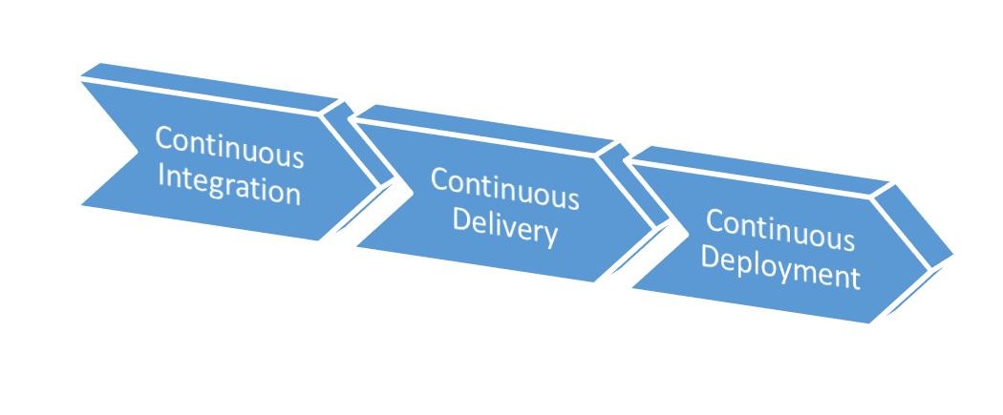
DevOps

Slide 13
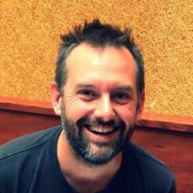
History of DevOps
10 Deploys Per Day: Dev and Ops Cooperation at Flickr
“Deployment pipelines”: Continuous Delivery
Lean Enterprise Institute
Agile Manifesto
Agile 2008: “Birds of a Feather”
First DevOpsDays conference
Continuous Deployment
1997
2001
2006
2008
2009

Slide 14
One Stop Shop
Ops creates centralized platforms and tools for Dev provisioned on demand
Virtual machines
Production-like environments
Automation
Monitoring and dashboards
No tickets needed
Not required but ideally most reliable and available self-service for Dev “customers”

Slide 15
Know Your Customer
Dev teams staffed with Ops personnel
Focused on team problems instead of Ops problems
Influence architecture and technology choices
Participate in ceremonies
Standups
Planning
Reviews and Retrospectives
Liaisons if embedding isn’t possible
Visualize Ops work

Slide 16
Definition of Really Done
“At the end of each development interval, we must have integrated, tested, working, and potentially shippable code, demonstrated in a production-like environment, created from trunk using a one-click process, and validated with automated tests.”
-- Kim, Humble, Debois

Slide 17
Infrastructure as Code
Fundamental to DevOps so developers can provision and configure infrastructure themselves
Version control
Puppet Labs 2014 State of Devops Report: Version control by Ops is the highest predictor of IT and organizational performance
Infrastructure significantly more configurable than code
Critical when failures occur
Changes delta
Rollback
Testable
Static analysis
Security testing

Slide 18
Immutable Infrastructure
Only way into production environments through version control
No manual changes
Rebuild over repair to promote predictability

Slide 19
Security
FBI/CIA JAR
Automated infrastructure built with security in mind
Provisioned environments
Security artifacts in version control
Training for Dev teams
Common functionality provided
Security liaisons with teams and participating in ceremonies
Security tests part of CI
Security issues treated the same as all others

Slide 20
Common Tools
Virtual machines
VMWare/VirtualBox
Vagrant scripts
Images on EC2
Infrastructure as code
Puppet
Chef
Ansible
Containers
Vagrant
Docker
Cloud environments

Slide 21
Keys to DevOps
Organizational commitment
Discipline
Automation

Slide 22
In Production
Continuous monitoring
Application performance monitoring
Business intelligence
Logs (but be wary of PII)
Social media
Numerous open-source libraries for collection and visualizing data
Metrics built in to some modern development frameworks

Slide 23
Why It Matters
Pre-award
DevOps maturity of vendors
Comfort with automation and continuous delivery/deployment
Possibly deployable artifacts as condition of award
Ability to work with existing infrastructure and/or Ops automation marketplace
Post-award
“Working software”
Availability of metrics
Comportment with agency policy

Slide 24

Questions and Discussion

Slide 25
Lunch
Notes:
The lunch break will run from 12:00-1:00 pm.
During lunch, we will prep for the shark tank panels by handing out rating forms & prepping for the arrival of the invited guests.

Slide 26
Shark Tank
Notes:
Duration: 3 hours
Timing: 1:00-4:00
Presented by: Traci Walker
Facilitator Notes:
Remind them to complete the eval forms if they have not already done so.
And we also have a panel of invited guests—our sharks—who will be providing ratings as well. Ask Traci to introduce the panel of invited USDS guests to the class.

Slide 27

Your LDA Journey
What you have accomplished:
Established a hypothesis
Developed a Product Vision
Designed a test for your hypothesis
Performed the test on your hypothesis
And now you have the chance to gain continued support and show how much you have learned!
Notes:
Duration: 5 mins
Timing: 1:00-1:05
Presented by: Traci Walker
Walk the students through a five-minute review of their LDA journeys.
You began by meeting and establishing your teams, during which you chose a project and created a hypothesis that filled in the following sentences:
We believe that [action] for [type of people] will achieve [specific outcome].
We will know this to be true when we see [quantitative measure/qualitative insight].
Once your hypothesis was approved, you developed your product vision and created a document that highlighted:
How your product would meet the user’s need
How things are currently being accomplished, and
How your product will be better and solve the problems of how things are currently done
Next, you needed to design a plan for how to test your hypothesis – a plan that would prove or disprove your hypothesis.
And then, you performed the test and compiled the results, documenting for yourselves how the results affect your project.
And now we are coming to the end of this journey - to the final presentation of each team - the delivery of a pitch to our panel of judges. Remember, your goal of this pitch is to gain continued support for your project in the coming year, as well as the chance to share your pitch with an even larger audience of your piers and managers!

Slide 28
Shark Tank Overview
Thank you to our distinguished panel members—our “sharks”!
Shark tank goal:
Gain the panels’ commitment of time and resources to fully build out your product
Notes:
Duration: 2 minutes
Timing: 1:05 – 1:07
Presented by: ICF/Peter Bonner
Facilitator Notes:
Remind participants that today is the day! As we discussed yesterday, you’ll be delivering your shark tank pitches this afternoon. Remember that these presentations will be similar to the reality show Shark Tank, where each group must pitch their Live Digital Assignment product to the panel to gain the panelists commitment of time and resources to pick up the project and build it out. Convince the sharks!

Slide 29
Shark Tank Reminders
Each group presents (about 15 minutes)
Judge Voting
( 5 minutes)
Shark Tank Questions
(about 5 minutes)
Notes:
Duration: 3 minutes
Timing: 1:07 – 1:10
Presented by: ICF/Peter Bonner
Facilitator Notes:
Remind participants of what they heard earlier about the timing of their presentations. Let them know that we’ll be holding up cards to warn them when they’re getting close to their presentation time limit.

Slide 30
Go Time!
Team 1: WebExers
Team 2: Pied Piper
Team 3: Stone Ponies
Team 4: Team US
Team 5: Scrum n' Roses
Team 6: Fragile Development
Notes:
Duration: ~2.5 hours
Timing: 1:10 – 3:55
Presented by: ICF/Peter Bonner
Facilitator Notes:
Ask the first team to come up & present. Have the slide decks for each team up on your computer & ready to go so that the presentations can be pulled up quickly. Proceed in this same manner for each team. Teams must be strictly held to the time limits discussed before lunch in order to stay on schedule. Let the teams know that you will give a one-minute warning when they’re approaching the end of their 15-minute presentation limit.
Here is a rough timeline for the presentations:
Team 1: 1:10-1:35
Team 2: 1:35-2:00
Team 3: 2:00-2:25
Team 4: 2:25-2:50
Team 5: 2:50-3:15
Team 6: 3:15-3:40
After the final team presents and the judges confer, then reveal the winner to the class!

Slide 31
Preview of Tomorrow
Notes:
Duration: 5 minutes
Timing: 3:55-4:00 pm
Facilitator: ICF/Peter Bonner

Slide 32
Day 3 Agenda
Morning | Course Assessment Program Feedback DHS FLASH Team Panel
Lunch (12:00-1:00 pm)
Afternoon | USDS Guest Speakers GRADUATION! Happy hour @ USDS (Jackson Place)
Notes:
Duration: 5 minutes
Timing: 3:55-4:00 pm
Facilitator: ICF/Peter Bonner
Facilitator Notes: Review the agenda as shown on the slide.

