Slide 1
Digital Services Contracting Professional Development MVP Program Orientation Day 3
August 2016

Slide 2
Day 2 Review/Check-in
Does anyone want to share one thing they learned?
Does anyone want to share any confusion or something they want to delve into even more?

Slide 3
Day 3 Agenda
Day 3 – Starting to Apply Digital Services to Acquisition
Morning | Pre-Program Survey Results Implementing Agile in Government Program Overview, Continued Digital Services Acquisition Case Study: Small Business Administration (SBA) ONE Contracting Systems Modernization Procurement
LUNCH
Afternoon | SBA Panel Discussion (or other panel discussion) TechFAR Hub Live Digital Assignment Group Work Orientation Review and Assessment

Slide 4
Pre-Program Survey Results

Slide 5
A Couple of Overview Notes on the Survey
Four topic areas – agile, digital acquisition, digital services, and leading/influencing change
Normal for percentages to decrease from aware → describe → act → teach
Percentages were obtained by imputing values (i.e., someone who indicated s/he could teach a topic was also included in the “aware,” “describe,” and “act” percentages for that topic)
Open Responses indicate several people are novice in Digital Services and looking forward to progressing to an Act or Teach level through the course of the program

Slide 6
Agile Methods Data Report Out
Around 93% (on average) feel they are aware of agile’s value proposition, contract writing, pricing, etc.
This was the lowest average awareness across the four topic groupings
Only about a third (32%) on average can describe these topics, and less than 10% can take action

Slide 7
Acquisition for Digital Services Data Report Out
95% (on average) feel they are aware of key acquisition for digital services contracts topics
Across the board “structuring solicitations to focus on outcomes instead of requirements” was the highest rated item (almost 70% feel they can describe this topic and 38% reported they can take action)
“Digital marketplace intelligence and types of suppliers” was the lowest rated item across the board (only 21% can describe it and only one person indicated they could teach/act)

Slide 8
Digital Services Concepts Data Report Out
Lowest average ability to describe (29%) for these topics
Comfort with acting ranged from 3% (e.g., open source software policy/tools and role of a Product Owner) to 14% (e.g., understanding platform as a service and the concept of a MVP)
Most instances where no one is comfortable at a “teach” level (64%)

Slide 9
Role as a Digital Services Professional Report Out
Highest average ratings across most levels:
99% average awareness
50% average ability to describe
29% average ability to act
Identifying those who are allies, persuadable and obstacles had the highest describe (62%) and act (41%) ratings

Slide 10
Program Overview, continued

Slide 11
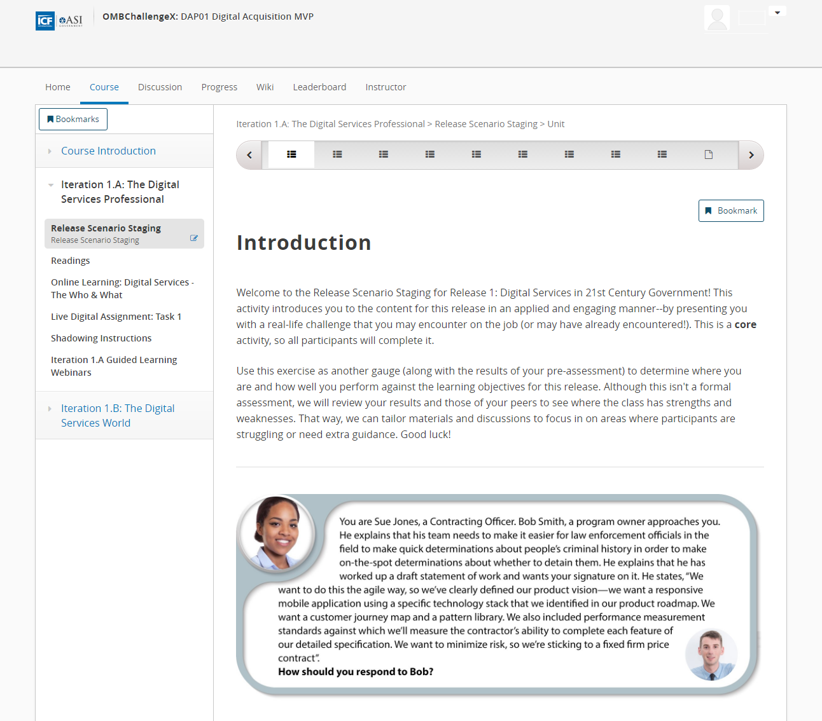
The Courseware Home Page
Left navigation is where content will display for each Iteration.
Tracking completion of content
Some content must be completed to unlock other pieces of content
Content will be marked, so you can pick out what is required/elective

Slide 12






Earning Badges
Two types of Badges
Olympic badges
Based on work completed in an iteration
Goes toward your participation grade
The number of CLPs you earn
Applied Skills badges
Based on activities performed outside of the program activities and content
Awarded by the category of activity performed
Different levels can be earned for engaging in an activity multiple times

Slide 13
Olympic Badging
- Complete all Iteration content marked with (B)
- Must complete 6 of 8 iterations for full Participant grade
- 60 CLPs upon completion of course
- ½ of (S&G) content and 7+ contributions to discussion boards
- Earn 1 CLP for each badge
- Silver badge earned in 7 of 8 Iterations: 10 CLPs upon completion of course
- All of (S&G) content and 10+ contributions to discussion boards
- Earn 1 CLP for each badge
- Gold badge earned in 7 of 8 Iterations: 10 CLPs upon completion of course
60
CLPs!
70
CLPs!
80
CLPs!

Slide 14

Applied Skills badges
Earn a badge in the following categories:
Practice and Experimentation
Getting Your Name on the Map
Developing Your Network
Study, Learning, and Exploration
Ad Hoc
Complete more than one activity to go up a level!
Earn the most and win a Prize!

Slide 15
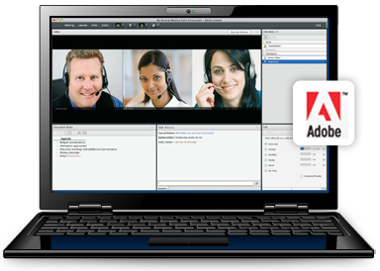
The Iteration Planning Meeting Webinar
What it is? | An introduction to the content, sessions, activities, and timing in each two-week iteration
Why it’s important? | It presents the iteration expectations and outcomes and provides a forum for questions
How to find it? | Follow the Adobe Connect link posted in the Course Info page of edX or respond to the meeting invite Begin August 8 and continue every other Monday
What’s the format? | Adobe Connect web conference
How long will it take? | 30 minutes

Slide 16

Release Scenario Staging
What it is? | A case study scenario that you review and answer questions about
Why it’s important? | It introduces you to the content and helps you to target development during the release (based on what you get right and wrong) It provides cohort-level information to facilitators
How to find it? | Release Scenario Staging link in the left navigation menu in the Courseware tab
What’s the format? | Case study scenario with questions
What’s the length? | 30 minutes

Slide 17
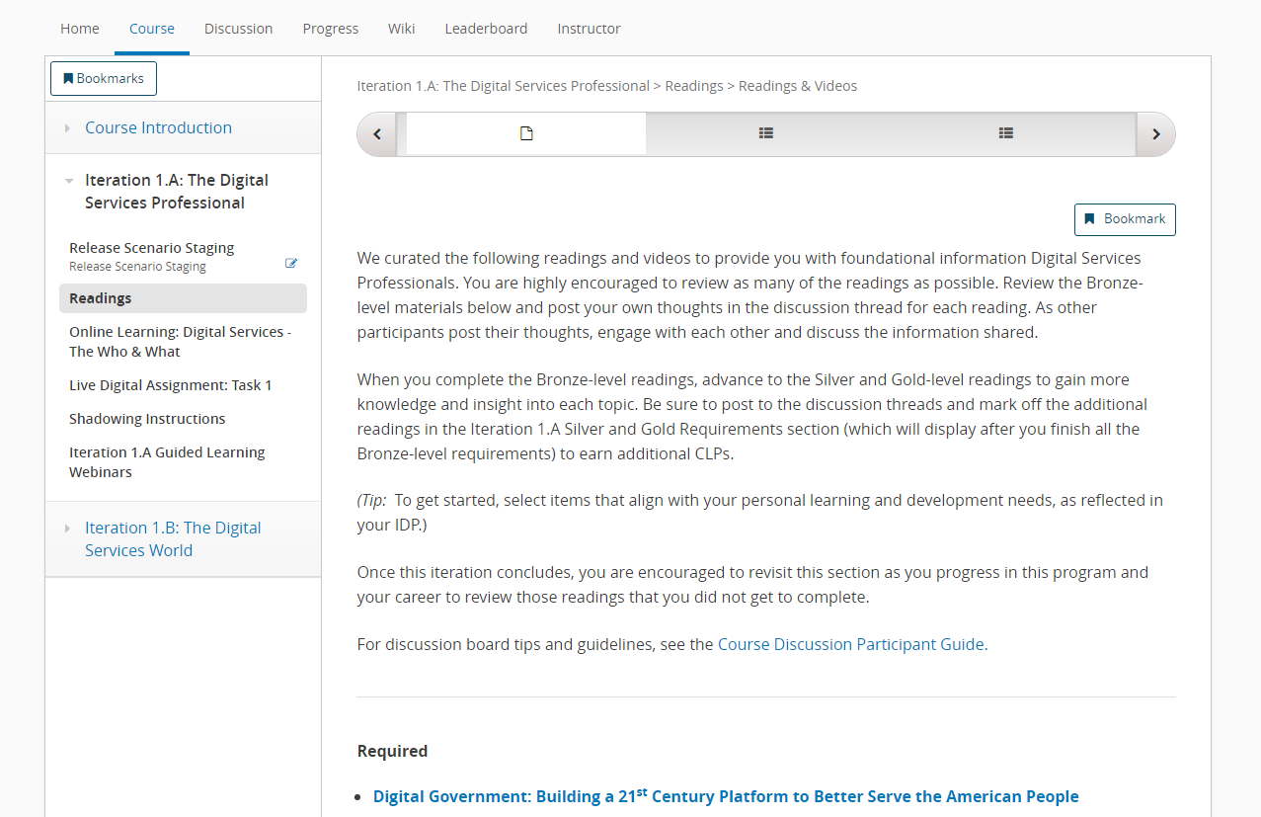
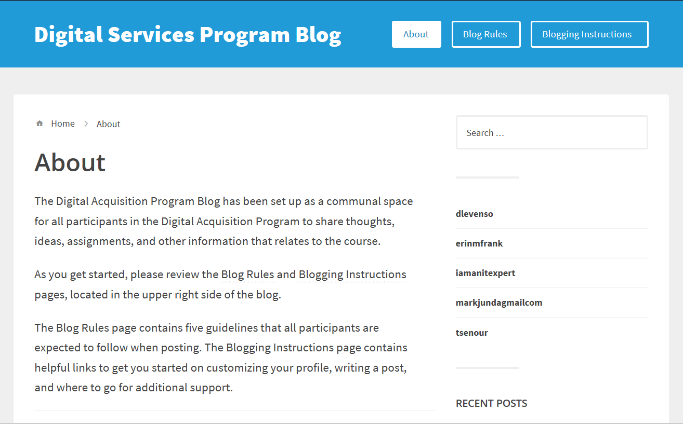
Self-Directed Learning – Reading Articles and Participating in Discussion Boards and Blog Posts
What it is? | Read articles and/or books that present foundational content and participate in discussion boards and blog posts to share your experiences and observations
Why it’s important? | It teaches you important content, provides future resources, and helps you to begin to synthesize and apply it to your situation
How to find it? | Under the title “Readings” in the left navigation of the iteration
What’s the format? | Articles, videos, podcasts, discussion boards, and blogs
How long will it take? | ~2 hours

Slide 18
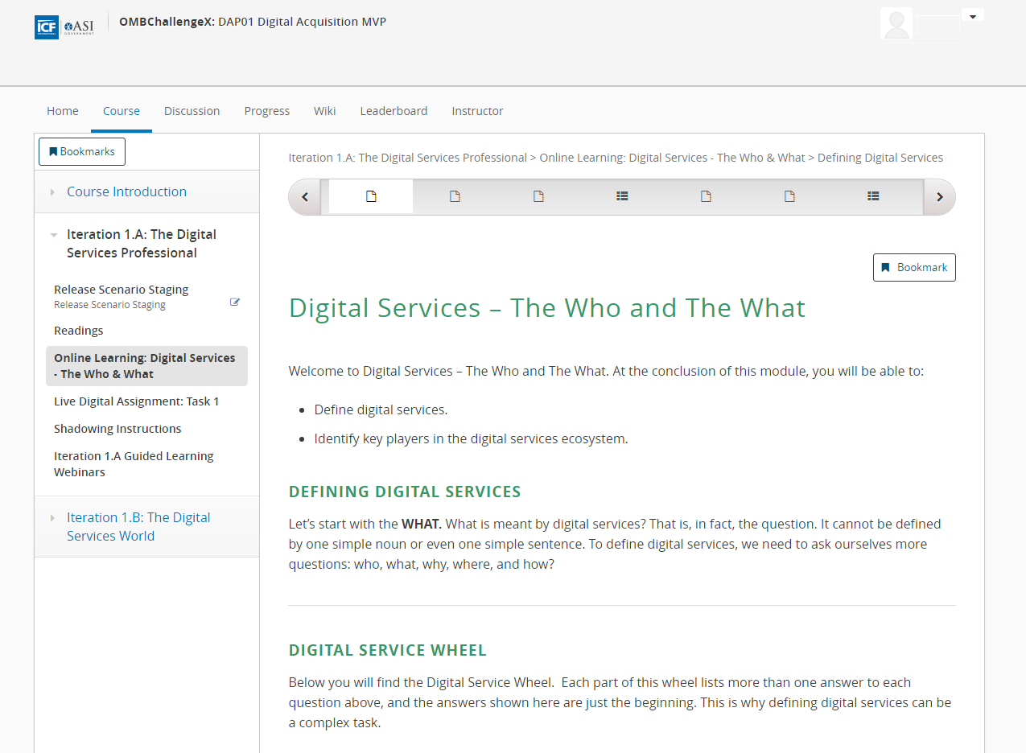
Self-Directed Learning - Online Learning
What it is? | Online learning content that delves into important topics and processes of the course
Why it’s important? | It teaches you key content, processes, and examples
How to find it? | Online Learning links in the left navigation menu of the Courseware tab
What’s the format? | Content is presented through text and images, videos, and knowledge checks
How long will it take? | ~60 minutes

Slide 19
Web Conferences
What it is? | An opportunity to address course content, function as an office hours session to answer questions or discuss additional information, function as a retrospective of what you learned, or hold a Demo Day for the Live Digital Assignments
Why it’s important? | Helps translate new knowledge into opportunities to practice Provides opportunities delve deeper into a topic or to reflect information you have gained Provides opportunities to present what is happening with your Live Digital Assignments and gain additional input or assistance
How to find it? | Follow the Adobe Connect link posted in the Course Info page of edX or respond to the meeting invite
What’s the format? | Adobe Connect webinar
What’s the length? | 60 minutes

Slide 20


Collaborative Classroom Session
What it is? | An opportunity for you to come together to dive into topics you haven’t tackled, practice what you’ve learned in a safe space, and reflect on the habits you’re developing
Why it’s important? | It provides a focused and longer time for you to engage in learning without distractions and to benefit from learning from each other
What’s the format? | Face-to-face classroom – come prepared to participate and do activities!
How long will it take? | 4 days
When are they? | Official dates will be posted on the Course Info page and emailed to all participants

Slide 21
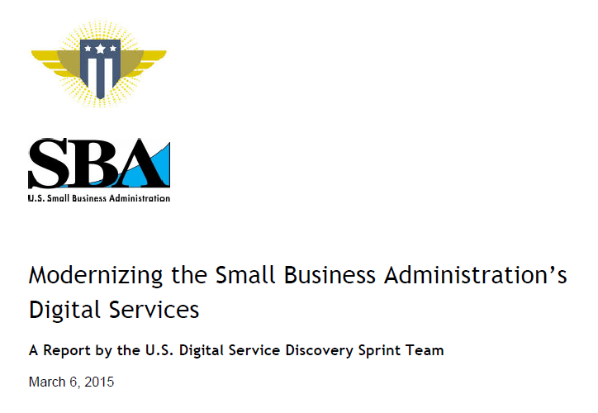
Opportunities for Apply What You’ve Learned: SBA Case Study and Threaded Scenario
What it is? | Activities and assignments to demonstrate knowledge transfer and innovation
Why it’s important? | It gets you to start practicing what you’re learning in a safe space and contributing to the field
How to find it? | In the left navigation menu of the Courseware tab, in classroom sessions, or shared via email
What’s the format? | Activity you complete or contribute your expertise to
How long will it take? | 60 minutes

Slide 22
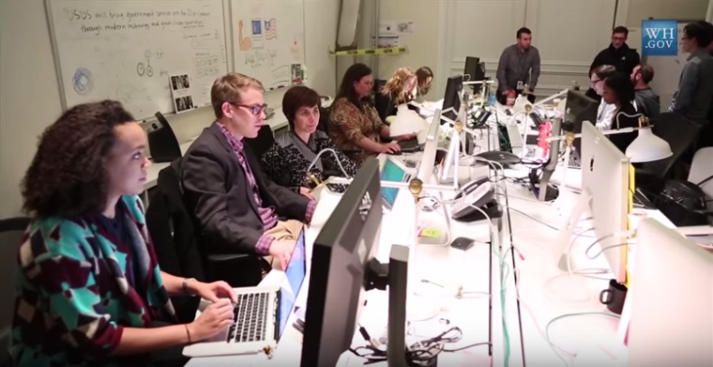
Opportunities for Apply What You’ve Learned: Acqu-a-thons
What it is? | Opportunity to observe digital services in action

Slide 23


Shadowing
What it is? | An activity where you find an opportunity to shadow a digital services implementation/delivery team
Why it’s important? | Build your familiarity with modern design and development approaches Engage directly with digital services teams to learn about their work Build trust among acquisition professionals and customers across government and/or industry
How to find it? | Release 1 will have additional guidance and will help you select someone to shadow
What’s the format? | Shadow a product manager, developer, or anyone on a digital services delivery team within or outside of government.
How long will it take? | Two days (16 hours)

Slide 24
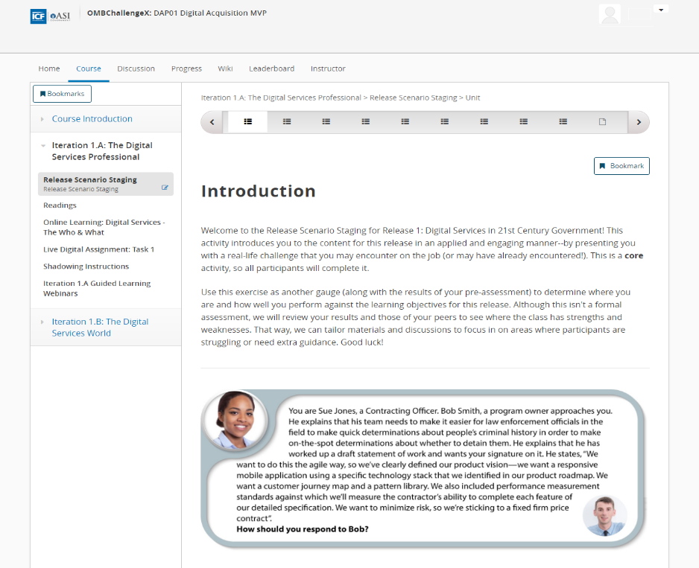
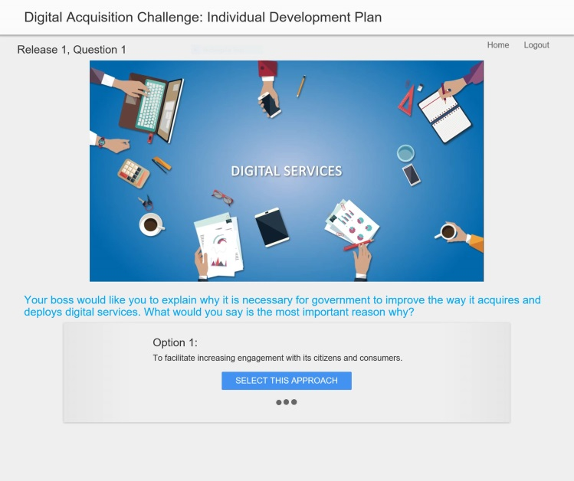
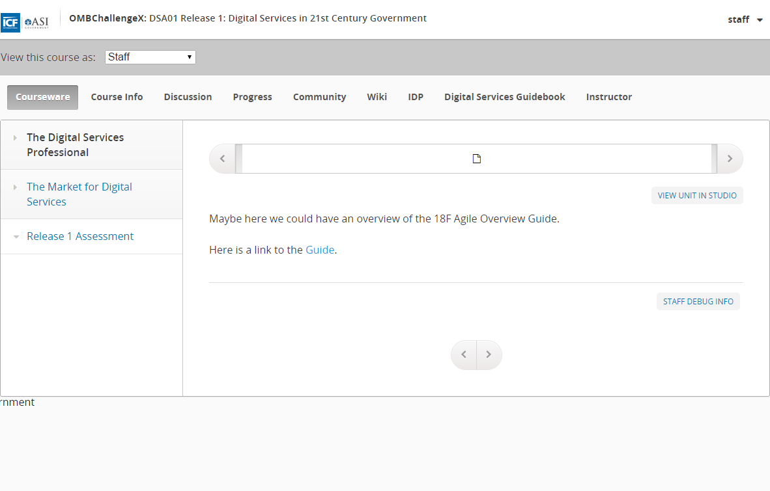
Assessment Opportunities
Program Pre-Assessment
Assess pre-program digital knowledge, skills, abilities
Release Scenario Staging
Self-assess knowledge, skills, abilities on a release
Release Assessment
Assess what was mastered/not mastered to refine the curriculum according to participants’ needs

Slide 25
Questions?
“Sometimes opportunities float right past your nose. Work hard, apply yourself, and be ready. When an opportunity comes, you can grab it.”
Julie Andrews

Slide 26

Break – 15 minutes
Simplicity--the art of maximizing the amount of work not done--is essential.
Guess the source of this statement! We’ll reveal the answer when you return from break.

Slide 27
Implementing Agile in Government
Traci Walker, USDS (or other Digital Services Expert)

Slide 28
Digital Services Acquisition Case Study: Small Business Administration (SBA) ONE Contracting Systems Modernization Procurement

Slide 29
Have You Ever…
Used a cross-type contract (e.g., products and services)?
Written an SOO?
Contracted using agile?
Contracted using fixed price agile?
Implemented a new technology stack?
Used a phased approach to a solicitation?
Evaluated experience using anything other than past performance?
Used an oral presentation to evaluate vendors?

Slide 30
SBA Solicitation Artifacts Review
Defining the Need (Requirement Definition)
Market Research
Digital Services Market Segments
Solicitation Methods
Source Selection/Eval Factors
Contract Type
Risk Analysis & Mitigation
Pricing/Budgeting
Award & Contract Admin

Slide 31
Working Lunch

Slide 32
SBA Panel Discussion

Slide 33
Break – 10 minutes

Slide 34
Introducing…the TechFAR Hub!

Slide 35
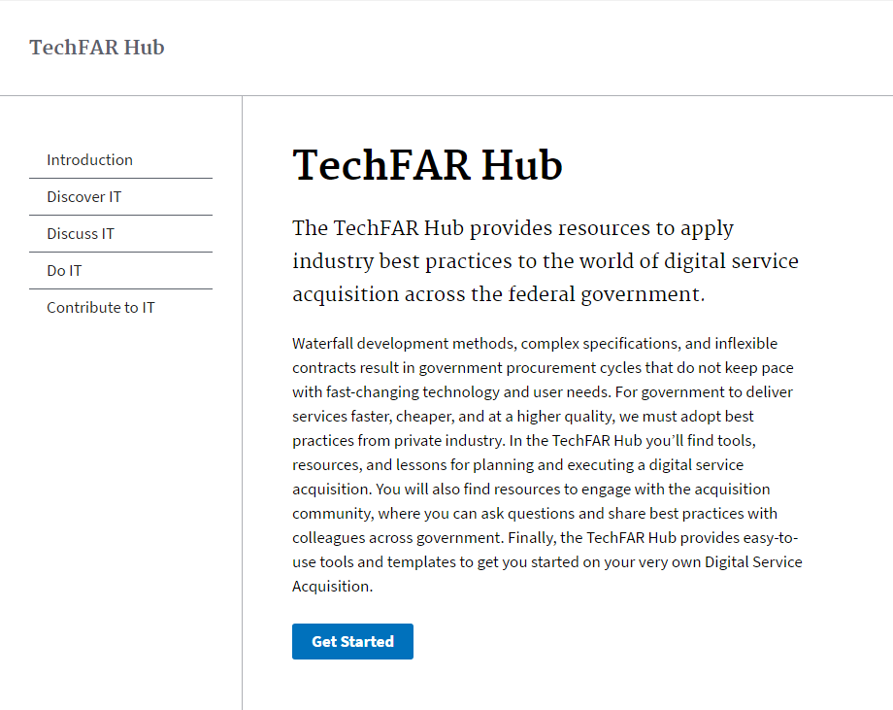
TechFAR Hub Demo

Slide 36
Live Digital Assignment Group Work

Slide 37
Remember Our Design Hypothesis Exercise
We believe that [action] for [type of people] will achieve [specific outcome].
We will know this to be true when we see [quantitative measure/qualitative insight].

Slide 38
Wrap Up & Orientation Feedback

Slide 39
Orientation Review – Day 1
Program Story – How it came to be
Vision of USDS - Haley’s TEDtalk and Mikey’s culture change strategy
Program Overview – What to expect
EdX Demo – How to get started
UX Design with Dan – Hypothesis creation
DiSC Debrief – How we work
Live Digital Assignment – What to expect and group introductions

Slide 40
Orientation Review – Day 2
Digital Services Playbook Overview
Digital Services – agile, open source, and cloud
Agile Workshop – building a petting zoo

Slide 41
Orientation Review – Day 3
Pre-program Survey Results
Implementing Agile in Government
Digital Services Acquisition Case Study
TechFAR Hub
Live Digital Assignment Group Work

Slide 42
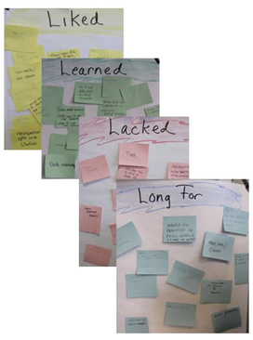
Liked, Learned, Lacked, Longed for Feedback on Orientation
Liked – things you really liked
Learned – things you have learned
Lacked – things you have seen the team doing, but consider that could be done better.
Longed for – something you desired or wished for

