Slide 1
Digital Acquisition Pilot Iteration 2.A Planning Meeting
September – October 2016

Slide 2
Agenda
Iteration 2.A Welcome and Introduction
Focus of the iteration
Sessions and activities that compose the iteration
Have you completed your Release 1 assessment yet?
Notes:
Facilitator Notes:
Release 1 Assessments are due by COB today.

Slide 3
Notes/Updates
We are continuing to map learning objectives to the IDP and are creating a more sustainable solution.
Great job getting your LDA project plans in to us!
Complete the Release 1 Assessment if you have not yet
Discussion board assignments reminder
First student to complete activity will hit “Add a Post” button
Everyone will respond to that thread
Facilitators will still be able to track participation by username
Don’t forget to complete the shadowing form!
Email the opportunity you identify to our program email address (DigitalAcquisitionMVP@icfi.com)
Notes:
Facilitator Notes:
Each team has submitted their project plan, thank you for getting those in. We’ll be introducing the next step of the LDA today.
Please don’t forget to complete the Release 1 Assessment if you haven’t been able to yet.
On Thursday, you received some additional directions from Traci about posting discussion assignments. We’re going to change things a little bit– now the first person to complete an activity will be adding the post, and everyone else will be posting as a response. We think that this will help encourage conversation and reduce the number of posts.
The shadowing assignment will have to be completed by December 31, but you must identify a shadowing opportunity by the end of this release. We have already received some opportunity submissions, so keep them coming! The shadowing form can be found in the Shadowing tab within the Course Introduction content.

Slide 4
Iteration 1.B – What It’s All About
Iteration 1.B – Where We’ve Been
Identified the available sources of supply within the digital services market segments, such as Open Source Software, Big Data, XaaS, Cloud, and more.
Identified the high-level principles of agile development that make it effective.
Described what sets agile methods apart from waterfall development and delivery methods.
Iteration 2.A – What’s Next
Analyze stakeholders in your sphere of influence that impact digital services acquisition.
Assess your agency’s readiness for change and innovation.
Ask effective questions to understand the agency’s need and make recommendations on a course of action for a digital acquisition procurement.
Analyze a digital service need to determine its most appropriate market.
Notes:
Facilitator Notes:
Congratulations on completing Release 1. To review, you:
Identified the available sources of supply within the digital services market segments, such as Open Source Software, Big Data, XaaS, Cloud, and more.
Identified the high-level principles of agile development that make it effective.
Described what sets agile methods apart from waterfall development and delivery methods.
In this next iteration, Iteration 2.A, you will:
Analyze stakeholders in your sphere of influence that impact digital services acquisition.
Assess your agency’s readiness for change and innovation.
Ask effective questions to understand the agency’s need and make recommendations on a course of action for a digital acquisition procurement.
Analyze a digital service need to determine its most appropriate market.

Slide 5
Iteration 1.B Timeline
Iteration 2.A – September/October
Sept. 5 | 6 | 7 | 8 | 9
Iteration Planning Meeting
11:00 – 11:30 am ET
Oct. 3 | 4 | 5 | 6 | 7
Iteration Web Conference
11:00 – 12:00 pm ET
Release Scenario Staging
30 minutes
Activity: Stakeholder Analysis
2 hours*
Activity: Change Readiness Survey
1 hour
Activity: Practice Analyzing A Digital Services Need
2 hours
Activity: Communicating the Mission/Need
1 hour
Live Digital Assignment: Product Vision
5 hours
Notes:
Facilitator Notes:
As we have mentioned in the past, we will have a three-week break in this iteration due to the busy time of year. Note that the Iteration Web Conference will be on October 4, and the iteration will end on Oct. 7.
There are four activities for this iteration, and the readings for the iteration are spread across the activities. Reading time is included in our time estimates.
Stakeholder Analysis: *Interviews for the stakeholder analysis are not included in this time estimate. Participants have until December 31 to complete all interviews (1 hr/interview, 2 interviews for bronze; 3 interviews for silver; 4 interviews for gold).

Slide 6
Iteration Web Conference
Iteration 1.B – September – October
Sept. 5 | 6 | 7 | 8 | 9
Iteration Planning Meeting
11:00 – 11:30 am ET
Oct. 3 | 4 | 5 | 6 | 7
Iteration Web Conference
11:00 – 12:00 pm ET
60-minute webinar in Adobe Connect
Bronze-level Requirement
A closer look at product vision, and a review of product vision material from a recent acqu-a-thon
Notes:
Facilitator Notes:
Feel free to bring any questions or comments about the LDA product vision assignment to this web conference.

Slide 7
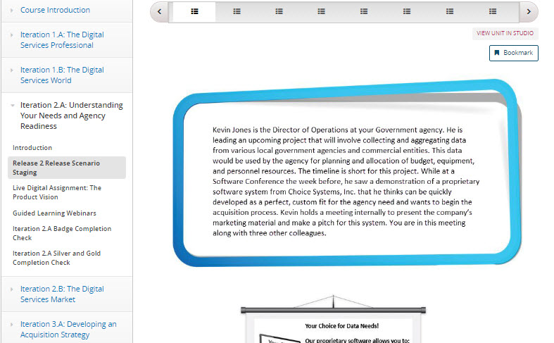
Release Scenario Staging
Release Scenario Staging
About 30 minutes
Bronze-level requirement
Presents you with a real-life challenge that you may encounter on the job
Use exercise as a gauge to determine your knowledge going into this iteration
Notes:
Facilitator Notes:
This 30-minute core activity introduces you to the content for this release in an applied and engaging manner--by presenting you with a real-life challenge that you may encounter on the job.
Use this exercise as another gauge (along with the results of your pre-assessment) to determine where you are and how well you perform against the learning objectives for this release.
Although this isn't a formal assessment, we will review your results and those of your peers to see where the class has strengths and weaknesses. That way, we can tailor materials and discussions to focus in on areas where participants are struggling or need extra guidance.

Slide 8
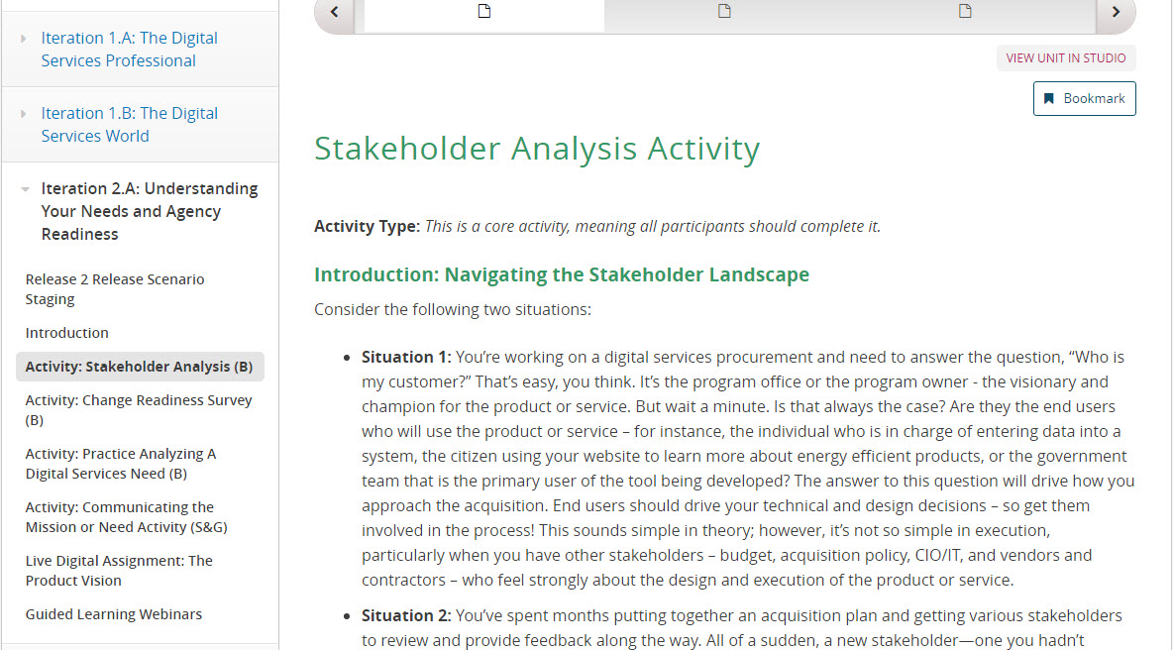
Activity: Stakeholder Analysis
Stakeholder Analysis
About 2 hours*
Bronze-level requirement
Deliverable due October 14.
Review the navigating the stakeholder landscape materials
Complete stakeholder analysis to identify who you will interview.
Silver/Gold-level requirements include interviewing up to 2 additional stakeholders
Notes:
Facilitator Notes:
The stakeholder analysis will first introduce you to different stakeholders that you will encounter when bringing your acquisition plans to fruition.
After learning who may be major stakeholders, you will identify 2-4 people within your own agency who you see as a major influencer. You will do some basic research on this person, hypothesize benefits/challenges to their engagement in digital services acquisition, consider how these individuals will perceive you, and develop a conversation structure. For your Bronze badge, you must submit a Word document that includes the following information:
Stakeholders you intend to interview,
status of scheduling those interviews,
and a list of questions that you plan to ask.
This document will be due to the program email by October 14, 2016.
Additionally, once you have completed those first steps, you will be conducting interviews with these individuals. These interviews will count for a badge in a later iteration. For the bronze-level you will need to conduct 2, 1-hour interviews. For the silver-level you will conduct 3 interviews, and you will interview 4 individuals to meet the gold requirement.
*Estimated 2 hours does not include interview times. Interviews must be at least 1 hour each.
Participants can interview 2 people for Bronze badge, 3 for Silver, and 4 for Gold.

Slide 9
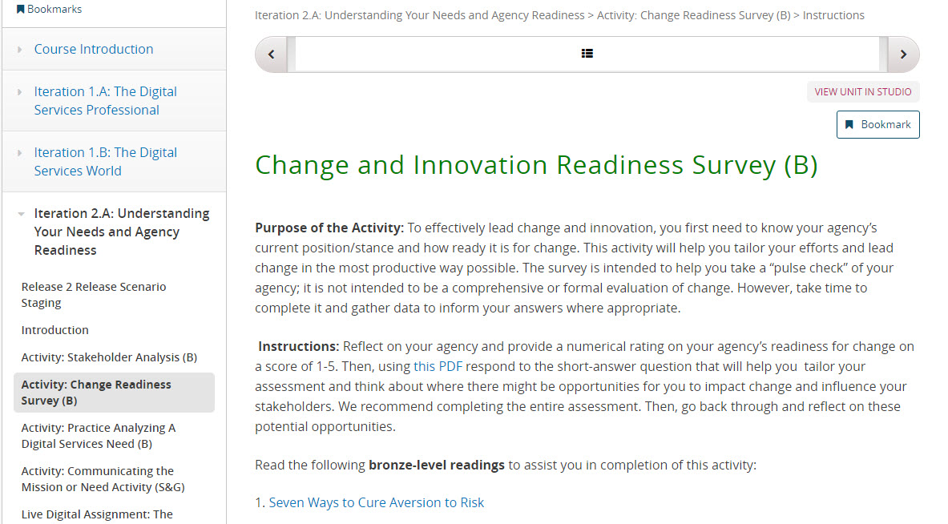
Activity: Change and Innovation Readiness Survey
Change and Innovation Readiness Survey
1 hour
Bronze-level requirement
Conduct a “pulse check” of you agency’s willingness to change and innovate.
Bronze-level readings
Notes:
Facilitator Notes:
With the Change and Innovation Readiness Survey, you will be assessing your agency’s current position on innovation and change, allowing you to tailor your future efforts to lead change.
This activity includes two bronze-level readings: “Seven Ways to Cure Aversion to Risk” and “Do You Have a hard Time Making Decisions” that should help to guide your responses.
Please note that there is a PDF form within the survey that you should use to elaborate on your responses.

Slide 10
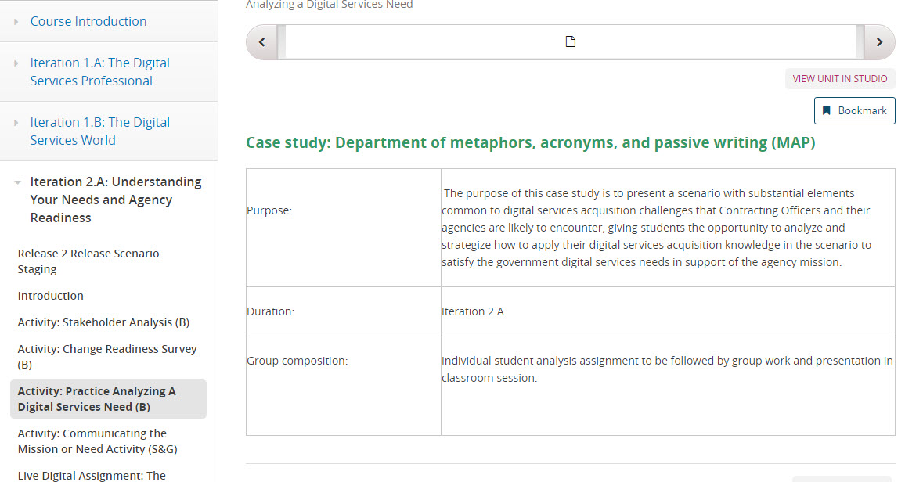
Activity: Practice Analyzing a Digital Services Need
Practice Analyzing a Digital Services Need
2 hour online learning
Bronze-level requirement
You will analyze a case study around a digital service need to determine whether open source, proprietary, or COTS solution is most appropriate
Bronze-level “Improving Cybersecurity Protections in Federal Acquisition,” reading
Notes:
Facilitator Notes:
For the Analyzing a Digital Services Need Case Study activity, you will be looking at a case study that contains several common digital services acquisition challenges encountered by Contracting Officers.
You will have an individual assignment in which you must research potential Open Source, Commercial Off-The-Shelf (COTS), or proprietary solutions to satisfy the product vision. You will be assigned a research topic based on your LDA group, and you will individually create a deliverable in which you defend your solution as being the most effective.
We will be using these results in the classroom session for an exercise, and you will be presenting your findings with your LDA team.

Slide 11
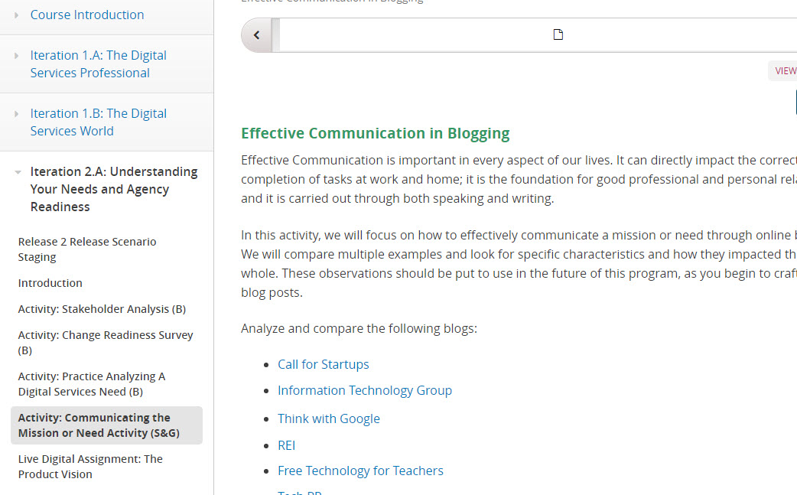
Activity: Communicating the Mission/Need
Communicating the Mission/Need
60-minute activity
Silver/gold-level requirement
Evaluate example blogs to determine how effective they are at communicating their mission or need.
Analyze the blogs from three different perspectives and share in a discussion post.
Notes:
Facilitator Notes:
Participants can earn three different credits toward their silver/gold badges in this activity.
You can observe the blogs individually
You can compare the blogs to each other
You can use the blogs to create a Best Practices list
This activity will help in preparing to write your own blog posts in the future. More importantly, the tech industry uses blogs to communicate and educate. Blogs are an ongoing source of information for how the industry is changing/evolving. As Digital Service Acquisition professionals, you need to be conversant in the space, but can also adapt it as your own industry practice. This is an opportunity for you to become movers and shakers.

Slide 12
Live Digital Assignment – The Product Vision
About 5 hours
Work with your live digital assignment team to create a product vision based on the feedback you received from your assigned coach
Draft submission due by Friday, Oct. 7, and your final version is due Oct. 14.
Guidelines for drafting your product vision, as well as an example can be found on the portal
Notes:
Facilitator Notes:
For your live digital assignment, you will be looking at your product vision.
The instructions in the portal give you an example of what this looks like, as well as a template to get you started. Our webinar for 2.A will provide additional guidance if you need it. Please coordinate with your LDA coach to develop a product vision that is no more than 70 words.

Slide 13
What’s Next

Slide 14
Release 2 Classroom Session
Iteration 2.B: The Digital Services Market
Identify why communicating openly and responsibly with potential vendors is critical to digital services acquisition success and how to do it.
Differentiate between buying compliance and buying outcomes.
Conduct effective market research for digital services.
Release 2 Classroom Session
Classroom Session for Release 2 will be from Oct. 17 – 21
ICF’s D.C. Office – 1725 I (Eye) St NW, Conference Center, Washington, DC 20006
Notes:
Facilitator Notes:
The next iteration, 2.B, will have you:
Identify why communicating openly and responsibly with potential vendors is critical to digital services acquisition success and how to do it.
Differentiate between buying compliance and buying outcomes.
Conduct effective market research for digital services.
Also remember that we will be having the classroom session from Oct. 17-21. Monday, Oct. 17 will be set aside for you to work with your groups, and the following days will be facilitator led training.

