Slide 1
Digital Acquisition MVP Iteration 1.A Planning Meeting
August 2016
Notes:
Facilitator Notes:
Welcome to the Iteration 1.A Planning Meeting. This meeting will be about ½ hour and the purpose is to introduce you to each of the sessions and activities, where they reside within the portal, and the likely time commitment.

Slide 2
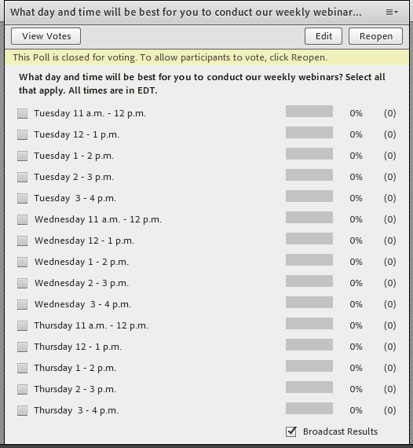
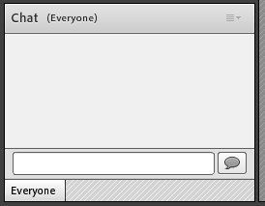

Adobe Connect Tutorial
Chat Feature
Raise Hand Feature
Live Polling
Works like standard IM – add text and hit enter
If you click someone’s name in participant list, you can chat privately
In upper menu bar, select icon that appears like below
Or, just jump in on the phone!
Respond to polls by selecting a response
Notes:
Chat feature
Raise Hand feature
Polling

Slide 3
Notes and Updates
Is everyone in Adobe Connect? Is anyone having accessibility issues?
Is everyone into the edX portal? Were you able to complete your pre-assessment (under the Individual Development Plan left navigation item)?
IDPs should be available if you’ve taken the pre-assessment!
All Orientation materials (e.g., PPTs, LDA expectations) have been posted under Course Introduction → Orientation Materials; feel free to give us any additional feedback on the discussion boards
Best day and time for webinars – poll the group!
Questions? Use the Digital Acquisition MVP email - DigitalAcquisitionMVP@icfi.com

Slide 4
Agenda
Iteration 1.A Welcome and Introduction
Focus of the iteration
Sessions and activities that compose the iteration
Notes:
Facilitator Notes:
Here is the agenda for today’s session; we will talk about:
Iteration 1.A Welcome and Introduction including a description of the focus of the iteration and the sessions and activities that will compose this iteration.
Also preview coming attractions. [TBD]

Slide 5
Iteration 1.A – What It’s All About
Iteration 1.A – The Digital Services Professional
Get inside the role of digital services professionals to understand what digital services are, who provides them, how they are delivered, and why successfully buying and delivering them is so critical
Overview of key guidance and digital services players – Digital Services Playbook, TechFAR, USDS, role of coders
Start getting plugged into the networks by finding an organization or thought leader in the digital service community and following his/her blog, newsletter, social media
Notes:
Facilitator Notes:
Consistent with the principles of user-center designed (as described in Digital Services Playbook Play 1), this first iteration—and release—focuses on the customers you’ll be interacting with or serving, including both internal government customers and those outside government (vendors and end users/citizens). In this first iteration, we’ll seek to get inside the role of digital services professionals to better understand what digital services are, who provides them (individuals, firms, government), how they are delivered (e.g., processes/methodologies like Agile and DevOps as well as tools and technologies used by digital service teams), and why successfully buying and delivering them is so critical. As part of this, we’ explore the origins and evolution of digital government.

Slide 6
Iteration 1.A Timeline
Iteration 1.A – August
8 | 9 | 10 | 11 | 12
15 | 16 | 17 | 18 | 19
Iteration Planning Meeting
11:00 – 11:30 am ET
Web Conference
Day and Time TBD based on polling response
Release Scenario Staging
30-minutes
Reading and Discussion Board Responses
1 – 2 hours
Online Learnings
3 hours
Live Digital Assignment: Task 1
3 hours
Notes:
Facilitator Notes:
Orange are webinars with fixed times, dark blue is for self-directed learning activities and light blue is for the live digital assignment.
Let’s talk about the three webinars briefly and then switch over to showing where all of this “lives” in the portal.

Slide 7
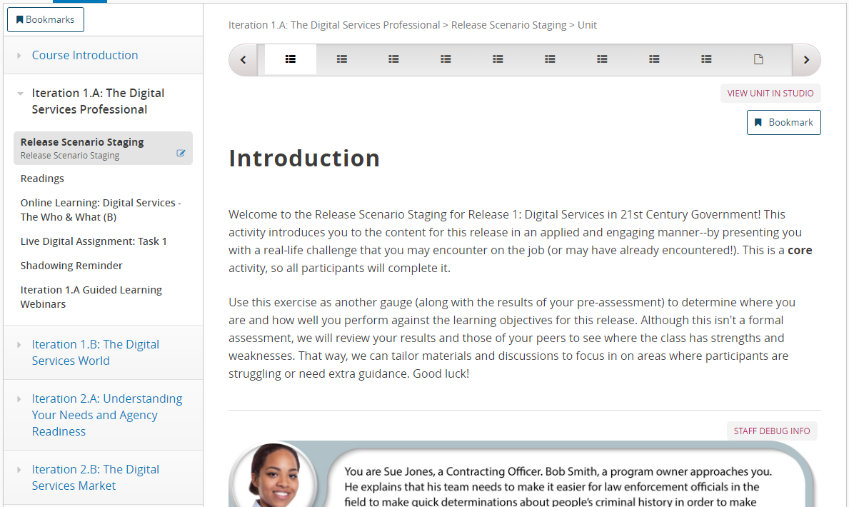
Release Scenario Staging (B)
Release Scenario Staging
About 30 minutes
Presents you with a real-life challenge that you may encounter on the job
Use exercise as a gauge to determine your knowledge going into this iteration – if you have extra time to work towards Gold/Silver, where should you spend it?
MUST BE DONE FIRST!
Notes:
Facilitator Notes:
I am going to switch over to sharing my desktop so you can see where these different activities live on the portal, but each of the slides on different activities is set up in this format – with a description of the activity and the time commitment on the left and a screen capture of where it lives on the portal on the right.
This 30-minute core activity introduces you to the content for this release in an applied and engaging manner--by presenting you with a real-life challenge that you may encounter on the job.
Use this exercise as another gauge (along with the results of your pre-assessment) to determine where you are and how well you perform against the learning objectives for this release.
Although this isn't a formal assessment, we will review your results and those of your peers to see where the class has strengths and weaknesses. That way, we can tailor materials and discussions to focus in on areas where participants are struggling or need extra guidance.

Slide 8
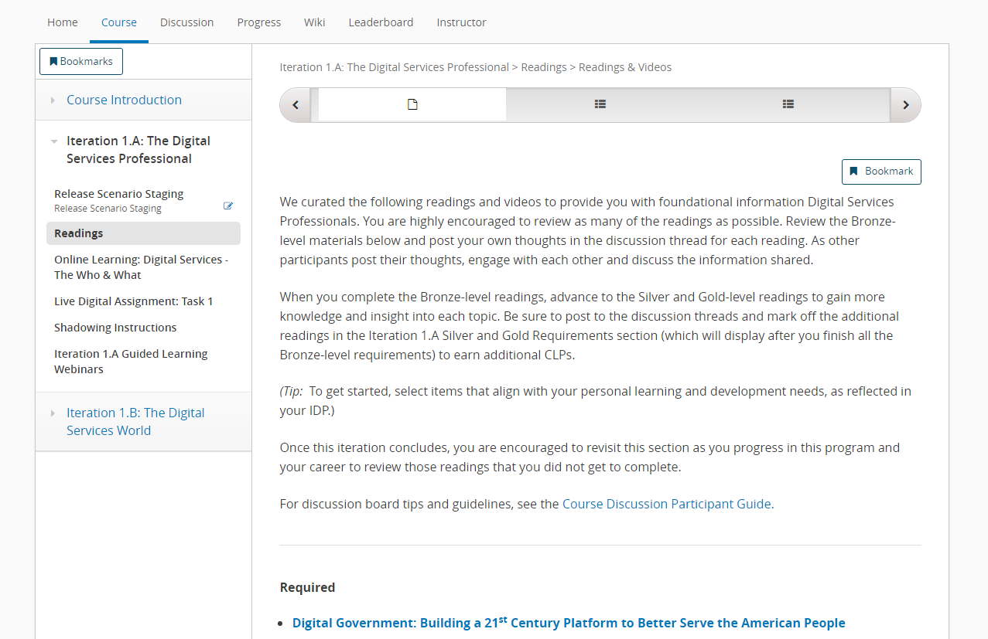
Readings and Discussion Board Posts (B)
Readings
About 1- 2 hours
Five bronze-level readings – combination of videos and articles
Silver and Gold-level readings
Post your own thoughts in discussion thread
Engage in discussion
Notes:
Facilitator Notes:
We have a number of readings in this go round – you are highly encouraged to review as many of the readings as possible.
Review the Bronze-level materials below then move on to the Silver and Gold-level readings to gain more knowledge and insight into each topic.
Post your own thoughts in the discussion thread for each reading.
Engage in discussion with other participants as they post their thoughts.

Slide 9
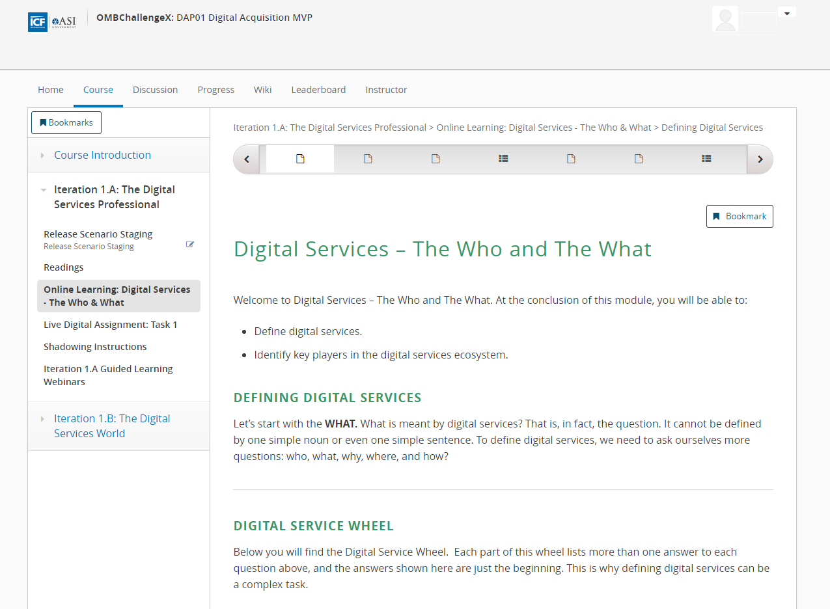
Online Learnings (B)
Online Learnings
3 online learnings
The Who & What
The How
Defining Your Role
About 60-minutes each
Examines the who, what, and how of digital services
Explores roles of individuals and teams within the digital services ecosystem
Knowledge checks
Don’t forget to select the “Mark as complete” at the end of the online learning – this helps us to track participation and unlocks more content!
Notes:
Facilitator Notes:
This online learning will go over the definition of digital services by looking at a use case and answering the questions: Who? What? Where? Why? and How?
We’ll look at digital services in terms of three layers: information, presentation, and platform.
We’ll go over the roles of individuals and teams within the digital services ecosystem.
There will short quizzes to check your knowledge on the topics presented in this module.

Slide 10
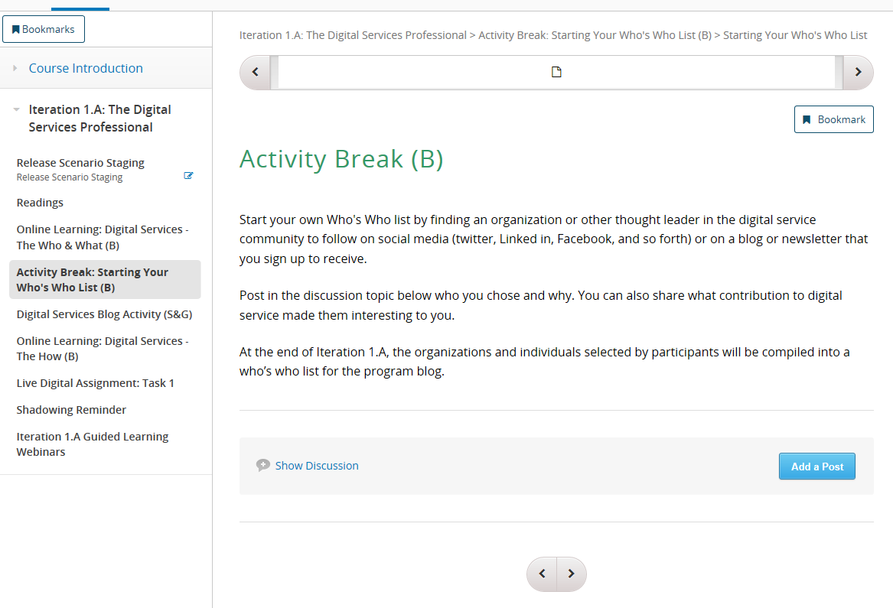
Other Activities
Starting Your Who’s Who List (B)
30 minutes
Find an organization or thought leader in digital services community to follow on social media, a blog, or a newsletter
Post who you chose and why in the discussion board
Digital Services Blog (S&G)
Read one of the recommended blogs and create a discussion board post
Unlocks after you complete the first online learning!
Notes:
Facilitator Notes
Two activities are available after you complete The Who and What online learning
The “Starting Your Who’s Who List” is a Bronze-level (required) activity that should take about 30 minutes to complete
The Blog Activity is a Silver/Gold (elective) activity that will take about 60 minutes to complete

Slide 11
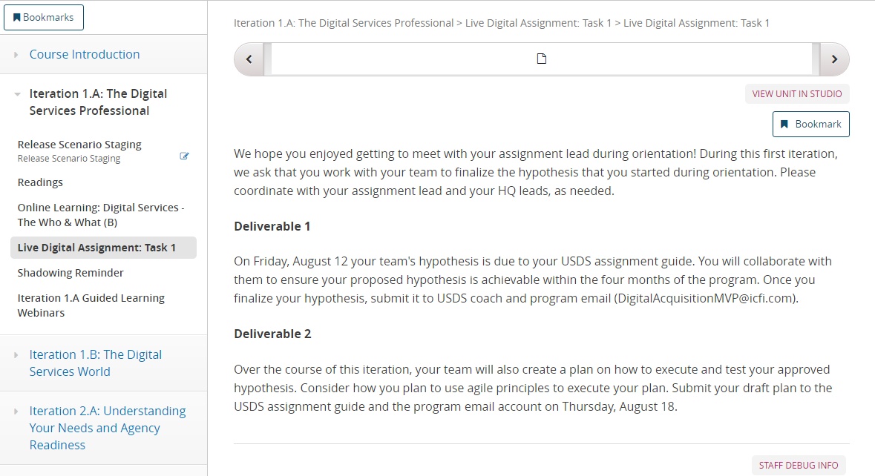
Live Digital Assignment – Task 1
Live Digital Assignment
About 3 hours
Hypothesis due to USDS assignment guide and program email – Friday, August 12
Create a plan for how your team plans to execute and test your approved hypothesis – Friday, August 19
Notes:
Facilitator Notes:
For the live digital assignment, teams will work together to finalize the hypothesis that you started during orientation.
There are two deliverables for this task –
Submission of hypothesis to your team's USDS coach
Submission of draft plan to the USDS assignment guide

Slide 12
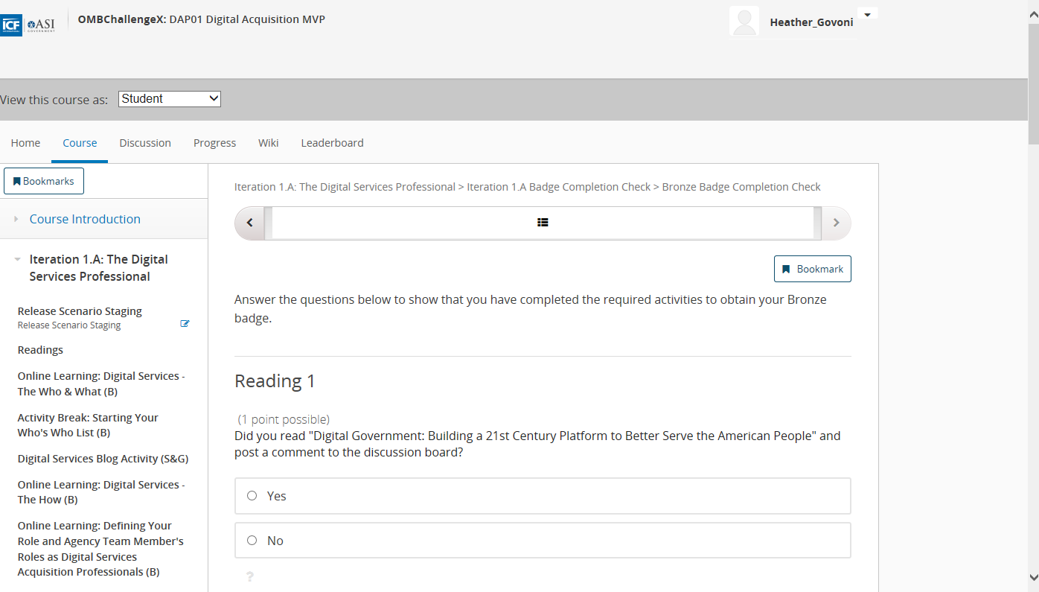
Last Step – Iteration 1.A Badge Completion Check
Iteration 1.A Completion Check
Go through and answer that you have completed required activities to obtain your Bronze badge

