Slide 1
Digital Acquisition MVP Iteration 4.B Planning Meeting
December 19– December 23, 2016

Slide 2
Agenda
Iteration 4.B Welcome and Introduction
Reminders and updates
Sessions and activities that compose the iteration
Capstone Overview and Classroom Preview
Notes:
Facilitator Notes:
Today we’ll be starting with some reminders and updates. Then we’ll go over all of the activities for this iteration, including a few reminders about the capstone presentation.

Slide 3
Notes and Updates
Assessments
Thank you for completing the 3.B post-assessment!
Please continue to push forward with the Release 4 content
Outstanding assignments
You should have a better idea of where you stand now
Thank you for sending us updates
All activities must be completed by December 31 for you to receive credit
Notes:
Facilitator Notes:
We now have results for the 3.B Post-Assessment from most of the class. If you have not yet completed iteration 4.A we ask that you do that as soon as possible. Please keep up the good work into the final iteration!
We sent out the course updates, thank you to everyone who has sent us updates and corrections. Remember that all activities must be completed by December 31 for you to receive credit for them.

Slide 4
Iteration 4.B – What It’s All About
Iteration 4.A – Where We’ve Been
Select a technical evaluation team with the necessary digital skills.
Identify how to get the best value solution for your program by negotiating tradeoffs.
Determine the next steps that follow contract award.
Identify the effective characteristics of a change agent and strategies to apply at different phases of the change lifecycle as you return to your agency.
Iteration 4.B– What’s Next
Identify software engineering practices for high-quality digital services like version control, continuous integration, and continuous delivery.
Identify metrics creation and utilization to help identify when failure actually occurs.
Determine how to execute an exit strategy and course correct.
Notes:
Facilitator Notes:
Congratulations wrapping up iteration 4.A. To review, you:
Select a technical evaluation team with the necessary digital skills.
Identify how to get the best value solution for your program by negotiating tradeoffs.
Determine the next steps that follow contract award.
Identify the effective characteristics of a change agent and strategies to apply at different phases of the change lifecycle as you return to your agency.
In this final iteration, Iteration 4.B, you will:
Identify software engineering practices for high-quality digital services like version control, continuous integration, and continuous delivery.
Identify metrics creation and utilization to help identify when failure actually occurs.
Determine how to execute an exit strategy and course correct.
NOTE that we’ll build on many of the activities in this iteration in the classroom, so be sure to do them & come prepared to discuss.

Slide 5
Iteration 4.B & Capstone Timeline & Bronze Activities
Dec. 19 | 20 | 21 | 22 | 23
Iteration Planning Meeting
11:00 – 11:30 am ET
Jan. 2 | 3 | 4 | 5 | 6
Capstone Skills Test Deadline
Iteration 4.B Pre- & Post-Assessment
30 minutes
Reading: Amplifying Agile Delivery
30 Minutes
Activity: Using Metrics and Incentives
1 hour
Activity: Exit Strategy
1 hour
Course Capstone Assessment
2 hours
Notes:
Facilitator Notes:
This week we have the Iteration Planning meeting today, and that’s your only scheduled webinar for this week. The following slides will have more details about that.
The activities you see on this page are the bronze-level activities, we will discuss the silver activities more with our activity walkthrough.
We also included the capstone skills test deadline here, although it is to be completed after release 4. We anticipate getting this out to you on Jan. 4. We need you to complete the assessment by the end of that week (1/6) so that we can determine who will and will not be graduating from the course. We’ll go into more details around that at the end of this webinar.

Slide 6
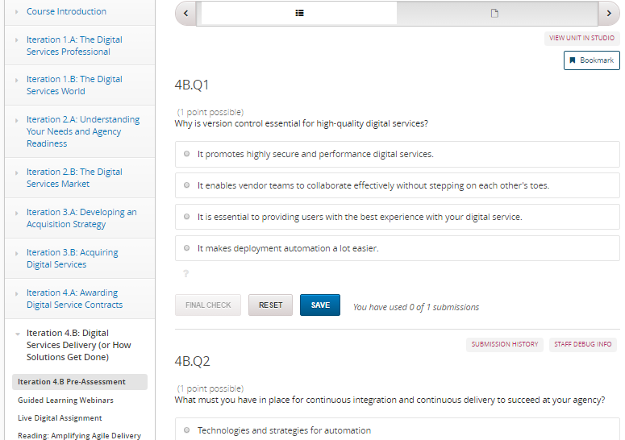
Iteration 4.B Pre-Assessment
Iteration 4.B Pre-Assessment
About 30 minutes
Bronze-level requirement
Presents you with a real-life challenge that you may encounter on the job
Use exercise as a gauge to determine your knowledge going into this iteration
Notes:
Facilitator Notes:
As with previous iteration, this 30-minute pre-assessment introduces you to the content for this release in an applied and engaging manner--by presenting you with a real-life challenge that you may encounter on the job.
Use this exercise a gauge to determine where you are and how well you perform against the learning objectives for this release. You will receive the results of your pre-assessment immediately along with the activities you need to complete to earn your badges for this iteration.
Although this isn't a formal assessment, we will review your results and those of your peers to see where the class has strengths and weaknesses. That way, we can tailor materials and discussions to focus in on areas where participants are struggling or need extra guidance.

Slide 7
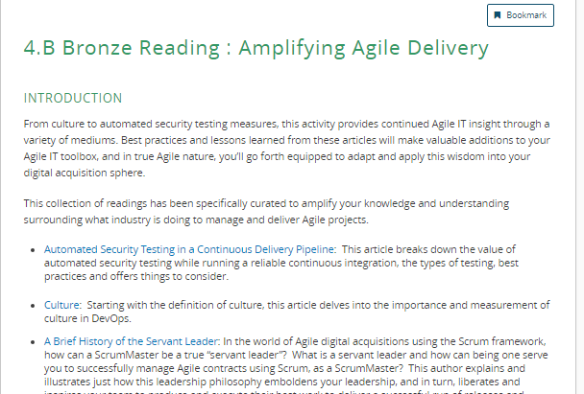
Readings: Amplifying Agile Delivery (B)
Readings: Amplifying Agile Delivery (B)
30 minutes
Bronze-level activity
Read about best practices in industry regarding the management and delivery of Agile projects
Share your thoughts in the discussion board
Share additional best practice resources in the course Wiki
Notes:
Facilitator Notes:
For the Amplifying Agile Delivery readings, you should read at least two of the articles we provided about best practices in Agile projects.
After you have read the articles, you should share which you found the most interesting and why in the linked discussion board.
You should conclude the activity by sharing additional resources that discuss Agile best practices in the course wiki.

Slide 8
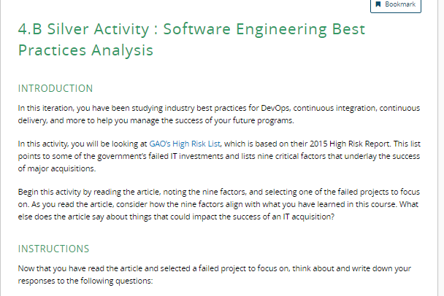
Activity: Software Engineering Best Practices Analysis (S)
Activity: Software Engineering Best Practices Analysis (S)
About 1 hour
Silver-level requirement
Analyze failed IT acquisitions in government
Determine what could have been done to ensure success
Engage in discussion posts
Notes:
Facilitator Notes:
So earlier in the iteration outline, we mentioned that you had some readings about amplifying agile delivery. Following that bronze reading, we have a silver-level activity,
For this activity, you will look at the GAO (Government Accountability Office) High Risk List that looks at some of the government’s failed IT investments, and outlines 9 critical factors that lead to successful acquisition.
When reading through the list, you should focus on one of the nine failed acquisitions.
In a discussion post, you will answer the following questions about the acquisition you selected:
What changes could have been made to help the project be successful?
If you were the CO called in to help, where would you dive into the project and begin looking for places to improve it?
If you were called to advise OMB on this project, how would you recommend that they address the situation? How would you think strategically and lead the change for this project?
You should also respond to your classmates’ discussion posts.
There is a second part to the activity as well. You will respond to a quote from the article, “OMB needs to direct agencies to ensure that delivery is done within the first year.”
What does that quote mean to you? What impact could it have on your future acquisitions?

Slide 9
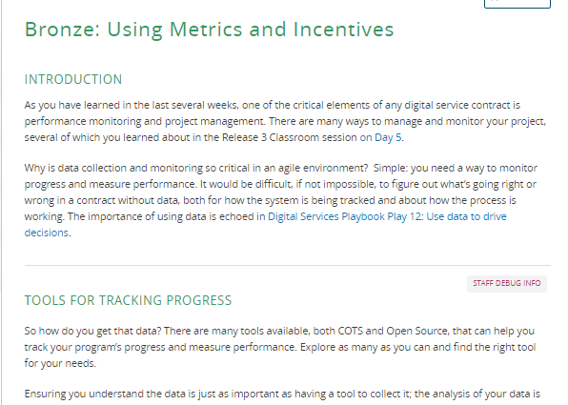
Activity: Using Metrics and Incentives (B)
Activity: Using Metrics and Incentives (B)
30 minutes
Bronze-level requirement
Continue the discussion of leveraging metrics that we began in Release 3
Introduces different types of incentives and how to use them
Practice thinking about incentive metrics in a discussion post
Notes:
Facilitator Notes:
In this bronze-level activity, you’ll learn more about metrics, and be introduced to different types of contract incentives that you can use.
You will take what you learned, and write about a metric that you can use to as an incentive metric in a discussion post.
You should reference Day 5 of the Release 3 classroom materials for a refresher on metrics.
We have also hyperlinked articles that will give you a more in-depth look at the different types of metrics and incentives.

Slide 10
Activity: Practice Building Incentives (S)
Activity: Practice Building Incentives (S)
30 minutes
Silver-level requirement
Builds from the Using Metrics and Incentives Activity
Practice developing language you would use to present an incentive to a vendor
Notes:
Facilitator Notes:
After being introduced to metrics, this silver-level activity will take the Using Metrics and Incentives (B) activity a step further.
Referencing the incentive articles from the Metrics and Incentives activity, you should identify any incentives that were built into that acquisition. You should also determine what incentive you would have used to ensure the highest quality product, the incentive type (monetary, non-monetary?).
Finally, you will write out the language you would use to present the incentive you have come up with to a vendor.
One of the articles has some examples of language that has been used, so you can use that as a starting point if necessary.

Slide 11
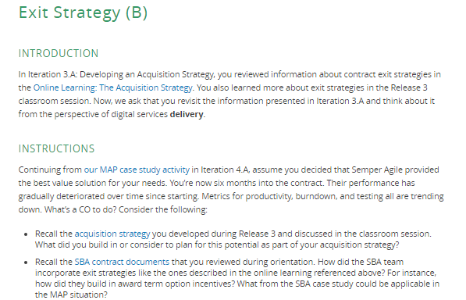
Activity: Exit Strategy (B)
Activity: Exit Strategy (B)
30 minutes
Bronze-level requirement
What happens when the performance of a contractor continuously declines?
You will weigh your options and think through what your next steps with the contractor should be.
Notes:
Facilitator Notes:
In this bronze-level activity, we discuss what to do when an acquisition goes wrong. We have provided several questions in the portal to guide your thinking:
We ask that you consider the acquisition strategy that you developed in Release 3-- did you build in any exit plans as part of the acquisition strategy?
You will also reference the SBA contract documents from orientation to see how the SBA team incorporated exit strategies. How did they build in award term option incentives? What can be applied from that case study to this MAP scenario?
We also encourage you to reference Mary O’Toole’s webinar and her experiences with the SBA modernization effort. What did she say in her presentation about how her team handled a downward trend?
We’ll build on this discussion in the classroom.
You should post your responses to these questions in the portal by December 23, and be prepared to discuss them more in the classroom session (Jan. 9-11).

Slide 12
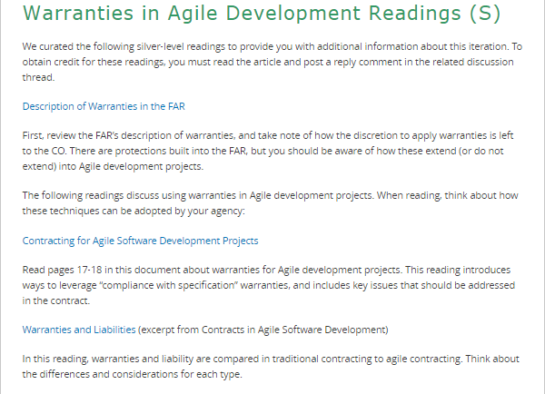
Readings: Warranties in Agile Development (S)
Readings: Warranties in Agile Development (S)
30 minutes
Silver-level activity
Read about the FAR description of warranties
Consider the unique characteristics of warranties in agile development projects
Post thoughts in a discussion board
Notes:
Facilitator Notes:
The final silver-level activity for this iteration are the warranties in agile development readings.
These readings start with the FAR description of warranty. From there, you’ll read about how to implement warranties in agile development projects, which can be difficult compared to a traditional contract.
Finally, you will share your thoughts in a discussion post.

Slide 13
What’s Next
Notes:
Facilitator Notes:

Slide 14
Iteration 4.B Post-Assessment
The 4.B Post Assessment will be ready by the week of December 27.
We ask that you complete the assessment by December 31, along with any additional outstanding activities.
Notes:
Facilitator Notes:
The 4.B Post-Assessment is under development now, it will be ready the week of December 27.
We ask that you complete that assessment, and any other remaining work, by the December 31 deadline.

Slide 15

Capstone Skills Test
After Release 4, you will take the Capstone Skills Test
Seven (7) real-world animated scenarios
3-5 situational questions per scenario
Will be available for completion Jan. 5-6; must complete by January 6
Notes:
Facilitator Notes:
Remind students that the Capstone Skills Test (the final test for the course that encompasses everything they have learned) is coming up at the end of Release 4. As we’ve talked about, part of your final grade will be the capstone skills test. This is a multiple-choice, scenario-based test that covers all performance objectives from the course; the format is similar to the assessments you’ve been completing throughout the course. The test has seven scenarios with 3-5 questions per scenario, and we expect it’ll take up to an hour to complete. It will be available for completion Jan. 5 and 6; we’ll send out an email update when it’s ready, likely the evening of Jan. 4. We need you to reserve time to take the test before you come to the classroom, as we’ll be analyzing your results over the weekend and on Jan. 9 so that we have everything ready for graduation on Jan. 11.
Everyone must complete the Capstone Skills Test by January 6.
If you’ll be out that week or are otherwise unavailable to carve out an hour of time, please email us & we’ll work with you.

Slide 16

Live Digital Assignment Final Presentation
Final presentation will be during the Release 4 Classroom session.
You will pitch your product to a panel of faculty and guests.
The goal is to gain the panels’ commitment of time and resources to fully build out your product.
The portal contains detailed instructions on what to present.
Evaluation criteria are in the portal as well
Presentation Rules
15 minutes to present; 10 minutes for questions
All team members must participate/talk in the presentation
Notes:
Facilitator Notes:
Live digital Assignment Final Presentation
They will be done during the Release 4 Classroom session.
Unlike the previous presentations, your final presentations will be a pitch in front of a panel comprised of USDS, OFPP or other guests.
The presentations will be similar to the reality show Shark Tank, where each group must pitch their Live Digital Assignment product to the panel to gain the panelists commitment of time and resources to pick up the project and build it out.
There are detailed instructions on the portal, including a list of talking points that must be covered during each presentation.
The presentation rules are:
Each group has 15 minutes to present and 10 minutes for questions
All team members must participate (meaning perform part of the presentation)

