Slide 1
DITAP
Iteration 1A - Day 1

Slide 2
DITAP - Iteration 1A - The Digital Services Professional
Tuesday
Welcome
Orientation
Learning goals
Live Digital Assessment
Digital Services
Introduction to Agile

Slide 3
Welcome from the USDS Administrator, MAtt Cutts

Slide 4


Slide 5
Digital Services
Defining Digital Services
Truth is that it cannot be defined by one simple noun or even one simple sentence.
To define digital services, we need to ask ourselves more questions: who, what, why, where, and how?

Slide 6
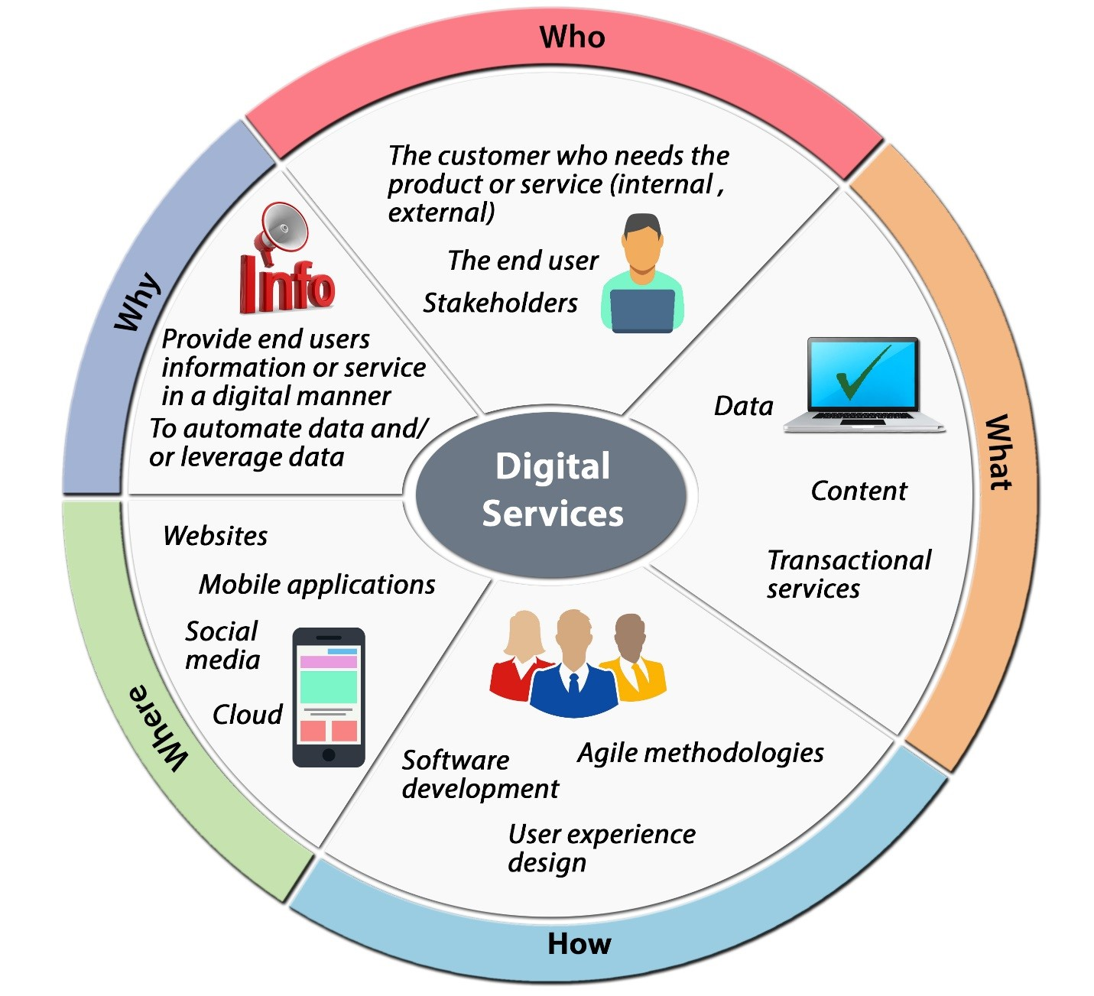
Digital Service Wheel
Notes:
Each part of this wheel lists more than one answer to each question above, and the answers shown here are just the beginning. This is why defining digital services can be a complex task.

Slide 7
Digital Services (What?)
“Digital services” refers to “the delivery of digital information (data or content) and transactional services (e.g., online forms, benefits applications) across a variety of platforms, devices, and delivery mechanisms (e.g., websites, mobile applications, and social media).” Digital services may be delivered to internal customers, external customers, or both.
[Digital Government Strategy]
Notes:
Review the full Digital Government Strategy in the Readings for this iteration.

Slide 8
Small group discussion: What are Digital Services?

Slide 9
myUSCIS as a Digital Service use case
Notes:
Refer to hand out

Slide 10
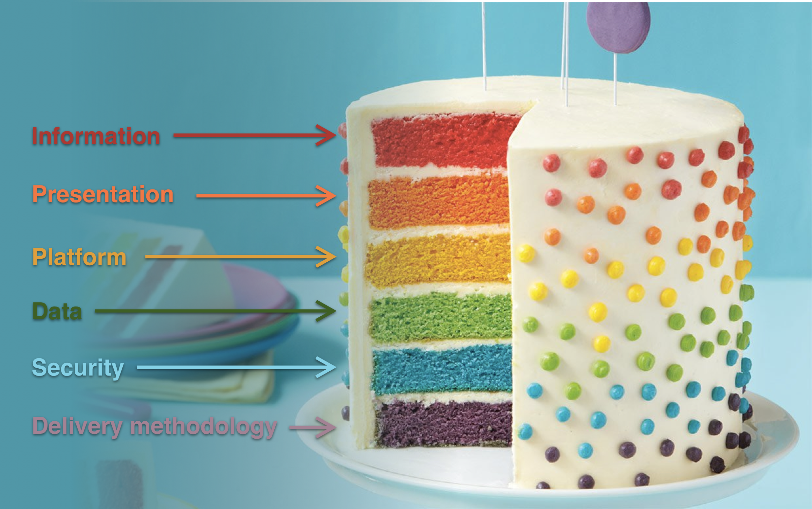
Digital Services
Notes:
Review the full Digital Government Strategy in the Readings for this iteration.

Slide 11
Information Layer
"Content," meaning any unstructured material that agencies/organizations provide online: Written materials (e.g., fact sheets, press releases, and compliance guidance)
Online transactions (e.g., benefits applications, purchases, job applications)
Multimedia (e.g., photos, video, audio)
"Data," meaning structured information (e.g., census and employment data, environmental measurements, activity logs, and structured website content).
Notes:
End users take a slice of the information layer likely every day when they look up information and images, or complete forms online or on a mobile device.

Slide 12
Presentation Layer
Delivery mechanisms:
Web browsers on any device (desktop, laptop, tablet, phone)
Native mobile apps
Social media
The presentation layer is a lot like the “Where.” This is where the end user accesses the information. This layer needs to be here to support the information layer.

Slide 13
Platform Layer
This is the technical ingredients for the cake. The platform layer is the place where business logic is performed. It makes it all possible and is the foundation for delivery of the digital services.
Some examples are:
Application Programming Interfaces (APIs)
Web Services
Web Content Management Systems
Notes:
Are these terms new to you? Access this link to Webopedia and type in the term to learn more.

Slide 14
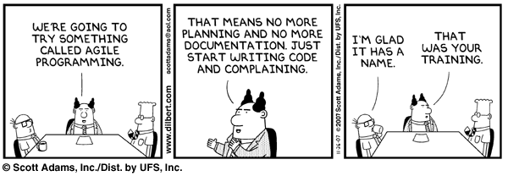
Hands-on Agile
Notes:
Exercise with facilitator asking students about where / how they can build a list

Slide 15
End of Day 1
Notes:
Exercise with facilitator asking students about where / how they can build a list

