Slide 1
DITAP
Iteration 1A - Day 1

Slide 2
DITAP - Iteration 1A - The Digital Services Professional
Wednesday
Recap and looking ahead
Software delivery methodologies
Digital Services ecosystem
Quiz #1
Building your list
Defining your role

Slide 3
Recap
What have we learned?
Defining Digital Services
What makes up Digital Services
Agile methodologies

Slide 4
Looking ahead
Classes and their themes
November
January
February
April
Digital Services in 21st Century Government
Understanding what you’re buying
Leading Change in Federal Contracting
Administering Digital Services Contracts
Learning about Digital Services and the professionals you should be aware of.
Getting to know what to buy, when, from whom, and communicating with vendors, and doing market research.
Creating digital services acquisitions, coming up with a strategy and building in communications, costs and evaluations.
How digital services are delivered; learning about evaluation metrics and what to do when failure occurs. Capstone delivery.

Slide 5
Software delivery methodologies
Notes:
I’m going to take a step back and we’ll talk about the different software delivery methodologies so that you have a complete context and background when we start speaking about “agile”

Slide 6
Software Development Life Cycle (SDLC) Models
Defining the SDLC
One of the basic notions of the software construction — is Software Development Life Cycle model:
SDLC — is a continuous process, which starts from the moment, when it’s made a decision to launch the project, and it ends at the moment of its full remove from the exploitation
There is no one single SDLC model
They are divided into main groups, each with its features and weaknesses
Each of them has basic stages.
Notes:
Are these terms new to you? Access this link to Webopedia and type in the term to learn more.

Slide 7
Software Development Life Cycle (SDLC) Models
SDLC stages
1. Planning and requirement analysis
2. Designing project architecture
3. Development and programming
4. Testing
5. Deployment
Notes:
Are these terms new to you? Access this link to Webopedia and type in the term to learn more.

Slide 8
Software Development Life Cycle (SDLC) Models
SDLC models
Waterfall model
Iterative model
Spiral model
V-shaped model
Agile model
Notes:
Are these terms new to you? Access this link to Webopedia and type in the term to learn more.

Slide 9
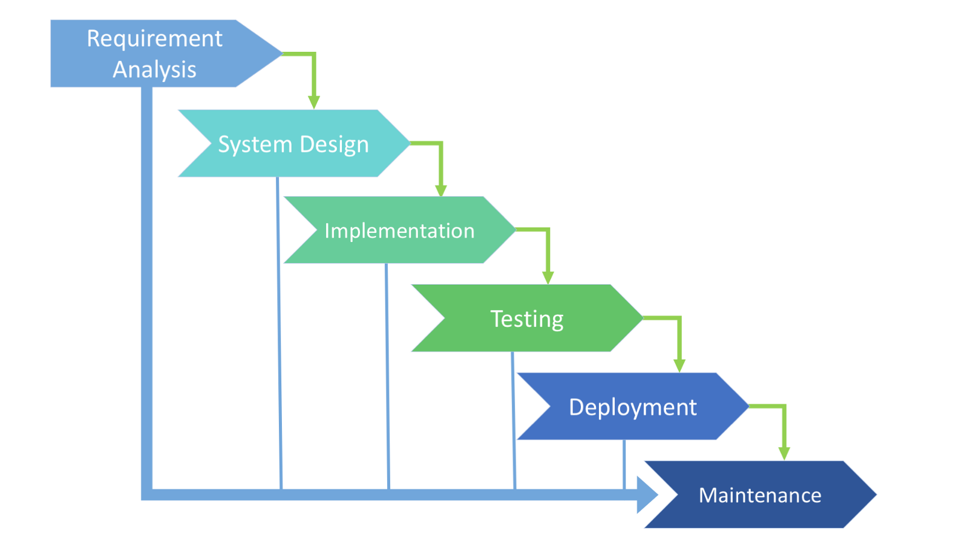
Software Development Life Cycle (SDLC) Models
Waterfall
A cascade model, in which development process looks like the flow, moving step by step through the phases of analysis, projecting, realization, testing, implementation, and support.
This process is strictly documented and predefined with features expected to every phase of this software development life cycle model.
Notes:
Are these terms new to you? Access this link to Webopedia and type in the term to learn more.

Slide 10
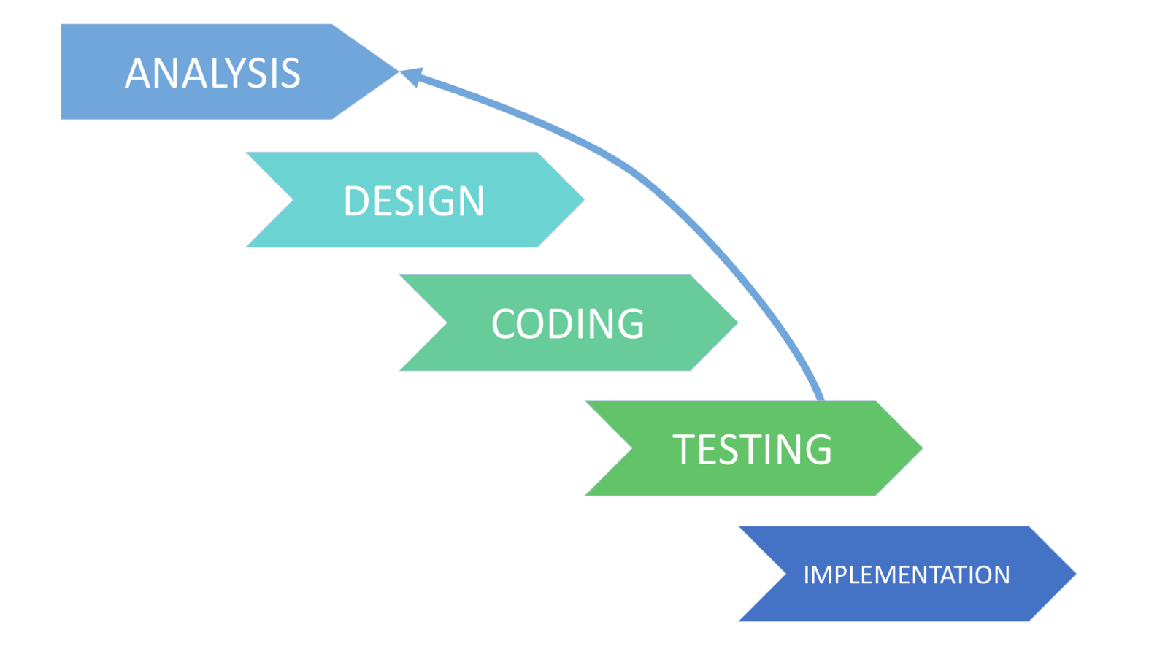
Software Development Life Cycle (SDLC) Models
Iterative
This model does not need the full list of requirements before the project starts. The development process may start with the requirements to the functional part, which can be expanded later. The process is repetitive, allowing to make new versions of the product for every cycle.
Every iteration includes the development of a separate component of the system, and after that, this component is added to the functional developed earlier.
Notes:
Are these terms new to you? Access this link to Webopedia and type in the term to learn more.

Slide 11
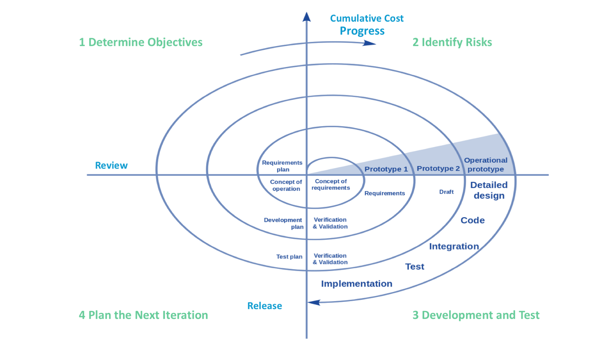
Software Development Life Cycle (SDLC) Models
Spiral
It combines architecture and prototyping by stages. It is a combination of the Iterative and Waterfall SDLC models with the significant accent on the risk analysis. The main issue of the spiral model — is defining the right moment to make a step into the next stage. The preliminary set time frames are recommended as the solution to this issue.
The shift to the next stage is done according to the plan, even if the work on the previous stage isn’t done yet.
Notes:
Are these terms new to you? Access this link to Webopedia and type in the term to learn more.

Slide 12
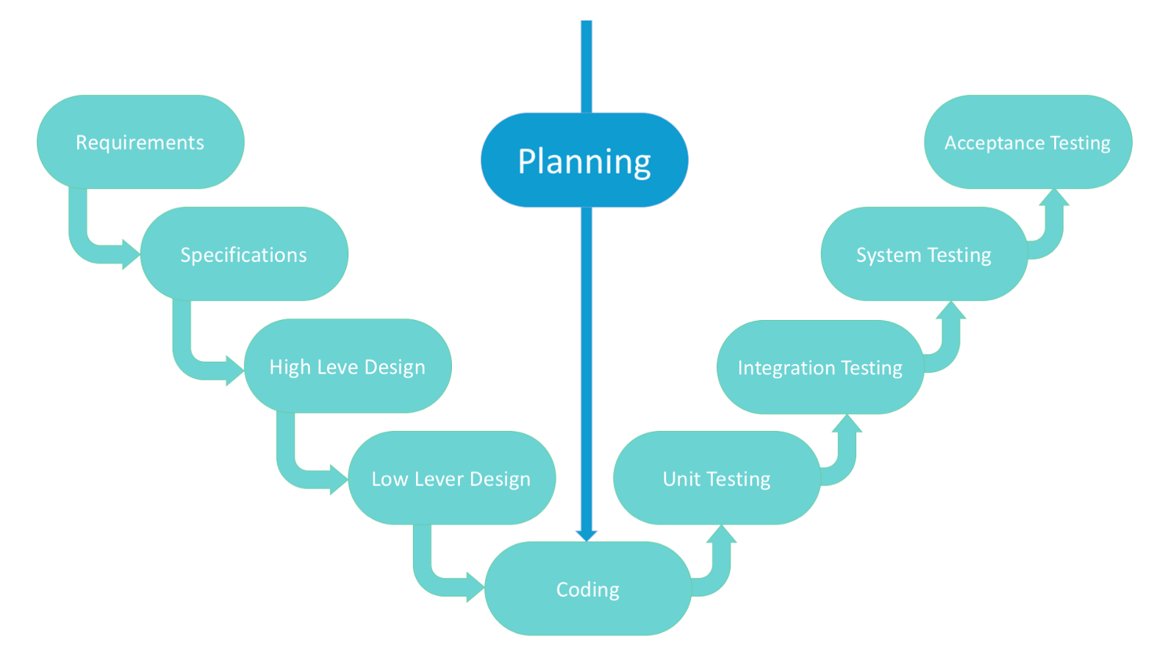
Software Development Life Cycle (SDLC) Models
V-Shaped
It is an expansion of classic waterfall model and it’s based on associated test stage for the every development stage. This is a very strict model and the next stage is started only after the previous phase is complete.
This is also called “Validation and verification” model. Every stage has the current process control, to make sure that the conversion to the next stage is possible.
Notes:
Are these terms new to you? Access this link to Webopedia and type in the term to learn more.

Slide 13
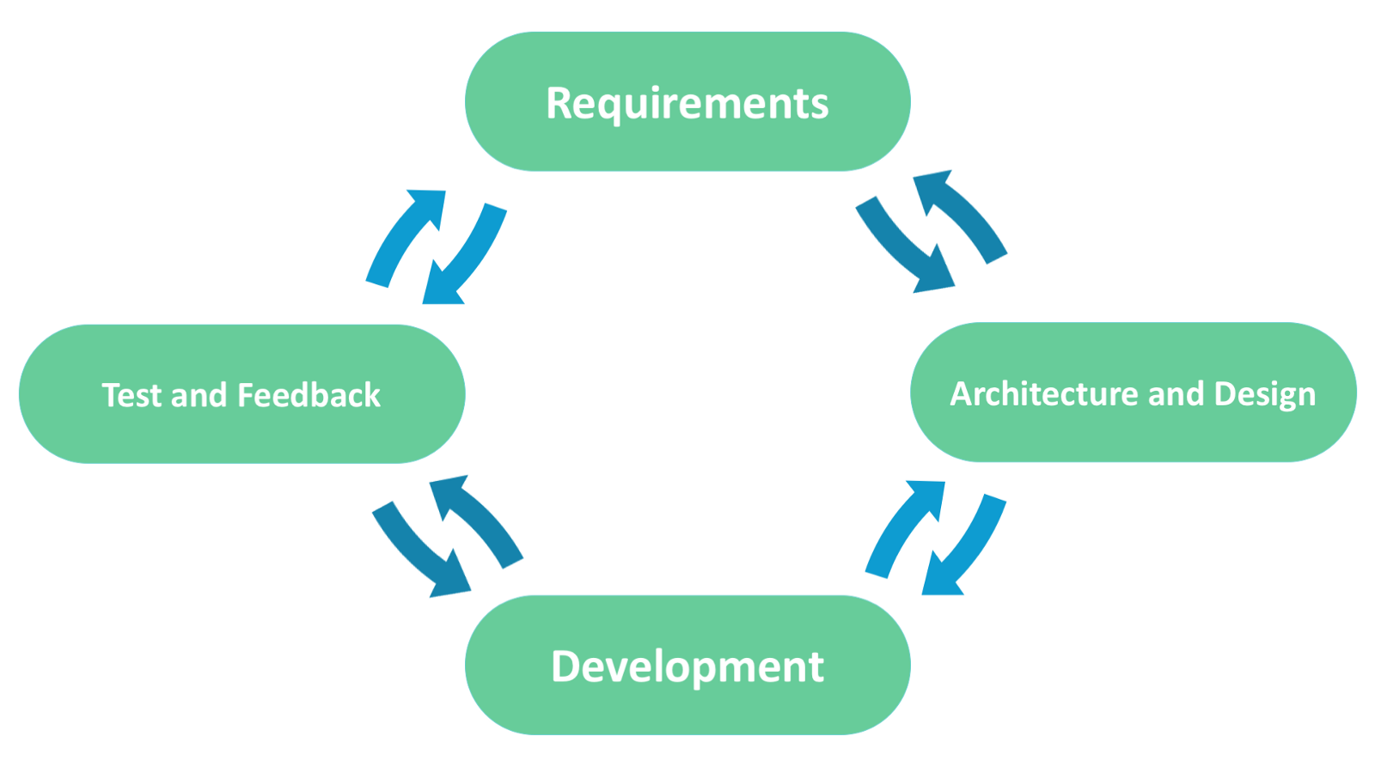
Software Development Life Cycle (SDLC) Models
Agile
In this model the customer is able to see the result and understand if they are satisfied or not. This is one of the advantages of the agile software development life cycle model. One of its disadvantages is that with the absence of defined requirements it is difficult to estimate the resources and development cost.
Extreme programming is one of the practical use of the agile model. The basis of such model consists of short weekly meetings — Sprints which are the part of the Scrum approach.
Notes:
Are these terms new to you? Access this link to Webopedia and type in the term to learn more.

Slide 14
New methods = new language
Waterfall Contracting | Agile Contracting
Individual Labor Categories | Agile Teams
Labor Rates or FFP completed system | New Unit of Measure: FFP Per Iteration
One Final End Solution | Repeated process for functional product
Full Solution Released (IOC/FOC) | Release Management / Minimum Viable Product (MVP)
Maintenance becomes Steady State | New development / bugs / enhancements prioritize equally as User Stories
New/Changed Features = Modification for New Cost/Schedule | New features = longer schedule to completion or reprioritization of effort underway
Formal Past Performance | Performance Retrospectives
Project Management | Product Owner
Full scoped out requirements | “Just in Time” Requirements in User Stories

Slide 15
Capstone team charter
Notes:
Exercise with facilitator asking students about where / how they can build a list

Slide 16
Team Charter
A team charter is a document that is developed in a group setting that clarifies team direction while establishing boundaries. It is developed early during the forming of the team.
The charter should be developed in a group session to encourage understanding and buy-in. The team charter has two purposes.
Notes:
Are these terms new to you? Access this link to Webopedia and type in the term to learn more.

Slide 17
Team Charter
Elements that need to be addressed in a team charter:
Roles
Team goals
Team values
Expectations
Communication expectations
Energy source
Obstacles
Conflict
Notes:
Are these terms new to you? Access this link to Webopedia and type in the term to learn more.

Slide 18
Digital Services ecosystem
Notes:
Exercise with facilitator asking students about where / how they can build a list

Slide 19
Digital Services EcoSystem (Who?)
In-House
When an organization has the personnel with the capabilities required to deliver the digital services to the end users.
They’d need:
Product Managers
Engineers
Researchers
Designers (UI, UX, and Product).
DevOps
Scrum Master
Notes:
Are these terms new to you? Access this link to Webopedia and type in the term to learn more.

Slide 20
Digital Services EcoSystem (Who?)
Professional Service Vendors
When outside help is needed, the organization (private sector or government sector) works with contracting officers to procure support.
Contracting officers (like you!) understand how to evaluate third-party technical competency so members of the organization can be paired with vendors who are good at both building and delivering effective digital services.
Notes:
Are these terms new to you? Access this link to Webopedia and type in the term to learn more.

Slide 21
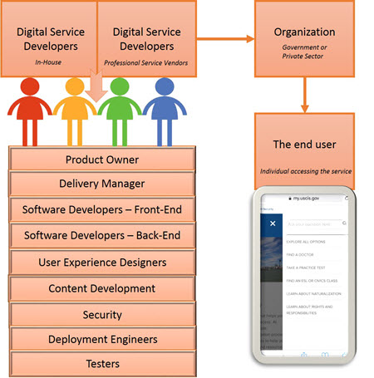
Digital Services EcoSystem (Who?)
Notes:
Product Owner: This individual represents the organization and is responsible for working with the digital services development team (in-house or vendor). Some of the roles include prioritizing development of features and functionality, defining acceptance criteria for features, and providing demonstrations and reviews to the organization’s stakeholders. The Product Owner is ultimately accountable for the success of the digital service.
Delivery Manager: This individual orchestrates the digital services team and enables the team to deliver a quality service on time and within budget.
Software Developers – Front-End: This team or individual works closely with the User Experience Designers, specifically interaction designers, to develop the front-end functionality and user interface to support the vision set forth by the organization.
Software Developers – Back-End: This team or individual develops the functionality behind the scenes to support data capture, data transfer, or other back-end functionality.
User Experience Designers: This team consists of individuals who focus on the visual design, interaction design, and user interface design to make things as intuitive as possible. They work with the front-end software developers to develop the front-end functionality and user interface to support the vision set forth by the organization.
Content Development: This team or individual builds the content and realizes the vision set forth by the organization following a digital content strategy.
Security: This team or individual supports the security component of the digital service development from the start and ensures the safe and secure delivery and use of digital services. This includes data protection, security, and privacy.
Deployment Engineers: This team or individual works to automate delivery of the digital service from the development environment to the test and ultimately production environments.
Testers: This team or individual works with the Product Owner to define acceptance criteria for features and with the developers to make sure they meet those criteria.

Slide 22
Who’s Who
Knowing the different roles of the people who design and develop digital services helps you picture the figure performing the actions.
The digital services ecosystem is an ever-changing, ever-evolving world that doesn't always flow in the same direction as the rest of society, having go-to sources of information can keep you abreast of what the latest and greatest offerings are, as well as enhancements to the tried and true products.
Notes:
Guided discussion on where to look to find these digital services leaders
Where to Look
You may be cringing right now, thinking that the first place you will be told to go to is social media. However, you're wrong. Social media will be the second thing you are recommended to go to. The first place you should go is your favorite search engine website. For many of us, this is Google, but there are other search engines out there, so feel free to use them! The most important thing is to use them, and use them well.

Slide 23
Who’s Who
Government entities
18F
USDS
UK Government Digital Services
Philly 311
Non-government entities
Code for America
CivicActions
Adhoc
Truss
Center of Civic Design

Slide 24
Building your list
Notes:
Exercise with facilitator asking students about where / how they can build a list

Slide 25
Digital Services (How?)
The rapid pace of change in the digital industry, shifting consumer expectations, and budget pressures of doing more with less are driving the U.S. Government to adopt new approaches for designing, developing, and delivering digital services.
Just as defining the digital services landscape can seem complex, so too can trying to define all the ways in which they are developed.
Notes:
While there is no one-size-fits-all process for how digital services should be developed, there are contemporary practices that can help build more effective digital services.

Slide 26
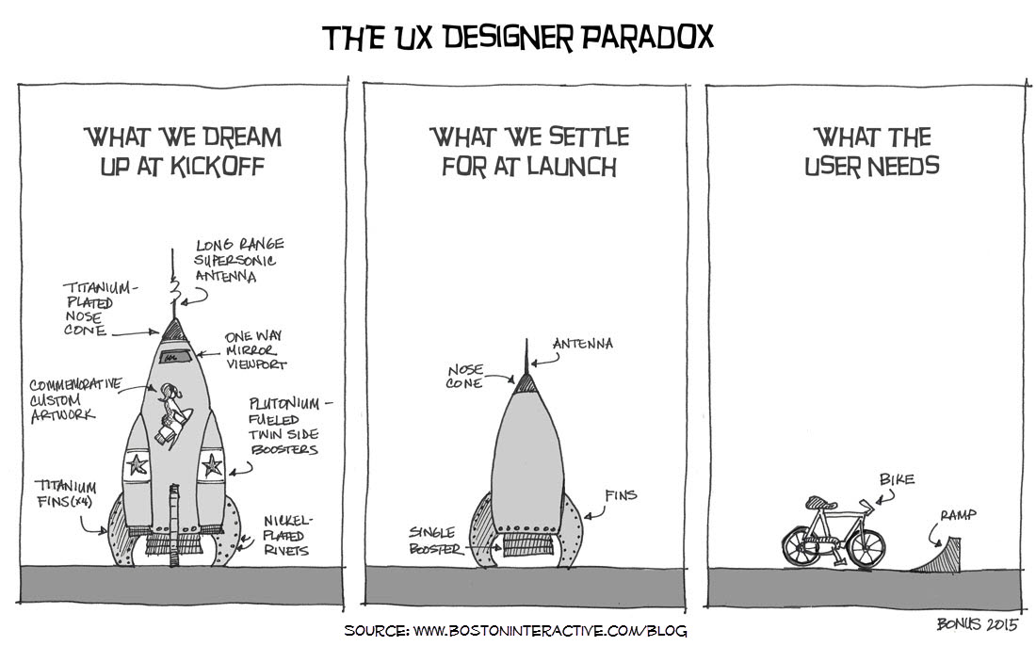
Digital Services (How?)
Notes:
The Common Denominator
All digital projects should start with the end user. This simple principle is foundational to designing, developing, and delivering digital services. In fact, “Understand what people need” is the first play in the U.S. Digital Service Playbook, which you will explore as you progress through this module.
Here are some strategies from Play 1 of the U.S. Digital Service Playbook to help keep you focused on what the user needs. Note that this list is not the be-all-end-all. It is a starting point that you will build on over the course of your learning journey.
Do your research
Spend time with current and prospective users of the service.
Do more than just interview; use a range of qualitative and quantitative research methods to determine people’s goals, needs, and behaviors; be thoughtful about the time spent.
Before the digital service is built, test prototypes on real people.
As the digital service is being built, regularly test it with potential users to ensure it meets people’s needs.
Document and share your findings
Document the findings about user goals, needs, behaviors, and preferences.
Share findings with the team and agency leadership.
Prioritize development tasks based on user needs
Next, let's take a closer look at a few techniques to help you realize the strategies listed in Play 1.

Slide 27
Digital Services (How?)
There are many techniques and approaches that can be put into play to understand your user’s needs, like everything in digital services, it depends on your needs to determine which is appropriate:
Minimum Viable Product (MVP)
A/B Testing
Personas
Journey Mapping
Notes:
Depending on the type of digital service being developed and the organization, you will hear about one or all of the following techniques for learning more about your users’ needs. Here, we present you with an overview of some of these techniques. As you progress in your learning journey, you will learn more about how to implement these techniques and when each is most appropriate

Slide 28
Digital Services (How?)
Contemporary Practices in Developing Digital Services
Agile Development
DevOps
Modern Tech Stacks
Open Source
Open Data
The Cloud
Notes:
Now that we’ve covered the common denominator of all digital services development, let’s explore some contemporary practices that are outlined in the U.S. Digital Services Playbook. Take this section for what it is—a survey, not an exhaustive list, of current practices. Remember that keeping pace with current technologies takes a concerted effort on your part. Consider this a starting point for building your digital service development know-how.

Slide 29
Defining your role: persona creation
Notes:
Persona creation - The DS Contracting Officer

Slide 30
Defining Your Role
To effectively use your sphere of influence on your digital services team, the following steps will assist in planning for and getting results from your influential relationships.
Identify the Party You Want to Influence and the Relationship
Identify Hypothesis(es) Regarding Action or Change and Reach Out
Engage and Follow Up (Continually)

Slide 31
Defining Your Role
Step 1: Identify the Party You Want to Influence and the Relationship
The first step in using influence is to evaluate the relationship and the kind of connection you have. The closer your connection and strength of influence, the greater trust in you and what you are trying to accomplish.
Notes:
In these relationships, you can remain less formal, test out ideas, ask for what you want, explore options, and agree to action more easily. However, be careful. If you are used to dealing with a close contact as a friend and you suddenly ask for support in a business relationship, be clear that you are asking to change the context for the relationship.
The more distant the relationship and influence, the more you will need to plan your approach. For example, you may have identified a source of funding for your digital services project that requires approval by the CFO or her deputy. If you have never met the Deputy CFO and the financial organization does not interact regularly with the procurement function, you may need assistance. Identifying a closer contact in the budget office or an associate of the Deputy CFO you know can help provide the introduction you need to have the influence conversation.

Slide 32
Defining Your Role
Step 2: Identify Hypothesis(es) Regarding Action or Change and Reach Out
In your day-to-day job, you will interact with many team members from peers to key stakeholders and leadership. You will also interact with contractors as you go through the various stages of the acquisition life cycle.
Notes:
This gives you a diverse work environment of team members who may not all agree on process, goals, or what constitutes success.
Who you are trying to influence and the strategies for influencing will change/adapt depending on the audience and the message you're providing. For example, how you approach giving your product owner bad news about a delay in the procurement may look very different from how you approach a junior team member with a new task.
Whatever the role or power of the party you are trying to influence, you need to prepare for the conversation. First, you need to identify your goal and the outcome you are trying to achieve and be clear and succinct in communicating them. Second, do your research on the likely interests and behaviors of the party you are working with. Third, plan how best to approach the person you need to influence. We will go into more detail on how to prepare for different types of influence conversations in Iteration 4.B, with templates to help you plan!
Finally, it is best to borrow from agile development with the use of personas and user stories to inform action. User stories describe the user role, what the user wants, and why they want it; this promotes user empathy. For example, say you have a user story that provides the insight that a customer is struggling to move from adding an item to his/her shopping cart to navigating to the upper right-hand corner to select the “Checkout” feature and then finally walking through the steps to process payment. Your user persona indicates that your customer is technically savvy, but frustrated by multiple steps that aren’t intuitive. In fact, in these situations, they sometimes give up and leave your site. Yes, we are making some big generalizations about millennials here! You hypothesize that you could add a “Are You Ready to Check Out Now?” button whenever they add something to their shopping cart. You build it and test with your audience. It works like a charm, and your customers are delighted that you continue to listen to and respond to what they like/don’t like about your site!
So, how you can create and test a hypothesis like this for an influence conversation? For example, say your digital services project needs some flexibility in the equipment configuration and cloud policies your agency has adopted. In this situation, you might hypothesize that you will need the support of the CIO or a director in the IT organization to gain approval for this flexibility. Now that you have a hypothesis, all you’ll need to do is try it out! We’ll cover the process for having effective influence conversations later in the program.

Slide 33
Defining Your Role
Step 3: Engage and Follow Up (Continually)
According to the theories in communications, media like email, phone, and some forms of social media are appropriate for delivering clear, unambiguous, factual information or direction.
However, with information or dialogue that is open to interpretation, when you are exploring ideas and options, or when conveying information that can result in unexpected emotional reactions, face-to-face communication is best.
Notes:
While there are situations where this will not be possible (e.g., if who you are negotiating with is across the country), try to build in face-to-face interactions when possible with these geographically distributed stakeholders.
When engaging and following up, another strategy is to demonstrate openness to partnering with the individual you are trying to influence. Research by Adam Grant at the Wharton School and by Amy Cuddy at Harvard provides evidence that those who ask for help or advice usually elicit a positive, empathetic response. If you’re curious to learn more about this, read the article “Connect, Then Lead” in your readings. Counterintuitively, asking for help also increases the perception of competence of the requestor by the one being asked. Authentically asking for help will improve your chances of influencing your outcome. However, using it as a ploy to get what you want will likely backfire, if not now, then eventually. Remember that if you are asking for help, ask also if you can help them with something in return.
It may make sense that you should ask for help from others, but what happens if you don’t even know where to begin? Or, if you’re not sure how to begin? The digital services acquisition initiative has the senior level support of your agency. In planning your outreach and engagement, you can use this support to gain an audience for your ideas and proposals.
Finally, follow up with appreciative emails with specific next steps and continue to reach out with information and updates

Slide 34
Issues in Creating Influence: Building your network
We all know people who connect with others quickly and appear to form deep relationships of great influence fast. They maintain and deepen these connections over time.
According to Malcolm Gladwell in The Tipping Point, these are the Connectors. These super Connectors are able to connect quickly and deeply with people. They seek to understand what motivates people, enjoy learning more about a perspective other than their own, and give people their full attention when they speak.
Notes:
Identifying and cultivating relationships with the Connectors you know will help you build your own network and sphere of influence over time.

Slide 35
Restrospective

Slide 36
DITAP - Iteration 1A - The Digital Services Professional
Thursday
Welcome and introduction
Norms and whatnot
Digital Services I
The Digital Services Professional
Modern delivery methodologies
Live Digital Assignment
Who’s who in the Digital Services world
The new “you” (defining your new role and capabilities)

