Slide 1
DITAP
Iteration 1B - Day 3

Slide 2
DITAP - Iteration 1B - The Digital Services Professional
Thursday
Recap
Persona creation exercise
Building your list exercise
Deep dive: The Digital Services Marketplace
Capstone option selection
Digital Services Playbook + exercise
TechFAR Hub Handbook

Slide 3
DITAP - Iteration 1B - The Digital Services Professional
What have we learned?
Defining Digital Services
Software Development Lifecycle Models
Digital Services ecosystem and roles
Building your list
Defining your role

Slide 4
Persona creation

Slide 5
Build your list

Slide 6
The Myth of the Full Stack role

Slide 7
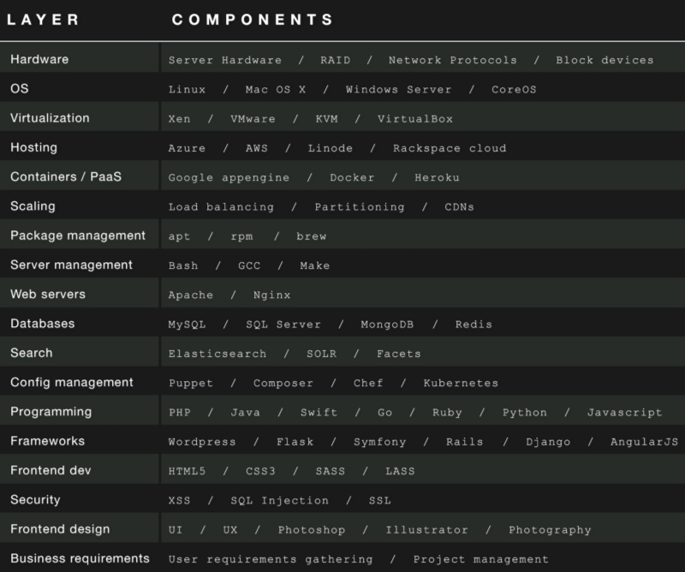
The Myth of the Full Stack role
The phrase “full stack” is really just a business buzzword, not an engineering designation.
The “stack” usually refers to the database, the operating system and the one-two languages used to deliver information.

Slide 8
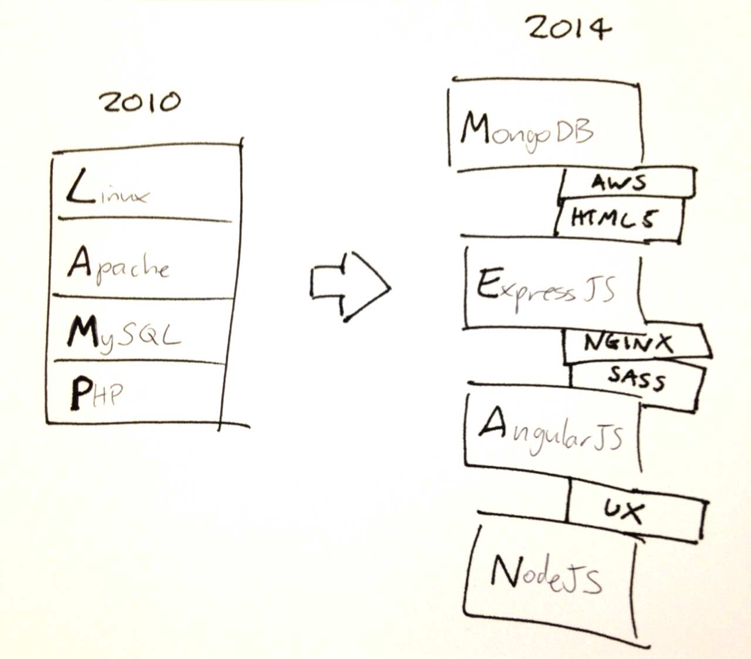
The Myth of the Full Stack role

Slide 9
The Myth of the Full Stack role
Oftentimes “full stack” is equated to “expert” or “experienced,” if that is the case, that’s what should be asked for.
Start asking questions
Get to the source of truth
If you need full stack engineers you’re probably creating silos and wasting your resources.
Notes:
Still not convinced? Look at it another way, the reason the assembly line revolutionized production is because we learned that although a craftsman can do it all, he shouldn’t. If you want to build chairs, you don’t hire 5 craftsman that are “full chair” craftsmen. You don’t tell each of them to go out and chop down trees, then tell all of them bring the wood back and cut it, then tell all of them carve the wood, etc. What you do is send one out to harvest wood. One sets up a cutting station and processes it. One sets up a carving station and carves. One sets up and assembly station. One sets up a finishing station. You specialize and you create a flow. You build synergy. Software is no different. At every point in your software production process you should have a place for your specialist in that area to engage, do their best work, and move on.

Slide 10
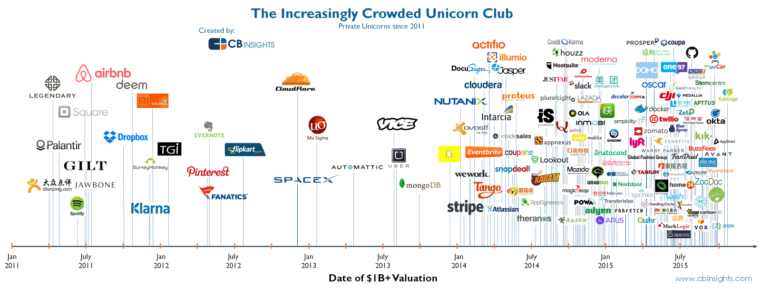
The Digital Services World
Notes:
A decade ago, the screen upon which you’re reading this document was technically unfeasible. Laptops had floppy disc drives, tablets were the white whale of personal computing, and the Blackberry was more status symbol than smartphone. What Moore’s Law has done for consumer technology is nothing short of amazing, and the race against the machine is challenging procurement organizations to keep pace with an accelerating software development lifecycle that shutters tech darlings and creates new ones overnight (Hello, Snapchat?). As we look across the field of technology, you will explore available sources of supply including X-as-a-service, Open Source Software, Big Data, Agile, and more!

Slide 11
Digital Services Marketplace
Notes:
Now that you have a feel for the types of suppliers, we can discuss the differences among them. How do they interact and participate in the marketplace? How does this impact the contract action?
Type Description
Large companies The IBM’s, Lockheed Martin’s, and Booz Allen’s of the world, large companies have experience doing business with the government, not to mention the cost structures necessary to compete for large contracts and vehicles. Their access to resources means they can service a wide variety of needs; if they don’t have the talent, they’ll go and hire them or partner with smaller companies.
Third-party resellers These are companies that sell another company’s products or services, ideally with that company’s express permission. For example, Amazon Web Services authorizes third parties to use its cloud services in sales to other clients. When you buy from a third party reseller, your contract is with that company and not with Amazon Web Services.
Value-add resellers When a third party offers a service and combines it with another service as a complete package, it is known as a value-added reseller.
Traditional vs. non-traditional Traditional firms are those that have a history of doing business with the government, such as the IBM’s, Lockheed’s, and Booz Allen’s listed above. Non-traditional suppliers are new entrants or startups with relatively little experience in the government marketplace. These firms might enter as small businesses and take advantage of set-asides, or they may look to establish mentor-protégé agreements with traditional firms as they build their Federal practice.
Joint ventures This is a legal structure that combines the services of two firms and enables the combined arrangement to compete as a distinct entity.
Shared service providers These are other government agencies that are authorized by the Economy Act (or related structure) to offer services through other transactional agreements. They are congressionally authorized to do this, and they have access to revolving funds like Working Capital and
Franchise Funds Buying
Internal consultants (e.g., 18F, agency digital service teams)
Public Private Partnerships These partnerships are a specific type of arrangement where a government agency may partner with a private firm to pursue, accomplish, or fulfill pre-defined objectives.

Slide 12
Digital Services Marketplace
Types of Firms
Large Firms
Third Party Resellers
Value-add Resellers
Traditional Firms
Non-Traditional Firms
Joint Ventures
Shared Service Providers
Franchise Funds
Internal Consultants
Public Private Partnerships
Notes:
Now that you have a feel for the types of suppliers, we can discuss the differences among them. How do they interact and participate in the marketplace? How does this impact the contract action?
Type Description
Large companies The IBM’s, Lockheed Martin’s, and Booz Allen’s of the world, large companies have experience doing business with the government, not to mention the cost structures necessary to compete for large contracts and vehicles. Their access to resources means they can service a wide variety of needs; if they don’t have the talent, they’ll go and hire them or partner with smaller companies.
Third-party resellers These are companies that sell another company’s products or services, ideally with that company’s express permission. For example, Amazon Web Services authorizes third parties to use its cloud services in sales to other clients. When you buy from a third party reseller, your contract is with that company and not with Amazon Web Services.
Value-add resellers When a third party offers a service and combines it with another service as a complete package, it is known as a value-added reseller.
Traditional vs. non-traditional Traditional firms are those that have a history of doing business with the government, such as the IBM’s, Lockheed’s, and Booz Allen’s listed above. Non-traditional suppliers are new entrants or startups with relatively little experience in the government marketplace. These firms might enter as small businesses and take advantage of set-asides, or they may look to establish mentor-protégé agreements with traditional firms as they build their Federal practice.
Joint ventures This is a legal structure that combines the services of two firms and enables the combined arrangement to compete as a distinct entity.
Shared service providers These are other government agencies that are authorized by the Economy Act (or related structure) to offer services through other transactional agreements. They are congressionally authorized to do this, and they have access to revolving funds like Working Capital and
Franchise Funds Buying
Internal consultants (e.g., 18F, agency digital service teams)
Public Private Partnerships These partnerships are a specific type of arrangement where a government agency may partner with a private firm to pursue, accomplish, or fulfill pre-defined objectives.

Slide 13
Digital Services Marketplace
Service Offerings / Buzz Words
Cloud Services
X-as-a-Service
Software Development
Open Source Software
UX Design
Big Data
Open Data
DevOps / DevSecOps
Security
Notes:
Segmenting the Digital Services Marketplace
As you have learned, the digital services marketplace is vast and ever expanding. It can be daunting to conduct market research with confidence that you have exhausted all avenues of supply. Therefore, you may find it helpful to view this marketplace in smaller segments. When you do that, you can identify which segment is most likely to provide the service type you need to meet your agency requirements, and you can start your research there. To begin, here are the major segments that address a majority of this marketplace today:

Slide 14
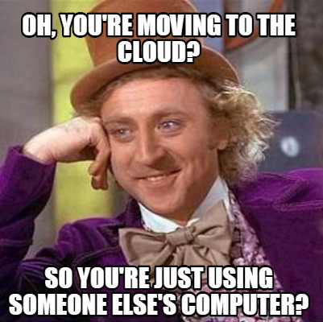
Digital Services Marketplace
Cloud Services
Leasing computers/storage/software
Decreased burden
More flexibility/scalability
Pay for what you use
“More like software”
Notes:
“To the Cloud!” This was a very popular catch phrase in the not too distant past. It had many consumers wondering what the “cloud” was and how they could buy and use it, both personally and professionally. Flash forward to present day, and we have far more clarity on the “cloud.” At its roots, the cloud is a place to store data via the internet.
As a service, Company X will provide storage space on its servers to any customer with internet access. Cloud services are designed to provide easy, scalable access to web/phone applications, and resources and services. They are fully managed by the cloud services provider (Company X). This takes the burden off of consumers to buy and maintain their own computer servers.
Other things worth mentioning:
Not worrying about power, physical space, hardware failures, parts, etc.
Hard drive space example
Easier rollback, to multiple geographic spaces
ATO at VA, tornadoes, flood, zombie apocalypse, etc.
Easier approval
Better talent

Slide 15
Digital Services Marketplace
Develop your strategy - Cloud Services
Consider the following:
How does the commercial sector buy cloud?
How are your peers buying this service and from whom?
Is the offering FedRAMP approved?
Notes:
The cloud services market is vast, which means you will need a strategy to navigate this segment. Consider the following:
How does the commercial sector buy cloud? To answer this, you will want to research the internet to see who the major vendors are and who is buying from them.
Who else is buying what you are buying and who do they buy from in the marketplace? Answer this question by reviewing the Federal Supply Schedule (FSS), Governmentwide acquisition contracts (GWACs), interagency, etc.
How are your peers buying this service? Contact your peers inside government to leverage their best practices, processes, and templates.
To help answer these questions, visit Cloud.gov. Cloud.gov is 18F’s platform as a service (PaaS) for other agencies based on non-profit CloudFoundry’s “open source, multi-cloud, and multi-vendor” approach. See 18F’s blog post about this effort as well as Federal News Radio’s perspective on it
Ask audience:
Are there questions about deciding to go with a cloud service or on-premise offering? (questions above are about after you’ve decided to go with a cloud service)

Slide 16
Digital Services Marketplace
X-as-a-Service
There are three basic types of “X-as-a-Service” models:
Infrastructure
Platform
Software
Notes:
There are three basic types of “X-as-a-Service” models: Infrastructure-as-a-Service (IaaS), Platform-as-a-Service (PaaS), and Software-as-a-Service (SaaS).
Infrastructure – an organization gets its computing resources over the internet from a cloud computing provider (e.g., Dropbox, Google Docs, Apple Cloud). This is good for organizations where computing is not a core capability or need of the business.
Platform – an organization’s web applications are hosted in a cloud computing provider’s infrastructure. The cloud provider offers their platform, which powers the website, email, communications, etc. (e.g., website design services like Squarespace or WordPress). This is good for organizations that don’t have complex and unique needs for servicing user needs.
Software – a licensing model where you pay a company to develop and provide a software solution. The provider is responsible for maintaining, updating, and operating the software (e.g., Microsoft 360, Mac OS). Nearly all organizations use SaaS for basic operating and administrative services, where a standard service will address the most important user stories.
Acknowledge

Slide 17
Digital Services Marketplace
Develop your strategy
Consider the following:
Does my agency have standard or preferred tech stack?
What is my customer trying to accomplish?
Feedback, past performance ratings, and market reputation
How does the service store data?
Will my customer have to ATO both the X-as-a-Service and what they’re putting into it? Does the contract support that?

Slide 18
Market segmentation
Software Development
Software development is all about the talent of the team/vendor and their ability to execute their process with maximum efficiency+reliability. The goal is to produce working software that measurably achieves an outcome.
The primary concern should always be with the outcome that is produced rather than the tool or processes used to develop the software. Evaluation can focus on whether the tools and processes can achieve the desired outcome.
Notes:
Software development is a more tangible concept than cloud services. When you think of your computing devices, such as a laptop, you need software to enable you to perform functions on that laptop. For example, you develop presentations using software like Microsoft PowerPoint.
However, what if your agency needs a software that does not exist in the commercial off-the-shelf (COTS) space? What if you need something unique, such as enabling a specific user interaction that also integrates with an existing process? To meet your requirements, it is likely that you will need to find a vendor that can build custom software for your agency.
Software development is all about the talent of the team/vendor and their ability to execute their process with maximum efficiency, because the goal is to produce working software. Therefore, you are most concerned with the outcomes a software development company can produce, rather than the specific tools they use or the processes they follow. When it comes to software development results, there are multiple project management disciplines teams use to govern their work (e.g., Scrum, Kanban, Lean), and within those disciplines, each team may have specific, nuanced applications based on their past experience. Attempting to prescribe a methodology to a team or understand the specific project management method they use may be a fool’s errand, given that our primary concern is the delivery of working software, not how they deliver it. If that sounds like performance-based acquisition, then you’re paying attention

Slide 19
Digital Services Marketplace
Develop your strategy
Consider the following:
Agency standard/preferred software and tech stacks
What is my customer trying to accomplish?
Who can help create an activity to evaluate vendors?
Feedback or past performance ratings
Approved vendor pools (18F Agile BPA, etc.)
Notes:
Does my agency have standard or preferred software and programming languages? Ask your customer or CIO point of contact whether they truly need something specific. Sometimes these preferences are legitimate constraints due to security or other needs to control the server environment and avoid the introduction of unvetted software, but sometimes these preferences may unnecessarily restrict the universe of potential effective and innovative solutions vendors can offer.
What is my customer trying to accomplish? Some languages are better for web development, while others are better for data analysis. Familiarize yourself with popular programming languages by reading this basic article (or check out a more advanced read here).
If you want to perform effective market research on software development companies, look for examples of what they have done, and problems they have solved for customers. Consider:
Feedback or past performance ratings. These can help differentiate the best from the rest, and you can use web research sites like Clutch.co to learn about commercial software development firms (check out their reviews here).
Vendors who competed for 18F’s Agile Services BPA. If you’re looking specifically for firms that play in the federal market, a good place to start is those vendors that competed for 18F’s Agile Services BPA. One good citizen compiled a list of them here.
Mention:
DSVA Caseflow RFP exercise
Activity: Will the people that complete the exercise be working on the project?

Slide 20
Digital Services Marketplace
Open Source Software
Software whose source code is publicly viewable, and usually free to use.
Important Concepts:
FOSS / Licenses
Support
Community Health
Notes:
Understanding Labor and Risk
Now that you know more about the nature of open source software, it is important to understand the labor and risk involved when using free software. If you choose to use open source software, you will need to research its technical requirements, limitations, level of support from the open source community, and history of patches and upgrades to keep it current, capable, and secure. It is critical to understand what you will be relying on. With open source software (IF you set up your procurement correctly), you’ll have easy access and full government rights to your software documentation, such as source code and testing documentation, and you can migrate to a new provider if necessary.

Slide 21
Digital Services Marketplace
Develop your strategy
Consider the following:
How long has the software been in existence?
How many programmers have contributed to it?
How does the community operate? (bugs, fixes, roadmap)
Are there external requirements for making the software function? And, do you need to purchase them?
What support options are available?
Can you customize, reproduce and redistribute it? (license)
Notes:
When thinking about open source software, what are some questions you’ll want to ask to determine if it will meet your needs? What experiences have you had using open source software in the government? An initial list of questions may include the following:
How long has the software been in existence? How many programmers have contributed to its development? Is there a list of technical requirements for making the software function? Are there plug-ins or COTS elements that you will have to purchase? Is it safe and secure? Can you customize, reproduce, and redistribute the applications you built on that software?

Slide 22
Digital Services Marketplace
UX Design
Designers focus on the what, why, and how of a service. They move back-and-forth between phases of:
Learn/Ask:
  What is the desired outcome? Why?
  What are the current services (if any),
  Why are they delivered that way?
  What problems exist that inhibit achieving the outcome?
Prototype/Hypothesize
Evaluate (i.e. user research interviews, monitoring)
Notes:
When you think of “design,” you might think about fashion, sports cars, or the interior of your home. The classic definition of design fits in these contexts: the purpose, planning, or intention that exists or is thought to exist behind an action, fact, or material object. The fashion designer starts with sketches, refines those sketches into patterns, and then creates a garment that is the best tangible manifestation of their design.
Design in the context of digital services is similar in that a designer starts with a plan, moves to prototypes, and then produces the final product. You can design an entire website or a specific part or function of a website in this manner. With regard to digital services, design is about striking the balance between form and function so that whatever is produced is capable of moving users closer to their digital goal, regardless of the device they are using to interact with that service.
When designers emphasize the importance or experience of the user’s interaction with their design, they’re doing it right. Read Why Human-Centered Design Matters from Wired Magazine to get a sense for why the customer matters in design. Next, read about 18F’s effort to create web design standards to make federal websites more useful and consistent.
Digital design may involve software development services, basic graphic design, and/or specific user experience, and/or user interaction expertise. As with all things in acquisition, it depends on your circumstances, so make sure you understand what your customer needs before diving too deep down any rabbit holes.

Slide 23
Digital Services Marketplace
UX Design
Types of UX Design services:
Content Strategy
Information Architecture
Service Design
Visual Design*
User Research*
Notes:
* Most common use of “UX Designer” often refers to someone with these two skills
When you think of “design,” you might think about fashion, sports cars, or the interior of your home. The classic definition of design fits in these contexts: the purpose, planning, or intention that exists or is thought to exist behind an action, fact, or material object. The fashion designer starts with sketches, refines those sketches into patterns, and then creates a garment that is the best tangible manifestation of their design.
Design in the context of digital services is similar in that a designer starts with a plan, moves to prototypes, and then produces the final product. You can design an entire website or a specific part or function of a website in this manner. With regard to digital services, design is about striking the balance between form and function so that whatever is produced is capable of moving users closer to their digital goal, regardless of the device they are using to interact with that service.
When designers emphasize the importance or experience of the user’s interaction with their design, they’re doing it right. Read Why Human-Centered Design Matters from Wired Magazine to get a sense for why the customer matters in design. Next, read about 18F’s effort to create web design standards to make federal websites more useful and consistent.
Digital design may involve software development services, basic graphic design, and/or specific user experience, and/or user interaction expertise. As with all things in acquisition, it depends on your circumstances, so make sure you understand what your customer needs before diving too deep down any rabbit holes.

Slide 24
Digital Services Marketplace
Develop your strategy
Consider the following:
What techniques have you used to research the design services market segment? What resources have you found?
What kind of UX design service are you looking for?
Who can help create an activity to evaluate vendors?
Will you allow UX designers to learn/ask to define problems problems and hypothesize solutions?
What kinds of artifacts should be delivered?

Slide 25
Digital Services Marketplace
Big Data
“Big data are datasets too large and complex to be analyzed with traditional software.” - Wikipedia
“The associated ethos of ‘store everything now and ask questions later’ to me more than anything else characterizes how the world of computational systems looks under the lens of modern “big data” systems.” - Josh Schwartz, ChartBeat
Notes:
Very buzz wordy; ambiguously defined: https://datascience.berkeley.edu/what-is-big-data
Big data are datasets too large and complex to be analyzed with traditional software. Most of us are familiar with discrete databases designed as part of a specific application, such as your contract writing or financial systems. Other examples in both public and private sectors can include:
Systems to capture and analyze sales
Systems to manage inventory and purchasing
Supply chain and logistics management
Labor and other resource management
Customer relationship management
These discrete databases have specific and limited data elements wherein the data is structured for use in the application. This means the data fields have specifically designed formats (“variety”), the amount of data is limited (“volume”), and the rate at which it is being captured in the database (“velocity”) is controlled by the organization’s operational tempo.
Advances in software, memory, and communications technology are driving The Internet of Things. The Internet of Things is the network of physical objects—sensors (e.g., weather, traffic, security, cameras, etc.), devices (laptops, smartphones, tablets), vehicles, appliances, buildings, and other items and systems (banks, retail, logistics, healthcare, and other commercial systems)—embedded with electronics, software, sensors, and network connectivity that enable these objects to collect and exchange data. That means a whole lot of data (“volume”) in a wide range of formats (“variety”) being generated and collected constantly from nearly unlimited sources (“velocity”).
This data is useful for many public and private sector purposes. For example:
Identifying and preventing fraud in Medicare and insurance claims
Weather prediction
Demographic and behavioral studies to improve service delivery
The human genome project for DNA sequencing
Controlling worldwide pandemics
However, it’s pointless if it can’t be properly collected and analyzed.

Slide 26
Digital Services Marketplace
Develop your strategy
Consider the following:
What is your customer trying to achieve?
Is it data or big data?
What is needed to store and process the data?
Does your customer have data science competencies, or need to procure it?
What are others using to analyze their big data?

Slide 27
Digital Services Marketplace
Open Data
Open data is the concept and practice that information generated by public (and some private) institutions should be accessible to the public online.
It can also be defined as a movement to provide open access and use of the massive amounts of projects and data being developed every day for commerce, science, and technology in order to promote progress and innovation, and improve the accountability of both private and public institutions. For government, some say it enables “government as a platform”.
Notes:
Open data is the concept and practice that information generated by public (and some private) institutions should be accessible to the public online. Many government entities, from local to federal, provide data sets to data.gov and/or operate their own open data websites so that information generated may be shared and utilized by the general public.
In the government sphere, open data is a recent development, growing from a need to provide more transparency into government operations. Open data can also be defined as a movement to provide open access and use of the massive amounts of projects and data being developed every day in commerce, science, and technology in order to promote progress and innovation, and improve the accountability of both private and public institutions.
At its core, open data means data that can be freely used, reproduced, and distributed by the general public or institutions, with the only restrictions usually being attribution and commitment to share derivative products and findings.
Open data can also contribute to big data projects. Open data has some focus in its projects (e.g., specific scientific areas and endeavors and types of public data, such as demographics or real estate trends) that make various repositories more valuable to Big Data projects by somewhat limiting the collection and sifting of the massive amounts of data available throughout the world. In conducting market research and selecting vendors for your big data projects, service providers should be able to explain how they use available data sources and why, as well as how they intend to make such data useful for your project.

Slide 28
Digital Services Marketplace
Develop your strategy
Consider the following:
What is your customer trying to achieve?
Who is your customer serving? How will they reach it?
How will data get stored, updated, maintained? Are services and/or software needed to support this?
Are you able to understand what the organization is selling or offering?

Slide 29
Digital Services Marketplace
DevOps
The culture of developers understanding and participating in the operation of their software, but sometimes is also used as a synonym for “system administrators”.
SRE (site reliability engineers) are system administrators that use methods practiced by developers to automate operations for maximum reliability, safety, and scalability. (“Sys admin that acts like a dev”)
Notes:
“methods practiced by developers”: Version control, coding things they do, automation, not focused on manual tasks

Slide 30
Digital Services Marketplace
Develop your strategy
Consider the following:
Does a vendor have system administrators or SREs?
How does a vendor approach managing applications and infrastructure?
Do their folks integrate well with developers, product managers, and others?
Do their methods scale?
Do they create monitoring metrics based on desired business outcomes?

Slide 31
Digital Services Marketplace
Security
Keeping information and/or power over business operations from falling into malevolent hands.
Threat model: assets, attack vectors, attackers
Mitigation: stop, contain, detect, log

Slide 32
Digital Services Marketplace
Develop your strategy
Consider the following:
What does your customer need to protect?
What are the consequences of failing to protect it?
How do respected technology firms handle security?
How does a vendor define your threat model?
Do proposed mitigation strategies actually protect your customer?
Is the data actually FISMA high?

Slide 33
Capstone option selection
Notes:
Match words to specific terminology

Slide 34
Digital Services Playbook
Notes:
add a slide with all of the plays

Slide 35
Digital Services Playbook
Today too many of our digital services projects do not work well, are delivered late, or are over budget. To increase the success rate of these projects, the U.S. Government needs a new approach.
The U.S. Digital Services created a playbook consisting of 13 key “plays” drawn from successful practices from the private sector and government that, if followed together, will help government build effective digital services.

Slide 36
Digital Services Playbook
Understand what people need
Address the whole experience, from start to finish
Make it simple and intuitive
Build the service using agile and iterative practices
Structure budgets and contracts to support delivery
Assign one leader and hold that person accountable
Bring in experienced teams
Choose a modern technology stack
Deploy in a flexible hosting environment
Automate testing and deployments
Manage security and privacy through reusable processes
Use data to drive decisions
Default to open

Slide 37
TechFAR Handbook

Slide 38
TechFAR Handbook
The TechFAR emphasizes Agile software development, a technique for doing modular contracting and a proven commercial methodology that is characterized by incremental and iterative processes where releases are produced in close collaboration with the customer. This process improves investment manageability, lowers risk of project failure, shortens the time to realize value, and allows agencies to better adapt to changing needs.
The TechFAR consists of a handbook, which discusses relevant FAR authorities and includes practice tips, sample language, and a compilation of FAR provisions that are relevant to Agile software development. This handbook is not intended to usurp existing laws, regulations, or Agency policy. It calls out specific sections of the FAR as examples, but the TechFAR should not be read too narrowly to only apply to the sections specifically mentioned.
Notes:
The Office of Management and Budget is creating tools to significantly upgrade the ability of Government digital services to deliver better results to our citizens and improve the way we capitalize on information technology to better serve the American people. The TechFAR is one of those tools, its vision for the TechFAR is that it will be expanded in future iterations to address many areas of IT.

Slide 39
Thank you.

