Slide 1
DITAP
Service Design & Identifying Customer Needs

Slide 2
Agenda
What is Service Design?
Service Design Case Study
How service design relates to procurement
Notes:
End users take a slice of the information layer likely every day when they look up information and images, or complete forms online or on a mobile device.

Slide 3
What is Service Design?

Slide 4
Knowing what questions to ask others and looking at
The activity of planning and organizing people, infrastructure, communication and material components of a service in order to improve its quality and the interaction between service provider and customers.
The purpose of service design methodologies is to design according to the needs of customers or participants, so that the service is user-friendly, competitive and relevant to the customers.
Notes:
End users take a slice of the information layer likely every day when they look up information and images, or complete forms online or on a mobile device.

Slide 5
Good Service Design follows these principles
User - centered: People are at the centre of the service
Co-creative: Should involve different types of disciplines and people - especially those who are apart of the service and/or system.
Be holistic: A holistic design takes into account the entire experience of a service. Context matters.
https://www.gov.uk/service-manual/service-standard
Notes:
End users take a slice of the information layer likely every day when they look up information and images, or complete forms online or on a mobile device.

Slide 6
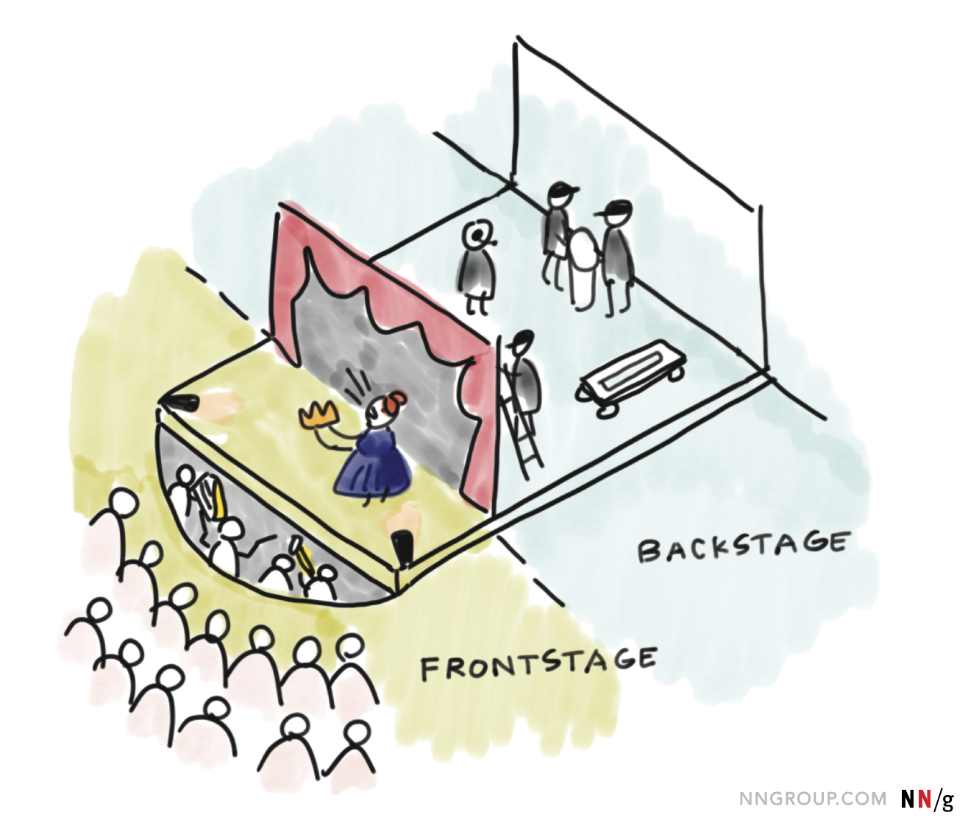
Think of it like a theatre production...
Notes:
End users take a slice of the information layer likely every day when they look up information and images, or complete forms online or on a mobile device.

Slide 7
Think of it like a theatre production...
Operations/Support
Support staff that clean and fix the theatre. Not directly supporting the play.
Customers interact with and see the actors and props up on stage.
Backstage
The crew pulling the currents and moving props onto the stage.
Notes:
Frontstage components include:
Channels
Products
Touchpoints
Interfaces
Backstage components includes:
Policies
Technology
Infrastructures
Systems

Slide 8
Service Design vs Designing a Service
Service design is not simply designing a service. Service design addresses how an organization gets something done and how they think through the necessary details to operate effectively and be human-centered.
Notes:
Frontstage components include:
Channels
Products
Touchpoints
Interfaces
Backstage components includes:
Policies
Technology
Infrastructures
Systems

Slide 9
Service Design
Case Study

Slide 10

Service Design Case Study
Notes:
End users take a slice of the information layer likely every day when they look up information and images, or complete forms online or on a mobile device.

Slide 11
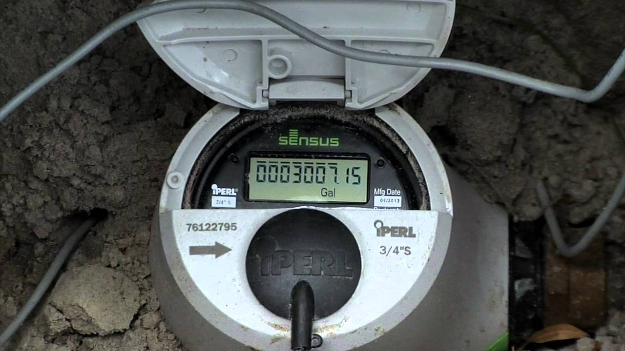
Let’s look at a different case study
Notes:
A company in Tallassee, Alabama that makes water meters. They are a company in Alabama that makes water meters these are the devices that plug into a house and tells the city how much water is being used. Up until 5-7 years ago there were mechanical devices with little spinning wheels and the city would send out someone with a form to write in the numbers displayed on the device. This is how they calculated the water bill.
The company figured out what if we made this digital!
Now the device has software
Now let’s put radio transmitters on things and pick up the readings automatically as the van drives around
Then some time later, what if we put radio repeaters all around the city so we don’t need a van
They kept iterating on things and before they knew it, they found themselves in an industry they never had been in before.
Companies like Honeywell were poised to come in and attack their business
no one had thought about it from a design perspective
they found themselves with a challenge they were
this introduced vulnerabilities into the system- if this gets hacked then someone could have access to that information
*they did not think or map out all the layers*
*think in the long term, but build in the short term and iterate*

Slide 12
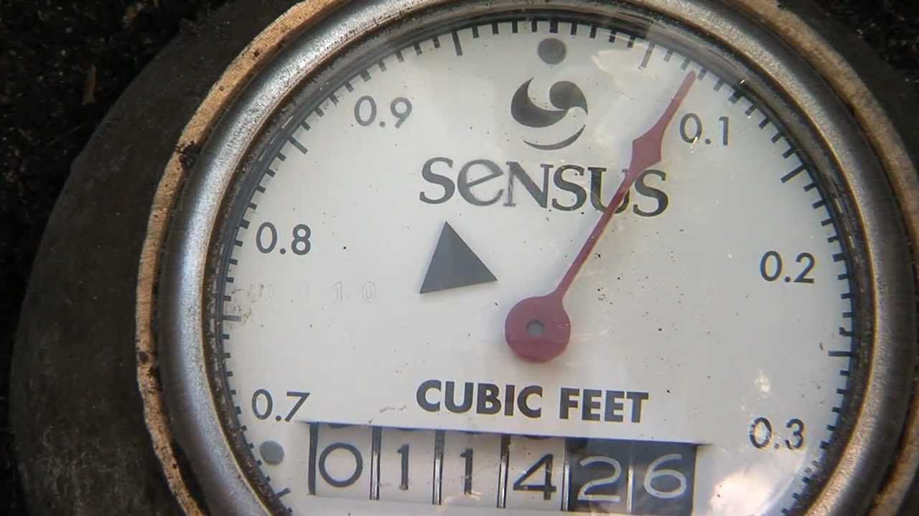
Let’s look at a different case study
Notes:
A company in Tallassee, Alabama that makes water meters. They are a company in Alabama that makes water meters these are the devices that plug into a house and tells the city how much water is being used. Up until 5-7 years ago there were mechanical devices with little spinning wheels and the city would send out someone with a form to write in the numbers displayed on the device. This is how they calculated the water bill.
The company figured out what if we made this digital!
Now the device has software
Now let’s put radio transmitters on things and pick up the readings automatically as the van drives around
Then some time later, what if we put radio repeaters all around the city so we don’t need a van
They kept iterating on things and before they knew it, they found themselves in an industry they never had been in before.
Companies like Honeywell were poised to come in and attack their business
no one had thought about it from a design perspective
they found themselves with a challenge they were
this introduced vulnerabilities into the system- if this gets hacked then someone could have access to that information
*they did not think or map out all the layers*
*think in the long term, but build in the short term and iterate*

Slide 13
Think long term, but build in the short term and iterate.

Slide 14
Service Design = long term understanding complexity, focused on thinking holistically.
Agile Development = short term building and managing complexity, through iteration.

Slide 15
So what does this have to do with procurement?

Slide 16
So what does this have to do with procurement?
You can help change the way that program offices have traditionally worked and how they’ve gone about performing market research.
You have the opportunity to work with the program office to identify the right product owners and SMEs to work with identified vendors.
Ultimately, you have the opportunity to ensure that a holistic team and resources are identified and assembled, and that these vendors can fully deliver on.

