Slide 1


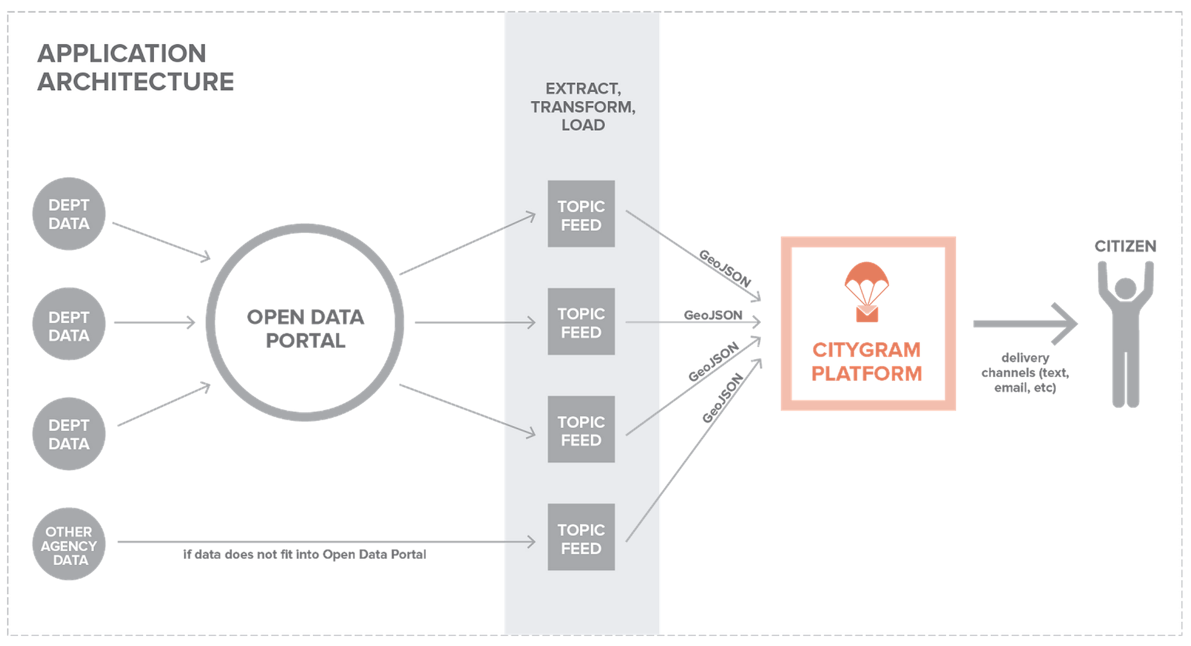
Atlanta Citygram Data Flow
(curated by Code For Atlanta)
github.com/codeforatlanta/citygram
(set up code on this forked repo, then submit
pull request to load into the citygram repo)
Socrata:
Code For Atlanta
Open Data Network Brigade
(see link below)
github.com/codeforatlanta/atl-citygram-data
(one subfolder per data source, including code to get & clean the data, and the data itself, in csv format)
Links
Code For Atlanta Open Data Brigade: https://brigades.opendatanetwork.com/brigade?brigade=Code%20for%20Atlanta
Image source (citygram getting started wiki): https://github.com/codeforamerica/citygram/wiki/Getting-Started-with-Citygram

