Slide 1

Team Name: 404 NOT FOUND
Nov 30th – Dec 2nd 2018 | National Incubation Center, Karachi
Challenge Theme: Smart Waste And Sewage Management Service
Team Participant Names:
1. Saad Pasta
2. Muhammad Shahzaib
3.Muhammad Aun ullah Khan
4.Muhammad Suleman
5.Syed Basit Mehdi
What technologies does your solution leverage?:
React
React-Native
Redux
Firebase

Slide 2

Civic Tech Hackathon 2018 | Problem-Solution Fit
What is your well-defined solution?
Trash To Cash
Provide Easy Access To Reusable Trash And Waste
Scavengers
KMC
Solid Waste Management Department
Recycling Companies

Slide 3
Civic Tech Hackathon 2018 | Problem-Solution Fit
How does your solution mitigate the challenge theme issue?
MITIGATION OF THEME ISSUE
Issues
No proper system of waste Management
Peoples dont know the value of trash
Solution
We will introduce Efficient Waste Management System
People will get Benefit from their trash
Someone Trash Is Another Man's Treasure

Slide 4
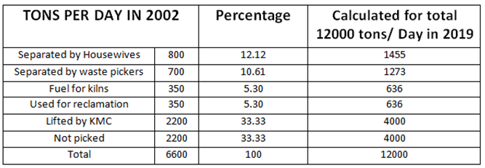
Civic Tech Hackathon 2018 | Potential Impact
Does your application solve a widespread community problem?
Municipal waste
Provide Solution For 33.33% Not Picked Recyclable Material

Slide 5
Civic Tech Hackathon 2018 | Potential Impact
Is there any market research on the problem and solution?
Karachi is producing 25 percent of Pakistan’s total waste per year.
Today, the recycling industry must be valued at Rs. 4 billion per annum. But the number of people it employs is unclear.
Green Earth Recycling Company utilises 300 tons per month of waste shopping bags and packaging plastics and 300 tons per month of scrap rubber, including tyres.

Slide 6
Civic Tech Hackathon 2018 | Potential Impact
Can the solution be scaled easily to actual deployment in the real world?
DEPLOYMENT OF SOLUTION IN REAL WORLD
One of the benefit which people will get is that they will very easily contribute their role in making country clean.
Second benefit which they will get is a reward which they will get in return of their waste.
So, we are confident that our idea will definitely work.

Slide 7
Civic Tech Hackathon 2018 | Novelty & Learning
We are giving easy solution of waste to the citizens & govt. .
We are also giving easy excess of waste to the recycling companies.

Slide 8
Civic Tech Hackathon 2018 | Prototype
How easy to use is your application?
EASY USAGE
User can login through facebook account
Garbage post submission is as easy as facebook post.
Urdu translation of all options that will help local users to understand.

Slide 9
Civic Tech Hackathon 2018 | Prototype

Slide 10
Civic Tech Hackathon 2018 | Sustainability
Is your team committed to scaling/deploying your application beyond this hackathon?
Will your app be adopted by users (govt/citizens/media) & its usage bee sustained over time?
We have to socialize this product to people of Karachi at startup purpose ,manage to work all over Pakistan.
waste is a main problem of karachi for both citizens and govt.

Slide 11
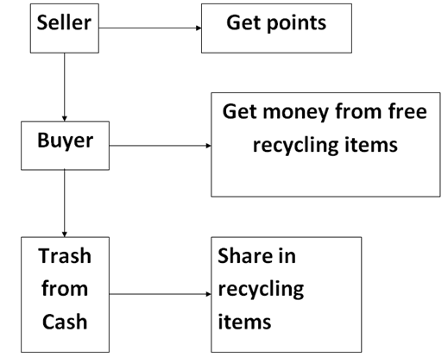
Civic Tech Hackathon 2018 | Sustainability
Do you have a business model?

