Slide 1
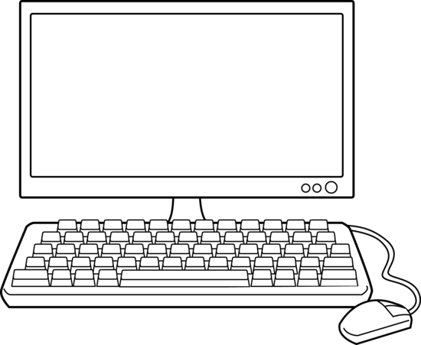


Application
Node Bindings
(Node API)
Libuv
JavaScript
Event Queue
V8
socket
url
fs
http
Event Loop
OS Operations

Slide 2

logMessageWithDelay(2000, "Message: 2")
V8 Call Stack
Node
setTimeout(() => { ... })
() => { ... }
logMessageWithDelay(2000, "Message: 2")
Timer
anonymous(...)
Event Loop
Event Queue
() => { ... }
After 2 seconds delay

