Slide 1

Retrieval Augmented Generation of Economic Data
Timothy Wilson
12/10/25

Slide 2
The Goal
A tool that would deliver concrete hallucination-free and up-to-date market information based on simple user queries with the shortest possible delay.
“What are top causes for consumer uncertainty? (1 week)
Mechanism: Semantic search using Embeddings & Cosine similarity

Slide 3
How AI interprets words
Word | Male | Female | Royal
Man | 1 | 0 | 0
Woman | 0 | 1 | 0
King | 1 | 0 | 1
Queen | 0 | 1 | 1
Massive Vector Embeddings
Directionality = Semantics
This is NOT keyword matching
  Regex vs Semantics
Values aren’t friendly (normalization)
Unit Vectors preserve semantics

Slide 4
Initial Development Stages
Initially built locally in VScode (bad idea)
  Small scale text files worked optimally
  Large scale (13 MB) files reveal limitations of processing power.
  Running on CPU due to conflicts.
  Embeddings created upon query
  User query also turned into embedding and compared

Slide 5
Next Targets
Run on HomeLab and or cloud CPU vs GPU.
Use Larger embedding model.
API for specific market data rather than just 10K documents.

Slide 6
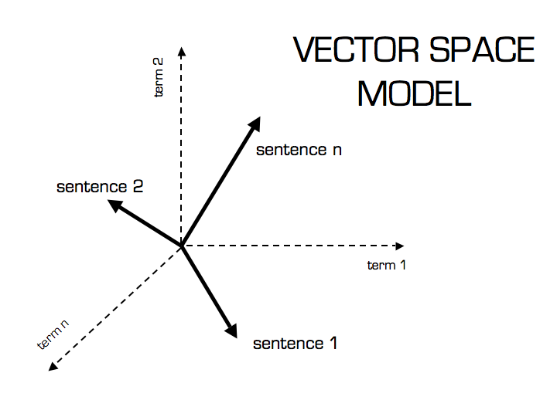

Cosine Similarity
Mathematically determine how "similar" a user's question is to a specific news article chunk.
$similarity=\frac{A⋅B}{∥A∥∥B∥}$
Normalized Similarity = $A⋅B$
Score Interpretation 0-1:
1.0 means perfect alignment.
0.0 means no semantic relation.

Slide 7
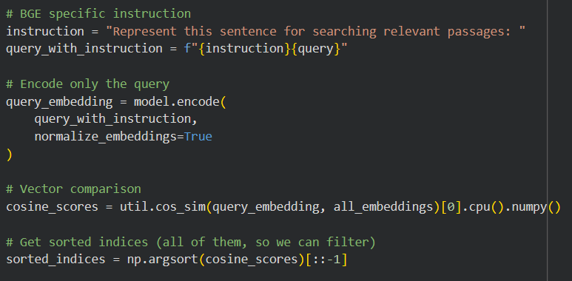
Design
Information Consumption
  https://eodhistoricaldata.com/api/news
Embedding
OLD:
all-MiniLM-L6-v2
NEW:
BAAI/bge-large-en-v1.5

Slide 8
Opportunities
Store Embeddings rather than text files
Full calculation only necessary for new files
Theoretically take list of popular or standard questions
-no real improvement predicted
Only assists on massive query that is unlikely to be represented
Remove chunks containing end of article.

Slide 9
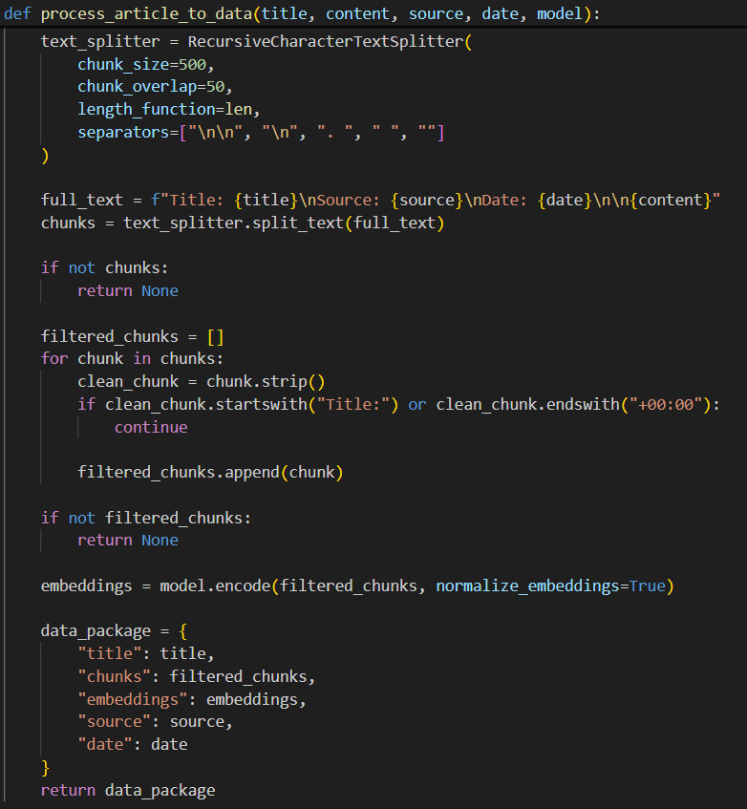
Article Processing
Chunking
  Size: 500
  Overlap: 50
    Overlapping intent
API data required cleaning
Embedding
  MiniLM-L6-v2 (384)
  BAAI/bge-large-en-v1.5 (1024)

Slide 10
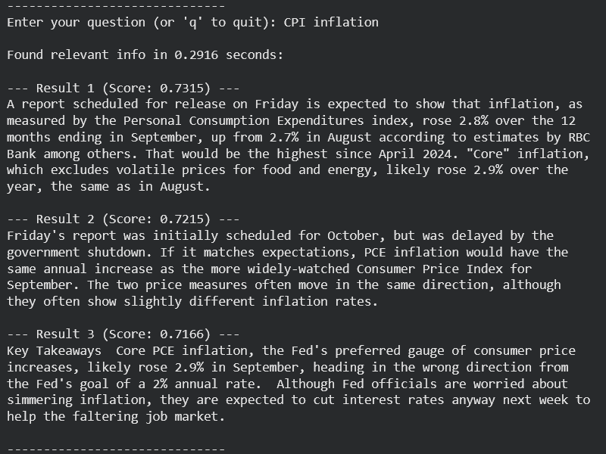
Results
Perceived relations
73.15%
72.15%
71.66%

Slide 11
Final Thoughts
The program runs as expected, returning the relevant data
Capabilities mainly bound by API choice and pricing
Speed was a main concern, but an interesting restructure would feed the most similar embeddings into a standard LLM for conversational tone.
  Jeopardizes time constraint & reintroduces chance of hallucinations

