Slide 1

Session:- 2025 -2026
BlogSpace:
A Student-Centric Blogging Platform
Team Members :
Ananya Singh (Leader)
Anshika Srivastava
Ayush Srivastava
Chirag Gupta
Mayank
Mini Project Assessment
(BCC-351)
Presented To:
Mrs. Saumya Saxena
(Assistant Professor)

Slide 2


Introduction: The World of Blogging
What is Blogging?
Blogging is the practice of regularly updating a website with informal, conversational posts that share thoughts, experiences, and expertise with an online audience.
From personal journals to professional portfolios, blogs have revolutionized how we communicate and share knowledge in the digital age.

Slide 3

Problem Statement ?
Limited Personal Expression
Complex Existing Platforms
Students lack accessible platforms to share academic insights, creative writing, and personal experiences with peers and educators.
Current blogging solutions are either too complex for beginners or lack customization options suitable for small student groups.
Gap We Address
Our platform bridges this gap by providing an intuitive, feature-rich environment designed specifically for student needs and academic collaboration.

Slide 4

Project Objectives
01
Create User-Friendly Platform
Develop an intuitive interface that
requires minimal technical knowledge,
allowing students to focus on content
creation rather than technical
complexities.

Slide 5

Project Objectives
02
Content Management System
Provide comprehensive tools for
writing, editing, and publishing
posts with rich text formatting
and media integration
capabilities.

Slide 6

Project Objectives
03
Implement Organization Features
Offer categorization systems and
tagging functionality to help users
organize and discover content
effectively

Slide 7

Project Objectives
04
Foster Community Engagement
Include commenting systems
and like features to
encourage interaction and
build a supportive academic
community.

Slide 8

Project Scope
Features Included
User registration and authentication
Rich text editor for post creation
Category and tag management
Comment and like functionality
Basic search capabilities
Responsive design for mobile devices
Current Limitations
Basic design templates only
Limited to essential blogging features
Not designed for enterprise-level usage
Single administrator model

Slide 9
Literature Review & Background
WordPress
Medium
Blogger
While powerful and feature-rich, WordPress can be overwhelming for beginners with its extensive plugin ecosystem and complex customization options.
Excellent for reading and writing but lacks customization and community features needed for small academic groups.
Simple but dated interface with limited modern features and poor mobile optimization for today's users.
What Makes Our Platform Different
BlogSpace combines simplicity with essential features, specifically designed for student needs. It offers the perfect balance between functionality and ease of use, without overwhelming new users with unnecessary complexity.

Slide 10


System Requirements
Hardware Requirements
Software Requirements
Minimum 4GB RAM
Web server
2GB available storage
CSS3
Internet connectivity
JavaScript
Modern web browser support
HTML5
The platform is designed to run efficiently on standard college computer lab specifications and personal laptops.

Slide 11

Technology Stack & Implementation
Frontend Technologies
HTML, CSS, JavaScript create a
responsive, interactive user
interface. Ensures consistent
styling and mobile compatibility
across all devices.

Slide 12

Technology Stack & Implementation
Backend Development
PHP handles server-side logic,
user authentication, and data
processing. Runs on Local data,
posts, comments, and platform
metadata securely.

Slide 13

Technology Stack & Implementation
Security Features
Input validation, password hashing,
and SQL injection protection
ensure platform security.
Session management and
protection safeguard user data.

Slide 14

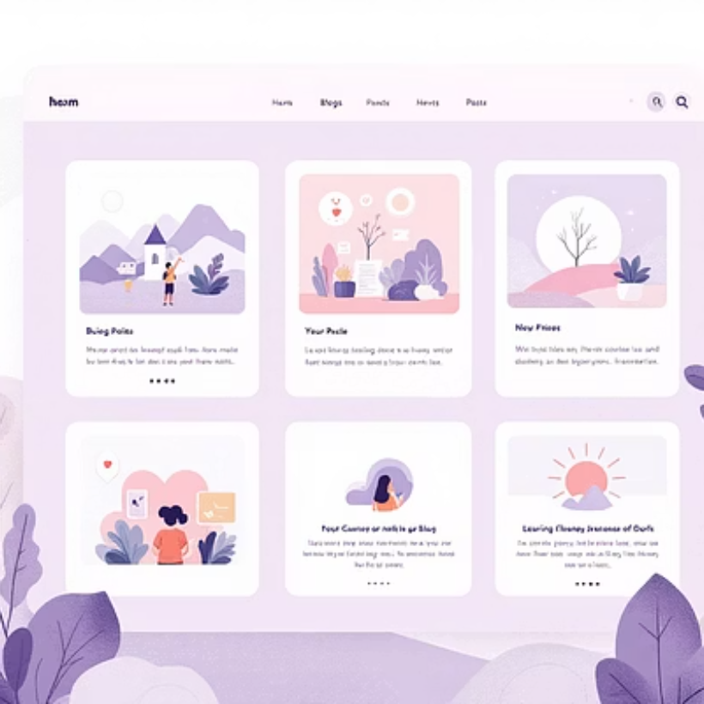
Key Features Demonstration
Intuitive Post Editor
Rich text formatting with real-time preview functionality
Clean Reading Experience
Optimized typography and layout for enhanced readability
Interactive Community
Seamless commenting and engagement features

Slide 15




Future
Enhancements
Current Success
Functional blogging platform with essential features
Future Enhancements
Advanced themes, multimedia support, and collaboration tools
Scalability
Potential for campus-wide deployment and feature expansion
.

Slide 16


Our online blog platform provides a simple and user-friendly space for sharing ideas and experiences.
It allows users to create, edit, and explore blogs easily with a clean interface.
Basic features like authentication, comments, and dark mode enhance usability.
The project helped us understand frontend–backend integration, database handling, and web application flow.
With more time, features like likes, analytics, and image uploads can be added.
A simple yet complete platform built to learn, create, and share.
.

Slide 17


