Slide 1

Team Z “TaskMaster” Project
1
Team Lead: Ben Molloy
Team Member: Brooks Arthur
Team Member: Quay Robinson
Team Member: Cody King
Team Member: Bryce Bien

Slide 2
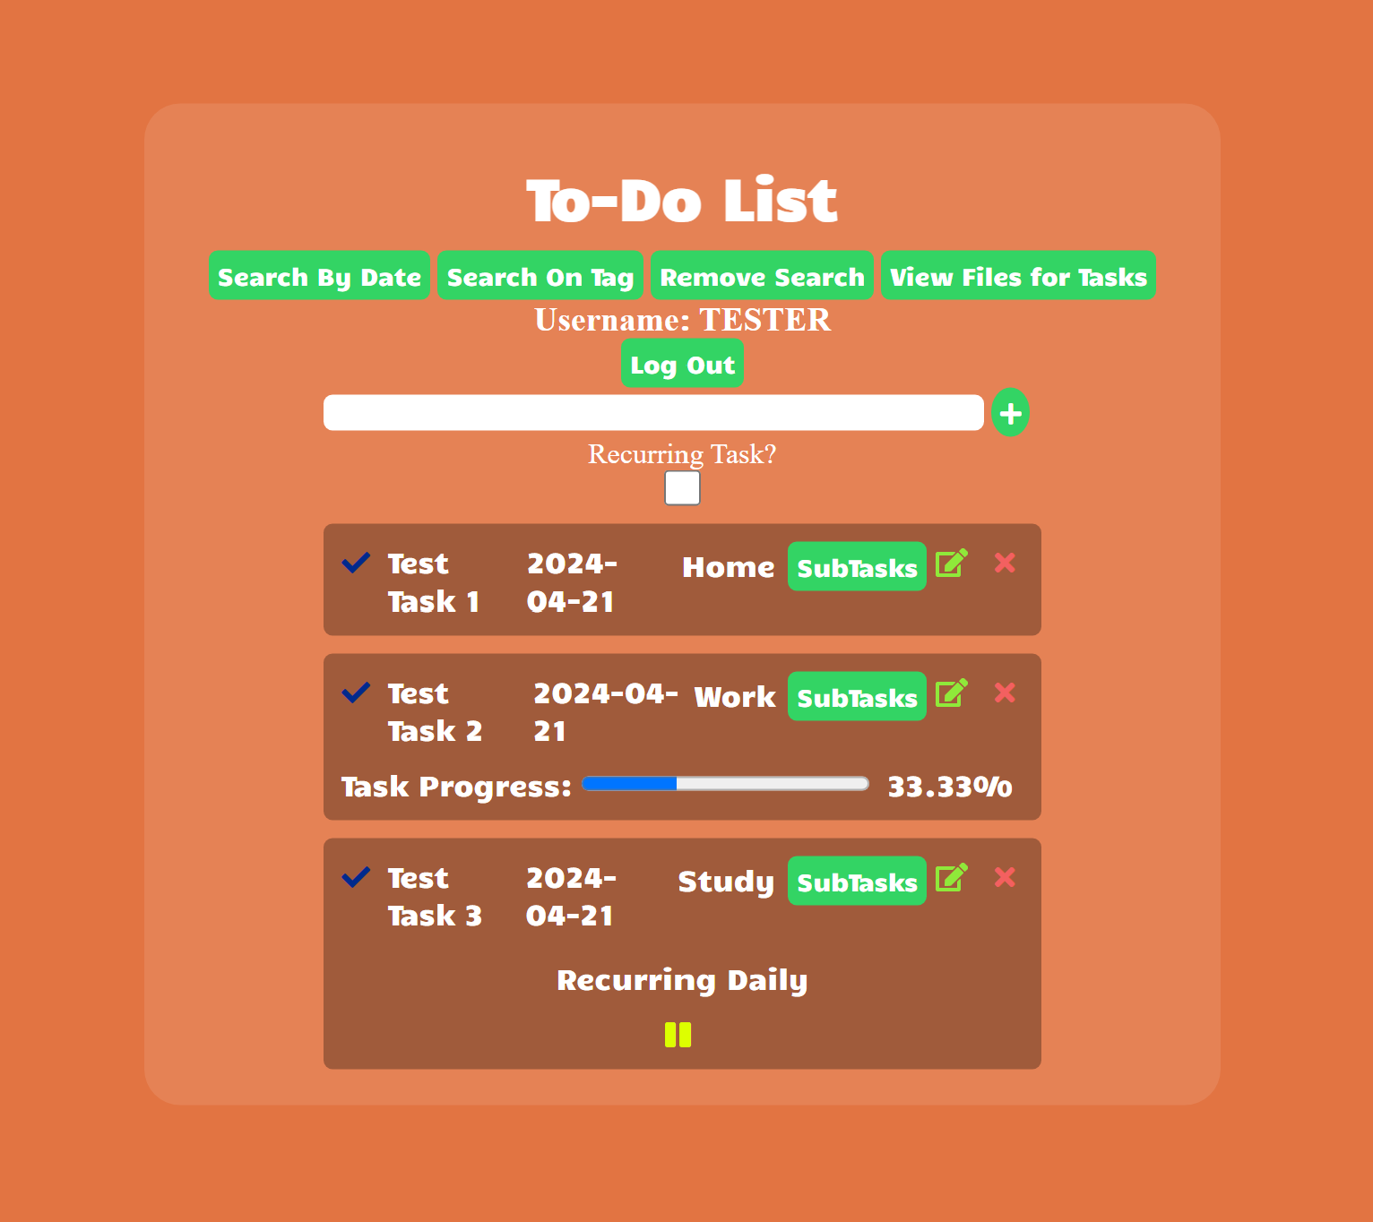
What is TaskMaster?
2
A streamlined task management solution with a user-friendly web application that enables effortless organization of daily tasks and deadlines by utilizing Mongoose/MongoDB for seamless operation.

Slide 3
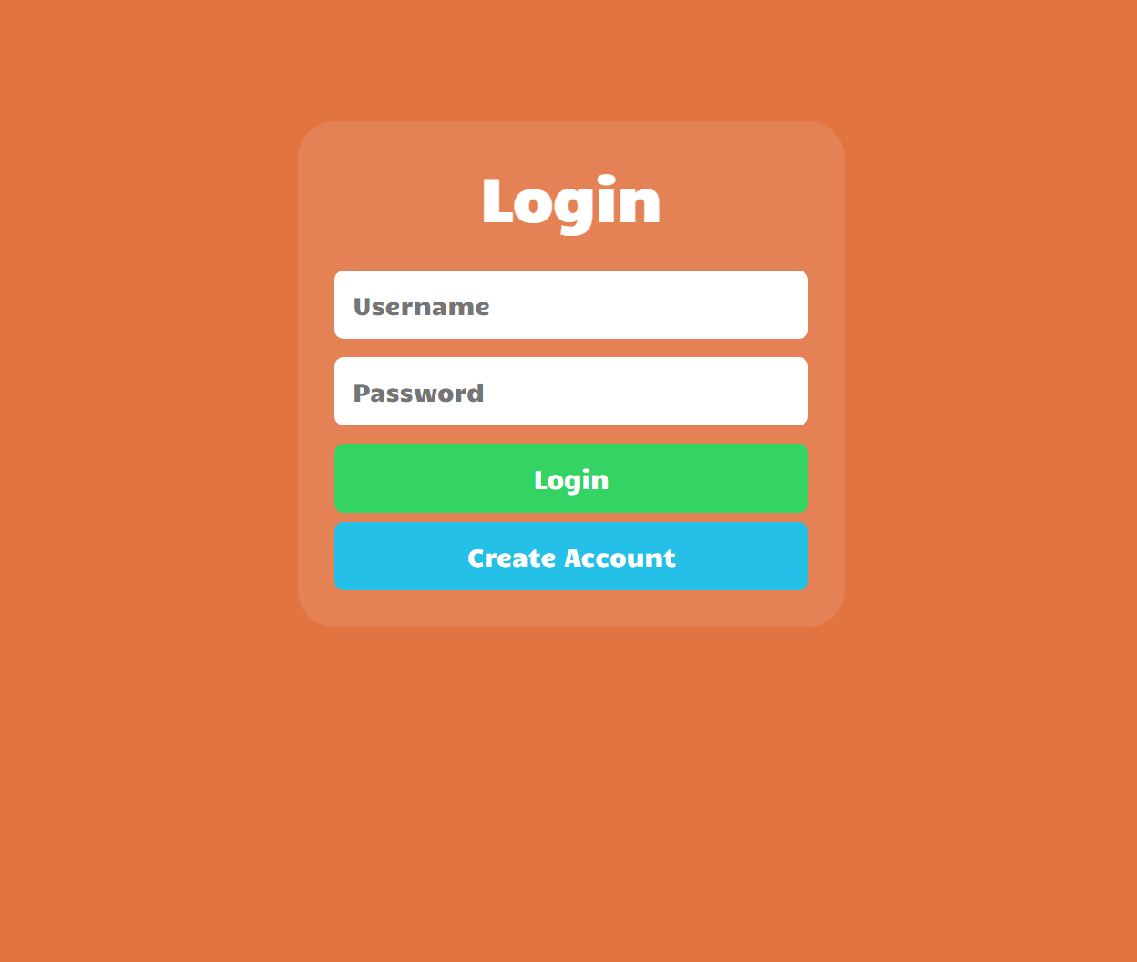
Brooks Arthur: User Login
3
The User Login feature allows more than one user to use TaskMaster.
When the user signs in, they can access their task list.

Slide 4
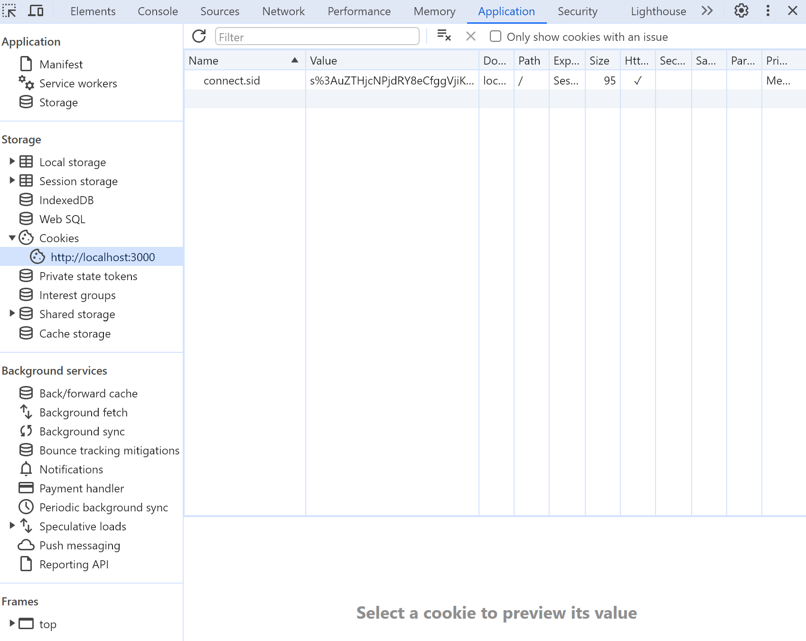
Brooks Arthur: Session Variables
4
The Session Variables feature is a crucial feature as it uses cookies to maintain a session.
Although not visually apparent, this feature acts as the backbone for TaskMaster as it prevents users from having to resign-in after every action.

Slide 5
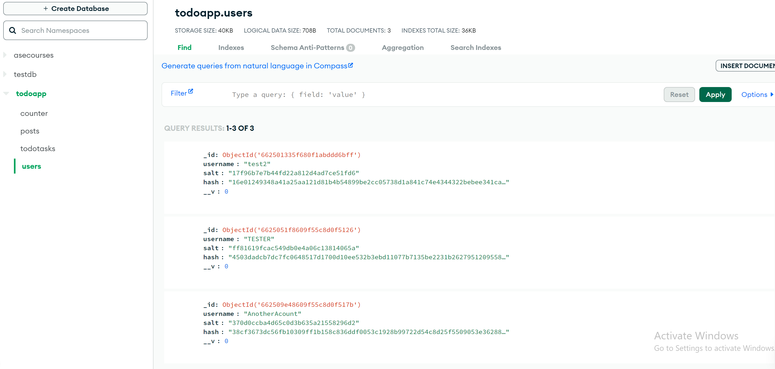
Bryce Bien: Password Encryption
5
The Password Encryption feature works on the back end to ensure safe transmission of user's passwords between client and server.
This feature prevents data from being stolen in case of a data breach.

Slide 6
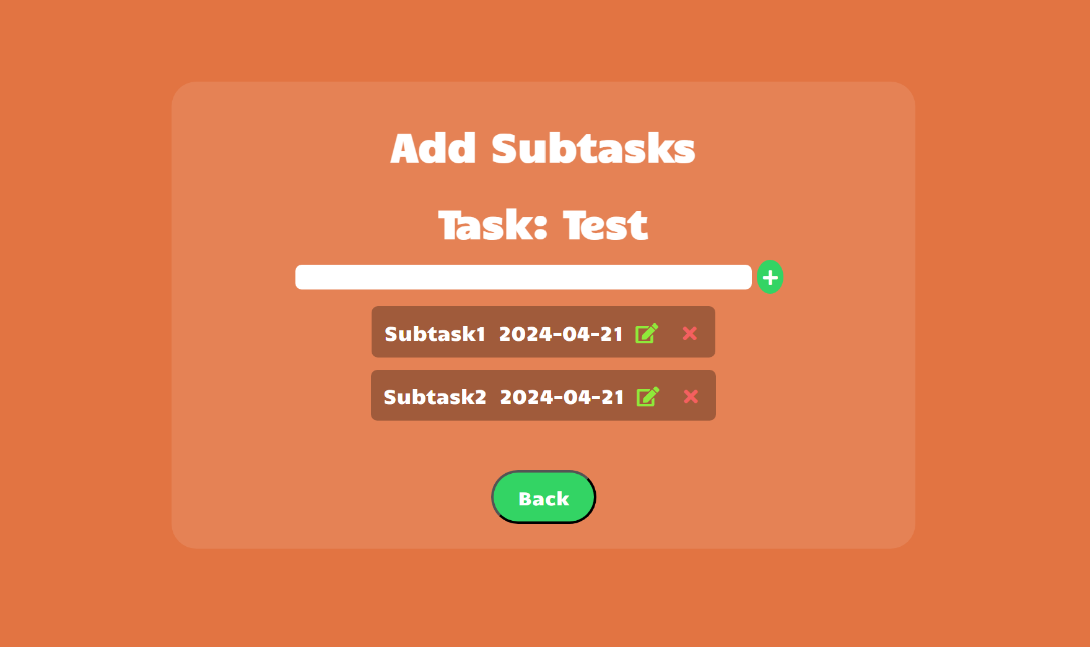
Bryce Bien: Subtasks
6
The Subtasks feature allows users to create subtasks of there main tasks.
When a task has subtasks, users can view their progress on that task, depending on how many subtasks are complete.

Slide 7
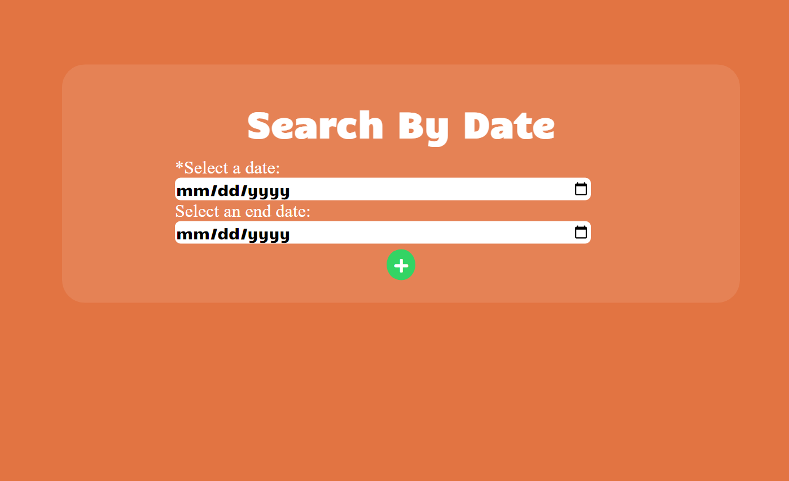
Cody King: Date Search
7
The Date Search feature allows users to search for certain tasks within a certain period specified by the user.
This feature can be especially useful for finding availability in their schedule.

Slide 8
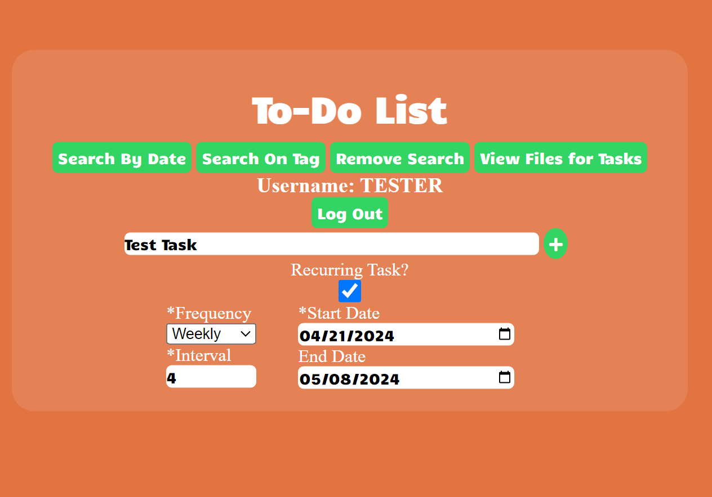
Cody King: Recurring Tasks
8
The Recurring Tasks feature allows users to create task that are recurring at a specified interval, frequency and period.
This feature prevents users from having to create many tasks that are identical, saving the time and resources of users.

Slide 9
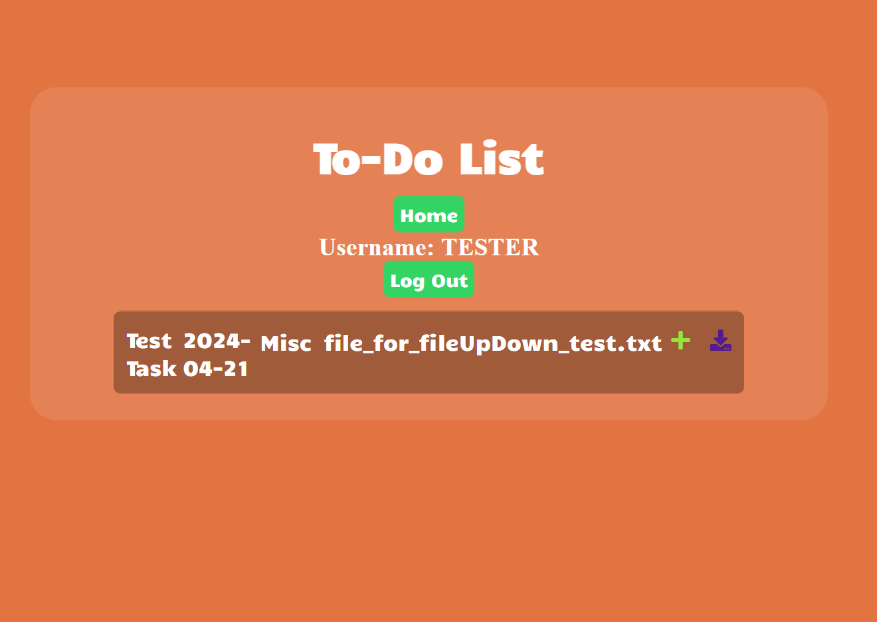
Quay Robinson: File Upload/Download
9
The File Upload/Download feature allows users to attach files to their tasks.
This feature adds a button to the home page UI that takes users to the file management page for uploading and downloading files to tasks.

Slide 10

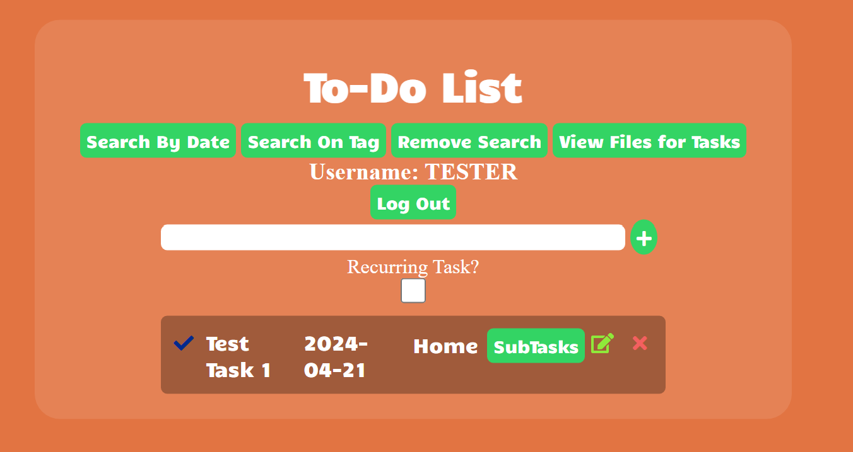
Quay Robinson: Tag Search
10
This feature lets users assign tags to their tasks with predefined tags.
Users can then search through there tasks based on the tag that their task has.

Slide 11
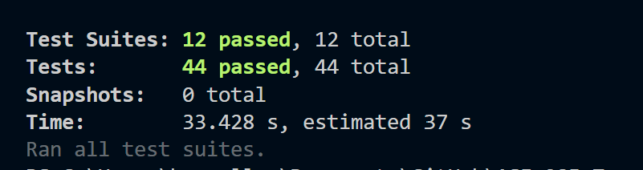
Testing Of All Features
11
Unit Tests Automated: 17
Unit Tests Manual: 9
Integration Tests Automated: 8
Regression Tests Automated: 4
Regression Tests Manual: 4
Acceptance Tests Automated: 2
Acceptance Tests Manual: 2
__________________________________________
Total: 46

Slide 12
TaskMaster Lifetime Growth (LoC)
12
Prototype Start (LoC): 659
Final Version (LoC): 3727

Slide 13
Drawing to a Close
13
Our take aways…
From this project we learned and got to practice the lesson of start early, finish early.
We learned secure server to client communication which we applied in our product.
Integrating security features are key if developing any online software.
This project also allowed us to learn about securely storing data in databases.

