Slide 1
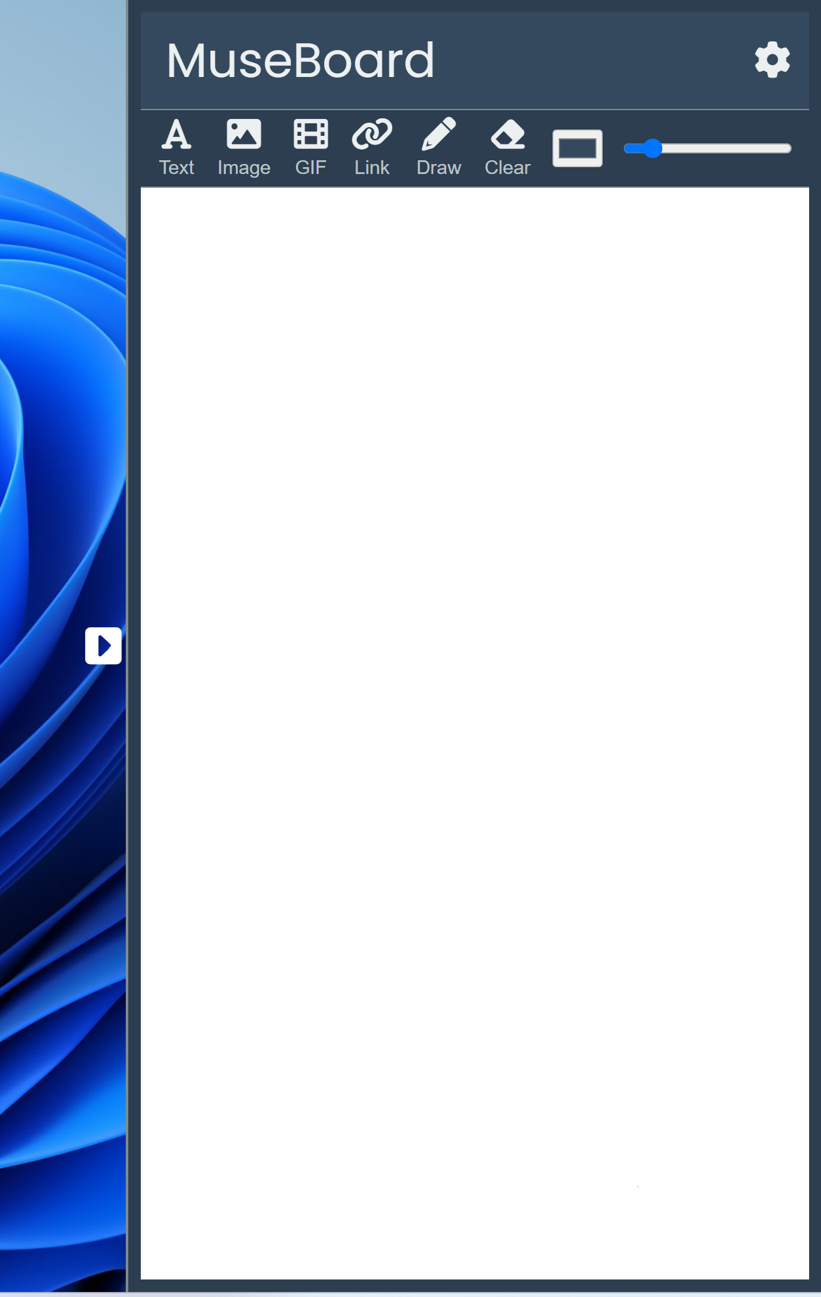
MuseBoard
Cody King, Ben Molloy, Jacob Nelson, Alli Garcia

Slide 2
Golden Pitch
MuseBoard is an all-in-one encompassing board to store notes, images, and gifs. You can also jot down notes with a drawing feature. Think of it as a digital whiteboard. Why are we presenting this idea? We believe users need a way to store ideas in a way that doesn’t interrupt their workflow and combines text and media for a more comprehensive and fun note-taking experience.
MuseBoard can also be used to express your creative ideas in a free form way. MuseBoard is neat because the hardest part of doing any project is starting, and MuseBoard allows you to easily access the UI so you can start adding things to the space. MuseBoard is an intuitive all-in-one desktop solution that’s quick, accessible, and simple to use with keyboard shortcuts.

Slide 3
Customer Personas
Researchers: Anyone working on a project involving extensive research can use this product. Researchers can benefit from our product because of our text and images features that allow you to jot down important information you come across while searching through sources. It’s a good way to quickly type down information to look at later. There is even a hyperlink feature that allows you to include a link that you may want to visit or reference later. You can also use the drawing feature to annotate your notes using different colors. The visual representation of your research excels your focus and motivation by having a tangible intake of your work. An article from Harvard Health publishing says that doodling while note-taking can help improve retention of memory, focus, and relieve stress. Our drawing feature can help those researching take a mental break from time to time to ultimately progress their research.

Slide 4
Customer Personas cont.
Artists: What a fun little way to express yourself while being on your technology! You don’t have to just be good at drawing to express your creativity. You can use the space to store references for your art, like human body studies, or references of landscapes you might want to paint. You can store links to sites that also might have good inspiration for your art, like Pinterest or Tumblr. The whiteboard can be used like a collage to organize your ideas, like a vision board, or an aesthetic collage you’d see on Instagram.

Slide 5
Customer Personas cont.
Organized Individuals: If you are someone who loves to keep a to-do list or reminder notes for later, MuseBoard is a good way to start a list quickly. The implementation of pictures and gifs can be useful to reference examples, such as charts or diagrams. This can be useful if you’re planning an event, and you need to keep lists of numbers, businesses, emails, or websites.
Project Managers: MuseBoard is a great way for project managers to set and track team goals, visualize progress on projects, and share data with their teams.

Slide 6
Customer Personas cont.
Students and Teachers: Students can use this in a way that the researcher would, but on a smaller scale. Students do have multiple classes, and with the ability to save multiple ‘notes’, students can keep their notes organized across their different classes. However, teachers can teach multiple classes, and with the ability to save multiple ‘notes’, teachers can organize their lesson plans for all the classes they teach as well. Teachers and students can save videos that are important to study. MuseBoard is an easy way to categorize study materials.

Slide 7
SWOT Analysis
Strengths:
MuseBoard is a comprehensive tool that combines multiple functionalities like notetaking, visual organizational, scheduling, ability to add pictures or links, etc. This allows us to appeal to a diverse crowd of users like researchers, artists, students, teachers, and project managers.
The visual elements of our product attract visual learners who appreciate engaging and dynamic organizational tools.
The flexibility of our product allows users to use our product in a way that suits them best. The versatility of our product allows anyone to use it.
Weaknesses:
There are many products like MuseBoard that are more established and with more features than MuseBoard. This isn’t exactly an untapped market.
As a new competitor in the market, we would need to invest and spend on marketing, which is difficult and requires expertise.
Our product might be too complex or overwhelming for some users to work with.
Opportunities
With the rise of remote work and digital nomadism, there’s a growing demand for digital productivity tools that facilitate online collaboration and organization.
As digital tools become more accessible, new segments of users, such as older adults and younger students, are increasingly adopting these technologies.
Opportunities exist to integrate with other platforms like Google Workspace, Microsoft Teams, or Slack, which could enhance usability and expand the user base.

Slide 8
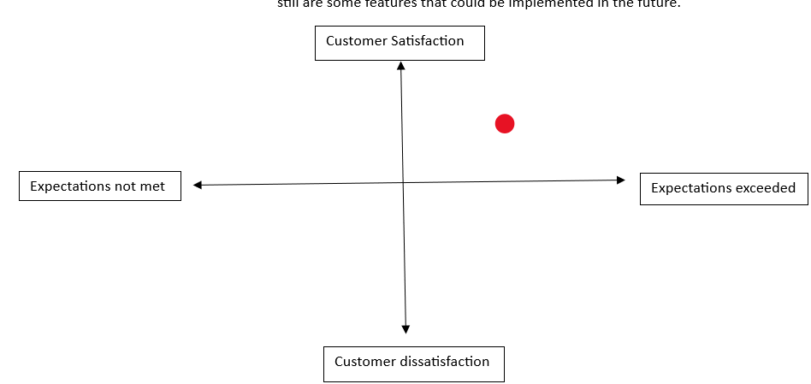
KANO Model
We put our product in the quadrant between customer satisfaction and expectations met because our users really liked our product, but wanted more features or disliked one aspect of the layout and we met all our expectations, but did not exceed them. There even still are some features that could be implemented in the future.

Slide 9
Business Model Canvas
Key Partnerships In the future, we could work with companies like Google Workspace, Microsoft Teams, or Slack, which could enhance usability and expand the user base. | Key Activities Type text, insert images, gifs, links, and draw. | Value Proposition A comprehensive, easy, and accessible way of notetaking that isn’t overcomplicated. Combination of text and media allow users can express themselves freely. |  | Customer Relationships Our customers can access our product via GitHub and either build off our product or give suggestions for future installments | Customer Segments Researchers, artists, organized individuals, students, teachers, and project managers. Anybody who has a computer can use our app.
 | Key Resources Node.js, Npm, Electron, and JavaScript |  |  | Channels Our channels would most likely be through word of mouth or recommendation.
Cost Structure The most expensive part of our project was most likely time. All of our goals are/were achievable through many means of technology accessible to us, so our biggest constraint was time. |  |  | Revenue We would not see revenue with out product because all of the tools we used are available to the general public.

Slide 10
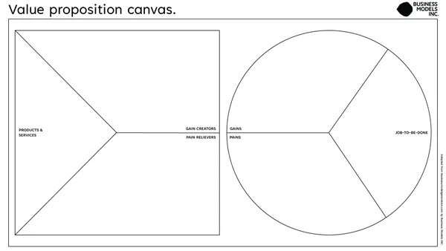
Value Proposition
Text, images, link, and draw features. Save feature.
Convenient
Multimedia options
Many options for media insertion in an easy and accessible way
Notetaking
Organize information, not just notes
There aren’t so many features that our product becomes overcomplicated. The placement of the app makes it easy to access.
Starting is the hardest part of any task

Slide 11
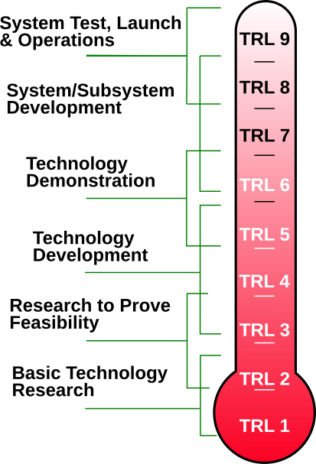
Technology Readiness Scale
We believe our product is between 6 and 7 on the technology readiness scale. We have a product that can be distributed to others through GitHub and users can download our app with an installer. Although we don’t have all the features we hoped for, but our product is really fledged out can be functional right now to users.

Slide 12
First Round of Prototyping
The point of our first round of interviews was to gauge if users understood how the app was supposed to work. For our first prototype we asked these questions:
Click the arrow to expand the window
What is your initial feeling opening the app?
Type something down, whatever you want
If you were to add a picture, what icon would you select?
If you were to add a hyper link, what icon would you select?
If you wanted to draw a picture, what icon would you select?
If you were to add a moving picture, what icon would you select?
If you wanted to add text, what icon would you select?
Click the arrow to hide the page
What would you use this for? Why would you use it? Or why would you not use it?
Is there anything you like about the app?
Is there anything you dislike about the app?
Is this app easy to understand? Is it difficult to interpret?
How usable is this app to you?
Is there anything you would like to see? Anything you would change?
Can you exit the app?
We learned that overall, users thought our UI was easy to understand and liked the idea of our product.

Slide 13
Second Round of Prototyping
Our second prototyping, we had users look at the second iteration of our prototype and gave them a general rundown of how the product would work, and then ask what they liked about our product, what they didn’t like, if they had any suggestions for future improvements, if they understood how to use it, and if they thought it was easy to use. This is what we learned.
Our users appreciate the ability to be able to have dark mode and to customize the theme of the program.
Users liked that they could save and auto-save their work
Users want the ability to customize the formatting of the text.
Some users wanted spell check
Users want the ability to bullet point or number their text
Users expressed concerns with clear button, worried about accidently deleting things.
Users would like the ability to have a confirmation before clearing the board.
Users also want the ability to be able to delete things individually.
Users wants the ability to have a undo/redo feature.
Users would like a tutorial or quick tooltip for first time users.
Users want to be able to easily access this app
Users preferred the idea of tabs or folders rather than scrolling with pins or bookmarks
Although the inclusion of scrolling with bookmarks was not entirely shunned

Slide 14
Third Round of Prototyping
These are the questions we asked users for our third prototyping:
Do you understand the App without a guide or walkthrough?
Was it easy to use?
What do you like most about the application?
What do you dislike about the application?
Where was the point of most friction or resistance?
Where was the point of least friction or resistance?
What feels like its missing from the application?
What might you use this application for?
Would you be willing to pay for this application (OTP)? If so, how much would you pay?
Overall, we learned that our users did really like our app and saw the intended use as well as the potential for the product. They really worried about the clear functionality and the ability to produce more notes. Also the UI could use some changes and the app itself does not move very fast when moving objects around the space. The click and drag function is also not 100% synced.

Slide 15
Our Plan Moving Forward
Key user-requested features:
Add separate tabs within the application.
Move line thickness and color settings under the "Draw" button for easier access.
Integrate a basic tutorial for functionality.
Allow deletion of individual objects and customizable UI elements.
More text features such as bold, italic, etc.

Slide 16
What Do We Need to Test Next?
Resolve non-critical bugs (e.g., arrow window preventing clicks).
Restructure codebase for multi-window support.
Conduct usability testing to address minor friction points.

Slide 17
Prototype Development and Feasibility
Current iteration qualifies as a prototype with desired features (drawing, embedding links, adding pictures/GIFs, note-taking, saving progress).
Estimated effort: Minimal, as prototype features align with user needs.

Slide 18
Real-Life Pursuit
Decision: Yes, based on strong user feedback.
Demand for a flexible, user-friendly note-taking app with essential features.
Belief in the project’s potential for real-world success.

Slide 19
What have we learned from this course?
Designing for diverse user needs is challenging due to varying preferences and limitations.
Insights from the Clovernook guest highlighted real-world accessibility struggles, particularly for visually impaired users.
Inclusivity can sometimes create trade-offs, making design harder for other user groups.
Gained a deeper understanding of target audiences and customer personas.
Broad product scope emphasized the importance of balancing user needs and functionality.

