Slide 1

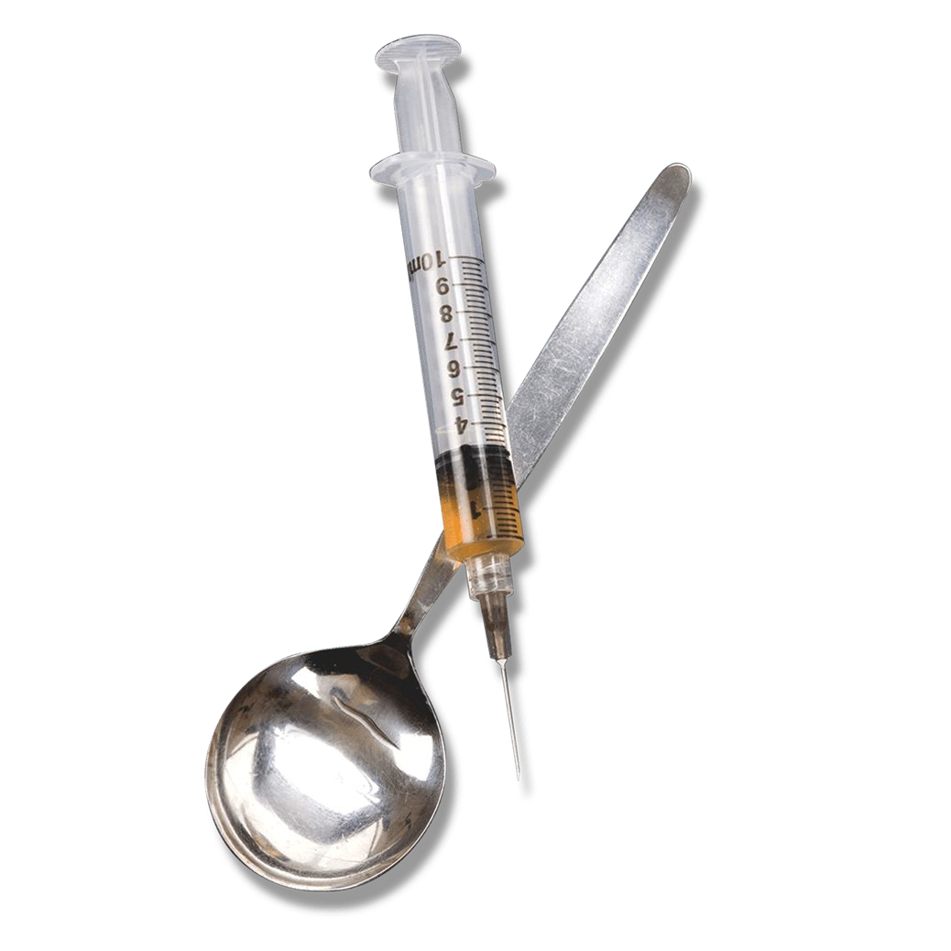
Heroin overdose prediction for Mesa
Rui Jiang, Jingyi Cai
To better allocate prevention resources
The City of Mesa has a dataset of heroin overdose locations. To estimate a geospatial risk prediction model, this project will predict overdoses as a function of environmental factors

Slide 2
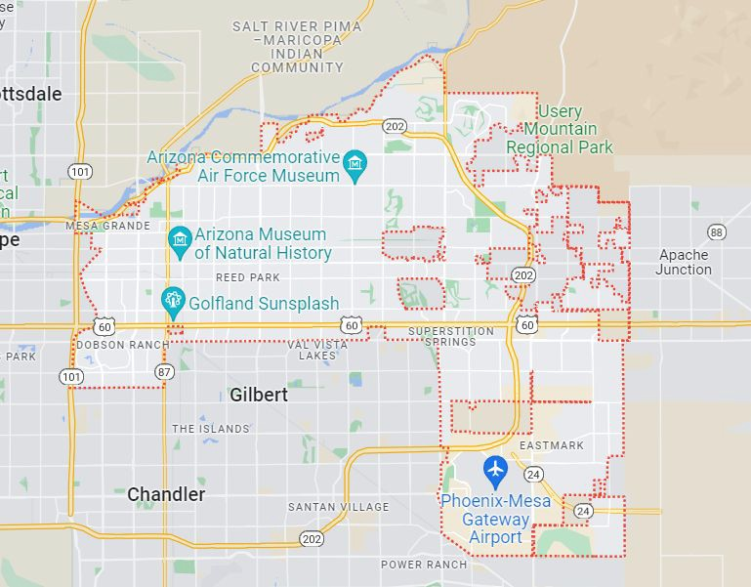

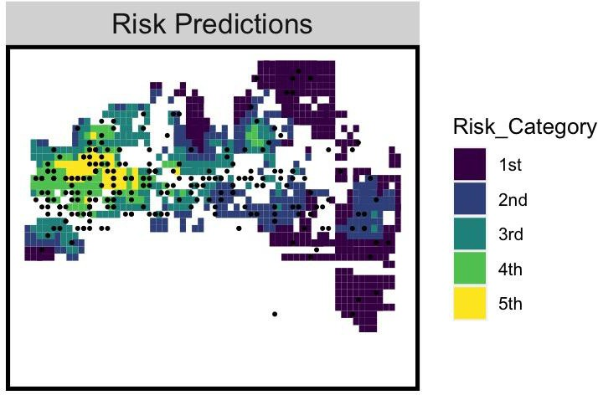

Introduction
APP
USER: public health ofﬁcial for the city of Mesa
GOAL: Use the APP to predict heroin overdose locations in Mesa to allocate resources
Mesa
1. Predict potential risks
2. Arrange sources(e.g. police) for those high-risk areas.

Slide 3



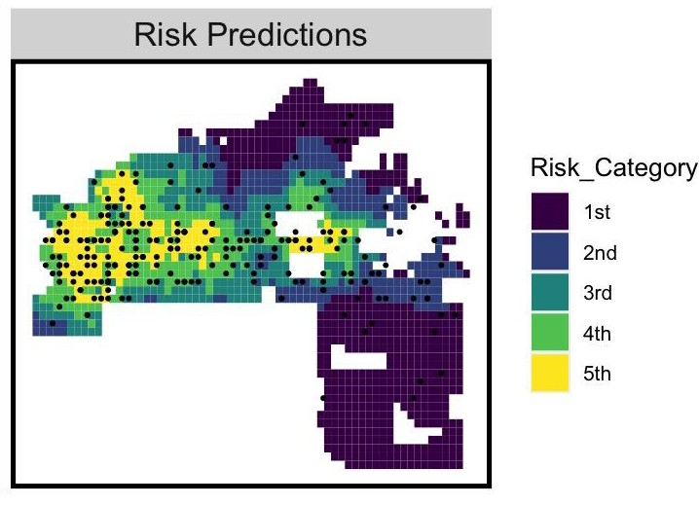
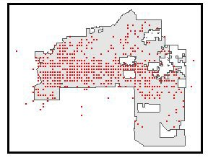
User Guide
APP
preH
FUNCTIONS
Report for Heroin overdose
Recent overdose
Location: Day & Time: Age
Time:
Recent Week Recent Month Recent Season Recent Year
SUBMIT &
Save location
1. Prediction map
Showing this year’s prediction based on last year’s data
2. Report
Reporting portal for public health ofﬁcial to record their work
3. Recent
Showing recent overdose data from reporting for public health ofﬁcial to better
allocate prevention resources

Slide 4
User Guide
APP
User App
For a non-technical decision maker， you can:
1. Prediction map:
2. Report
Report for Heroin overdose
2. Recent
Recent overdose
Time:
Gender: Incidence disposition: treatment:
Recent Week Recent Month Recent Season Recent Year
SUBMIT &
Save location
Choose the input data by year
Type in the information
Choose the time you want to see.
Predict the upcoming overdose in map.
Record the overdose.
Show the recent overdose.

Slide 5
User Guide
APP
User App
For a non-technical decision maker， you can:
1. Prediction map:
2. Report
Report for Heroin overdose
2. Recent
Recent overdose
Time:
Gender: Incidence disposition: treatment:
Recent Week Recent Month Recent Season Recent Year
SUBMIT &
Save location
Choose the input data by year
Type in the information
Choose the time you want to see.
Predict the upcoming overdose in map.
Record the overdose.
Show the recent overdose.

Slide 6




Use Case
APP
Main Client
Our App
Other Clients
 |  | Reallocate prevention resources
Overdose prediction
Medical/ Police Service
Report overdose data |  | Record them into database
Health Center & ofﬁcials
Provide data
Data/Spatial Analyst
Show Recent Data
Improve model
Others interested

Slide 7
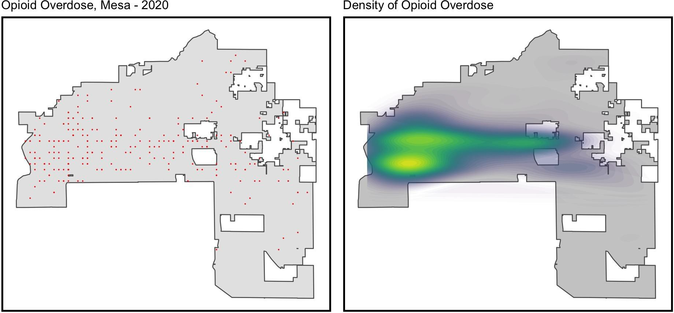
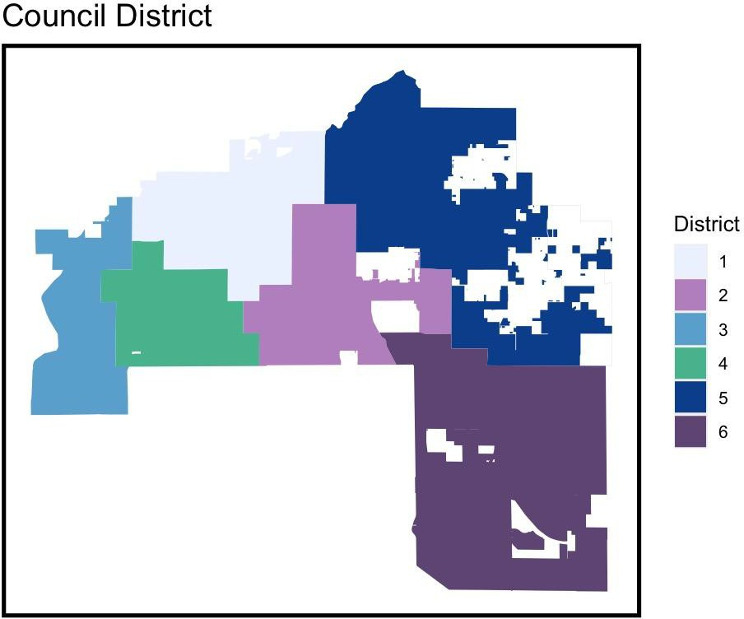
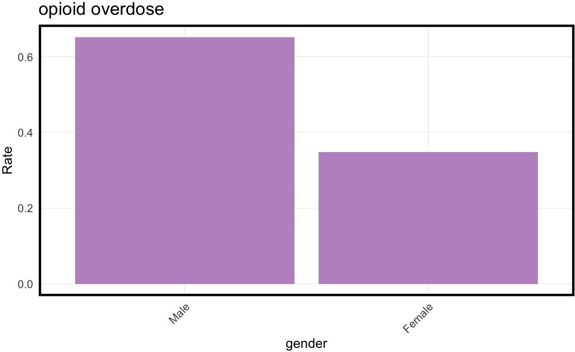
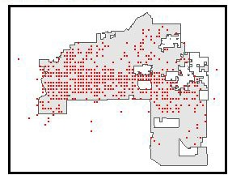
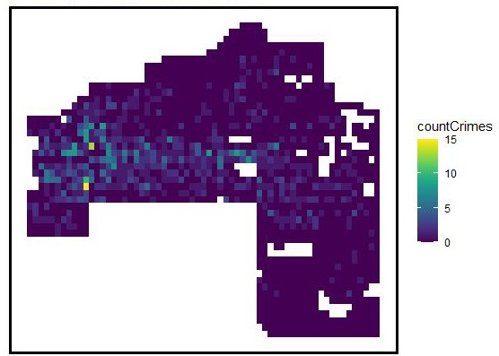
Data Exploration
Model
Overdose data & count map - all
More features will be added…

Slide 8
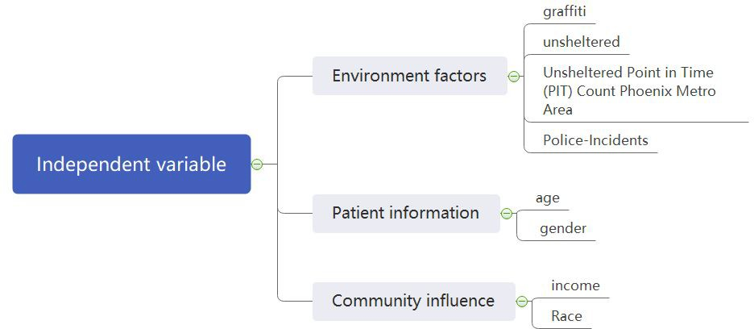

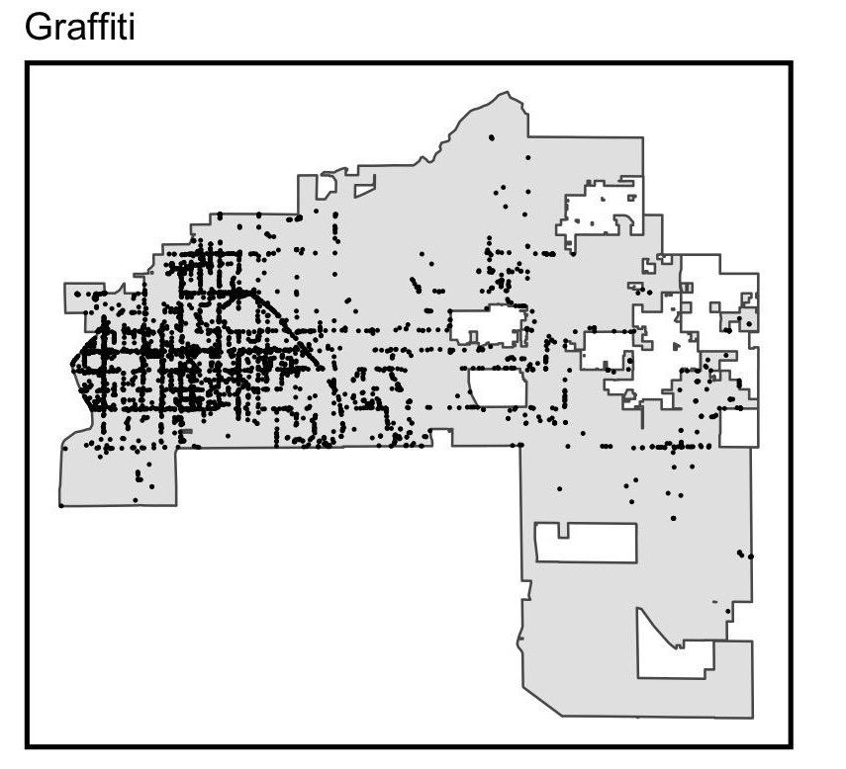
Model
Predict heroin overdose events to better allocate prevention resources
Dependent variable
Independent variable
Overdose data & count map - all
More...
Jingyi Cai, Rui Jiang

Slide 9
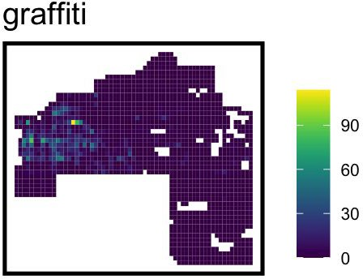
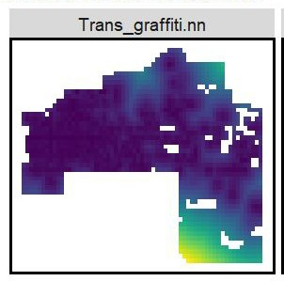
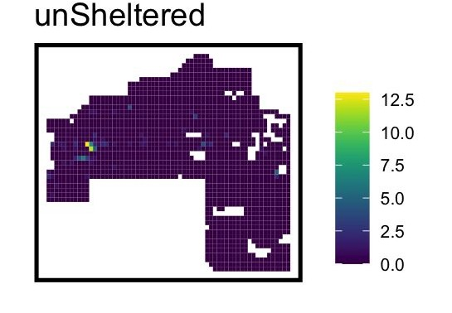
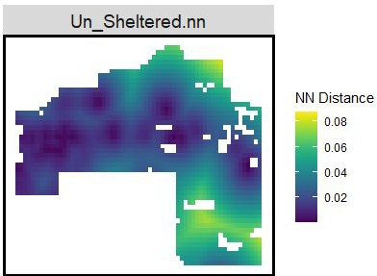
Engineering Features
Model
Engineering
More features will be added…

Slide 10
Geospatial risk modeling：
We will use geospatial risk model which is a regression model, Predictions from these models are interpreted as ‘the FORECAST RISK /opportunity of that event occurring here’.
The goal is to borrow the experience from places where crime is OBSERVED and test whether that experience generalizes to places that MAY BE AT RISK, even if few events are reported.

Slide 11
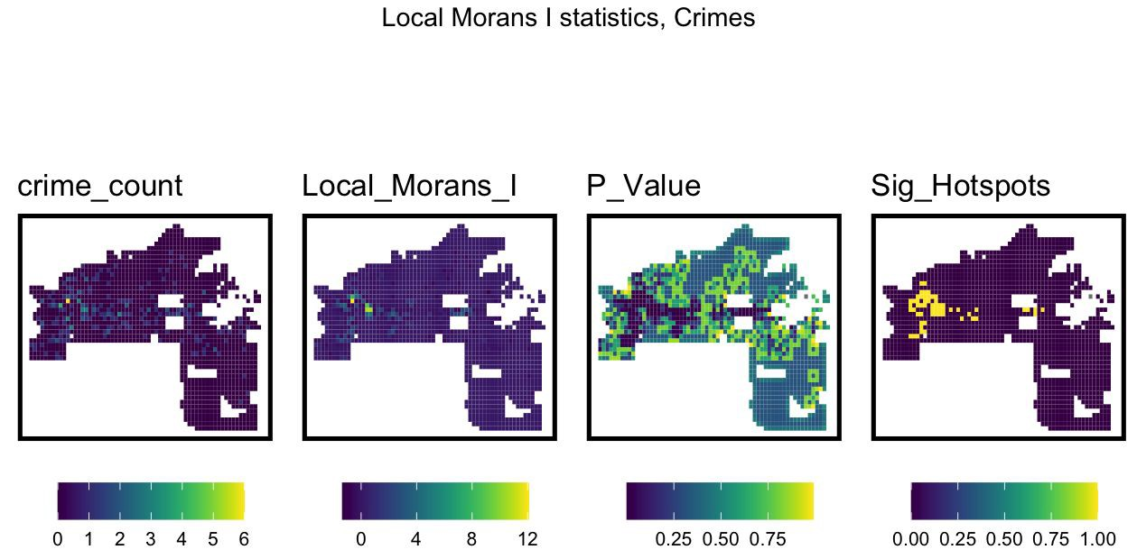

Slide 12
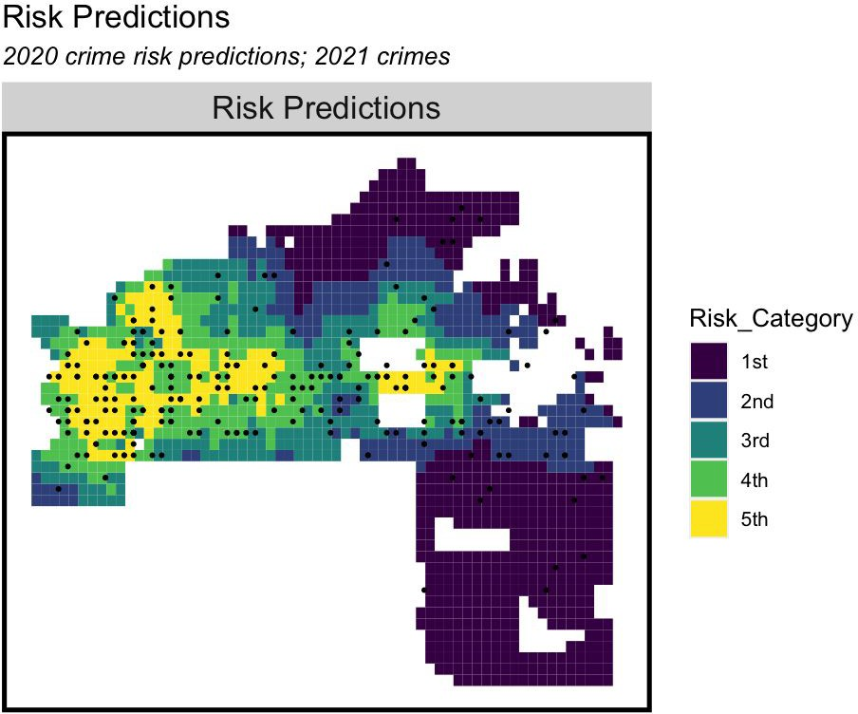
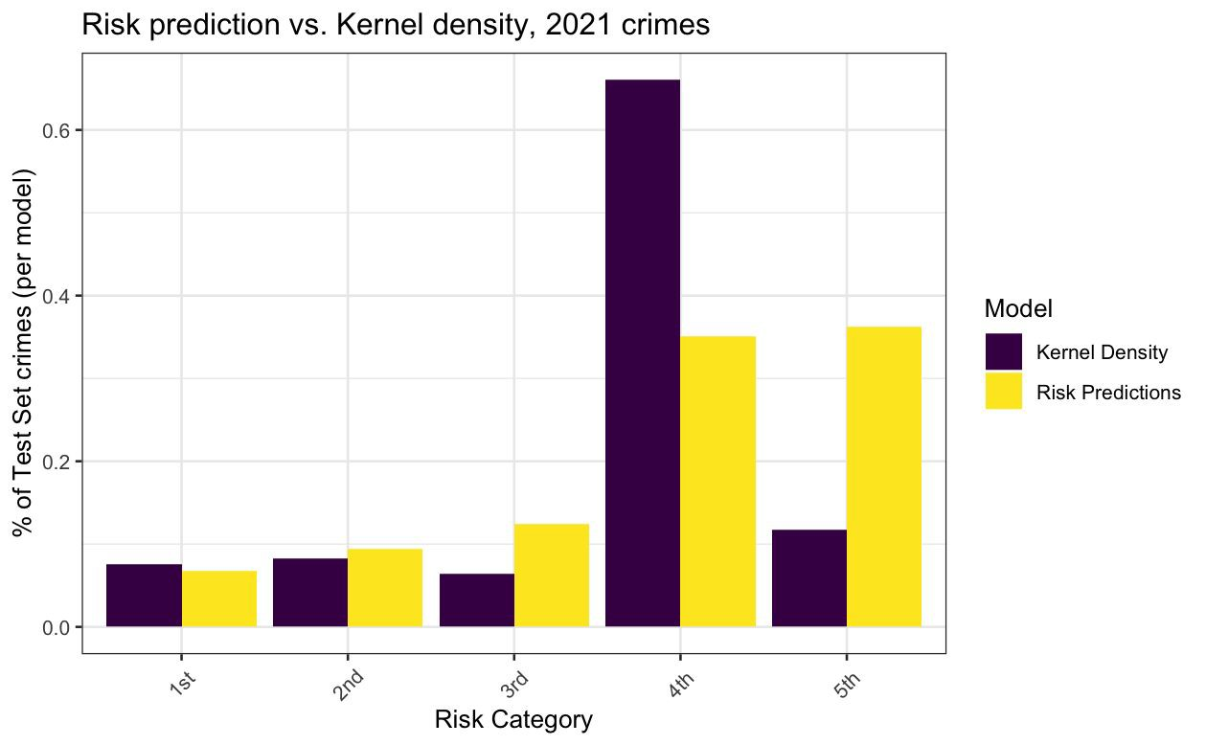
Result

Slide 13
Result

Slide 14
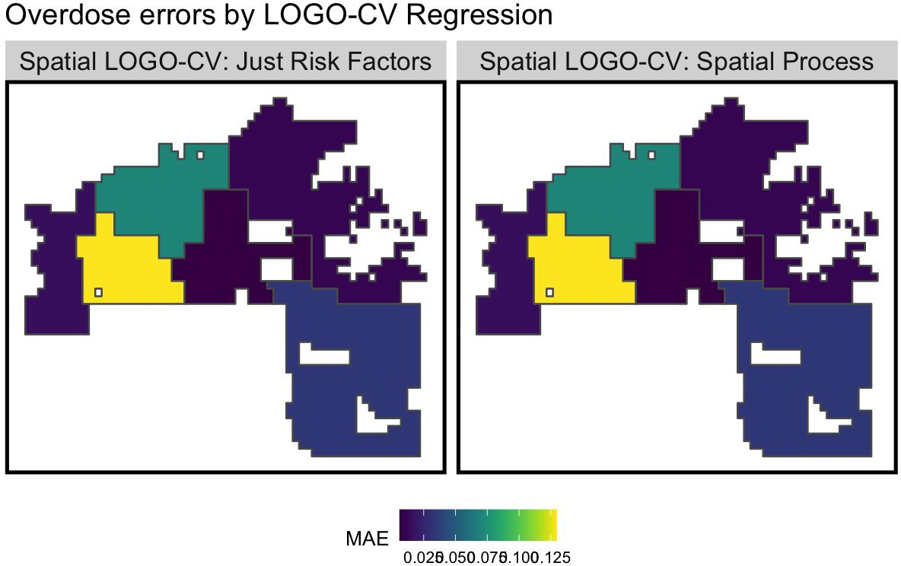
Validation

