Slide 1
Metrics
!
Joe Rustad
Software Engineering Sr. Manager, Foglight APM

Slide 2
About me 自我介绍
Joe Rustad
15 years experience in APM and related fields (network simulation, application modeling, web traffic analysis and mobile internet acceleration)
Primary inventor on 3 APM related patents
Trained and led the first Quest Software (now Dell) APM development team in China
University courses lectured (San Diego State University)
Network Simulation (CS 580)
Programming for Business Majors (CS 103)

Slide 3
What we’re going to cover today 今日要点
Why metrics?
What metrics should you collect?
How to display and use metrics
Discreet and structured data

Slide 4
Why Metrics?

Slide 5
Key reasons for using metrics
Show Trends
Baseline
Compression
Thresholds
First and foremost, a metric is a time series representation of a value.
Is it going up, down, or flat?
Is this metric outside it’s norm?
Keeping track of a value against known cyclic variance can give important insight,
Are more people viewing my travel site because of the holiday or my ad campaign?
Store the average, min, max, mean, sum, standard deviation and sum of squares, or store every discreet observation.
More values means more disk and more CPU to process the values.
When the value goes over or under a set limit, it is crossing a threshold.
CPU Utilization over 90%? Call IT!

Slide 6
Showing Trends
Granularity is Important

Slide 7
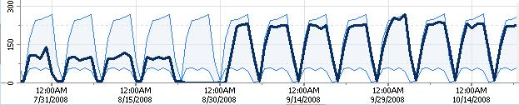
Baselining
Find the true variance from the norm
More powerful than simple trending

Slide 8
Compression and Rollup
Compress values into sample sets, those can be rolled up again without loosing important detail
Count | Sum | Average | Min | Max | Stdev | Sumsq
4 | 565 | 141.25 | 53 | 209 | 59.37 | 93907
4 | 1540 | 385 | 291 | 494 | 75.52 | 615714
5 | 3492 | 698.4 | 571 | 808 | 85.40 | 2475282
4 | 3988 | 997 | 888 | 1082 | 74.13 | 3998022
17 | 9585 | 563.82 | 53 | 1082 | 323.46 | 7182925
STDEV Total = SQRT ((SUMSQ – AVG* SUM)/COUNT)

Slide 9
Compression and Rollup
Metrics must be aggregable
What’s the average of:
20%, 50%, 80%, 30%
If it is CPU Utilization, it’s 45% (.2+.5+.8+.3)/4 = .45
If it’s “Percent of a time period to transfer 100kb” you have to use the harmonic mean:
4 / (1/.2 + 1/.5 + 1/.8 + 1/.3) = .345324
Another example is speed:
40 km/h for 5 km, 60 km/h for 5 km – average speed is 48 km/h
Lesson
express rates as counts per second not seconds per task.
Avoid ratios as metrics

Slide 10
Thresholds

Slide 11
What metrics should you collect?

Slide 12
Metric Types
Performance and Throughput
Availability and Capacity
Business Value

Slide 13
Performance and Throughput
Response time for a website
Hits per second
Database call count
Page content size
Kbps served from a web server
Question for the class – any more examples of performance and throughput metrics?
课堂提问 : 还有更多的例子吗？

Slide 14
Availability and Capacity
Uptime
CPU Utilization
Memory Utilization
Java Heap Available
Disk Capacity
SAN IOPS
Question for the class – any more examples of availability or capacity metrics?
课堂提问 : 还有更多的例子吗？

Slide 15
Business Value
Shopping Cart Value
Shopping Cart Abandonment Rate
Conversion Rate
Promotion Code Usage
Question for the class – any more examples of business value metrics?
课堂提问 : 还有更多的例子吗？

Slide 16
Sampled Versus Measured
Average =87
Average =39

Slide 17
Sampled Versus Measured
Average=67.6

Slide 18
Slices of Data

Slide 19
Slices of Data

Slide 20
How to display and use metrics

Slide 21
Time Plot
Time ->

Slide 22
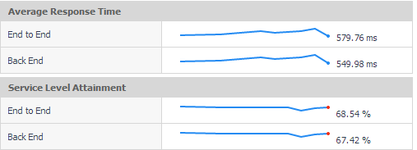
Sparklines

Slide 23
Sparkline Overload!
Don’t Do This

Slide 24
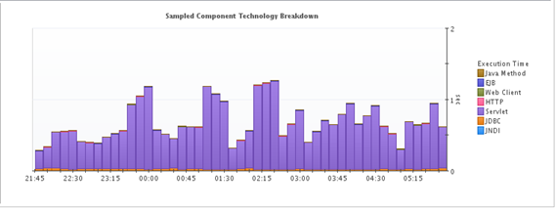
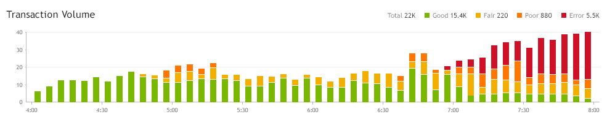
Bar Charts

Slide 25
Area Chart

Slide 26
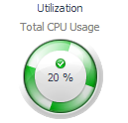
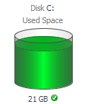
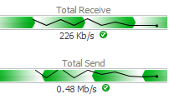
Spinners and Gauges

Slide 27
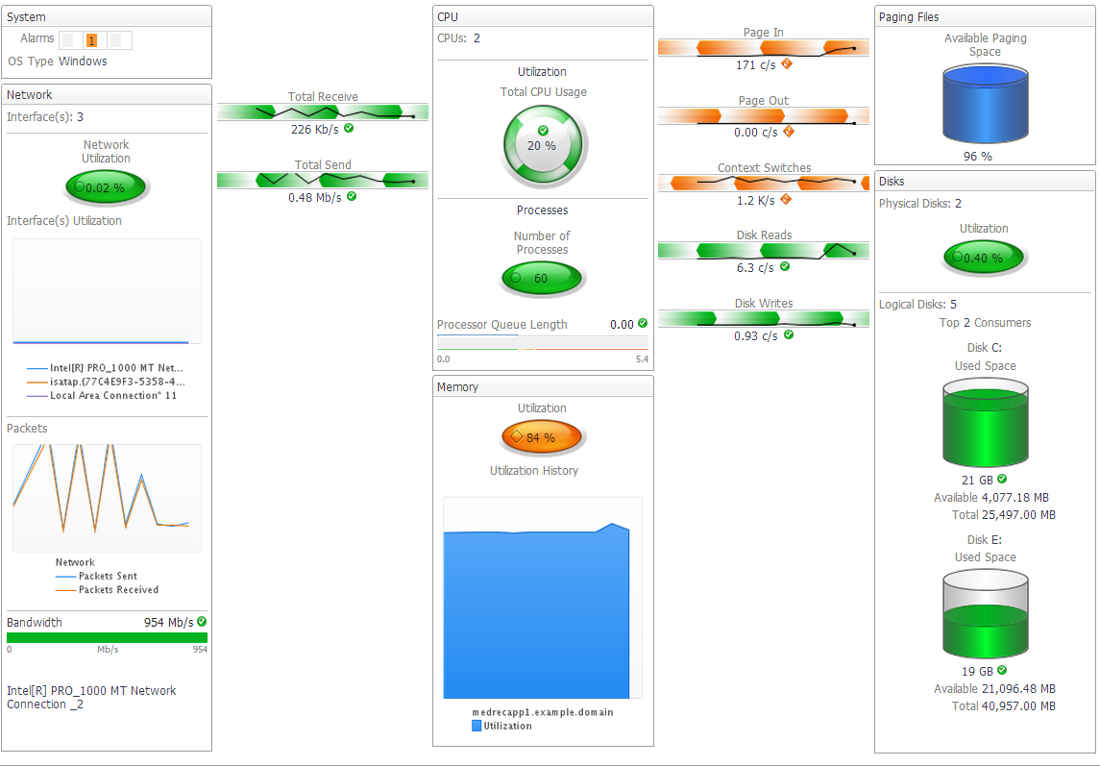
Dashboards

Slide 28
Discreet and structured data

Slide 29
Structured Data
Some data can’t be converted into simple metrics and must be stored as a complex observation
Sometimes it’s necessary to store data together for alignment

Slide 30
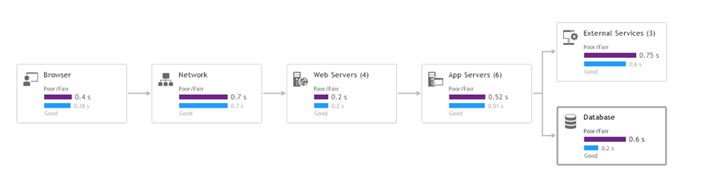
Structured Data

Slide 31
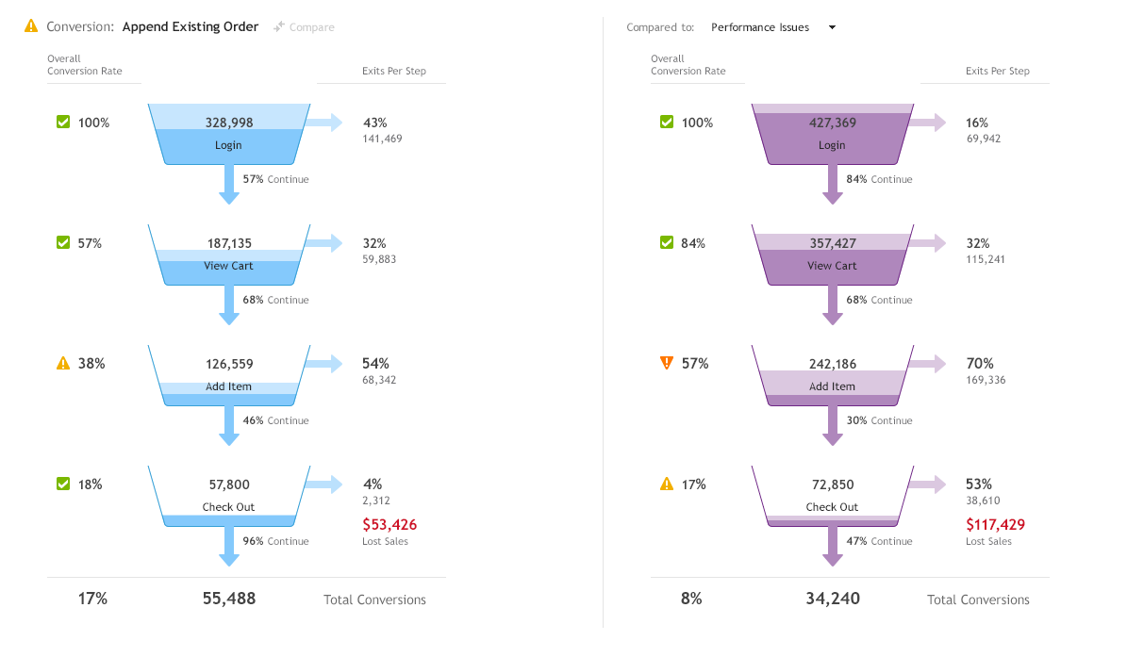
Structured Data (cont)

Slide 32
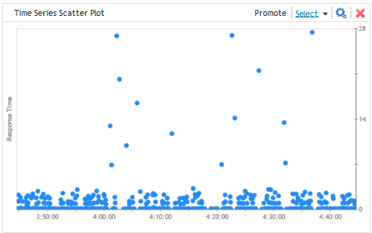
Discreet Data
Should we just store all raw data?

Slide 33
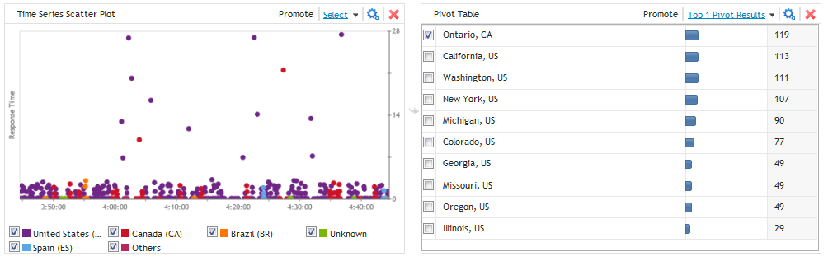
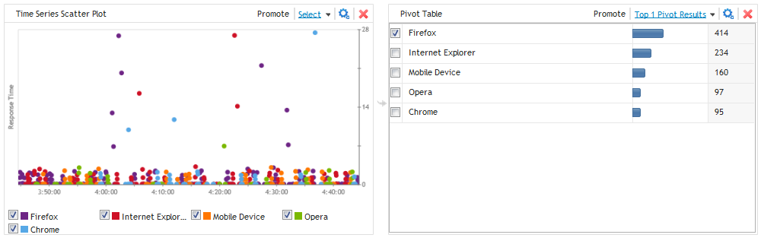
Discreet Data
Can be sliced on the fly:

Slide 34
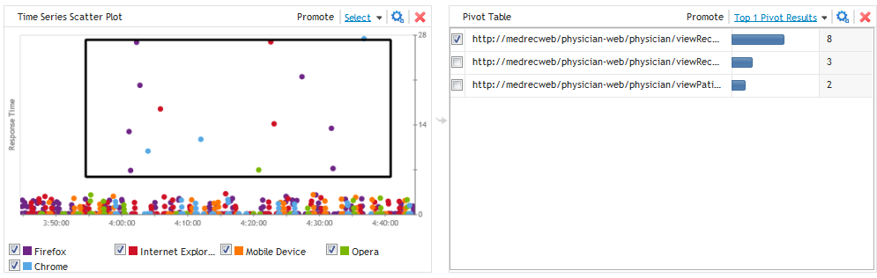
Discreet Data
Can be used to filter:

Slide 35
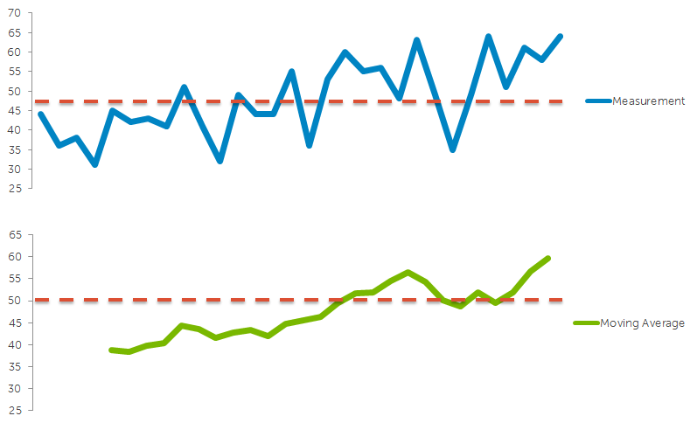
Discreet Data
With discreet data you lose:
Trending
Thresholds
And compression, of course

Slide 36

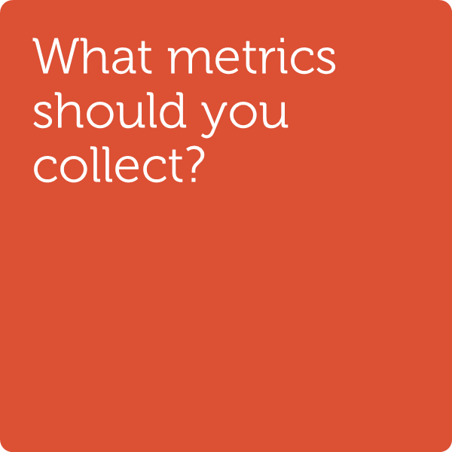


What we covered 今日要点总结

Slide 37
Thank you 谢谢

